Slide 1
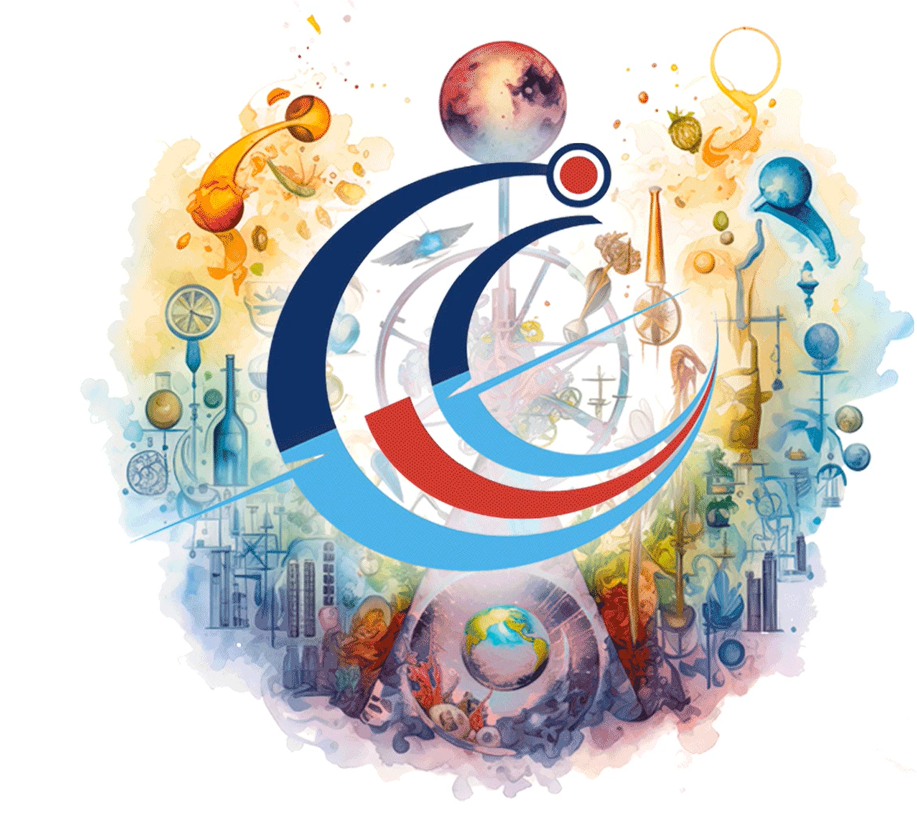
A Call for Action from Young Academies and Associations
Hiba Baroud, Ph.D.
Vanderbilt University
Global Young academy

Slide 2
Fundamental Science for Sustainable Development
Critical role of fundamental science in ensuring a sustainable future
Decline in the support of and investment in fundamental science
Inequity within the research sector
Call for action
  Support interdisciplinary research aligned with sustainable development goals
  Enhance transitions from research to innovation
  Ensure equitable global knowledge and resource sharing

Slide 3
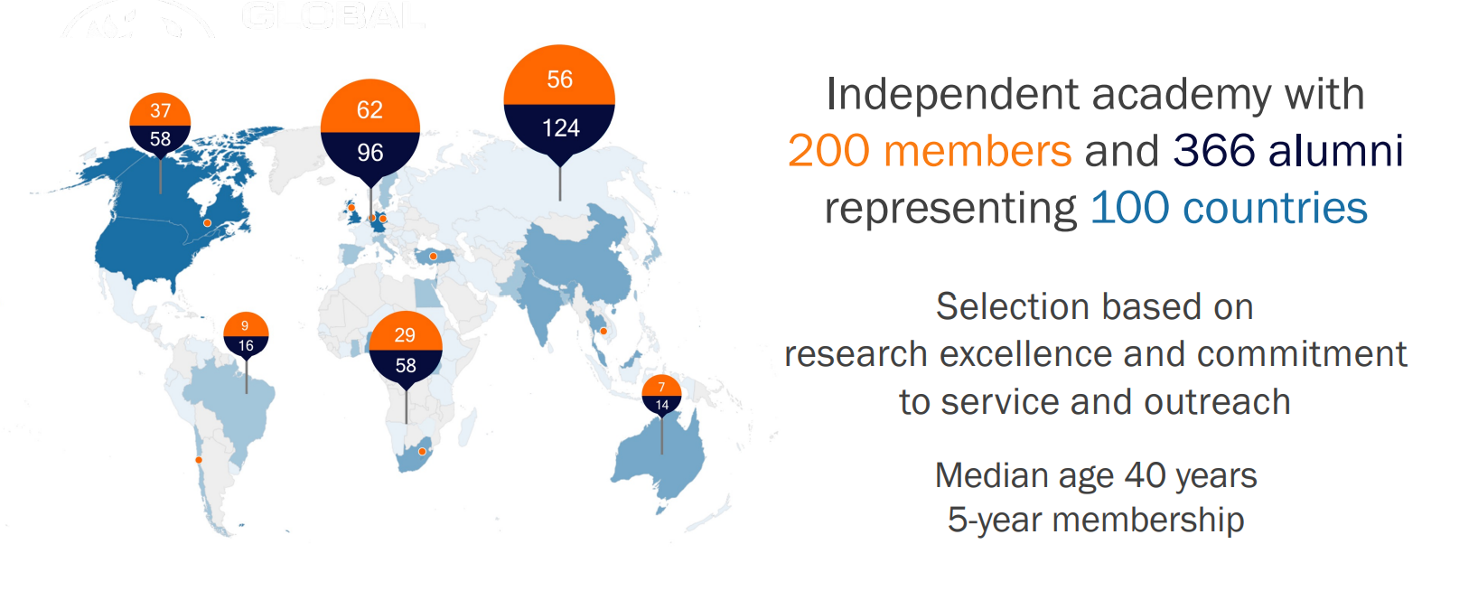

About the Global Young Academy (GYA)
Notes:
The vision of the Global Young Academy (GYA) is science for all; science for the future, and its mission to give a voice to young scientists around the world.
The GYA develops, connects and mobilises young talent from six continents, and empowers young researchers to lead international, interdisciplinary and intergenerational dialogue. The GYA aims to elevate the voice of young scientists in evidence-informed and inclusive global, regional and national decision making.
The GYA has 200 members, comprised of passionate young scientists, typically 3-10 years after their PhD, between 30 to 40 years of age, and in the early stages of their independent academic careers. Members are selected for their scientific excellence and commitment to engage with society, and serve five-year terms. The Members and alumni together represent over 100 countries.
The vibrancy of this global community is a result of the energy of its members, who are passionate about the role of science in creating a better world.
GYA members engage in working groups, strategic projects and collaborations with international partner organisations. This webinar is one such example of activities led by the GYA.

Slide 4
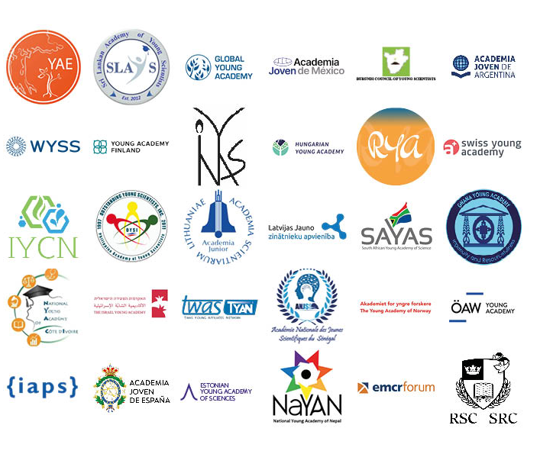
Statement signatories

Slide 5
Acknowledgements
GYA statement team
  Eshchar Mizrachi, Devina Lobine, Houda Ennaceri
GYA office
  Anna-Maria Gramatte
GYA Executive Committee
IYBSSD
  Luc Allemand

