Slide 1
Supporting the next generation of scientists in Africa: Key findings from a multi-country study
Heidi Prozesky
SciSTIP & CREST, Stellenbosch University
IYBSSD Closing Ceremony
15 December 2023

Slide 2

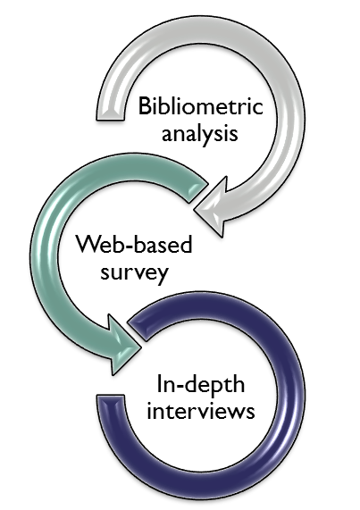

Slide 3
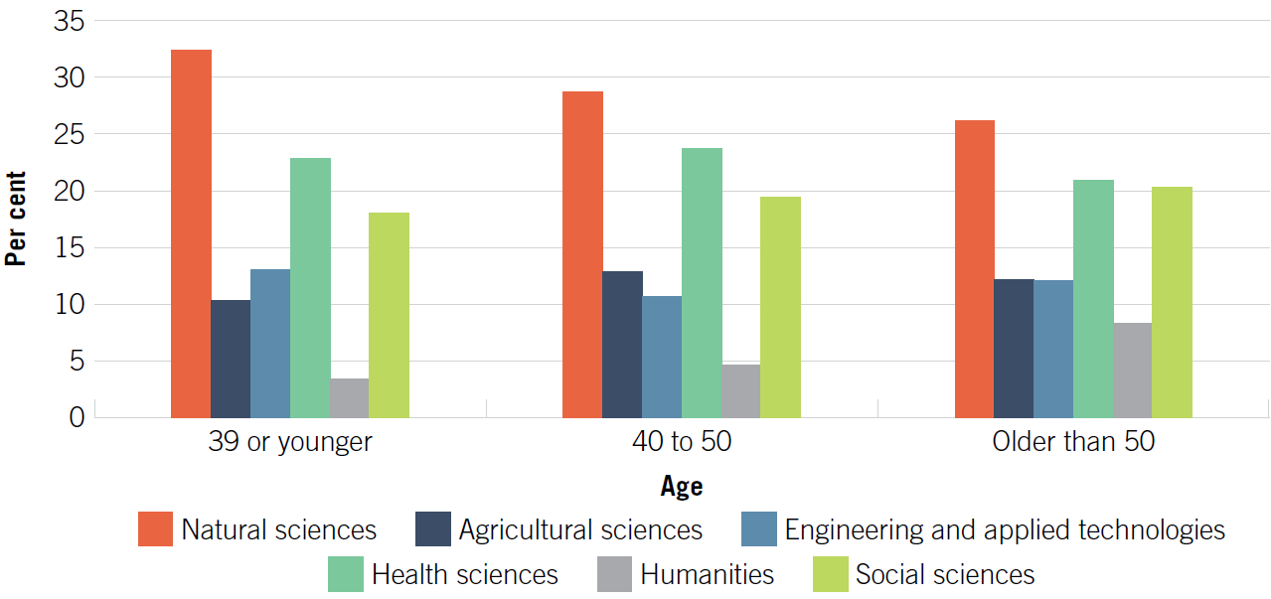
Young scientists defined as 39 years or younger
Early-/mid-career
  Most are in the HE sector (70%) where most (74%) hold the rank of lecturer/senior lecturer
  65% have a PhD
Science domains

Slide 4
Point of departure

Slide 5
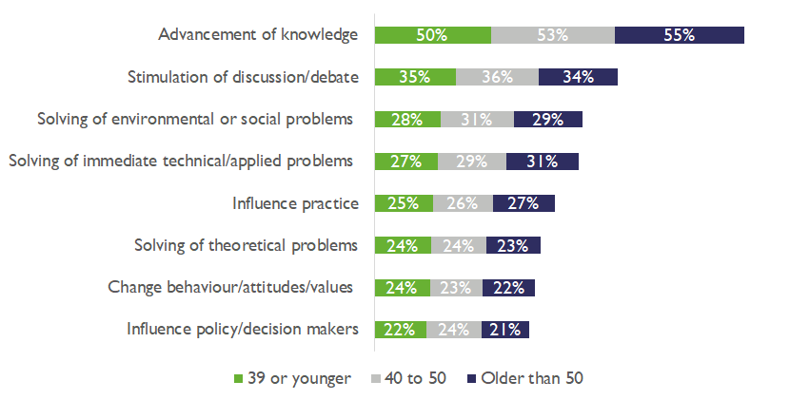
Attaining value / outcome of research (% of respondents reported highly successful), by age
“Enhance the training of early career researchers, with the aim of empowering them to effectively inform decision makers”

Slide 6
The focus of the remainder of this presentation, aligned with the Call for Action
Call for Action
Research questions
To empower and equitably support early- to mid-career researchers in resource-limited countries
Lack of opportunities for early- and mid-career researchers, especially in developing nations
How do young African scientists differ from their older counterparts in terms their need for empowerment and support?
What are the major lack of opportunities to be addressed for young African scientists?

Slide 7
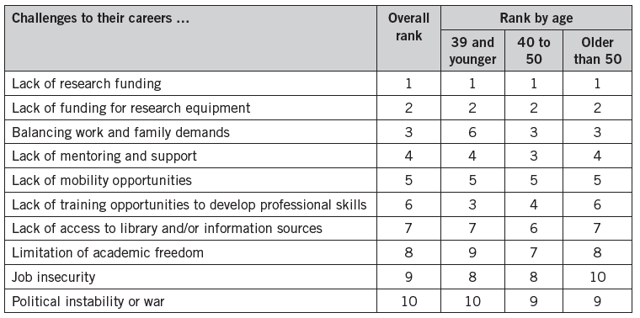
Respondents’ perceptions of the impact of 10 challenges on their careers, by age

Slide 8
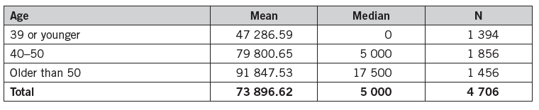
Reported amount of funding (US$) received as primary recipient in preceding 3 years, by age
Inexperience as a major barrier to securing funding
  Requirements of funders
  Writing quality proposals (time consuming)
Those who are unsuccessful, have no option but to use personal financial resources

Slide 9
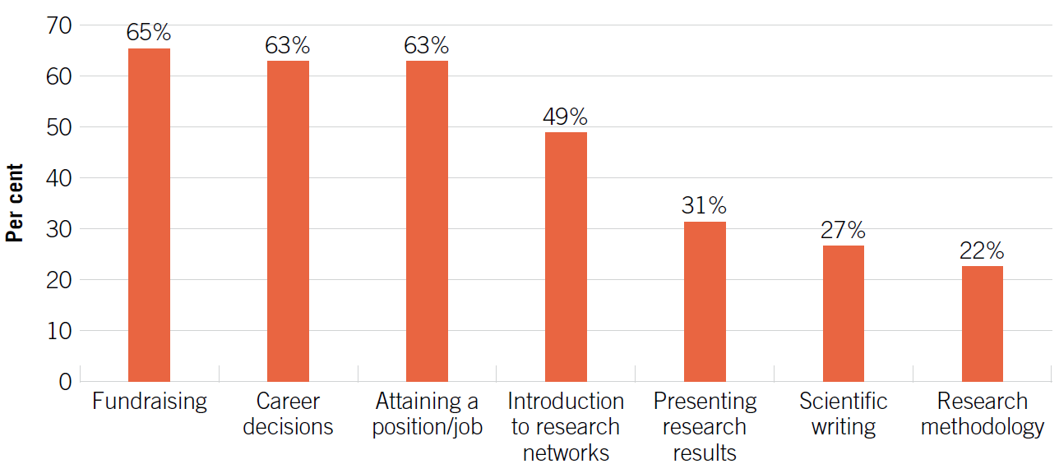
Never/rarely received mentoring on specific issues (% of respondents younger than 40)
CfA: “to develop a skilled workforce that can drive technological and scientific innovation”

Slide 10
Lack of clarity on the requirements involved in pursuing a successful research career
Many young African scientists tend to be first-generation academics
  Understanding of university culture
  Expectations and roles associated with their positions
The struggle to find suitable mentors (brain drain, power differentials and competition)

Slide 11
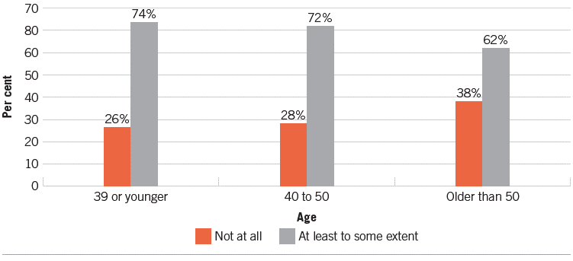
Negative impact of lack of mobility opportunities on career, by age
37% of the respondents younger than 40 had an opportunity to study and/or work abroad in preceding 3 years

Slide 12
International collaboration
Barriers to international collaboration
  Inability to find partners
  Lack of resources
  Language barriers
  Institutional barriers
Negative experiences of international collaborations
  Local institutions are the weaker partner
  Loss of research autonomy
  Unequal distribution of workload

Slide 13




Research funding
  Dedicated funds for early-career scientists
  Support in sourcing research funding
Mentoring and training
  More detailed, constructive feedback on unsuccessful grant proposals and rejected papers
  Formal mentoring programmes
Mobility
  More information and funding
  But encourage brain gain
Institutional environment conducive for research
  University and line managers (e.g., HoDs, deans)
  Senior academic staff

Slide 14


Thank you
Acknowledgements: other members of the research team; technical and administrative support staff; and the scientists who took the time to complete the questionnaire and/or be interviewed
This work is based on research supported by the IDRC (Canada), grant number 107987-001; the Robert Bosch Stiftung (grant number 11.5F081.0006.0), and the National Research Foundation of South Africa (Grant No 91488).

