Slide 1
IUPAP in the Pacific
David Hutchinson
University of Otago
New Zealand

Slide 2
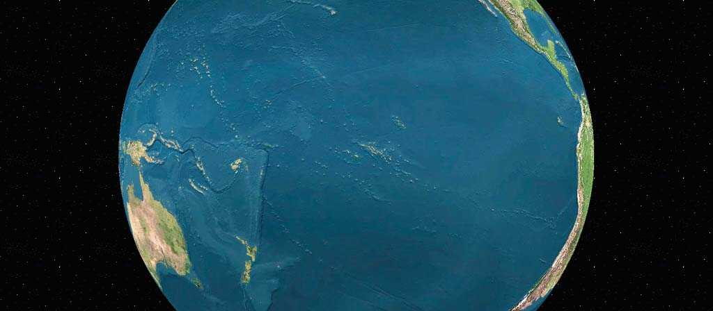
None of the developing nations of the Pacific are members of IUPAP
(Photo credit: University of Hawaii)

Slide 3
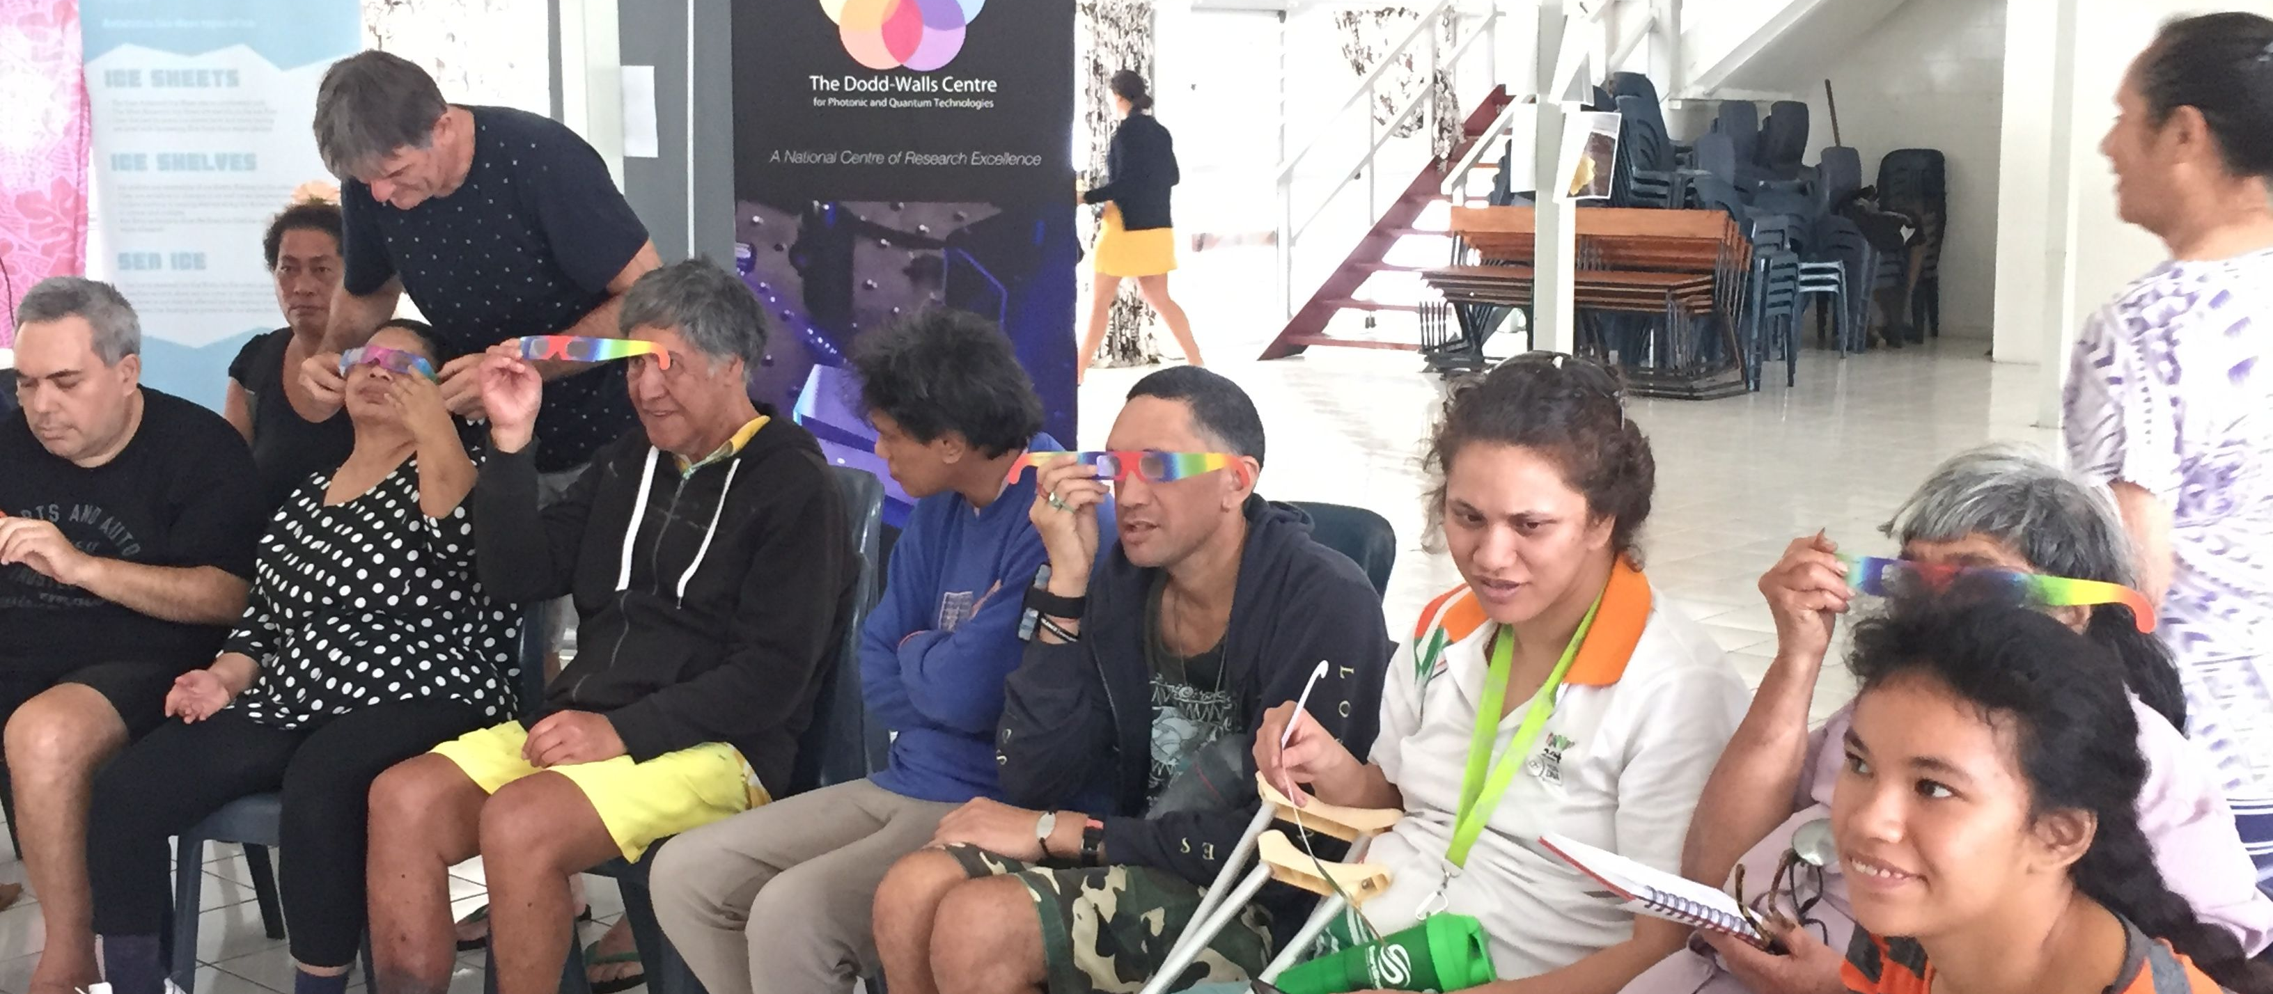
The Roles IUPAP can play
Education

Slide 4
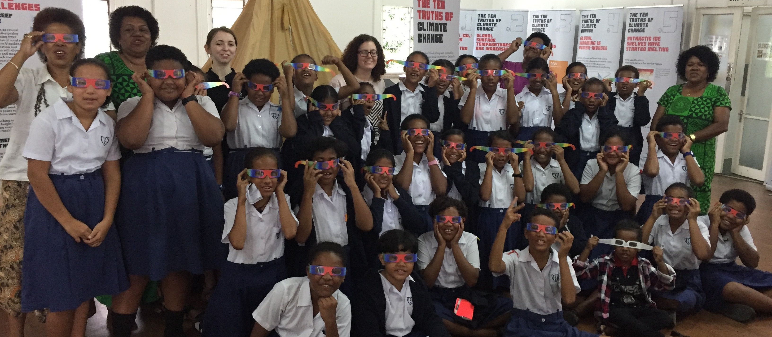
The Roles IUPAP can play
Education – climate change

Slide 5
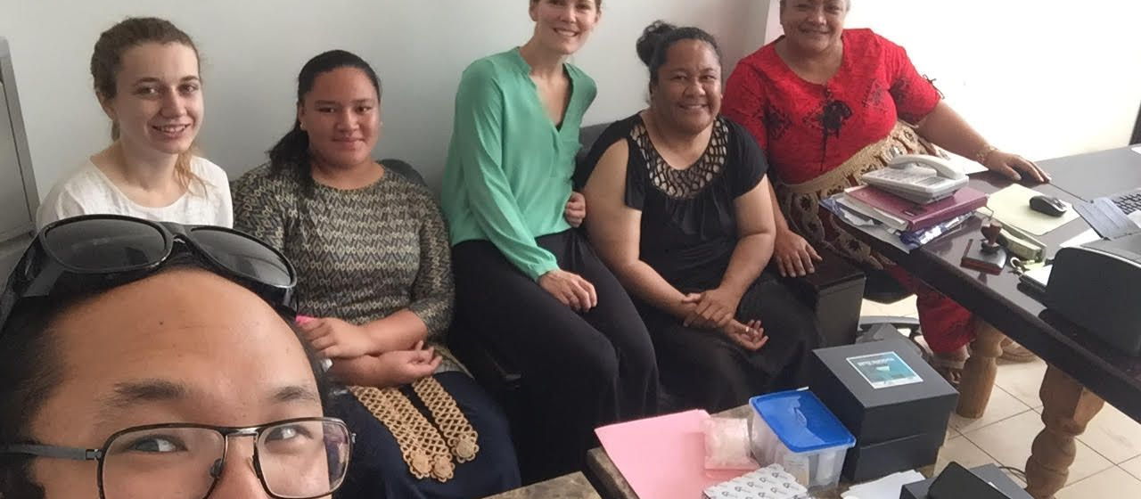
The Roles IUPAP can play
Education

Slide 6
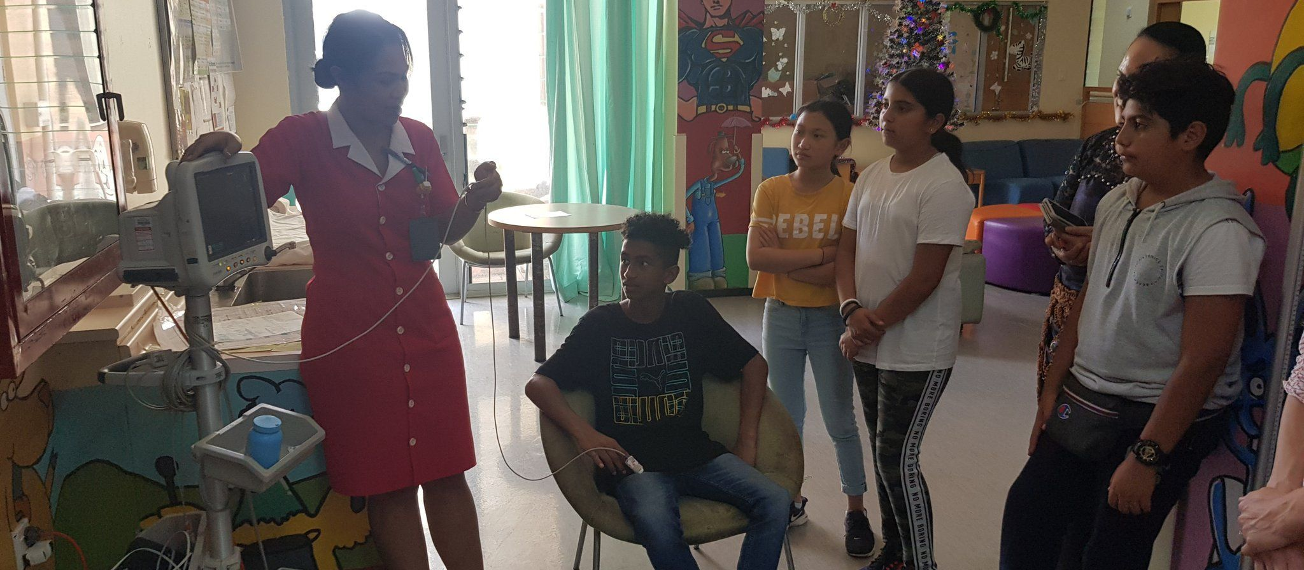
The Roles IUPAP can play
Medical physics

Slide 7


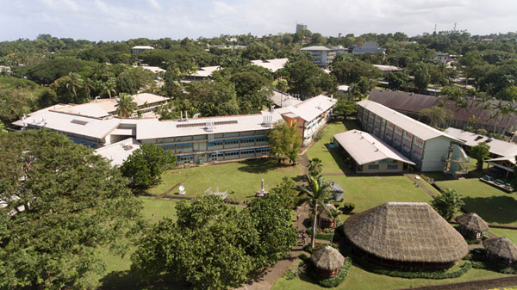

Current capacity
Fiji - Atmospheric and Space science, Renewable energy, and Environment

Slide 8
To develop Physics capacity in the Pacific, IUPAP should seek to aid Fiji in becoming a member.
(Photo credit: University of Hawaii)

