Slide 1
Terms of References
To be edited by WG14 team !
IUPAP WG14 – Meeting #16
Christine Darve
22 November, 2024
https://indico.cern.ch/event/1477779/

Slide 2
Terms of References
1. Mandate: Clearly define the working group’s goals and objectives. What is the group aiming to achieve? In IUPAP, WGs were meant to be temporary, but since this is not the case for WG14, the goals should indicate this.
2. Scope: Outline the boundaries of the group's work. What tasks and activities are within the group's remit, and what are not?
3. Membership: List the working group members, including their roles and responsibilities. This section should detail the criteria for membership and the process for selecting members and the chair, including the serving period. The membership's expertise should match the scope and mandate.
4. Governance and Reporting: Describe how the group is governed, including decision-making processes and how progress will be reported to IUPAP.
5. Meetings: Specify the frequency, location, and format of meetings.
6. Resources and Budget: Identify the need for resources (e.g., budget) and how they will be used.
7. Timeline: If there are any, could you provide a timeline for the group's activities, including key milestones?
8. Review and Amendments: Explain how the ToR will be reviewed and updated as needed. This will ensure that the document remains relevant and accurate over time.

Slide 3
1. Mandate - Proposed
Particle Accelerators for Science & Society
IUPAP WG14 promotes knowledge exchange in Particle Accelerators for Science and Society, engaging both the scientific community and the public.
This mandate emphasizes promoting applications of particle accelerators across a range of scientific fields and societal needs, including:
Industrial, medical, energy, and environmental applications of accelerator technologies
Scientific advancements enabled by accelerators (e.g. light sources, neutron sources, and high-energy physics (HEP), heavy ion)
Development of future facilities (e.g. laser, plasma, compact accelerator neutron source) for research and societal benefits
Research on accelerator principles, innovations, and sustainable operations
Supporting global knowledge-sharing and professional engagement through developing teaching materials, educational platforms, workshops, and conferences
Notes:
Update to take into account the advices of Florencia Canali (C11 coordinator)

Slide 4
2. Scope - Proposed
The working group consists of international experts committed to promoting these objectives on a global scale, utilizing local expertise and networks.
The group’s activities include:
Developing resources and communication channels for sharing accelerator science and applications
Creating engaging content to inform and inspire both scientific and public audiences
Mapping and reviewing accelerator applications and requirements in addressing the SDG, such as life science & healthcare, scientific research & technology
Enabling and promoting sustainable accelerator facility over its full life cycle
Supporting workshops, conferences, and professional gatherings on accelerator technologies and applications

Slide 5
3. Membership:
  One Chair → for 4 years – renewable
  One Vice-Chair (TBD?) → for 4 years – renewable
  Up to 22 Members at large: → for 4 years – renewable
    From 18 countries ! (incl. Cameroon and Botswana not yet IUPAP members)
  Associate members (ex-officio)
    Add C11 Chair ?
    Add early career scientists ?

Slide 6
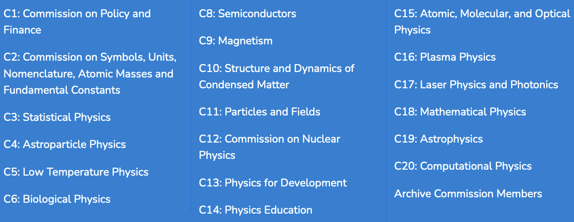
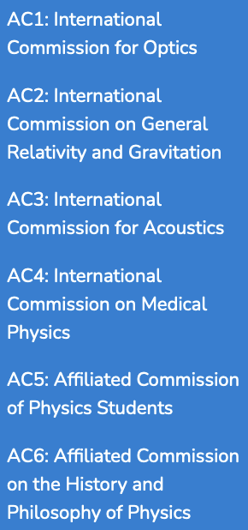
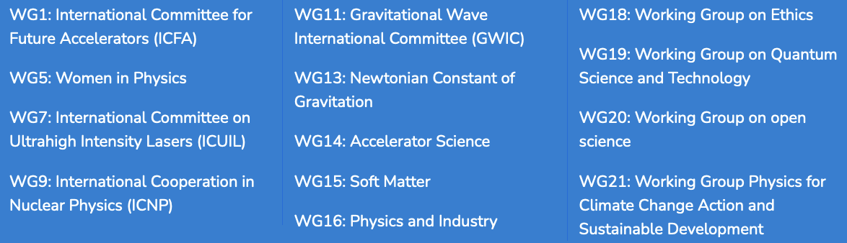
IUPAP Units

Slide 7
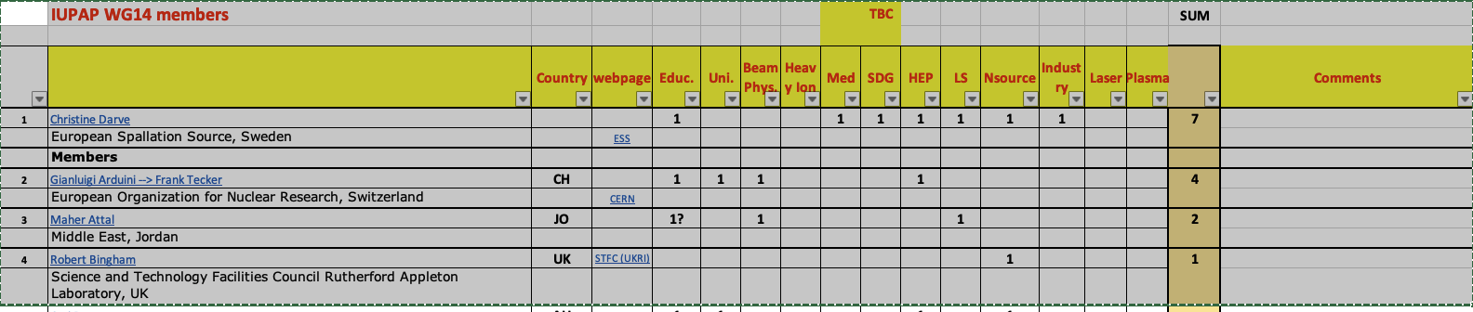
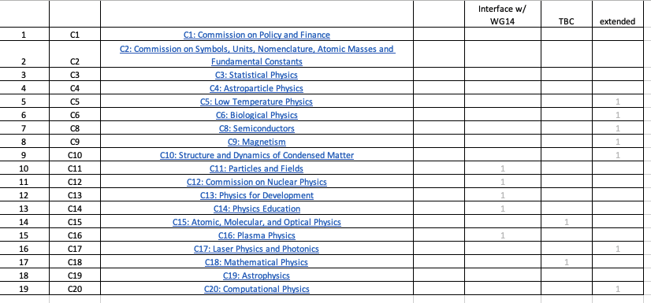
WG14 and IUPAP Units ?
Could you please correct the excel spreadsheet available at:
  https://cernbox.cern.ch/s/7YTO9LOmnQ8oh2W
  By showing your domains of expertise and
  IUPAP Units interfacing with WG14
Country | webpage | Educ. | Uni. | Beam Phys. | Heavy Ion | Med | SDG | HEP | LS | NSource | Industry | Laser | Plasma | Comments
Commissions, Affiliated Commission and Working Groups

Slide 8
ToR
Governance and Reporting
  Decision-Making: Decisions are proposed by members of the Executive Committee and approved unanimously during Executive Meetings.
  Reporting: The Chair and Vice-Chair report annually to the IUPAP Secretary and General Assembly, updating on progress and strategic goals.
Meetings
  Executive Meetings: Held online at least three times per year.
  In-Person Meetings: Scheduled in conjunction with significant conferences, such as the IPAC, to foster direct collaboration.
Resources and Budget – TO BE DEVELOPPED and finalized by end of 2024
  A 10,000 CHF budget has been allocated for developing Creative Commons licensed Materials.
  A 5,000 CHF budget is proposed to support short film productions (applications to Med. & SDG)
  2025-2029: we are considering more movies, hackathons, and meetings to engage broader audiences and the accelerator community.

Slide 9
ToR
Timeline
  Web Platform Updates: Continuous updates to keep the community informed and engaged.
  Creative Commons Licensed : Initial materials will be distributed by spring 2025.
  Conferences and Workshops: Organized approximately twice a year to discuss advancements and applications of accelerator science.
Review and Amendments
The Terms of Reference (ToR) will be reviewed and approved annually during the first Executive Meeting of the year, with amendments voted on to ensure continued alignment with WG14’s objectives and relevance to the evolving field of Accelerator Science.

Slide 10
Complementary slides

Slide 11
Storing data
Webpage
  International Union of Pure and Applied Physics (IUPAP) WG14 - Accelerator Science
Indico
  https://indico.cern.ch/event/1477779/
  MoM on Indico
CERNBox
  Access : https://cernbox.cern.ch/s/fzIlZ8y2Immi9vD

Slide 12
Example of sentences to be added in webpage?
IUPAP WG14 was created in 2015 to promote the exchange of knowledge on particle accelerators, benefiting both science and society
Particle accelerators are vital in cancer treatment through precise radiation therapy
They enable the production of medical isotopes for diagnostics and imaging.
Accelerators drive scientific breakthroughs in materials science, revealing atomic structures.
Particle accelerators play a key role in clean energy research and nuclear waste management.
Particle accelerators help improve manufacturing processes, from semiconductors to food sterilization.
They advance our understanding of fundamental physics, shedding light on the universe’s building blocks.

Slide 13
1. Mandate - old
Promote the exchange of information and views among the members of the international scientific community in the field of Accelerator Science including, but not limited to, the following:
Education and training in Accelerator Physics and Technology
The theory and experiments concerned with the nature and properties of particle accelerators and beam physics
The improvement of international communication in Accelerator Science through the sponsorship of professional meetings
The future of accelerator facilities for various fields that benefit science and society
The industrial, medical, energy production and environmental applications of relevant accelerator technologies

