Slide 1
Developing resources for the public understanding of Accelerator Physics:
Progress Update
Adam Steinberg and Suzie Sheehy
For IUPAP WG14

Slide 2

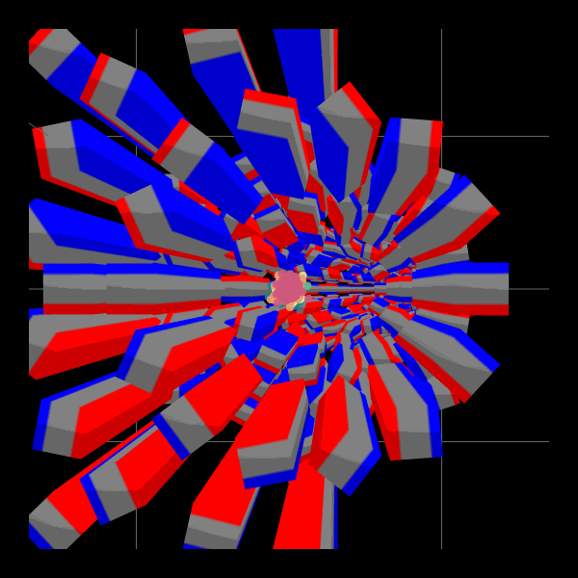
A Quick Introduction - Adam
MPhys Oxford 2016-2020
PhD, Cookson Scholar (Manchester/Melbourne joint-studentship) 2020-2024
      Passed oral examination at start of November
Currently a research assistant for the UniMelb Pelletron (DC accelerator, protons ~3MeV)
Simultaneous transport of different energy beams through the 'TURBO' Fixed Field Accelerator arc, to be constructed at UniMelb

Slide 3

Premise
What the project hopes to do
3

Slide 4
Project Objectives
Facilitate and grow engagement about particle accelerators and their applications worldwide
Enable informed decision making about accelerator topics by policymakers
Encourage young people to consider accelerator science career pathways
Streamline and facilitate engagement with accelerators and applications for those in the field
Enhance the understanding of accelerator users and operators
Create materials that outreach teams can utilise for engagement activities
Supply templates and presentations for academics and students
Provide resources useful to schoolteachers for classroom activities
Improve awareness of accelerators and their applications among target public audiences
Overall goal
Strategic aims
Example cases
4

Slide 5
Project Deliverables – as originally suggested
Creative Commons licensed presentation materials with consistent style
A slide deck (~5 slides) on ‘intro to accelerators’
A slide deck (~10 slides) on each of the ‘key messages’
A slide deck (~50 minutes) covering all key messages
Additional materials for accelerator outreach and education
Notes and dot points accompanying each presentation, specific to different audiences
A brief report including evaluation and lessons learned, to be published
5

Slide 6

Puzzles
Outstanding questions we should answer
6

Slide 7
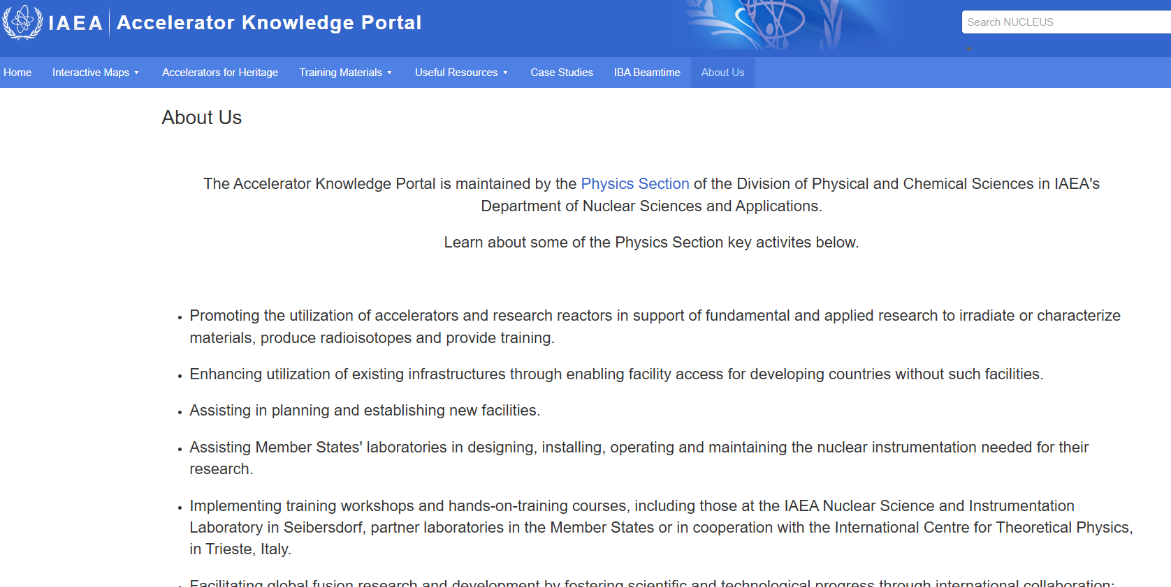
Compare – IAEA Accelerator Knowledge Portal

Slide 8
The ‘Five Key Messages’
The suggestions in the last meeting:
Accelerators from discovery science to the real world
Applications of accelerators for the environment and sustainability
Particle accelerators transforming human health
Future accelerator technologies drive fundamental physics breakthroughs
Accelerators as collaborative tools and enablers of peace
8
Notes:
On Suzie's previous slides:
Our future depends on particle accelerators (sustainability focus, including environmental and societal spin-offs, UN SDGs etc)
Particle beams are a force for good: impact in health and medicine
Accelerators are the hidden enablers: from discovery to industry
Future particle accelerators rely on fundamental breakthroughs in a wide range of areas: electromagnetism, plasma physics, beam dynamics, lasers, materials etc
Accelerators bring together large groups of people from a wide range of disciplines to solve complex issues – the power of collaboration

Slide 9
Our Current Thinking - Themes
Continuing from the themes, some initial thoughts on content
Possible example cases are
Environmental
Energy (ADS)
Water/air treatments
Solar panels/materials
The goal is to show that research into a green, sustainable future is enabled by accelerator facilities
Possible example cases are
Radiotherapy linacs
Proton therapy facilities
Nuclear medicine
The goal is to show that accelerators are vital to the treatment of many diseases and improve our health
Possible example cases are
Lasers for accelerators
Superconductivity
Plasmas
Sustainable accelerators
The goal is to show that accelerator research has a symbiosis with technology development, enabling wide societal impact
Accelerators for Sustainability
Accelerators for Health
Accelerators of the Future
Accelerators for Peace
Possible example cases are
SESAME collaboration
The impact of CERN
The STELLA project
Interdisciplinary collab
International collab
The goal is to show that accelerators bring together people with all backgrounds, united by research
This forms the central theme, combining content from all other themes. The central story shows accelerators as an enabling technology. Accelerators are unique in their ability to meet green goals, to cure illnesses, to drive technological innovation, and to bring people together.
Particle Accelerators: Transforming Science and Society
9

Slide 10
Our Current Thinking – Approach
Key Questions:
How do we reach our audience/publics?
How do we make the best use of our resources?
How do we ensure the resources are appropriate to the audience?
We explored multiple routes:
Provides access to existing resources
It would be very cool
Existing CC resources have poor metadata
Costs well beyond available budget
IUPAP retains control
Can make use of CC resources
Difficult to disseminate
Difficult to know if it will be utilised
Keeps everything local
We can ensure high quality
Beyond project scope to make much novel material
Maintenance becomes an issue
AI-based Search Tool
Creating our own Slide Decks
Hosting IUPAP Resource Database
10

Slide 11
Our Current Thinking - Uniqueness
The greatest strength of the IUPAP is to bring people together
The working group consists of international experts committed to promoting these objectives on a global scale, utilizing local expertise and networks.
The group’s activities include:
Developing resources and communication channels for sharing accelerator science and applications
Creating engaging content to inform and inspire both scientific and public audiences
Mapping and reviewing accelerator applications and requirements in addressing the SDG, such as life science & healthcare, scientific research & technology
Enabling and promoting sustainable accelerator facility over its full life cycle
Supporting workshops, conferences, and professional gatherings on accelerator technologies and applications
Back to basics – scope of IUPAP WG14
Make the best use of limited resources
11
Notes:
Mandate:
IUPAP WG14 promotes knowledge exchange in Particle Accelerators for Science and Society, engaging both the scientific community and the public.
This mandate emphasizes promoting applications of particle accelerators across a range of scientific
fields and societal needs, including:
• Industrial, medical, energy, and environmental applications of accelerator technologies
• Scientific advancements enabled by accelerators (e.g. light sources, neutron sources, and high-
energy physics (HEP), heavy ion)
• Development of future facilities (e.g. laser, plasma, compact accelerator neutron source) for
research and societal benefits
• Research on accelerator principles, innovations, and sustainable operations
• Supporting global knowledge-sharing and professional engagement through developing teaching
materials, educational platforms, workshops, and conferences

Slide 12

Updated Scope:
Accelerators Engagement Ambassadors Initiative
12

Slide 13
Accelerator Engagement Ambassadors
Rather than making material without a clear set of ‘users’, we think it may be most effective to pilot an ambassador programme:
Select and uplift a diverse group of young accelerator scientists to create and deliver resources aligned with themes, that are relevant to their interests & community
Pilot Project: limited scope, with potential to grow
Recruit one ambassador for each of the themes – all ambassadors contribute to overall theme
Provide opportunities for researchers to develop skills
Harness the creativity of the global accelerator community
IUPAP still curates resources
No limit on what they can produce: slides, videos, podcasts, whatever they want to propose
Use the current funded project in part to seed fund ambassador projects - $1500AUD ($850CHF) per ambassador?
13

Slide 14
Recruitment Methodology
Open call to Early-Mid Career Researchers (PhD or < 10 years post-PhD FTE)
Social media
Lab/institute email
Word of mouth
WG14 members
Short CV/bio
Why do you want to be an Accelerator Engagement Ambassador (1 par.)
Which theme would be best suited to you as an Ambassador?
Pitch your idea (<300 words). Consider:
  Target audience (eg. Primary school students, fellow academics, etc.)
  Medium (eg. Slide deck, hands-on demos, podcast, video, etc.)
  Content – what would your project look like?
  Success evaluation
How to reach people
Call Outline – What info?
Transparent process
WG14 Subcommittee
Selecting ambassadors
Vision for proposal
Equity and representation
Enthusiasm
Selection criteria

Slide 15
Impact
The Initiative can have a positive effect for a range of parties
Up-skilling opportunities
Network of peers
Recognition of contributions
Support for ideas
Access to curated content
Community needs well-met
Reach out to new sectors
Receive engaging talks by talented, young, excited scientists
Develops both resources and communication channels
Creating engaging content
Improved visibility
Engagement Ambassadors
Audiences
IUPAP WG14
This is intended as a pilot project:
if successful, there can be a new group of engagement ambassadors each year
Over time, ambassadors can be given further support, training, publicity etc

Slide 16
Project Outline
Nov-Dec: Create recruitment call, send it out
Jan-Feb: Select ambassadors, hold kick-off meeting
Mar-Apr: Online workshop(s) on presentation skills (S. Sheehy)
May-Jun: Production of first versions of resources. Feedback process
Jul-Aug: Working on the resources. Community feedback
Sep-Oct: Release of the resources. Iteration where required
Nov-Dec: Evaluation. Decision on next phase of Inititative
16

Slide 17
Next Steps
Approval from WG14 to modify the scope of the project
Formation of a subcommittee to oversee the Engagement Ambassadors Initiative
Recruitment process
17

Slide 18
Thank You
The University of Melbourne (Australian University) PRV12150/CRICOS 00116K

