Slide 1
IUPAP WG14 – Meeting #15
Agenda, Minutes & Follow-up of actions
G. Arduini and Christine
3 June, 2024
https://indico.cern.ch/event/1423360/
https://ess-eu.zoom.us/j/6420621364

Slide 2
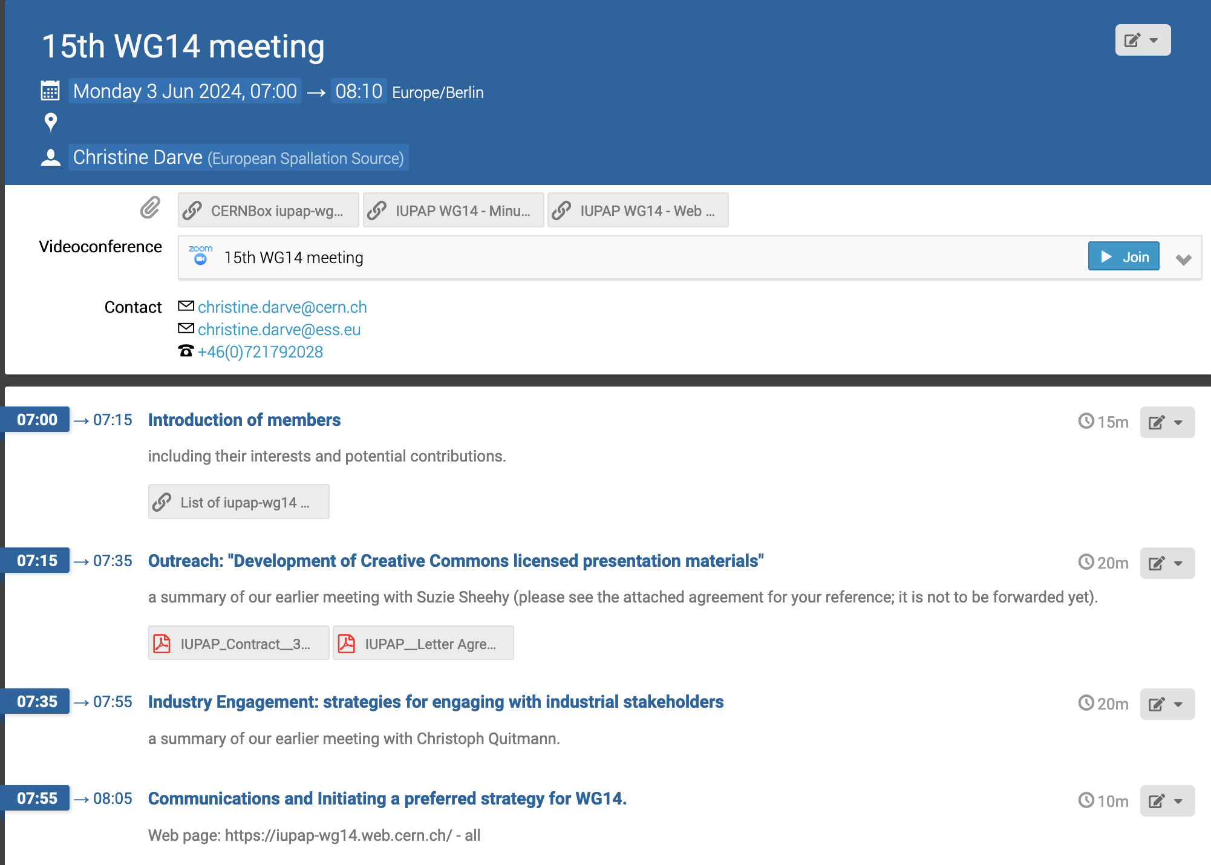
Agenda - https://indico.cern.ch/event/1423360/

Slide 3
Pending actions – from Meeting #14
7 dec. 2023 - https://indico.cern.ch/event/1348000/
Communication (Web site, etc.). We are missing support to help with the content and to suggest contributions. Action: all
A report on recent developments for accelerators for therapy and radiobiological studies will be produced. Bob Bingham and Michael Moyers to take the lead.
An intern at Melbourne University could be hired to create material for communicating the benefits of accelerators. Action: Suzie to contact J. Vigens for the formalities to transfer the funds.

Slide 4
Mandate
Promote the exchange of information and views among the members of the international scientific community in the field of Accelerator Science including, but not limited to, the following:
Education and training in Accelerator Physics and Technology
The theory and experiments concerned with the nature and properties of particle accelerators and beam physics
The improvement of international communication in Accelerator Science through the sponsorship of professional meetings
The future of accelerator facilities for various fields that benefit science and society
The industrial, medical, energy production and environmental applications of relevant accelerator technologies

Slide 5
Description displayed @ website
The International Union of Pure and Applied Physics (IUPAP) WG14 - Accelerator Science, promotes the exchange of information and views among the members of the International Scientific Community in the filed of Accelerator Science
The International Union of Pure and Applied Physics (IUPAP) WG14 - Accelerator Science, fosters the exchange of information and perspectives among members of the global scientific community in the field of Accelerator Science.
There are more than 30,000 accelerator world wide
Accelerators are Discovery Machines allowing us to understand the origins of Our Universe
Notes:
Collect pictures
Collect citations

Slide 6
Storing data
Webpage
  International Union of Pure and Applied Physics (IUPAP) WG14 - Accelerator Science
Indico
  https://indico.cern.ch/category/14662/
  MoM on Indico
CERNBox
  Access : https://cernbox.cern.ch/s/fzIlZ8y2Immi9vD

