Slide 1
Agenda, Minutes & Follow-up of actions
G. Arduini

Slide 2
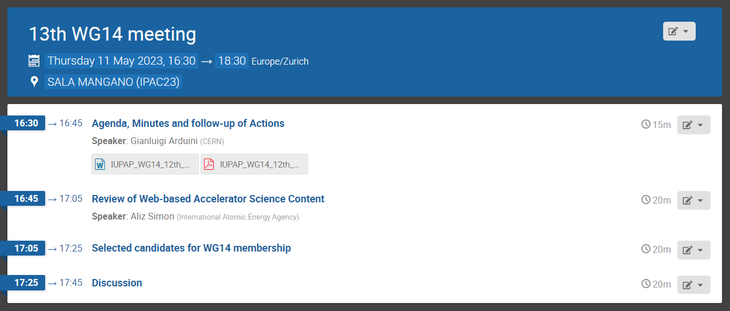
Agenda

Slide 3
Pending actions
Communication (Web site, etc.). We are missing support to help with the content and to suggest contributions. Action: all
A report on recent developments for accelerators for therapy and radiobiological studies will be produced. Bob Bingham and Michael Moyers to take the lead.
An intern at Melbourne University could be hired to create material for communicating the benefits of accelerators. Action: Gianluigi to look for funding for this initiative. Done. Funding secured
Aliz mentioned that she has hired and intern at IAEA to collect and classify the information available on the web on Accelerator Science. This could provide important input for the preparation of the communication material. Action: Aliz will circulate the terms of reference of the work to be conducted by the IAEA intern for possible feedback. This meeting.
Lin noted that it would be important to make sure that our web page is publicized and we should profit of the forthcoming IPAC23 and International Accelerator School to make it “visible” by adding links to the web pages of these events. Action: Gianluigi. Done.
Gianluigi asked the WG members to propose candidates to replace the four members leaving taking into account as far as possible expertise, gender and regional diversity. Action: all working group members to send a list of proposed candidates (name, affiliation, few lines of introduction) to Gianluigi by Friday 21st April 2023. This meeting

Slide 4
New members
Caterina Biscari, Di-Jing Huang, Lia Merminga and Minh Quang Tran have asked to step down from WG14
New elected Members:
  Ceri Brenner
  Sarah Cousineau
  Christine Darve
  Anke-Susanne Mueller
New Associate members:
  Fulvia Pilat , IPACC and IPAC’24 Chair

Slide 5
Membership
32 representatives (25 Members and 7 Associate Members)
Diversity (geographical, gender)
  Africa: 3
  Americas: 10
  Asia: 5
  Europe: 10
  Middle East: 1
  Oceania: 3
Female: 11
Male: 21

Slide 6
Any Other Business

Slide 7
Future Meetings
September (week starting 18/09). Try meeting in the evening (21:00 GVA time)?
December

