Slide 1
Agenda, Minutes & Follow-up of actions
G. Arduini

Slide 2
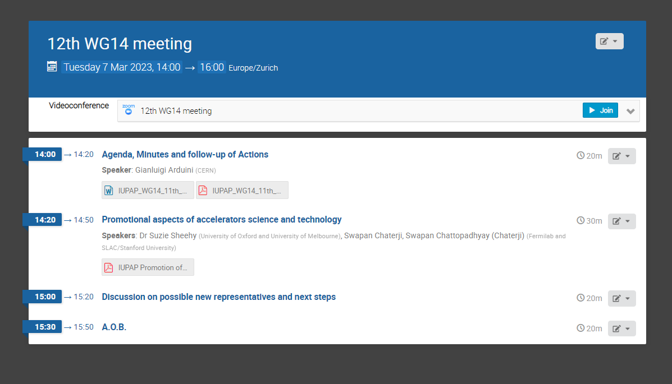
Agenda

Slide 3
Pending actions
Publications: WG14 should provide a position statement and a plan of action. Caterina (lead), Di-Jing, Gianluigi, Nikolay, Oliver will address this. Action: Caterina, Di-Jing, Gianluigi, Nikolay, Oliver. Lin will report on the discussions at the last JACoW stakeholders’ meeting at the next WG14 meeting. Lin could not attend the meeting and she will report at the next WG14 meeting.
IPAC as WG14 Conference and IPAC MoU. Action: Gianluigi (lead), Caterina, Lenny, Lia, Lin, Tadashi to resume the discussions ➔ not able to find a slot with people available. Do we consider this a high priority subject? If yes, Volunteers to help?
Communication (Web site, etc.). Action: WG members to pro-actively contribute to the content of the web page. Here we are missing support to help with the content and to suggest contributions
Liangting volunteered to provide an article on activities in Accelerator Science in China for the IUPAP WG14 website. Action: Liangting. Liangting will send an article by the end of January 2023. Done ➔ published on our web page. Other proposals. Document on sustainability of accelerators?

Slide 4
Any Other Business

Slide 5
Documents
Initially planned to submit an abstract to PTCOG’23 with an overview on recent progress in accelerator concepts and technology towards compact accelerators for radiobiology studies and radiotherapy.
  After discussion with B. Bingham and M. Moyers, propose to write a WG14 report on that that ➔ Bob and Michael to take the lead ➔ volunteers?

Slide 6
Membership
Minh Quang Tran has asked to step down from the WG
I understand that Caterina Biscari would like to step down, too
Need to have team of people with availability to participate and contribute!

Slide 8
Future Meetings
May (week starting 7/5) – in person (with possibility of remote connection) at IPAC’23
  Thursday 11/5 from 16:30 to 18:30
September (week starting 18/09). Try meeting in the evening (21:00 GVA time)?

