Slide 1
Nordic accelerator school MOOC
Nordic Particle Accelerator Project (NPAP) and beyond
christine.darve@ess.eu
https://cdarve.web.cern.ch/

Slide 2
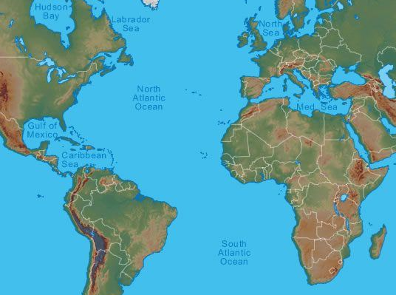
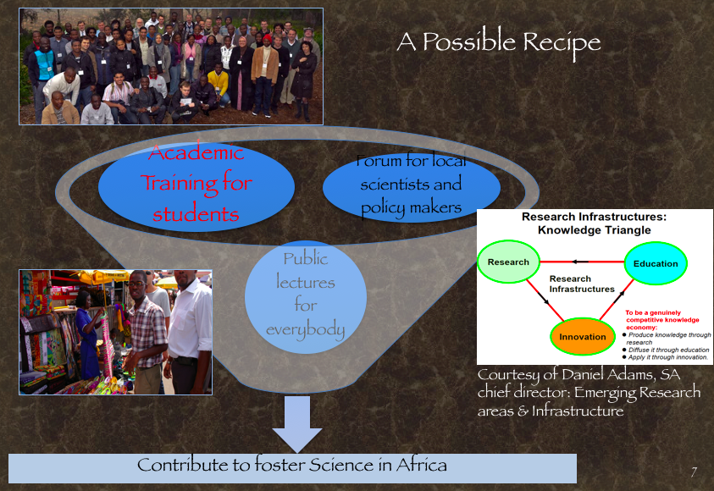
Short biography – Christine Darve
https://cdarve.web.cern.ch/
ESS
  Diplome d’ingenieur UTBM, Institut Polytechnique de Sevenans (FR), ”Thermomechanical of System and Materials”
  PhD Northwestern University (USA), "Phenomenological and Numerical Studies of Helium II Dynamics in the Two-Fluid Model”
20 years as Engineering Scientist at CERN, FNAL, and ESS
From design to operation of particle accelerators in large scale collaborations (incl. Large Hadron Collider, Cryogenic Magnets and Cavities, LH₂ absorber, ESS Superconducting LINAC)
CERN
FNAL
Main volunteering organisations:
Forum on International Physics (FIP), Chair-elected, American Physical Society (APS)
Nordic Particle Accelerator Program (NPAP) (schools, MOOC) co-founder, organiser and lecturer
→ African School of Physics and Applications (ASP) co-founder, organiser and lecturer
→ Physique-sans-frontieres (1998 Sc. Secretary) ”WWW: A Windows on Science and Technology”, Sarajevo
Notes:
International Collaborations have been the building blocks of any large scale projects

Slide 3
IDEAL: Influence and Transform communities to reach technological paradigms, applicable to societal challenges
Topics of interest: Fundamental Physics and Applications based on Accelerator Science
Education as a vector for development !
Outline
  NPAP: From Summer Schools to Massive Open Online Courses (MOOCs)
  Beyond NPAP: Accelerating Teaching and more educational platforms
Science Transcending Boundaries !
Notes:
An ecosystem consists of all the stakeholder/organisms and the (physical) environment with which they interact.
Not limited to Biotic

Slide 4
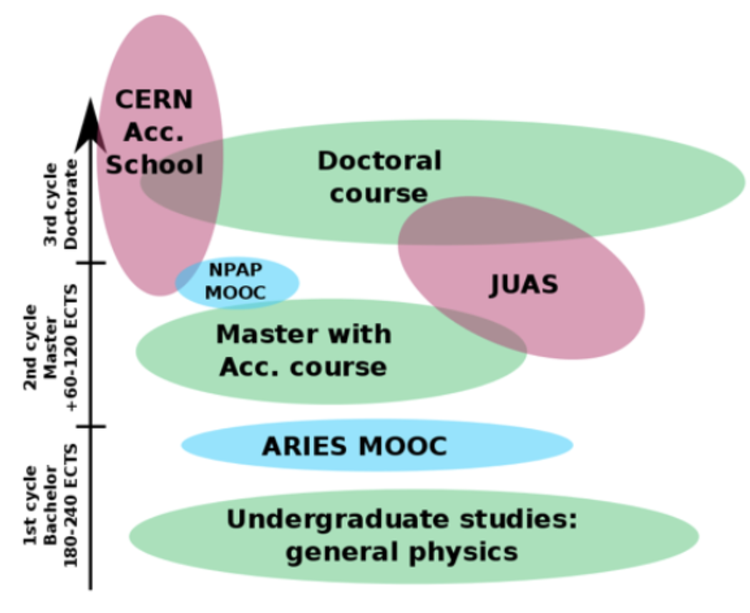
The European Accelerator Landscapes
Nordic Particle Accelerator Project (NPAP)
Existing educative platforms and programs:
Accelerator schools: JUAS, CAS, HASCO, USPAS, ACAS, ASP, etc
University programs (e.g. Aarhus, LU)
EU-TIARA market surveys
EU-ARIES and I.FAST
Why do we need new Pedagogical tools for Accelerator science?
School levels are typically advanced
Domains/Field complementarity; User communities
To provide sustainable and “users-friendly” tools
Develop capacity in Northern Europe with emphasize on MAXIV and ESS
Notes:
Students with basic knowledge in physics
Worldwide Universities
Employees at accelerators
Companies
Users
In-Kind ESS collaborations
Hospitals

Slide 5
Useful links
Innovation Fostering in Accelerator Science and Technology (I.FAST)
JUAS – European Scientific Institute
CERN Accelerator School (CAS) , e.g. Introduction to Accelerator Physics 2016
US Particle Accelerator School: USPAS
MOOC ARIES : Accelerator Research and Innovation for European Science and Society
HERCULES European courses via ESRF
FASEM: Joint French-Swedish school on X-rays and Neutrons techniques and Indico Link
At CERN and at Diamond at Fermilab (Lederman Science center); SciTech Hands On Museum
Science and engineering videos of Veritasium
Science Communications: LightSources.org and Accelerating News
Brochures: LAAAMP and APS brochures: Acc. and Beams and Advanced Light Sources

Slide 6
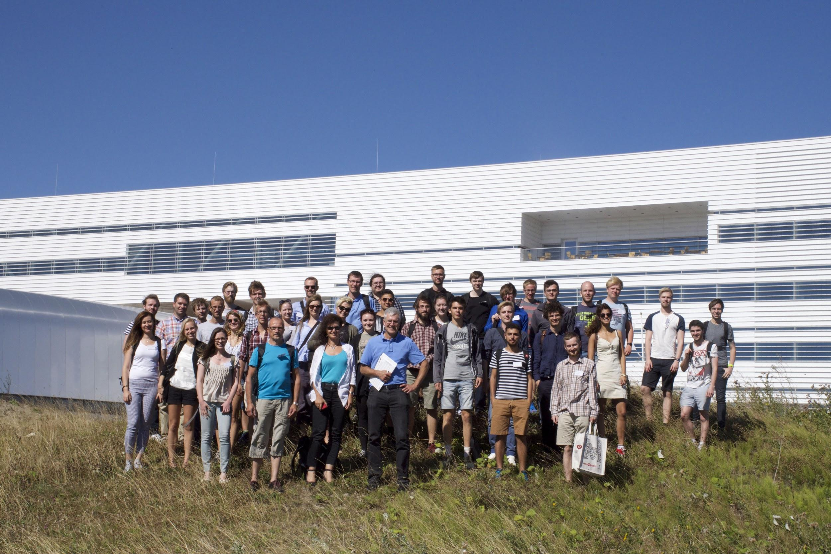
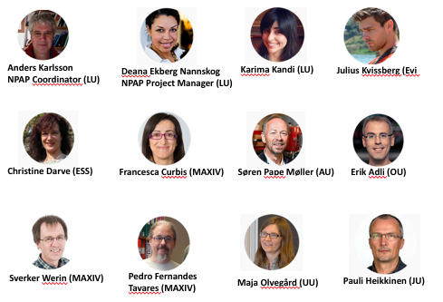
Nordic Particle Accelerator Schools
Team building
Three Summer Schools
90 students
Nordic Particle Accelerator School 2015 → The proof of Concept
Education in accelerator technology
Visit of MAXIV and ESS
6
Notes:
The first part of NPAP was to create a Summer School.
In three Summer Schools we have given 90 students an education in accelerator technology. The first Summer School was held in 2015. This was before the Program had started, but all partners were involved already then. The Summer Schools were held during two weeks in August.
AK: NPAP Coordinator Prof. at the Dep. of Electromagnetic Theory at Lund University
Deana Ekberg Nannskog: Project Manager & Educational Concept Designer at the Department of Commissioned Education at Lund University
CD Engineering Scientist at ESS
SV: Prof. at the Dep. of Accelerator Physics at MAX IV Laboratory
Søren Pape Møller (AU): Centre Director at the Dep. of Physics and Astronomy – Institute for Storage Ring Facilities at Aarhus University
EA: Associate Professor at the The Department of Physics at University of Oslo
Pauli Heikkinen
Chief Engineer at the Department of Physics at University of Jyväskyläpauli.heikkinen@jyu.fi
Francesca Curbis
Associate Professor at Department of Accelerator Physics at MAX IV Laboratory, Lund University
Maja Olvegård
Researcher at Department of Physics and Astronomy, FREIA at Uppsala University
Pedro Fernandes Tavares
Accelerator physicist at Department of Accelerator Physics at the The MAX IV Laboratory, Lund University
JK: Julius Kvissberg
Producer of Digital Resources at the Department of Commissioned Education at Lund University
Karima Kandi
Project administrator at the Department of Commissioned Education at Lund U

Slide 7


NPAP - Team building
Nordic Particle Accelerator School 2015 → The proof of Concept
Grant for the Nordic Particle Accelerator Program
Main deliverables: 2 summer schools and 3 MOOCs
Strategic partnership and building cross-sectoral bridges
Support innovative practices from international to regional to organisational and individual levels
Nordic accelerator school MOOC
Notes:
434 kE → 327 725 euro 3 years
The intellectual outputs of the program have been disseminated through campus-based Summer Schools in Lund. Further, the outputs is also widely disseminated through Massive Open Online Courses (MOOCs) at Coursera– accessible to various audiences within the public and private sectors in Europe, in due course.
NPAP aims to broaden the opportunities for education in accelerator physics and technology with the purpose of encouraging students to conduct their master’s / Ph.D. project in accelerator physics as well as encouraging professionals (e.g. medical physicists, radiologists or engineers) to move into the world of accelerator technology. Ultimately, we strive to enhance interest and support future professionals in the field as well as establishing a broader use of the intellectual and technological outputs that particle accelerator research provides.
This program is an Erasmus+ Strategic Partnerships for higher education project and a Key Action 2 Cooperation for innovation and exchange of good practices. Funded by the European Union.
Based on the observations listed earlier, we built a team to create the NPAS2015:
The objective is to teach the basics of accelerator physics and technology, and to demonstrate for the students that this is an interesting and broad subject, carried out in an international environment. The initiative shall encourage students to pursue a career in accelerator physics and technology.
Limited cost by institutional support.
--
Strategic partnership and building cross sectoral bridges: Ultimately, we believe that inviting more people to creatively take part in the knowledge of the area, will enhance engagement and at length expand the field with more creative and innovative minds. But not only that! By bringing more people in from other fields, we have seen that cross sectoral work increases and bridges are being built! As a result, we see innovation opening up and the impact as well as use of accelerator technology increase, benefiting society in a whole other way which would otherwise be impossible if knowledge is left isolated.
The interconnectivity between different fields and sectors, both nationally and transnationally is an important step for us. In fact, our three year transnational project is specifically an Erasmus + programme for strategic partnership and networking (KA2) (have a pic of the funding from EU in PP) This type of programme aims to support the development, transfer and implementation of innovative practices at everything from international, European, national and regional to organisational and individual levels.

Slide 8
Nordic Particle Accelerator Project MOOC
Nordic Particle Accelerator Project (NPAP) - MOOC
MOOC1: Particle Accelerators introduction
→ Launched in August ’19
→ 5110 learners enrolled
MOOC2: Fundamentals of accelerator technology
→ Launched in March ’19
3918 learners enrolled
MOOC3: Medical Applications of Particle Accelerators
Launched in Nov. ’18
5988 learners enrolled
@ 19 Dec 2022
Accelerators for Synchrotron Light Light and Light Sources Accelerator to make light The development of accelerators for synchrotron light Photon light sources and MAXIV Synchrotron radiation Bending magnets, wigglers and undulators Free Electron Lasers Spallation source and ESS Introduction and neutron science European Spallation Source Particles Colliders Introduction to Particles Colliders The LHC and its experiments Linear Colliders Future Circular Colliders Plasma Wakefield (to be completed) | RF-System Introduction to RF-systems RF cavities Waveguides RF Amplifiers More about cavities Magnets technology for accelerators Magnets part1/2/3 Beam Diagnostics An overview Beam intensity and position Transverse Beam Profile Longitudinal Beam Profile Beam Loss Monitoring Basics of Vacuum techniques An overview and motivation Residual gases and vacuum regions Vacuum equipment Other vacuum components | Introduction to the course and radiotherapy Introduction Biological rational for radiotherapy Intro. to the electron linac for radiation therapy Electron Linacs for radiation therapy The multi-energy electron Linac structure Dose delivery to the patient Proton therapy 1 Rationale of proton therapy Accelerators for proton therapy Treatment delivery of proton therapy Proton therapy II and production of medical radionuclides Heavy ion therapy Challenges in pr. th. and heavy ion th. Introduction to medical radionuclides Production of medical radionuclides

Slide 9
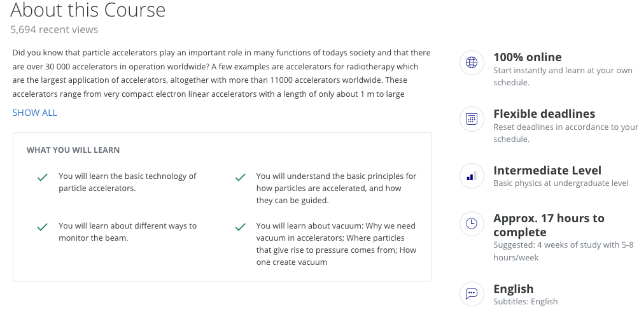
Nordic Particle Accelerator Project MOOC
Example: MOOC2: Fundamentals of accelerator technology
https://www.coursera.org/learn/fundamentals-particle-accelerator-technology

Slide 10
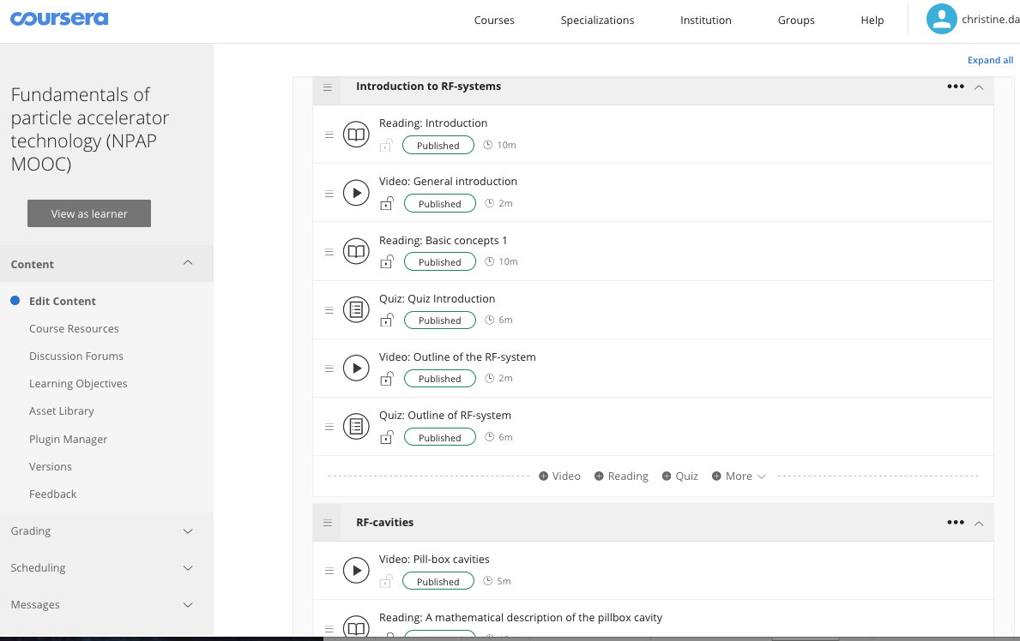
Nordic Particle Accelerator Project MOOC
Coursera Architecture

Slide 11
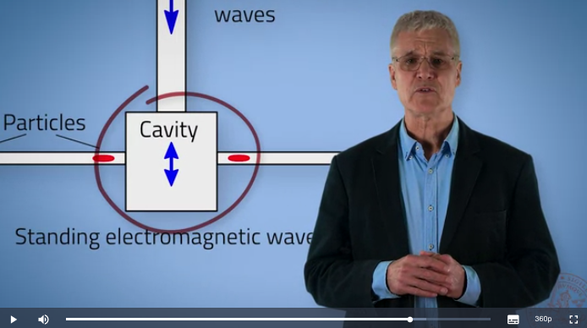
Nordic Particle Accelerator Project MOOC
Example of Lecture
https://www.coursera.org/lecture/fundamentals-particle-accelerator-technology/general-introduction-wf3CB

Slide 12
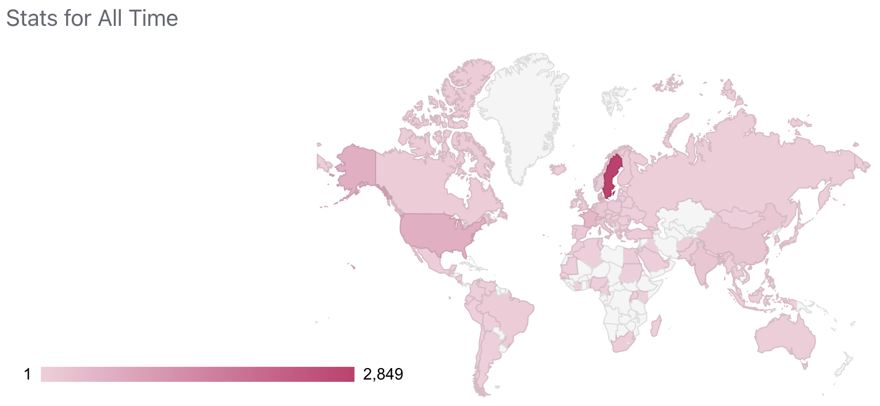
Nordic Particle Accelerator Project MOOC
Few statistics
We have reached out 100 Countries worldwide !
In December 2022
15,000 NPAP students

Slide 13
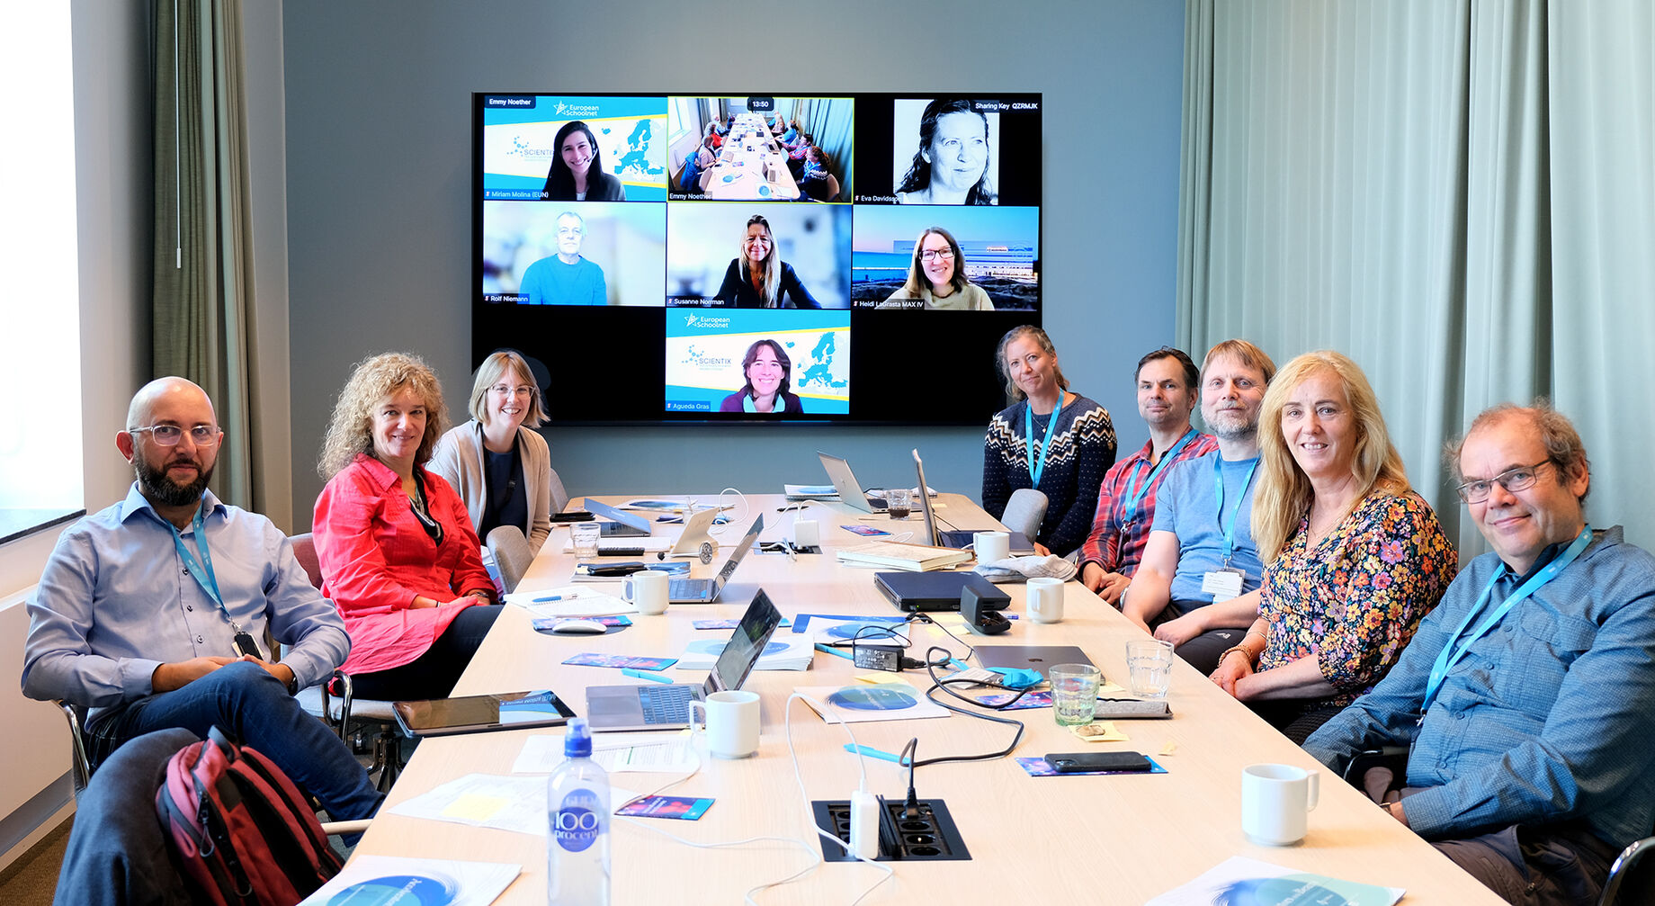
Next MOOC… Accelerating Teaching
New ERASMUS+ grant
ERASMUS+ grant for a project called “Accelerating Teaching – approaching particle accelerators and new scientific research through online professional development” (article)
The primary aspect of the project will be to construct the online resource, but it will also evaluate and explore teachers’ experiences from the course, as well as from their use in classroom and non-classroom settings. The project builds on an existing set of summer schools and MOOC, also funded by an ERASMUS funding back in 2015, called Nordic Particle Accelerator Program (NPAP)
EU SchoolsNet, Malmö University, Copenhagen University, Lund University including MAX IV and Vattenhallen, Experimentarium science centre in Copenhagen.
CERN and many others as observers
Notes:
250.000 Euro over 2 years
so that the project benefits from the expert knowledge found at particle accelerators, within science education research, teacher practice in classrooms, and science and technology centres, as well as online professional development courses.
he primary aspect of the project will be to construct the online resource, but it will also evaluate and explore teachers’ experiences from the course, as well as from their use in classroom and non-classroom settings. The project builds on an existing set of summer schools and MOOC, also funded by an ERASMUS funding back in 2015, called Nordic Particle Accelerator Program (NPAP).
The project will select the most relevant parts of the MOOC and repackage it to make it accessible and suitable for teachers of secondary science across Europe, by:
Incorporating the most relevant content into a new MOOC hosted on the EU School Net platform for European Science teachers (see an example here)
Collating high quality classroom materials that those teachers can use to gain up-to-date knowledge of particle accelerators, in order to provide context to teaching in key curriculum areas
Developing at least one new activity that can be used in classrooms or science centre settings by educators to inspire young people regarding Europe’s big science facilities

Slide 14
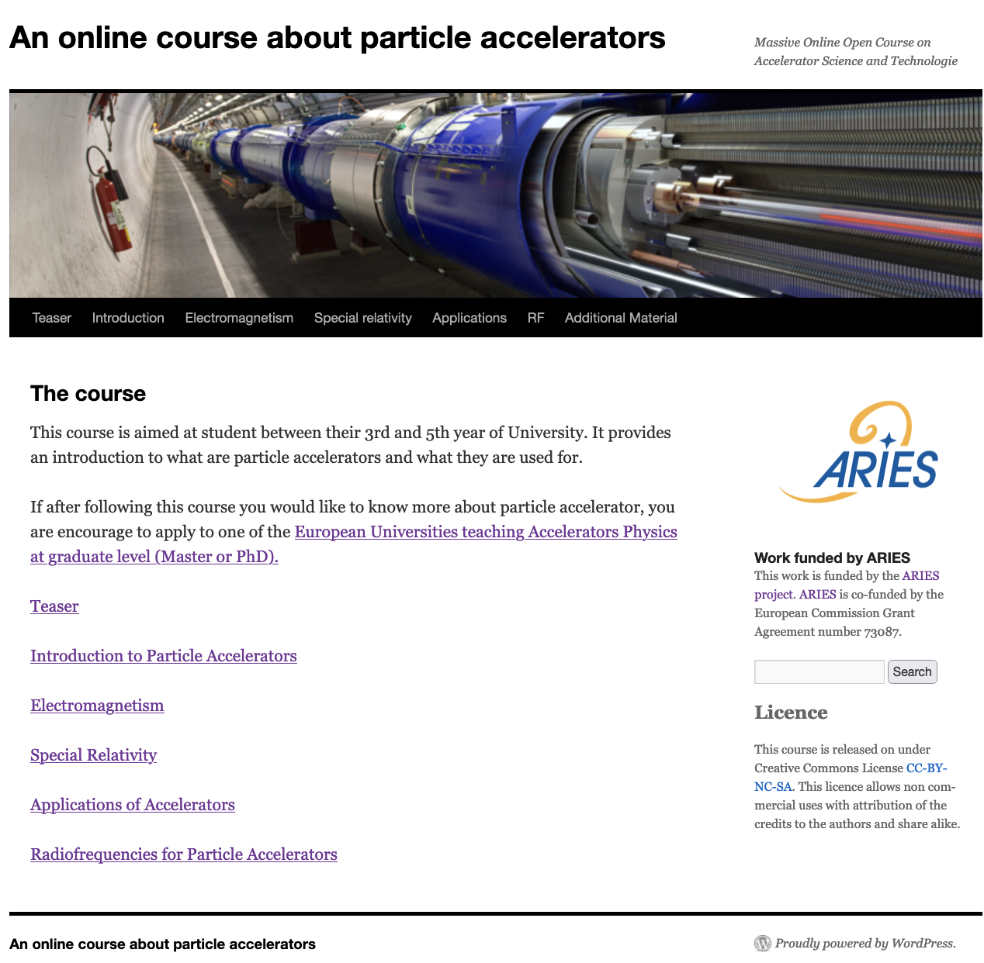
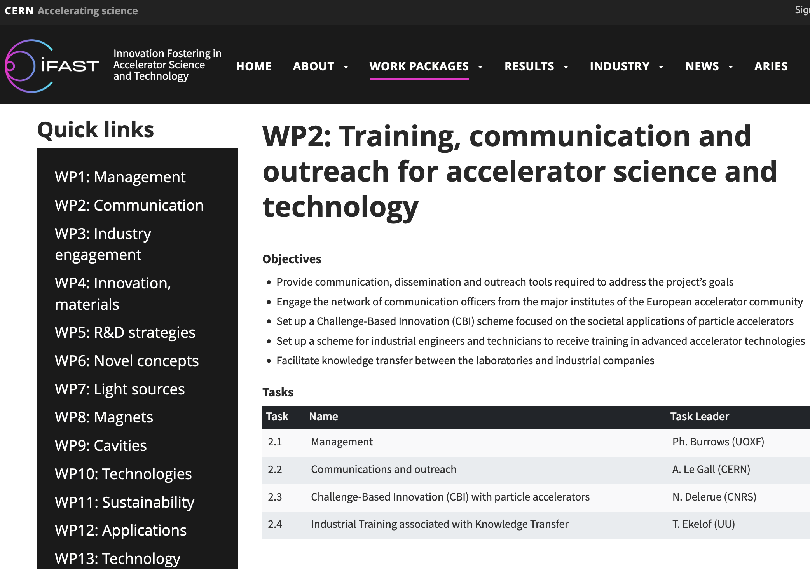
Complement: Next MOOC and I.FAST
Accelerate your Innovative EcoSystem
Ref: NPAP and Accelerating News
“Accelerate your Innovative EcoSystem”

Slide 15
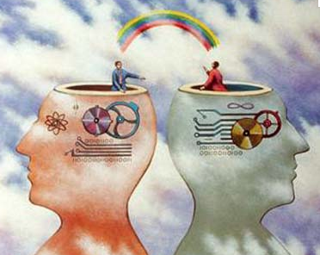
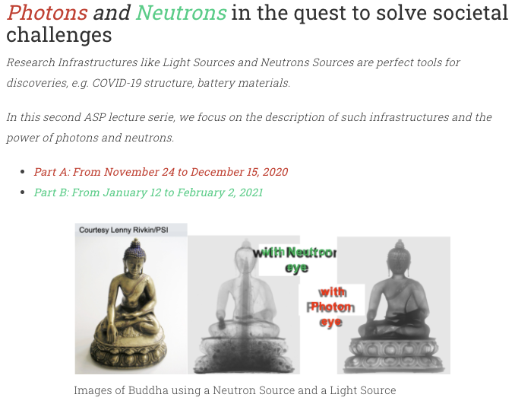

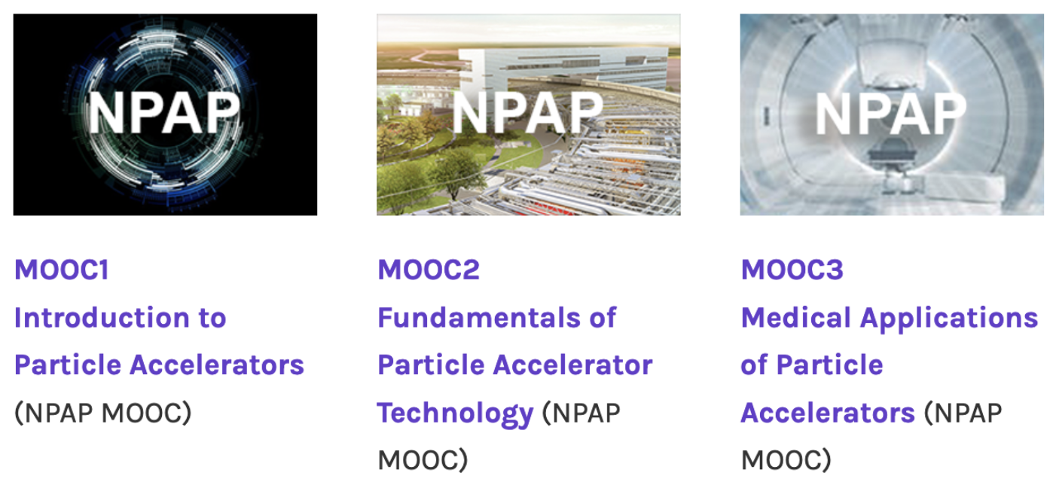
Particle Accelerators for User Communities
Technology and knowledge transfer are the pillars of the development of this innovative ecosystem, using scientific communication, education and collaboration as their vectors !
Two examples to learn more about particles accelerators and foster science in developing communities:
African School of Fundamental Physics and Applications (ASP)
In-person & online courses, conferences for students, teachers and learners since 2010 (intro)
  e.g. Synchrotron and Neutron based diffraction and spectroscopic techniques
Notes:
To enable an optimum transfer of knowledge and savoir-faire, scientific communication, training and education can use the novel technology and methodologies
Enhanced by information Communication technology. ICT
We show now some examples of initiatives to reach this goal:
Like the NPAP MOOCs teaching today accelerator physics and technologies to almost 15 000 learners since 2019.
Due to the pandemic online lectures have become a clear added values to educative tools, like the ASP series teaching the mystery of photons and neutrons….
An many more communication channel and Public engagement that you can discover in the link provided in this paper.

Slide 16
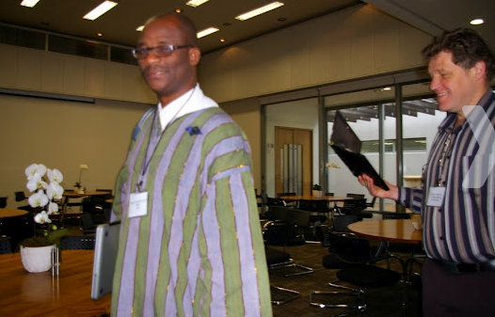
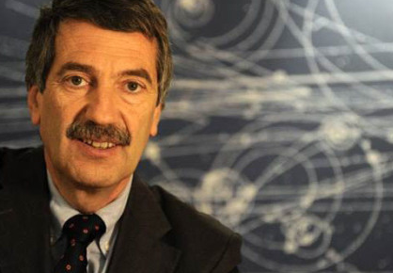
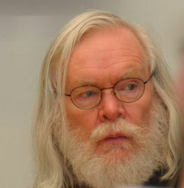
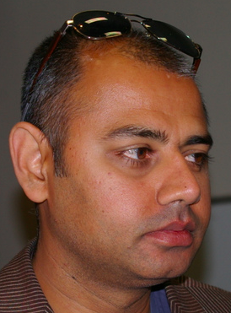
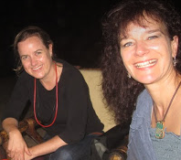
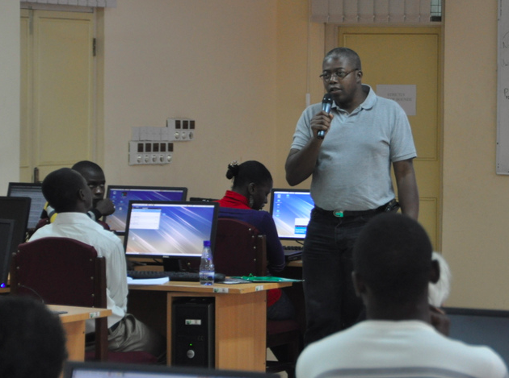
Transfer of Knowledge
African School of Fundamental Physics and Applications (ASP) - as a start-up
SEVEN editions completed since 2010 !
ASP2022 in Port Elisabeth / Gqeberha (SA)
A non-profit organization created by a small group of worldwide scientists to stimulate and include more African talented physics students in the world scientific community
The aim of the school is to build capacity in African countries, to harvest, interpret, and exploit the results from physics experiments with particle accelerators, and to increase proficiency in related applications and technologies.
To contribute to a world w/ equal access to knowledge
To support financially up to 90 (+97virtual) African students for 2 to 3-week classes
To establish a biennial educative program to be hosted across Africa
To provide high quality classes by international re-known Scientists
Notes:
Based on the experience of few European and American scientists, we have created a network, an organization, to stimulate and include more African talented physics students in the world scientific community.
Our mission is to help increase the number of African students acquiring higher education.
We have felt that American and European big science programs, have a lot to share in order to improve the world condition, hence science transcending boundaries…
“Everything “ pass by knowledge, and education is the pillar of well-being, and a peaceful world. Our goal was also to contribute to limiting the brain drain, by increasing capacity within African universities and promote spin-off for large scale activities IN Africa (see SKA, Af LS)
---
This is achieved through an outreach effort, an increased awareness of the potential of high quality training offered by large scale experiments in context in various scientic disciplines, and a system of networking on the international scale.
There is a strong alignment between the mission and the vision of African governments and policy makers on education and capacity building and their programs with the goals of the ASP.

Slide 17
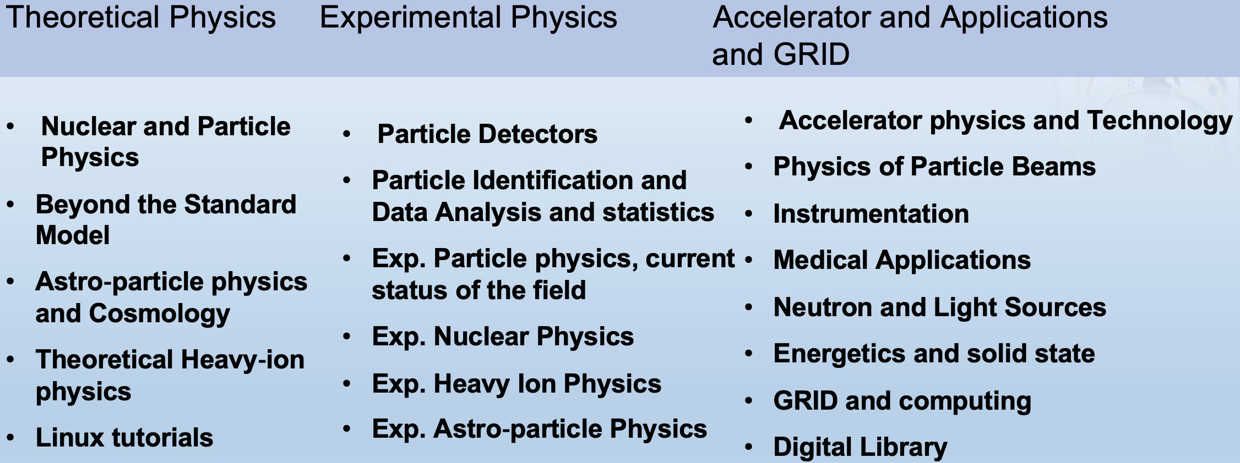
Transfer of Knowledge
African School of Fundamental Physics and Applications (ASP)
TOPICS OF INTEREST – Broad range of Physics Teaching
17
Notes:
Which topics are we covering ?
Beyond our core topics of interested, based on our own background (th. Exp. App), we have continuously adapted the program, to reflect the African students level and preferences. E.g we have added more computing hands-on Linux Boot Camp).
- Th: describe the standard Model and quantum field theory.
- Exp: deals with detectors , data analysis and statistical treatment to give participants an introduction to how raw data is transformed into final measurements
- Appl: . The scientific disciplines are thr basics of particle accelerator technology, applied physics , medical physics and material science.
- The two-day sessions are dedicated to GRID computing session supported by the DOSAR Distributed Organization for Scientic and Academic Research (DOSAR) and the Open Science Grid (OS-Grid).
Medical applications , nuclear physics and astrophysics are systematically topics of interest in Africa.
We systematically include local lecturers to cover their topics.
Depending on the host country, different categories can be enhanced.
Timetable of African School of Fundamental Physics and Applications:
ASP2010: https://indico.cern.ch/event/78565/timetable/?view=standard
ASP2012: https://indico.cern.ch/event/145296/timetable/?view=standard
ASP2014: https://indico.cern.ch/event/276481/timetable/?view=standard
ASP2016: https://indico.cern.ch/event/528094/timetable/?view=standard
ASP2018: https://indico.cern.ch/event/656460/timetable/?view=standard

Slide 18
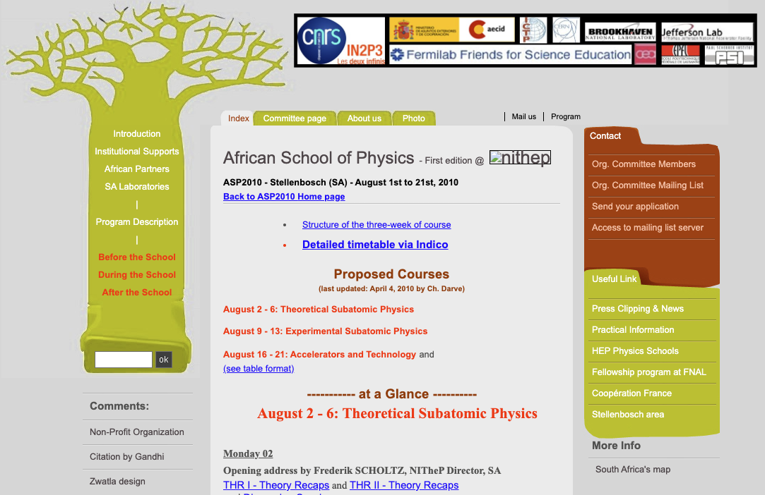
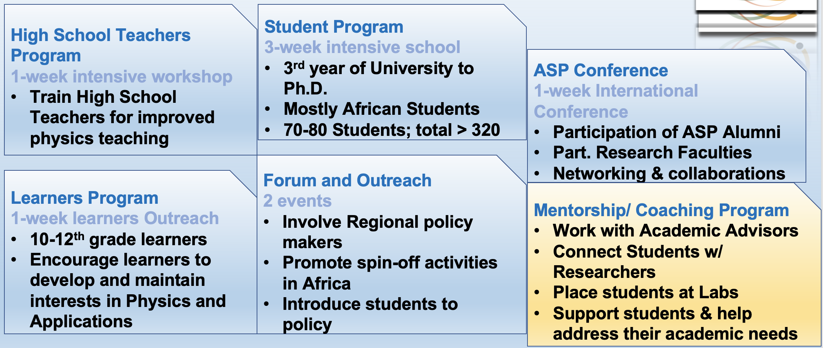
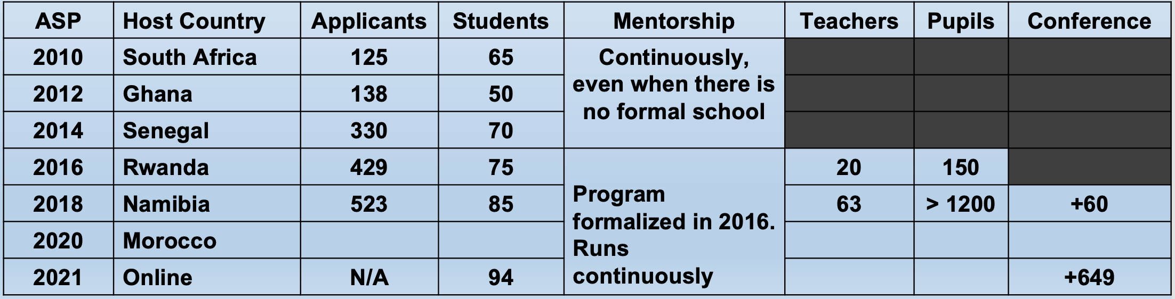
Transfer of Knowledge
https://www.africanschoolofphysics.org
ASP in a nutschell - Educating developing communities
From: ASP2010 to ONLINE ASP2020and ASP2022 (Nov 28 – Dec 9, 2022)
94 students from 40 African countries in-person engagements,
an additional up to 97 for online participation80 in-person SA high school teachers
450 in-person high school pupils (Dec 5-9) from the region around Gqeberha.
In-person and online !
@ African Light Source – ASFAP → African Accelerator School ?
Notes:
; students received support to boost their internet connectivity;

Slide 19
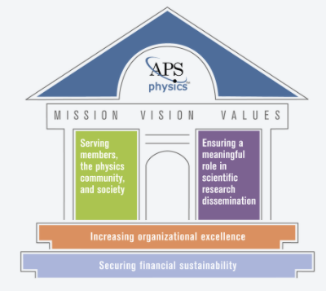
APS and FIP principle
The openness of the FIP agenda reflects the grassroots origin of this Forum.
Advancing the knowledge of physics and its diffusion by fostering cooperation and communication among physicists of all countries.
4288 FIP members in 2022
Further synergies with the program of the African School of Fundamental Physics and Applications
and IUPAP
Year | FIP members
2018 | 4186
2019 | 4179
2020 | 3794
2021 | 4067
2022 | 4288
* APS Free Trial Student Membership
Notes:
The openness of the FIP agenda reflects the grassroots origin of this Forum.
- Specific actions will include: EMBRACING DIVERSITY, INCLUSION, AND EQUITY at the highest levels of APS leadership; establishing best practices in the hiring and retention of staff, the population and education of committees, and the evaluation and selection of honorees.
- Physical Review : EXPLORING NEW AND SUSTAINABLE EDITORIAL, PUBLISHING, AND BUSINESS MODELS;
REDUCING INTERNAL BARRIERS AND ENCOURAGING CROSS-ORGANIZATIONAL COLLABORATION;
INCREASING PHILANTHROPIC EFFORTS

Slide 20
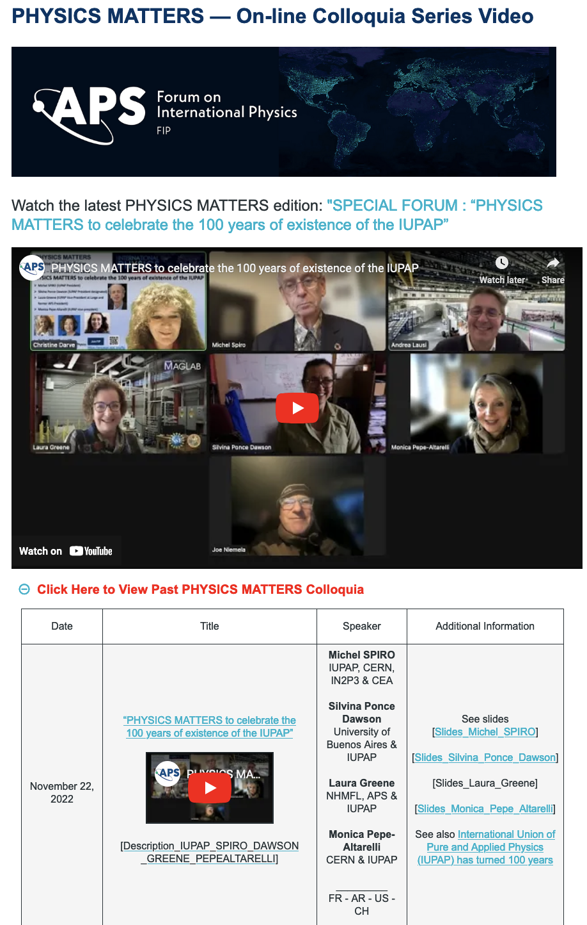
PHYSICS MATTERS
Monthly colloquia series “Physics for Development”
LIVE on-line colloquia that will primarily target and involve some test centers, selected from within the partner countries of the SESAME project supported by the APS.
Visit our 27 Past colloquia and forums recordings
and
Attend our next event
Notes:
initiative in COVID times.

Slide 21

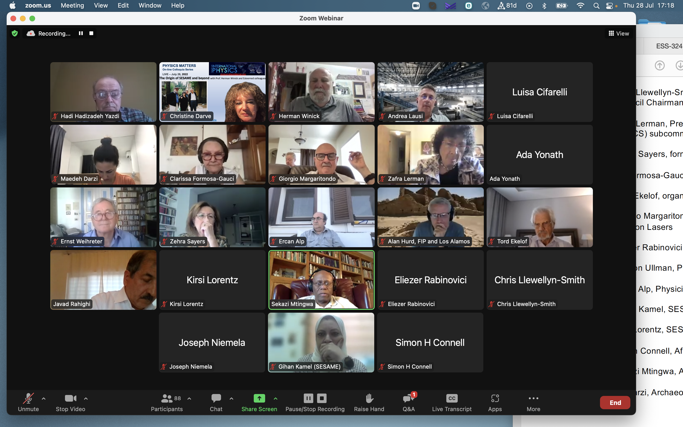
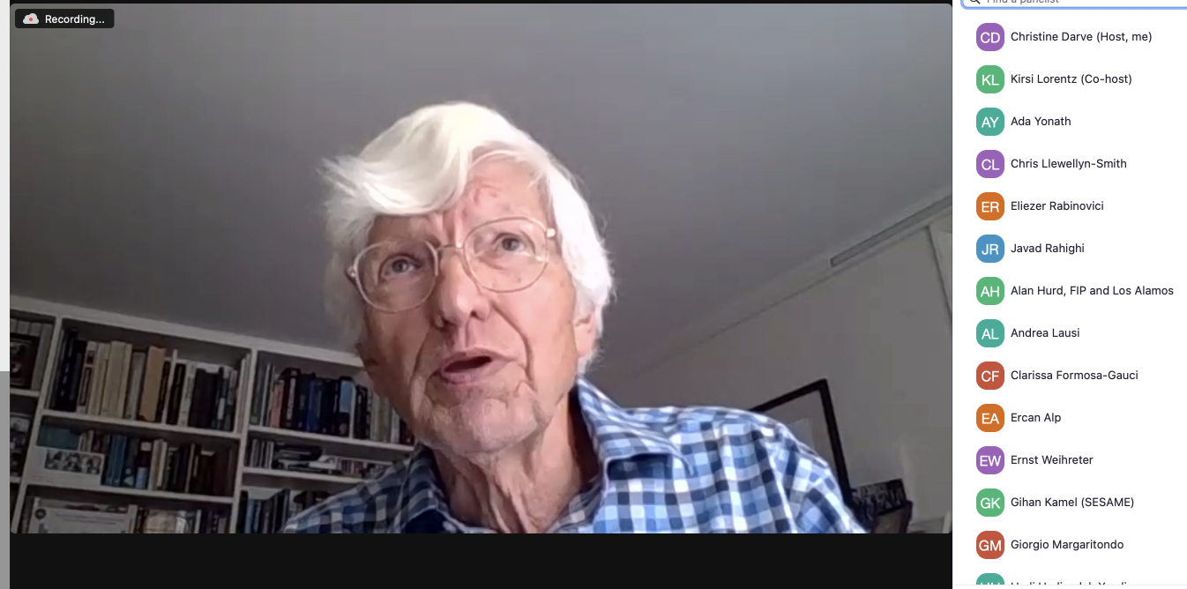
More International Synergies
SCIENCE FOR DEVELOPMENT & SCIENCE FOR PEACE – FIP
28 July 2022 – PHYSICS MATTERS
The Origin of SESAME (YouTube)
21 May 2021 - Physics, Peace, Human Rights: Sakharov-100

Slide 22
IUPAP and Accelerator at APS Meetings, 2023
Tuesday, March 7 | FIP/DCMP | IUPAP@100: International Science in Changing Societal and Geopolitical Landscapes
IUPAP |  | Monica Pepe-Altarelli : 100 Years of Existence of the International Union of Pure and Applied Physics, IUPAP
 |  | Silvina Ponce Dawson : The role of IUPAP to Increase the Inclusion of Women and Underrepresented Groups
 |  | Chandralekha SINGH : Challenges and Opportunities in Physics Education for the 21st Century
 |  | Laura Greene : Science Policy Advising and Diplomacy
 |  | Steward Prager : Perspectives on Nuclear Threat and Global Security
April 15-18 | FIP/ DPB | Accelerate solving energy crisis : From Fission to Fusion
 |  | Ait Abderrahim Hamid, MYRRHA, “ The perspectives of MYRRHA in solving the energy crisis”
 |  | Mieczyslaw Witold Krasny, CERN, “A novel, Gamma-Factory-driven energy source — exploratory studies”
 |  | Ahmed Diall, PPPL, “Perspective of ARPAE in fusion, in particular R&D and market potential for fusion”
 |  | Ali Haghigat, Nuclear engineering program at Virginia Tech, “ Status and outlook of ADS at US”
CD / 2022/12/20
Nordic accelerator school MOOC

Slide 23


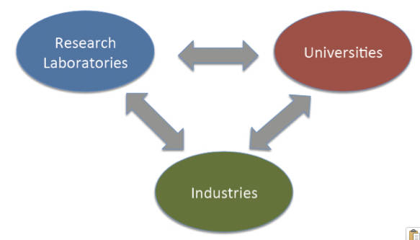
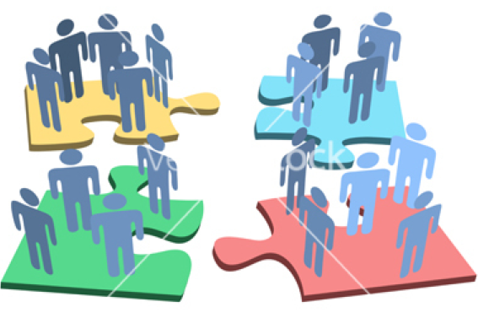
Conclusion:
Science for Society to transcend Boundaries
From Regional, European to International Educational transfer of knowledge
MOOC to support the use and construction of Particle Accelerators
Synergies between Education, Research Infrastructures, and Industry as leitmotif
Innovation is based on a collective and multidisciplinary approach.
Building together tomorrow world !
See more links at "Accelerate your Innovative EcoSystem”
23

