Slide 1
Agenda, Minutes & Follow-up of actions
G. Arduini

Slide 2
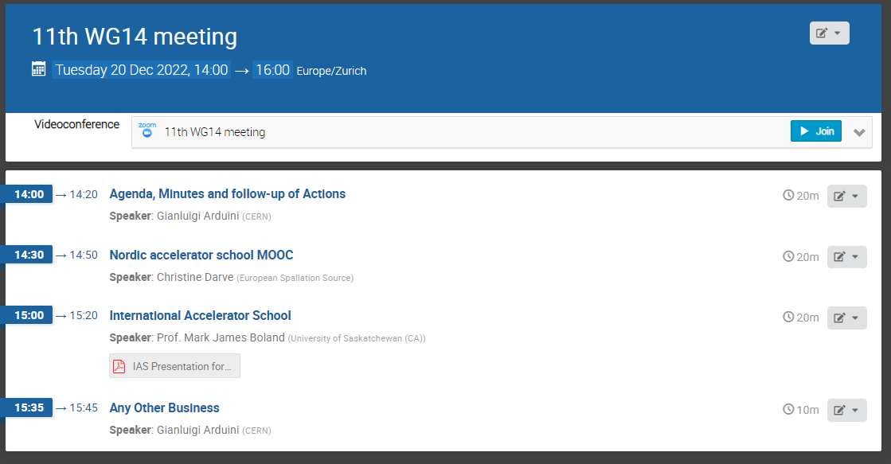
Agenda

Slide 3
Pending actions
Publications: WG14 should provide a position statement and a plan of action. Caterina (lead), Di-Jing, Gianluigi, Nikolay, Oliver will address this. Action: Caterina, Di-Jing, Gianluigi, Nikolay, Oliver. Liu will report on the discussions at the last JACoW stakeholders’ meeting at the next WG14 meeting. ➔ this meeting
IPAC as WG14 Conference and IPAC MoU. Action: Gianluigi (lead), Caterina, Lenny, Lia, Lin, Tadashi to resume the discussions ➔ not able to find a slot with people available. Do we consider this a high priority subject? If yes, Volunteers to help?
M. Lindroos believes that the majority of the students of the Lund University MOOC (3000 so far with 1000 getting a formal degree) are from developing countries. He will provide some more information for the next meeting. C. Darve will report at the next meeting ➔ this meeting
Communication (Web site, etc.). Action: WG members to pro-actively contribute to the content of the web page
Schools and workshops can be co-sponsored by IUPAP WG14. Action: all WG members to propose schools/workshops for endorsement/sponsoring by IUPAP WG14. ➔ Proposal this meeting
Nikolai will send some information concerning talks on accelerators. Action: Nikolai. ➔ Done. Information being added on the web page
WG14 could contribute to define an accelerator session at the next PTCOG meeting. Michael to liaise with the other members of the WG14 members and PTCOG. Action: Michael.
Liangting volunteered to provide an article on activities in Accelerator Science in China for the IUPAP WG14 website. Action: Liangting.

Slide 4
Any Other Business

Slide 5
Future Meetings
  February (week starting 20/2) - Zoom
  May (week starting 7/5) – in person at IPAC’23
    Propose Thursday 11/5 from 17:00 to 18:30 (room for ~30 people to be booked)

