Slide 1
News from the IUPAP General Assembly
G. Arduini

Slide 2
News from IUPAP
There is a plan to review the IUPAP structure (commissions, affiliated commissions, working groups):
  First discussions have started and commissions overseeing the WGs have been asked to provide input
  WG14 (and WG1 – ICFA) are overseen by C11 (Particles and Fields)
  Presentation of WG14 activities at IUPAP-C11 meeting during ICHEP (10 July 2022):
    Well received

Slide 3
News from IUPAP
WG14 has been extended for 3 years until the next General assembly to be held in 2024
  Comments made during the Executive Committee Session:
    Overlap with ICFA (it was mentioned that this might become an affiliated commission as they have a “life on their own”)
    Past and present WG14 chairs are from High Energy Physics Laboratories in spite of the emphasis on the complementarity WG1/14
  Need to take this into account
We should aim to apply to become a commission by 2024

Slide 4
IUPAP General Assembly:
Resolutions on Working Groups
Dissolution of inactive working groups
  It is resolved that the Working Groups “Communication in Physics” (WG2), “Astroparticle Physics International Committee” (WG10), and “Energy” (WG12) be dissolved with their termination taking effect immediately
Extension of existing working groups
  It is resolved that the existence of the Working Groups that are already set up and functioning (WG1, WG5, WG7, WG9, WG11, WG13, WG14, WG15, and WG16) be extended until the next in person General Assembly that will be held in 2024

Slide 5
IUPAP General Assembly:
Resolutions on Working Groups
Mission/mandate for proposed working group on open science (WG20)
  Make a recommendation for a strategy to foster a culture of open science and aligning incentives for open science across all disciplines of physics—in particular, lay out the requirements to be put in place, with regards to open science, for IUPAP sponsored and endorsed conferences.
  Closely follow the implementation of the UNESCO Recommendation on Open Science and take part in relevant UNESCO Open Science Working Groups to advocate the interest of physics.
  Survey open science practices in physics and share the findings with the IUPAP commissions. - Establish a resource for physics of open science infrastructures, tools, and techniques.
  Organize a big event on Open Science in the framework of IYBSSD, possibly in Honduras (June 2023

Slide 6
IUPAP General Assembly:
Resolutions on Working Groups
Working Group on Physics and the Green Economy (Cf WG12:Energy)
  Identify, facilitate, grow, inspire, promote, encourage, engage, discuss, debate, etc., the unique role that physics is and should be playing in this area
  Entrench an evidence-based approach to responses to climate change studies
  Establish a strong bridge between physics and the broad international public on these topics
  Suggest and encourage ways of incorporating Green Economy thinking in university curricula and research training
Composition
  Chaired by one of the recent Nobel Prize winners
  Comprising other two Nobel Prize winners plus 12 other champions, physicists and other climatology experts drawn from across the world, an open call for nominations
The WG is tasked to propose to EC a programme of activities for itself – low cost
  Advise Executive Council on actions to be taken, work to be done, statements to be issued
  At least one major conference on Physics and the Green Economy over the next 3 years
  Liaise with Regional, national Physics Society, with other Unions in other fields in the spirit of IYBSSD.
  Target an International Day of Physics for Society and Sustainable Development or of Basic Sciences for Sustainable Development

Slide 7
General information
Ukraine New Territorial Member
Corporate Associate Members:
  European Organization for Nuclear Research (CERN), Switzerland
  Advanced Laser Light Source (ALLS), Canada
Concept of Associate Territorial Membership to foster the accession of new countries being discussed:
  10% cost of one unit, benefits are limited, spelt out in MoU
  Member country must commit to programme of physics development (quid quo pro), hence of mutual benefit, not simply a discounted levy
  On invitation rather than on application, e.g. Nepal
  Max 10% Associate Territorial members, so max 6
To be approved at next GA in 2023

Slide 8
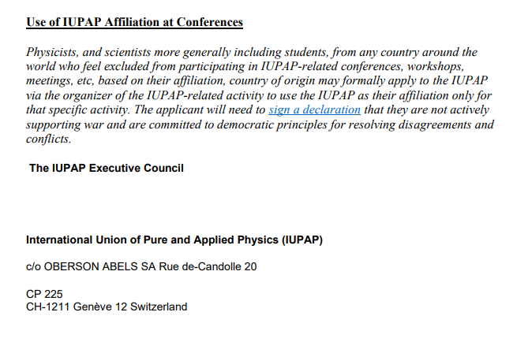
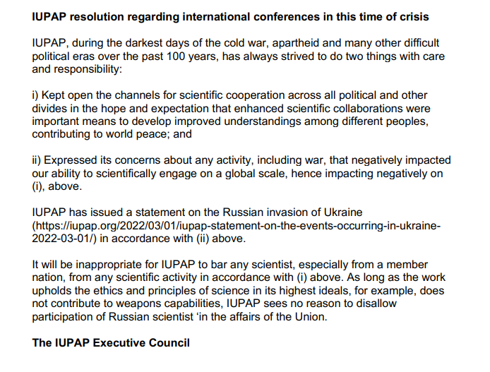
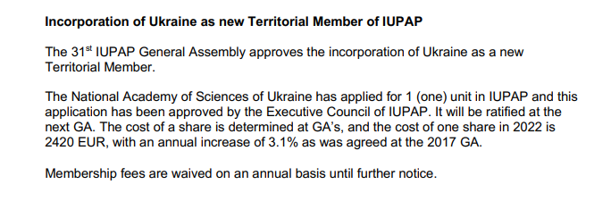
IUPAP General Assembly

