Slide 1
Agenda, Minutes & Follow-up of actions
G. Arduini

Slide 2
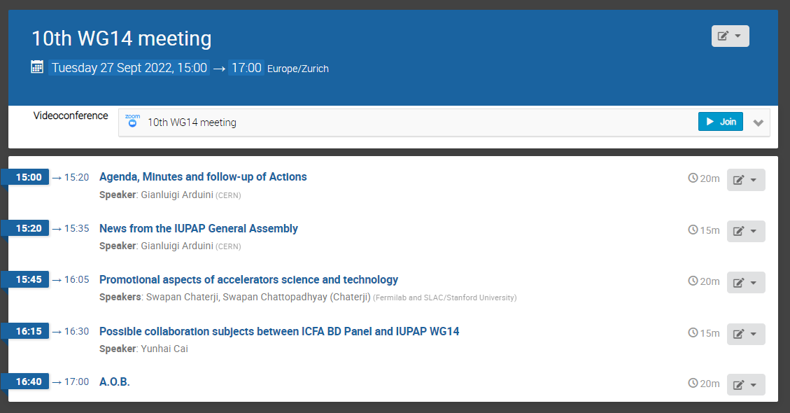
Agenda

Slide 3
Pending actions
Promotion of Accelerator Science: S. Chattopadhyay, in collaboration with L. Rivkin, will develop further the promotional aspects of accelerator science and technology globally and will report on it at a future meeting of WG14. Action: Swapan, Lenny. Action: all WG members to send their ideas to S. Chattopadhyay by the end of July ➔ Presentation today
Publications: WG14 should provide a position statement and a plan of action. Caterina (lead), Di-Jing, Gianluigi, Nikolay, Oliver will address this. Action: Caterina, Di-Jing, Gianluigi, Nikolay, Oliver.
Interactions with other commissions/committees/WG/Organizations (IAEA/ICFA/ICUIL…) ➔ ICFA-BD panel today
IPAC as WG14 Conference and IPAC MoU. Action: Gianluigi (lead), Caterina, Lenny, Lia, Lin, Tadashi to resume the discussions ➔ not able to find a slot with people available. Do we consider this a high priority subject? If yes, Volunteers to help?
M. Lindroos believes that the majority of the students of the Lund University MOOC (3000 so far with 1000 getting a formal degree) are from developing countries. He will provide some more information for the next meeting. Action: Mats. C. Darve will report at the next meeting
Website: S. Jacquemot suggested to have at least one page about future accelerators (e.g. EUPRAXIA). Gianluigi fully supported this suggestion and asked Sylvie to send a possible picture and text. Action: Sylvie. Ongoing
Communication (Web site, etc.). Action: WG members to pro-actively contribute to the content of the web page

