Slide 1
WG14 and Education in Accelerator Science
O. Kester

Slide 2
International Accelerator School (IAS) -background
The precursor of the IAS is the Joint Accelerator School (JAS). 4 institutes/labs being concerned with the organization, CAS, USPAS, JINR, KEK.
The initiative for new events is left open and consequently in the history of the JAS the intervals between courses are irregular.
Mark Boland (Canadian Light Sources, CLS) entered for the 2021 issue (now 2022 due to Covid) and has support from TRIUMF.
Suzie Sheehy has announced interest for 2024 to organize a course in Melbourne. During the discussions the JAS was rebaptized IAS.
During 2019 Hermann Schmickler (CAS) made the IAS known to ICFA and in order to obtain an ICFA sponsorship of about 20000 Dollars/ course.
This ICFA sponsorship would have to be approved through presentations in committee meetings, but Covid and other issues scrambled things that this never happened.

Slide 3
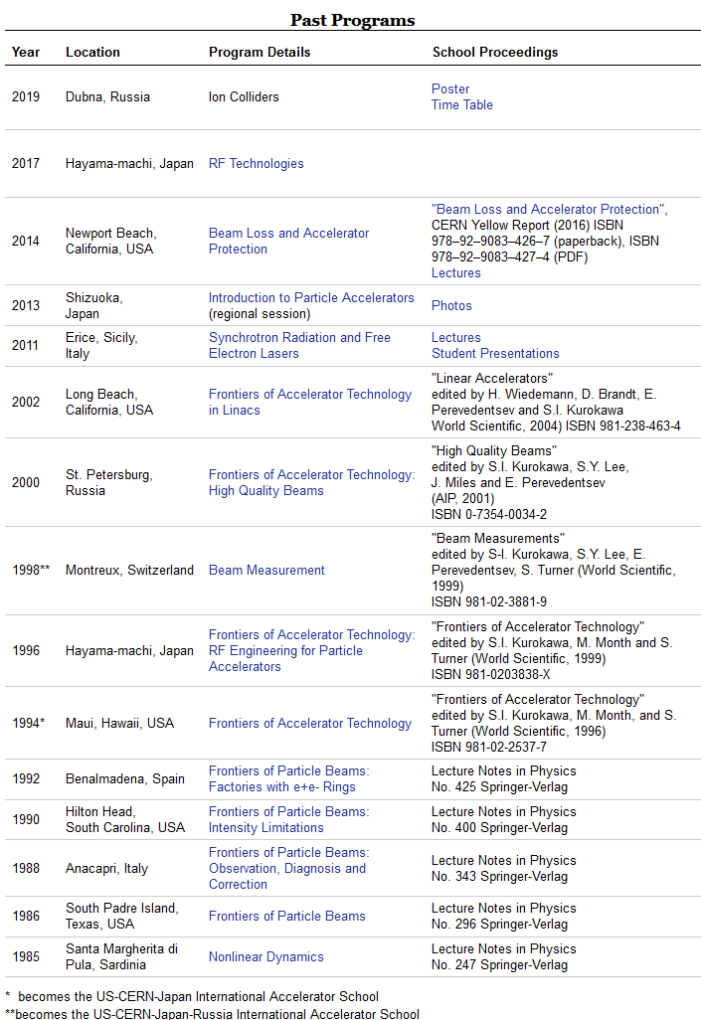
JAS History
https://uspas.fnal.gov/programs/JAS/index.shtml
Boland has been approached in 2017 and 2019 by colleagues in JAS to make a proposal (unsuccessful attempt made in 2011 to host a JAS in Australia).
Canada (CLS and TRIUMF) included as part of a push for a new International Accelerator School (IAS) transition promoted by CERN.
No past program specifically on Superconductivity (SC) and SC-technology.
→ picked up by Boland and Kester

Slide 4
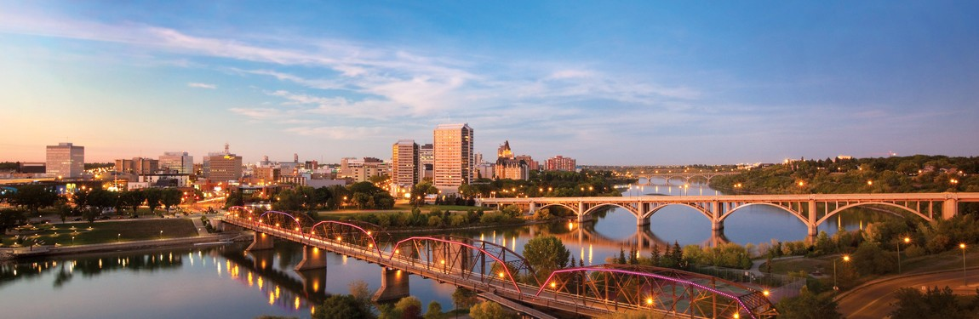
IAS 2022, Saskatoon, Canada
July 11-21, 2022
School on superconducting technology in accelerators – inc. RF, magnets, ancillary engineering systems.
Aimed at postgraduate MSc, PhD, and staff scientists and engineers.
Motivated by Canadian activities; HL-LHC upgrade, ARIEL at TRIUMF, SRF at CLS, Fundamental SRF research at University of Victoria and TRIUMF and international collaborations.
Located on the campus of University of Saskatchewan with tours of CLS SRF and SC magnet facility.
July 2022 to fit in between USPAS usually June and CAS usually Aug/Sep.

Slide 5
IUPAP WG14 and IAS - discussion
The IAS has no governance structure; therefore the steady evolution is slow.
Its not intended to have IAS as a competition, but an extension of CAS, USPAS and other education activities
→ a memorandum from Bill Barletta about the intention of IAS exists
The IAS would be idea to support students from countries that have not sufficient resources to send students abroad – sponsorship
WG14 to connect with ICFA chair Stuart Henderson and discuss governance of ISAS and potential financial support for students
Any support from IUPAP possible? Governance, financial

