Slide 1


Strategy for Accelerator Science & Technology Education and Workforce Training
for
IUPAP WG 14 Working Group/Committee
Swapan Chattopadhyay
February 22, 2022

Slide 2
OUTLINE
1. Prelude and Motivation
Demand/Competition for Resources
Commonalities/Differences between Different Applications
Strategy
References
Group Discussion and Feedback
NOTE: Andrei Seryi (Jlab), Bill Barletta (MIT), Steve Lund (MSU),
Zhirong (SLAC) and Mei Bai (SLAC) contributed to the ideas
in this talk in connection with US Snowmass 2022 activities.

Slide 3
PRELUDE
A beam of charged/neutral particles or photons consists of packets of ‘focused’ and ‘directed’ energy and information, delivered in appropriate staccato fashion, to explore/probe matter at the smallest distances and fastest time-scales for fundamental sciences.
High energy particle physics, nuclear physics, basic energy sciences (atomic, molecular, condensed matter, chemistry) and life sciences
Societal and industrial applications : Energy, Environment (Climate), Health, Economic & National Security, in accordance with global mission of agency stewardship and technology transfer.
The whole enterprise is enabled by educated and trained experts in the physics and engineering of beams and associated techniques and technologies.

Slide 4
PRELUDE (cont’d)
The trained work force is a critically relevant international resource, whose development has been historically provided by particle and nuclear physics communities for the entire society
Today with relevance and demand from significant growth areas beyond high energy physics, establishing an internationally coordinated and synergistic education and training program of the accelerator work force is a critical need
The high energy - nuclear physics, photon –neutron –fusion –atomic -molecular science communities are encouraged to take the strategic lead in establishing an enhanced program in this area in collaboration with Engineering & Technology and Industry.

Slide 5
DEMAND and COMPETITION for RESOURCES
High Energy Physics (HEP) was the center of mass of accelerator physics and technology in the USA, though historically HEPAP has run accelerator R&D for the benefit of the broader community. Situation is not too dissimilar in Europe and Asia.
Over the years, the center of mass has shifted to nuclear, photon and neutron sciences and industrial applications have become more significant
From this perspective, high energy particle accelerator applications compete with other areas for talent to advance technological needs
So, workforce training is also chained to medicine, national security and commerce
Many of the relevant technologies have dual applications and advances made for non-science applications can benefit science
In this situation it is best if strategies for workforce training recognize the situation and
coordinate to the extent possible for mutual advantage.
Notes:
Ty and commerce

Slide 6
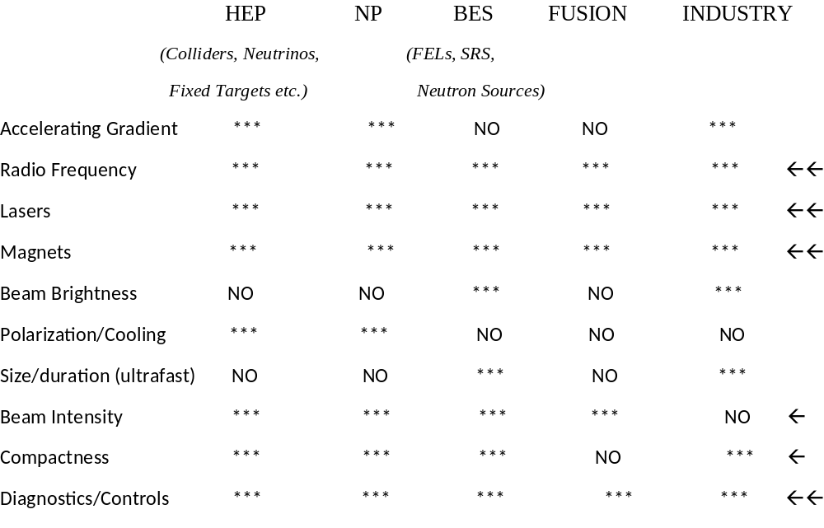
Recognition of Key Differences and Commonalities
yes
yes
?
?
yes
yes
yes
yes
Probably
yes
Pulsed power/high power electronics
yes

Slide 7
STRATEGY
Collaborating with the various international physics and other scientific societies, Engineering & Technology societies and institutes, and international industrial community, establish an all-inclusive education and training program in accelerators.
Accelerator schools, seminar series, etc. should be examined for deficiencies. A long term, sustainable strategy should be developed to fill in any missing components and improve training opportunites to grow a new generation of high performers for accelerators for future: e.g. add:
→ Laser and nano-technology
→ AI (Artificial Intelligence) and ML(Machine Learning)
→ QIS (Quantum Information Science), Quantum Sensors etc.
→ Research infrastructure management into training.
We recommend surveying educational opportunities to support identified synergistic topics and PUBLISH IT IN A REFEREED JOURNAL for wider visibility.

Slide 8
Presence at Universities/Survey Examples
FNAL-NIU (US)
BNL-SBU (US)
SLAC-UCLA (US)
JLAB-ODU, NSU,HU Graduate Traineeships (USA)
(DOE/HEP funded -- VITA - Virginia Innovative Traineeships
in Accelerators)
EPFL-ETH-PSI, CI-JAI-RAL-DL, UH-DESY, CERN-EU universities,
GSI-Darmstadt,...etc (Europe)
(https://uspas.fnal.gov/opportunities/educational-opps/DOE-traineeships.shtml)

Slide 9
HISTORICAL REFERENCE
W. Barletta, S. Chattopadhyay, and A. Seryi:
“Educating and Training Accelerator Scientists and Technologists for
Tomorrow”
Reviews of Accelerator Science and Engineering, Vol 05 (2012), World
Scientific (Publisher), pp 313-331
2. Swapan Chattopadhyay, Steve M Lund, Zhirong Huang and Mai Bai:
“Strategy for HEP Accelerator Workforce Training in Coordination with
BES, NP, and Industry”
Letter of Intent submitted for Snowmass 2021, Beam Physics and
Accelerator Education topical group AF1

