Slide 1
INTRODUCTION OF EC&CC MEMBERS
IUPAP EXECUTIVE COUNCIL
COMMISSIONS
AFFILIATE COMMISSIONS
WORKING GROUPS

Slide 2
IUPAP EXECUTIVE COUNCIL
President | Silvina Ponce Dawson
Past President | Michel Spiro
President-Designate | Sunil Gupta
Associate Secretary General | Rudzani Nemtudi
Treasurer Secretary General for Legal and Financial Affairs | Boris Sharkov Jens Vigen
Secretary General for Administrative Affairs | Stefano Fantoni
Deputy Secretary General | Sandro Scandolo
Deputy Secretary General | Florencia Canelli
Vice-President at Large (Projects) | Kuijuan Jin
Vice-President at Large (Equity, diversity, and inclusion ) | Gillian Butcher
Vice-President at Large (Membership and development) | Igle Gledhill
Vice-President at Large (Outreach and Ethics) | Laura Greene
Vice-President from Commission Chairs | Gloria Platero (C8)
Vice-President from Commission Chairs | Shinji Yuasa (C9)
Vice-President from Commission Chairs | Marcelo Gameiro Munhoz (C11)
Vice-President from Commission Chairs | Cather Simpson (C17)
Vice-President from Commission Chairs | Simone Warzel (C18)
Commission for Policy and Finance (C1)

Slide 3
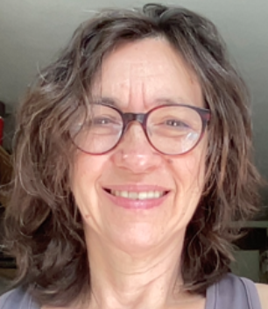

Silvina Ponce Dawson
President
Affiliation to IUPAP:
President
Commission/Category:
Executive Council / Commission on Policy And Finance (C1)
Current Job Title:
Full Professor
Current Affiliation :
University of Buenos Aires, Argentina, National Research Council (CONICET), Argentina
Previous IUPAP Experience:
Chair, IUPAP Working Group on Women in Physics (2011-2014), Vice President at Large and Gender Champion (2017-2019), President Designate (Acting: 2019-2021; 2021-2024)
Area of research:
Biological Physics, Nonlinear Dynamics, Statistical Physics
Latest paper:
“Biological physics to uncover cell signaling”, SPD, Biophys Rev (submitted)
Other Information:
Fellow of the International Science Council (ISC)

Slide 4
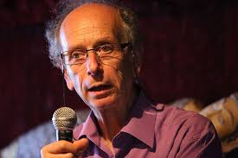
Michel Spiro
Past president
Affiliation to IUPAP:
Past president IUPAP
Commission/Category:
Executive Council / Commission on Policy And Finance (C1)
Current affiliation (Institution):
CEA-CNRS
Area of Study/Research/Expertise:
Particle and Astroparticle Physics
Last Physics paper written with date of publication:
2019: “Neutrino Physics Sociology”, Proceedings of the International Conference on History of the Neutrino: 1930-2018 : Paris, France. September 5-7, 2018.
Any other information:
Chair of the Steering Committee for the Earth Humanity Coalition working if support of the International Decade of Sciences for Sustainable Development

Slide 5
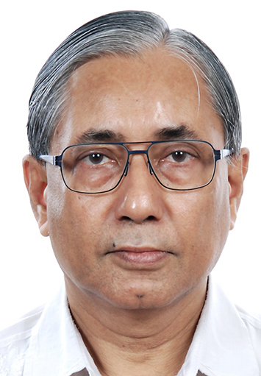
Sunil Gupta
President-Designate
Affiliation to IUPAP:
President Designate (2025-)
Commission/Category:
Executive Council / Commission on Policy And Finance (C1)
Current affiliation (Institution):
Tata Institute of Fundamental Research, Mumbai, India
Current Job Title:
Senior Professor & Raja Ramanna Fellow (2021-2024)
Area of Study/Research/Expertise:
Astroparticle physics, Cosmic rays, Space weather, Instrumentation
Other Information:
IUPAP Commission C4, Chair (2017-2021), Vice-Chair (2014-2017), Member (2011-2014)
Founding Member: GRAPES-3 India-Japan Collaboration
Recent Publications are here
Email: gupta.crl@gmail.com & guptask@tifr.res.in
Contact: +91-98694-39435 (India), +1 (201) 895 9945 (USA)

Slide 6
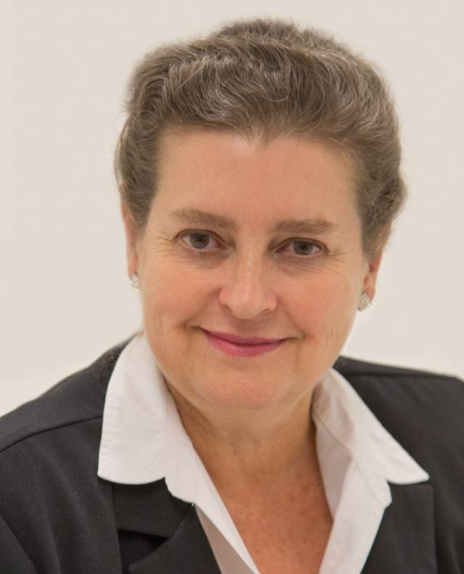
Irvy (Igle) Gledhill
Vice-President, Membership and Development
Affiliation to IUPAP:
Vice-President
Commission/Category:
Membership and Development
Current Job Title:
Honorary Adjunct Professor
Current affiliation (Institution):
University of the Witwatersrand, South Africa
Area of Study/Research/Expertise:
Applied Computational Physics
Last Physics paper written with date of publication:
BB Ndebele and IMA Gledhill, Two Dimensional Vortex Shedding from a Rotating Cluster of Cylinders, Journal of Applied Fluid Mechanics, 16 (11) 2175-2188, 2023
Any other information:
South African Institute of Physics

Slide 7
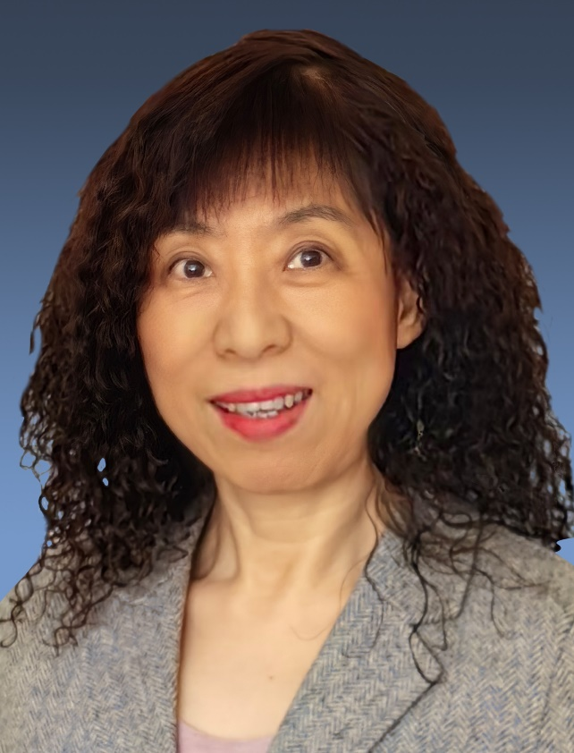
Kuijuan Jin
Vice-President, Projects
Affiliation to IUPAP:
Vice-President at large, Project
Current Job Title:
Profess of Physics, Academician of Chinese Academy of Sciences,
Current affiliation (Institution):
Institute of Physics, Chinese Academy of Sciences
Area of Study/Research/Expertise:
Optics and condensed matter physics
Last Physics paper written with date of publication:
Shuai Xu, Jiesu Wang, Pan Chen, Kuijuan Jin*, et., al., Magnetoelectric coupling in multiferroics probed by optical second harmonic generation, Nature Communications, 14, 2274 (2023)
Any other information:
Fellow of The World Academy of Sciences

Slide 8
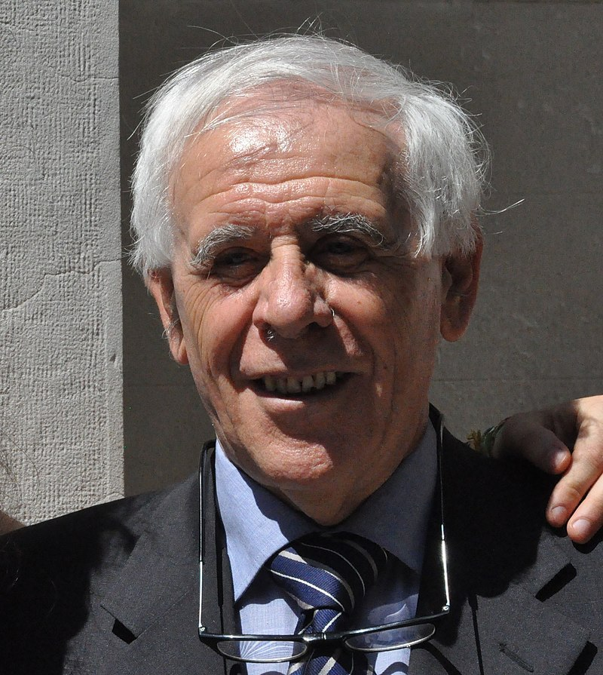
Stefano Fantoni
Secretary General for Administrative Affairs
Affiliation to IUPAP:
Secretary General for Administrative Affairs
Commission/Category:
Executive Council / Commission on Policy And Finance (C1)
Current Job Title:
President
Current affiliation (Institution):
International Foundation Trieste for the Progress and Freedom of Sciences
Area of Study/Research/Expertise:
Theoretical Nuclear Physics and Low Temperature Physics
Last Physics paper written with date of publication:
2020: “Nuclear Matter Theory”, O. Benhar and S. Fantoni, CRC Pres, Boca Raton, FL, 2020.
Any other information:

Slide 9
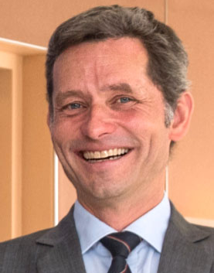
Jens Vigen
Secretary General for Legal and Financial Affairs
Affiliation to IUPAP:
Secretary General for Legal and Financial Affairs
Commission/Category:
Executive Council / Commission on Policy And Finance (C1)
Current Job Title:
Scientific Information Officer
Current affiliation (Institution):
CERN
Area of Study/Research/Expertise:
Information Science, Libraries and Publishing
Last Physics paper written with date of publication:
Do not publish in physics
Any other information:

Slide 10
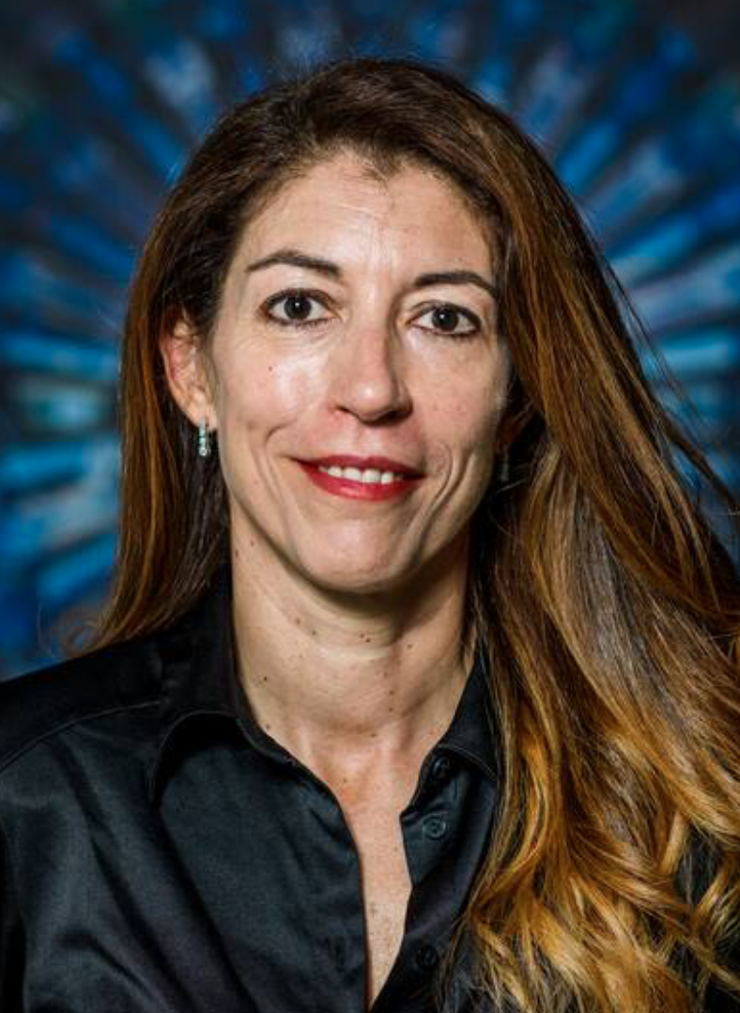
Florencia Canelli
Deputy Secretary General for Legal and Financial Affairs
Affiliation to IUPAP:
Deputy Secretary General for Legal and Financial Affairs
Commission/Category:
Executive Council / Commission on Policy And Finance (C1)
Current Job Title:
Professor
Current affiliation (Institution):
University of Zurich
Area of Study/Research/Expertise:
Experimental particle physics
Last Physics paper written with date of publication:
List of publications in Inspire-HEP
Any other information:
Swiss scientific delegate to the CERN council

Slide 11
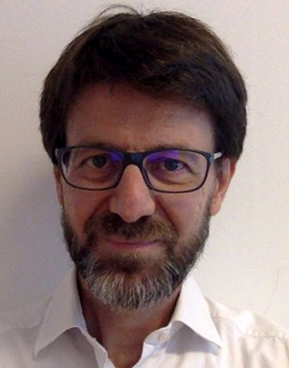
Sandro Scandolo
Deputy Secretary General for Administrative Affairs
Affiliation to IUPAP:
Deputy Secretary General
Commission/Category:
Executive Council / Commission on Policy And Finance (C1)
Current Job Title:
Head of Research
Current affiliation (Institution):
Abdus Salam International Centre for Theoretical Physics (ICTP)
Area of Study/Research/Expertise:
Condensed Matter Physics, Atomistic Simulation of High-Pressure Phenomena
Last Physics paper written with date of publication:
17 January 2022: “How to determine solubility in binary mixtures from Neutron Scattering data: the case of methane and water”, V.N. Robinson et al., J. Chem. Phys. (in press) (2022).
Any other information:

Slide 12
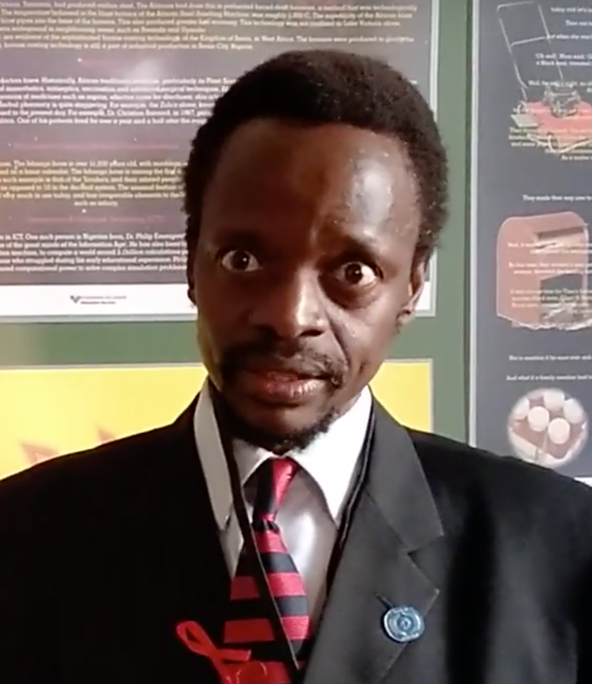
Rudzani Nemutudi
Associate Secretary General
Affiliation to IUPAP:
Associate Secretary General
Commission/Category:
Executive Council / Commission on Policy And Finance (C1)
Current Job Title:
Deputy Director: NRF, iThemba LABS - International Relations and Training
Current affiliation (Institution):
iThemba LABS (Laboratory for Accelerator Based Sciences), Cape Town, South Africa
Area of Study/Research/Expertise:
Semiconductor Physics and Accelerator-Based Ion Beam Analysis
Last Physics paper written with date of publication:
iThemba LABS, Faїçal Azaiez , Rudloph Nchodu, R. Nemutudi, Mathis Wiedeking, Nuclear Physics News International, Vol. 30 No. 4 (2020) p5
Any other information:
Member of the Executive Council of the South African Institute of Physics (SAIP)

Slide 13
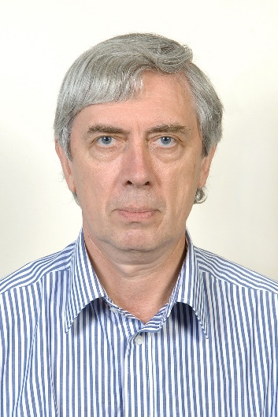
Boris Sharkov
Treasurer
Affiliation to IUPAP:
Treasurer
Commission/Category:
Executive Council
Current Job Title:
Professor, Dr.dr.h.c., Academician of Russian Academy of Sciences
Current affiliation (Institution):
Joint Institute for Nuclear Research, Dubna
Area of Study/Research/Expertise:
Accelerator Physics, Plasma Physics
Last Physics paper written with date of publication:
"High-energy-density-science capabilities at the Facility for Antiproton and Ion Research”
Physics of Plasmas 27, 043103 (2020); https://doi.org/10.1063/1.5134846
Any other information:
Full member of Academia Europea, Special representative of JINR DG to international research organizations

Slide 14
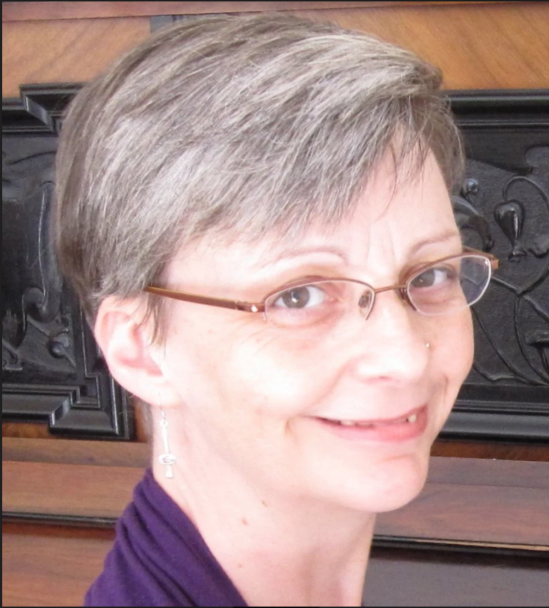
Gillian Butcher
Vice-President at Large (Equity, diversity and inclusion)
Affiliation to IUPAP:
Vice-President at Large (Gender Champion)
Commission/Category:
Executive Council
Current Job Title:
Research Associate
Current affiliation (Institution):
University of Leicester
Area of Study/Research/Expertise:
Space instrumentation
Last Physics paper written with date of publication:
6 July 2018: “Microchannel plate x-ray optics on the Mercury imaging x-ray spectrometer”, A. Martindale et al., Proc. SPIE 10699, 106990W.
Any other information:

Slide 15

Laura H. Greene
Vice-President at Large (Outreach and Ethics )
Affiliation to IUPAP:
Vice-President at Large (Outreach and Ethics )
Commission/Category:
Executive Council
Current Job Title:
Chief Scientist and Marie Krafft Professor of Physics
Current affiliation (Institution):
National High Magnetic Field Laboratory and Florida State University
Area of Study/Research/Expertise:
Quantum Materials and Policy
Last Physics paper written with date of publication:
10 June 2021: “Spectroscopic Evidence for the Direct Involvement of Local Moments in the Pairing Process in the Heavy-Fermion Superconductor CeCoIn₅”, K. Shrestha et al., Phys. Rev. B 103, 224515.
Any other information:
US President’s Council of Advisors for Science and Technology (PCAST).

Slide 16
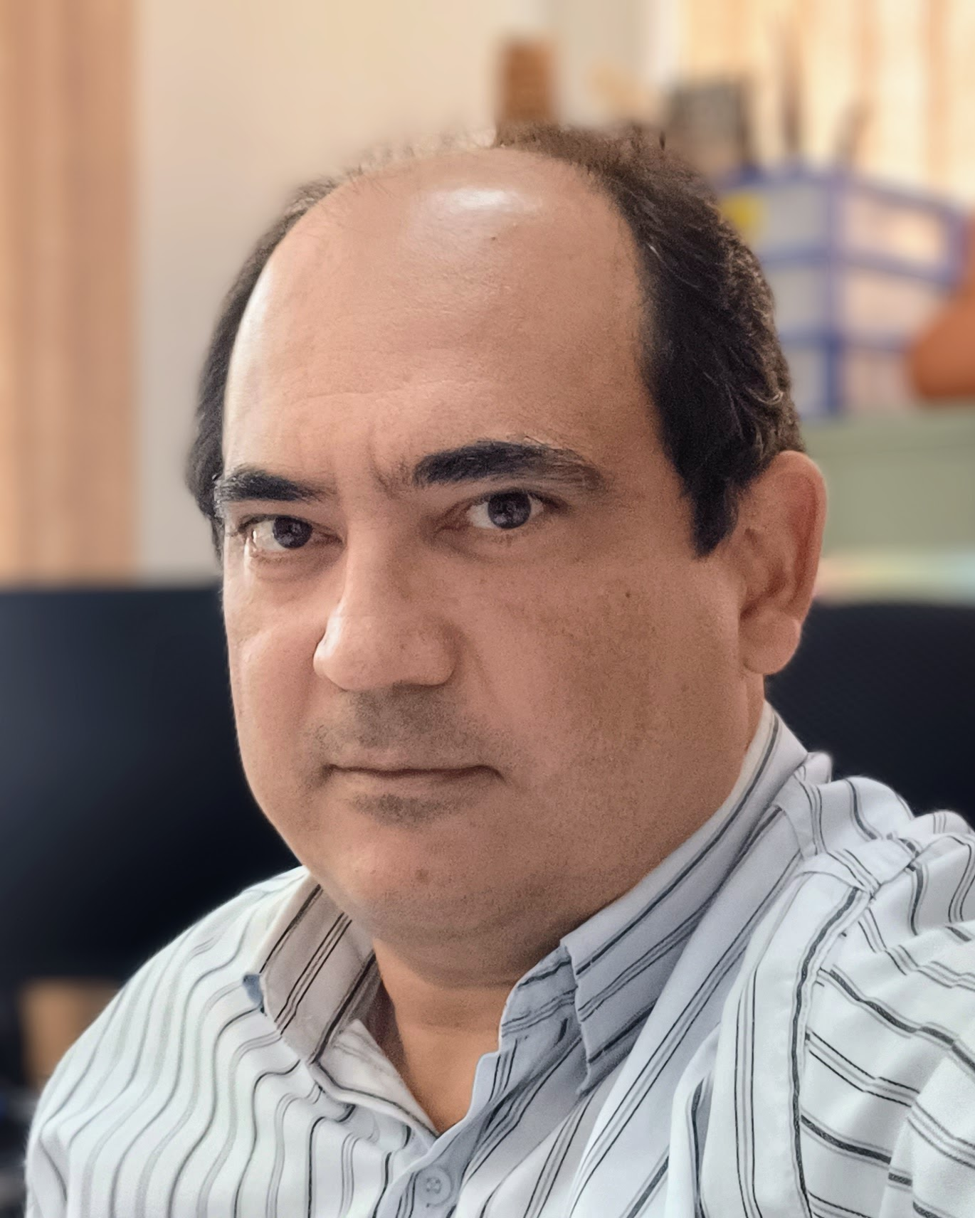
Daniel Varela Magalhães (C2)
Affiliation to IUPAP:
Chair
Commission/Category:
Commission on Symbols, Units, Nomenclature, Atomic Masses and Fundamental Constants (C2)
Current Job Title:
Associate Professor
Current affiliation (Institution):
University of São Paulo
Area of Study/Research/Expertise:
Atomic Physics, Time and Frequency Metrology
Last Physics paper written with date of publication:
N.D.Gomes et al., Microwave spectroscopy assisted by electromagnetically induced transparency near natural Förster resonance on Rubidium, Results in Physics, Volume 68, 2025, 108081
Any other information:
Brazilian Physics Society

Slide 17
Janos Kertesz (C3)
Statistical physics

Slide 18
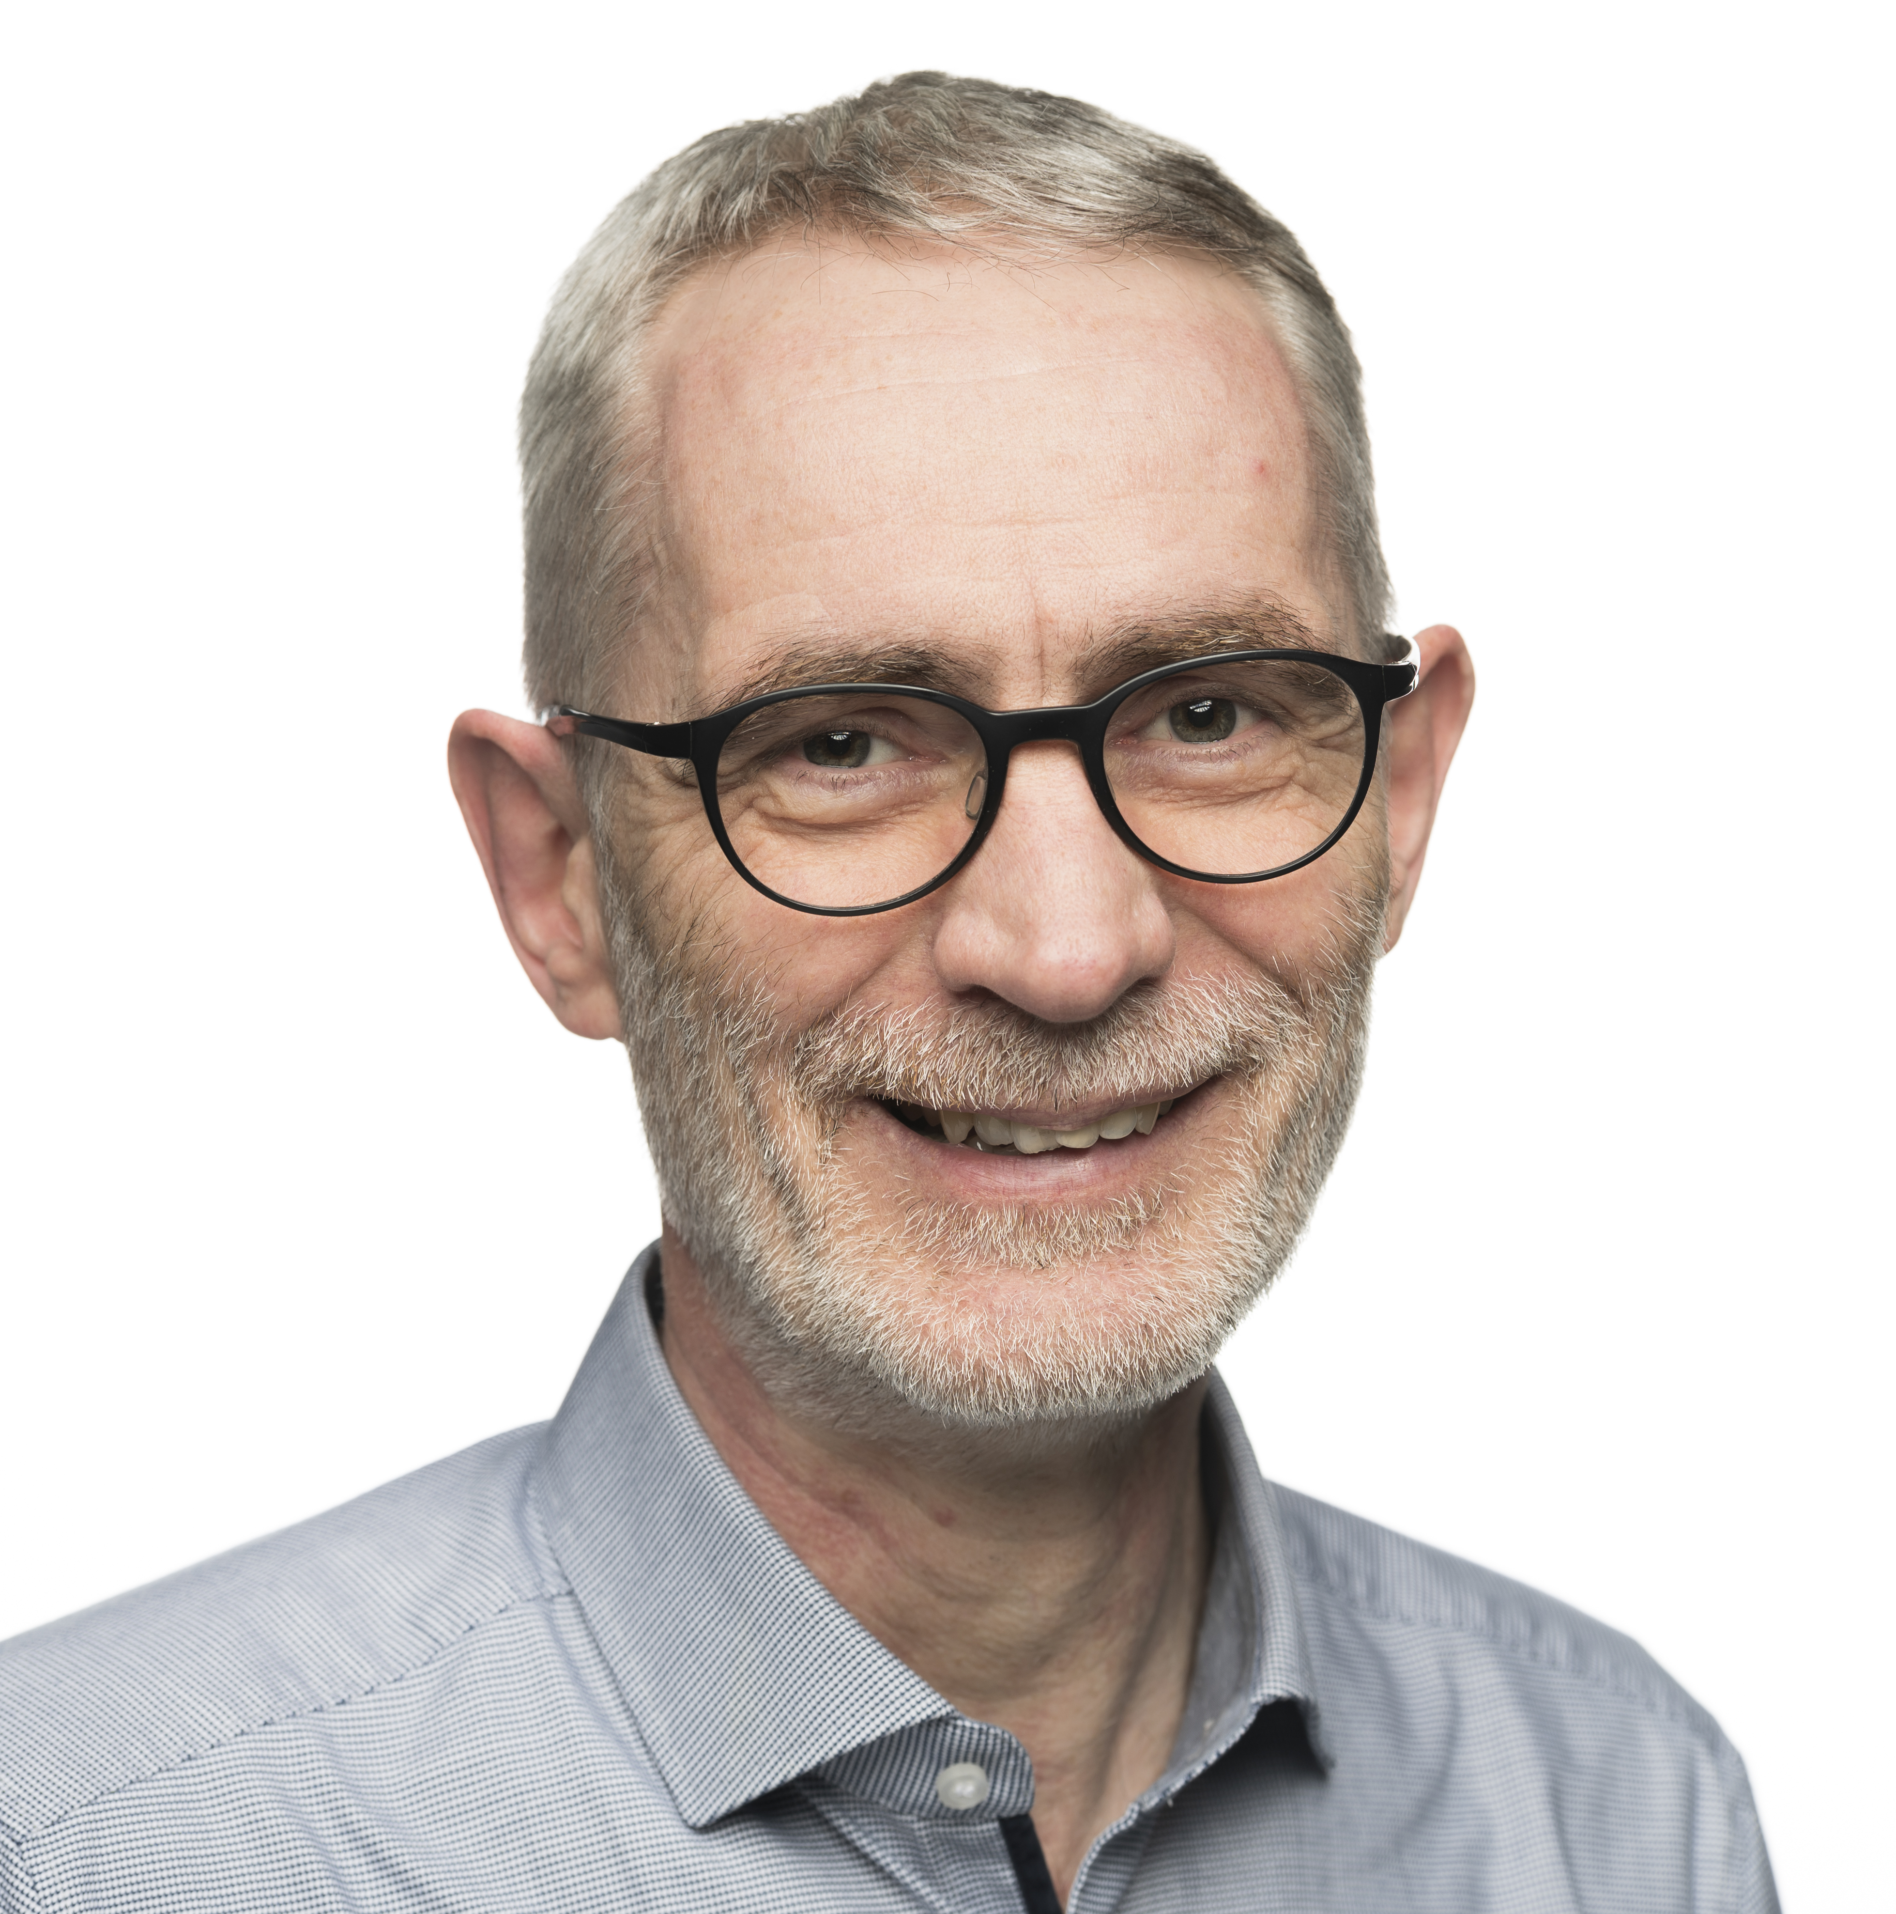
Ralph Engel (C4)
Affiliation to IUPAP:
Chair
Commission/Category:
Commission on Astroparticle Physics (C4)
Current Job Title:
Full Professor
Current affiliation (Institution):
Karlsruhe Institute of Technology (KIT)
Area of Study/Research/Expertise:
Cosmic rays, high-energy neutrinos, hadronic interactions
Last Physics paper written with date of publication:
Pierre Auger Collab., “Inference of the Mass Composition of Cosmic Rays with Energies from 10^{18.5} to 10²⁰eV Using the Pierre Auger Observatory and Deep Learning” Phys. Rev. Lett. 134 (2025) 2, 021001
Any other information:
German Physical Society, deputy chair of Division Particle Physics
Spokesperson of Helmholtz Program Matter and the Universe

Slide 19
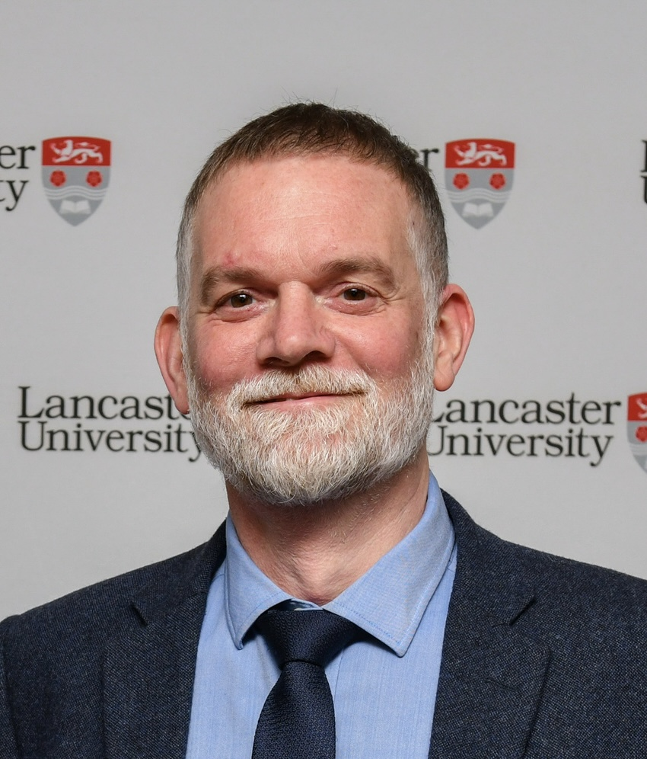
Richard Haley (C5)
Affiliation to IUPAP:
Chair
Commission/Category:
Commission on Low Temperature Physics (C5)
Current Job Title:
Chair in Low Temperature Physics
Current affiliation (Institution):
Lancaster University, UK
Area of Study/Research/Expertise:
Low Temperature Physics
Last Physics paper written with date of publication:
QUEST-DMC superfluid ³He detector for sub-GeV dark matter
QUEST-DMC Collaboration, European Physical Journal C: Particles and Fields 84(3), March 2024.
Any other information:
Institute of Physics, UK

Slide 20
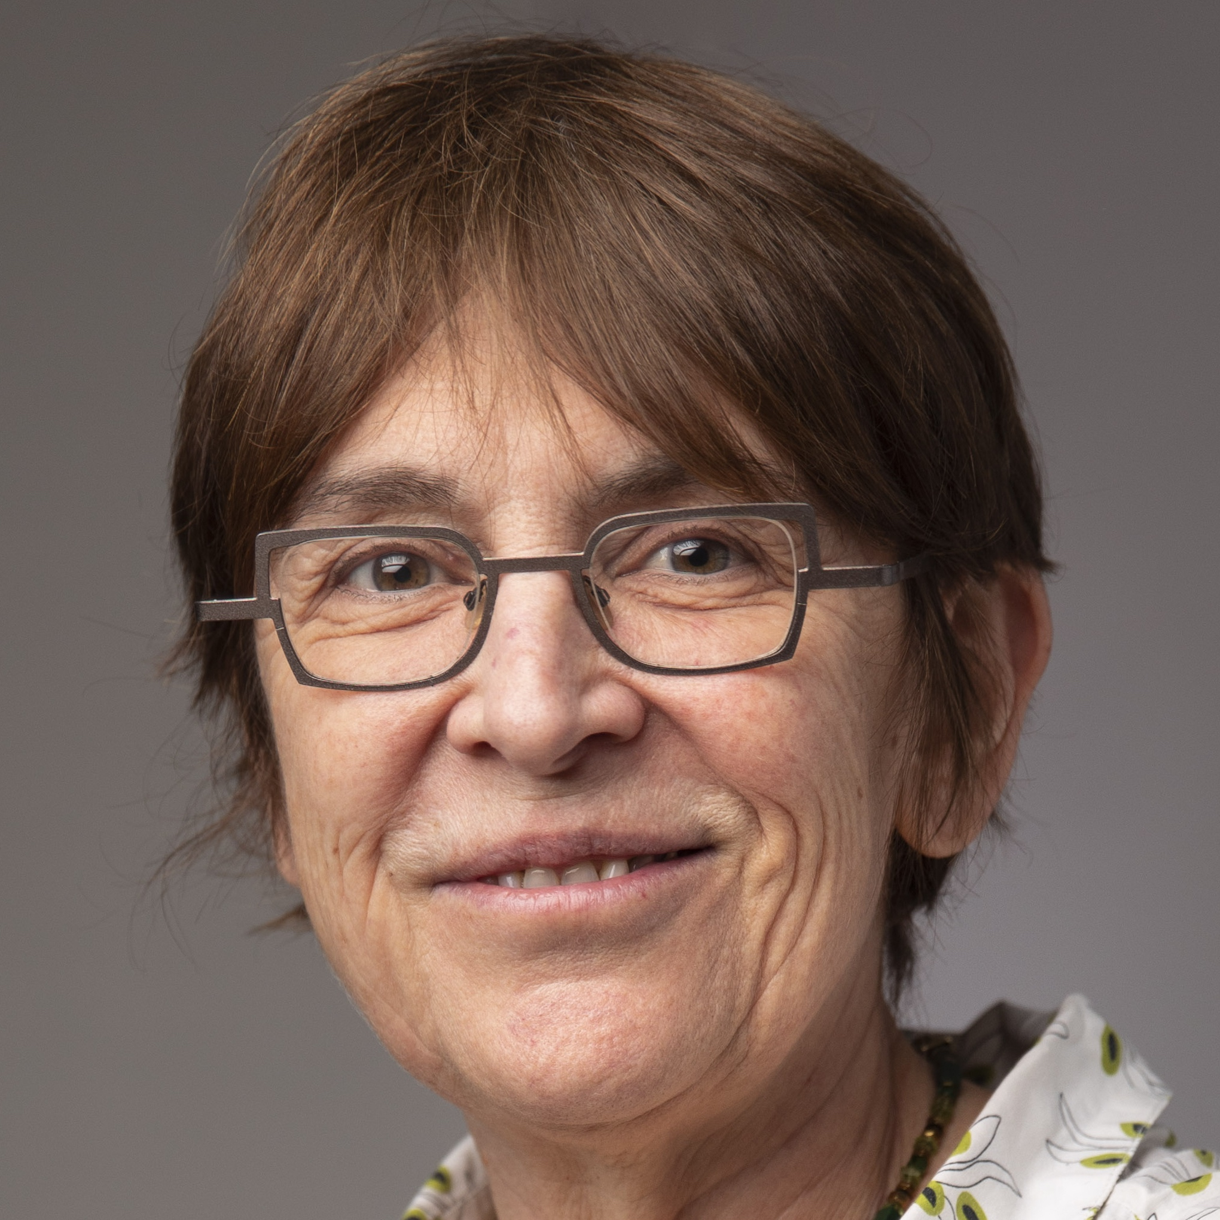
Patricia BASSEREAU (C6)
Affiliation to IUPAP:
Chair
Commission/Category:
Commission Biological Physics (C6)
Current Job Title:
CNRS Research Director
Current affiliation (Institution):
Institut Curie (Paris, France)
Area of Study/Research/Expertise:
Membrane Biophysics, Physics of Cells
Last Physics paper written with date of publication:
Tsai F.-C et al, Activated I-BAR IRSp53 clustering controls the formation of VASP-actin-based membrane protrusions Science Advances 8 eabp8677 (2022)
Any other information:
Biophysical Society (US, council member); Society of Physics (SFP, France); EMBO Fellow (Fellowship committee); HFSP (council member)

Slide 21
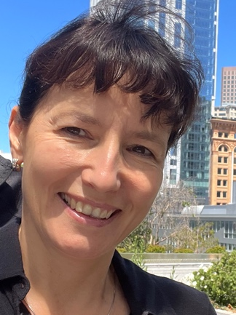
Joanna Trylska (C6)
Affiliation to IUPAP:
Secretary
Commission/Category:
Commission Biological Physics (C6)
Current Job Title:
Professor
Current affiliation (Institution):
University of Warsaw (Poland)
Area of Study/Research/Expertise:
Molecular Biophysics
Last Physics paper written with date of publication:
Piotr Chyży, Marta Kulik, Ai Shinobu, Suyong Re, Yuji Sugita, Joanna Trylska, Molecular dynamics in multi-dimensional space explains how mutations affect the association path of neomycin to a riboswitch, Proc. Natl. Acad. Sci., 121 (15) e2317197121, 2024
Any other information:
Fulbright Fellow, Biophysical Society, American Chemical Society, Polish Society for Bioinformatics

Slide 22
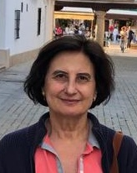
Gloria Platero (C8)
Affiliation to IUPAP:
Chair
Commission/Category:
Commission on Semiconductor Physics (C8)
Current Job Title:
Research Professor
Current Affiliation (Institution):
Materials Science Institute of Madrid, CSIC (Spanish Research Council)
Area of Study/Research/Expertise
Condensed Matter Theory, QuantumTechnologies
Last physics paper written with date of publication:
“Flying Spin Qubits in Quantum Dot Arrays Driven by Spin-Orbit Interaction”,
D. Fernández-Fernández, Y. Ban, G. Platero, Quantum, 8, 1533 (2024)
Any other information:
Web-page https://wp.icmm.csic.es/npqsic/

Slide 23
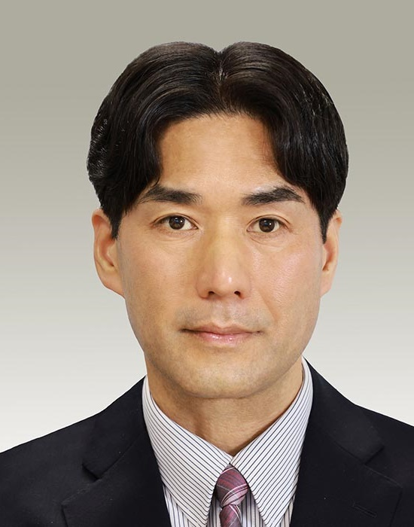
Shinji YUASA (C9)
Affiliation to IUPAP:
Chair
Commission/Category:
Commission on Magnetism (C9)
Current Job Title:
Director and Professor
Current affiliation (Institution):
National Institute of Advanced Industrial Science and Technology (AIST), Japan
Area of Study/Research/Expertise:
Solid State Physics, Magnetism, Spintronics
Last Physics paper written with date of publication:
1 November 2024: “Thermally robust electrically reversible spin selection in a quantum dot qubit with double reservoir spin accumulations”, R Jansen and S Yuasa, Physical Review Applied, 22 (5), 054049, 2024.
Any other information:
University of Tsukuba

Slide 24
Shobhana Narasimhan (C10)
Structure and Dynamics of Condensed Matter
\

Slide 25
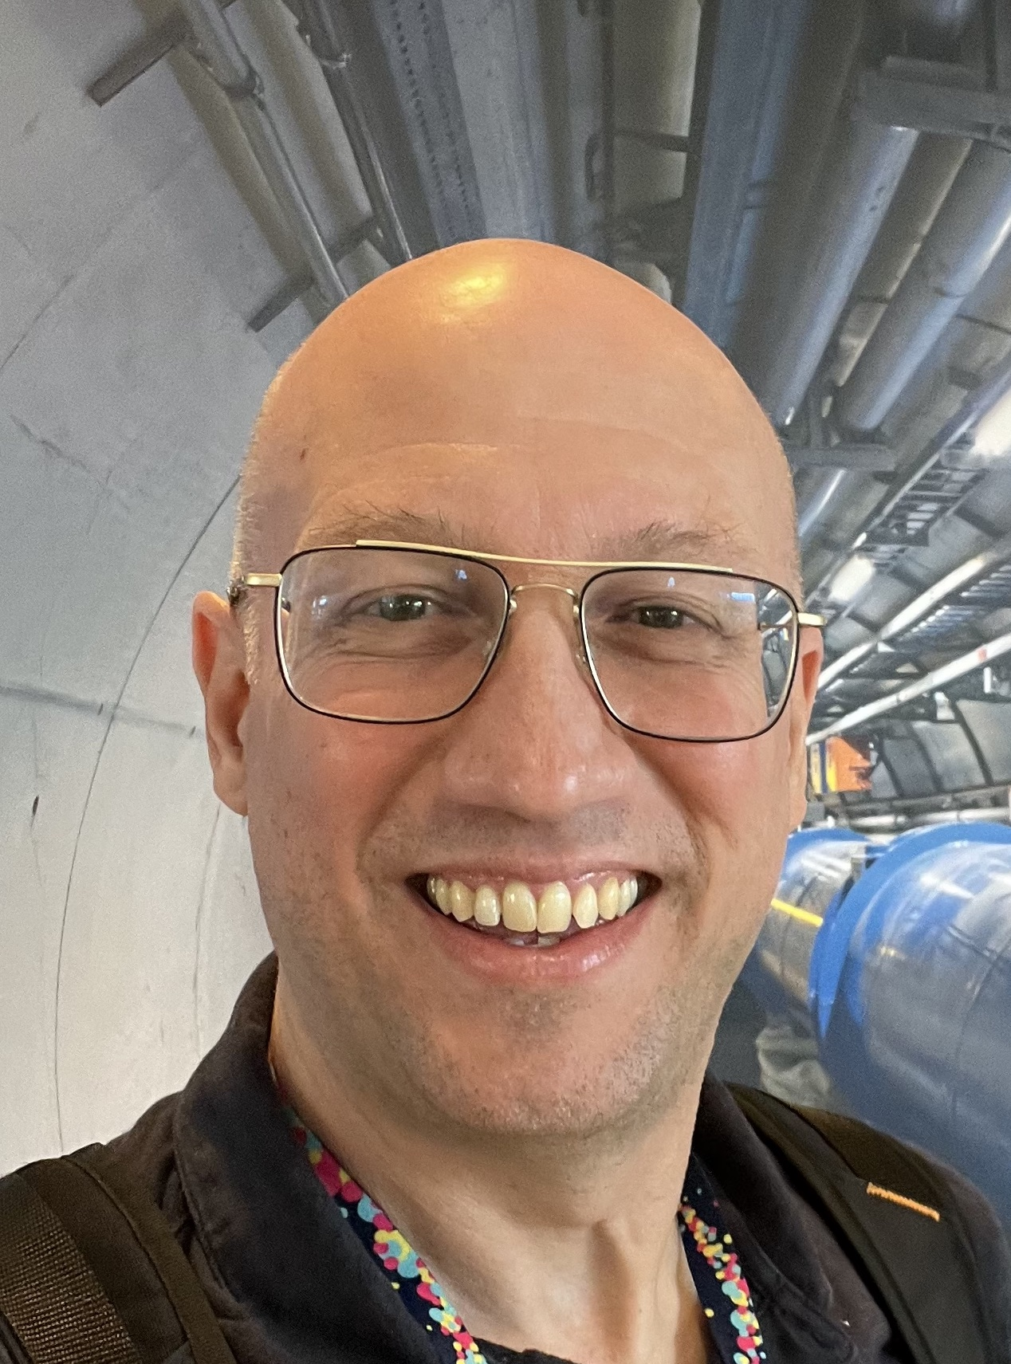
Marcelo Munhoz (C11)
Affiliation to IUPAP:
Chair
Commission/Category:
Commission on Particles and Fields (C11)
Current Job Title:
Full Professor
Current affiliation (Institution):
University of São Paulo, Brazil
Area of Study/Research/Expertise:
Particle Physics (Relativistic Heavy Ion Collisions)
Last Physics paper written with date of publication:
January 2025: “Jet cone radius dependence of RAA and v2 at PbPb 5.02 TeV from JEWEL+TRENTo+v-USPhydro”, L. Barreto et al., Physics Letters B 860 (2025) 139217
Any other information:
Vice coordinator of the National Institute for Science and Technology “CERN-Brazil”

Slide 26
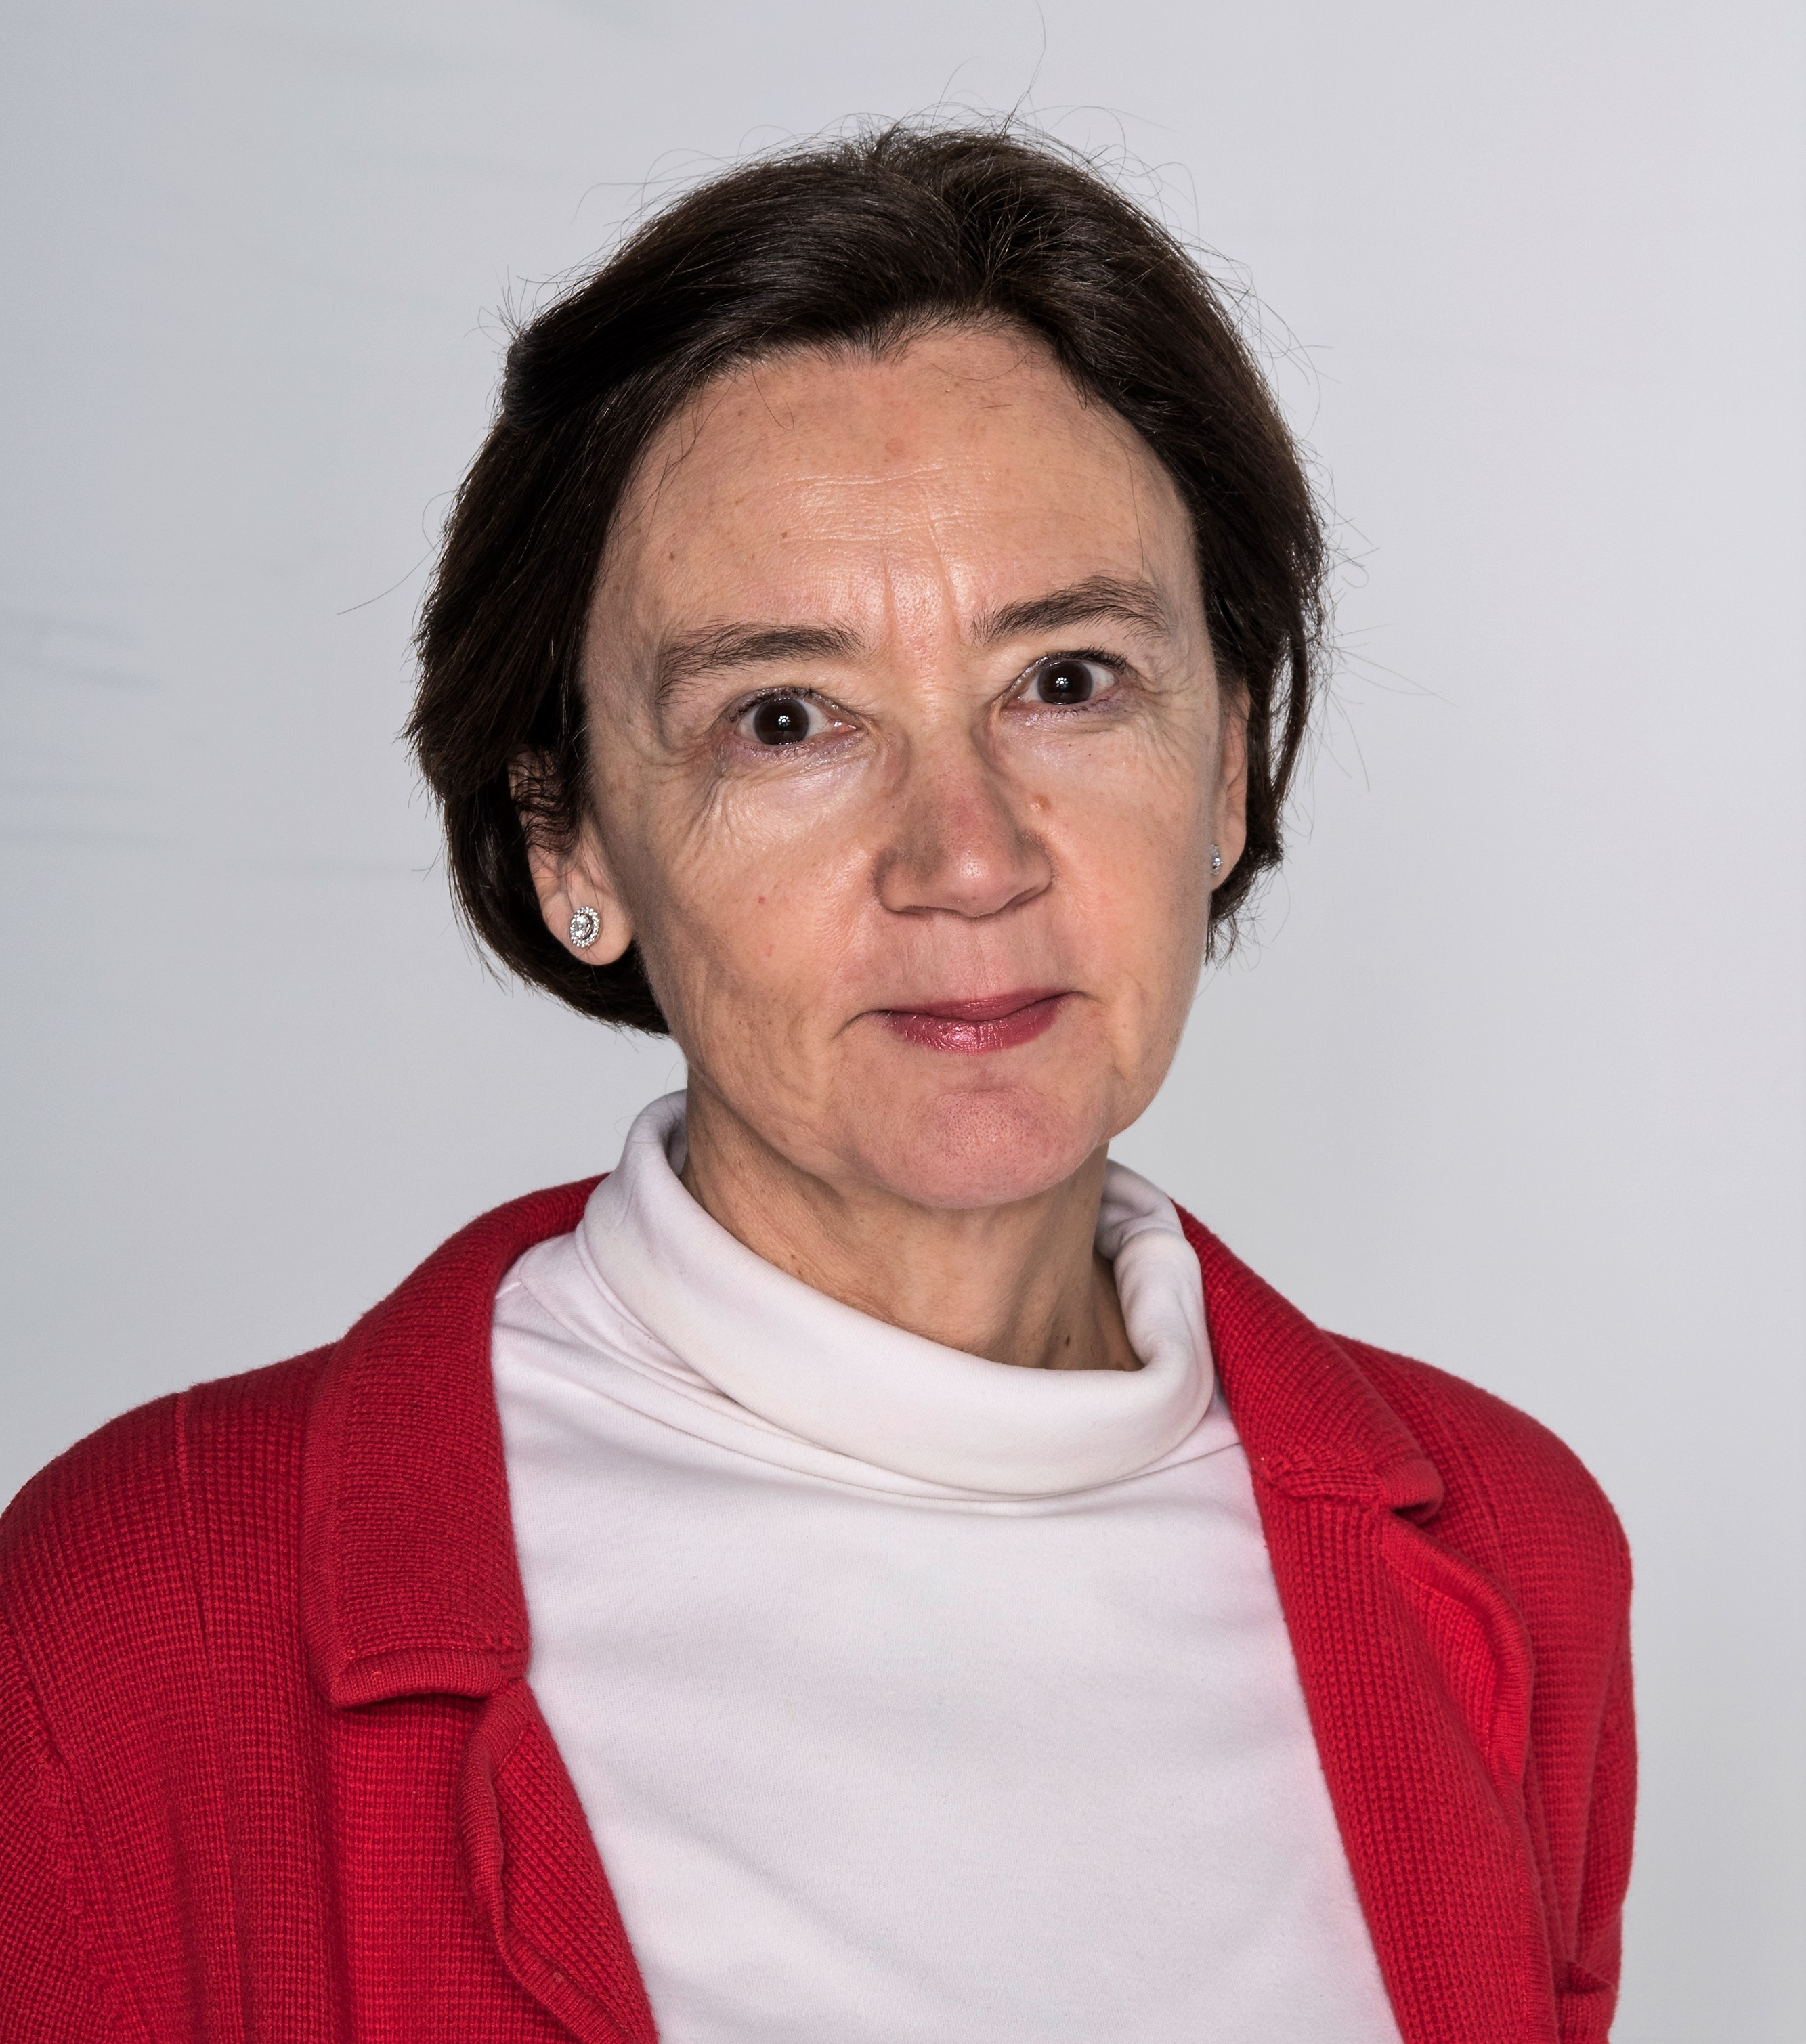
Maria Jose Garcia Borge (C12)
• Affiliation to IUPAP:
Chair
• Commission/Category:
Commission on Nuclear Physics (C12)
• Current Job Title:
Research Professor
• Current Affiliation (Institution):
Institute of the Structure of the Matter, CSIC (Spanish Research Council)
• Area of Study/Research/Expertise
Structure and dynamics of light nuclei
• Last physics paper written with date of publication: “Strong coupling effects on near-barrier 15C + 208Pb elastic Scattering”, V.G, Távora et al., Phys Lett B855, 138770 (2024)
• Any other information: Web-page https://fnexp.iem.csic.es/

Slide 27
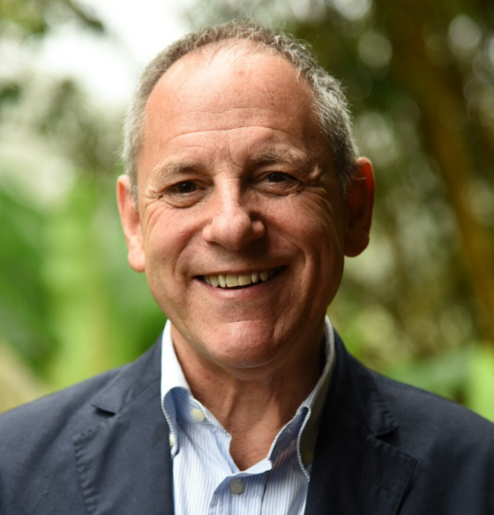
Joseph Niemela (C13)
• Affiliation to IUPAP:
Chair
• Commission/Category:
Commission on Physics for Development (C13)
• Current Job Title:
Scientist Emeritus
• Current affiliation (Institution):
UNESCO-ICTP
• Area of Study/Research/Expertise:
Low Temperature Physics/Fluid Dynamics
• Last Physics paper written with date of publication:
10 November 2024: “Utilization of cryogenic phases of helium as “magic” working fluids in laboratory experiments: Pushing the boundaries of fluid dynamics”, L. Skrbek, J.J. Niemela, P. Urban, Physics of Fluids 36 (2024) 101303
• Any other information:
Fellow, American Physical Society
Foreign Fellow, Pakistan Academy of Sciences

Slide 28
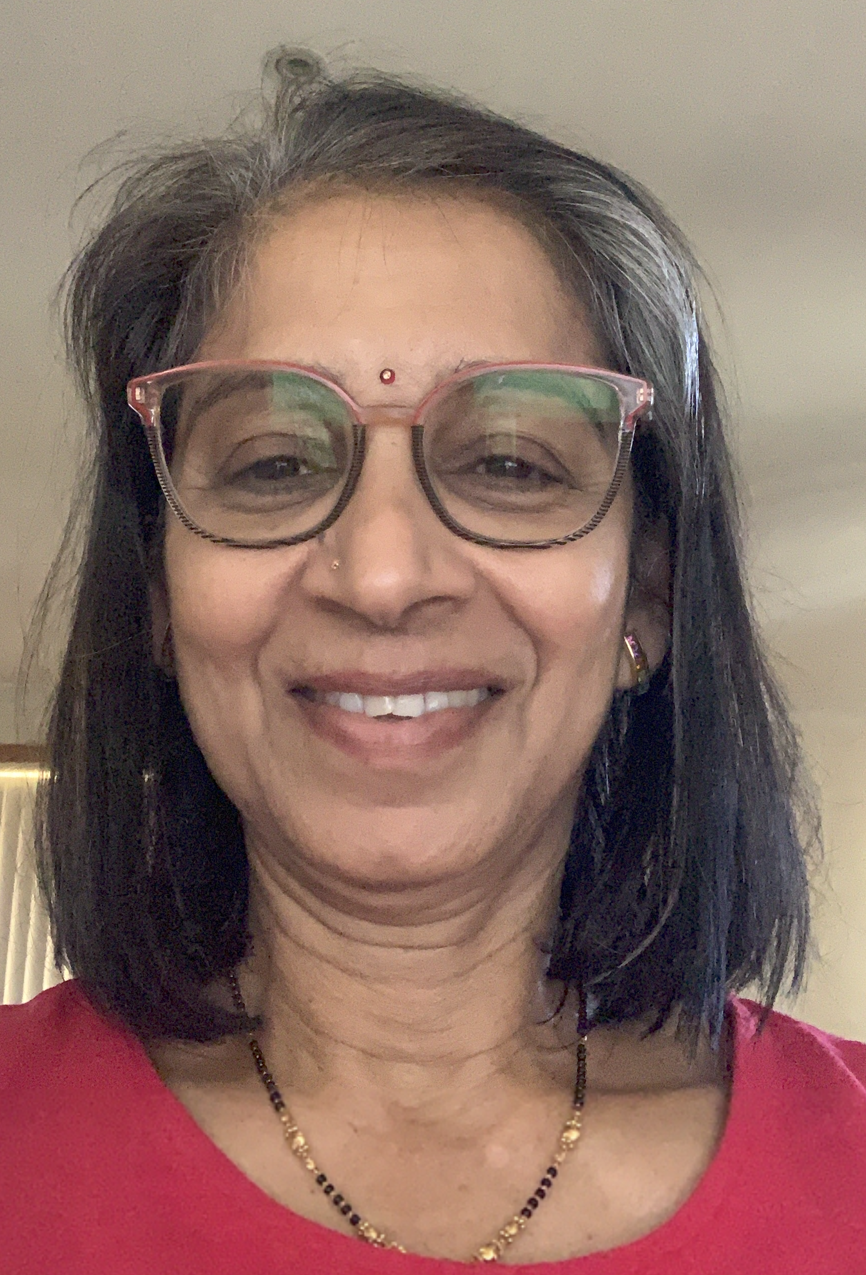
Manjula Sharma(C14)
Affiliation to IUPAP:
Chair
Commission/Category:
Commission on Physics Education (C14)
Current Job Title:
Director
Current affiliation (Institution):
The University of Sydney
Area of Study/Research/Expertise:
Physics Education
Last Physics paper written with date of publication:
A Eambaipreuk, K Arayathanitkul, N Emarat, MD Sharma, Ways of incorporating active learning experiences: an exploration of worksheets over five years in a first year Thai physics courses, European Journal of Physics 42 (3), 035703 (2021).
Any other information:
Australian Institute of Physics

Slide 29
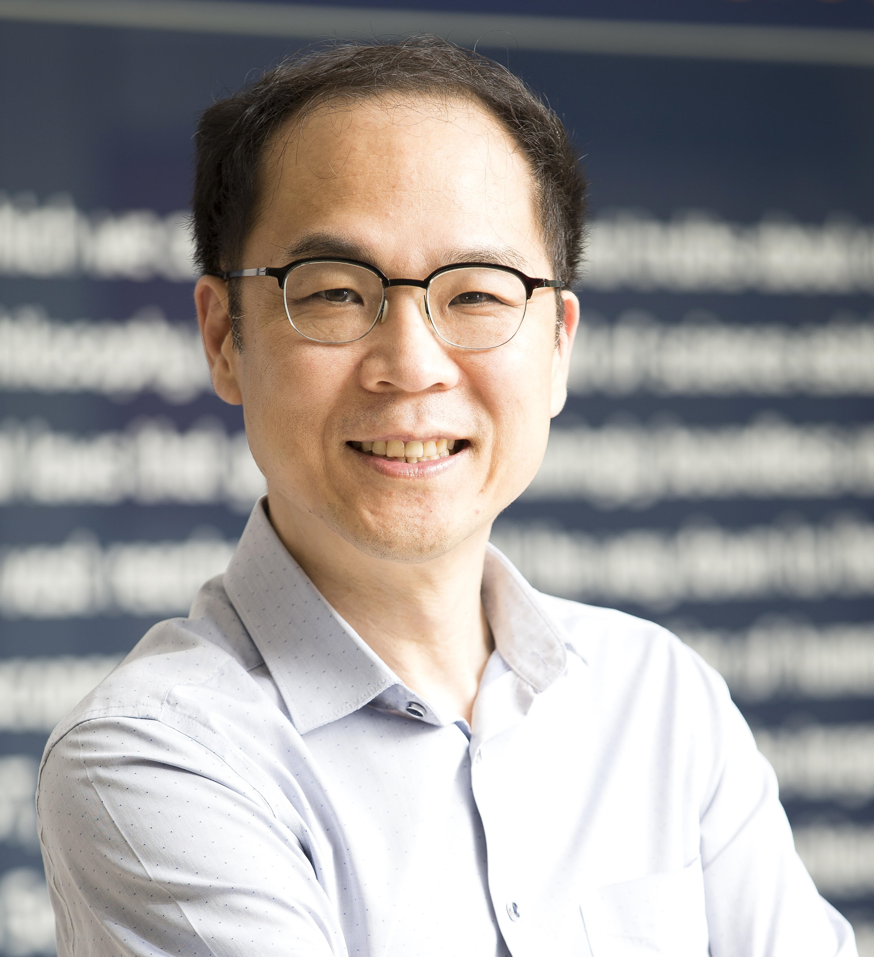
Jaewook Ahn (C15)
Affiliation to IUPAP:
Chair
Commission/Category:
Commission on Atomic, Molecular, and Optical Physics (C15)
Current Job Title:
Professor
Current affiliation (Institution)
Korea Advanced Institute of Science and Technology
Area of Study/Research/Expertise
Atomic Physics/Quantum Computing
Last Physics paper written with data of publication
11 October 2024L “Programming higher-order interactions of Rydberg atoms,” A. Byun, S. Jeong, and J. Ahn, Phys. Rev. A 110, 042612 (2024)
Any other information
Korean Physical Society

Slide 30
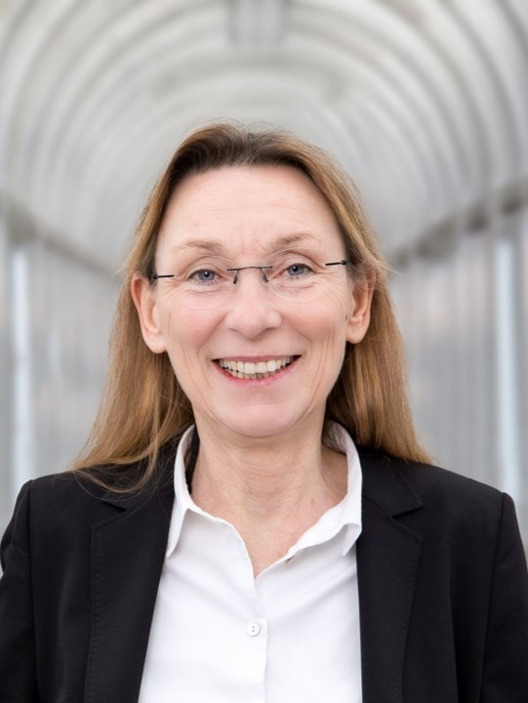
Ursel Fantz (C16)
Affiliation to IUPAP:
Chair
Commission/Category:
Commission on Plasma Physics (C16)
Current Job Title:
Division Head: ITER Technology & Diagnostics & Professor at University Augsburg
Current affiliation (Institution):
Max-Planck-Institute for Plasma Physics, Garching & University of Augsburg, Germany
Area of Study/Research/Expertise:
Plasma Physics, Low Temperature Plasmas and Fusion Technology
Last Physics paper written with date of publication:
Contributions of the extended ELISE and BATMAN Upgrade test facilities to the roadmap towards ITER NBI, Nuclear Fusion 64 (2024) 086063 (11pp)
Any other information:
German Physical Society, European Physical Society, Academia Europaea

Slide 31
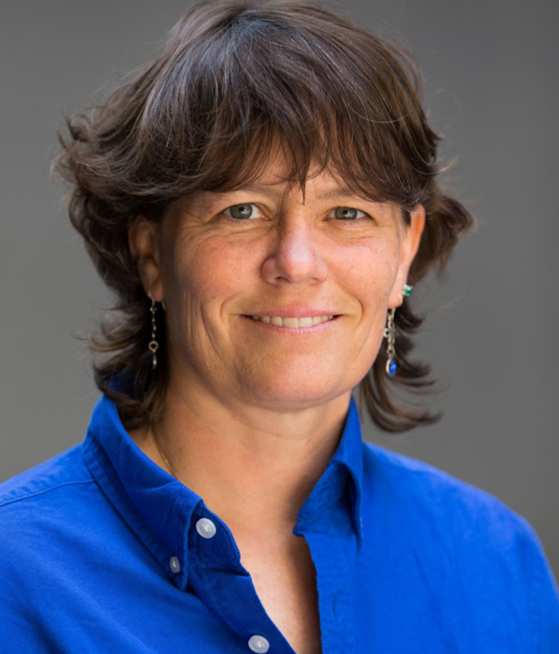
Cather Simpson (C17)
Affiliation to IUPAP:
Chair
Commission/Category:
Laser Physics and Photonics (C17)
Current Job Titles:
Professor of Physics and Chemical Sciences Chief Executive Officer
Current affiliation (Institution):
The University of Auckland
Orbis Diagnostics
Area of Study/Research/Expertise:
Chemical physics, Light-matter interactions, Photonics, Fluid dynamics and microfluidics
Last Physics paper written with date of publication:
“Lab on a bead with oscillatory centrifugal microfluidics for fast and complete mixing enables fast and accurate biomedical assays” DE. Williams et al., Sci. Rep. (2024) 14, 8637.
Any other information:
Royal Society Te Apārangi (New Zealand), Convenor of Technology, Applied Science & Engineering & Member, Academy Executive Council

Slide 32
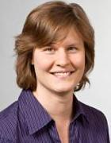
Simone Warzel (C18)
Affiliation to IUPAP:
Chair
Commission/Category:
Commission on Mathematical Physics (C18)
Current Job Title:
Full professor
Current affiliation (Institution):
Technical University of Munich, Germany
Area of Study/Research/Expertise:
Mathematical physics
Last Physics paper written with date of publication:
M. Lemm, B. Nachtergaele, S. Warzel, A. Young: The charge gap is greater than the neutral gap in fractional quantum Hall systems, arXiv:2410.11645 [cond-mat.str-el].
Any other information:
German Physical Society

Slide 33
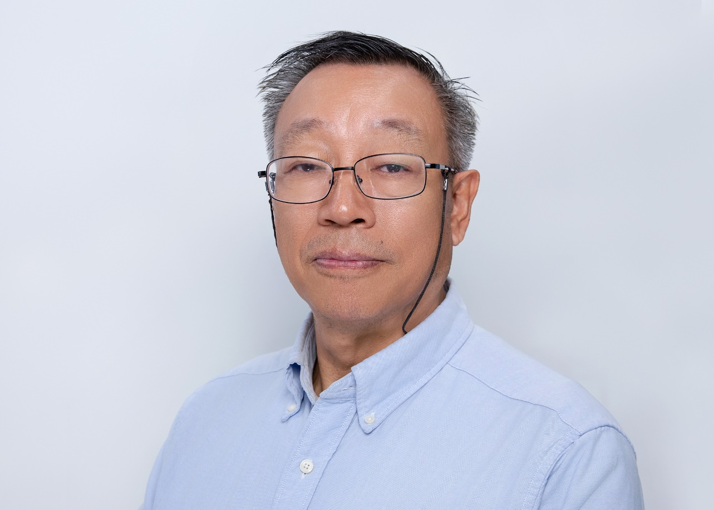
Shuang-Nan Zhang (C19)
Affiliation to IUPAP:
Chair
Commission/Category:
Commission on Astrophysics (C18)
Current Job Title:
Full professor
Current affiliation (Institution):
Particle Astrophysics Division, Institute of High Energy Physics, the Chinese Academy of Sciences, Beijing, China
Area of Study/Research/Expertise:
High energy astrophysics, black holes, neutron stars, space instrumentation
Last Physics paper written with date of publication:
Moradi, R. et al: , The Astrophysical Journal, 977 (2) 155, Dec. 2024, arXiv:2410.17189
Any other information:
Chinese Astronomical Society; PI of several ongoing space (X-ray, gamma-ray and high energy particle) missions of China, e.g., Insight-HXMT, POLAR-2, eXTP, HERD, etc.

Slide 34
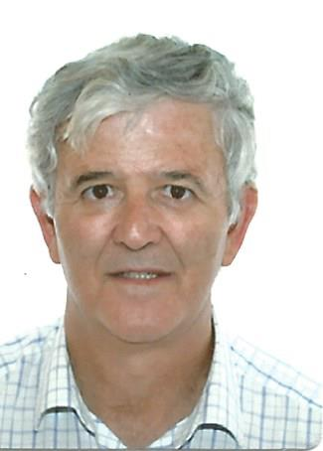
Alfonso Muñoz González (C20)
• Affiliation to IUPAP:
Chair
• Commission/Category:
Commission on Computational Physics (C20)
• Current Job Title:
Honorary Professor
• Current affiliation (Institution):
Universidad de La Laguna, Tenerife, Canary Islands. Spain
• Area of Study/Research/Expertise:
Computational Physics. Condensed Matter. Matter under extreme conditions.
• Last Physics paper written with date of publication:
High-pressure structural and electrical properties of pyrochlore: Enhanced octahedral distortions and electrical resistance of La2Sn2O7, Jia S. et al, Journal of Materials Research and Technology, 34 (2025), 175-183 . Pub. Jan-feb 2025.
• Any other information:
Royal Spanish Physical Society. https://portalciencia.ull.es/investigadores/80940/detalle

Slide 35
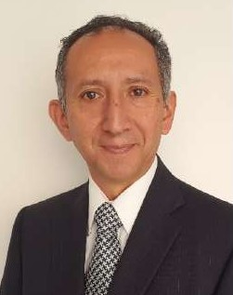
Eric Rosas (AC1)
Affiliation to IUPAP:
Affiliated Commission Chair - President
Commission/Category:
AC1 – International Commission for Optics
Current Job Title:
President
Current affiliation (Institution):
Clúster Mexicano de Fotónica / Universidad Autónoma del Estado de México
Area of Study/Research/Expertise:
Optics & Photonics
Last Physics paper written with date of publication:
Irena Fryc et al, The spectral mismatch correction factor estimation using broadband photometer measurements and catalog parameters for tested white LED sources, Optics and Lasers in Engineering 184 (2025) 108614.
Any other information:
Former ICO Appointed Vice-President by the Red Iberoamericana de Óptica

Slide 36
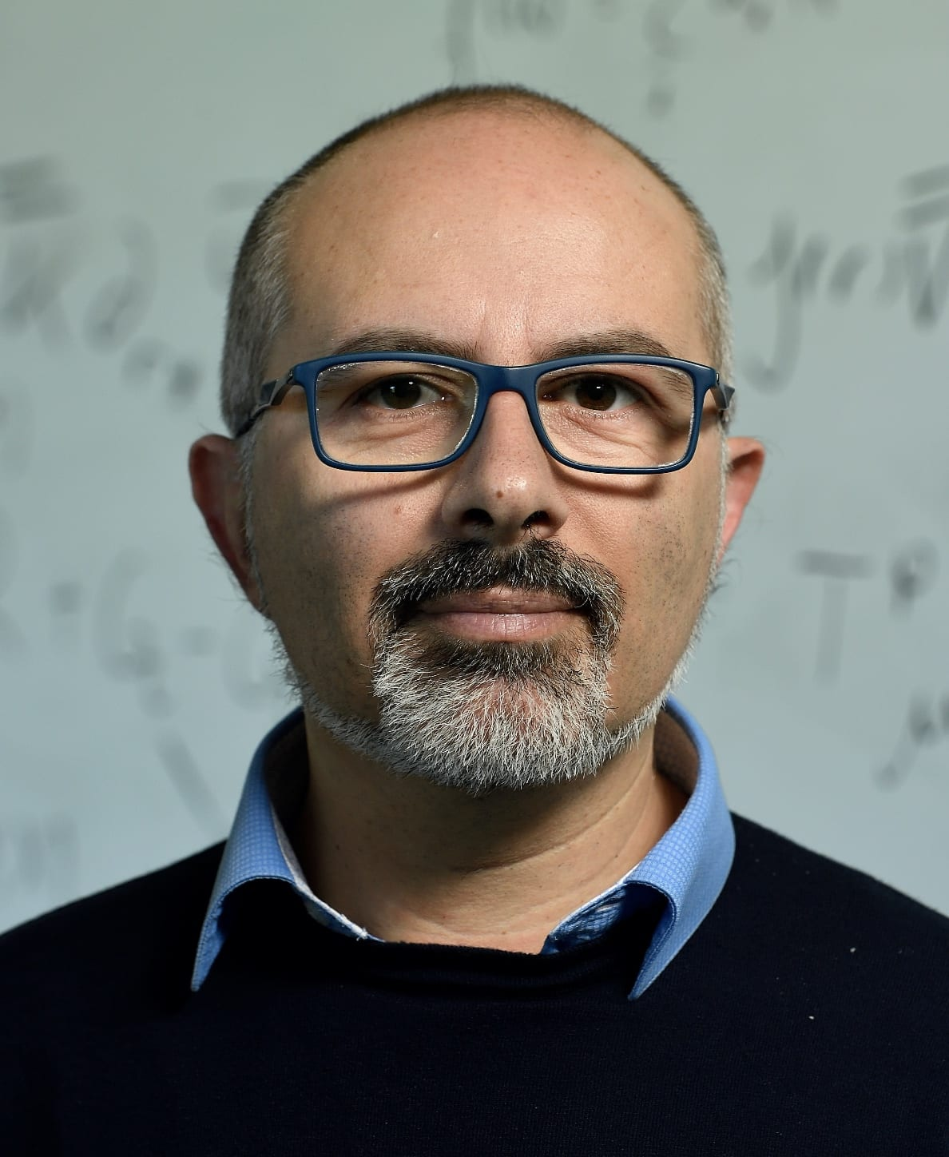
Emanuele Berti (AC2)
Affiliation to IUPAP:
President
Commission/Category:
AC2 – International Society on General Relativity and Gravitation
Current Job Title:
Professor
Current affiliation (Institution):
Johns Hopkins University, USA
Area of Study/Research/Expertise:
Gravitational physics
Last Physics paper written with date of publication:
E. Berti, Tests of general relativity with future detectors, Gen. Rel. Grav. 56 12, 145 (2024)
Any other information:
Former Chair of Division of Gravitational Physics, American Physical Society

Slide 37
Dorthe Hammershøi (AC3)
International Commission for Acoustics

Slide 38
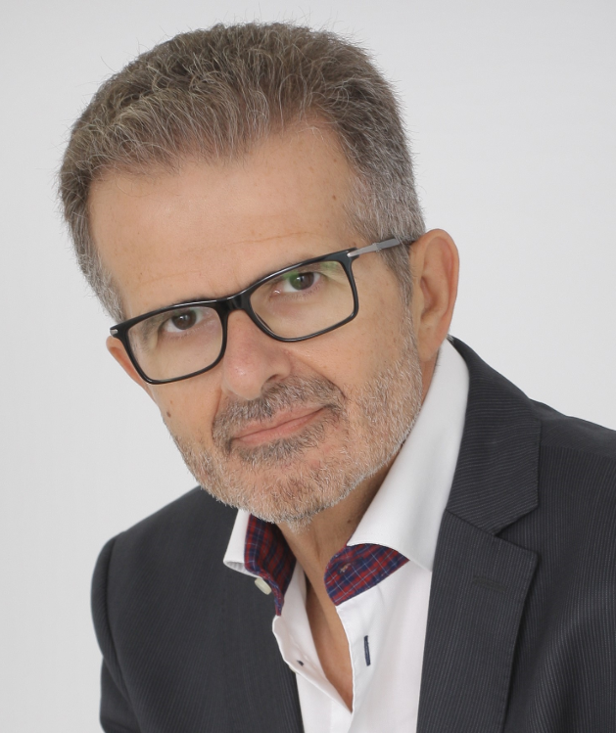
John Damilakis (AC4)
Affiliation to IUPAP:
Chair
Commission/Category:
International Commission on Medical Physics
Current Job Title:
Professor
Current affiliation (Institution)
University of Crete, Greece
Area of Study/Research/Expertise
Medical Physics
Last Physics paper written with data of publication
Damilakis J, Stratakis J,
J Radiol Prot. 2024 Dec 27;44(4), doi: 10.1088/1361-6498/ad9f71.

Slide 39
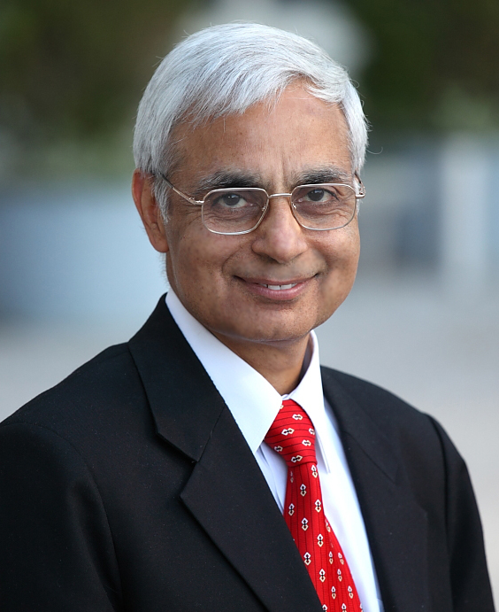
Madan Rehani (AC4)
Affiliation to IUPAP
Co-Chair
Commission/Category:
  Affiliate Commission on Medical Physics (AC4)
Current Job Title:
Professor
• Current affiliation (Institution):
  Harvard Medical School & Massachusetts General Hospital
• Area of Study/Research/Expertise:
  Medical Physics
• Last Physics paper written with date of publication:
  4 Sept 2024: “Real-time patient-specific-dose in CT through use of artificial intelligence. J Radiol Prot. 2024 Sep 4;44(3), doi: 10.1088/1361-6498/ad750e.
Any other information:
  President, International Union of Physical & Engineering Sciences in Medicine

Slide 40
Niloofar Jokar (AC5)
International Association of Physics Students

Slide 41
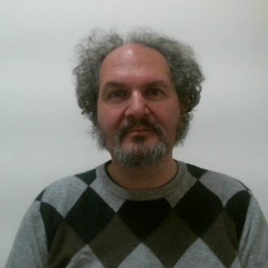
Roberto Lalli (AC6)
Affiliation to IUPAP:
Vice-Chair
Commission/Category:
History and Philosophy of Physics (AC6)
Current Job Title:
Assistant Professor
Current affiliation (Institution):
Politecnico di Torino, Italy
Area of Study/Research/Expertise:
History of Physics
Last Physics paper written with date of publication:
8 July 2024: “The birth of StatPhys: the 1949 Florence conference at the juncture of national and international physics reconstruction after World War II”, R. Lalli and P. Politi, European Physical Journal H 49 (2024).

