Slide 1
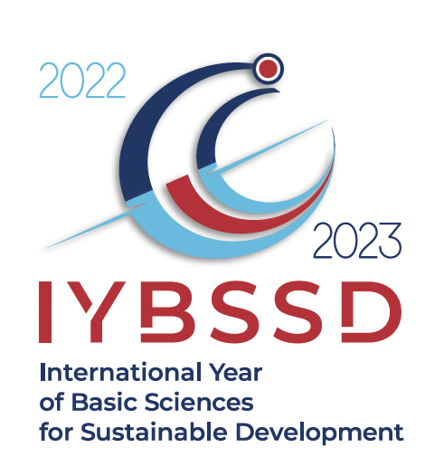
Sciences for Sustainability: from the International Year of Basic Sciences for Sustainable Development in 2022/2023, to the International Decade of (all) Sciences for Sustainable Development 2024 - 2033 proclaimed by UN and under the auspices of UNESCO
Michel Spiro
PAST President of IUPAP
Chair of the
International Year of Basic Sciences
for Sustainable Development in 2022/2023 (IYBSSD)
https://www.iybssd2022.org/en/home/
2022/2023

Slide 2
International Year of Basic Sciences for Sustainable Development in 2022/2023, under the auspices of UNESCO and hosted by IUPAP
Proclaimed by the United Nations General Assembly on December 2nd, 2021
Opening July 8th, 2022 at UNESCO, closing December 15^{th,} 2023 at CERN
Resolution brought up by Honduras with the support of Armenia, Azerbaijan, Bahrain, Bolivia, Brasil, Burkina Faso, Chad, Chile, Colombia, Cuba, Dominican Republic, Ecuador, El Salvador, Fiji, Georgia, Guatemala, India, Indonesia, Israel, Japan, Jordan, Kyrgyzstan, Malawi, Nicaragua, Panama, Paraguay, Peru, Philippines, Qatar, Russian Federation, Saudi Arabia, Serbia, Spain, South Africa, Thailand, Vietnam
https://www.iybssd2022.org/en/home/
2022/2023

Slide 3
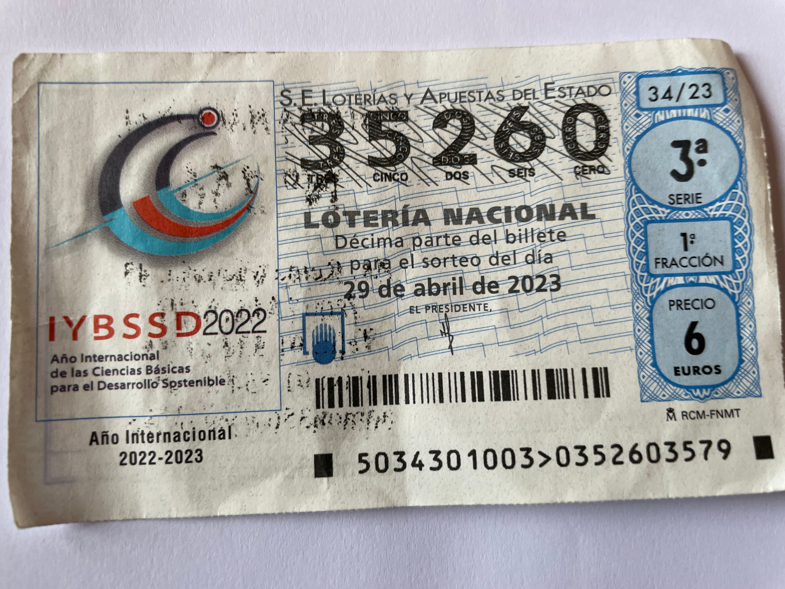
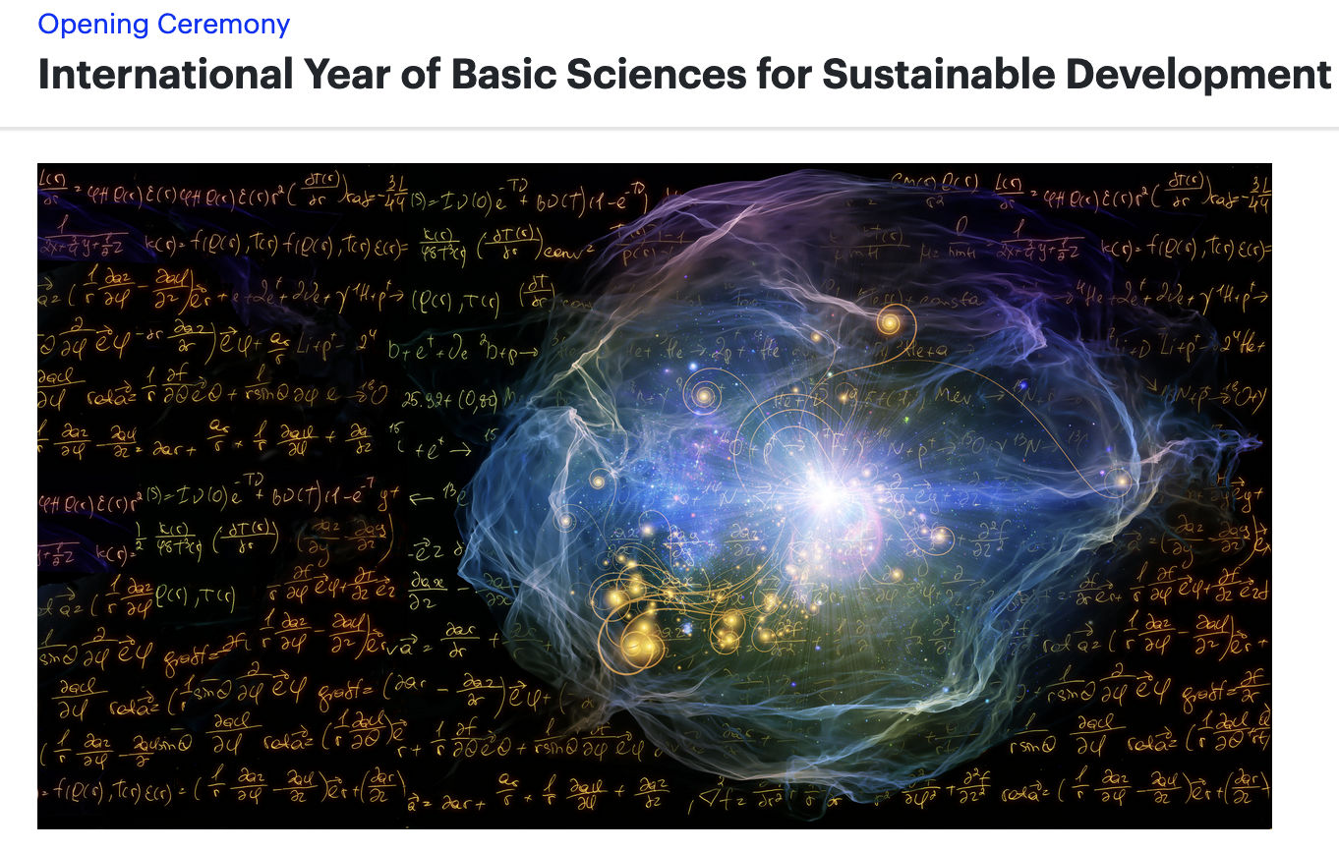
Rationale
- Curiosity-driven sciences construct the pool of knowledge which future generations will use for their development
- Basic sciences are not always and everywhere considered as they deserve, in the discussions concerning the societal, environmental and economic development
- Curiosity-driven sciences re-enchant our world and make it worth to be sustainable
- Serendipity plays a role!
- Basic sciences explore the soul of the Universe!!
2022/2023

Slide 4
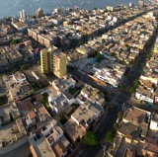
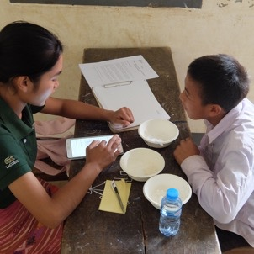
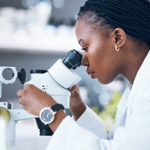
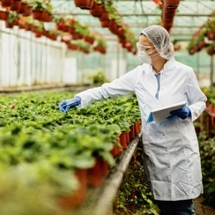
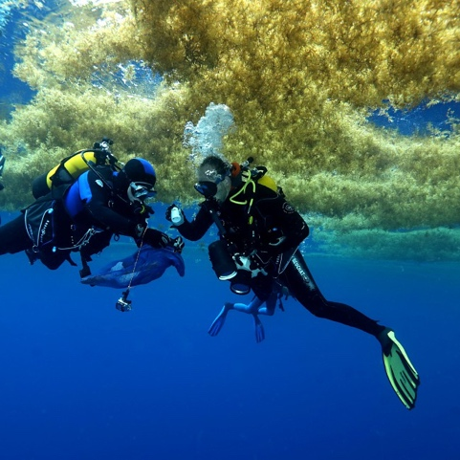
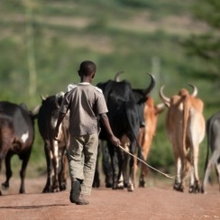
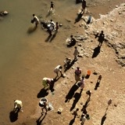
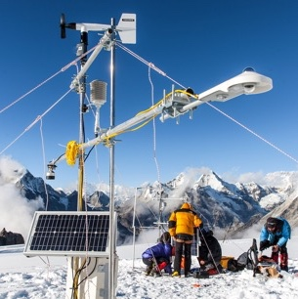


From IYBSSD to IDSSD
Although ESSENTIAL, BASIC SCIENCES ARE NOT ENOUGH
All Sciences AND ALL KNOWLEDGE ARE NEEDED for Equitable Wellbeing on a Healthy Planet
Enabling the International Decade of Sciences
for Sustainable Development 2024-2033 (IDSSD)
      In collaboration with

Slide 5
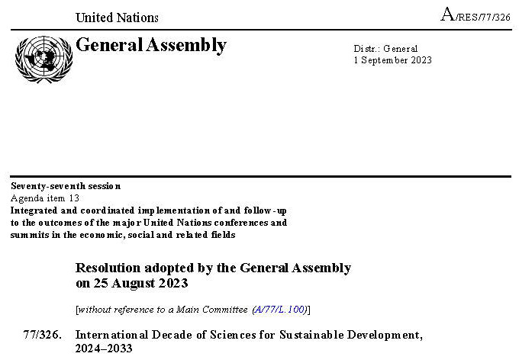
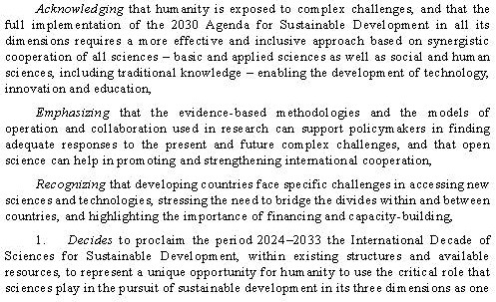
United nations Resolution
IDSSD
The language and ambitions of the UN resolution declaring the international decade for sustainable development are telling of the priorities being embraced and promoted by the earth-humanity coalition

Slide 6
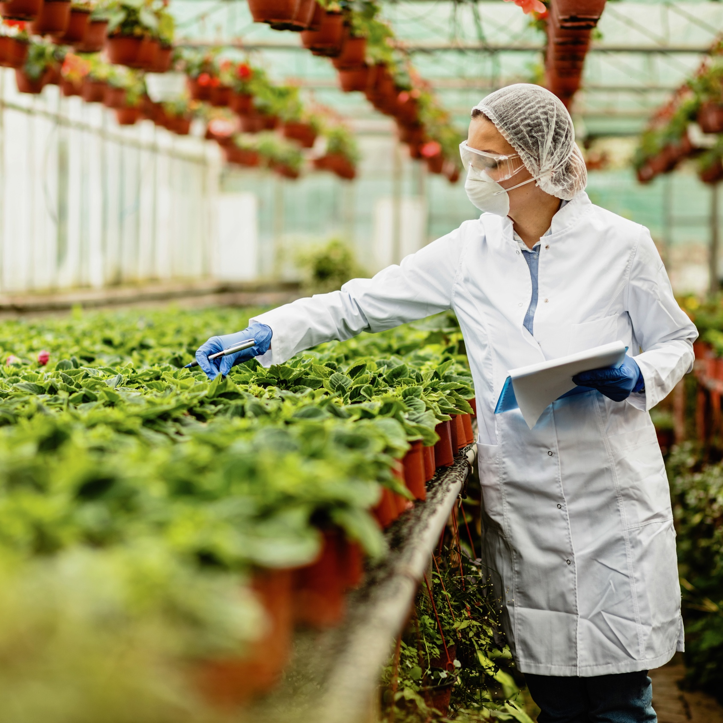
The Earth – Humanity Ambitions
Integrated knowledge mobilization
      Collaborate across all sciences
      Including traditional & indigenous knowledge (transdisciplinarity/co-conconstructed/participative science)
      With a focus on sustainability driven by equity and wellbeing for all on healthy territories (regenerative development)→Integrated SDGs approach and more ambitious
Reimagining the role of science
      Enhance science’s responsiveness to humanity's immediate and future needs
      Improve integration with governance and policymaking.
  TRANSFORMATIVE IMPACT GOALS
  Reframe processes of research and innovation, and the science-society nexus: interconnect science and society in a worldwide web/grid of co-constructed initiatives for well-being on a healthy planet

Slide 7

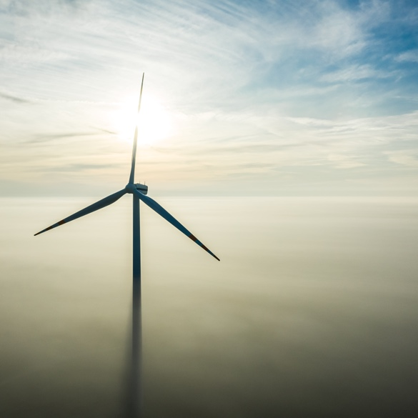
About The Earth-Humanity Coalition
      A global bottom-up network to connect and mobilize all kinds of organizations (about 50 now) and transdiciplnary hubs worldwide (academic and non academic)
      Fostering transformative action at multiple scales (from local to global) and leveraging existing efforts, with dynamism, agility, and effectiveness
      Partnering and complementing with UNESCO, ISC and other organizations to achieve the ambitious goals of the IDSSD
    In collaboration with

Slide 8
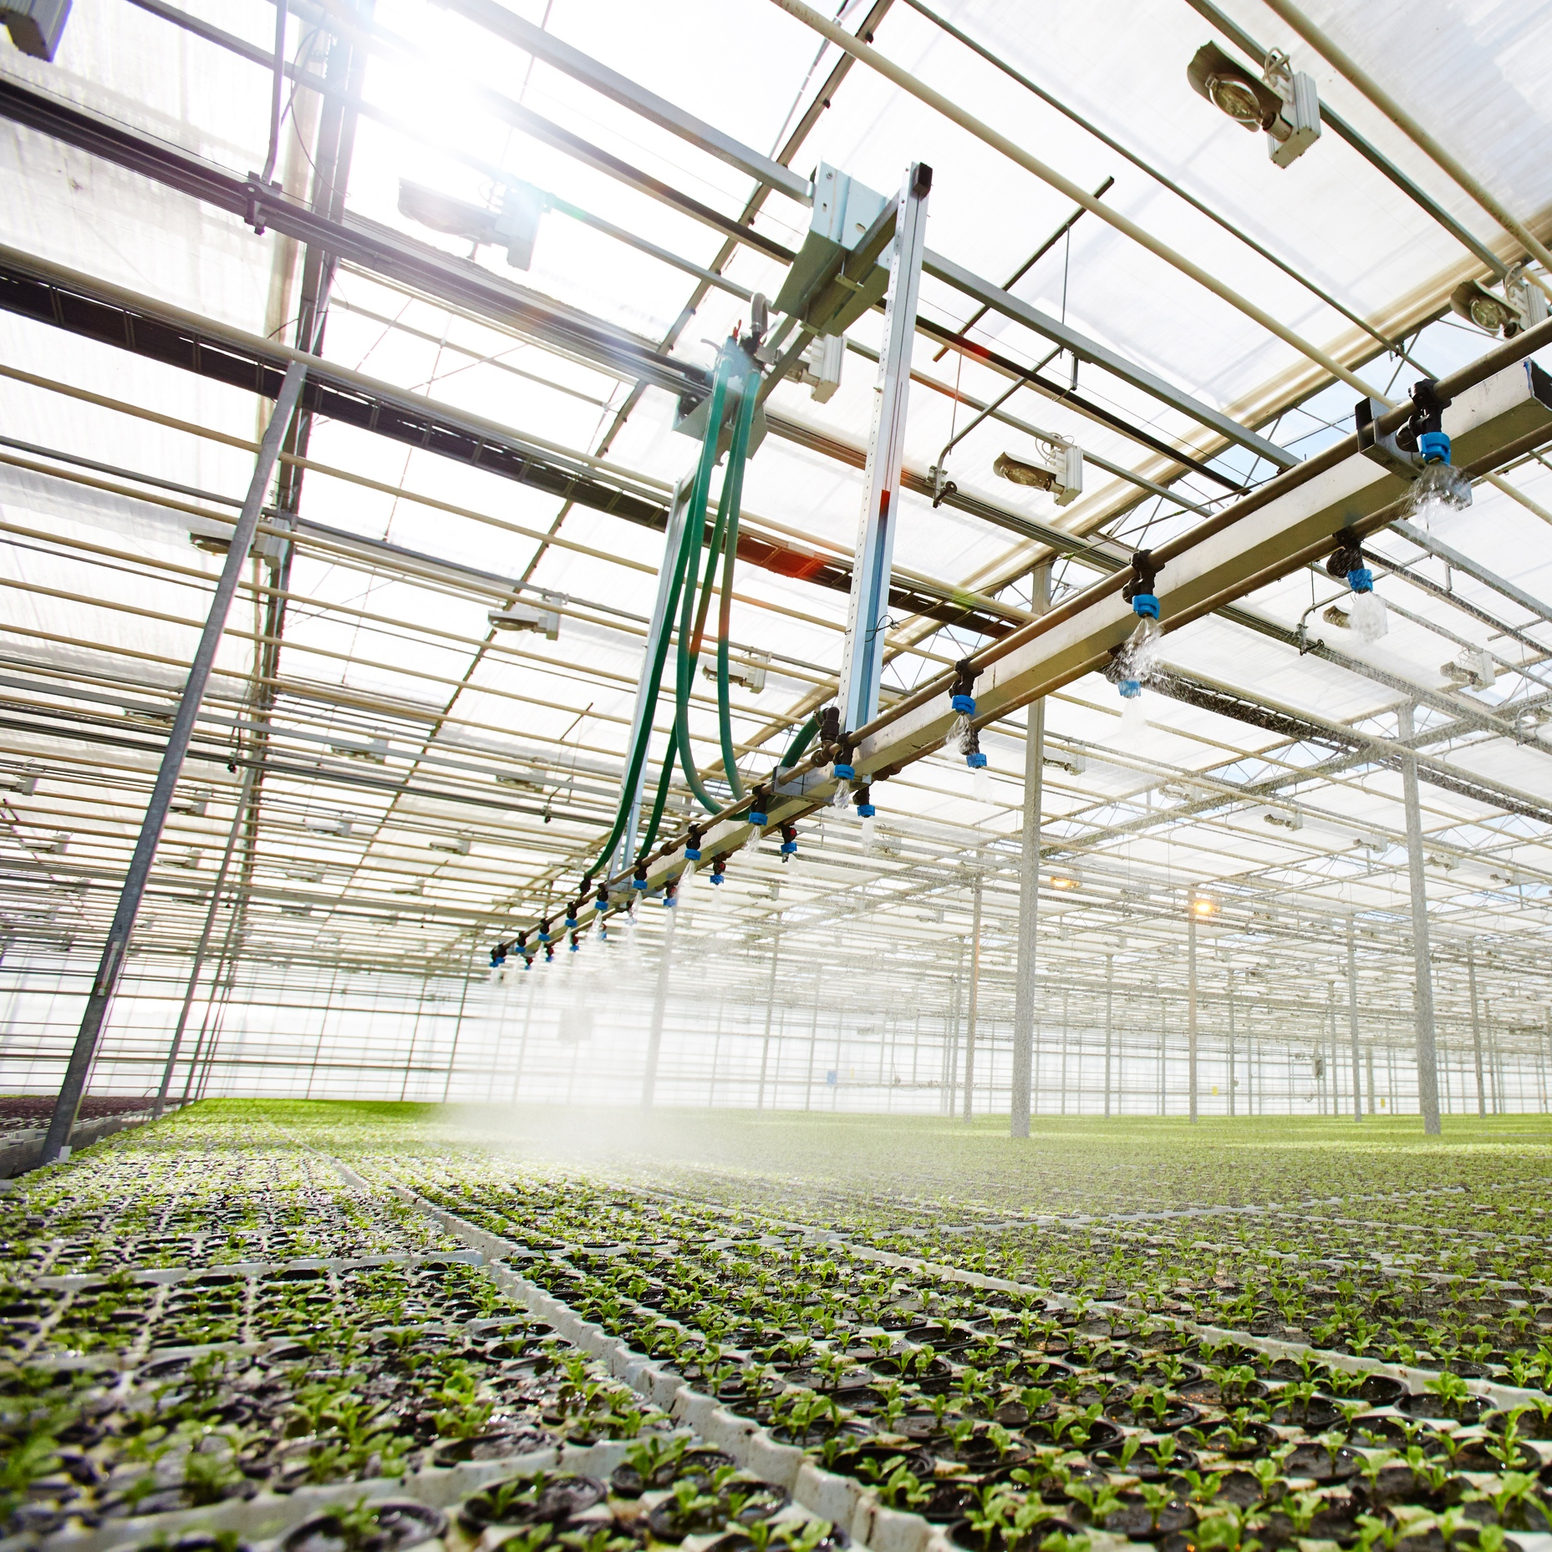
CREATING THE CONDITIONS
FOR TRANSFORMATIVE CHANGE
Goals for a Transformative Decade
  Co-create the Web of Earth-Humanity Sciences:
      Establish a global network of transdisciplinary hubs for sustainable development
      Establish Zenodo open repository(ies) for transdisciplinary hubs (MoU with Belmont Forum). Help of CERN.
      Promote transformative collaboration across cultures and disciplines
      Extend Big Science’s and International Unions spirit of intercultural bridges and peace
  Support a new culture of wellbeing:
      Embrace science and wisdom for collective responsibility and creativity
      Redefine human development within Earth's boundaries
      View Earth as a living whole, emphasizing unity and interdependence
  Formulate critical questions for equitable wellbeing:
      Use diverse knowledge sources to address existential challenges

Slide 9
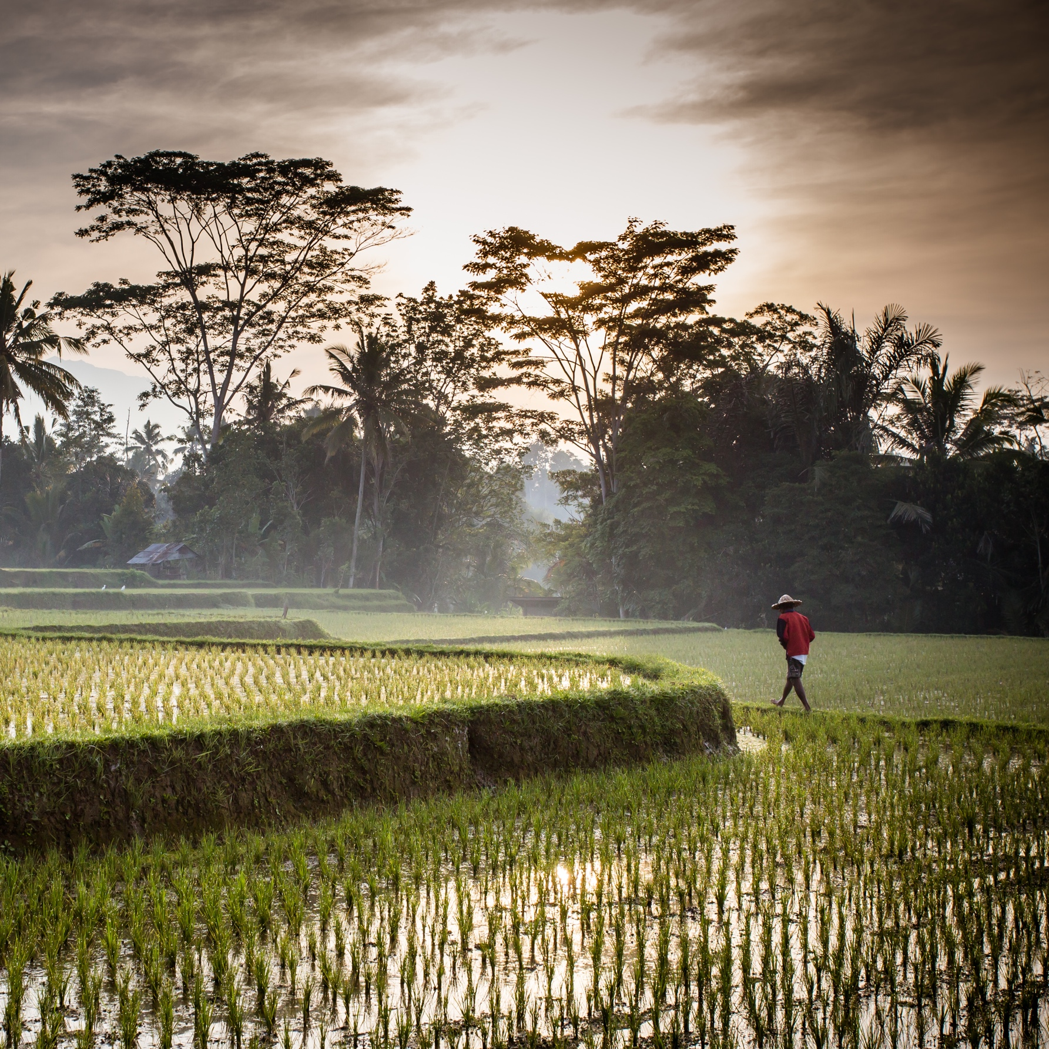
Identifying the value add of EHC
  Cooperative and open attitude and work practices
  Holistic knowledge integration
  Global bottom-up network of transdisciplinary hubs
  Mobilizing infrastructures for sustainability at all scales
  Focus on equity, just futures and planetary reconciliation at all territorial scales
  Ambition to reframe science-policy nexus and R&I agendas
  Working for resonance
      Partnering with UNESCO and ISC, to ensure the synergy and complementarity with the wider IDSSD agenda
      Partnering with The Club of Rome, the UNESCO-MOST BRIDGES Coalition and the World Academy of Art and Science to promote integrated knowledge production and action for transformative change at local community and regional levels

Slide 10

Role of IUPAP and WG 21 in EHC and IDSSD
Iupap
EHC
IDSSD
IUPAp is hosting for the moment the earth-Humanity coalition
Like it did for IYBSSD
IUPAP is Leading the effort to use for transdisciplinary researches on sustainable development, zenodo , a cern now well known, open platform repository of all sort of artefacts (papers, data, narratives, videos, software…), intensively used worldwide for the higgs boson discovery and study, intensively used also for covid19
We have an MoU with the Belmont forum (worldwide forum of funding agencies for transdisciplinary research for sustainable development) to use zenodo in all their activities
We need to have more partners, worldwide to increase the visibility of this initiative, to develop zenodo so that it becomes a worldwide grid of zenodo platforms deployed (each place being responsible for its own zenodo platform). JOINT task by ehc, cern, iupap/wg21?
This zenodo initiative was started by PHYSICS
WG21 RESOnates with EHC and more generally with idssd. Wg21/iupap could be leading the efforts of the unions within isc and within idssd

Slide 11
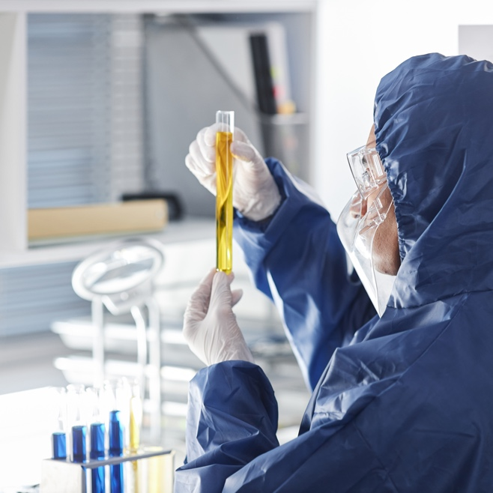
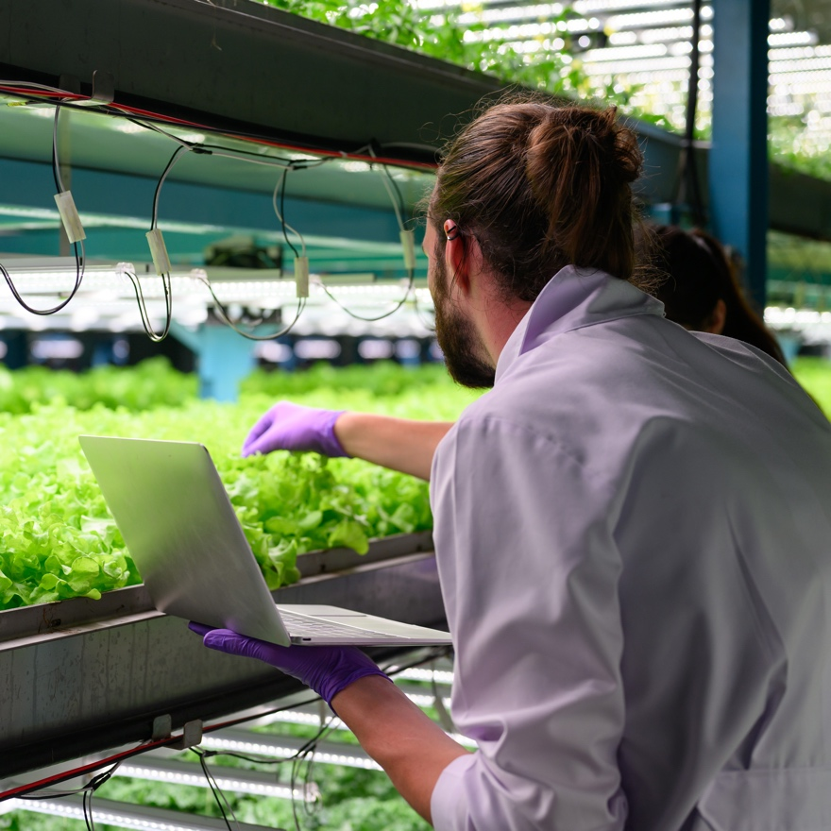
Current EHC Steering Group:
      Michel Spiro, President of IUPAP and Chair of the Steering Committee of IYBSSD, France
      Carlos Alvarez Pereira, The Club of Rome, Spain
      Lesley Green, University of Cape Town, South Africa
      Steven Hartman, UNESCO-MOST BRIDGES Coalition, Sweden
      Nebojša Nešković, The World Academy of Art & Science, Serbia
      Marian Nkansah, Kwame Nkrumah University of Science and Technology, Ghana
      Prajval Shastri, Raman Research Institute, India
      Luc Allemand, Coordinator, The Earth-Humanity Coalition
      Raad Sharar, Program Coordinator, The Club of Rome
    In collaboration with

Slide 12

Thank you

