Slide 1


IUPAP and IDSSD Proposals
EC&CC meeting January 2025
I. Gledhill, M. Spiro, N. Chetty

Slide 2
1. Inter-Union activities
Consider a strategic report uniting relevant Unions
Choose an SDG that is relevant and viable for IUPAP
  Sustainable energy, SGD 7?
IUPAP’s unique role: discovery and innovation through physics
  In scope for energy: the future of fusion and superconductivity
Collaborate with related Unions
  e.g. SCOPE, Scientific Committee on Problems of the Environment; IUPAC, energy storage
consider expectations very carefully
  on what kind of report(s)or material would provide useful resources?
Seek project support?

Slide 3
1. Inter-Union activities
Consider a strategic report uniting relevant Unions
Choose an SDG that is relevant and viable for IUPAP
  Sustainable energy, SGD 7?
IUPAP’s unique role: discovery and innovation through physics
  In scope for energy: the future of fusion and superconductivity
Collaborate with related Unions
  e.g. SCOPE, Scientific Committee on Problems of the Environment; IUPAC, energy storage
consider expectations very carefully
  on what kind of report(s)or material would provide useful resources?
Seek project support?

Slide 4
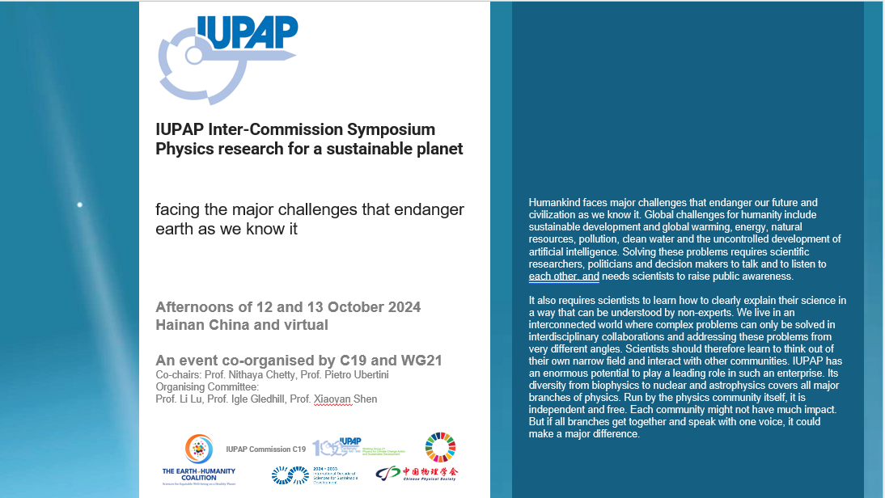
2. Build on the Inter-Commission Symposium format
2025, 2026: online symposia
Precursors to major conference
Strong involvement of Commissions and Working Groups
  how their work contributes to sustainable development, and climate change action
  Contribute to defining IUPAP’s position
In series with the virtual General Assemblies
2024: “Physics Research for a Sustainable Planet”

Slide 5

3. Major IUPAP conference in climate change action and Regenerative Development
2027
Host to be chosen
Deadline for expression of interest 10 Jan 2025
Hybrid format
Accessible to developing countries
Regenerative:
  Sustainable can include inequitable
  not only slowing degradation, but reversing degeneration
  more systemic approach

Slide 6
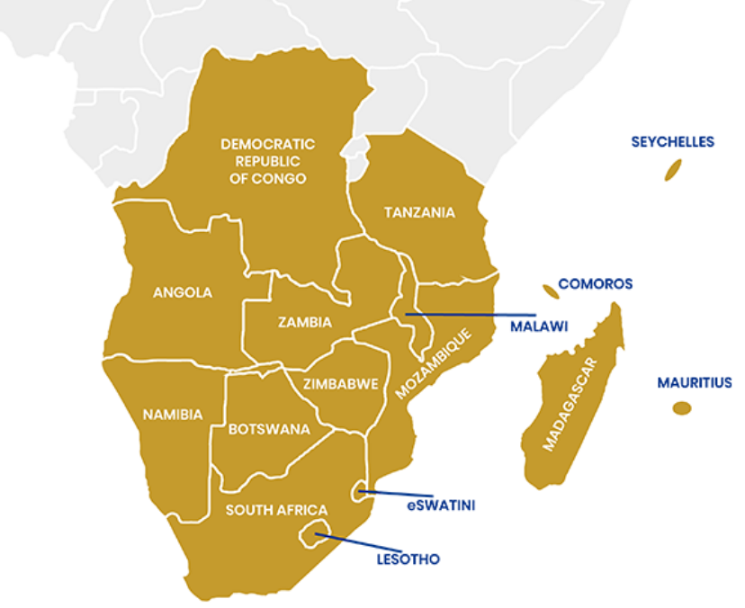
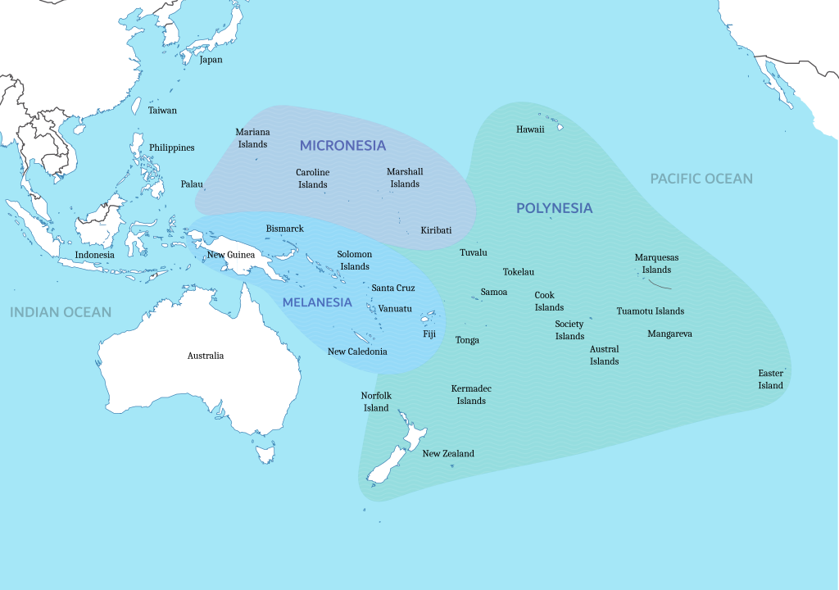

4. Regional development and regeneration
2027 Southern African Physics Network SAPhysNet: proposal to host IUPAP GA and Conference on Physics for Climate Change Action and Regenerative Development
2025 A Sustainability-oriented conference in the Pacific region in the first half of 2025: proposal in progress
https://zanzibareducationpanel.blogspot.com/2019/01/historical-background-of-southern.html
By Edmund1234 - Original sourced from: https://commons.wikimedia.org/wiki/File:Pacific_Culture_Areas.svg, CC BY-SA 4.0, https://commons.wikimedia.org/w/index.php?curid=148457632
To be continued in IDSSD

Slide 7
5. WG21: Climate change action and sustainable development
Defining document what the role of physics is and should be in climate change action and sustainable/regenerative development
  brief and to the point; issues and actions
  useful in inter-Union liaisons
Evidence-based communication strategy: done
  2025: establish communication with physicists, learn best practice
Physics curricula
Advise executive
  statements
Ongoing IDSSD planning

Slide 8
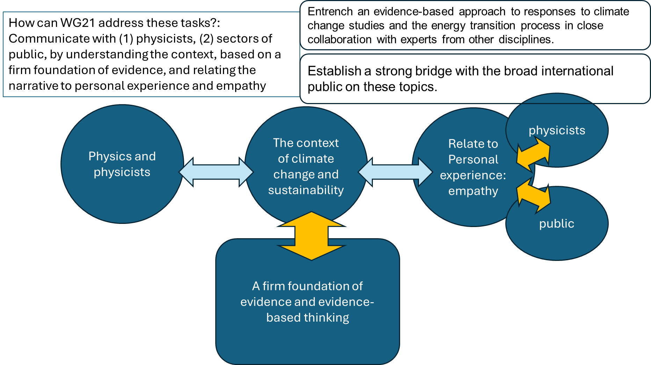
example: Communication strategy (from WG21)

Slide 9





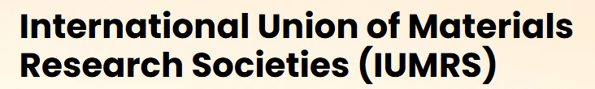







Unions: Possibilities…think widely

