Slide 1
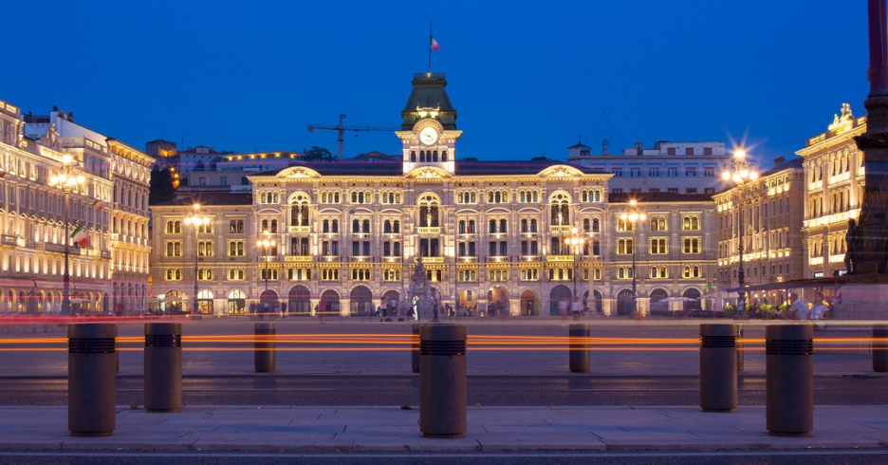


IUPAP Administrative Office in Trieste
Stefano Fantoni
(IUPAP Secretary General for Administrative Affairs, FIT President)

Slide 2
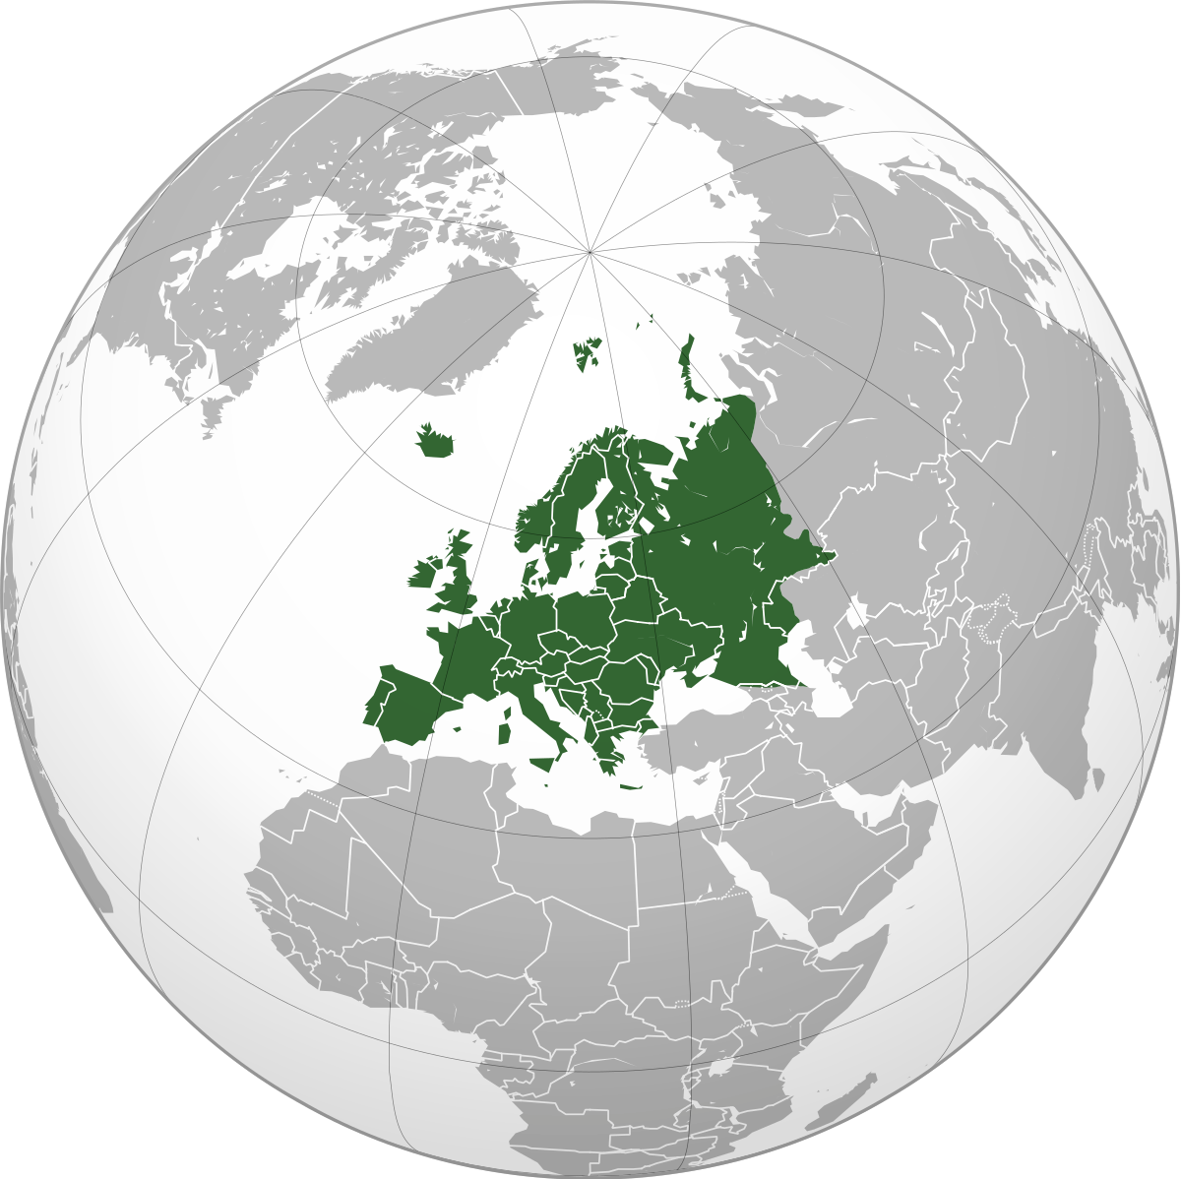
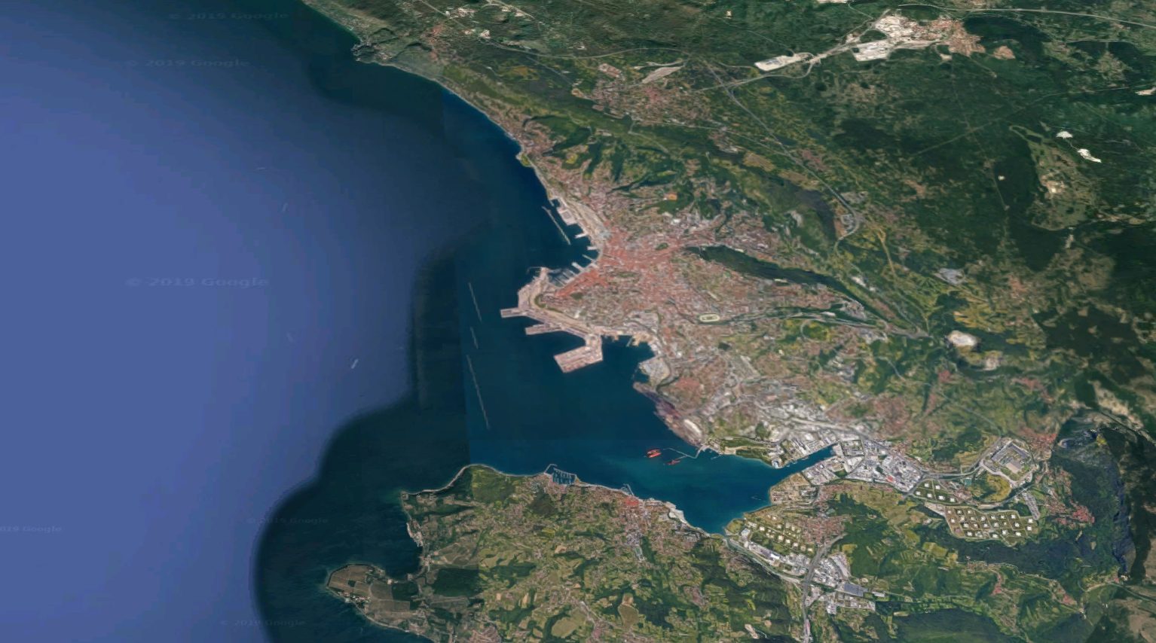
The “Trieste Science System”
TWAS
OGS
ICTP
More than 150,000 physicists have visited ICTP from all over the world
Trieste is the city with the highest density of researchers in Europe
Trieste was the European City of Science 2020
Hosts the National synchrotron radiation facility (Elettra)
The largest national Science Park
SISSA
Univ of
Trieste
Area Science Park
ICGEB
CNR
Elettra

Slide 3
The Trieste International Foundation for Scientific Progress and Freedom (FIT)
Created in 1988 by Abdus Salam to promote and support the development, freedom and dissemination of science, and its peaceful applications.
FIT is a private-law entity regulated by statute and bylaws. Its legal status is recognized by the Italian Ministry of Education (with no restriction on any country, Taiwan included ).
Members: most Trieste-based scientific institutions, including ICTP, SISSA, TWAS, University of Trieste, the “Elettra” synchrotron radiation facility, etc.
FIT has organized ESOF2020, Trieste European City of Science, and is now in charge of A Laboratory on quantitative sustainability (TLQS)
FIT has signed on 2021 MoU with IUPAP, extended to 2026

Slide 4

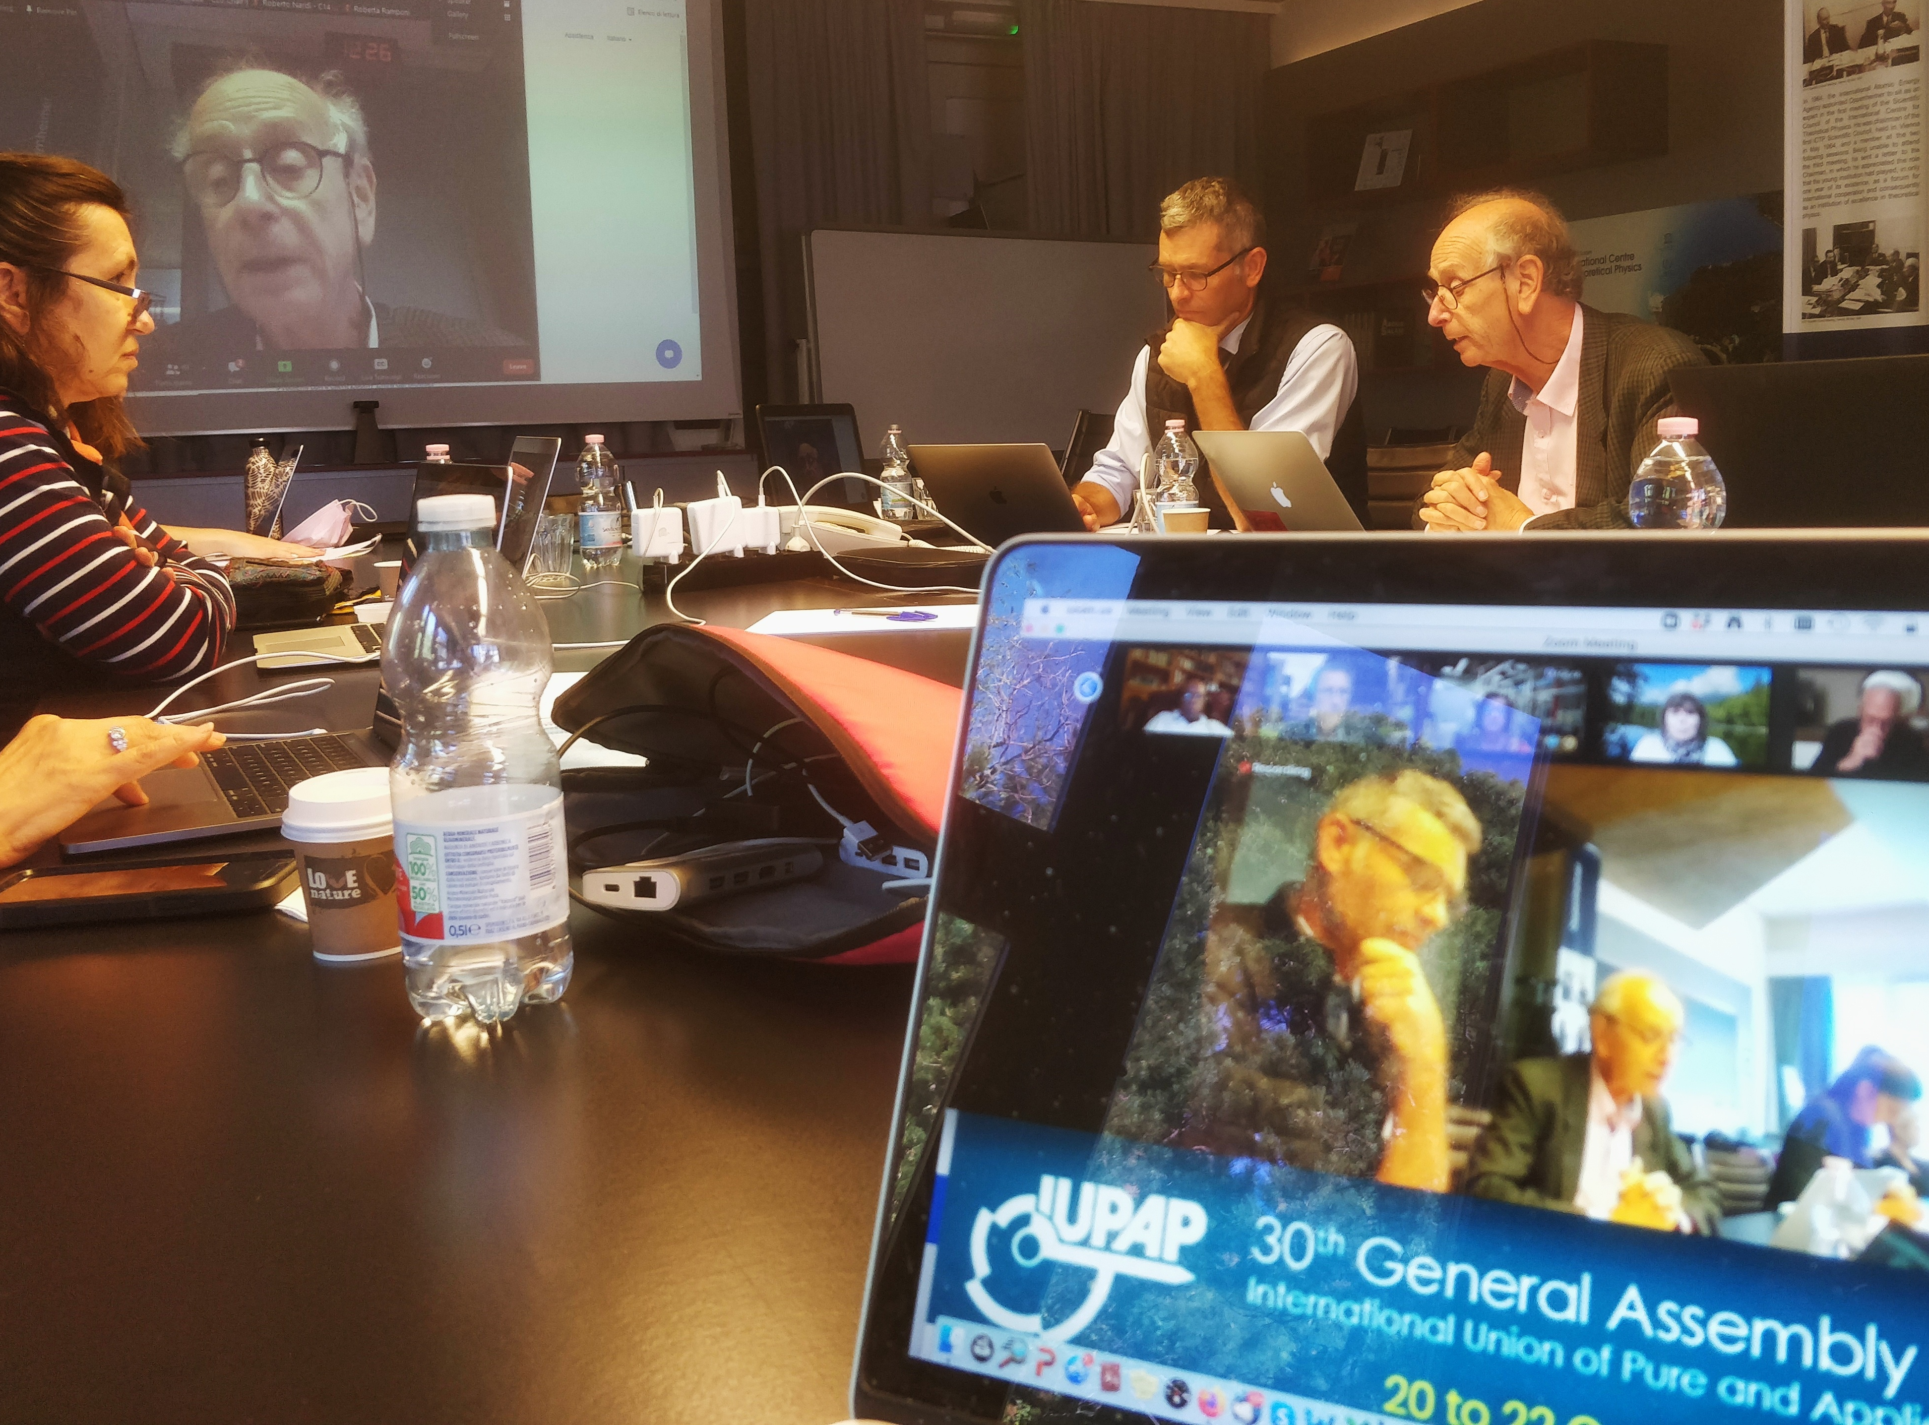
FIT and IUPAP
In 2024 IUPAP moved its administrative offices at the first floor of SottoStazione Elettrica (SSE) building of Porto Vecchio.
IUPAP events held in Trieste:
2021: General Assembly
2022: IUPAP Centenary (with EC&CC and GA)

Slide 5

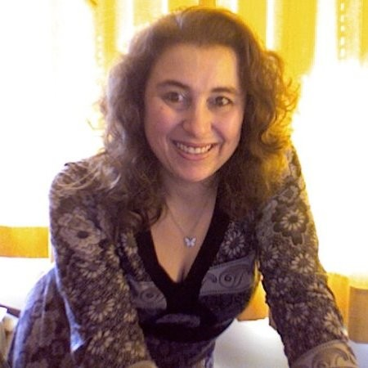

IUPAP team in Trieste
Stefano Fantoni Secretary General for Admin Affairs
Sandro Scandolo Deputy Secretary General
Gabriella Marra IUPAP Secretary
Ariella Kranjek FIT Secretary
Francesca Zavino IUPAP Communication
Contacts:
secretariat@iupap.org (all administrative matters)
communication@iupap.org (Web updates, newsletter, etc.)

Slide 6
FIT and IUPAP: Main activities 2024
Work side by side with the General Secretary for Legal and Financial Affairs;
Support to IUPAP official meetings;
Support to all processes related to Conferences and Awards;
Database preparation, invoicing, dues, payments, assistance in analyzing statements and all administrative matters;
IDSSD preliminary support administration;
Matters related to possible corporate members (BSBF2024) and to sustainability research (TLQS)
COMMUNICATION (Sandro Scandolo)
  (website, newsletter, social media management)

Slide 7
FOR COMMISSION CHAIRS
TWO «KEEP AT HAND» SLIDES
for administration

Slide 8
Early Career Scientist Prize
information needed by IUPAP Secretariat
medals:
    names of the awardees and the year of the prize.
    Name, address and a phone number for the delivery
bank details for the 1000 CHF monetary prize:
Name and surname of the payee
address of the payee
email of the payee
Name of Bank
Address of Bank
Country of Bank
Swift of Bank/ ABA number
Account number
IBAN
for the news on the website, send an email to Francesca Zavino on communication@iupap.org sending her a photo, the motivation for the prize and a short bio.
Certificate is filled and printed autonomously by the Commission (template sent by secretariat)

Slide 9
Claims for reimbursements
Reimbursement of expenses are managed sending the IUPAP claim form (provided by Secretariat)
Suggestions to fasten the process:
    Follow instructions in the claim form and provide receipts and/or invoices related to the expenses
    Always provide all bank details needed in the claim
    Indicate the preferred currency for the reimbursement. All conversions are made centrally at the moment of the reimbursement according to the date of the expense.

Slide 10
IUPAP Administrative Office in Trieste
Thank you.

