Slide 1

Gender Champion Report
October 2024
Dr Gillian Butcher
University of Leicester, UK
IUPAP Vice-President: Gender
Gender Champion Report for IUPAP C&CC Meeting 10th October 2024

Slide 2
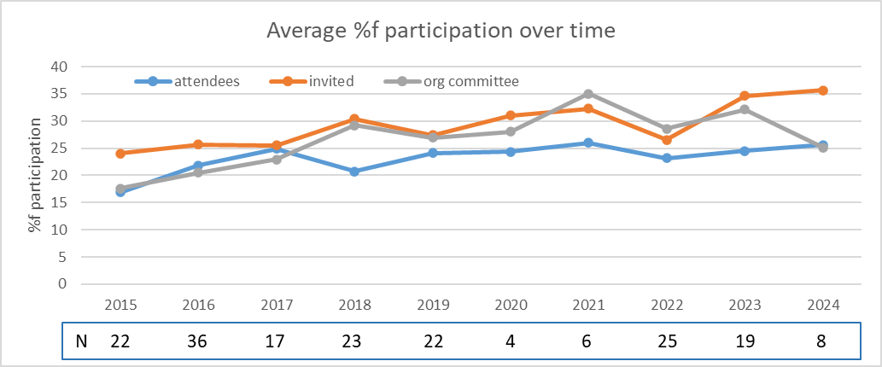
IUPAP Conferences Report
182 conferences over 10 years
Conference organisers return information on:
Number of attendees, female attendees
Number of invited speakers, female invited speakers
Number on organising committee, females on org c’ttee
2020/21 all online
2022 online, in person, hybrid

Slide 3
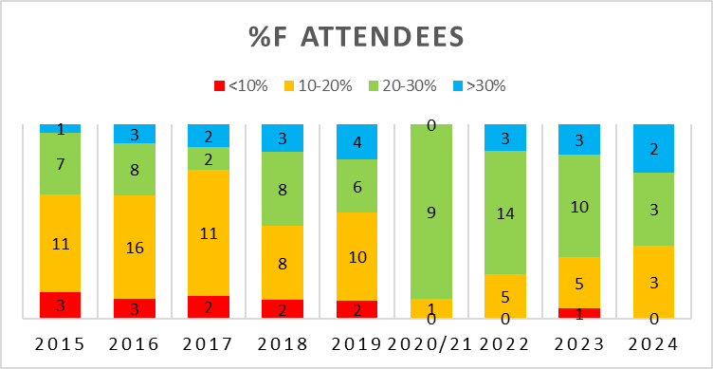
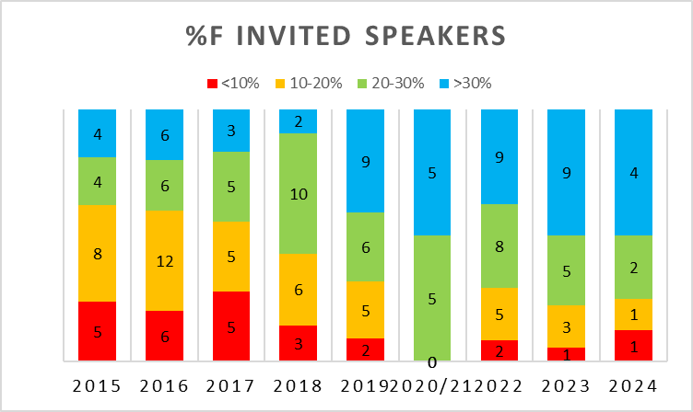
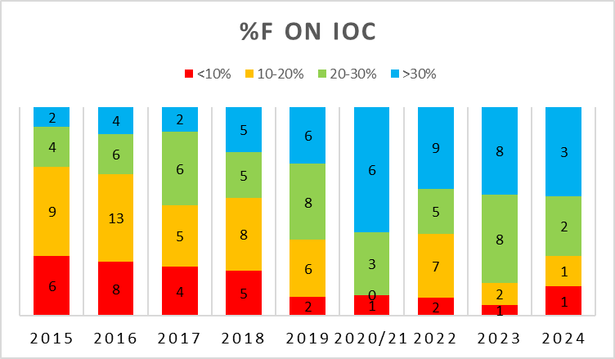
Normalised number of conferences: %female participation
>30%
20% - 30%
10-20%
<10%

Slide 4

Conference Reports
All reports nominated a person to act as adviser in harassment issues.
Diversity talks: in 2022, 5 out of 24, 2023, 5 out of 25 and to date for 2024, 3 out of 9 conferences:
  plenary talks on diversity/EDI/Gender in STEM,
  panel discussions on EDI topics,
  a networking breakfast for women
  social media campaign and lounge as a safe space to discuss diversity.
Other topics have included sustainability and ethics talks and also having digital posters alongside physical posters, for accessibility.

Slide 5
Conference Reports: Travel Assistance
Form asks for numbers assisted, individual amounts and total amount.
2020/21 conferences - all online:
2022 conferences - some hybrid. 18 out of 24 reported providing assistance
2023 conferences (1 hybrid) and 2024
  waiving or reducing of registration fees,
  assistance for those who reside in developing or disadvantaged countries.
  supporting flights and accommodation and subsistence
  supporting students
Encourage conferences to provide technology or accessibility grants
Generally consider how to make your conference more accessible

Slide 6










SCGES
Standing Committee on Gender Equality in Science
24 organisations signed MoU (as of Sept 2024)
One representative from each partner organisation
IUPAP rep: Gillian Butcher
and Deputy
IUPAP Deputy rep: Rudzani Nemutudi
€275 per partner annually
Annual Report imminent, including joint survey with ISC
2023 Report on website
https://gender-equality-in-science.org/

Slide 7
SCGES Aims
Helps partners to promote gender equality within their organizations, and in particular
Follows the progress of the implementation by partners of the recommendations of the Gender Gap in Science Project;
Endorses projects and initiatives to promote gender equality in science proposed to it by partners;
Facilitates communication among partners, among other things by developing and maintaining a website.
Website gender-equality-in-science.org
Twitter account SCGES@_SCGES_

Slide 8
SCGES Activities
Working Groups
Web and social media Working Group
Webinar Working Group
International Science Council Liaison Working Group
Annual report Working Group
Best practices Working Group
Interview Working Group
Webinar Series
Popularizing science without gender bias
  hybrid meeting, combined with Global Womens Breakfast
Website gender-equality-in-science.org
Twitter account SCGES@_SCGES_

Slide 9

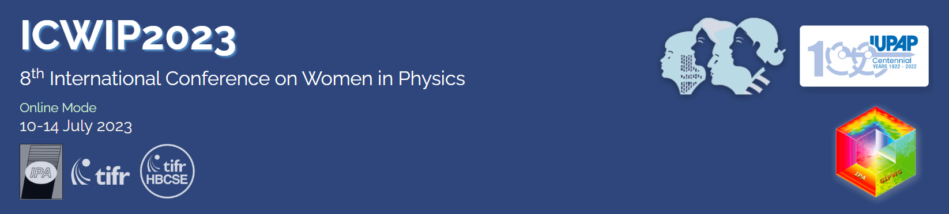

WG5
Gender Champion is ex-officio member of WG5
ICWIP2023 Proceedings in preparation
11th October 2-6 pm
Convention Centre
IUPAP-CPS Women in Physics Forum
celebrate 25th Anniversary of IUPAP WG5 Women in Physics
its beginnings
its positive impact on our Union and across regions of the world
to discuss the future of IUPAP’s actions to increase gender diversity and inclusion

Slide 10
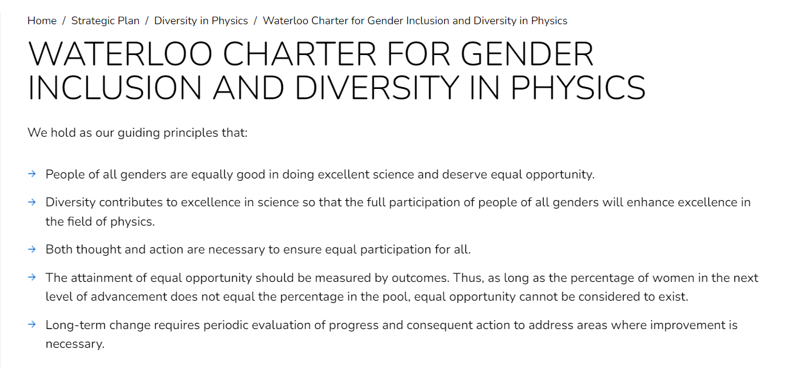
Waterloo Charter
https://iupap.org/strategic-plan/diversity-in-physics-2/waterloo-charter-for-women-in-physics/

