Slide 1
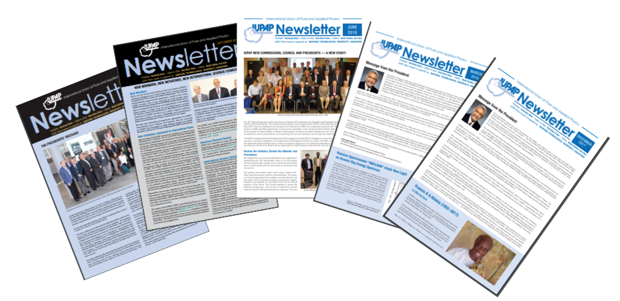
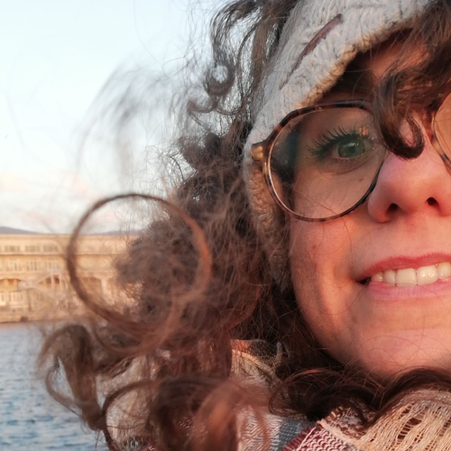
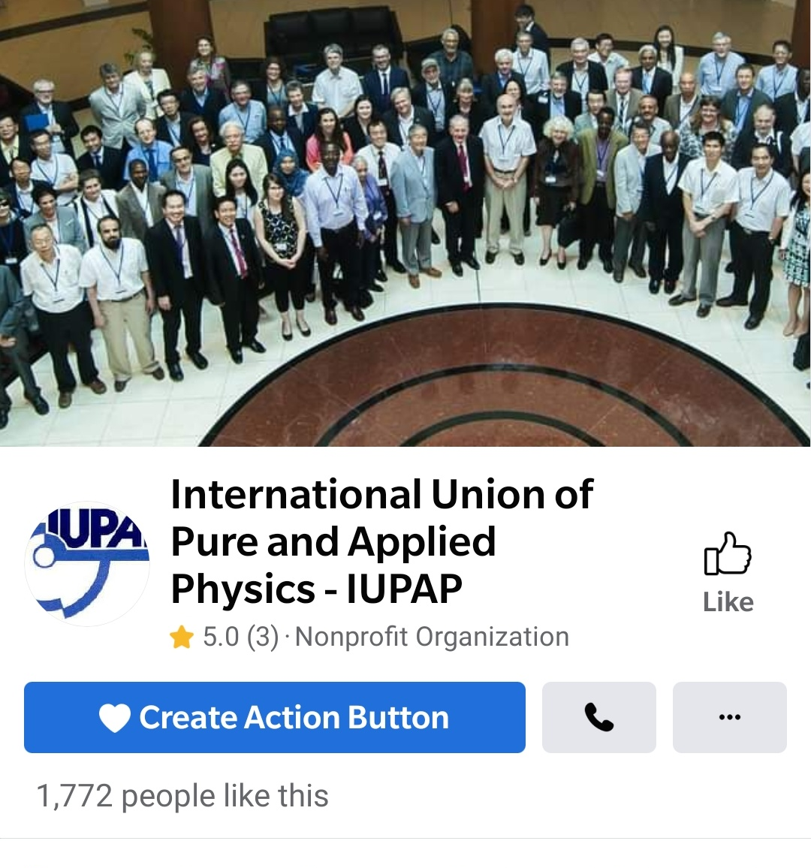
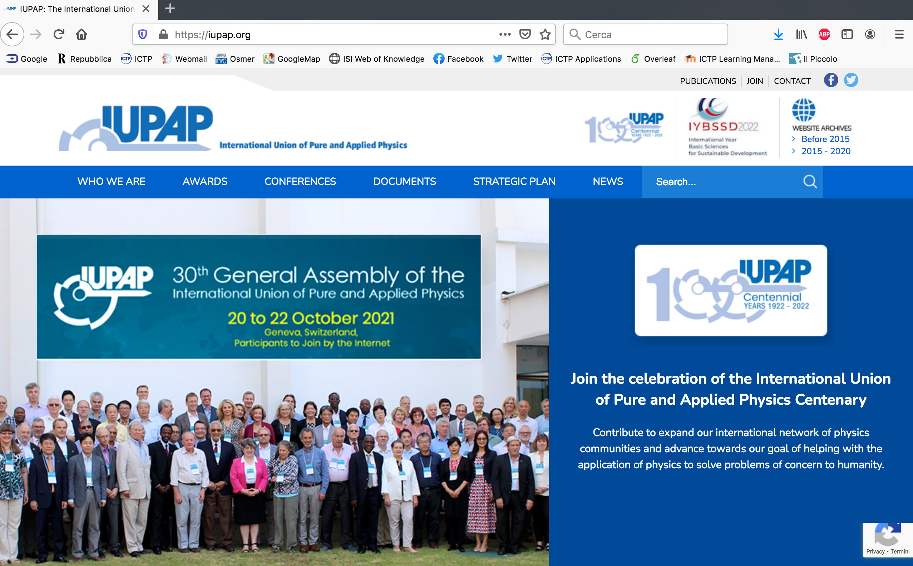




IUPAP Communication EC&CC October 2024
Francesca Zavino
communication@iupap.org

Slide 2
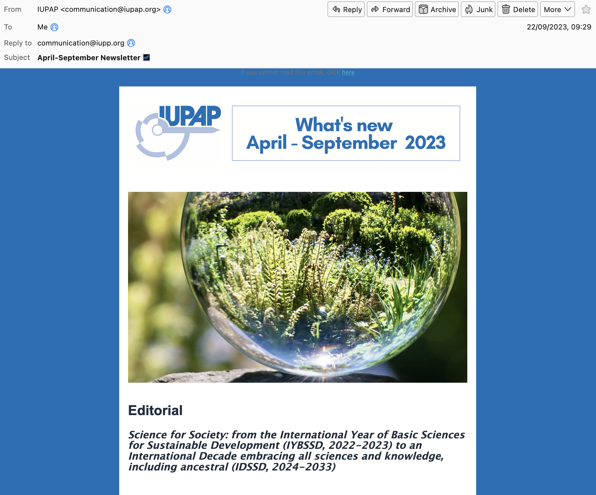
IUPAP Communication
e-Newsletter
Quarterly e-newsletter
pdf posted on website
1.130 contacts
(+281 from 2023)

Slide 3
IUPAP Communication
e-Newsletter contents
Q1 - 2024
Editorial
The next General Assembly
Kennedy Reed Medal
Meet out team (Michel)
2021 ICPE Medal
Early Career Scientist Prizes
Q2 – 2024
Editorial
IUPAP EC&CC meeting and 33rd IUPAP General Assembly
IUPAP Early Career Scientist Prizes 2024
Meet the Team (Monica)
Obituary: Tsung-Dao Lee
Article by by Evelyn Tang, IUPAP Interdisciplinary Early Career Scientist Prize 2023
Experiences applying for US Visas

Slide 4
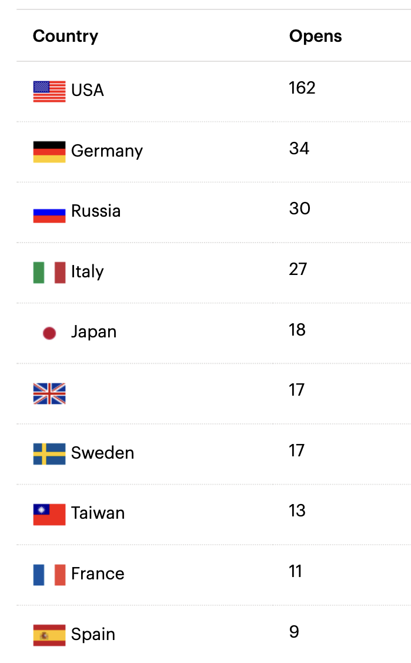
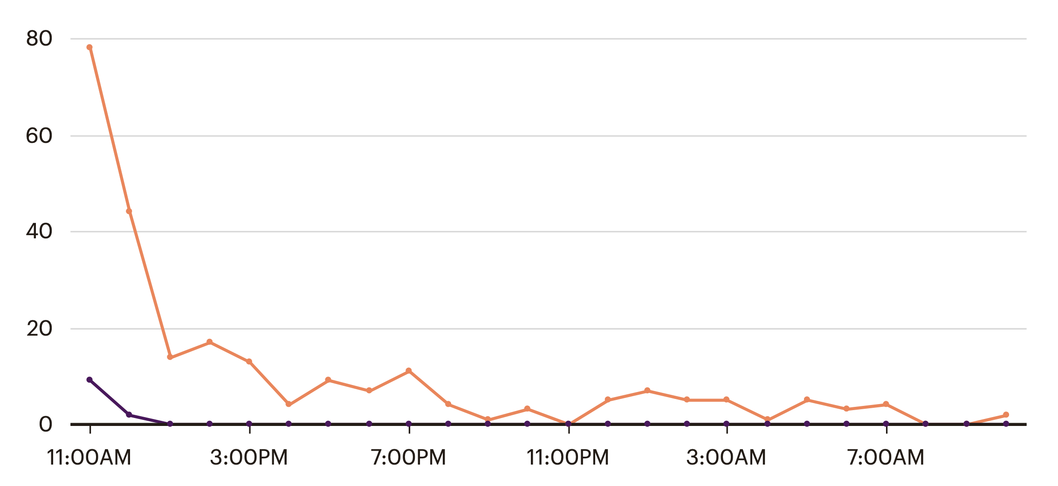
IUPAP Communication
e-Newsletter
1130 email addresses (+ 281)
. 44,39% total opens
. 8,55% clicked on link
Opened
Clicked
24 hours

Slide 5
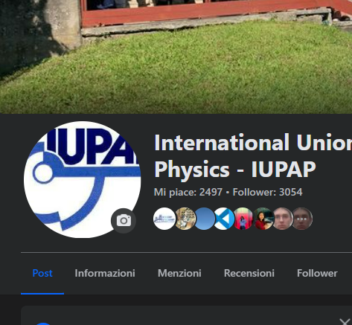
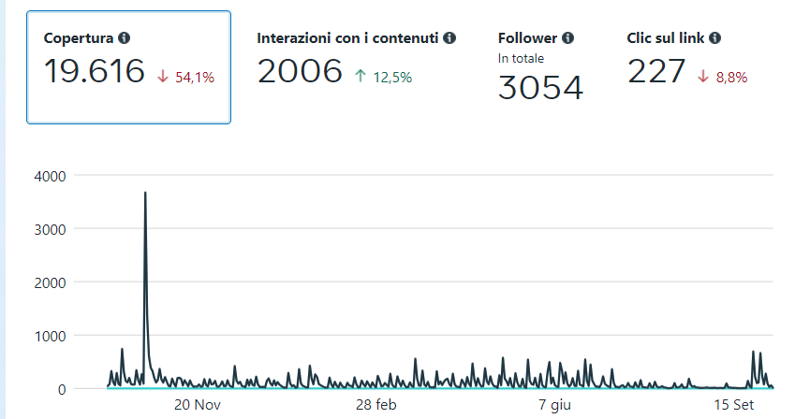
IUPAP Communication
Facebook page
Regular Facebook posts (2-3/week)
Reach
Interactions
Followers
Click

Slide 6


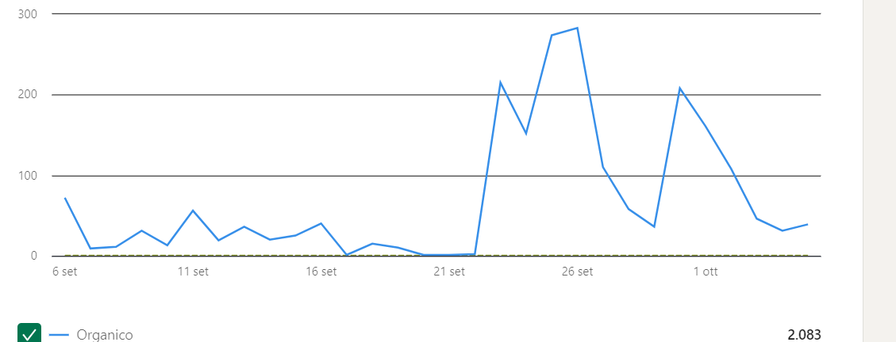
IUPAP Communication
Social media
Facebook: followers: 2786 (jun 2023) => 3054 (October 2024)
Twitter (now “X”) account re-activated in 2022. 1381 => 1683 followers
LinkedIn (1488 followers)
Impressions: 2083
Collaboration with communication teams at other organizations (ICTP, CERN, IYBSSD, other Unions, etc) for post re-sharing

Slide 7

IUPAP Communication
Website
Updated by communication team
Commissions/AC/WG are responsible for their content on website
-> please send your content/updates to communication@iupap.org
Francesca
Hari
Silvina

Slide 8

IUPAP Communication
Homework for you (especially Chairs)
Please send us (to communication@iupap.org):
  Content updates for website from Commissions / AC / WG
  Newsworthy updates (e.g. conferences, events) - send pics & brief text
  Early Career Scientist Prize winner information (and other awards)
  Commissions will be contacted for rotating «feature» in newsletter
  Any other suggestions to improve the communication
Please help us sharing news on social media and involving local communication officers when relevant (please tag @iupap in your posts!!)
«Outcomes» of General Assembly on newsletter and news/social media

Slide 9
IUPAP Communication
Recommendations from external report
1. Develop a communications plan. Identify the target audience and what the purpose of the communications is and invest sufficient funds to enable professional and appropriate communications.
a. Create a role or a position on the executive that is responsible for communication and contract professional communication staff.
2. Adopt best practice and global standards for inclusivity for communications (especially for disabilities)
3. Increase the budget investment in communications.
a. Funds could be raised to support this investment through sponsorship from relevant stakeholders.
b. Allocate 5-15% of the budget to communications – 25k-74k Euros [this could be funded by sponsorship from physics relevant companies].
4. Collect and track data on communications metrics such as downloads and use this to test success of any approaches.
5. Consider establishing an e-newsletter (?)
6. Use digital platforms to hold webinars to enable better communication and elevation of IUPAP outputs.

Slide 10
IUPAP Communication
Who’s who
Francesca Zavino
A special thanks to Hari Haran (GRAPES-3 experiment, Tata Institute of Fundamental Research)
communication@iupap.org: News and web items
[managed by Francesca Zavino]
secretariat@iupap.org: All types of «business» messages
[managed by Gabriella Marra, read by entire EC]

