Slide 1

Membership matters
Nithaya Chetty
Vice President – Membership and Development
Jens Vigen
Secretary-General
With support from Igle Gledhill
Report to the IUPAP EC&CC Oct 2024

Slide 2
Strategic vs Administration
VP Membership and Development responsible for strategic engagements and negotiations
  New members
  Defaulting members
  Excluded members
IUPAP Secretariat responsible for administration
  Keep current records of Adhering Body and Liaison Chairs
  Roll out negotiated arrangements for new members and resumption of old membership as per signed MoU
  Issues invoices and receives dues
  Etc

Slide 3
Defaulting members
For the time leading to the Centenary Celebration, it was felt that IUPAP should be lenient in dealing with defaulting members
However, perennially defaulting members were ‘given notice’ at the 2023 GA to make arrangements to meet their obligations or else they will be formally excluded at the 2024 GA in China.
We made arrangements with some countries, e.g. Nigeria, Jordan, etc.
  Signed new MoU underscoring new commitments.

Slide 4
Exclusion from the Union
All other countries who have not been fully paid up for past 6 years should be formally excluded from the Union on the following conditions
  They should be informed of their exclusion and the consequences thereof
  Their debt should be capped for a 6 years period for 1 unit (CHF 15 000 in current terms)
  IUPAP continues to communicate with them, keeps them connected with the work of the Union
  VP Membership and Development through Membership Committee continues to engage with them, develop plan for resumption of full membership
Action item

Slide 5
Membership Committee
Membership Committee was agreed to at 2023 GA
  VP Membership and Development (Chair)
  VP Membership and Development past
  Jens Vigen
  Gabriella Mara
Will meet regularly to strategize on how to deal with members in arrears of between 3 and 6yrs
  Will have engagements with such defaulting members to work out a mutually agreeable plan

Slide 6
Rights of defaulting members
No voting rights for members in arrears of between 3 and 6yrs
Does not form part of the quorum for voting at the GA
May continue to serve on Commissions and WG’s

Slide 7
Resumption plan
An example of a resumption plan (each case to be negotiated individually)
  Year 1: pay 0% cost of 1 unit
  Year 2: pay 50% cost of 1 unit
  Year 3 and onwards: pay 100% of cost of 1 unit
  Year 6: if above has been adhered to, the debt is officially written of in the books of the IUPAP

Slide 8
Members at different stages of evolution
Current fully paid up members
New members
Potentially new members
Defaulting members
Excluded members
Developing members (ATM’s)

Slide 9
Keep current IUPAP membership intact
About 65 members (195 countries, i.e., 1/3 global membership)
Cannot afford to neglect interests of our paying members
  Must continue with one-on-one engagements on 3-year cycle
    Encourage proposals for new activities, new initiatives from Liaison Committees, not just Executive Council, Commissions and WG’s
  Members must readily see direct benefits and not lose interest in IUPAP
  IUPAP should remain relevant to its members even as these times change
    The world is not static
    IUPAP must adapt to changing times
    The work of IUPAP must be communicated to membership and beyond
  Nominations linked to number of units
    Special care for new members
    Senior appointments also linked to countries with stable membership and high number of units
    Reward long-term commitment to IUPAP
Action item

Slide 10
Quest for new members
Devise strategies to approach potentially new members
  Target most physics-productive countries that are not members
Conversations with potentially new countries must be ongoing
  Uzbekistan
Use every opportunity that comes up, follow every lead
  Commissions and WG’s have an important role to play
  Use global networks
  Connect with embassies, PK, Ukraine
Negotiate a mutually attractive deal to bring new members on board
  Sign MoU with special conditions

Slide 11
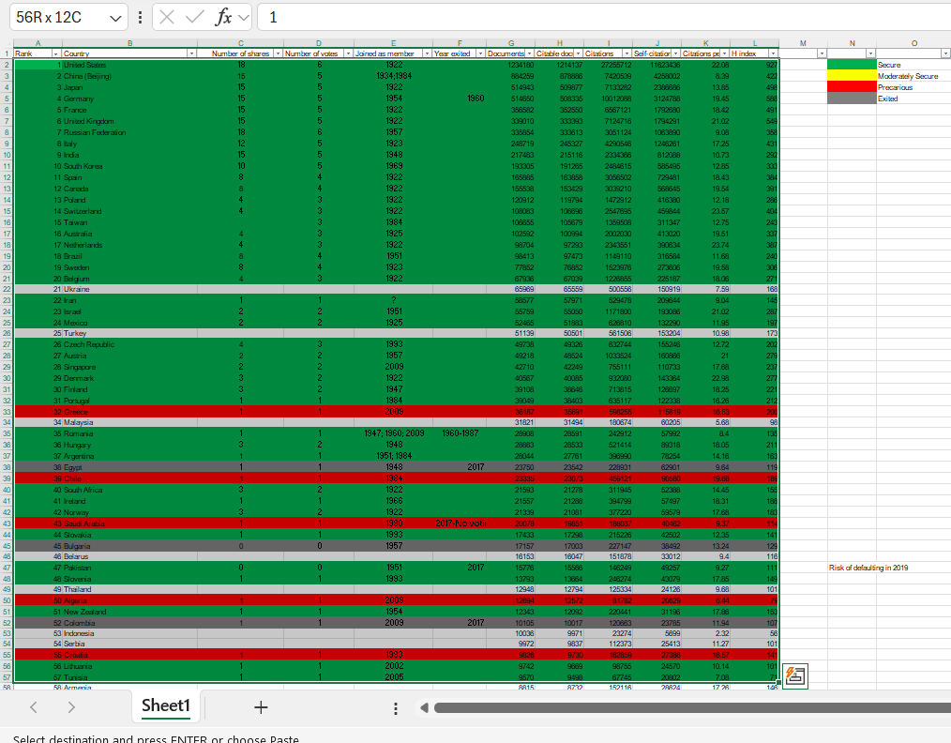

Slide 12
New membership plan
An example of a new membership plan (each case to be negotiated individually)
  Year 1: pay 0% cost of 1 unit
  Year 2: pay 50% cost of 1 unit
  Year 3 and onwards: pay 100% of cost of 1 unit

Slide 13
Increase number of units
I will give the President of the SAIP a brief opportunity to speak to this at the GA
South Africa is only country in 7 years that has increased number of units from 3 to 5
SA was a founding member of IUPAP
  Important voice for physics in the Developing World
Took several years to negotiate this with the NRF/DSI
  Can be done if you win the interests of the government, calls for delivery of real benefits to the country, to the region, the continent
  Fits into the overall strategic plan of the government
  Physics is the proverbial canary in the coalmine when physics is strong, the science system is strong

Slide 14
Associate Territorial Membership (ATM)
Articles have been updated in 2023
10% cost of one share, benefits are limited, spelt out in MoU
Not more than 10% of members should be ATM’s
Member country must commit to programme of physics development (quid pro quo), of mutual benefit
  Not simply a discounted levy
In principle, an open call for applications on website
Renewal on 3-year cycle, following submission of a report
  Can morph into full membership
Action item

Slide 15
Regional Physics Cooperative of Heads of Physics Departments
Long term Goal: Regional Physical Society
IUPAP ATM
IUPAP Full membership

Slide 16
[1] Nepal
Nepal is an important test case
  Thanks to Nilam Shrestha
IUPAP and Nepalese Physical Society must work strongly together to help develop physics in Nepal
  Spin-off effects in the region
Work with other physics organisations in the region, also internationally
In 2026, we will assess progress made
  Nepal hosted International Conference of Physics for Sustainable Energy 2023
  Nepal representative on WG21
  Nepal associate member of C13 or C14
Action item

Slide 17
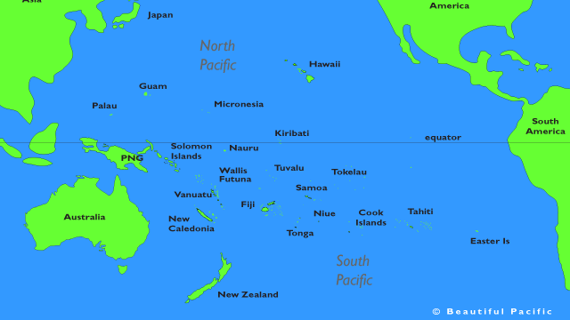

Slide 18
[2] Pacific Island nations
National University of Samoa (NUS) as a regional coordinating institution
  Thanks to Gabriel Bioletti and David Hutchinson
  Connecting with Fiji, Tonga and other island nations
  IUPAP, NIP, Australian Academy of Science, APS, French Physical Society partners
Plan for major workshop in 2025 on Energy for the Future
  Energy is a pressing issue for local communities
  LOC is being formed
  Involve rangatahi (youth) aimed at late high school/early university-aged students
  Preparing a Mission Statement
  Preparing a budget

Slide 19
[3] Southern African physics cooperative
SAIP to play a coordinating role
  Thanks to Rudolph Erasmus, Azwinndini Muronga
  IUPAP, APS, AfPS partners
First consultative forum on co-creating the Southern Africa Physics Network (SAPhysNet) on 5 July 2024
Grow physics cooperation in region, address problems of regional importance
  DSI/NRF have expressed strong support
  Aligned with strategies of DSI, SADC, AU
  Role of Science, Technology, and Innovation (STI) in achieving sustainable socioeconomic development
A task team has been established to drive the establishment of the cooperative
  Develop ToR’s for cooperative

Slide 20
[4] Eastern African physics cooperative
EAIFR can play a coordinating role
IUPAP, ICTP, IoP, SAIP, APS, AfPS partners

Slide 21
[5] ATM member in Latin America
Leave this to incoming President and incoming VP Membership and Development to pursue further
  Can be a single ATM country as with Nepal or
  Can be a regional physics cooperative

Slide 22
Time to say goodbye
I will rotate off the Council at conclusion of GA 2024
  Remain Chair of WG21 until Oct 2026, major conference in 2027
Establish Membership Committee
  I am happy to lend support to new incoming VP Membership and Development
Many thanks to Kennedy Reed, Michel Spiro, Bruce Mckellar, Jens Vigen
  Singapore Office
  Trieste Office
Thanks to Edmund Zingu, Manfred Hellberg, Igle Gledhill
Action item

