Slide 1
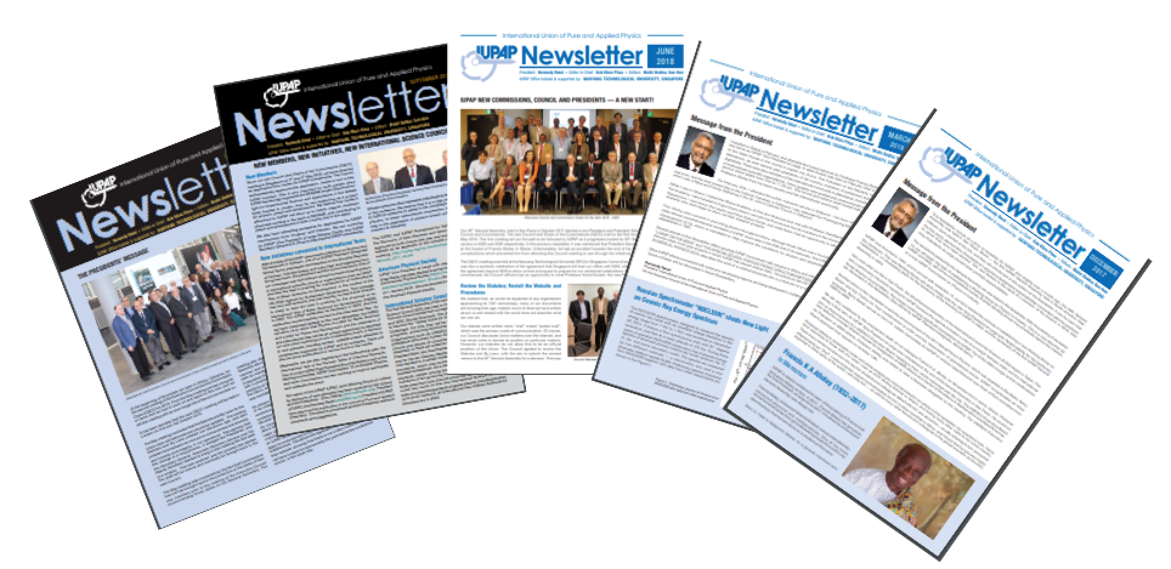
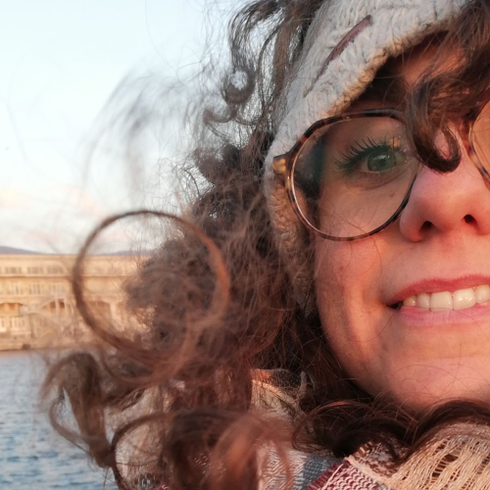
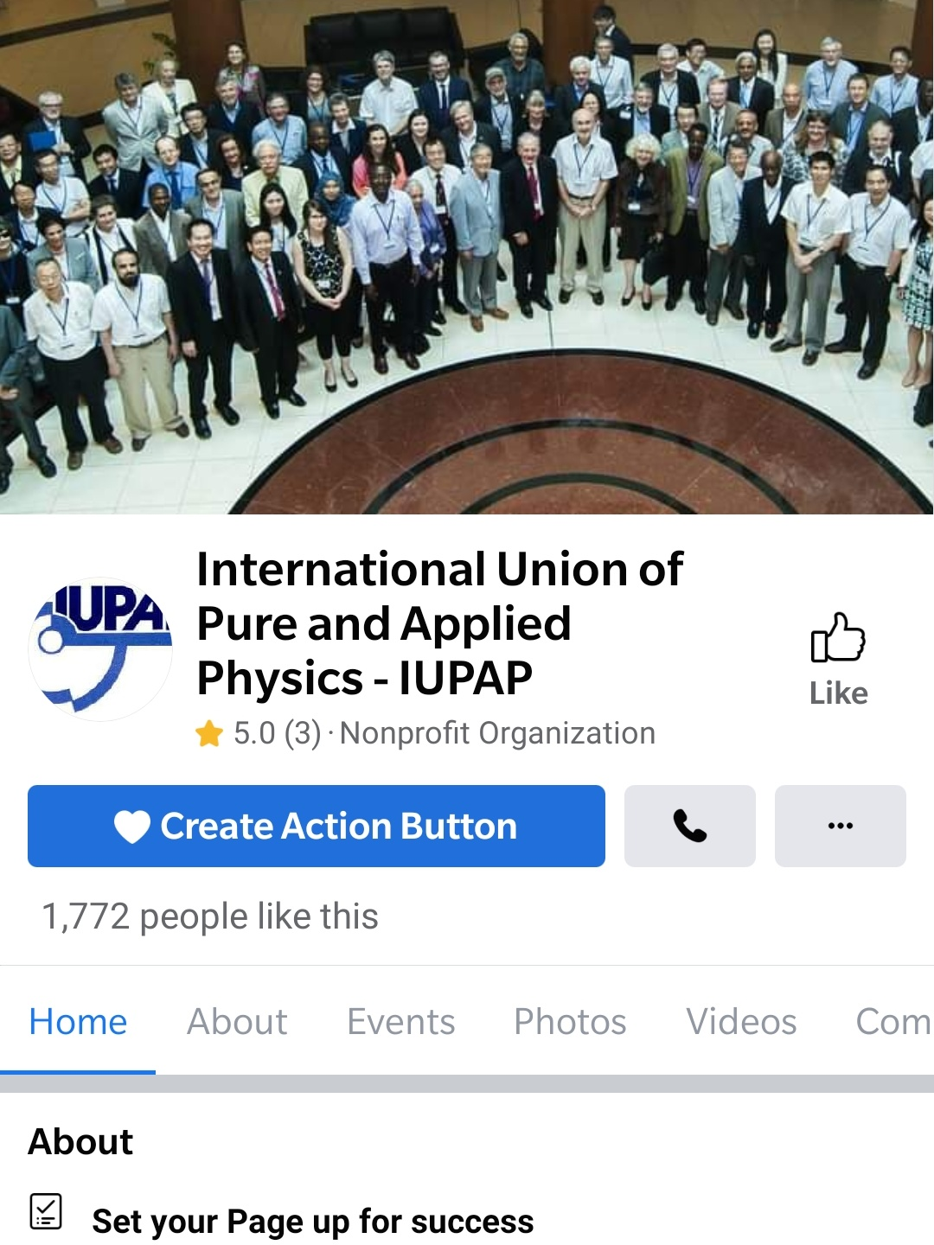
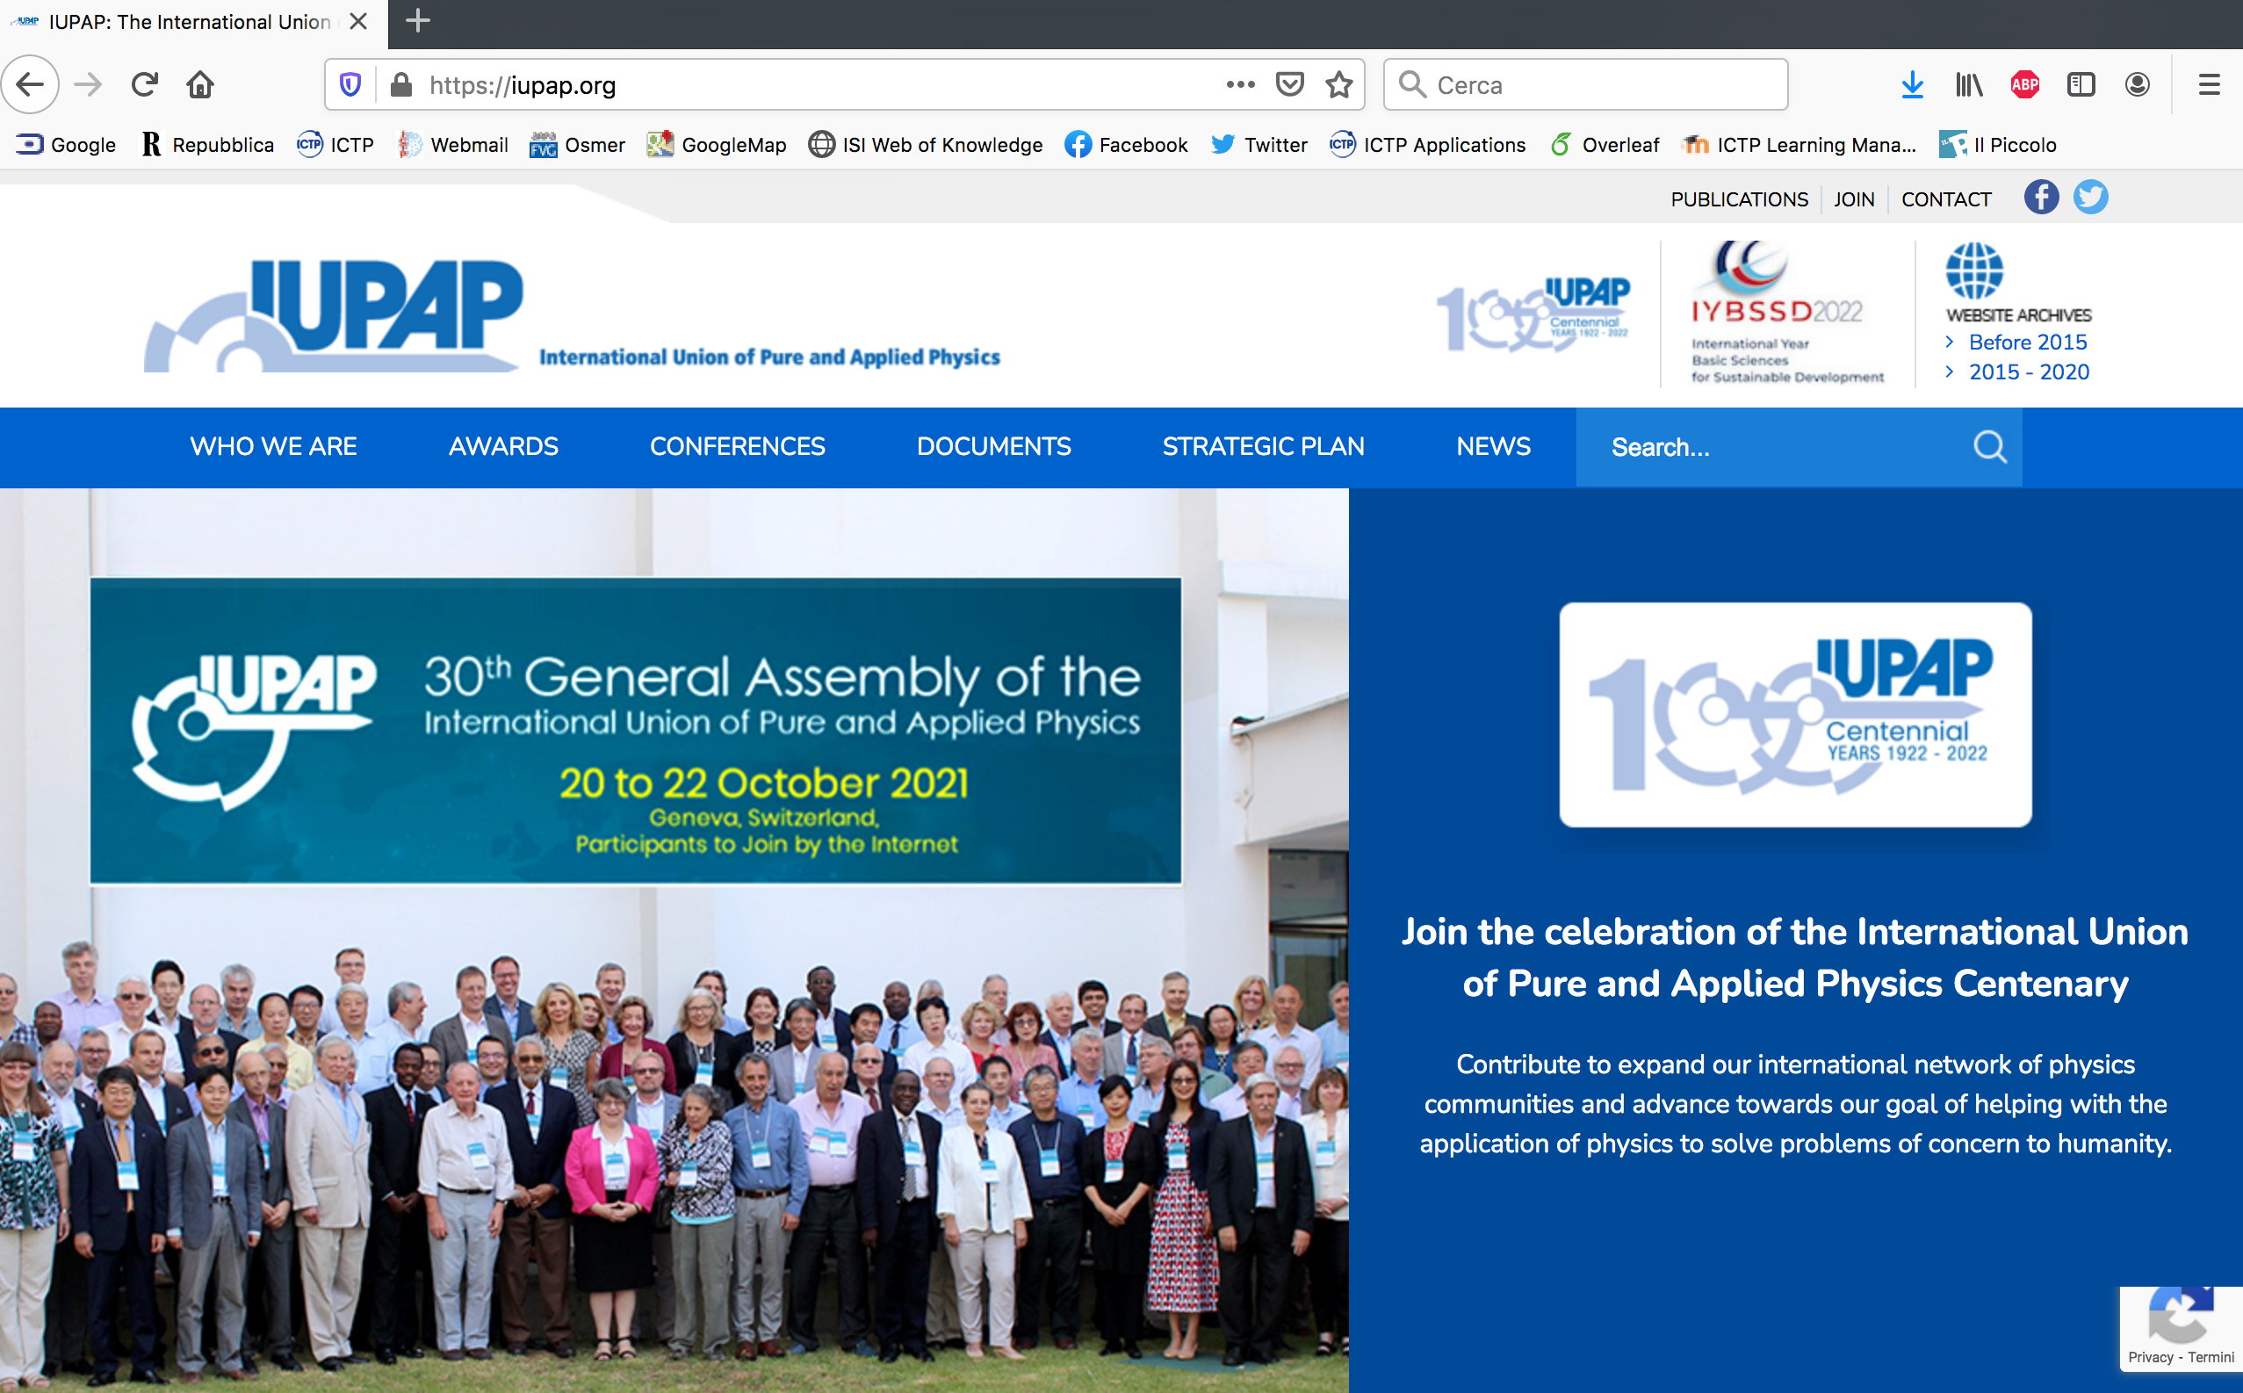




IUPAP Communication EC&CC October 2023
Francesca Zavino
communication@iupap.org

Slide 2
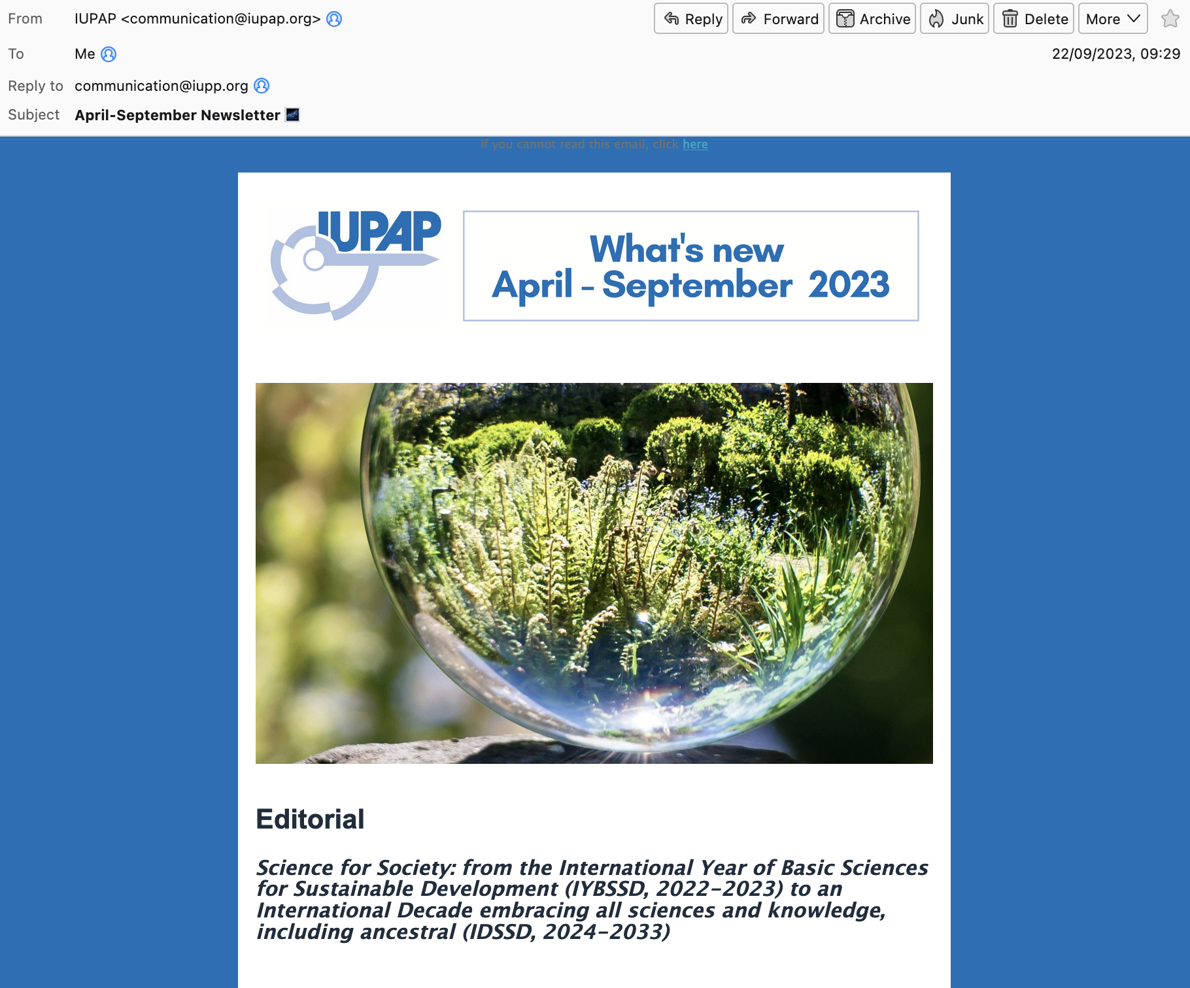
IUPAP Communication
e-Newsletter
Quarterly e-newsletter
pdf posted on website
898 email addresses

Slide 3
IUPAP Communication
e-Newsletter contents
Q2 - 2023
Editorial
Science for Society: from IYBSSD to IDSSD
8th IUPAP Conference on Women in Physics India, July 10-14 2023
Meet our team
StatPhys29 – Florence (Italy), July 13-18 2025
The African School of Fundamental and Applied Physics (ASFAP) - by Kétévi A. Assamagan
IUPAP Early Career Scientist Prize 2023
IUPAP Open Calls
Q3 – 2023 (to be issued by end of October)
Editorial
The 2023 Nobel Prize in Physics - by Philippe Balcou (C17)
100 years from first IUPAP GA
IUPAP Early Career Scientist Prize 2023
Calls: C13 Medal,
Meet the Team
....

Slide 4
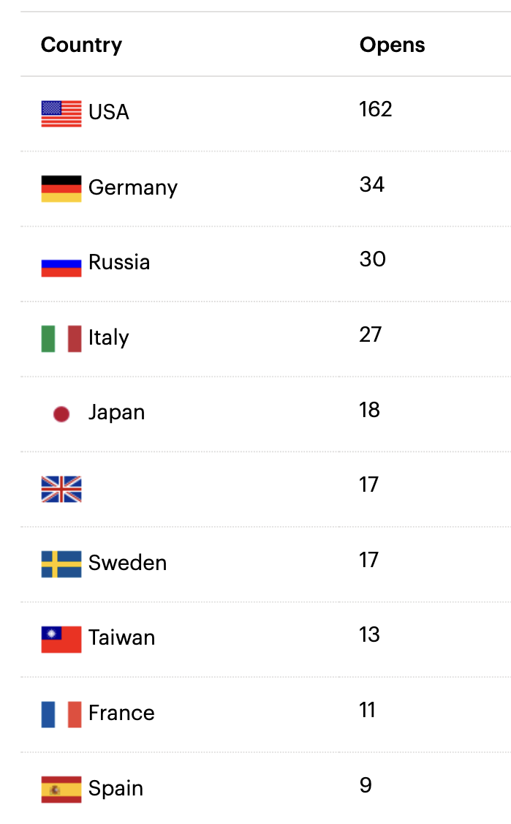
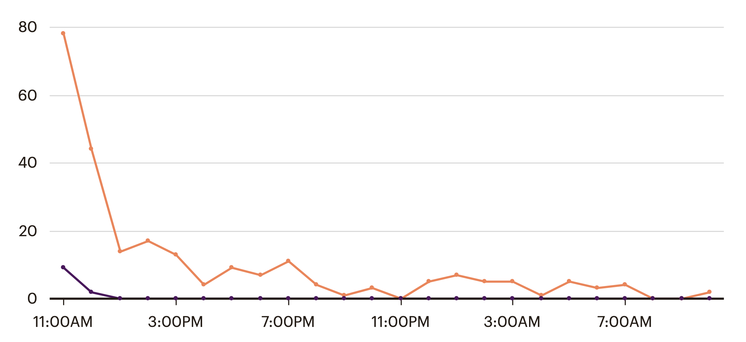
IUPAP Communication
e-Newsletter
898 email addresses
. 55% opened
. 13% clicked on link
Opened
Clicked
24 hours

Slide 5
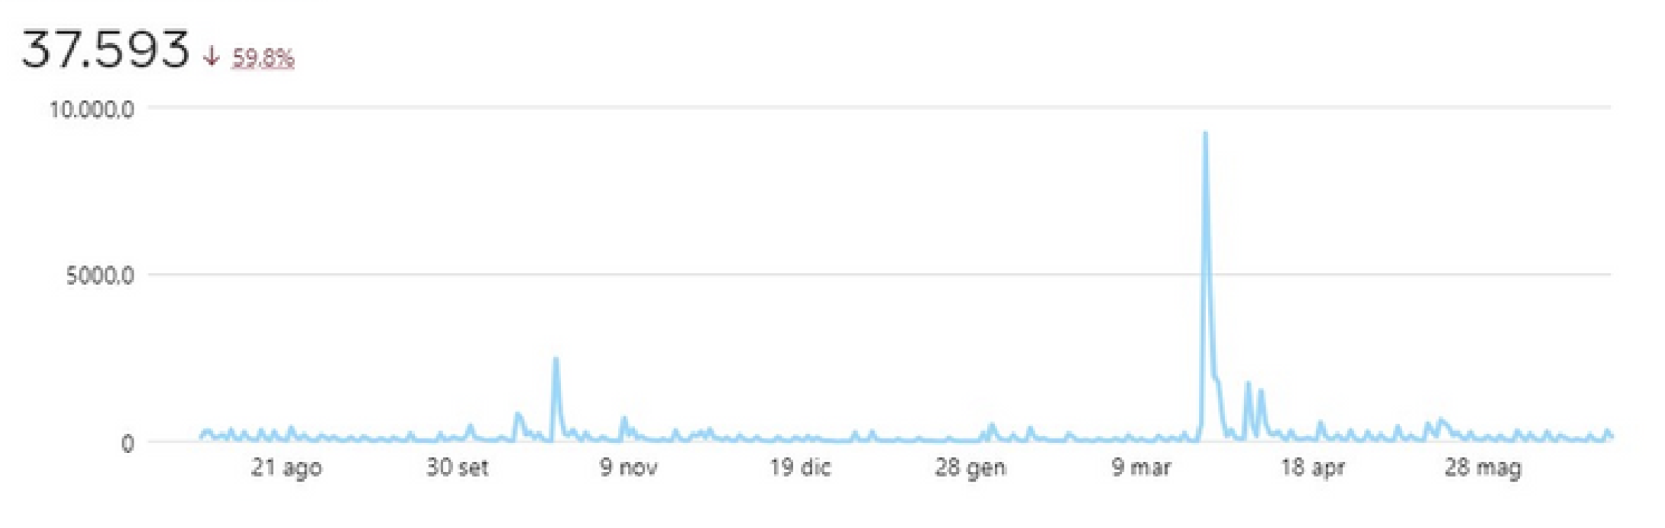
IUPAP Communication
Facebook page
Regular Facebook posts (2-3/week)

Slide 6


IUPAP Communication
Social media
Facebook: followers: 1772 (jun 2022) => 2786 (jun 2023)
Twitter (now “X”) account re-activated (810 -> 1381 followers, 122K impressions)
LinkedIn (741 followers)
Collaboration with communication teams at other organizations (ICTP, CERN, IYBSSD, other Unions, etc) for post re-sharing

Slide 7

IUPAP Communication
Website
Updated by communication team
Commissions/AC/WG are responsible for their content on website
-> please send your content/updates to communication@iupap.org
Francesca
Hari
Silvina

Slide 8

IUPAP Communication
Homework for you (especially Chairs)
Please send us (to communication@iupap.org):
  Content updates for website from Commissions / AC / WG
  Newsworthy updates (e.g. conferences, events) - send pics & brief text
  Early Career Scientist Prize winner information (and other awards)
  Any other suggestions to improve the communication
Please help us sharing news on social media and involving local communication officers when relevant
«Outcomes» of General Assembly on newsletter and news/social media

Slide 9
IUPAP Communication
Who’s who
Francesca Zavino
A special thanks to Hari Haran (GRAPES-3 experiment, Tata Institute of Fundamental Research)
Both featured in newsletters («Meet the team»)
communication@iupap.org: News and web items
[managed by Francesca Zavino]
secretariat@iupap.org: All types of «business» messages
[managed by Gabriella Marra, read by entire EC]

