Slide 1


Report to IUPAP, September 2023

Slide 2
Background
Issues around climate change are set to grow in the coming years.
Global problems require a global effort.
While it’s a transdisciplinary endeavour across all sciences,
  Including basic sciences, engineering, human and social sciences, law, health sciences, and many others,
The 2021 Nobel Prizes emphasised that there are roles for physics.

Slide 3
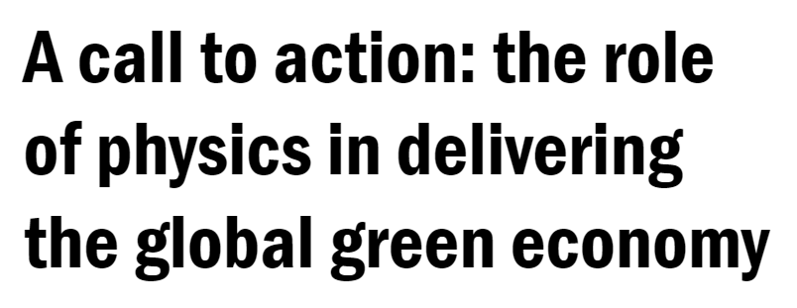
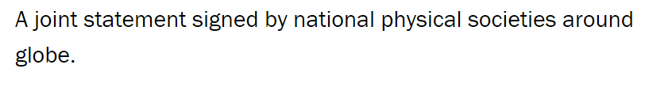




Alignment
There is alignment with, among others,
IYBSSD, the International Year of Basic Sciences for Sustainable Development, Chair of Steering Committee: Michel Spiro, https://www.iybssd2022.org/
The call to action issued by IoP, the Institute of Physics, London https://www.iop.org/strategy/physics-climate-change-sustainability/global-green-economy
The long-standing actions of ISC, the International Science Council https://council.science/publications/the-international-council-for-science-and-climate-change/
The proclamation by the United Nations General Assembly of 2024 to 2033 as the "International Decade of Sciences for Sustainable Development (IDSSD) https://www.iybssd2022.org/en/an-international-decade-of-sciences-for-sustainable-development/

Slide 4
Proposal to establish a new Working Group on Physics and the Green Economy:
supported by the General Assembly on 14 July 2022
approved by the IUPAP Executive Council on 21 September 2022

Slide 5
The task of the WG is to promote and grow the unique role that physics is, and should be, playing in the green economy, climate change and sustainable development.

Slide 6
Current members
We are still in the process of completing the appointments to the WG21
Low- and low-middle income countries and island states must be represented.
Bringing diverse voices to the table is critical.
Prof Nithaya CHETTY | South Africa | Chair, IUPAP VP Membership and Development
Prof. Irvy (Igle) GLEDHILL | South Africa | Secretary; Past Chair, IUPAP Working Group on Women in Physics
Prof. Fida KHATTAK | Pakistan | Pak-Austria Fachhochschule: Institute of Applied Sciences and Technology
Dr. Hyunjung LEE | Korea | Korea Institute of Fusion Energy
Prof. Jon SAMSETH | Norway | Chair SCOPE - Scientific Committee of Problems of the Environment; member, IUPAP WG6 on Energy; chair, IUPAP WG12 on Energy
Prof. Jean-Louis SCARTEZZINI | Switzerland | Former Director, Director of EPFL Solar Energy and Building Physics Laboratory, École Polytechnique Fédérale de Lauzanne
Dr. Tomás M. SINTES | Spain | University of the Balearic Islands, Palma de Mallorca
Dr. Gry TVETEN | Norway | Expert Analytics AS, Oslo
Prof. Carolina VERA | Argentina | Vice-Chair of WG1 Bureau of the IPCC (Intergovernmental Panel for Climate Change) 2016-2023; Director, Argentinean-French Institute for Climate Studies and its impacts

Slide 7
Meetings
For the present, the WG meets virtually.
First meeting: 4 September 2023.
  Introductions to gaps relevant to physics were presented by Carolina Vera, for Climate science, and by Jon Samseth, in sustainable energy
  The working group engaged with the aims of the working group,
  proposed a name including Physics, Climate Change, Sustainable Development,
  We are confirming the Terms of Reference as a group.
  We will converge on a list of activities by the 2nd meeting.
Second meeting will be before the end of 2023.
We will develop a communications strategy for WG21.

Slide 8
WG21 is planning a major conference in 2025/26.
we will run an international bid to host the conference,
and the organisers will be expected to raise funds from international sources.
It is therefore essential that IUPAP allocates funds for this conference.

Slide 9
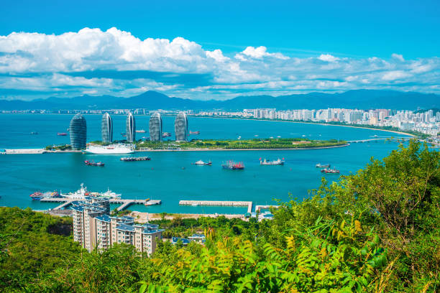
Current activities
A proposal has been made for an Inter Commission symposium in conjunction with the GA in 2024, based on the title “IUPAP Joint Activity for the Future of Planet Earth”. The proposal is made by Pietro Ubertini & Andreas Burkert on behalf of C19.
WG21 is ready to be involved in organising the symposium.

Slide 10
Current activities
Nepal is joining as an IUPAP Associate Territorial Member:
LOWER-MIDDLE INCOME ECONOMIES ($1,136 TO $4,465)
a category with an expectation that the member will undertake to develop physics in its territory
the Nepal Physical Society chose the topic and was organiser
IUPAP assisted with sponsorship, through the International Advisory committee
Under aegis of WG21.

Slide 11
