Slide 1

Gender Champion Report
October 2023
Dr Gillian Butcher
University of Leicester, UK
IUPAP Vice-President: Gender
Gender Champion Report for IUPAP C&CC Meeting 6th October 2023

Slide 2
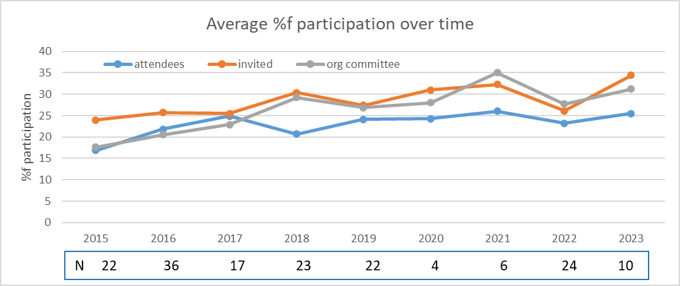
IUPAP Conferences Report
164 conferences over 9 years
Conference organisers return information on:
Number of attendees, female attendees
Number of invited speakers, female invited speakers
Number on organising committee, females on org c’ttee
2020/21 all online
2022 online, in person, hybrid

Slide 3
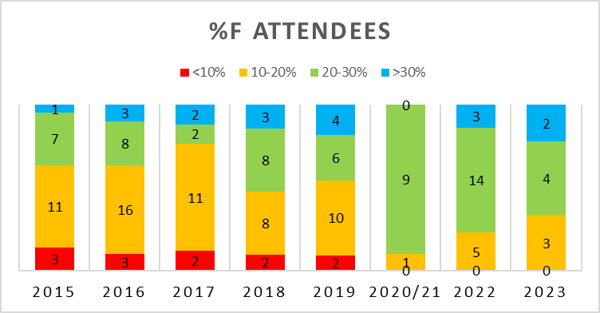
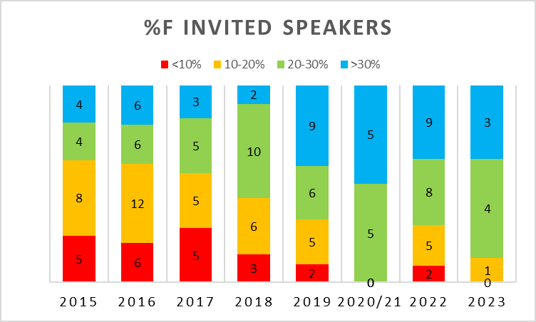
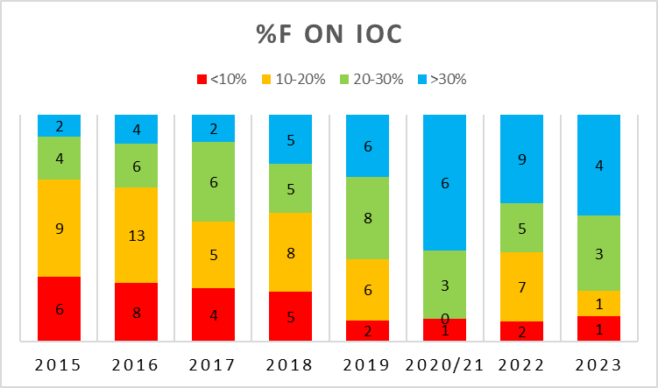
Normalised number of conferences: %female participation
>30%
20% - 30%
10-20%
<10%

Slide 4
Conference Reports
All reports nominated a person to act as adviser in harassment issues.
Diversity talks: in 2022, 5 conferences (out of the 24) and to date for 2023, 3 out of 9 conferences:
  plenary talks on diversity/EDI/Gender in STEM,
  panel discussions on EDI topics,
  a networking breakfast for women
  social media campaign and lounge as a safe space to discuss diversity.
Other topics have included sustainability and ethics talks and also having digital posters alongside physical posters, for accessibility.

Slide 5
Conference Reports: Travel Assistance
Form asks for numbers assisted, individual amounts and total amount.
2020/21 conferences - all online:
  waive the registration fee
  assistance for those who reside in developing or disadvantaged countries.
2022 conferences - some hybrid. 18 out of 24 reported providing assistance
2023 conferences – 1 hybrid. 8 out of 9 provided some level of assistance
  waiving or reducing of registration fees,
  supporting flights and accommodation and subsistence
  supporting students
Encourage conferences to provide technology or accessibility grants

Slide 6













SCGES
Standing Committee on Gender Equality in Science
23 organisations signed MoU (as of Sept 2023)
One representative from each partner organisation
IUPAP rep: Gillian Butcher
and Deputy
IUPAP Deputy rep: Rudzani Nemutudi
~€300 per partner annually
Annual Report imminent

Slide 7
SCGES Aims
Helps partners to promote gender equality within their organizations, and in particular
Follows the progress of the implementation by partners of the recommendations of the Gender Gap in Science Project;
Endorses projects and initiatives to promote gender equality in science proposed to it by partners;
Facilitates communication among partners, among other things by developing and maintaining a website.
Website gender-equality-in-science.org
Twitter account SCGES@_SCGES_

Slide 8
SCGES Activities
Webinar Series
Developing and Enacting Codes of Conduct in Professional Unions:
  IUPAP Codes and requirements
  IUCr CoC – guide, support, message
  IUPESM Ethics as part of Engineering Education and Profession
Gender Equality and Beyond in the Polar Sciences July 2023
How to Evaluate and Reduce the Gender Gap in Science Feb 2023
  hybrid meeting, combined with Global Womens Breakfast
Website gender-equality-in-science.org
Twitter account SCGES@_SCGES_

Slide 9
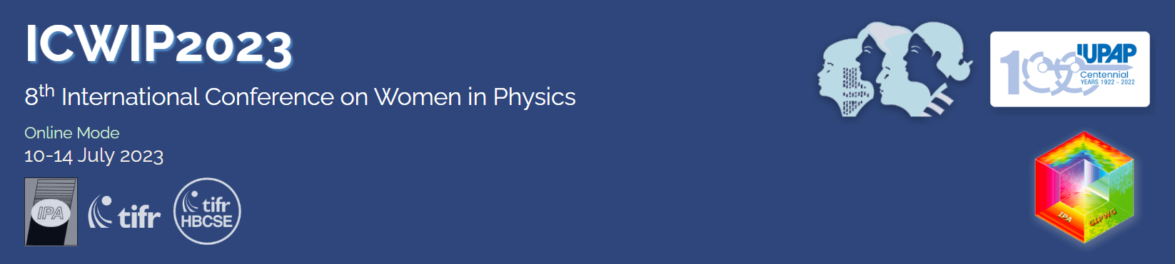
WG5 / ICWIP 2023
Gender Champion is ex-officio member of WG5
ICWIP2023 July, hosted by India
plenary talk on IUPAP by Silvina
Waterloo Charter
Beyond Gender
Session at Centenary Symposium
ongoing discussions
embed within IUPAP restructuring

