Slide 1
IUPAP 2022 ACCOUNTS
Singapore and Geneva

Slide 2
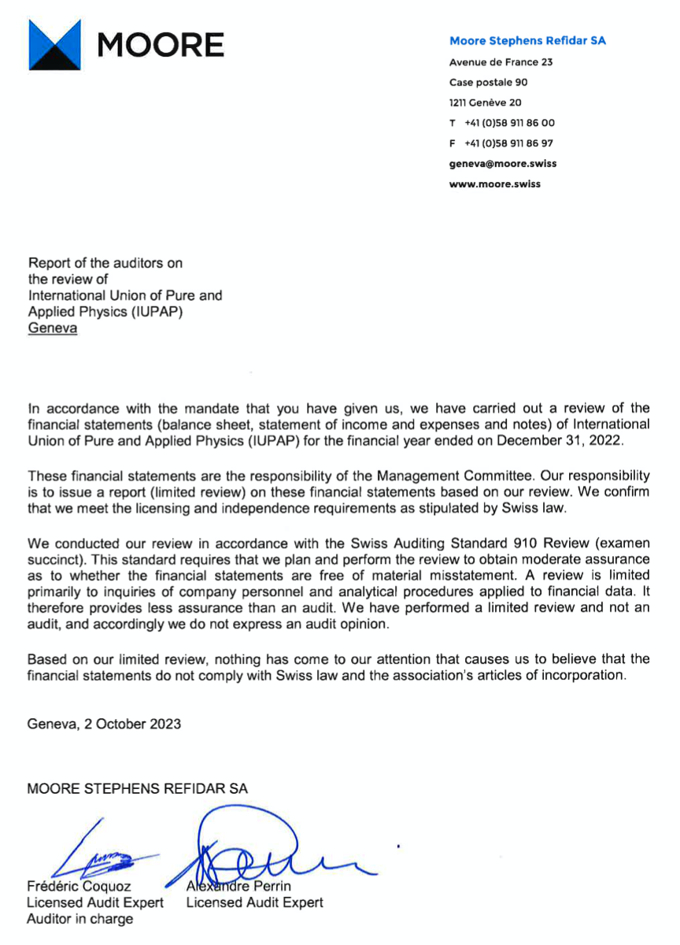

Slide 3
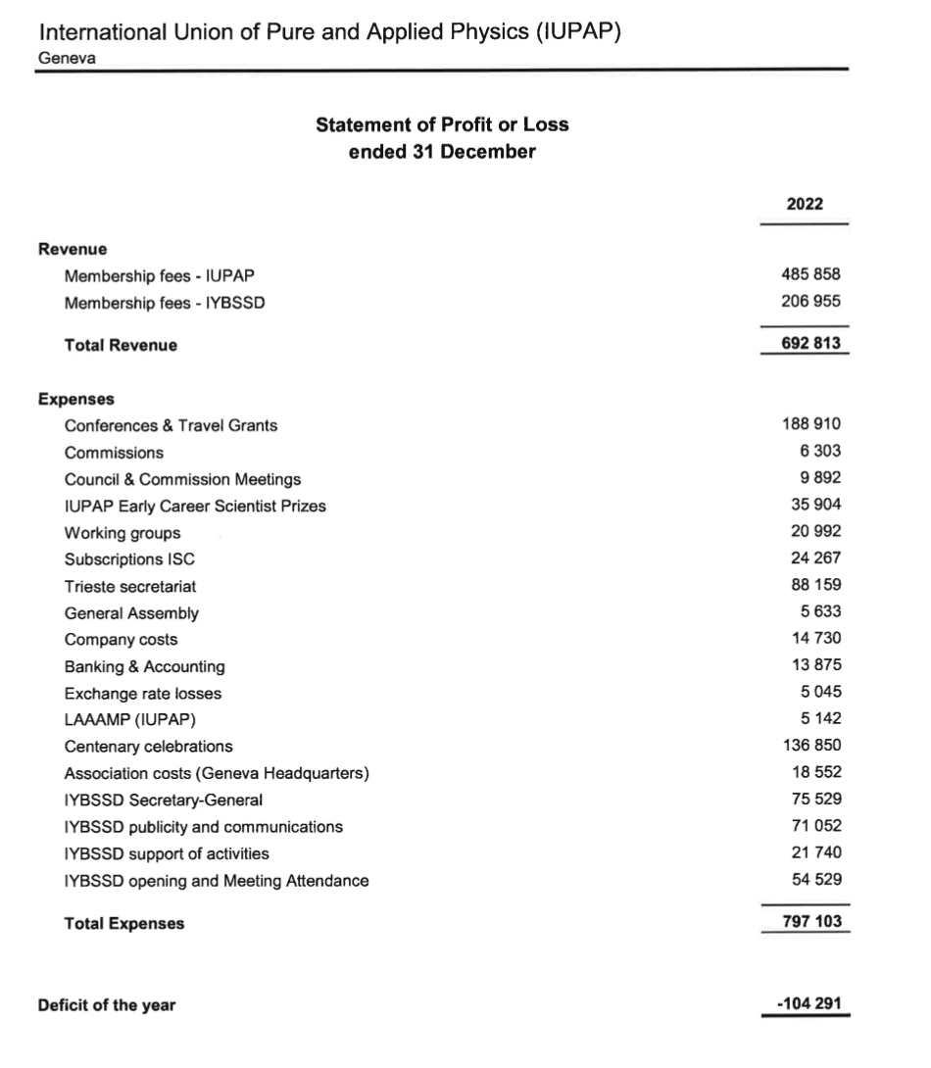

Slide 4
