Slide 1



IUPAP Administrative Office in Trieste
Stefano Fantoni
(IUPAP Secretary General for Administrative Affairs, FIT President)

Slide 2
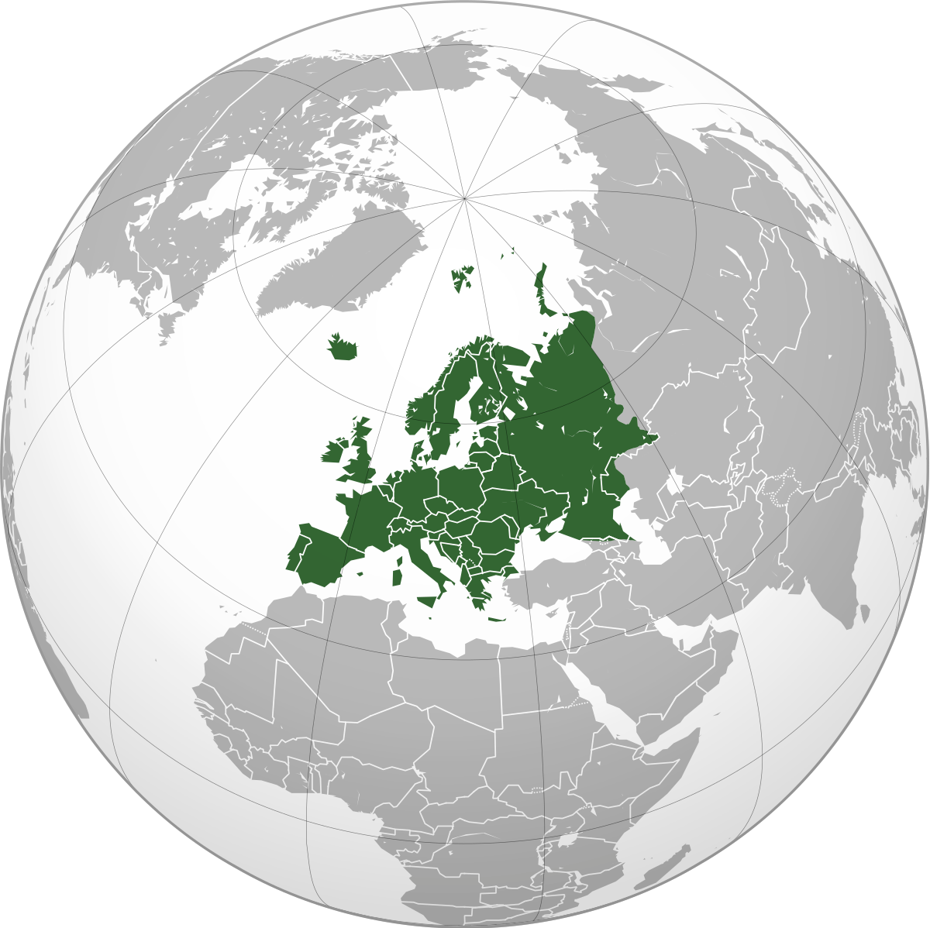
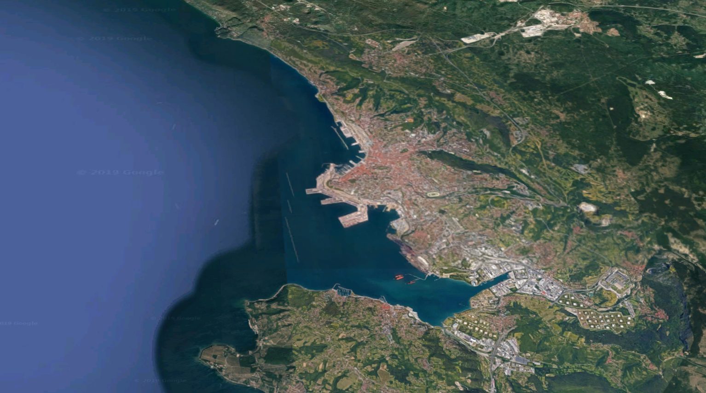
The “Trieste Science System”
TWAS
OGS
ICTP
More than 150,000 physicists have visited ICTP from all over the world
Trieste is the city with the highest density of researchers in Europe
Trieste was the European City of Science 2020
Hosts the National synchrotron radiation facility (Elettra)
The largest national Science Park
SISSA
Univ of
Trieste
Area Science Park
ICGEB
CNR
Elettra

Slide 3
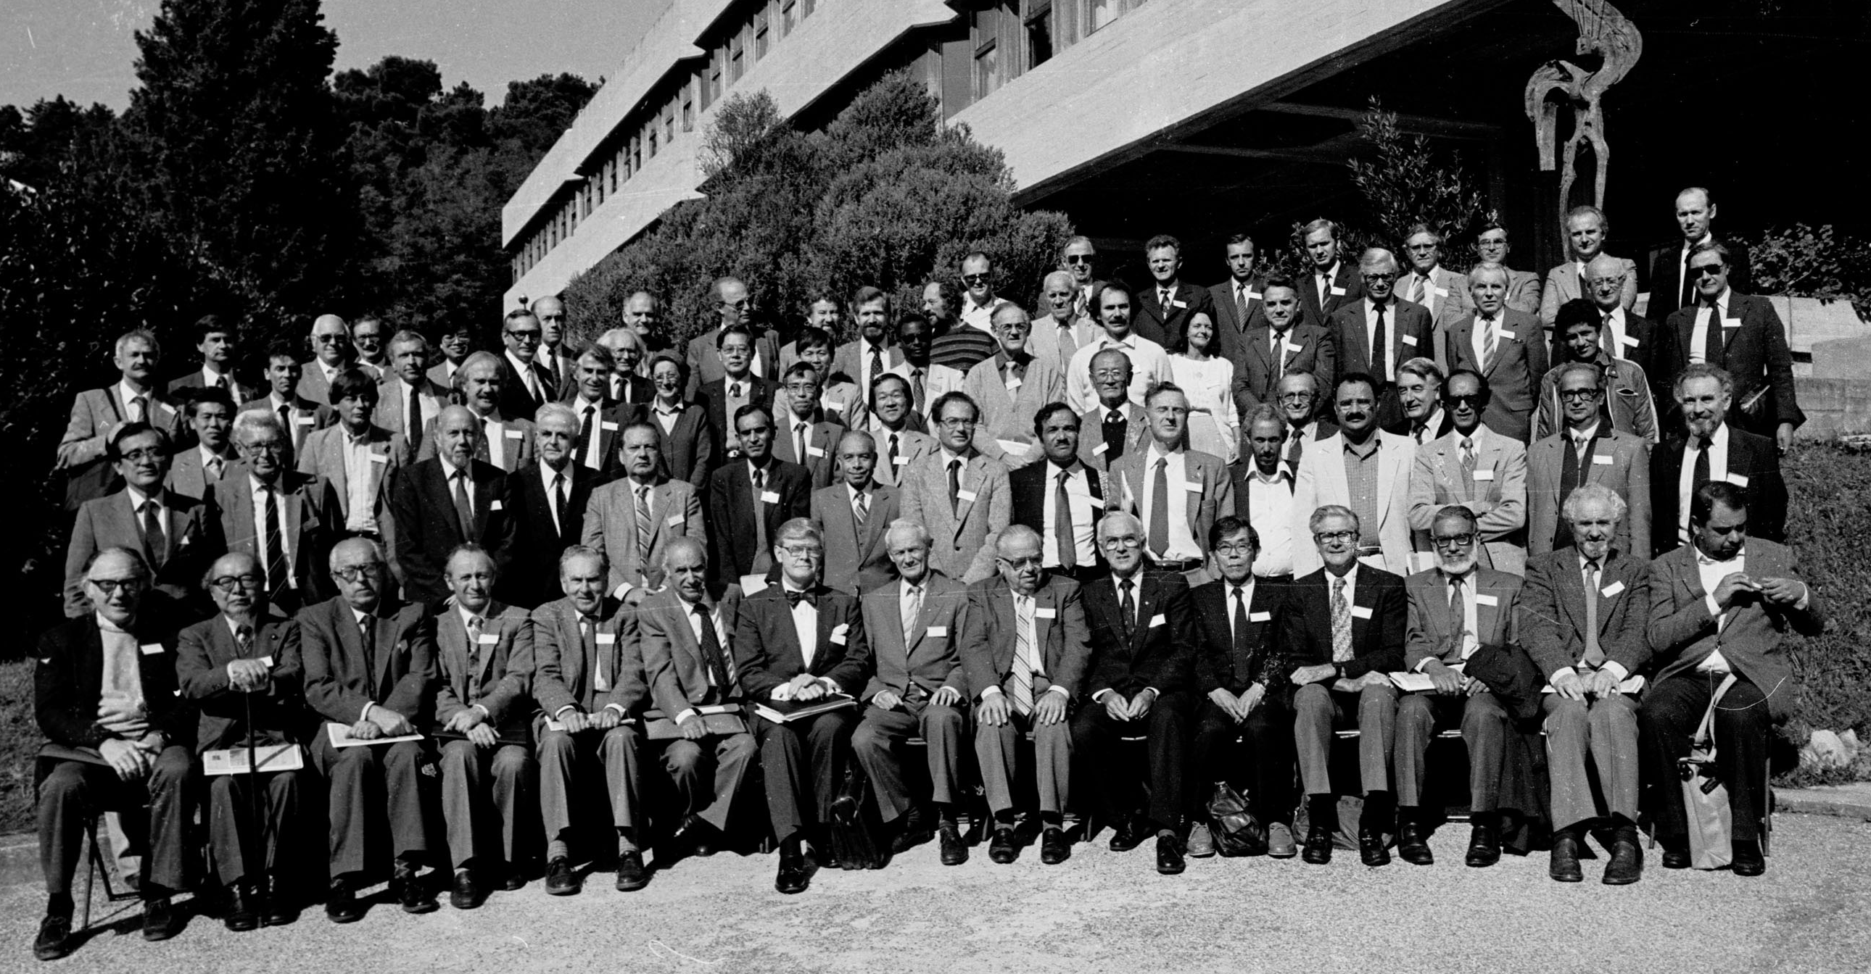
IUPAP General Assembly 1984 at ICTP

Slide 4
The Trieste International Foundation for Scientific Progress and Freedom (FIT)
Created in 1988 by Abdus Salam to promote and support the development, freedom and dissemination of science, and its peaceful applications.
FIT is a private-law entity regulated by statute and bylaws. Its legal status is recognized by the Italian Ministry of Education (with no restriction on any country, Taiwan included ).
Members: most Trieste-based scientific institutions, including ICTP, SISSA, TWAS, University of Trieste, the “Elettra” synchrotron radiation facility, etc.
FIT has organized ESOF2020, Trieste European City of Science, and is now in charge of A Laboratory on quantitative sustainability (TLQS)
FIT has signed on 2021 MoU with IUPAP, extended to 2026

Slide 5
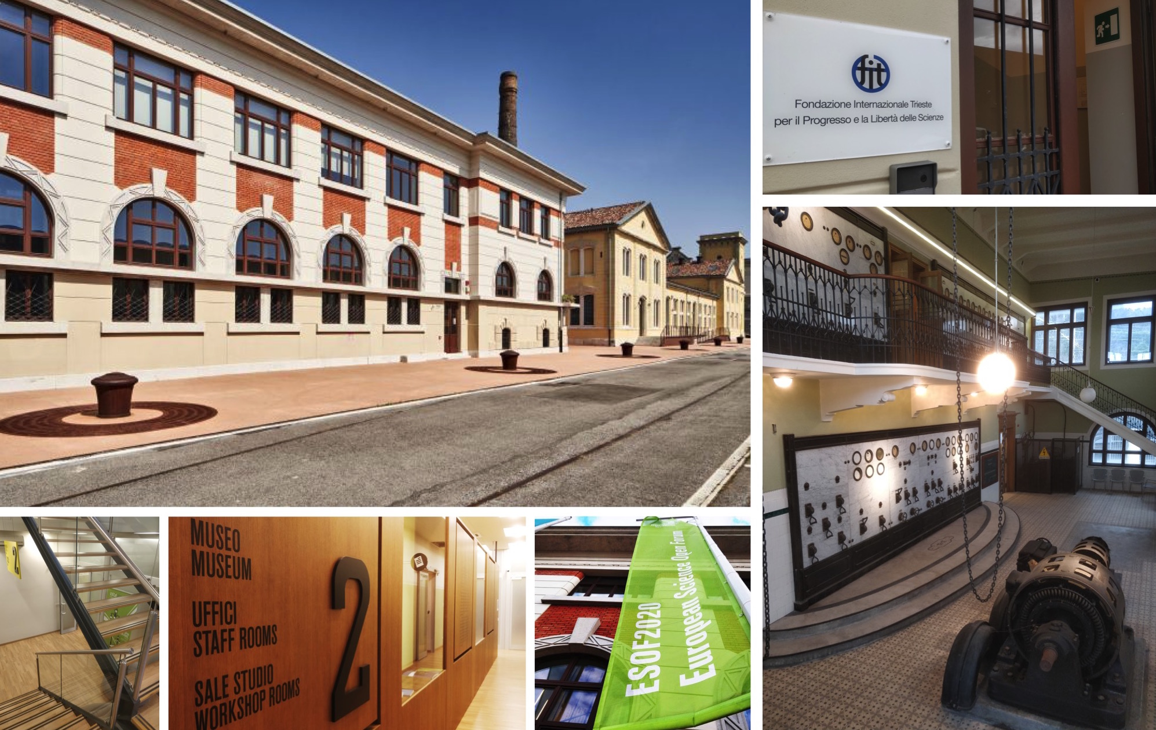
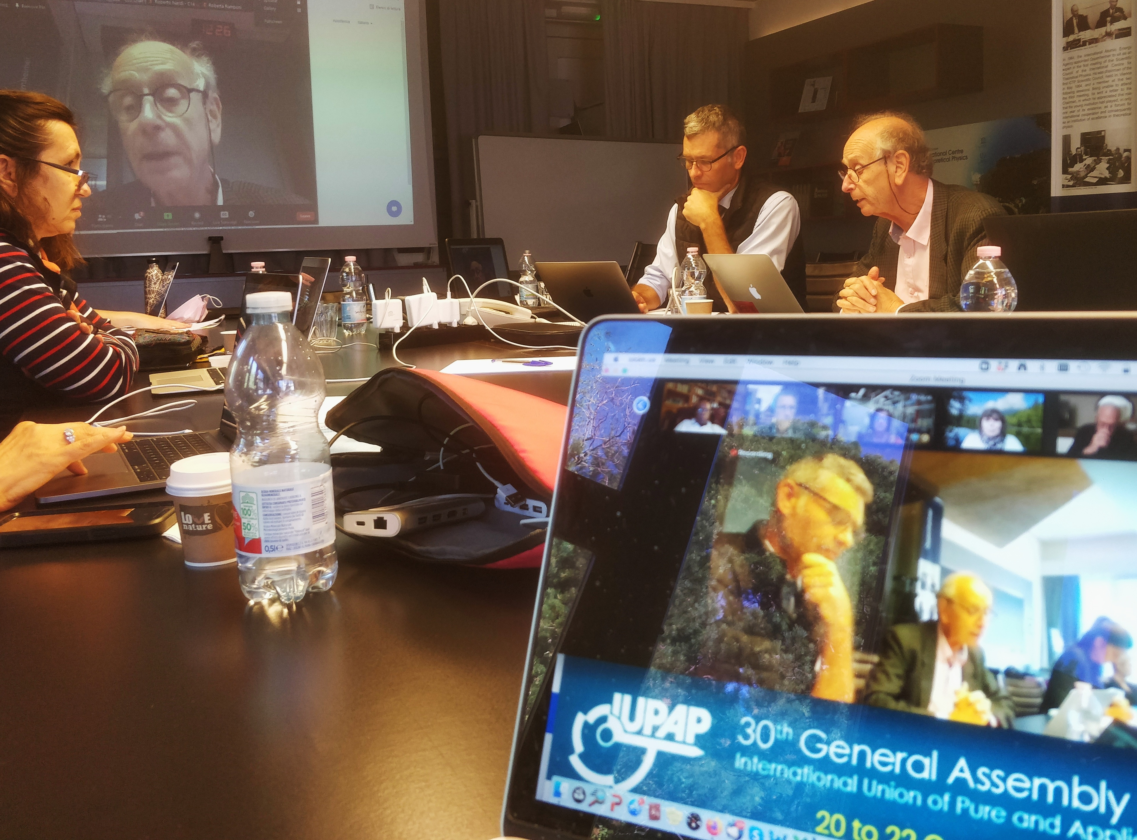
FIT and IUPAP
In 2021 IUPAP moved its administrative offices in Trieste, maintaining an office and a discussion room at the second floor of Sottostazione elettrica of Porto Vecchio.
IUPAP events held in Trieste:
2021: General Assembly
2022: IUPAP Centenary (with EC&CC and GA)

Slide 6

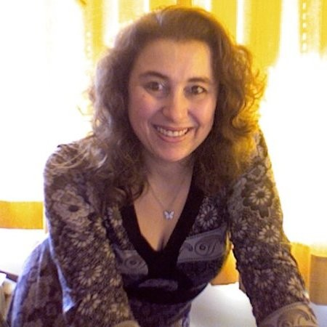

IUPAP team in Trieste
Stefano Fantoni Secretary General for Admin Affairs
Sandro Scandolo Deputy Secretary General
Gabriella Marra IUPAP Secretary
(Transition of administrative tasks from Cecilia
Cressi completed in May 2023.)
Ariella Kranjek FIT Secretary
Francesca Zavino Communication
Contacts:
secretariat@iupap.org (all administrative matters)
communication@iupap.org (Web updates, newsletter, etc.)

Slide 7
FIT and IUPAP: Main activities 2023
Work side by side with the General Secretary for Legal and Financial Affairs;
Support to IUPAP official meetings;
Support to all processes related to Conferences and Awards;
Database preparation, invoicing, dues, payments, assistance in analyzing statements and all administrative matters.
Matters related to possible corporate members (BSBF2024) and to sustainability research (TLQS)
COMMUNICATION (Sandro Scandolo on Friday)
  (website, newsletter, social media management)

Slide 8
IUPAP Administrative Office in Trieste
Thank you.

