Slide 1

Membership matters (10min)
Nithaya Chetty
Vice President – Membership and Development
With Support from Jens Vigen and Igle Gledhill
Report to the IUPAP EC&CC Oct 2023

Slide 2
Current situation
About 65 members (195 countries, i.e., 1/3 global membership)
Cannot afford loss in membership
  For the time leading to the Centenary Celebration, it was felt that IUPAP should be lenient in dealing with defaulting members
  However, perennially defaulting members are hereby ‘given notice’ to make arrangements to meet their obligations or else they will be formally excluded at the 2024 GA in Beijing. Jens Vigen to report.
Cannot afford to neglect interests of our paying members
  Must continue with one-on-one engagements on 3-year cycle
  Members must readily see direct benefits
  The work of IUPAP must be communicated to membership and beyond
On-going conversations with many different countries, both old and new
  e.g. Philippines, Peru, Vietnam
Action item

Slide 3
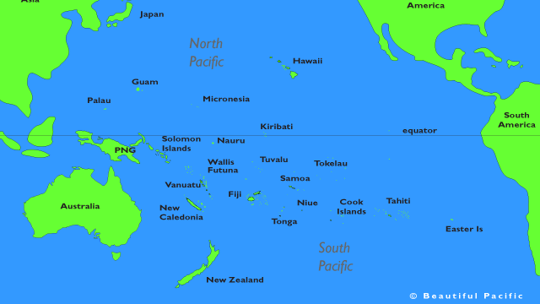

Slide 4
Pacific Island nations
Will be disproportionally affected by global problems
  Climate, energy, food security
  Need a stronger basis for scientific development
  Physics is a lead discipline
  When physics is strong, science is strong
Thanks to
  New Zealand Institute of Physics: David Hutchinson (C13), Gabriel Bioletti (NUS)
  Australian Academy of Science: Halina Rubinsztein-Dunlop; Rosanna Shamshudin, Swastika Devi, Nancy Pritchard, Meaghan Dzundza
  APS: Amy Flatten
  Surya Raghu (UNESCO), Richard Martin (ASESMA)
  IUPAP: Michel Spiro, Jens Vigen, Igle Gledhill, Kwek Leong Chuan

Slide 5
Pacific Island nations
National University of Samoa (NUS) as a regional coordinating institution
  Connecting with Fiji, Tonga and other island nations
Major online meeting Feb 2023, involve all stakeholders
  Island physicists, senior university administrators, government
  Coalition of international partners
Follow up with an in-person planning workshop and a scientific meeting (school, workshop, conference, etc.) at NUS
  Exact format of which is yet to be determined
  Offer various options to the Island physicists and their institutions
Action item

Slide 6
Associate Territorial Membership (ATM)
Jens Vigen to address changes to Articles
10% cost of one share, benefits are limited, spelt out in MoU
Not more than 10% of members should be ATM’s
Member country must commit to programme of physics development (quid pro quo), of mutual benefit
  Not simply a discounted levy
In principle, an open call for applications on website
Nepal is an important test case (see later)
Renewal on 3-year cycle, following submission of a report
  Can morph into full membership
Action item

Slide 7
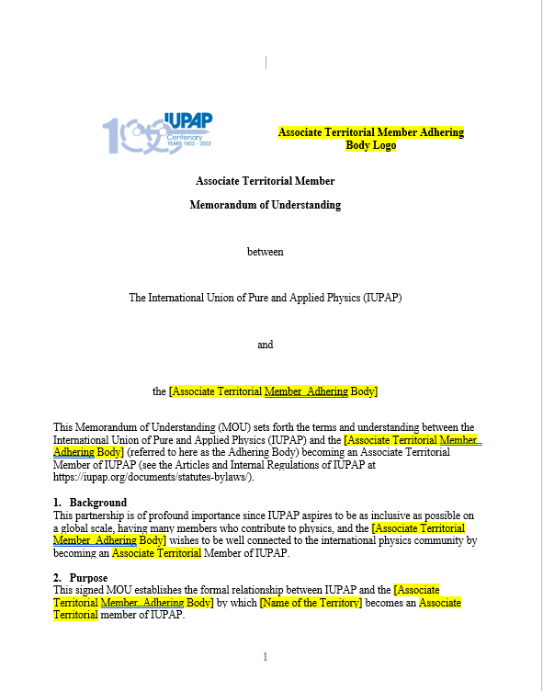

Slide 8
Succession planning
I will rotate off the Council at conclusion of GA 2024
Propose Membership Committee
  To meet quarterly
  I am happy to lend support to new incoming VP Membership and Development
Action item

Slide 9
Candidates to become ATM (15min)
Nithaya Chetty
Vice President – Membership and Development
With Support from Jens Vigen and Igle Gledhill
Report to the IUPAP EC&CC Oct 2023

Slide 10
Nepal
Herculean effort by Nilam Shrestha (President of Nepalese Physical Society)
Led by Igle Gledhill, Jens Vigen, Michel Spiro, NC
International Conference on Physics for Sustainable Energy (ICPSE-2023)
  22, 23 Sept 2023
  Under auspices of WG21
Admitted as the first ATM following approval of changed Articles concerning ATM
Action item

Slide 11
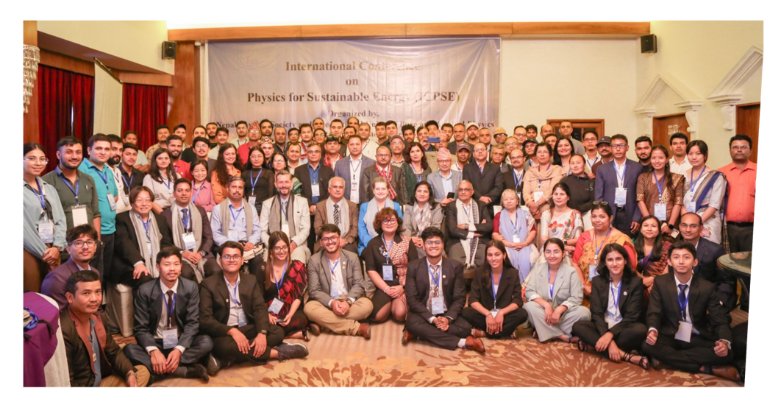
About 90 participants, 20% Women!

Slide 12
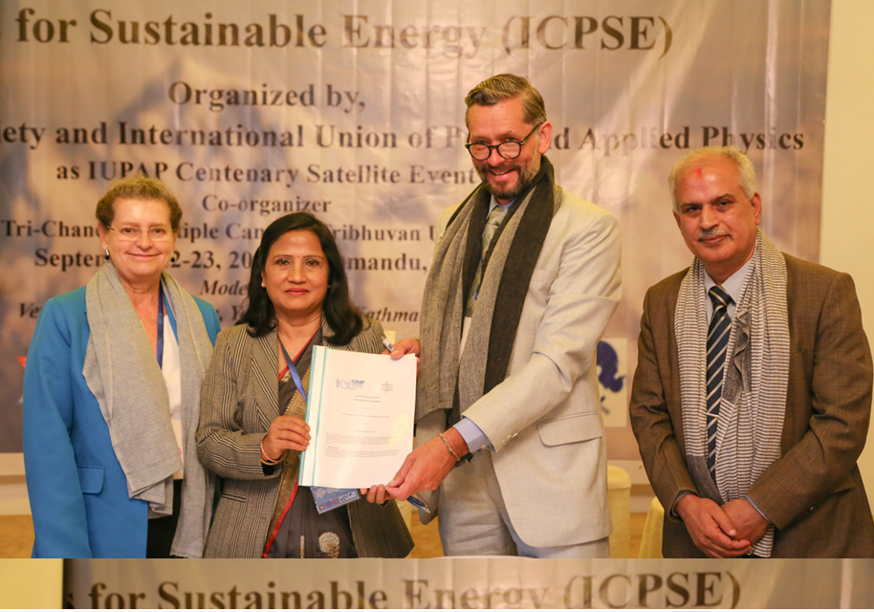
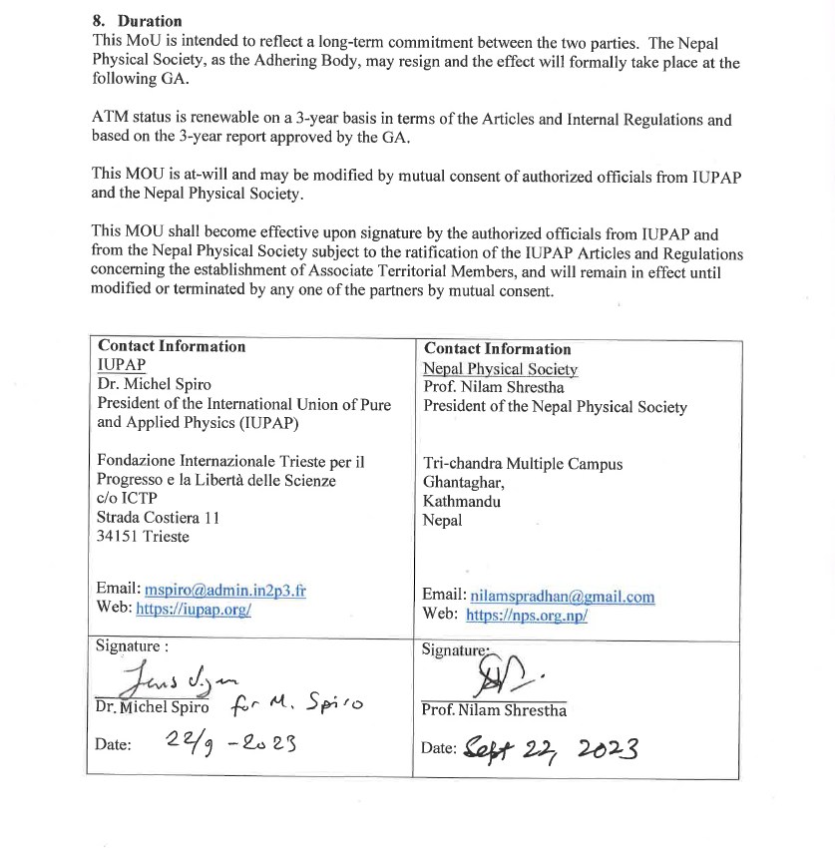
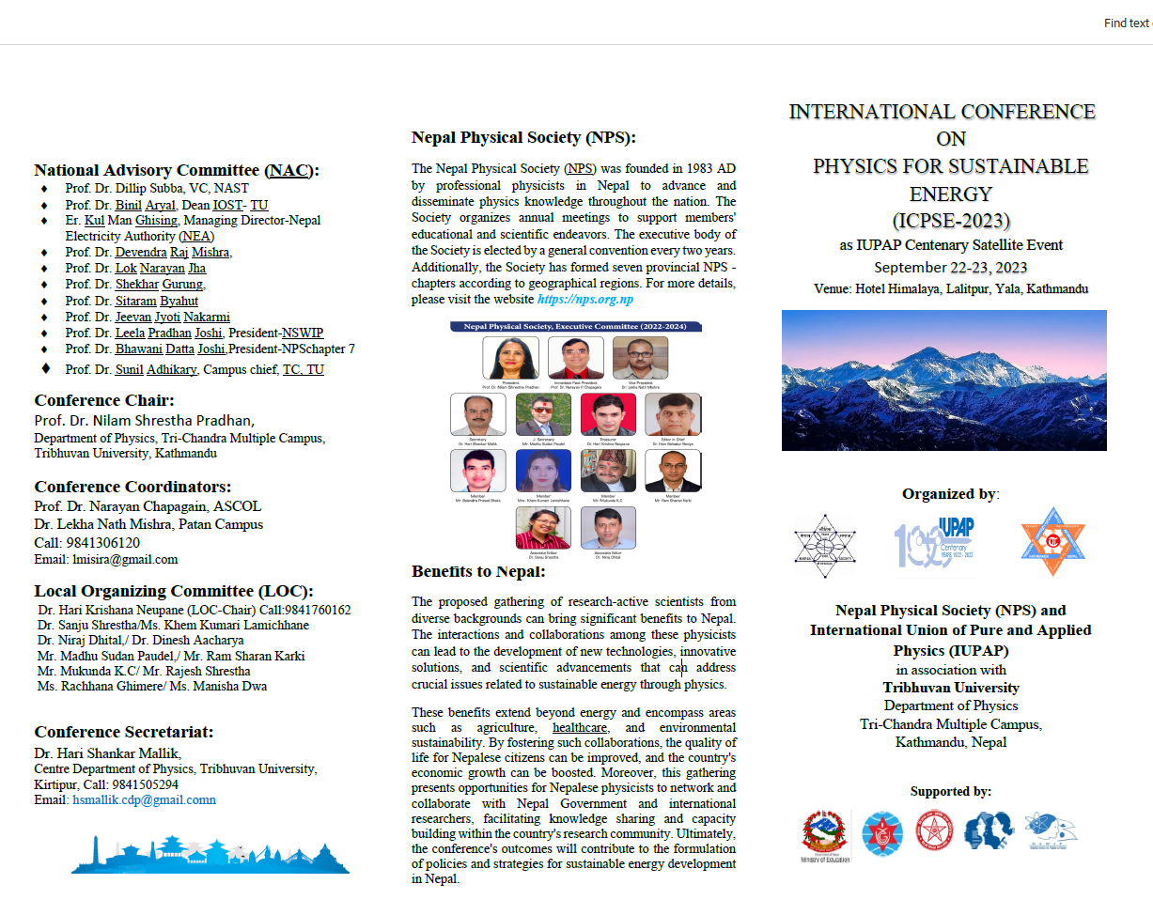

Slide 13
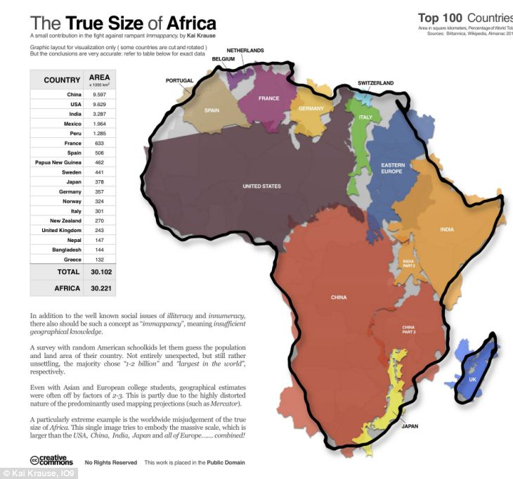
A vast and inhomogeneous continent with much diversity
Anglophone, Francophone, Lusophone
Different cultures, different indigenous languages, different histories, different geographies, different economies, different politics
Not a one-size-fits-all

Slide 14

Proposed regional physical societies in Africa
Jim Gubernatis, Igle Gledhill, NC
Follows on Physics in Africa Project 2016
  APS, IoP, EPS, ICTP, and SAIP
  APN one of the outcomes
Most countries do not have a physical society
We propose working through the heads of physics departments in the region
  Form regional physics co-operative
  A forum and central point of communication and organization
  Pilot programs with Southern Africa led by the SAIP and Eastern Africa led by ICTP/EAIFR
  Secure support from IUPAP, APS, IoP, EPS, etc.

Slide 15
Regional Physics Cooperative of Heads of Physics Departments
Long term Goal: Regional Physical Society
IUPAP ATM
IUPAP Full membership
Action item:
Budget for 2 regional meetings of heads of physics departments

Slide 16
Development of physics and
Physics for Development

