Slide 1

Gender Champion Report
Dr Gillian Butcher
University of Leicester, UK
Gender Champion Report for IUPAP C&CC Meeting 7th July 2022

Slide 2
IUPAP Conferences Report
135 conferences over 8 years
Year | 2015 | 2016 | 2017 | 2018 | 2019 | 2020 | 2021 | 2022
N | 22 | 36 | 17 | 23 | 22 | 4 | 6 | 5
Conference organisers return information on:
Number of attendees, female attendees
Number of invited speakers, female invited speakers
Number on organising committee, females on org c’ttee
2020/21 all online
2022 online, in person, hybrid

Slide 3
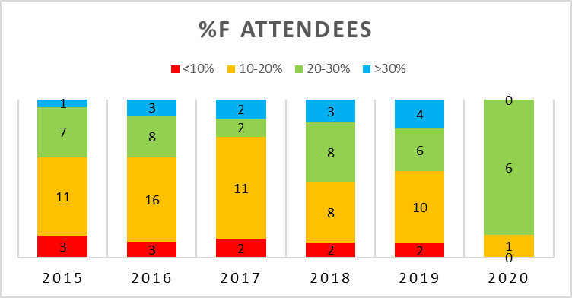
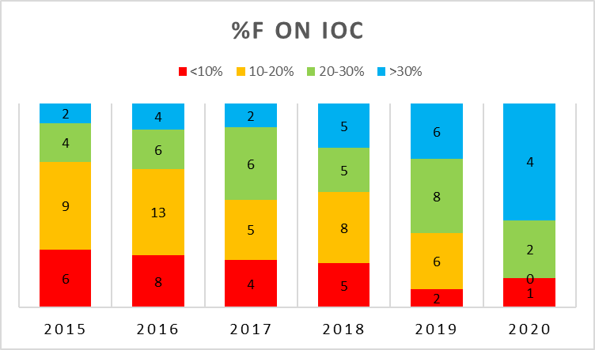
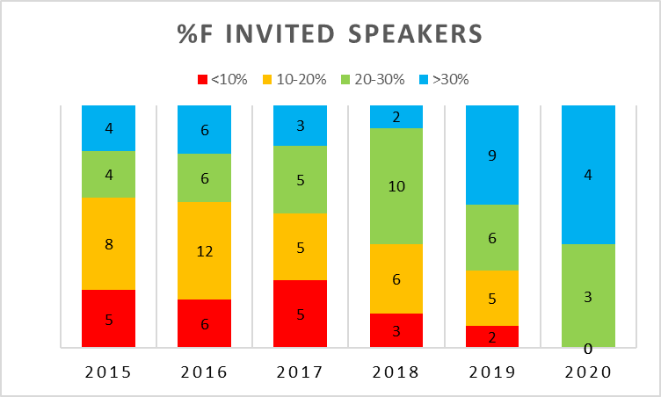
Normalised number of conferences: %female participation
>30%
20% - 30%
10-20%
<10%

Slide 4














SCGES
Standing Committee on Gender Equality in Science
20 organisations signed MoU
One representative from each partner organisation
IUPAP rep: Gillian Butcher
and Deputy
IUPAP Deputy rep: Rudzani Nemutudi
~€300 per partner annually

Slide 5
SCGES Aims
Helps partners to promote gender equality within their organizations, and in particular
Follows the progress of the implementation by partners of the recommendations of the Gender Gap in Science Project;
Endorses projects and initiatives to promote gender equality in science proposed to it by partners;
Facilitates communication among partners, among other things by developing and maintaining a website.
Webinar Series
Website gender-equality-in-science.org
Twitter account SCGES@_SCGES_

Slide 6
Beyond Gender
Centenary Symposium
Session on under-represented groups
Monday 11th July
Panel:
Lilia Meza Montes, Benemérita Universidad Autónoma de Puebla, Mexico - Chair WG5
Pegah Maasoumi, Swinburne University of Technology, Australia
Joe Niemela, ICTP Italy
Chandralekha Singh, University of Pittsburgh, USA

