Slide 1
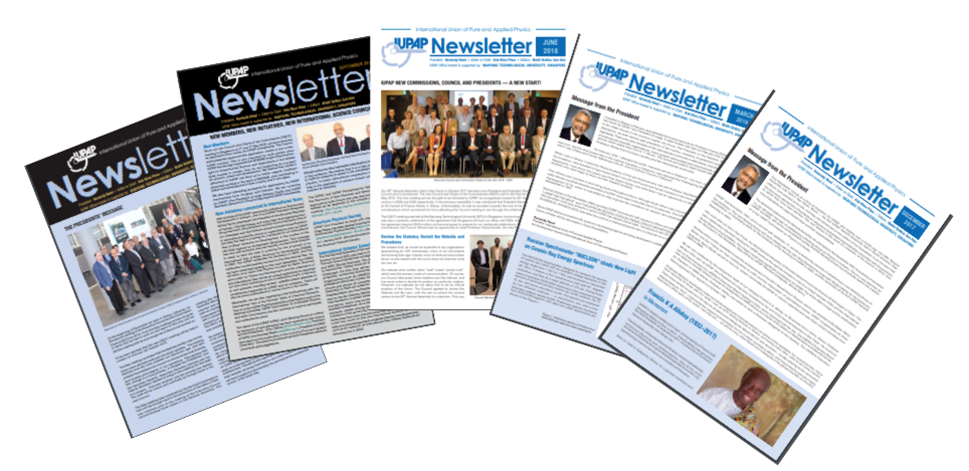
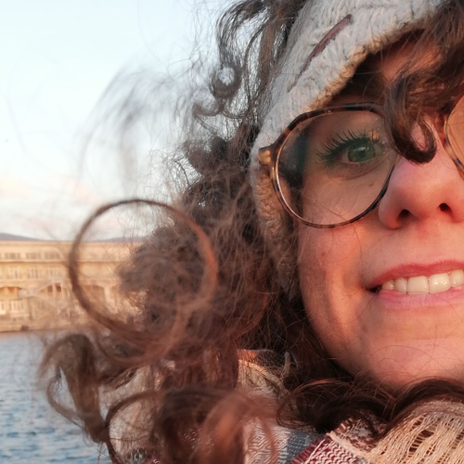
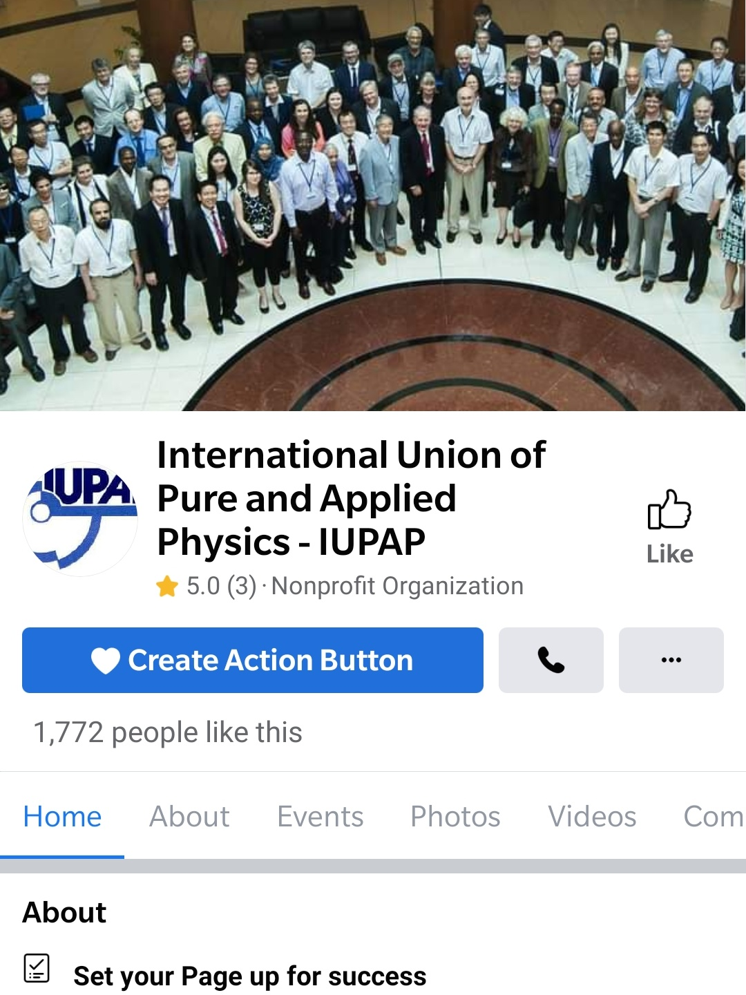
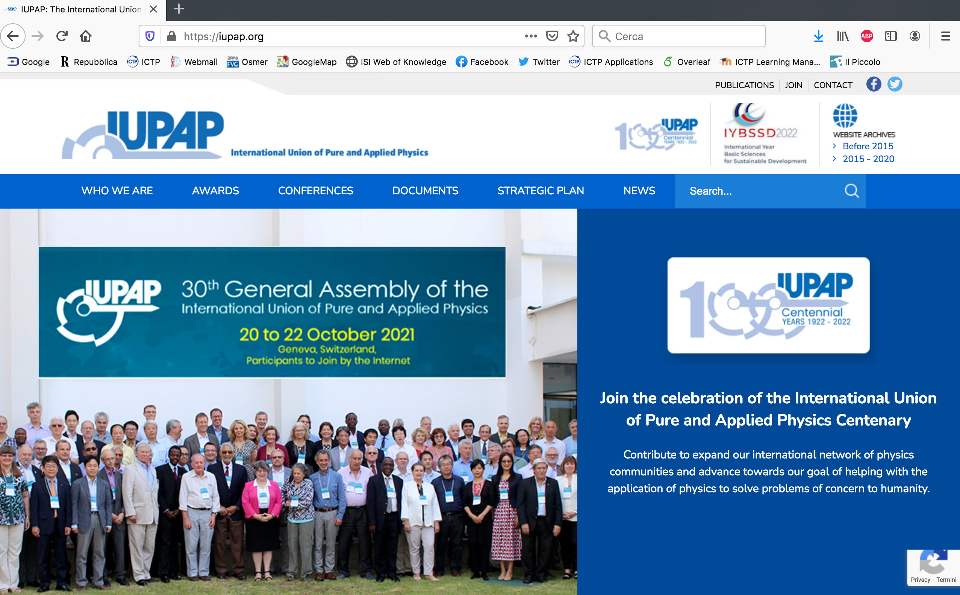



IUPAP Communication – EC&CC July 2022
Francesca Zavino
communication@iupap.org

Slide 2
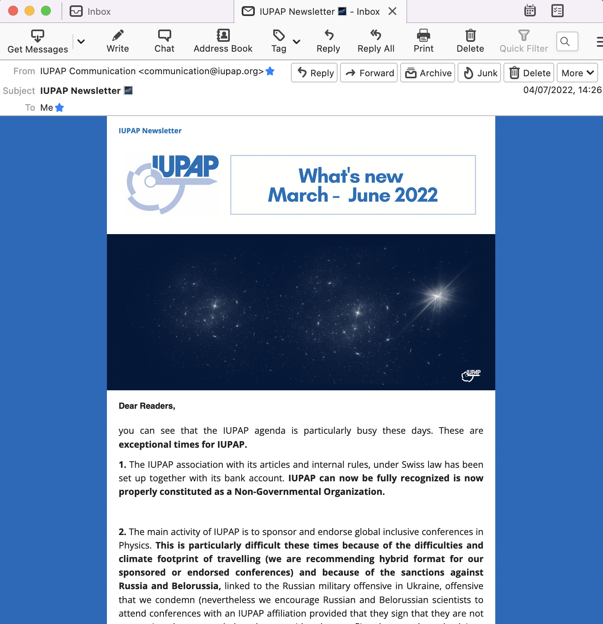
IUPAP Communication
Newsletter
December 2021:
last printed newsletter
March – June 2022 e-newsletter!

Slide 3
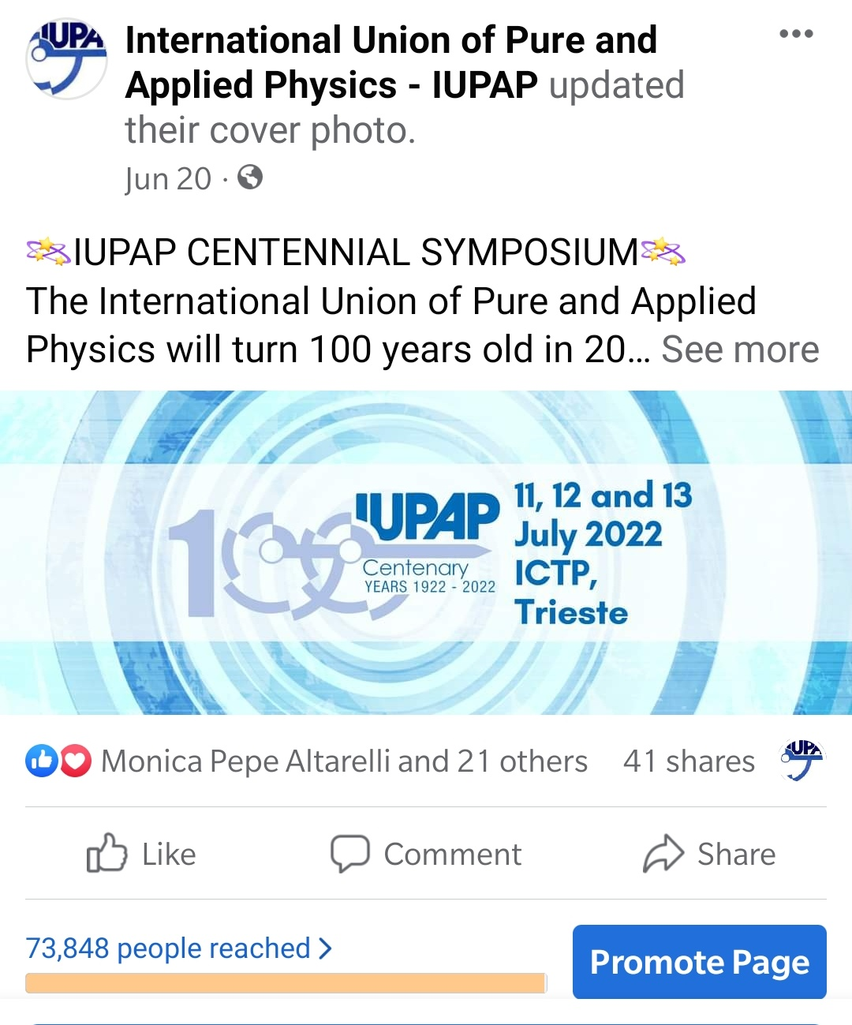
IUPAP Communication
Facebook page
in July 2022
in January 2022

Slide 4



IUPAP Communication
Social media - plans
Regular Facebook posts (1-2/week)
Re-activate Twitter account
Activate Instagram account (with photo contest winning entries)
Collaboration with communication teams at other organizations (ICTP, CERN, IYBSSD, other Unions, etc) for post re-sharing

Slide 5

IUPAP Communication
Website
Silvina
Paola
Hari
Francesca

Slide 6
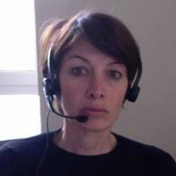
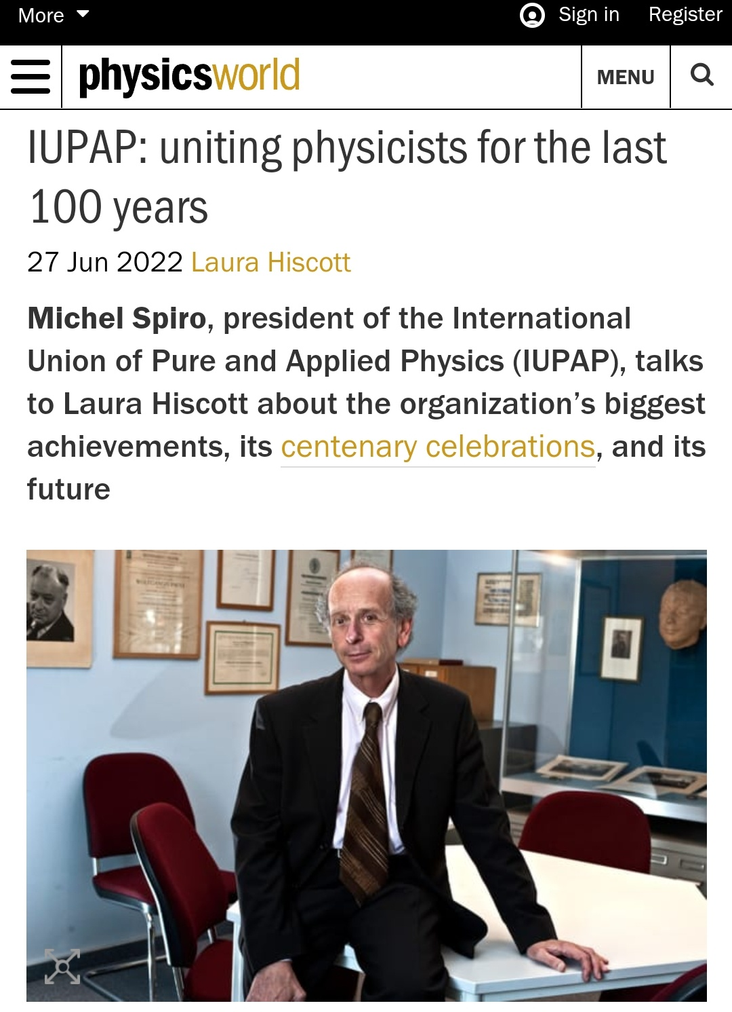
IUPAP Communication
Centenary
Parthership with
SISSA MediaLab
Social media campaign
Interview to Michel in Physics World
Interview to G. Parisi in L’Espresso
Long article on IUPAP and gender balance in
Le Science (Italian edition of Sci. American)
Laura Greene, Samia Chadour, Toni Palmer,
others, interviewed by Italian media outlets.
Toni Feder (Physics Today), Laura Hiscott (Physics World), Andrea Taroni (Nature Physics) and several Italian journalists will attend the IUPAP Centenary in person
Federica Sgorbissa

Slide 7
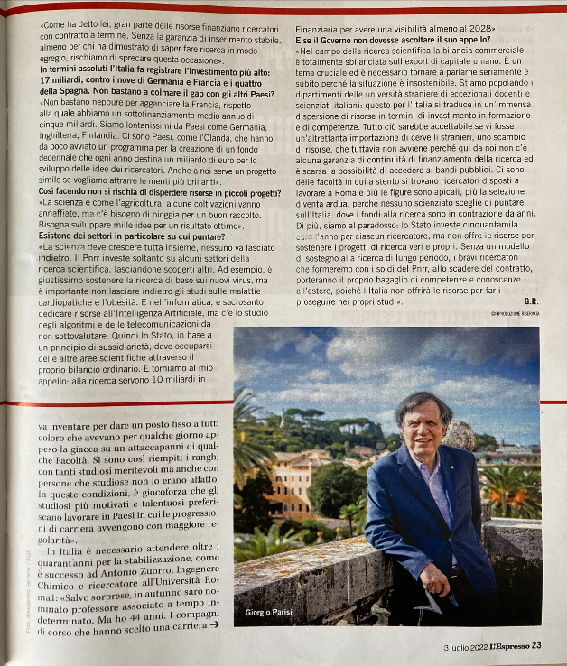
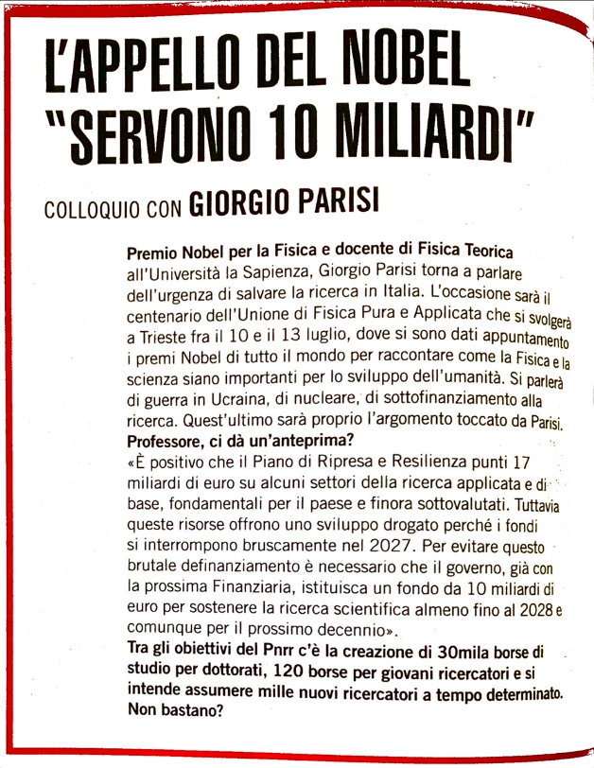

IUPAP Communication
Centenary

Slide 8

IUPAP Communication
Homework for you (especially Chairs)
Please send us (to communication@iupap.org):
  Newsworthy updates from Commissions / AC / WG
  Early Career Scientist Prize winner information (and other awards)
  Any other suggestions to improve the communication
Please help us sharing news on social media and involving local communication officers when relevant

Slide 9
IUPAP Communication
Who’s who
“Outreach committee” (GA 2021)
Laura Greene, Paola Rodari, Silvina Ponce Dawson, Monica Pepe-Altarelli, Sandro Scandolo
Trieste communication team
Francesca Zavino, Federica Sgorbissa (SISSA MediaLab, for Centenary), Paola Rodari, Sandro Scandolo
A special thanks to Hari Haran (GRAPES-3 experiment, Tata Institute of Fundamental Research)
communication@iupap.org

Slide 10
IUPAP email addresses
communication@iupap.org: News and web items
[read by Francesca Zavino and Sandro Scandolo]
secretariat@iupap.org: All types of «business» messages
[managed by Cecilia Cressi, read by entire EC]
iupap100@iupap.org: Centenary (Symposium, etc)
[read and managed by Anna Lisa Cesaro, Centenary secretary]

