Slide 1
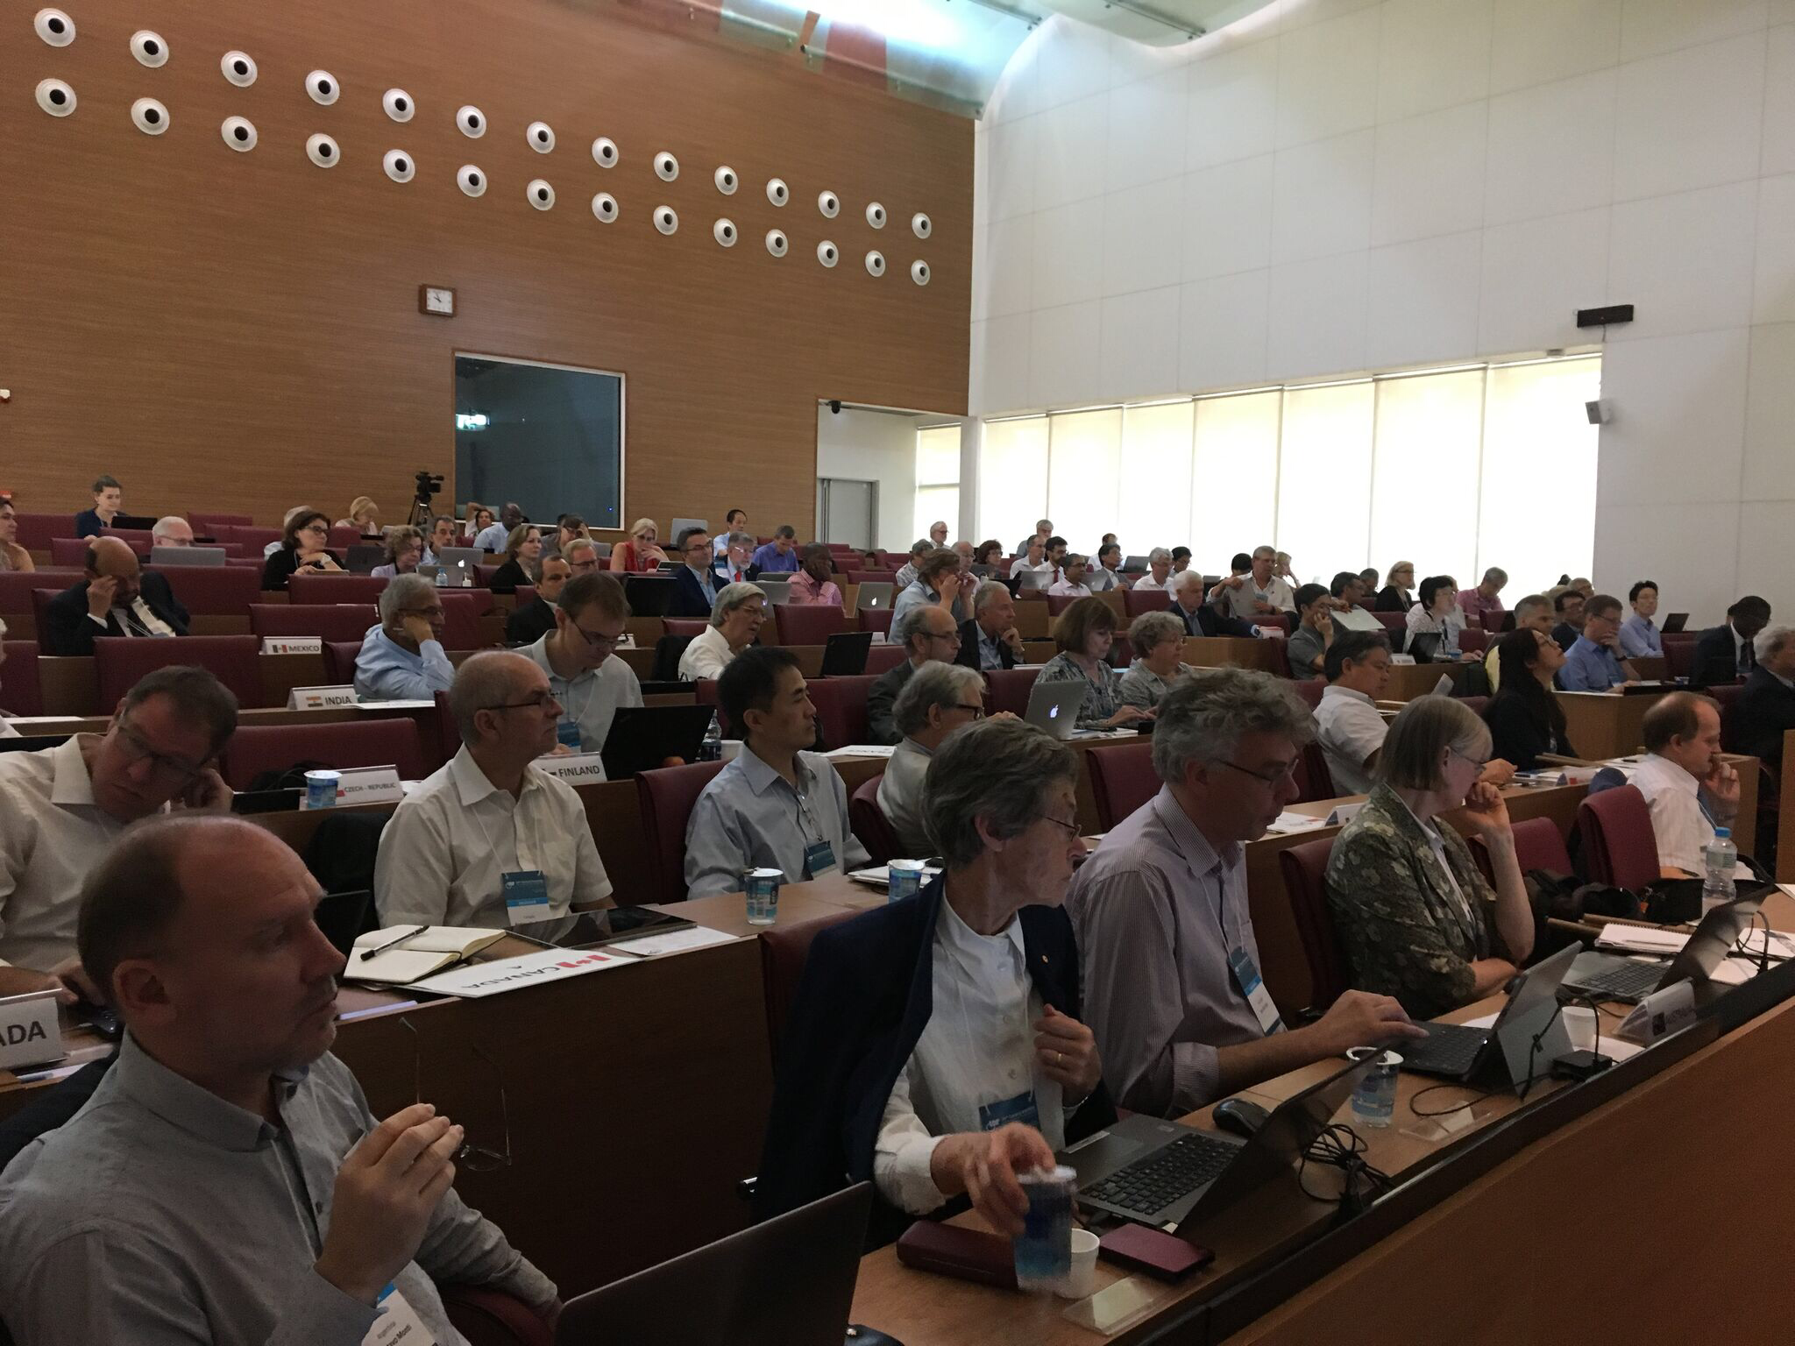
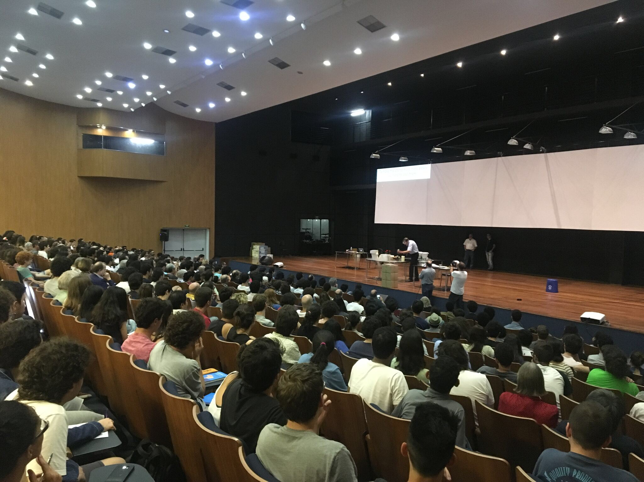
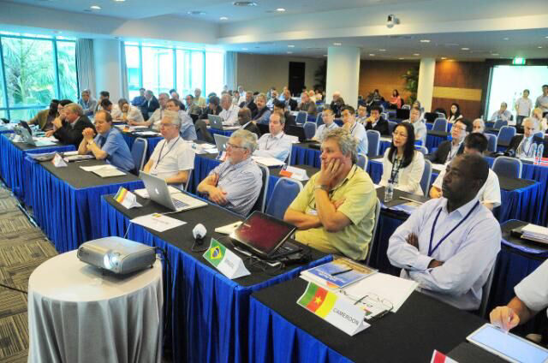
IUPAP
Mission:
“To assist in the worldwide development of physics, to foster international cooperation in physics, and to help in the application of physics toward solving problems of concern to humanity”.
Updated: Mar 24, 2019

Slide 2

The aims of the Union are:
to stimulate and promote international cooperation in physics;
to sponsor suitable international meetings and to assist organizing committees;
to foster the preparation and the publication of abstracts of papers and tables of physical constants;
to promote international agreements on other use of symbols, units, nomenclature and standards;
to foster free circulation of scientists; to encourage research and education

Slide 3
Further IUPAP principles:
Foster openness and inclusiveness in physics;
Ensure integrity and credibility;
Promote physics as a building block of innovation and multidisciplinary research;
Promote physics as an essential tool for development and for sustainability;

Slide 4
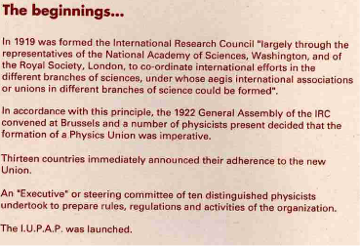
1922
From
The history of our first 70 years,
see the IUPAP website
http://iupap.org/about-us/the-history-of-iupap-1922-1992/

Slide 5
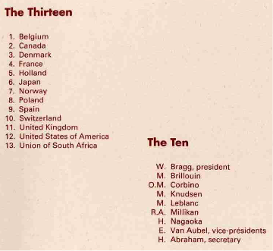
1922
William Bragg
First IUPAP President

Slide 6
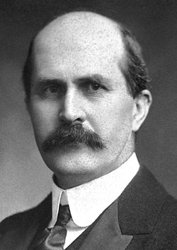
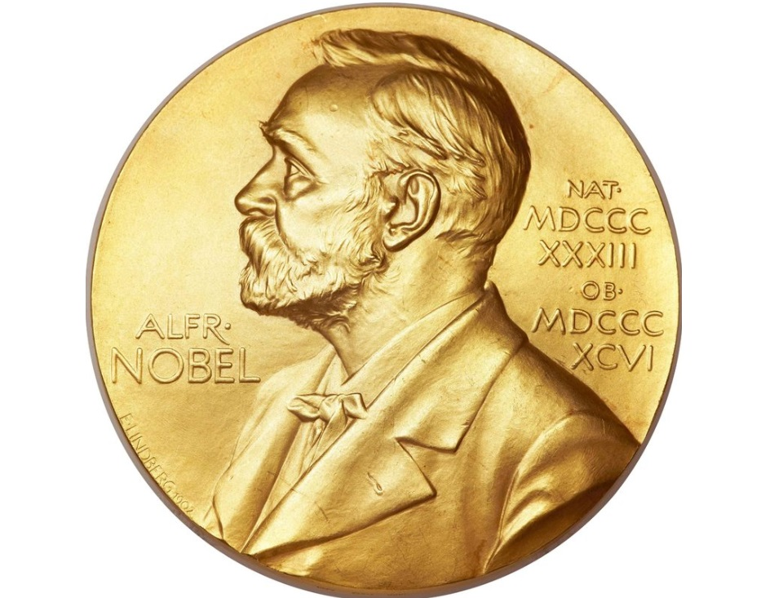
Established in 1922
First President: Sir William Bragg
(1922-1931)

Slide 7
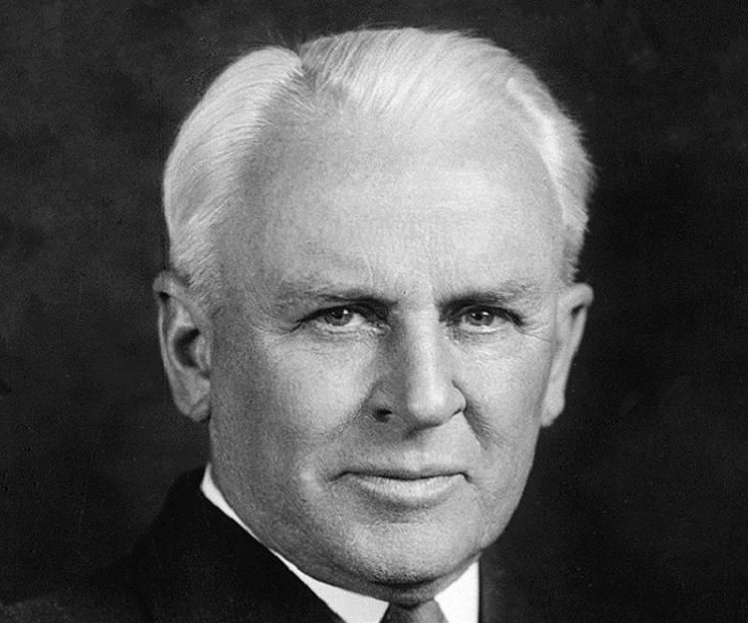
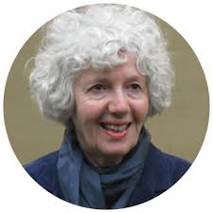
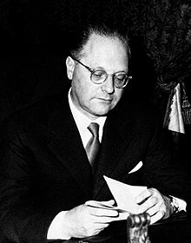
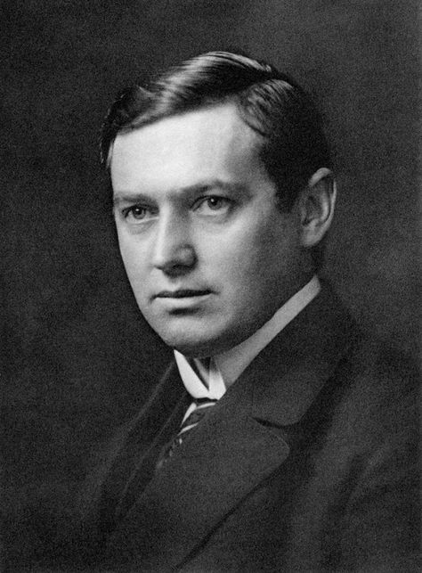
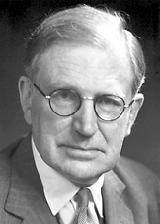
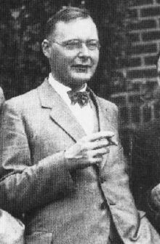
Then.....
Robert Millikan (1931-1934)
Cecilia Jarlskpg
(2011-2014)
Edoardo Amaldi
(1957-1960)
Kennedy Reed
(2017-2019)
Manne Siegbahn
(1934-1947)
Neville Francis Mott
(1951-1957))
Hans Kramers
(1947-1951)

Slide 8
Members (60)
Algeria
Argentina
Australia
Austria
Belgium
Brazil
Bulgaria
Canada
Chile
China: Beijing
China: Taipei
Colombia
Costa Rica
Croatia
Cuba
Cyprus
Czech Republic
Denmark
Egypt
Estonia
Ethiopia
Finland
France
Germany
Ghana
Greece
Hungary
India
Iran
Ireland
Israel
Italy
Japan
Jordan
Korea
Latvia
Lithuania
Mexico
Netherlands
New Zealand
Norway
Pakistan
Peru
Philippines
Poland
Portugal
Romania
Russia
Saudi Arabia
Senegal
Singapore
Slovak Republic
Slovenia
South Africa
Spain
Sweden
Switzerland
Tunisia
UK
Uruguay
USA
Four regional Physics Societies are observers: African, American, Asian Pacific and European
Corporate Associate Members are being considerered

Slide 9
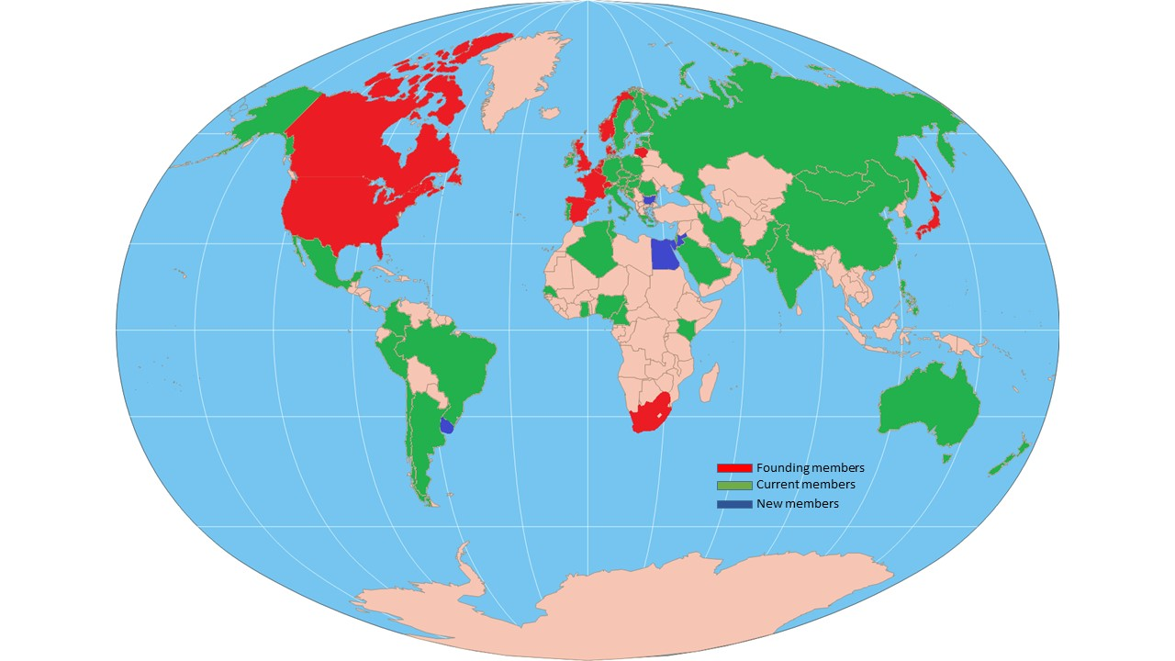
IUPAP Members

Slide 10
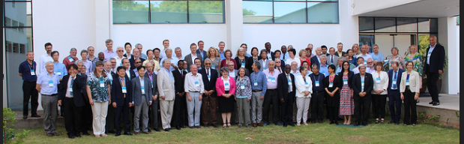
Governance
Governed according to the New Statutes and Bylaws of the International Union of Pure and Applied Physics (as adopted by the General Assembly, 2021) to become Articles and Internal Rules as soon as IUPAP get the legal status of an NGO as an Association under Swiss Law located in Geneva with the Administrative Office in Trieste

Slide 11
Governance:
The General Assembly
The General Assembly of all members is the highest governing body of the Union. It:
Creates and amends these statutes (requires a two-thirds majority of those present).
Sets and amends the procedural bylaws (requires a three-fifths majority of those present).
Elects the Executive Council that oversees Union activities between General Assemblies.
Elects members of its Commissions.
Sets the members’ dues.

Slide 12
Governance:
The Executive Council
The Executive Council has all of the authority of the General Assembly between General Assemblies (every 3 years in person, every year virtually in between) except for certain items specified in the statutes, subject to ratification at the next General Assembly. It may fill vacancies in the Commissions that occur between General Assemblies.

Slide 13
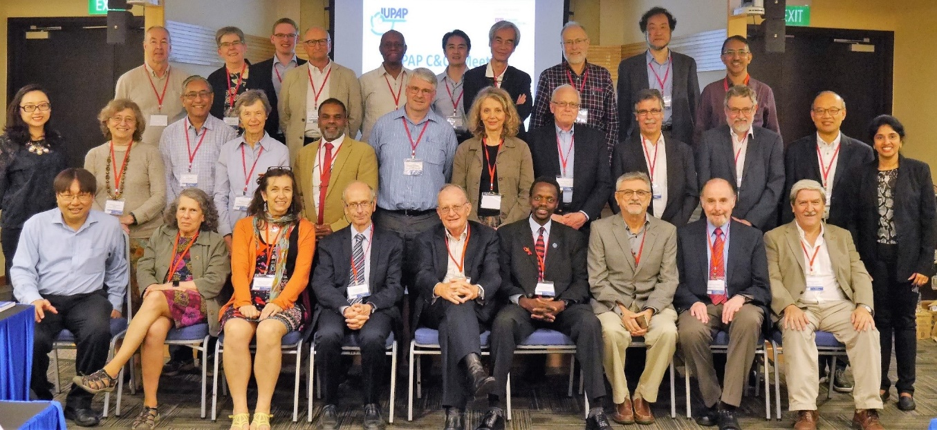
Commissions
• Symbols, Units, etc (C2)
• Statistical Mechanics (C3)
• Astroparticle Physics (C4)
• Low Temperature Physics (C5)
• Biological Physics (C6)
• Semiconductors (C8)
• Magnetism (C9)
• Condensed Matter (C10)
• Particles and Fields (C11)
• Nuclear Physics (C12)
• Physics for Development (C13)
• Physics Education (C14)
• Atomic Molecular and Optical Physics (C15)
• Plasma Physics (C16)
• Laser Physics and Photonics (C17)
• Mathematical Physics (C18)
• Astrophysics (C19)
• Computational Physics (C20)
The first scientific commission, on Units, was established in 1931 at the third General Assembly.
Currently there are 18 Commissions.
Organize the major International conferences in their field; and award Young Scientist Prizes

Slide 14

LAAAMP Project (C13)
Utilisation of Light Source and Crystallographic Sciences to Facilitate the Enhancement of Knowledge and Improve the Economic and Social Conditions in Targeted Regions of the World
LAAMP Colloquium presentation by Prof. Diego G. Lamas at the OpenLab Inaugural Ceremonies in San José, Costa Rica, 4 December 2017

Slide 15
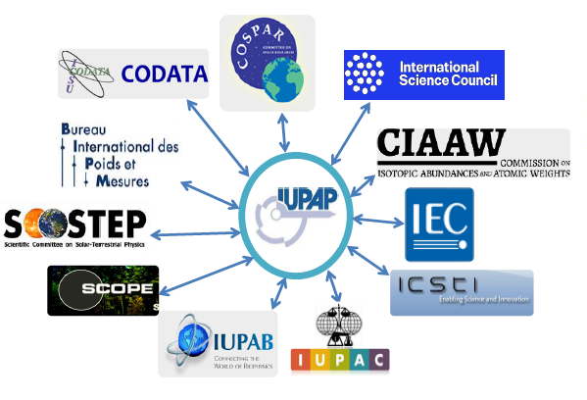
Affiliated commissions
• International Commission for Optics (AC1)
• International Commission on General Relativity and Gravitation (AC2)
• International Commission on Acoustics (AC3)
• International Commission on Medical Physics (AC4)
• International Association of Physics Students (AC5 New)
• Affiliated Commission on the History and Philosophy of Physics (AC6 New)
International committees or organizations of physicists, with their own administrative structure, who wish to join IUPAP commissions
Currently there are 4 +2 affiliated commissions
Participate in IUPAP activities, endorse IUPAP principles

Slide 16
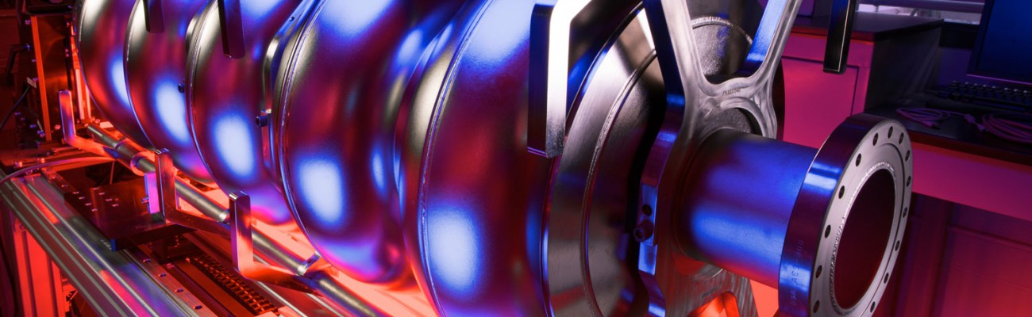
Working Groups
WG1: International Committee for Future Accelerators (ICFA)
WG2: Communication in Physics
WG5: Women in Physics
WG7: International Committee on Ultrahigh Intensity Lasers (ICUIL)
WG9: International Cooperation in Nuclear Physics (ICNP)
WG10: Astroparticle Physics International Committee (ApPIC)
WG11: Gravitational Wave International Committee (GWIC)
WG12: Energy
WG13: Newtonian Constant on Gravitation
WG14: Accelerator Science
WG15: Soft Matter
WG16: Physics and Industry
WG17: Centenary
WG18: Ethics
WG19: Quantum Science and Technology
Some working groups have had close links with working groups of the OECD Global Science Forum
The Working Group on Women in Physics

Slide 17
Working Groups
WG1: International Committee for Future Accelerators (ICFA)
WG2: Communication in Physics
WG5: Women in Physics
WG7: International Committee on Ultrahigh Intensity Lasers (ICUIL)
WG9: International Cooperation in Nuclear Physics (ICNP)
WG10: Astroparticle Physics International Committee (ApPIC)
WG11: Gravitational Wave International Committee (GWIC)
WG12: Energy
WG13: Newtonian Constant on Gravitation
WG14: Accelerator Science
WG15: Soft Matter
WG16: Ethics (New)
WG17: Quantum (New)
Some working groups have had close links with working groups of the OECD Global Science Forum
The Working Group on Women in Physics

Slide 18
Gender Gap
How to Measure It?
How to Reduce It?
Now -> Standing Committee on Gender Equality in Sciences
The International Mathematical Union (IMU) leads the “Gender Gap in Science” Project, which is currently carried on with the participation of IUPAP and many other unions and with the financial support of the International Council of Science and the union partners.
The aim of the Project is to provide data to be able to analyze the gender gap in mathematical, computing and natural sciences, paying particular attention to regional differences. Moreover, the project aims to provide easy access to material proven to be useful in encouraging girls and young women to study science.
Silvina Ponce Dawson, Marie-Francoise Roy and June Barrow-Green

Slide 19
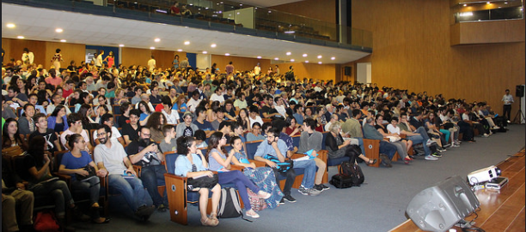
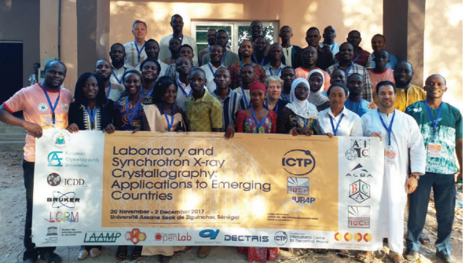
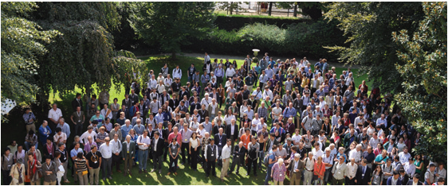
CONFERENCES
IUPAP sponsors and endorses ~50 conferences per year:
Very large, medium size, specialized
everywhere with a special attention to developing countries
Requirements are:
scientific interest
worldwide attendance with no a priori restriction or difficulty to attend
inclusiveness and diversity

Slide 20
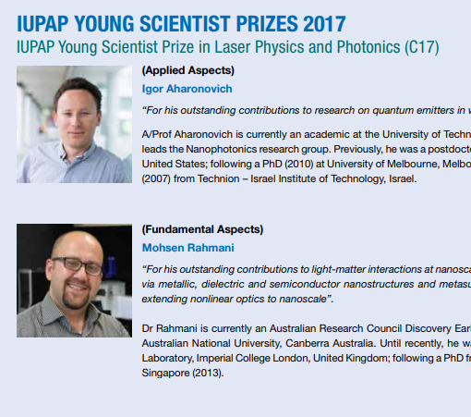
Early Career Scientific Prize Awards
The Early Career Scientist Prize is granted by IUPAP on the recommendation of a Commission or an Affiliated Commission.
The award consists of a certificate, medal and a monetary award.
A presentation also takes place at an international conference sponsored through the commission.
192 prizes awarded between 2006 and 2018!

Slide 21
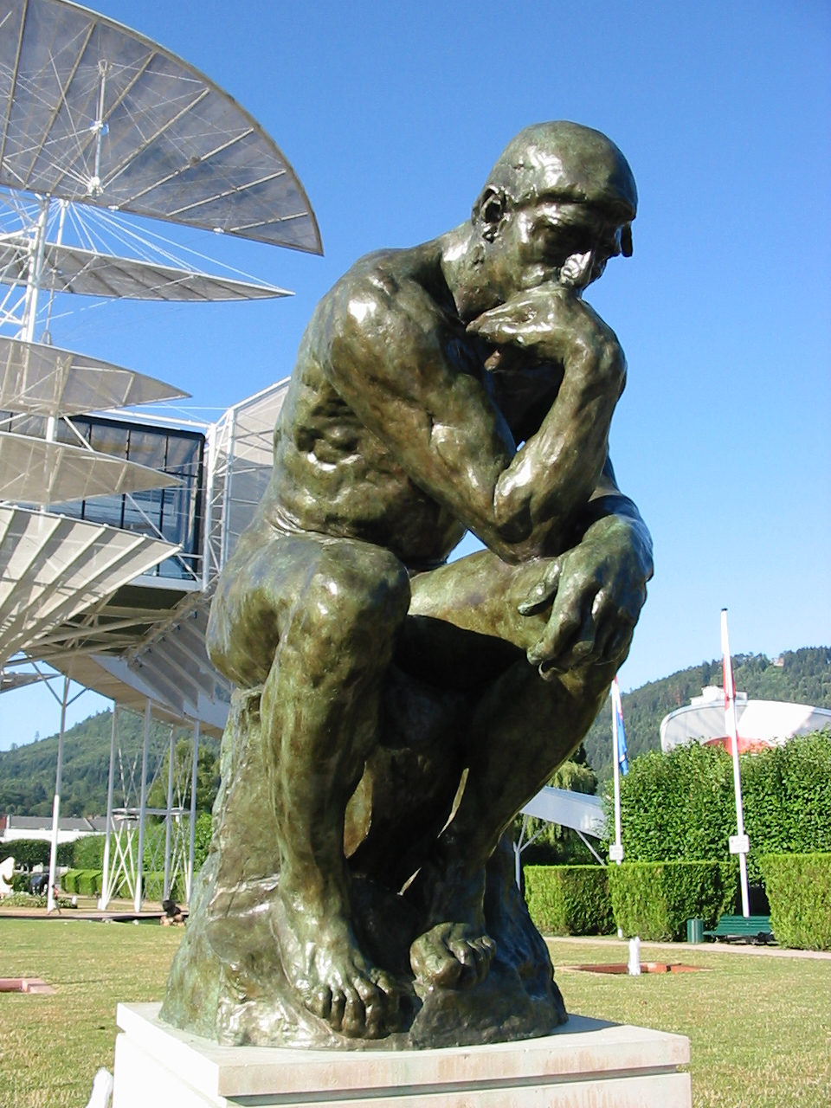











2022/ 2023
Centenary of IUPAP
IYBSSD
June 2022/June 2023
International Year of Basic Sciences for Sustainable Development
Basic Sciences under the spotlight
Basic Sciences are a key tool to provide a multi-cultural dialogue, with “scientific diplomacy” a known and demonstrated means to contribute to a more peaceful world
Leading Union
https://www.iybssd2022.org/

Slide 22
You are all invited to celebrate IUPAP Centenary and the International Year of Basic Sciences for Sustainable Development in 2022 and 2023, by particpating to and creating all sort of events!!

Slide 23
Why be a member? (1)
To reach across national boundaries and ensure the free circulation of scientists through global physics cooperation in a world that is becoming more fragmented
To enable scientists to participate in decision-making that impacts physics on an international level in significant ways.
To create an international platform where scientists can raise their voices and express their views on any matter that relates to physics and the practice of physics, and in so doing help to propose solutions and action plans to address such matters.

Slide 24
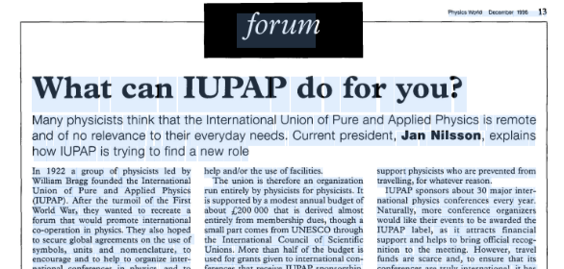
Why be a member? (2)
4. To enhance the role of physics and physics education with a particular emphasis to the developing world.
5. To help address major societal challenges, such as environmental and energy problems, as physics will continue to underpin all science and technology for the foreseeable future.

Slide 25
IUPAP Members

Slide 26
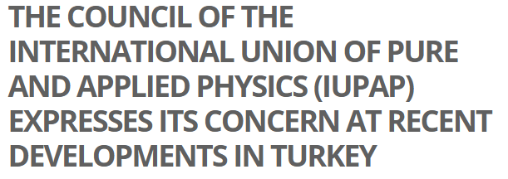
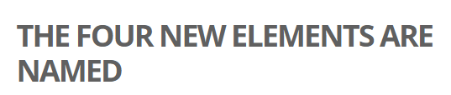
What are the benefits to become a member? (1)
To be part of the world physics community represented by IUPAP and thus enable scientists to cooperate freely across political boundaries.
To allow IUPAP to consolidate its global footprint and strengthen its position for scientific evidence-based decision making in the wake of modern forms of irrationality.
To have a fair participation to the IUPAP decision making process (General Assemblies, Council).

Slide 27
What are the benefits to become a member? (2)
To have a fair representation in commissions and other physics endeavours of general interest for every country, namely physics for development, physics and industry, physics education, physics for society…To participate in working groups and committees that are relevant to addressing some specific challenge facing physics in the world.
To have links and networks with allied disciplines of physics though affiliated commissions and other allied international unions, and through IUPAP to be a part of ISC (the council of all scientific unions).

Slide 28
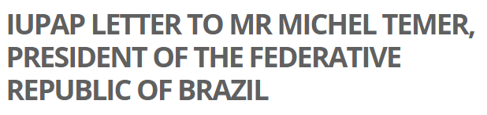
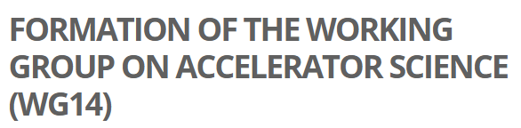
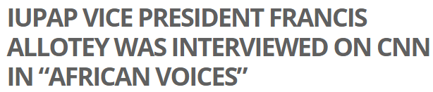
What are the benefits to become a member? (3)
A special attention will be given to host IUPAP conferences, meetings and events in new member countries.
IUPAP can be active in supporting physics and science in countries as the need and circumstances demand (e.g. recent communications to Brazil, Argentina, Turkey).
.

Slide 29
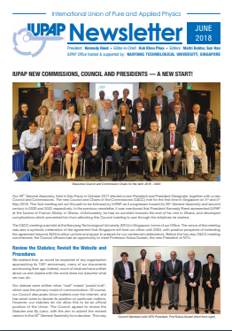
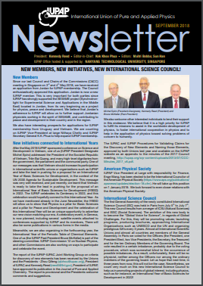
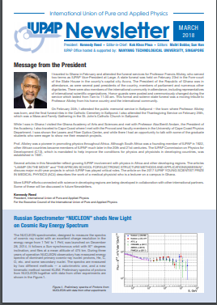
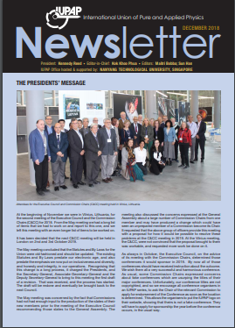
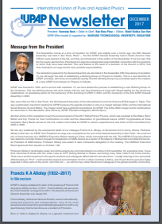
Newsletter
http://iupap.org/publications-3/

Slide 30
Summary
International collaboration, consultation and competition has been an integral part of physics for over a thousand years, and almost 100 years ago the International Union of Pure and Applied Physics was set up to stimulate and promote international cooperation in physics. It has expanded its actions, but is now facing more challenges, including
Freedom of movement of scientists
Freedom from harassment in conferences and the workplace
Distortion of publication practices because of the use of “objective metrics" to judge physicists
A proliferation of fake conferences and fake journals
Setting standards of rational thought in the face of irrationality
Addressing urgent environmental and energy problems
Better connecting with developing countries
It is our task to address these and other concerns of the global physics community.

Slide 31
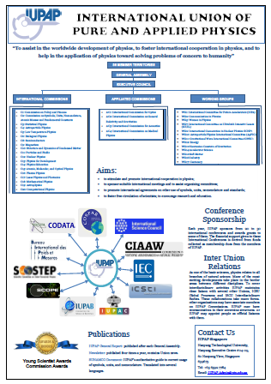
SIMPLIFIED POSTER
(without details on commissions..)

