Slide 1

Regional e-conference
Pakistan
January 18th, 2022

Slide 2
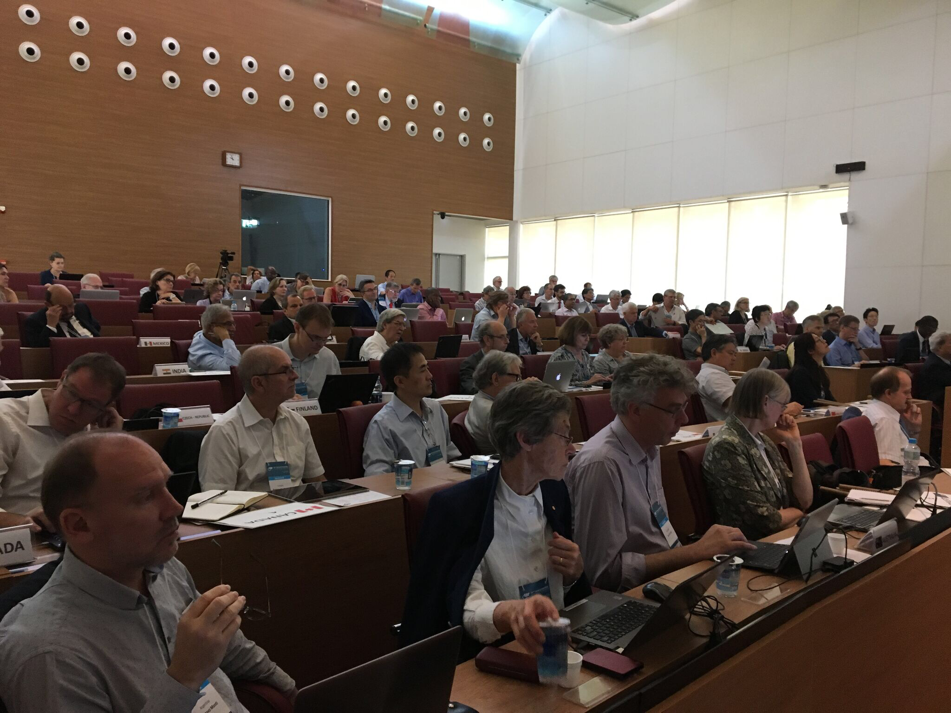
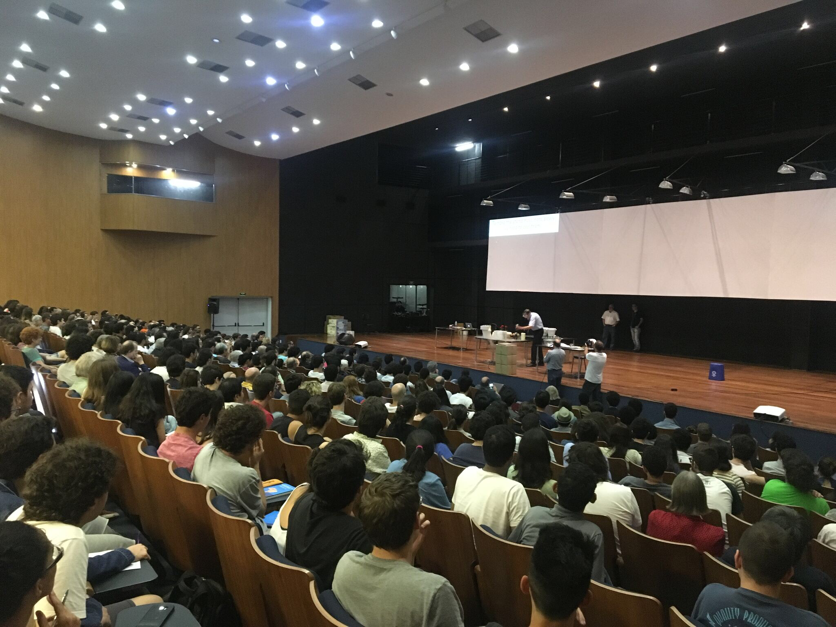
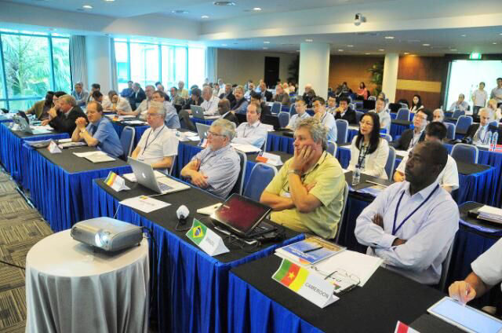
IUPAP (http://iupap.org/)
Michel Spiro
President
Mission:
“To assist in the worldwide development of physics, to foster international cooperation in physics, and to help in the application of physics toward solving problems of concern to humanity”.
Updated: Dec 4, 2019

Slide 3

Further IUPAP principles:
Foster openness and inclusiveness in physics;
Promote free circulation of physicists (and of data?)
Ensure integrity and credibility;
Promote physics as a building block of innovation and multidisciplinary research;
Promote physics as an essential tool for development and for sustainability;

Slide 4
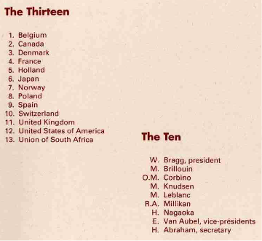
1922
William Bragg
First IUPAP President
First general assembly in 1923

Slide 5
Members (60)
Algeria
Argentina
Australia
Austria
Belgium
Brazil
Canada
Chile
China: Beijing
China: Taipei
Colombia
Costa Rica
Croatia
Cuba
Cyprus
Czech Republic
Denmark
Estonia
Ethiopia
Finland
France
Germany
Ghana
Greece
Hungary
India
Iran
Ireland
Israel
Italy
Japan
Korea
Latvia
Lithuania
Mexico
Netherlands
New Zealand
Norway
Pakistan
Peru
Philippines
Poland
Portugal
Romania
Russia
Saudi Arabia
Senegal
Singapore
Slovak Republic
Slovenia
South Africa
Spain
Sweden
Switzerland
Tunisia
UK
USA
Bulgaria, Egypt, Jordan, Uruguay joined recently
Corporate Associate Members are being considered
Four Regional Physics Society (American, African, Asian Pacific, European)
are observers

Slide 6
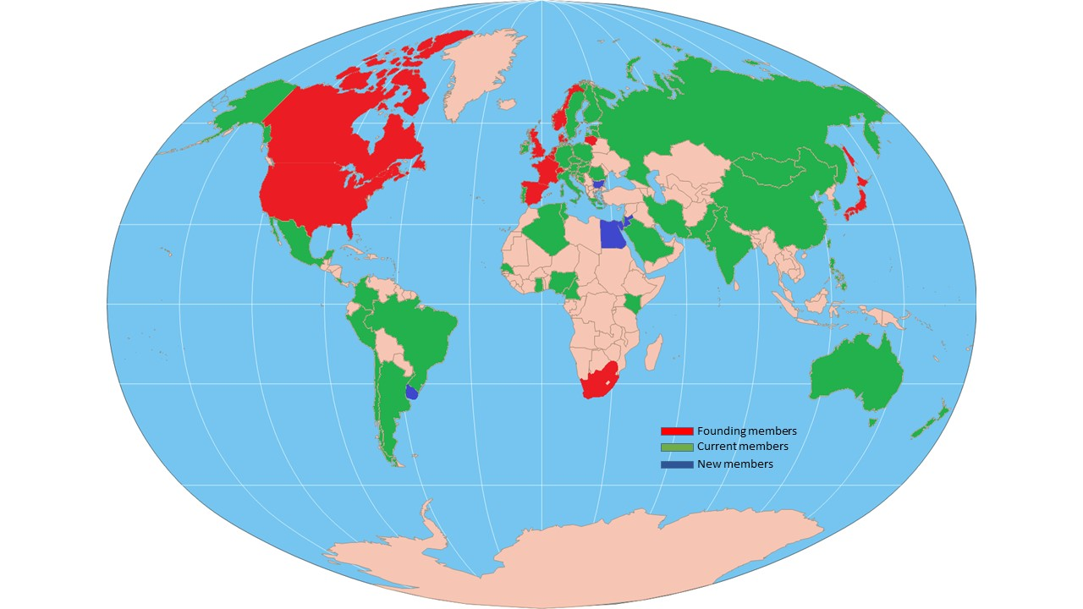
IUPAP Members

Slide 7
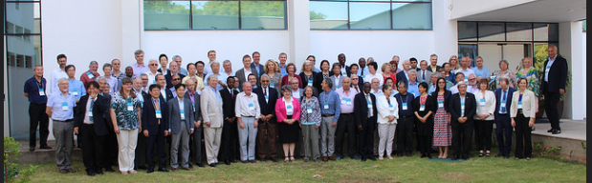
Governance
Governed according to the New Statutes and Bylaws of the International Union of Pure and Applied Physics (as adopted by the General Assembly, 2021) to become Articles and Internal Rules as soon as IUPAP get the legal status of an NGO as an Association under Swiss Law located in Geneva with the Administrative Office in Trieste

Slide 8
Governance:
The General Assembly
The General Assembly of all members is the highest governing body of the Union. It:
Creates and amends these statutes (requires a two-thirds majority of those present).
Sets and amends the procedural bylaws (requires a three-fifths majority of those present).
Elects the Executive Council that oversees Union activities between General Assemblies.
Elects members of its Commissions.
Sets the members’ dues.

Slide 9
Governance:
The Executive Council
The Executive Council has all of the authority of the General Assembly between General Assemblies (every 3 years in person, every year virtually in between) except for certain items specified in the statutes, subject to ratification at the next General Assembly. It may fill vacancies in the Commissions that occur between General Assemblies.

Slide 10
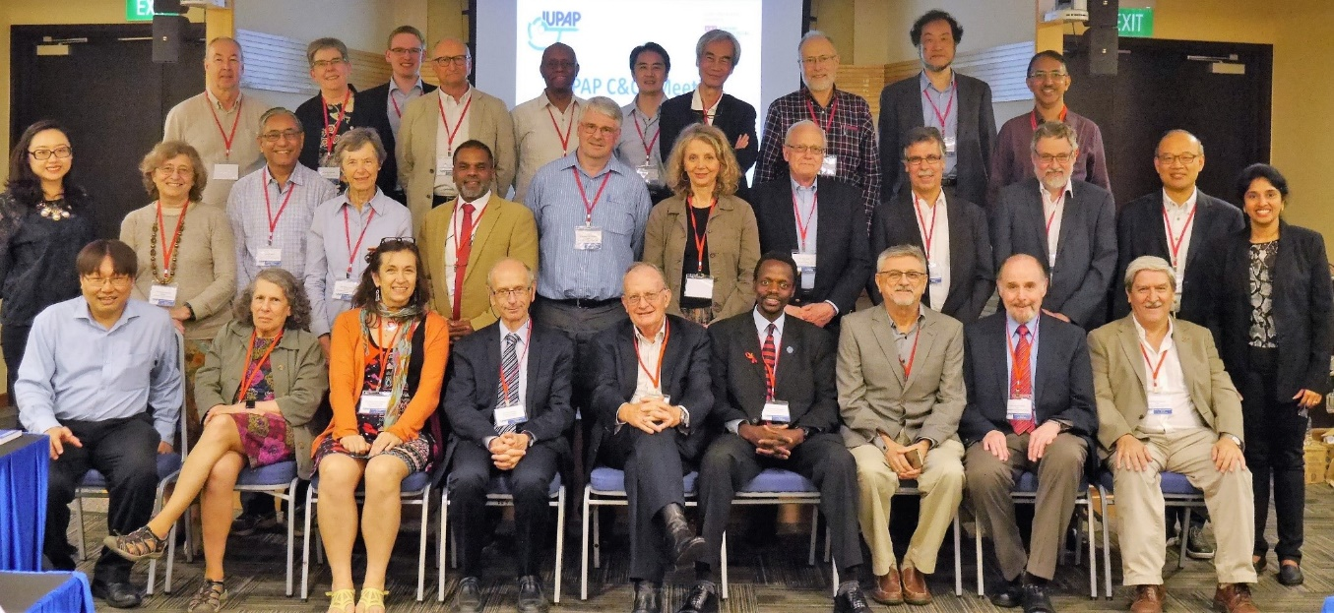
Commissions
• Symbols, Units, etc (C2)
• Statistical Mechanics (C3)
• Astroparticle Physics (C4) New name
• Low Temperature Physics (C5)
• Biological Physics (C6)
• Semiconductors (C8)
• Magnetism (C9)
• Condensed Matter (C10)
• Particles and Fields (C11)
• Nuclear Physics (C12)
• Physics for Development (C13)
• Physics Education (C14)
• Atomic Molecular and Optical Physics (C15)
• Plasma Physics (C16)
• Laser Physics and Photonics (C17)
• Mathematical Physics (C18)
• Astrophysics (C19)
• Computational Physics (C20)
The first scientific commission, on Units, was established in 1931 at the third General Assembly.
Currently there are 18 Commissions.
Organize the major International conferences in their field; and award Young Scientist Prizes

Slide 11
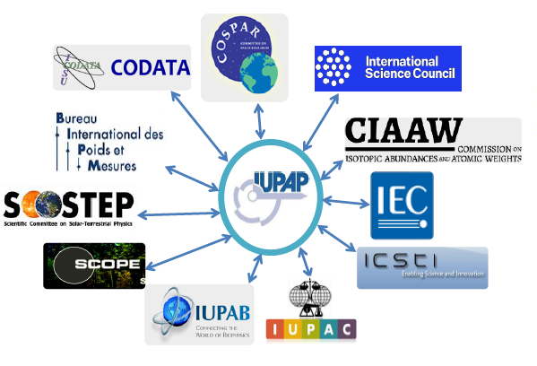
Affiliated commissions
• International Commission for Optics (AC1)
• International Commission on General Relativity and Gravitation (AC2)
• International Commission on Acoustics (AC3)
• International Commission on Medical Physics (AC4)
• International Association of Physics Students (AC5 New)
• Affiliated Commission on the History and Philosophy of Physics (AC6 New)
International committees or organizations of physicists, with their own administrative structure, who wish to join IUPAP commissions
Currently there are 4 +2 affiliated commissions
Participate in IUPAP activities, endorse IUPAP principles

Slide 12
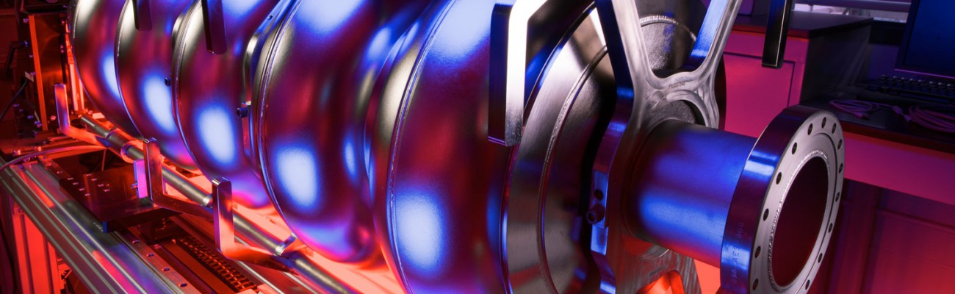
Working Groups
WG1: International Committee for Future Accelerators (ICFA)
WG2: Communication in Physics
WG5: Women in Physics
WG7: International Committee on Ultrahigh Intensity Lasers (ICUIL)
WG9: International Cooperation in Nuclear Physics (ICNP)
WG10: Astroparticle Physics International Committee (ApPIC)
WG11: Gravitational Wave International Committee (GWIC)
WG12: Energy
WG13: Newtonian Constant on Gravitation
WG14: Accelerator Science
WG15: Soft Matter
WG16: Physics and Industry
WG17: Centenary
WG18: Ethics
WG19: Quantum Science and Technology
Some working groups have had close links with working groups of the OECD Global Science Forum
The Working Group on Women in Physics

Slide 13
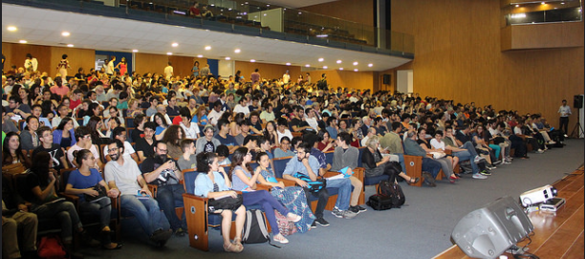
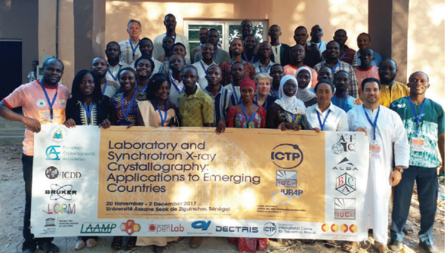
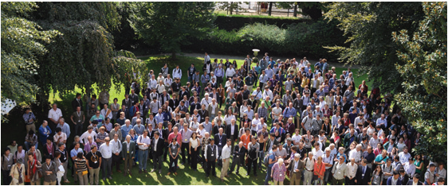
CONFERENCES
IUPAP sponsors and endorses ~50 conferences per year:
Very large, medium size, specialized
everywhere with a special attention to developing countries
Requirements are:
scientific interest
worldwide attendance with no a priori restriction or difficulty to attend
inclusiveness and diversity

Slide 14
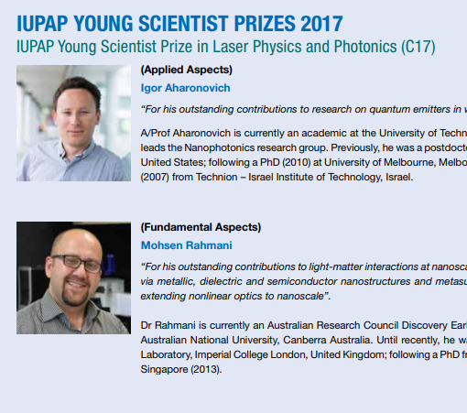
Early Career Scientist Prize Awards
The Early Career Prize is granted by IUPAP on the recommendation of a Commission or an Affiliated Commission.
The award consists of a certificate, medal and a monetary award.
A presentation also takes place at an international conference sponsored through the commission.
192 prizes awarded between 2006 and 2018!

Slide 15
Gender Gap
How to Measure It?
How to Reduce It?
Now -> Standing Committee on Gender Equality in Sciences
The International Mathematical Union (IMU) leads the “Gender Gap in Science” Project, which is currently carried on with the participation of IUPAP and many other unions and with the financial support of the International Council of Science and the union partners.
The aim of the Project is to provide data to be able to analyze the gender gap in mathematical, computing and natural sciences, paying particular attention to regional differences. Moreover, the project aims to provide easy access to material proven to be useful in encouraging girls and young women to study science.
Silvina Ponce Dawson, Marie-Francoise Roy and June Barrow-Green

Slide 16

LAAAMP Project (C13)
Utilisation of Light Source and Crystallographic Sciences to Facilitate the Enhancement of Knowledge and Improve the Economic and Social Conditions in Targeted Regions of the World
LAAMP Colloquium presentation by Prof. Diego G. Lamas at the OpenLab Inaugural Ceremonies in San José, Costa Rica, 4 December 2017

Slide 17
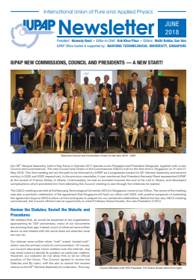
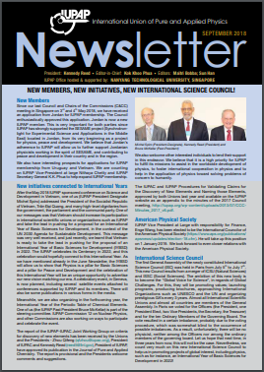
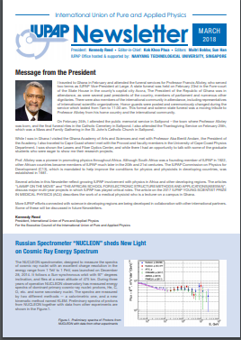
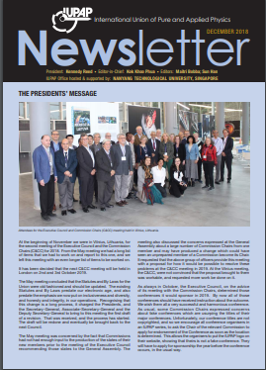
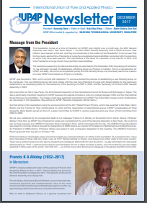
Newsletter
http://iupap.org/publications-3/

Slide 18
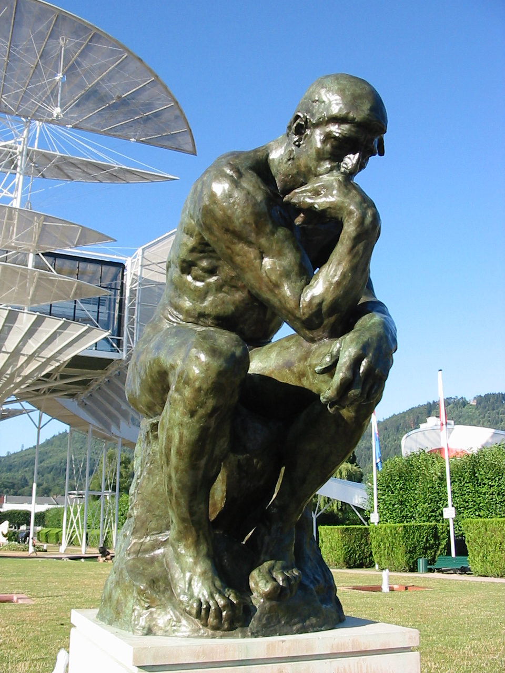











2022/ 2023
Centenary of IUPAP
IYBSSD
June 2022/June 2023
International Year of Basic Sciences for Sustainable Development
Basic Sciences under the spotlight
Basic Sciences are a key tool to provide a multi-cultural dialogue, with “scientific diplomacy” a known and demonstrated means to contribute to a more peaceful world
Leading Union
https://www.iybssd2022.org/

Slide 19
You are all invited to celebrate IUPAP Centenary and the International Year of Basic Sciences for Sustainable Development in 2022 and 2023, by particpating to and creating all sort of events!!

