Slide 1
INTRODUCTION OF EC&CC MEMBERS
IUPAP EXECUTIVE COUNCIL
COMMISSIONS
AFFILIATE COMMISSIONS
WORKING GROUPS

Slide 2
IUPAP EXECUTIVE COUNCIL
President | Michel Spiro
Past President | Bruce McKellar
President-Designate | Silvina Ponce Dawson
Associate Secretary General | Rudzani Nemtudi
Secretary General for Legal and Financial Affairs | Jens Vigen
Secretary General for Administrative Affairs | Stefano Fantoni
Deputy Secretary General | Sandro Scandolo
Former Deputy Secretary General | Kwek Leong Chuan
Vice-President at Large (Centenary) | Monica Pepe-Altarelli
Vice-President at Large (Gender Champion) | Gillian Butcher
Vice-President at Large (New Members) | Nithaya Chetty
Vice-President at Large (Outreach and Ethics) | Laura Greene
Vice-President from Commission Chairs | Tetyana Antimirova
Vice-President from Commission Chairs | Ani Aprahamian
Vice-President from Commission Chairs | Takaaki Kajita
Vice-President from Commission Chairs | Kuijuan Jin
Vice-President from Commission Chairs | Tae Won Noh
Commission for Policy and Finance (C1)

Slide 3
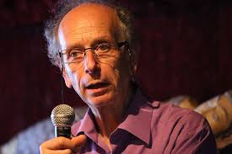
PRESIDENT /
COMMISSION ON POLICY AND FINANCE (C1)
MICHEL SPIRO

Slide 4
MICHEL SPIRO
Affiliation to IUPAP:
President IUPAP
Commission/Category:
Executive Council / Commission on Policy And Finance (C1)
Current affiliation (Institution):
CEA-CNRS
Area of Study/Research/Expertise:
Particle and Astroparticle Physics
Last Physics paper written with date of publication:
2019: “Neutrino Physics Sociology”, Proceedings of the International Conference on History of the Neutrino: 1930-2018 : Paris, France. September 5-7, 2018.
Any other information:
Chair of the Steering Committee for the International Year of Basic Sciences for Sustainable Development

Slide 5
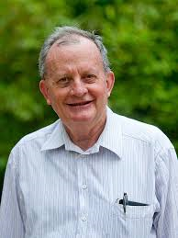
BRUCE H. McKELLAR
Affiliation to IUPAP:
Past - President
Commission/Category:
Executive Council / Commission on Policy And Finance (C1)
Current Job Title:
Emeritus Professor
Current affiliation (Institution):
University of Melbourne
Area of Study/Research/Expertise:
Theoretical Physics
Last Physics paper written with date of publication:
3 April 2017 : “Relativistic dipole interaction and the topological nature for induced HMW and AC phases”, Xiao-Gang He and Bruce McKellar , Phys.Lett. A381 (2017) 1780-1783.
Any other information:

Slide 6
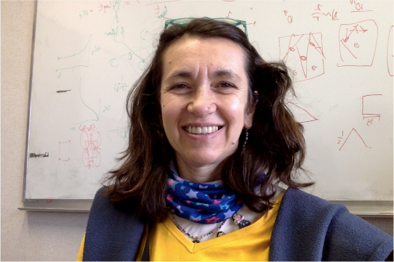
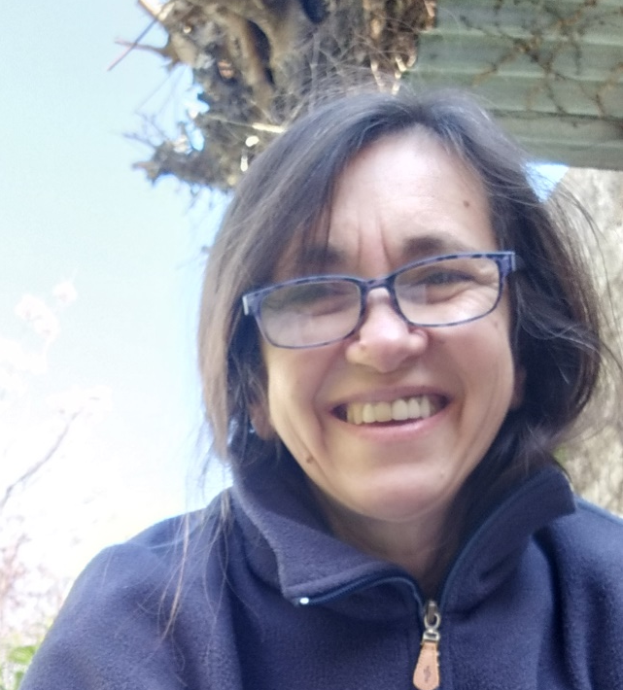
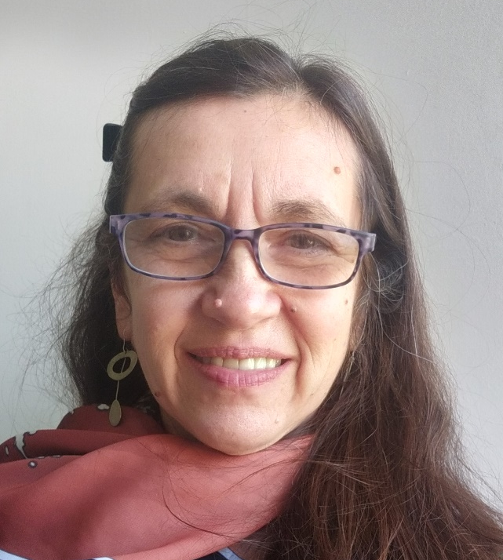
SILVINA PONCE DAWSON
Affiliation to IUPAP:
President-Designate
Commission/Category:
Executive Council / Commission on Policy And Finance (C1)
Current Job Title:
Professor
Current affiliation (Institution):
University of Buenos Aires and CONICET
Area of Study/Research/Expertise:
Biological Physics
Last Physics paper written with date of publication:
13 November 2021: “Group testing with nested pools”, I. Armendári et al., IEEE Transactions on Information Theory, 68(2), pp. 1119 - 1132.
Any other information:
Previous Gender Champion

Slide 7
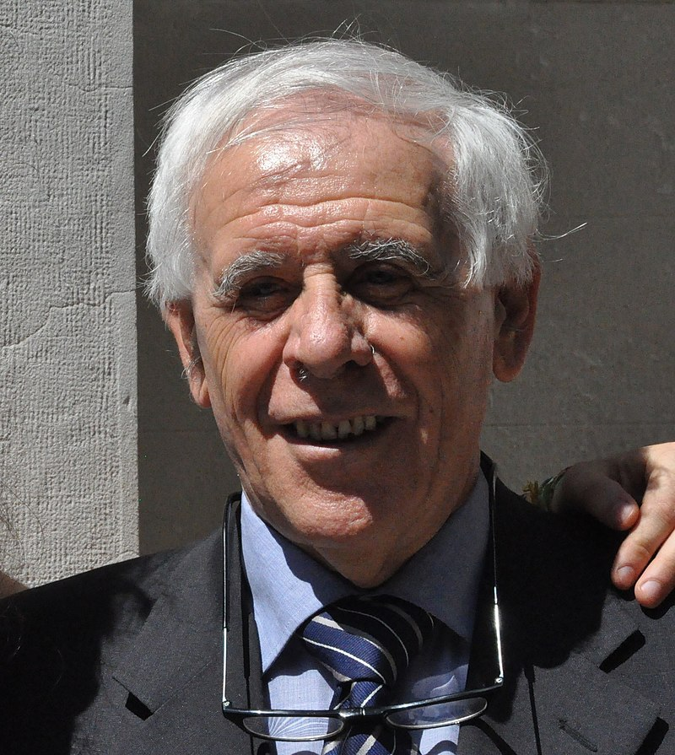
STEFANO FANTONI
Affiliation to IUPAP:
Secretary General for Administrative Affairs
Commission/Category:
Executive Council / Commission on Policy And Finance (C1)
Current Job Title:
President
Current affiliation (Institution):
International Foundation Trieste for the Progress and Freedom of Sciences
Area of Study/Research/Expertise:
Theoretical Nuclear Physics and Low Temperature Physics
Last Physics paper written with date of publication:
2020: “Nuclear Matter Theory”, O. Benhar and S. Fantoni, CRC Pres, Boca Raton, FL, 2020.
Any other information:

Slide 8
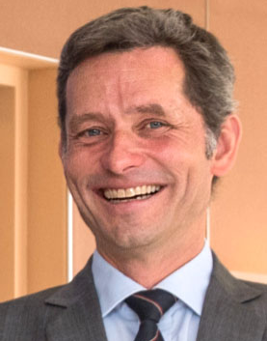
JENS VIGEN
Affiliation to IUPAP:
Secretary General for Legal and Financial Affairs
Commission/Category:
Executive Council / Commission on Policy And Finance (C1)
WG2: Communication in Physics
Current Job Title:
Scientific Information Officer
Current affiliation (Institution):
CERN
Area of Study/Research/Expertise:
Information Science, Libraries and Publishing
Last Physics paper written with date of publication:
Do not publish in physics
Any other information:
Leading the process to establish IUPAP as an association domiciled in Geneva, Switzerland.

Slide 9
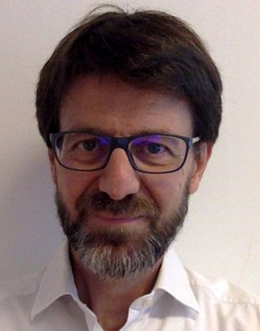
SANDRO SCANDOLO
Affiliation to IUPAP:
Deputy Secretary General
Commission/Category:
Executive Council / Commission on Policy And Finance (C1)
Current Job Title:
Head of Research
Current affiliation (Institution):
Abdus Salam International Centre for Theoretical Physics (ICTP)
Area of Study/Research/Expertise:
Condensed Matter Physics, Atomistic Simulation of High-Pressure Phenomena
Last Physics paper written with date of publication:
17 January 2022: “How to determine solubility in binary mixtures from Neutron Scattering data: the case of methane and water”, V.N. Robinson et al., J. Chem. Phys. (in press) (2022).
Any other information:

Slide 10
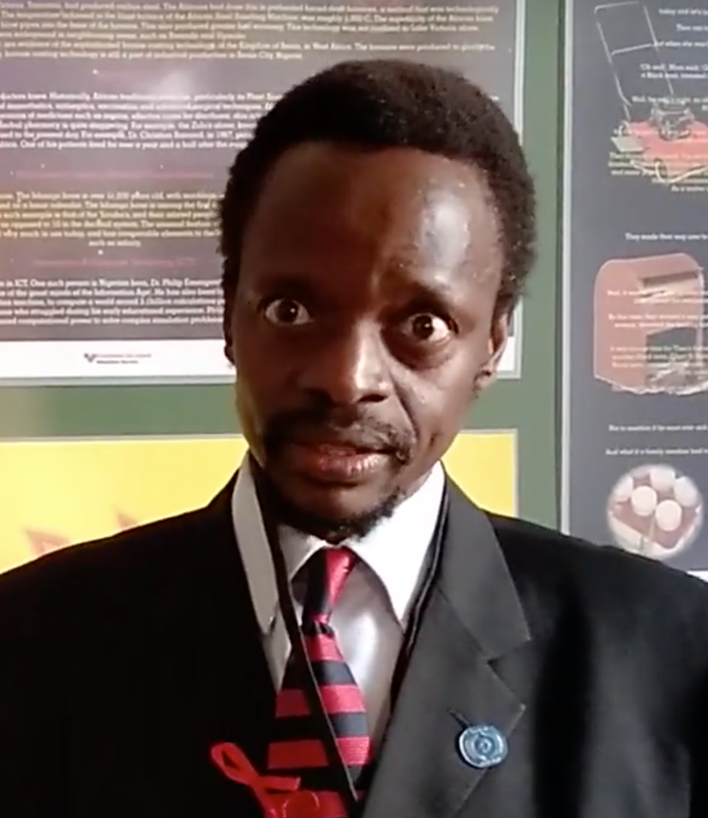
RUDZANI NEMUTUDI
Affiliation to IUPAP:
Associate Secretary General
Commission/Category:
Executive Council / Commission on Policy And Finance (C1)
Current Job Title:
Deputy Director
Current affiliation (Institution):
iThemba LABS (Laboratory for Accelerator Based Sciences), Cape Town, South Africa
Area of Study/Research/Expertise:
Mesoscopic semiconductor devices fabricated using proximal probe microscopic techniques such as AFM (Atomic Force Microscope) and STM (Scanning Tunneling Microscope), surface science and accelerator-based ion beam analysis19.
Last Physics paper written with date of publication:
2012: “Simonkolleite nano-platelets: Synthesis and temperature effect on hydrogen gas sensing properties”, J. Sithole et. al., Applied Surface Science 258 (2012) pp.7839.
Any other information:
Member of the Executive Council of the South African Institute of Physics (SAIP)

Slide 11

LEONG CHUAN KWEK
Affiliation to IUPAP:
Deputy Secretary General
Commission/Category:
Executive Council / Commission on Policy And Finance (C1)
Current Job Title:
Professor
Current affiliation (Institution):
Center for Quantum Technologies, National University of Singapore
Area of Study/Research/Expertise:
Quantum Information Science and Atomtronics, Physics
Last Physics paper written with date of publication:
19 November 2021: “Noisy intermediate-scale quantum algorithms”, K. Bharti et al., accepted for publ. in Rev. Mod. Phys.
Any other information:
Quantum information science

Slide 12

MONICA PEPE-ALTARELLI
Affiliation to IUPAP:
Vice-President at Large (Centenary)
Commission/Category:
Executive Council / Commission on Policy And Finance (C1)
Current Job Title:
Senior Staff Physicist
Current affiliation (Institution):
CERN
Area of Study/Research/Expertise:
High Energy Particle Physics (LHCb collaboration)
Last Physics paper written with date of publication:
20 April 2020: Phys. Rev. D 101, 072004 – (personal paper) and many recent LHCb publications
Any other information:
Chair, WG 17 - Centenary celebrations

Slide 13
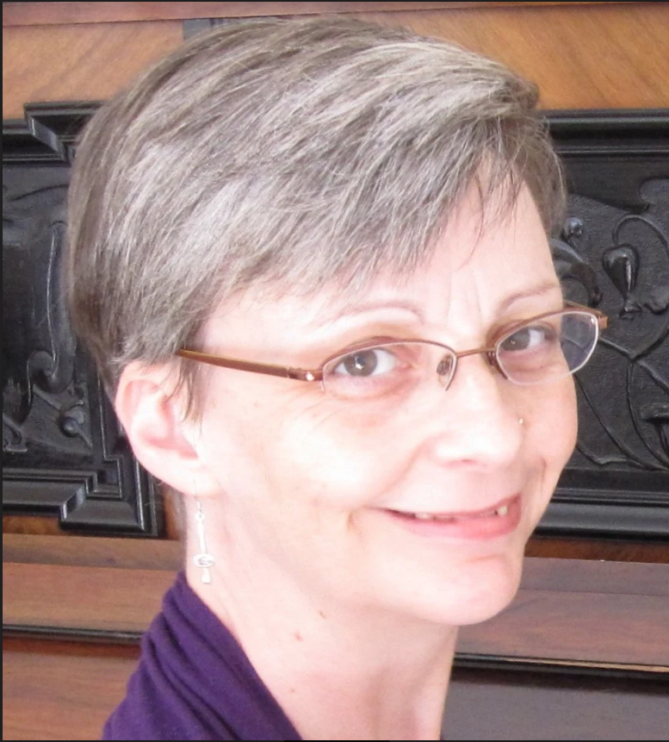
GILLIAN BUTCHER
Affiliation to IUPAP:
Vice-President at Large (Gender Champion)
Commission/Category:
Executive Council
Current Job Title:
Research Associate
Current affiliation (Institution):
University of Leicester
Area of Study/Research/Expertise:
Space instrumentation
Last Physics paper written with date of publication:
6 July 2018: “Microchannel plate x-ray optics on the Mercury imaging x-ray spectrometer”, A. Martindale et al., Proc. SPIE 10699, 106990W.
Any other information:

Slide 14
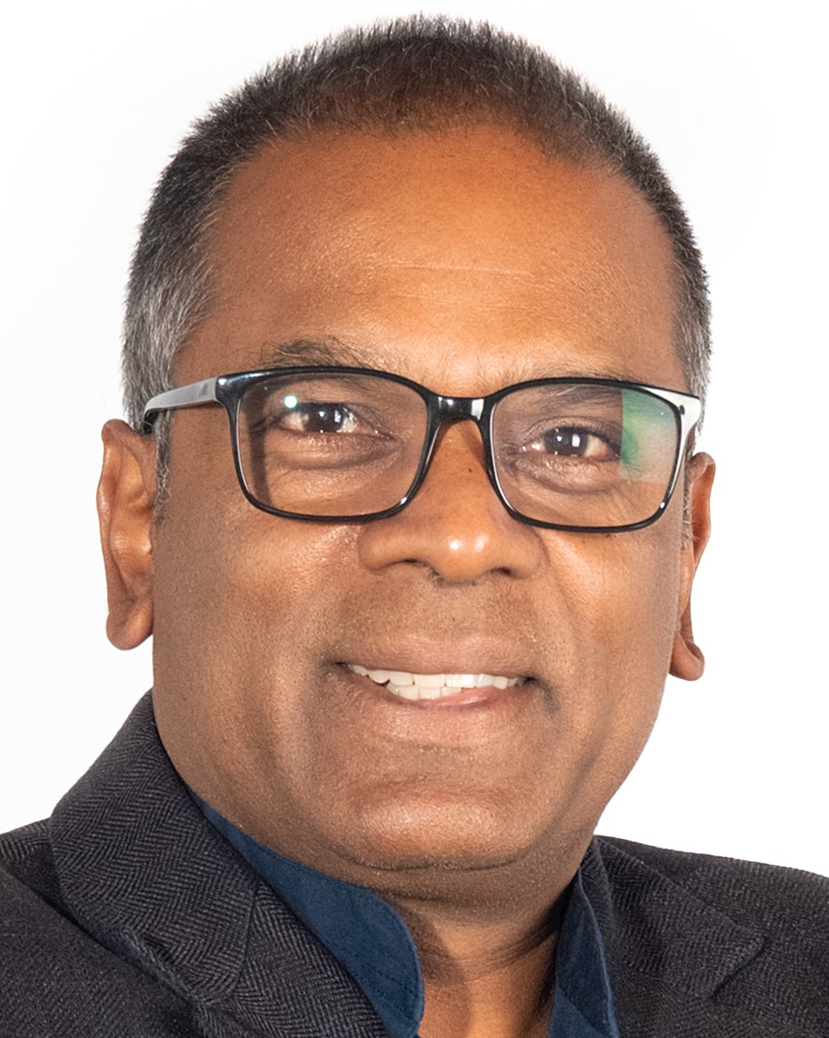
NITHAYA CHETTY
Affiliation to IUPAP:
Vice-President at Large (New Members)
Commission/Category:
Executive Council
Current Job Title:
Dean of the Faculty of Science
Current affiliation (Institution):
University of Witwatersrand
Area of Study/Research/Expertise:
Computational Solid State Physics
Last Physics paper written with date of publication:
20 August 2019: “Electronic properties of vacancies in bilayer graphene”, R.E. Mapasha et al., Physica B: 573 (2019) pp. 67-71.
Any other information:
To fight poverty and promote equality, developing countries should pursue the highest levels of unfettered, open-ended scientific inquiry. See Aim for the Sky, But Keep Your Feet on the Ground by Nithaya Chetty

Slide 15
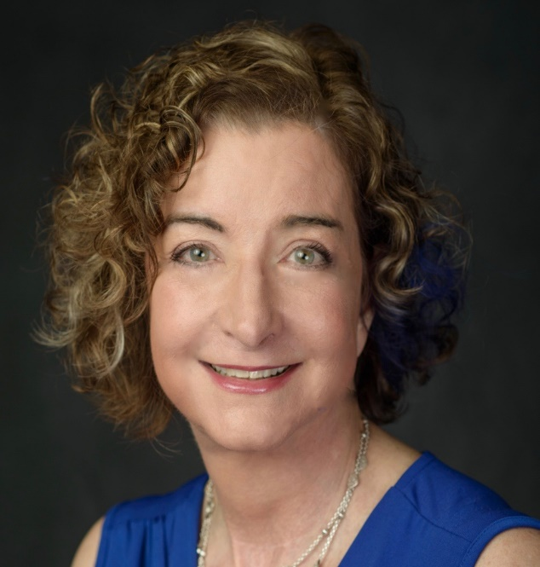
LAURA H. GREENE
Affiliation to IUPAP:
Vice-President at Large (Outreach and Ethics )
Commission/Category:
Executive Council
Current Job Title:
Chief Scientist and Marie Krafft Professor of Physics
Current affiliation (Institution):
National High Magnetic Field Laboratory and Florida State University
Area of Study/Research/Expertise:
Quantum Materials and Policy
Last Physics paper written with date of publication:
10 June 2021: “Spectroscopic Evidence for the Direct Involvement of Local Moments in the Pairing Process in the Heavy-Fermion Superconductor CeCoIn₅”, K. Shrestha et al., Phys. Rev. B 103, 224515.
Any other information:
Recently appointed to the US President’s Council of Advisors for Science and Technology (PCAST).

Slide 16
Vice-Presidents elected from the Commission Chairs
Takaaki Kajita (C4)
Tae Won Noh (C10)
Ani Aprahamian (C12)
Kuijuan Jin (C13)
Tetyana Antimirova (C14)

Slide 17
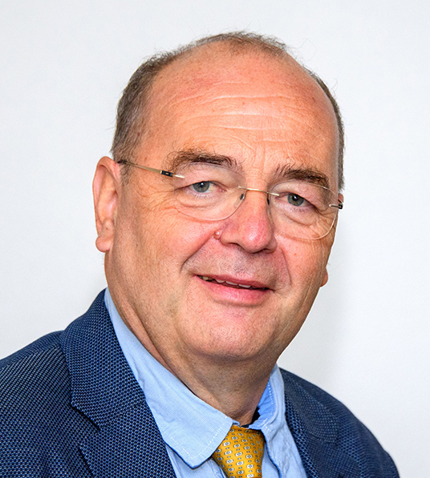
MARC HIMBERT (C2)
Affiliation to IUPAP:
Chair
Commission/Category:
Commission on Symbols, Units, Nomenclature, Atomic Masses & Fundamental Constants (C2)
Current Job Title:
Professor of metrology
Current affiliation (Institution):
Conservatoire National des Arts et Métiers (CNAM)
Area of Study/Research/Expertise:
-
Last Physics paper written with date of publication:
-
Any other information:
-

Slide 18

LUCILLA DE ARCANGELIS (C3)
Affiliation to IUPAP:
Chair / Vice-Presidents Elected from the Commission Chairs
Commission/Category:
Commission on Statistical Physics (C3)
Current Job Title:
Professor
Current affiliation (Institution):
University of Campania Luigi Vanvitelli
Area of Study/Research/Expertise:
Percolation Theory, Self-Organized Criticality, Power Laws in Fracture
Last Physics paper written with date of publication:
-
Any other information:

Slide 19
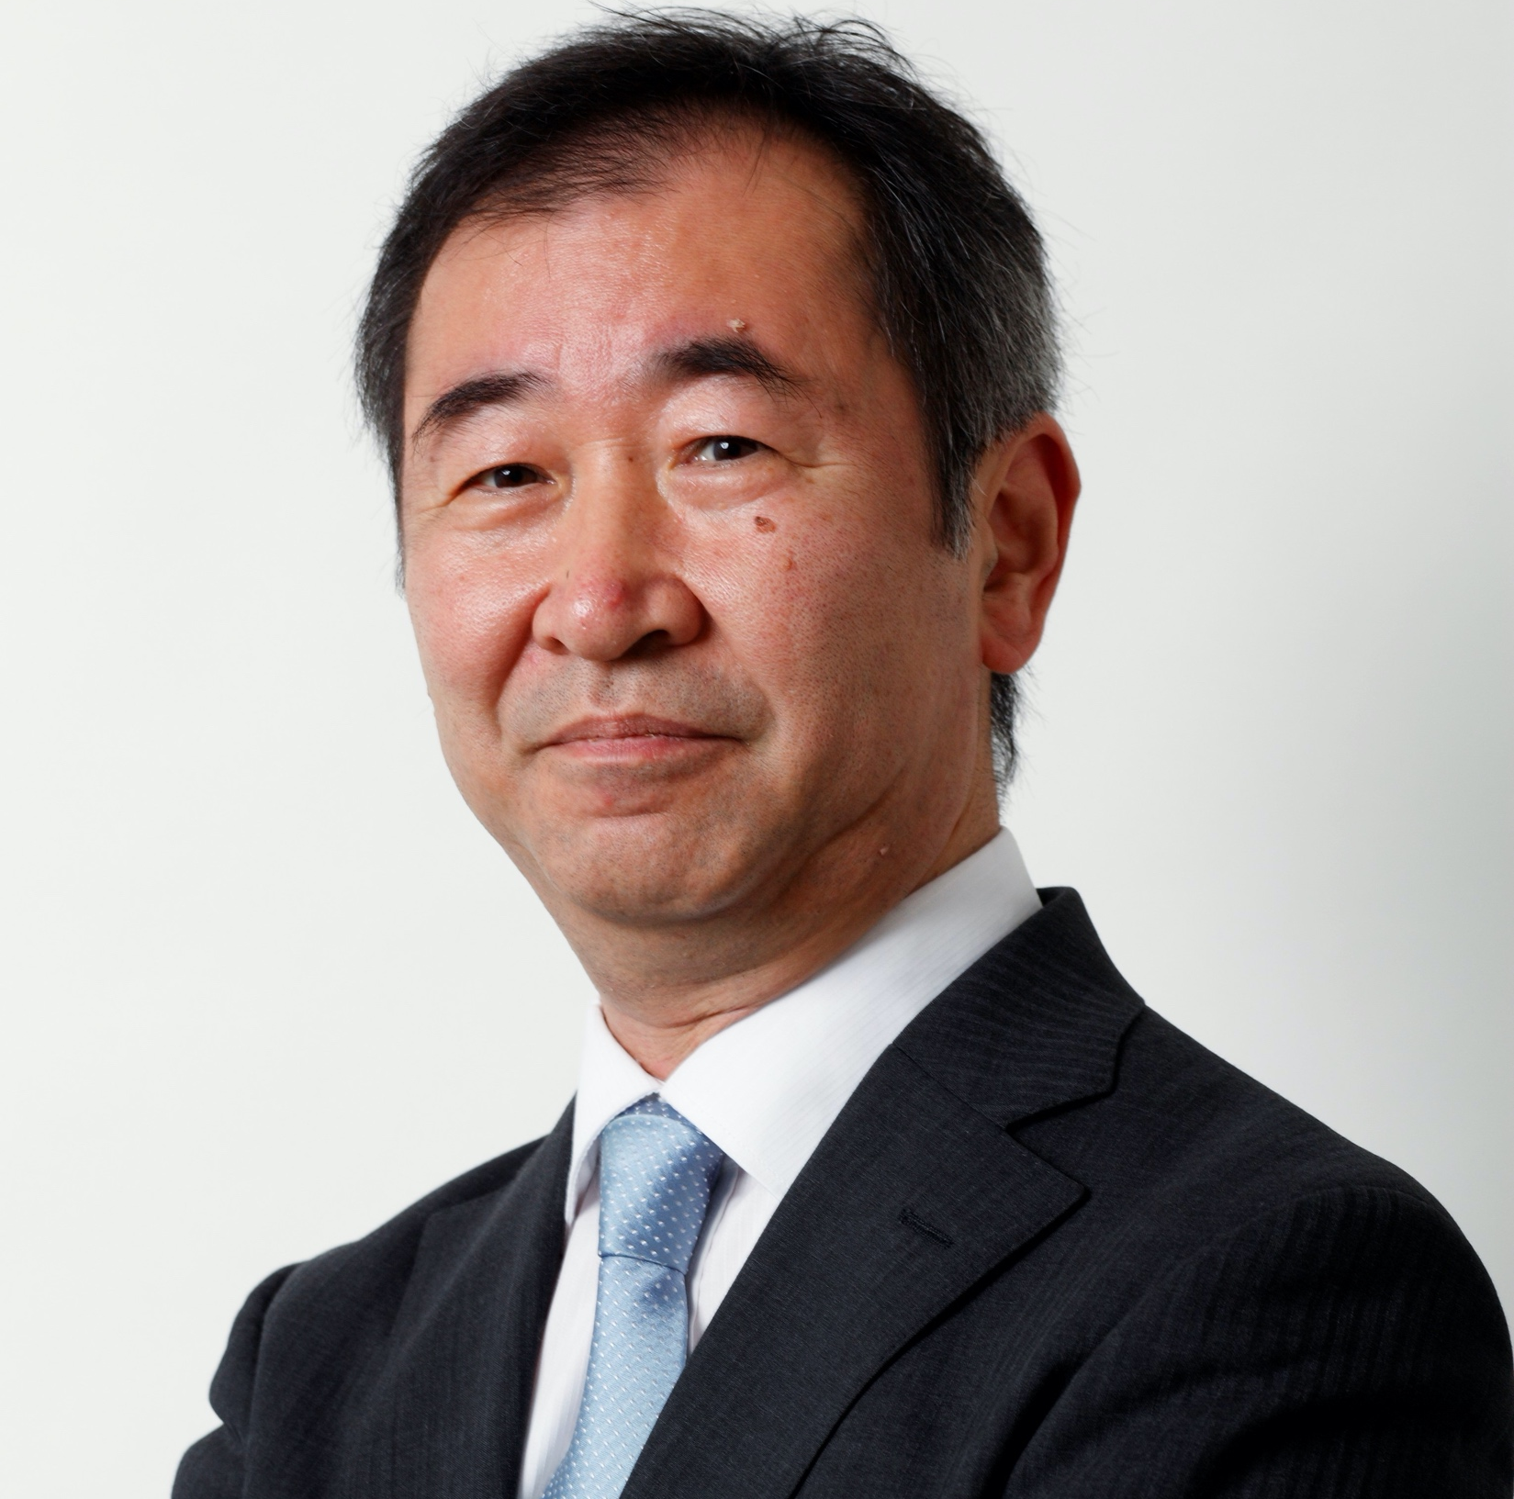
TAKAAKI KAJITA (C4)
Affiliation to IUPAP:
Chair / Vice-Presidents Elected from the Commission Chairs
Commission/Category:
Commission on Astroparticle Physics (C4)
Current Job Title:
Professor
Current affiliation (Institution):
Institute for Cosmic Ray Research, The University of Tokyo
Area of Study/Research/Expertise:
Cosmic Rays, Neutrinos and Gravitational Waves
Last Physics paper written with date of publication:
17 August 2020: "Overview of KAGRA : Detector design and construction
history”, T. Akutsu et al., (KAGRA collaboration), Prog. Theo. Exp. Phys. 2021 (5), 05A101.
Any other information:
President of the Science Council of Japan (until Sep. 2023)

Slide 20
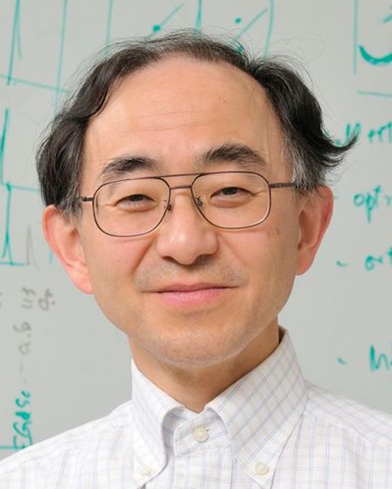
NAOTO NAGAOSA (C5)
Affiliation to IUPAP:
Chair
Commission/Category:
Commission on Low Temperature Physics (C5)
Current Job Title:
Professor
Current affiliation (Institution):
RIKEN Center for Emergent Matter Science (CEMS)
Area of Study/Research/Expertise:
Condensed Matter Theory. Strong Electron Correlation, Magnetism, and Superconductivity in Solids. Topological Aspects of Electronic Systems.
Last Physics paper written with date of publication:
-
Any other information:

Slide 21
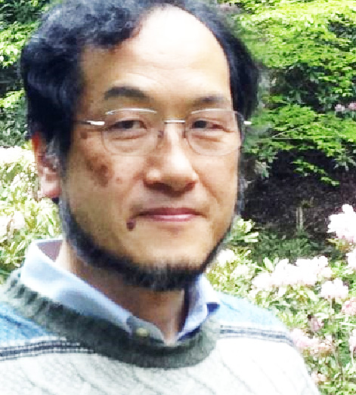
MASAKI SASAI (C6)
Affiliation to IUPAP:
Chair
Commission/Category:
Commission on Biological Physics (C6)
Current Job Title:
Professor of Applied Physics
Current affiliation (Institution):
Nagoya University, Nagoya, Japan
Area of Study/Research/Expertise:
Theoretical Biological Physics
Last Physics paper written with date of publication:
7 May 2021: “Generation of dynamic three-dimensional genome structure through phase separation of chromatin”, S. Fujishiro and M. Sasai, bioRxiv.
Any other information:

Slide 22
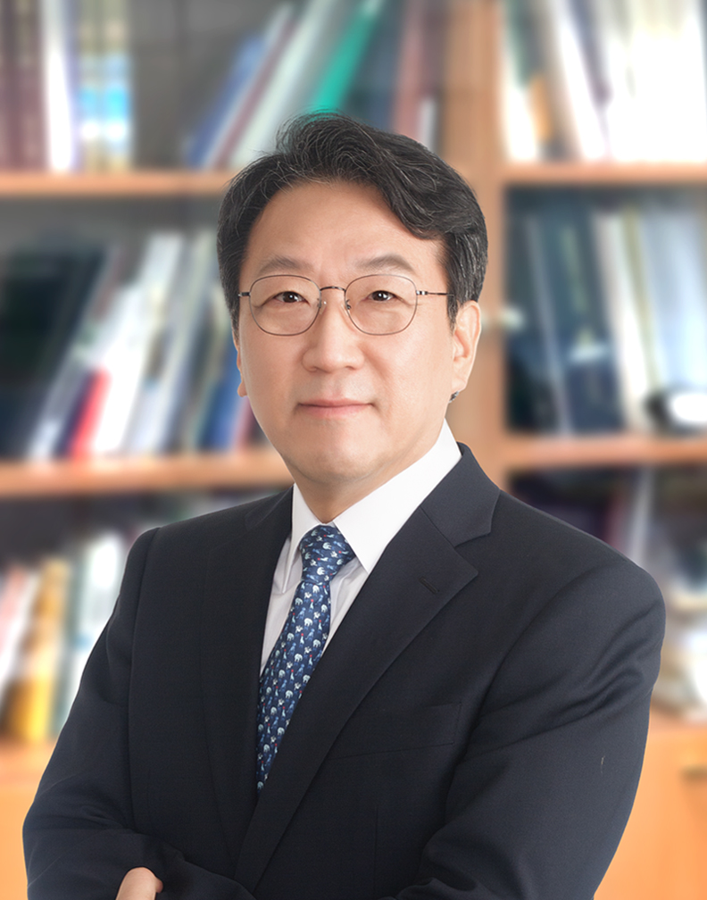
YOUNG DONG KIM (C8)
Affiliation to IUPAP:
Chair / Liaison Chair of Korean Physical Society
Commission/Category:
Commission on Semiconductors (C8)
Current Job Title:
Professor of physics
Current affiliation (Institution):
Kyung Hee University, Seoul, South Korea
Area of Study/Research/Expertise:
Semiconductors/Optical Properties/Ellipsometry
Last Physics paper written with date of publication:
10 June 2021, "Maximum-entropy revisited: Optimal filetring of spectra", Journal of Applied Physics 129, 224902
Any other information:

Slide 23
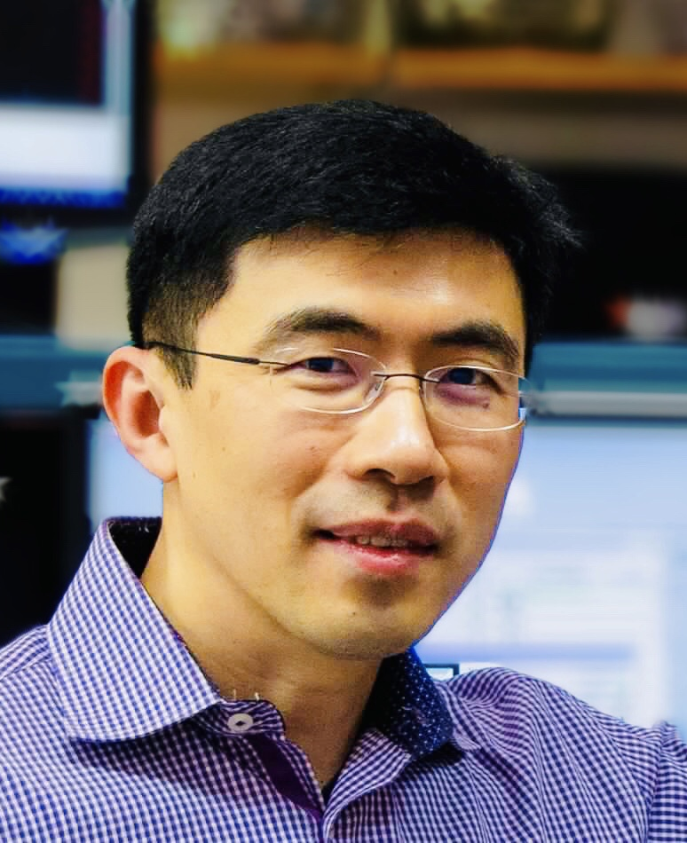
KAI LIU (C9)
Affiliation to IUPAP:
Chair
Commission/Category:
Commission on Magnetism (C9)
Current Job Title:
Professor and McDevitt Chair in Physics
Current affiliation (Institution):
Georgetown University, Washington, DC
Area of Study/Research/Expertise:
Experimental Condensed Matter Physics, Nanomagnetism and Spintronics
Last Physics paper written with date of publication:
23 June 2021: ”Reversible writing/deleting of magnetic skyrmions through hydrogen adsorption/desorption”, G. Chen et al., Nature Communications, in press.
Any other information:

Slide 24
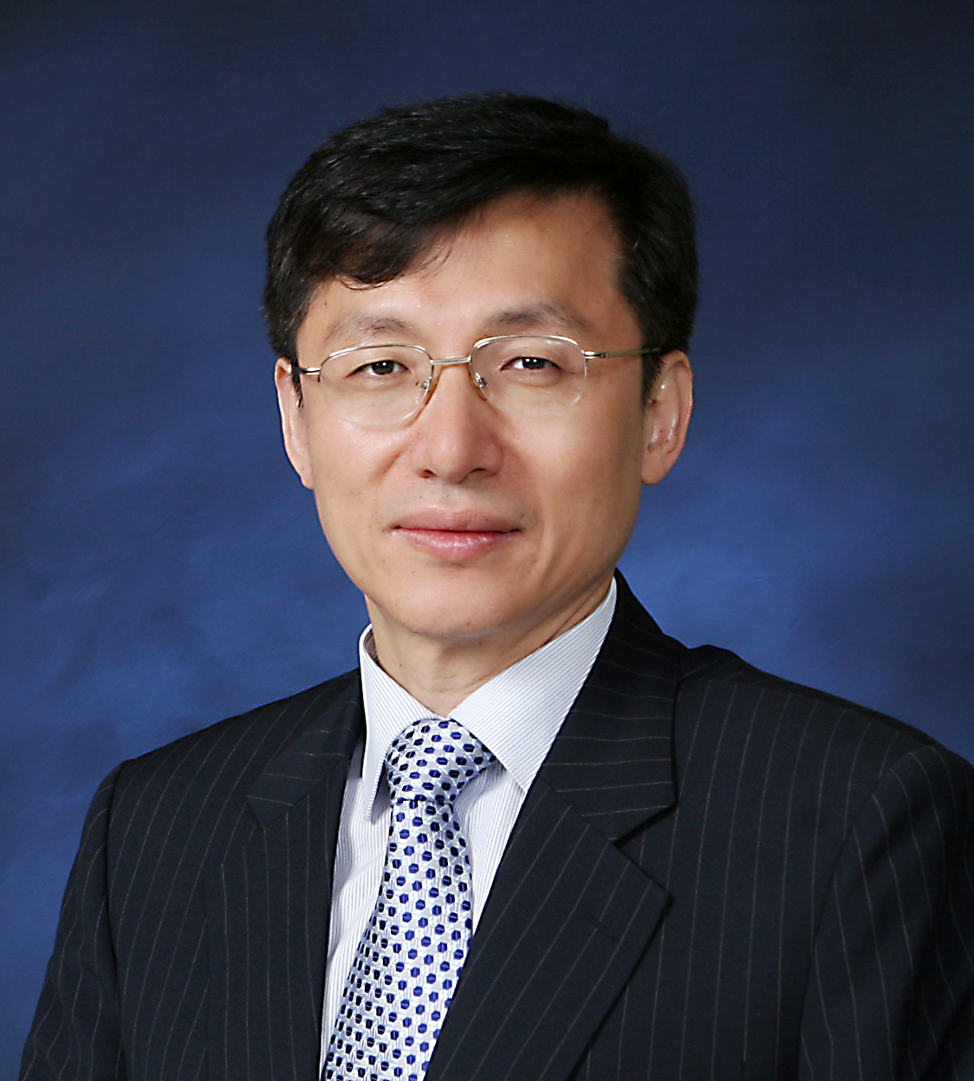
TAE WON NOH (C10)
Affiliation to IUPAP:
Chair / Vice-Presidents Elected from the Commission Chairs
Commission/Category:
Commission on Structure and Dynamics of Condensed Matter (C10)
Current Job Title:
Professor of Physics, Director
Current affiliation (Institution):
Seoul National University, IBS Center for Correlated Electron Systems
Area of Study/Research/Expertise:
Condensed Matter Physics, Correlated Electron Systems
Last Physics paper written with date of publication:
3 January 2022: “Nematic response revealed by coherent phonon oscillations in BaFe₂As₂”, M-C Lee et al., Phys. Rev. B 105, 024501.
Any other information:
President of the Korean Physical Society.

Slide 25
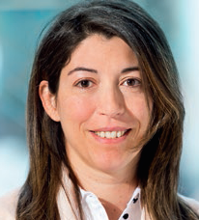
FLORENCIA CANELLI (C11)
Affiliation to IUPAP:
Chair
Commission/Category:
Commission on Particles and Fields (C11)
Current Job Title:
Professor of Physics
Current affiliation (Institution):
University of Zurich
Area of Study/Research/Expertise:
Experimental Particle Physics
Last Physics paper written with date of publication:
18 January 2022: “Measurement of the inclusive and differential ttˉγ\mathrm{t\bar{t}}\gammattˉγ cross sections in the dilepton channel and effective field theory interpretation in proton-proton collisions at s\sqrt{s}s ​ =13 TeV”, CMS Collaboration, arXiv 2201.07301 [hep-ex].
Any other information:
Current physics coordinator of the CMS experiment, CERN.

Slide 26
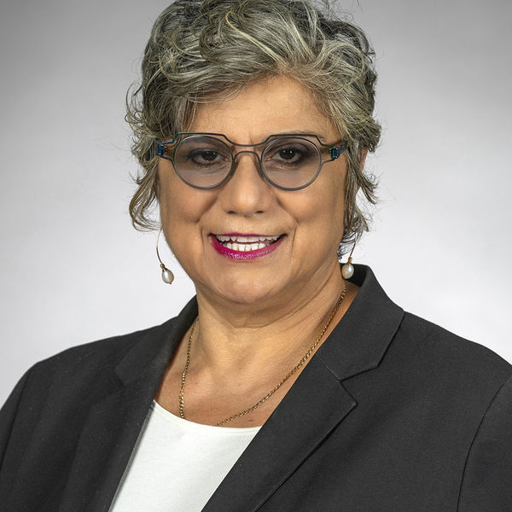
ANI APRAHAMIAN (C12)
Affiliation to IUPAP:
Chair / Vice-Presidents Elected from the Commission Chairs
Commission/Category:
Commission on Nuclear Physics (C12)
Current Job Title:
Professor / Director
Current affiliation (Institution):
University of Notre Dame / A. Alikhanyan National Science Laboratory of Armenia
Area of Study/Research/Expertise:
Nuclear Physics
Last Physics paper written with date of publication:
14 September 2021: “Open Challenges to Nuclear Physics Resulting from the Neutron Star Merger”, Nuclear Physics News, 31(3), 2021, pp. 11–16.
Any other information:
Nine publications in 2021—the reference above being most relevant for the IUPAP meeting.

Slide 27
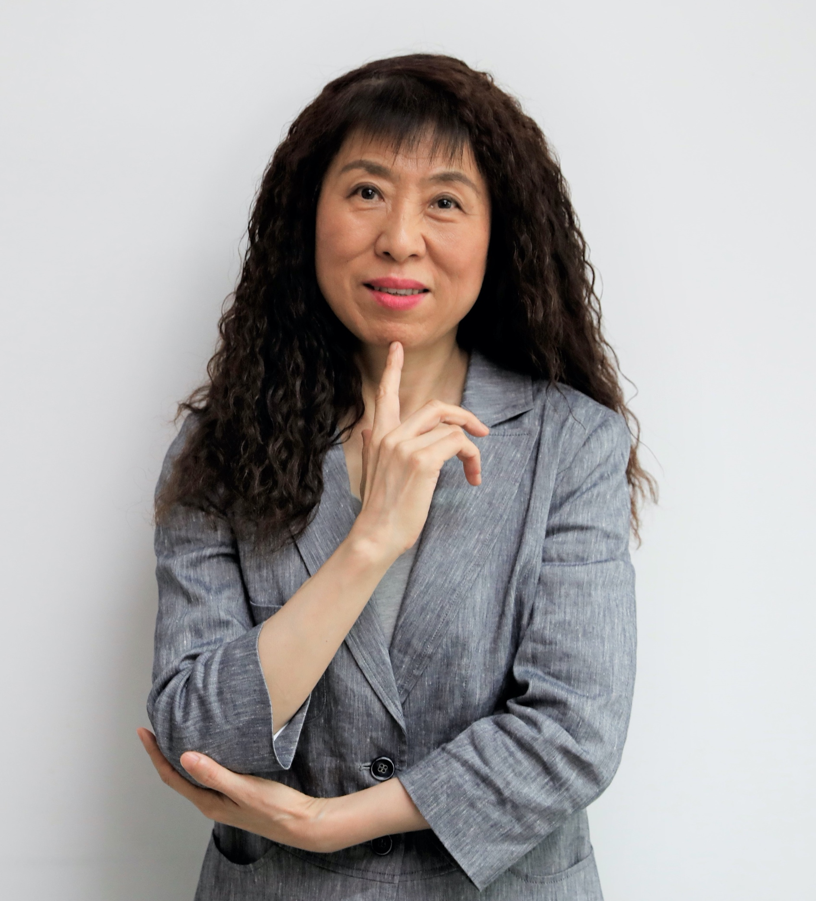
KUIJUAN JIN (C13)
Affiliation to IUPAP:
Chair / Vice-Presidents Elected from the Commission Chairs
Commission/Category:
Commission on Physics for Development (C13)
Current Job Title:
Professor, Group Leader
Current affiliation (Institution):
Institute of Physics, Chinese Academy of Sciences
Area of Study/Research/Expertise:
Exploring novel properties of low dimensional perovskite oxides, especially with optical method.
Last Physics paper written with date of publication:
List of 2021 publications
Any other information:
Elected Fellow of the British Institute of Physics since 2011, and a Fellow of the American Physical Society since 2012.

Slide 28
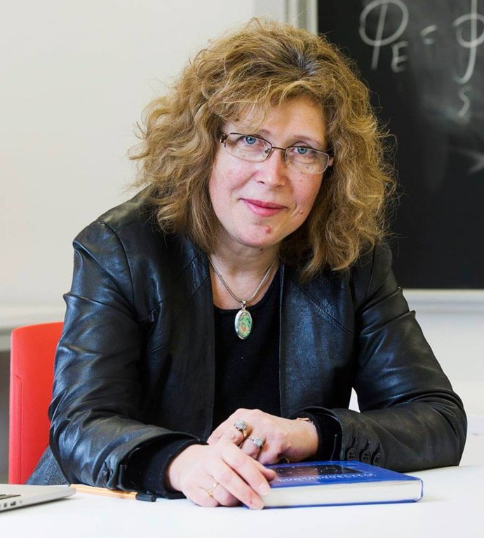
TETYANA ANTIMIROVA (C14)
Affiliation to IUPAP:
Chair / Vice-Presidents Elected from the Commission Chairs
Commission/Category:
Commission on Physics Education (C14)
Current Job Title:
Associate Professor
Current affiliation (Institution):
Department of Physics, Ryerson University, Toronto, Ontario, Canada
Area of Study/Research/Expertise:
Physics Education Research (PER), Science Education and Outreach, Research-Informed Curriculum Development
Last Physics paper written with date of publication:
July 2021: “Remote Teaching and Learning: Undergraduate Physics Laboratories During a Pandemic and Beyond” in EDULEARN21 Proceedings 13th International Conference on Education and New Learning Technologies, 5-6 July 2021, pp. 351-358.
Any other information:
The Ryerson University is in process of renaming. For more information please see: Renaming in process

Slide 29
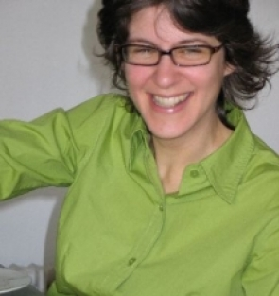
JIMENA GORFINKIEL (C15)
Affiliation to IUPAP:
Vice Chair
Commission/Category:
Commission on Atomic, Molecular, and Optical Physics (C15)
Current Job Title:
Senior Lecturer
Current affiliation (Institution):
The Open University
Area of Study/Research/Expertise:
Molecular Physics
Last Physics paper written with date of publication:
22 November 2021: “Evaluation of Recommended Cross Sections for the Simulation of Electron Tracks in Water”, A. García-Abenza et al., Atoms 2021, 9(4), 98.
Any other information:

Slide 30
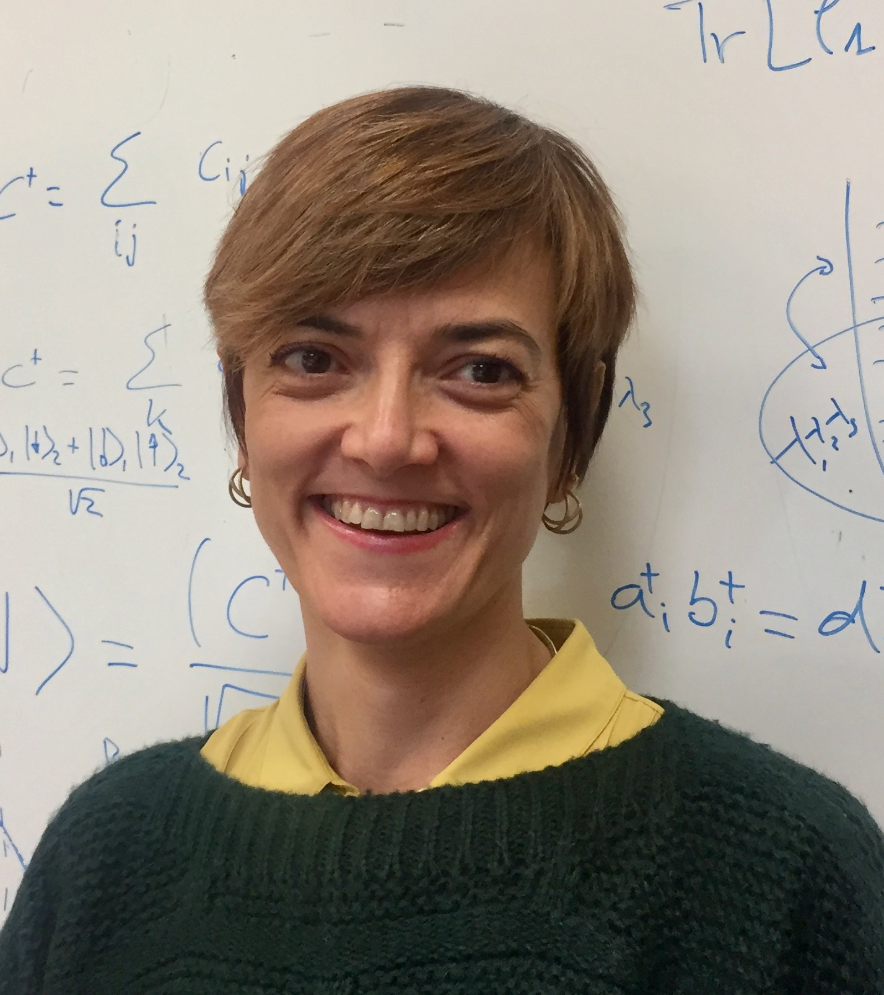
ROSARIO GONZÁLEZ-FÉREZ (C15)
Affiliation to IUPAP:
Chair
Commission/Category:
Commission on Atomic, Molecular, and Optical Physics (C15)
Current Job Title:
Professor of Atomic Molecular and Nuclear Physics
Current affiliation (Institution):
Universidad de Granada, Granada, Spain
Area of Study/Research/Expertise:
Atomic and Molecular Physics
Last Physics paper written with date of publication:
27 January 2021: “Ultralong-Range Rydberg Bimolecules”, R. González-Férez et al., Phys. Rev. Lett. 126, 043401.
Any other information:

Slide 31
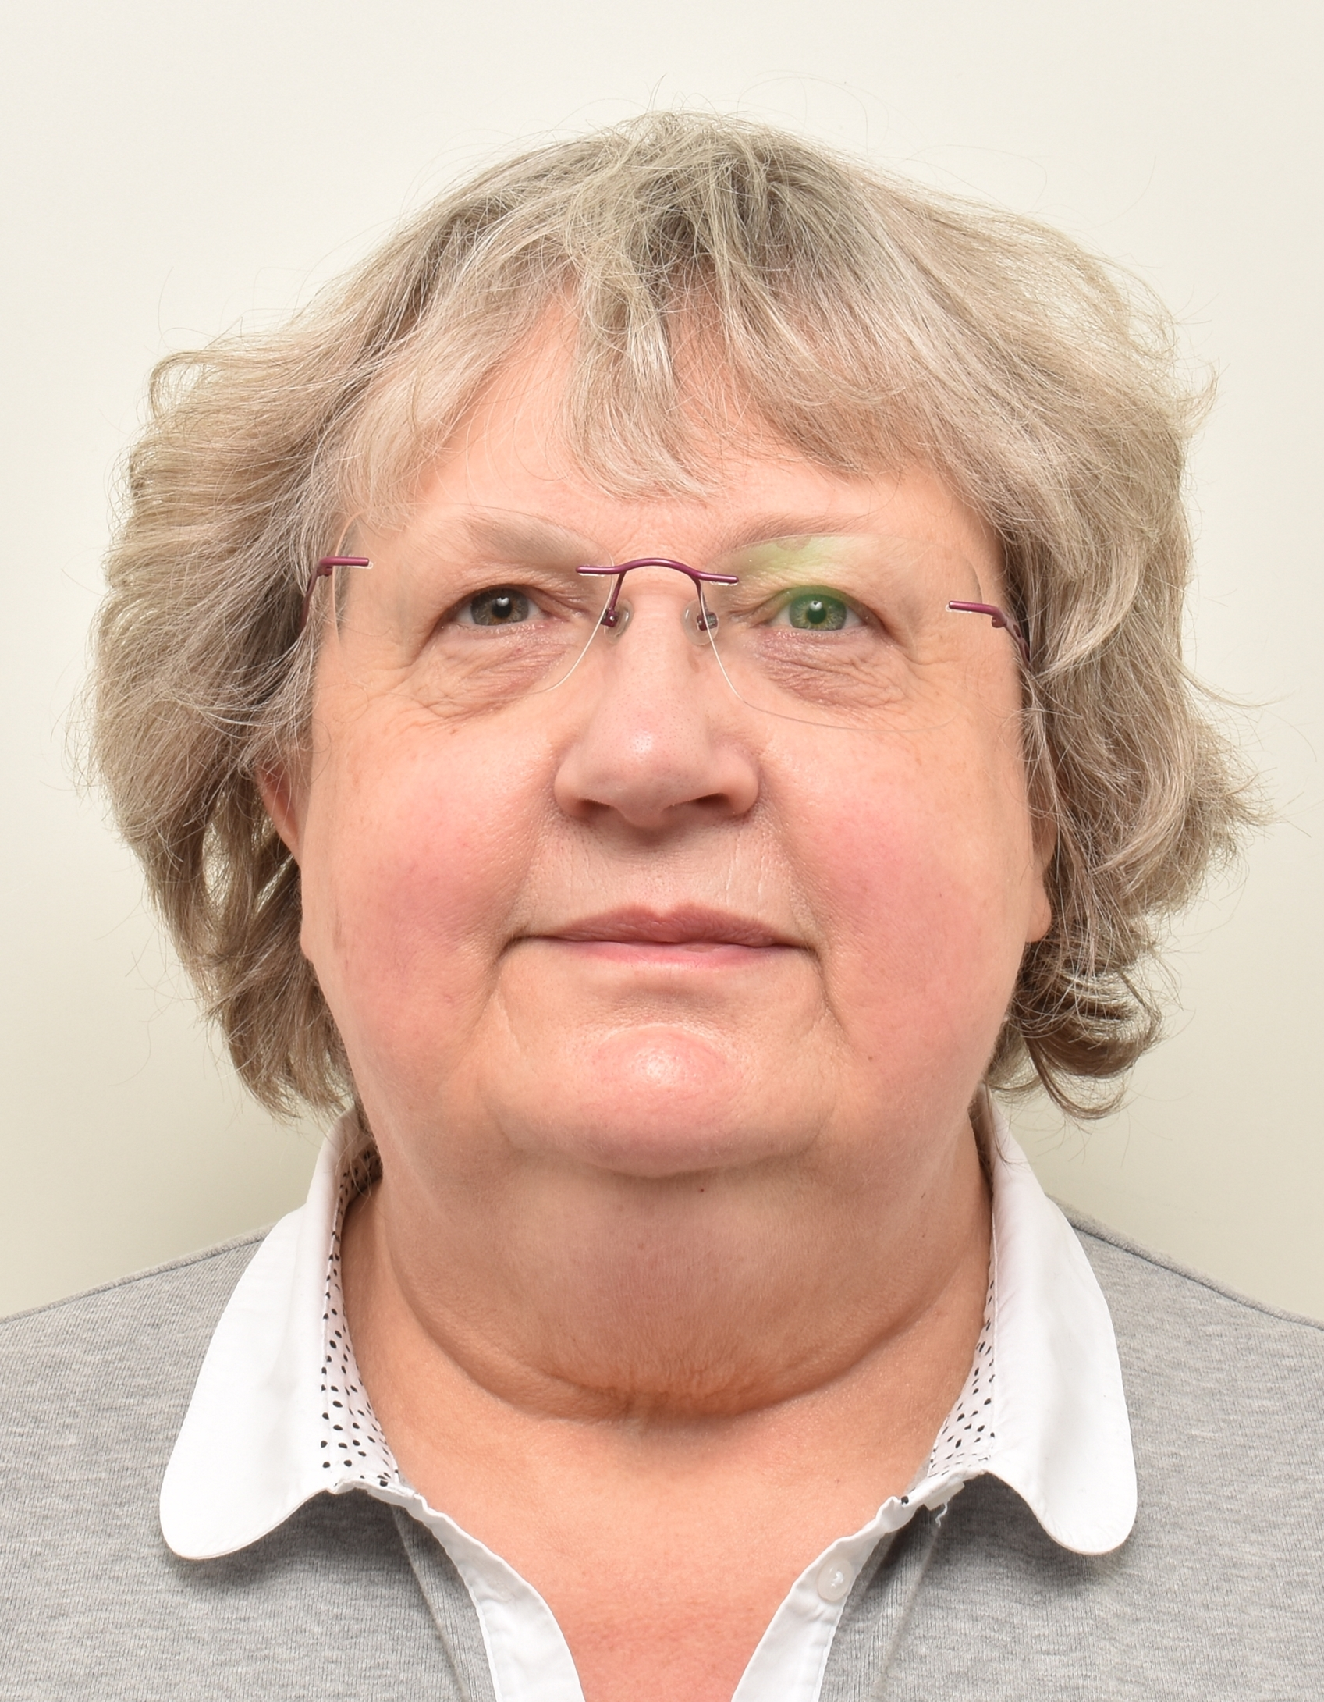
SYLVIE JACQUEMOT (C16)
Affiliation to IUPAP:
Chair / WG14 associate member
Commission/Category:
Commission on Plasma Physics (C16)
Current Job Title:
Coordinator of the Laserlab-Europe European project; task officer in charge of European affairs at Ecole Polytechnique
Current affiliation (Institution):
LULI, Ecole Polytechnique, France
Area of Study/Research/Expertise:
Laser-Produced Plasmas and Secondary Sources; Laser Fusion
Last Physics paper written with date of publication:
7 November 2017: ”Toward compact and ultra-intense laser-based soft x-ray lasers”, S. Sebban et al., Plasma Phys. Control. Fusion 60 (2018) 014030.
Any other information:

Slide 32
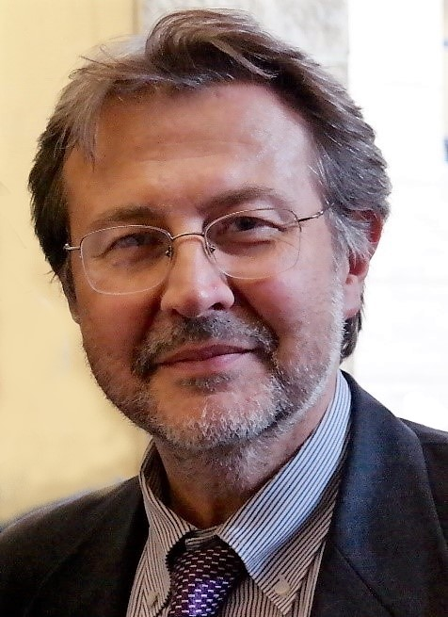
ROBERTO PINI (C17)
Affiliation to IUPAP:
Chair (2017-2021: secretary of C17, 2014-2017: member of C17
Commission/Category:
Commission on Laser Physics and Photonics (C17)
Current Job Title:
Physicist, CNR Research Director
Current affiliation (Institution):
Institut Nello Carrara Institute of Applied Physics, Italian National Research Council (CNR)
Area of Study/Research/Expertise:
Laser applications, Biophotonics, Nanophotonics
Last Physics paper written with date of publication:
4 June 2021: “Cost effective silver nanowire‐decorated graphene paper for drop‐on SERS biodetection”, Amicucci, C., D’andrea, C., de Angelis, M., Banchelli, M., Pini, R., Matteini, P. Nanomaterials, 2021, 11(6), 1495).
Any other information:

Slide 33
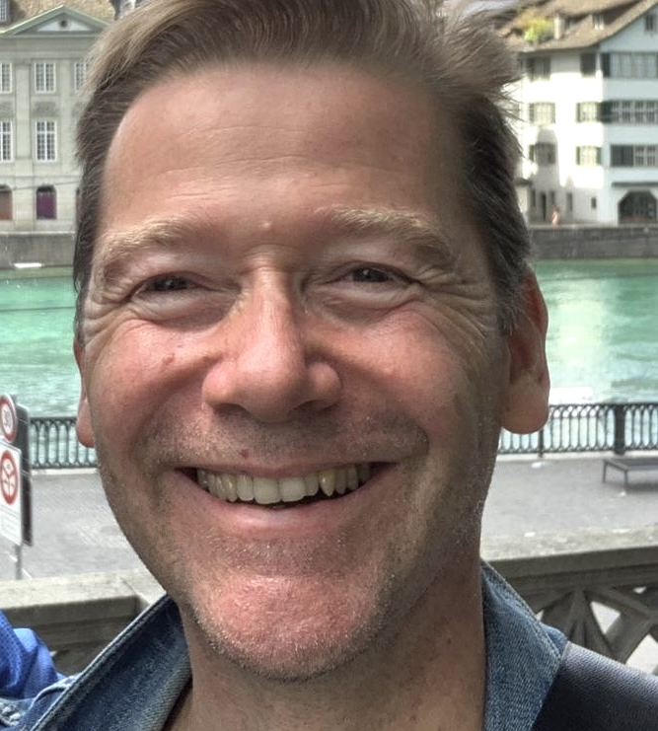
ALAIN JOYE (C18)
Affiliation to IUPAP:
Chair
Commission/Category:
Commission on Mathematical Physics (C18)
Current Job Title:
Professor
Current affiliation (Institution):
Institut Fourier, Université Grenoble Alpes, France
Area of Study/Research/Expertise:
Mathematical Physics
Last Physics paper written with date of publication:
15 July 2021: “Fermionic Walkers Driven Out of Equilibrium”, S. Andréys et al., J. Stat. Phys. 184 (2021) 14.
Any other information:

Slide 34
PIETRO UBERTINI (C19)
Affiliation to IUPAP:
Chair
Commission/Category:
Commission on Astrophysics (C19)
Current Job Title:
Research Director (retired) , Professor Astrophysics, Associate to National Institute of Astrophysics (INAF) and Italian Space Agency (ASI)
Current affiliation (Institution):
Institute of Space Astrophysics and Planetology (IAPS), Rome, Italy
Area of Study/Research/Expertise:
High Energy Space Astrophysics, Space Weather
Last Physics paper written with date of publication:
9. December 2021: “Daily variability at milli-arcsecond scales in the radio-quiet NLSy1 Mrk 110”, F. Panessa et al., Month. Not. Royal Astron. Soc., 510 (2022) pp. 718–724.
Any other information:

Slide 35
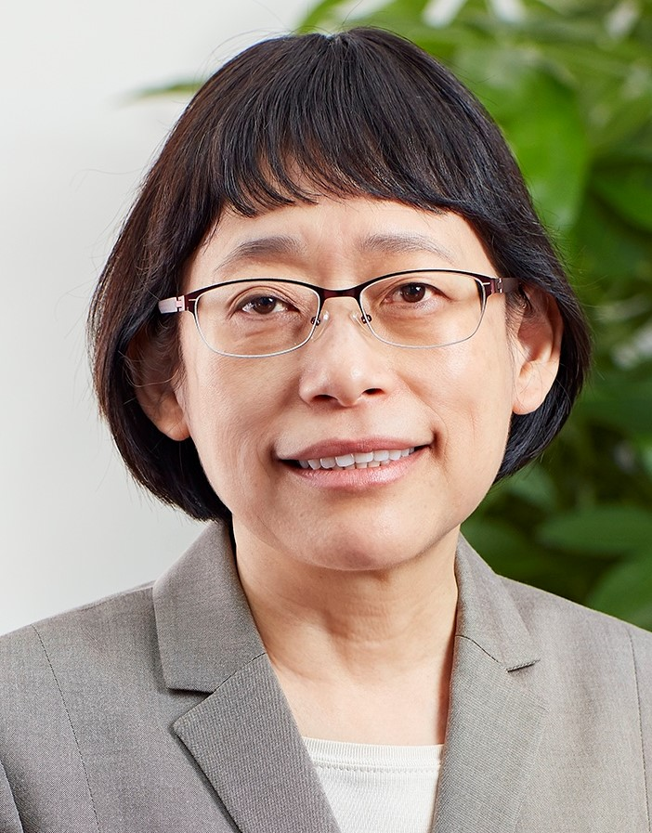
MEI-YIN CHOU (C20)
Affiliation to IUPAP:
Chair
Commission/Category:
Commission on Computational Physics (C20)
Current Job Title:
Distinguished Research Fellow and Vice President
Current affiliation (Institution):
Academia Sinica, Taiwan
Area of Study/Research/Expertise:
Computational Physics
Last Physics paper written with date of publication:
7 October 2021: “Structure Relaxation and Liquidlike Enhanced Cu Diffusion at the Surface of β-Cu₂S Chalcocite”, J. Wang et al., Nano Lett. 21 (2021) pp. 8895–8900.
Any other information:
Taiwan Physical Society

Slide 36
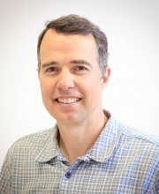
JOHN HOWELL (AC1)
Affiliation to IUPAP:
Chair [President of the International Commission for Optics]
Commission/Category:
International Commission for Optics (AC1)
Current Job Title:
Professor of Physics
Current affiliation (Institution):
Hebrew University
Area of Study/Research/Expertise:
Quantum/Classical Optics
Last Physics paper written with date of publication:
24 September 2021: “Generalized nighttime radiative deficits”, J.C. Howell et al., Journal of Hydrology, 603B (2021) 126971.
Any other information:
This is not a typical paper for me though ...

Slide 37
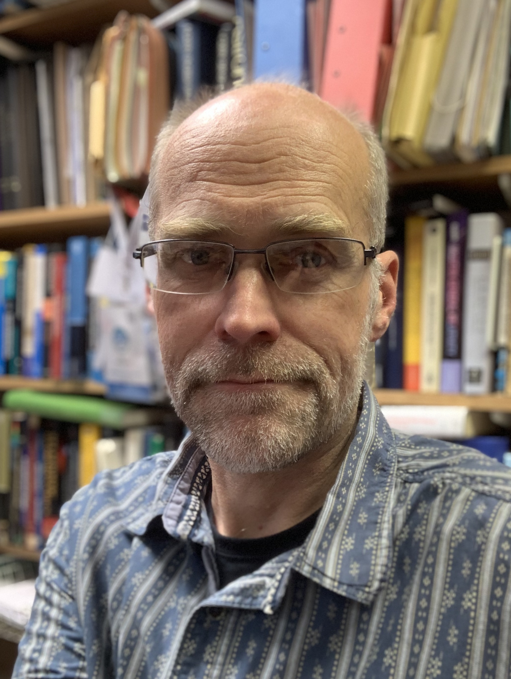
NILS ANDERSSON (AC2)
Affiliation to IUPAP:
Chair / President of the Society on General Relativity and Gravitation
Commission/Category:
International Society on General Relativity and Gravitation, ISGRG (AC2)
Current Job Title:
Professor
Current affiliation (Institution):
University of Southampton
Area of Study/Research/Expertise:
Gravitational Physics
Last Physics paper written with date of publication:
25 November 2021: ”The physics of non-ideal general relativistic magnetohydrodynamics”, N. Andersson et al., Month. Not. Royal Astron. Soc., 509 (2022) pp. 3737–3750.
Any other information:

Slide 38
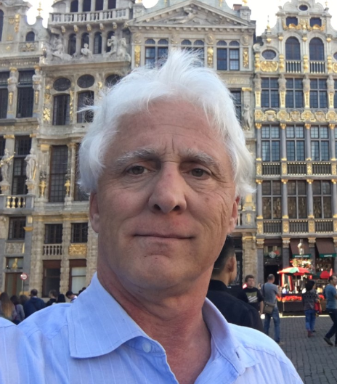
MARK HAMILTON (AC3)
Affiliation to IUPAP:
President
Commission/Category:
International Commission for Acoustics, ICA (AC3)
Current Job Title:
Professor
Current affiliation (Institution):
University of Texas at Austin
Area of Study/Research/Expertise:
Physical Acoustics
Last Physics paper written with date of publication:
-
Any other information:
Past President of the Acoustical Society of America

Slide 39
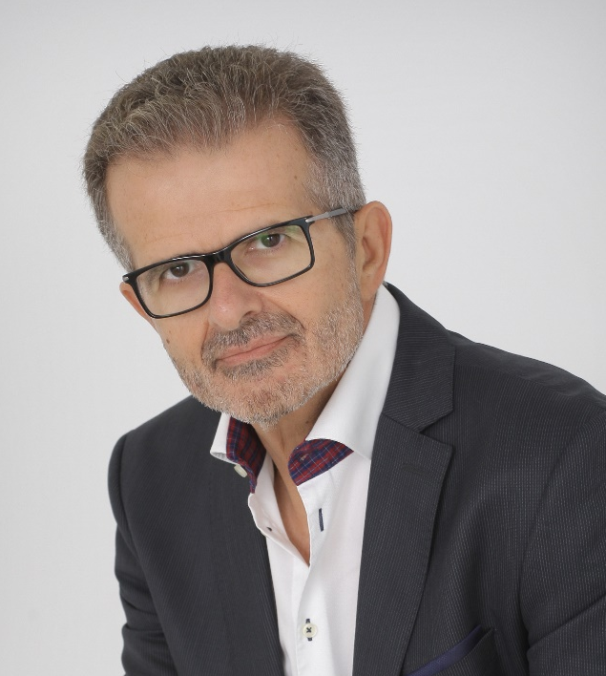
JOHN DAMILAKIS (AC4)
Affiliation to IUPAP:
Chair
Commission/Category:
International Organisation on Medical Physics, IOMP (AC4)
Current Job Title:
Professor of Medical Physics
Current affiliation (Institution):
University of Crete, Greece
Area of Study/Research/Expertise:
Medical Radiation Physics
Last Physics paper written with date of publication:
23. December 2021: “European consensus on patient contact shielding”, P. Hiles et al., European Journal of Medical Physics, article in press.
Any other information:

Slide 40
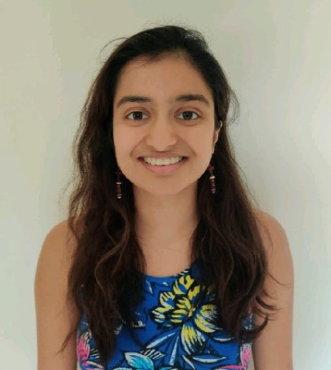
RUHI CHITRE (AC5)
Affiliation to IUPAP:
Chair [President at the International Association of Physics Students]
Commission/Category:
Affiliated Commission of Physics Students (AC5)
Current Job Title:
-
Current affiliation (Institution):
University of Warwick
Area of Study/Research/Expertise:
-
Last Physics paper written with date of publication:
-
Any other information:

Slide 41
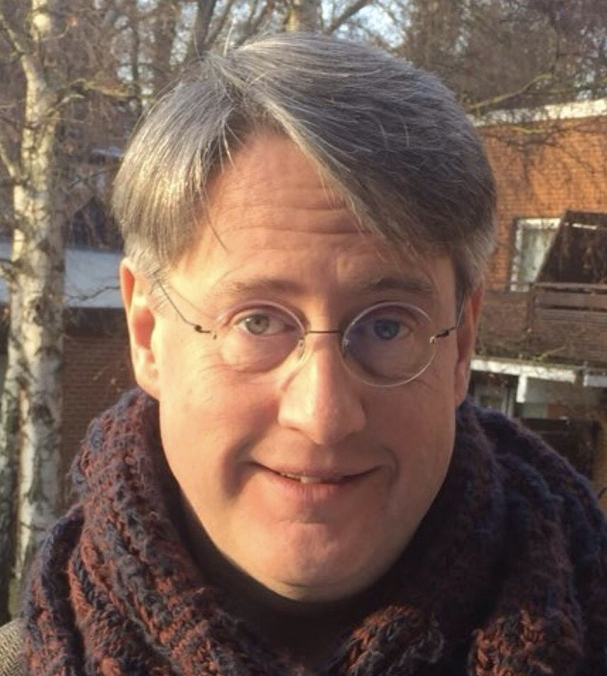
JAUME NAVARRO (AC6)
Affiliation to IUPAP:
Chair
Commission/Category:
Affiliated Commission on the History and Philosophy of Physics (AC6)
Current Job Title:
Professor
Current affiliation (Institution):
University of the Basque Country
Area of Study/Research/Expertise:
History of Science, History of Physics
Last Physics paper written with date of publication:
3 November 2020: ”Whittaker, Einstein, and the History of the Aether: Alternative interpretation, blunder, or bigotry?”, History of Science, 59 (2021) pp. 287-314.
Any other information:

Slide 42
OBSERVERS—LISTED AS REGISTERED
Jun'ichi Yokoyama | AAPPS
Christophe Rossel | WG16 Chair
Cyrus Pan Walther | AC5 Vice–Chair
Arun Grover | C14 member
Timo Eckstein | AC5 member
Michael Taroudakis | AC3 former Chair
Andrew Horsfield | C20 Vice-Chair
Andreas Burkert | C19 Vice-Chair
Lilia Meza-Montes | WG5

Slide 43
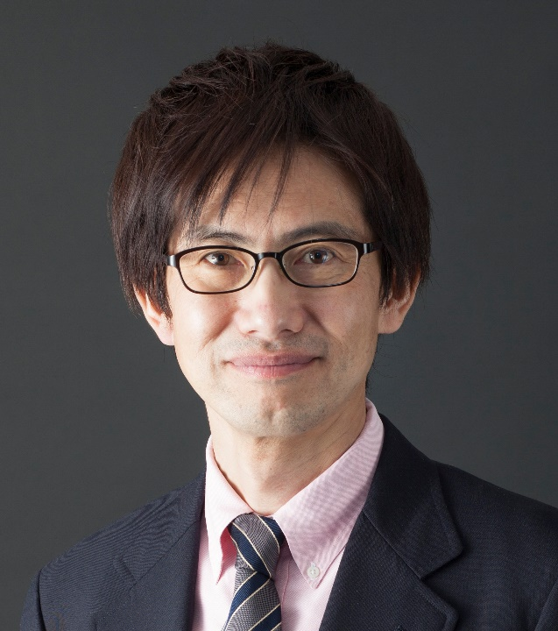
JUN'ICHI YOKOYAMA (AAPPS)
Affiliation to IUPAP:
Observer from Association of Asia Pacific Physical Societies / Vice-Chair C19
Commission/Category:
AAPPS Representative
Current Job Title:
Professor
Current affiliation (Institution):
Research Center for the Early Universe(RESCEU), The University of Tokyo
Area of Study/Research/Expertise:
Cosmology and Gravitational Waves
Last Physics paper written with date of publication:
5 April 2021: “Why primordial non-Gaussianity must be very small?”, J. Kristiano and Jun'ichi Yokoyama , arXiv:2104.01953 [hep-th].
Any other information:
President of Association of Asia Pacific Physical Societies (AAPPS), Chair of KAGRA Science Congress

Slide 44
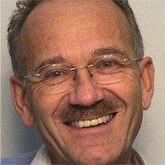
CHRISTOPHE ROSSEL (WG16)
Affiliation to IUPAP:
Observer; WG16 Chair
Commission/Category:
WG16: Physics and Industry
Current Job Title:
Emeritus Research Staff Member
Current affiliation (Institution):
IBM Research-Zurich, Switzerland
Area of Study/Research/Expertise:
-
Last Physics paper written with date of publication:
-
Any other information:

Slide 45
CYRUS PAN WALTHER (AC5)
Affiliation to IUPAP:
Vice-Chair
Commission/Category:
Affiliated Commission of Physics Students (AC5)
Current Job Title:
-
Current affiliation (Institution):
-
Area of Study/Research/Expertise:
-
Last Physics paper written with date of publication:
-
Any other information:

Slide 46
ARUN GROVER (C14)
Affiliation to IUPAP:
Commission member
Commission/Category:
Commission on Physics Education (C14)
Current Job Title:
Current affiliation (Institution):
Area of Study/Research/Expertise:
Last Physics paper written with date of publication:
Any other information:

Slide 47
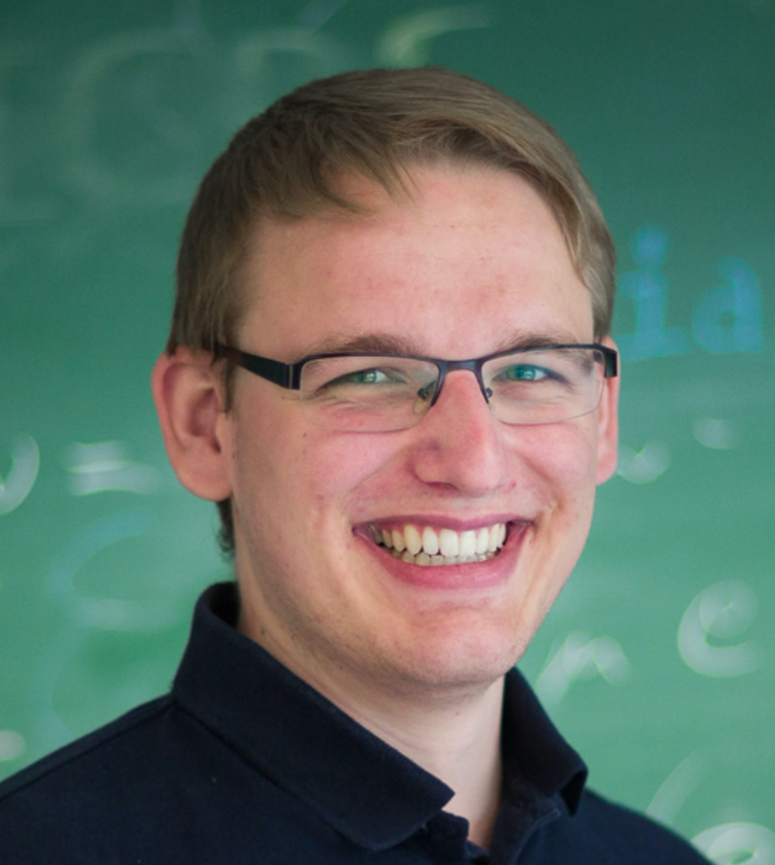
TIMO ECKSTEIN (AC5)
Affiliation to IUPAP:
Commission member [former IAPS Vice President]
Commission/Category:
Affiliated Commission of Physics Students (AC5)
Current Job Title:
PhD student
Current affiliation (Institution):
FAU Erlangen, Germany
Area of Study/Research/Expertise:
Quantum computing
Last Physics paper written with date of publication:
22. December 2021: “Classical Variational Optimization of Gate Sequences for Time Evolution of Translational Invariant Quantum Systems”, Mansuroglu, Eckstein et. Al., arXiv:2106.03680.
Any other information:
Initiated contact between IUPAP and IAPS in 2017, first student at an EC&CC Meeting in Singapore in 2018, Member of OCs of IUPAP-supported International Conference of Physics Students 2019 and IUPAP centenary event PLANCKS 2022.

Slide 48
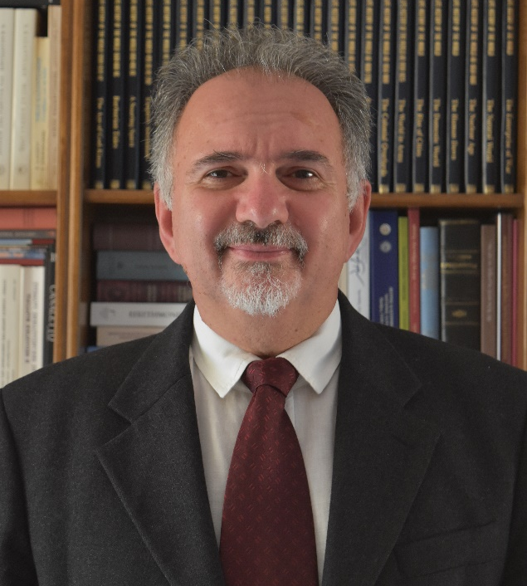
MICHAEL TAROUDAKIS (AC3)
Affiliation to IUPAP:
Former Chair
Commission/Category:
International Commission for Acoustics, ICA (AC3)
Current Job Title:
Professor
Current affiliation (Institution):
University of Crete, Greece
Area of Study/Research/Expertise:
Underwater Acoustics
Last Physics paper written with date of publication:
Any other information:
Professor of Applied Mathematics at the Department of Mathematics and Applied Mathematics of the University of Crete. Past President of ICA (2019-2022), President of ICA (2016-2019), President of the European Acoustics Association (EAA) 2013-2016, Rector of the University of Crete (UoC) (2015-2016), Dean of the School of Sciences and Engineering UoC(2013-2016), Chairman of the Department of Mathematics, UoC (2007-2011), Co-Coordinator of the International Year of Sound 2020-2021.

Slide 49
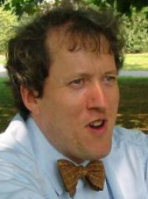
ANDREW HORSFIELD (C20)
Affiliation to IUPAP:
Vice-Chair
Commission/Category:
Commission on Computational Physics (C20)
Current Job Title:
Professor of Theory and Simulation of Materials
Current affiliation (Institution):
Imperial College, London
Area of Study/Research/Expertise:
Last Physics paper written with date of publication:
Any other information:

Slide 50

ANDREAS BURKERT (C19)
Affiliation to IUPAP:
Vice-Chair
Commission/Category:
Commission on Computational Physics (C20)
Current Job Title:
Professor, Chair of theoretical and computational astrophysics
Current affiliation (Institution):
Ludwig-Maximilians University Munich, Germany
Area of Study/Research/Expertise:
Theoretical astrophysics with focus on Dark matter, Galaxy formation and evolution, star formation and origin of life
Last Physics paper written with date of publication:
12 January 2022: “Star formation near the Sun is driven by expansion of the Local Bubble”, C. Zucker et al., Nature 601 (2022) pp. 334-337.
Any other information:

Slide 51
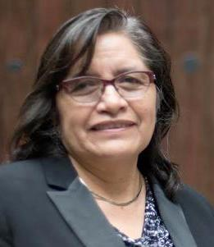
LILIA MEZA-MONTES (WG5)
Affiliation to IUPAP:
Chair
Commission/Category:
Working Group Women in Physics (WG5)
Current Job Title:
Senior lecturer
Current affiliation (Institution):
Benemérita Universidad Autónoma, Department of Physics
Area of Study/Research/Expertise:
Solid State Physics
Last Physics paper written with date of publication:
Any other information:

Slide 52
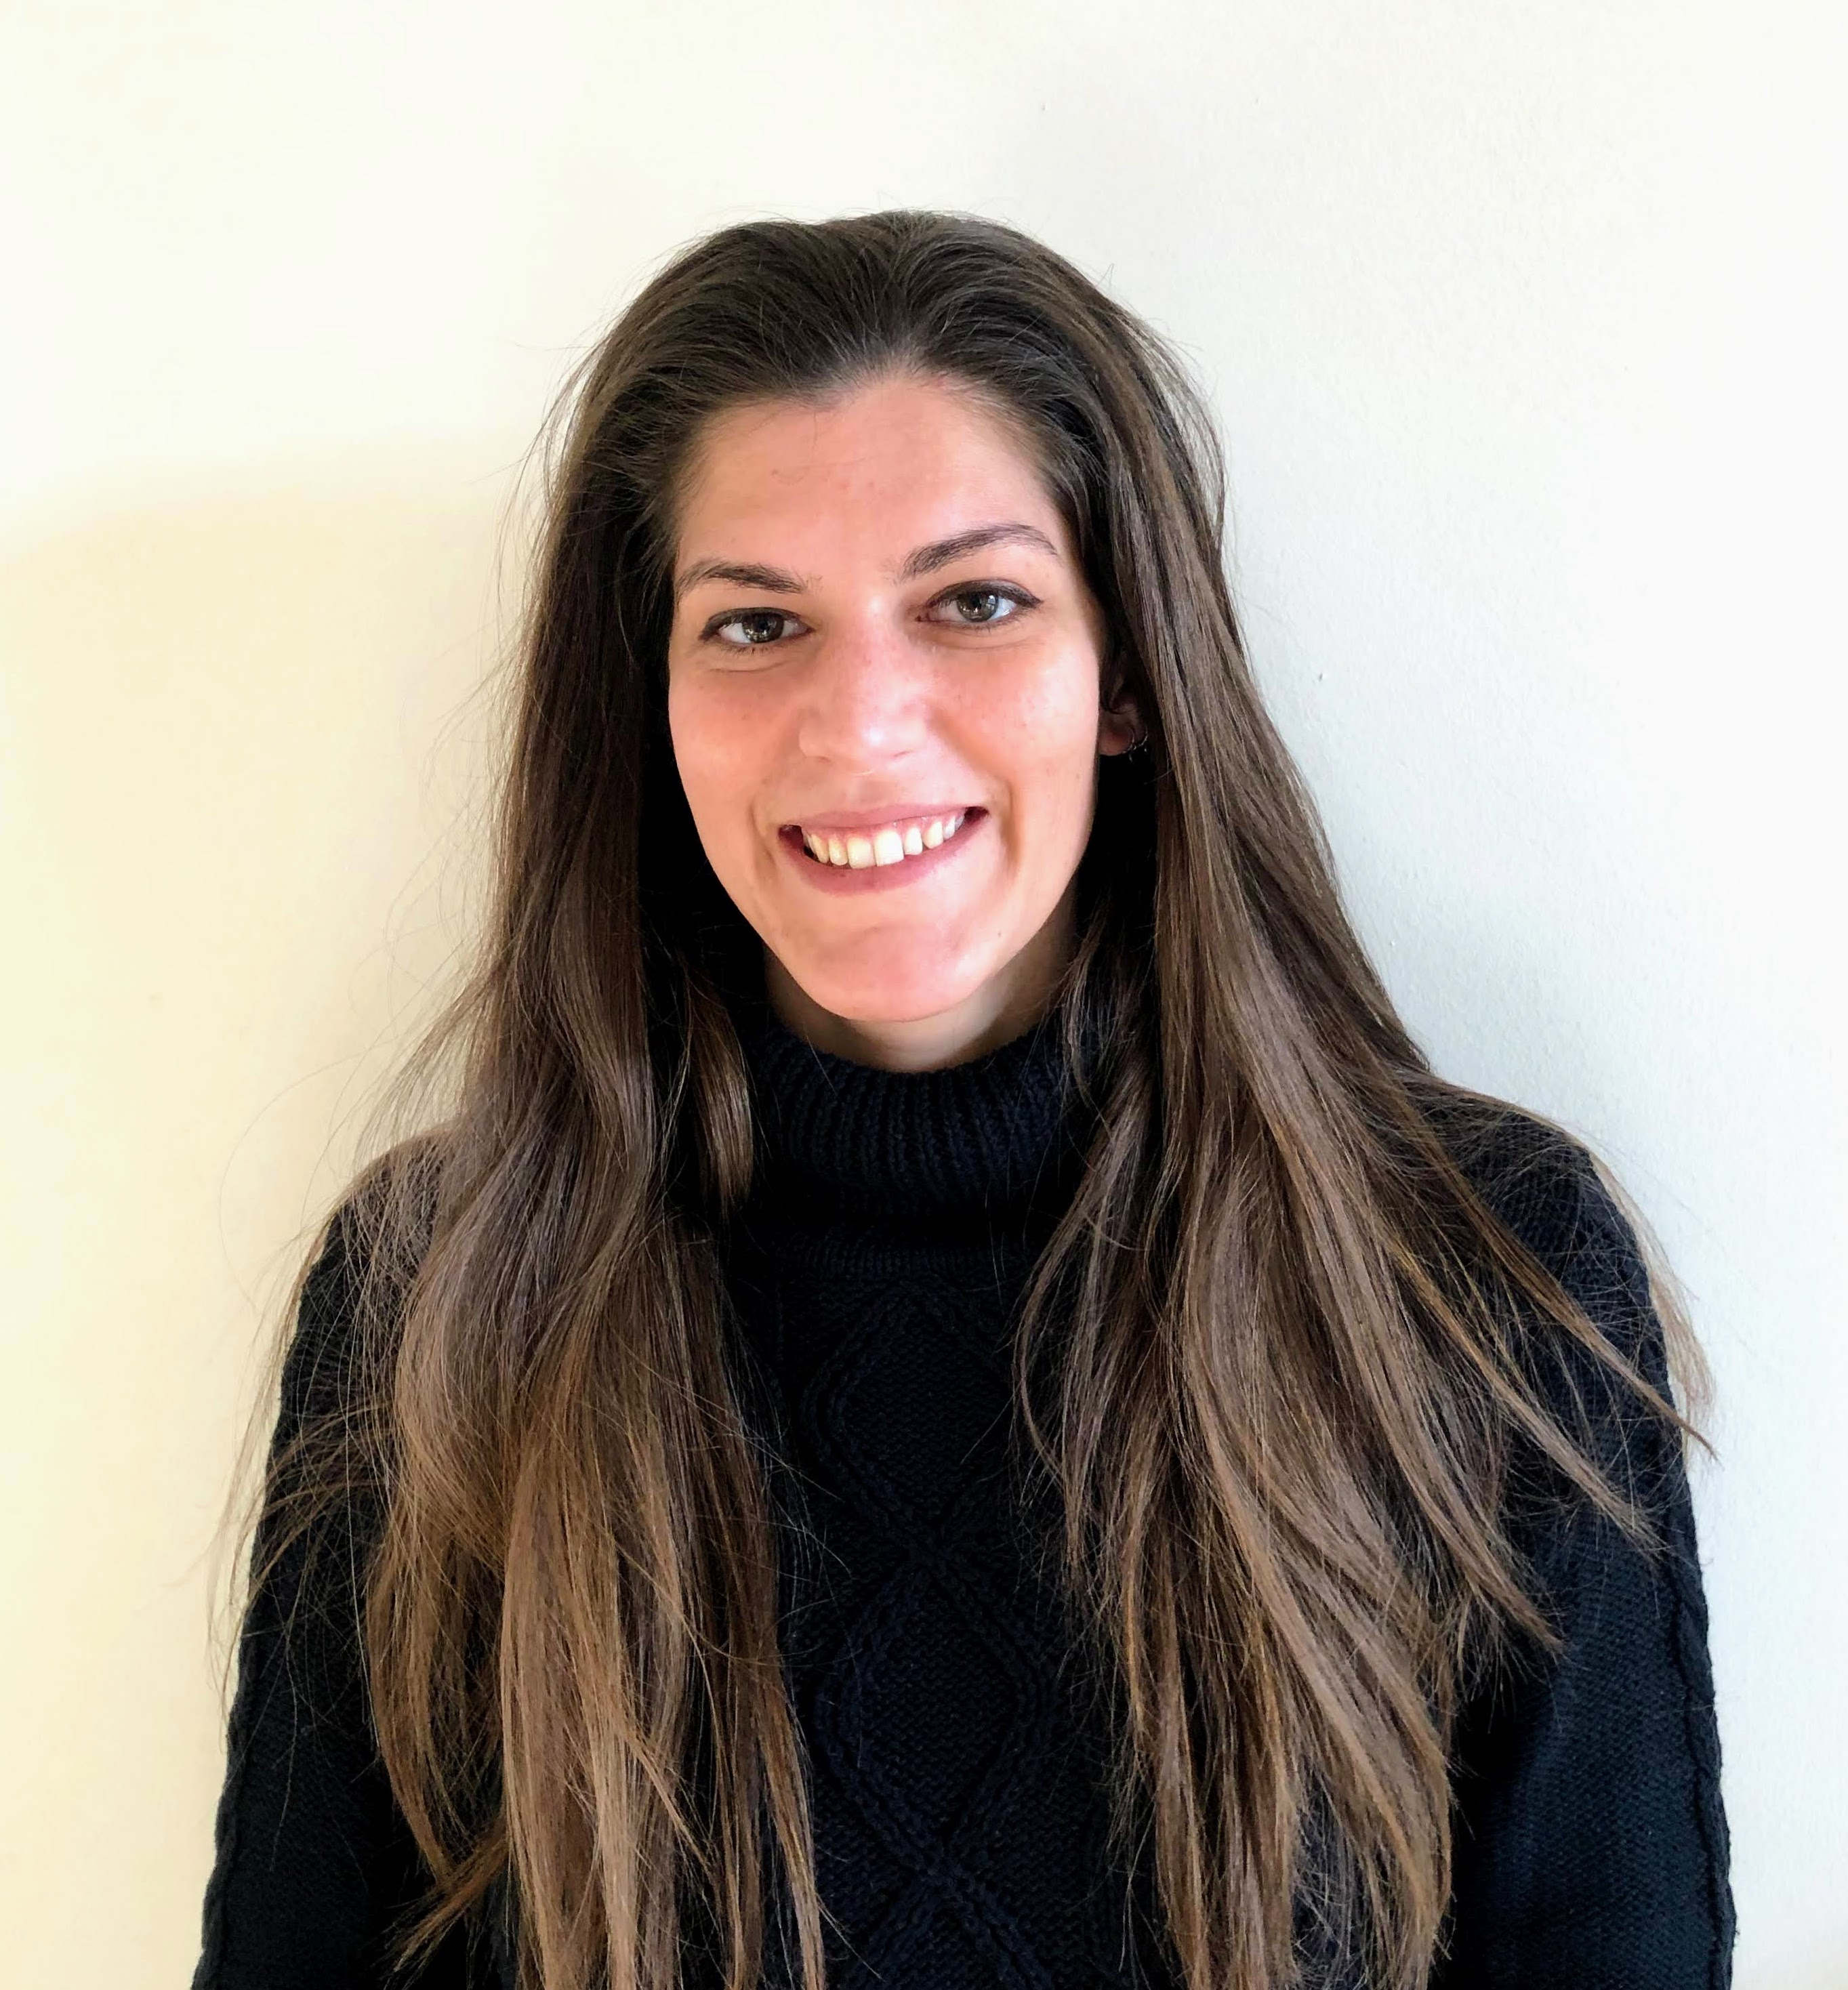
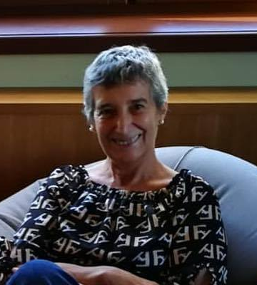
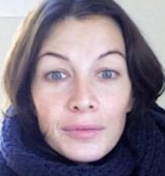
IUPAP SECRETARIAT
CECILIA CRESSI
FIT
PAOLA RODARI
FIT / SISSA MediaLab
FEDERICA SGORBISSA
SISSA MediaLab for
IUPAP Centenary Communication

