Slide 1
The Chinese Physical Society (CPS)
would like to thank
IUPAP
for offering the opportunity to host
The 33rd IUPAP EC&CC and GA meetings in China.
This is a great honor and support to the
Chinese physical community

Slide 2
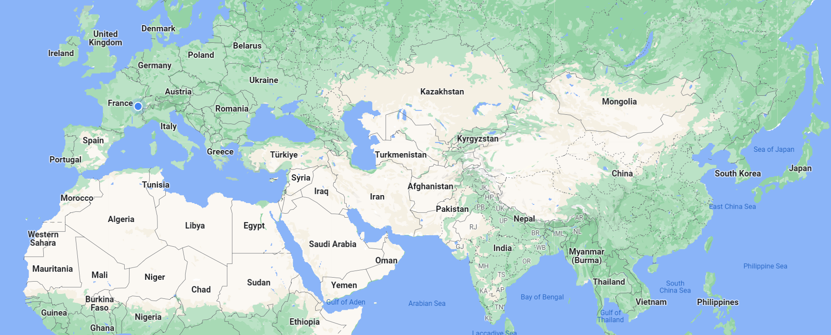
Location: Haikou City, Hainan Province, China
a special visa-free-entry district, and also a great resort area
Hainan Island
Greece
Holland
Hungary
Iceland
Indonesia
Ireland
Italy
Japan
Kazakhstan
Latvia
Lithuania
Luxembourg
Macedonia
Malaysia
Malta
Mexico
Monaco
Montenegro
Norway
Philippines
Poland
Portugal
Qatar
Romania
Russia
Serbia
Singapore
Slovakia
Slovenia
Spain
South Korea
Sweden
Switzerland
Thailand
United Arab Emirates
United States
New Zealand
United Kingdom
Ukraine
Visa Free Entry
for citizens of
59 countries
https://www.travelchinaguide.com/cityguides/hainan/visa-free.htm
Albania
Argentina
Australia
Austria
Belarus
Belgium
Bosnia-Herzegovina
Brazil
Brunei
Bulgari
Canada
Chile
Croatia
Cyprus
Czech Republic
Denmark
Estonia
Finland
France
Germany

Slide 3

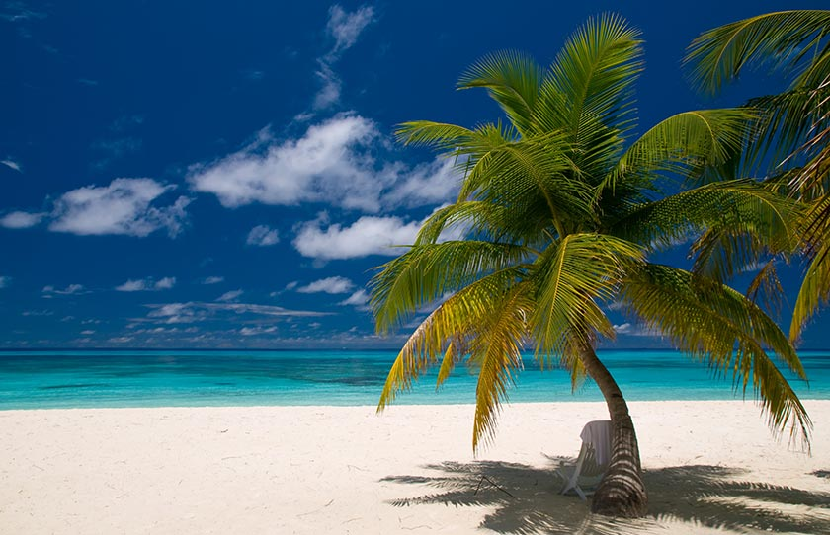
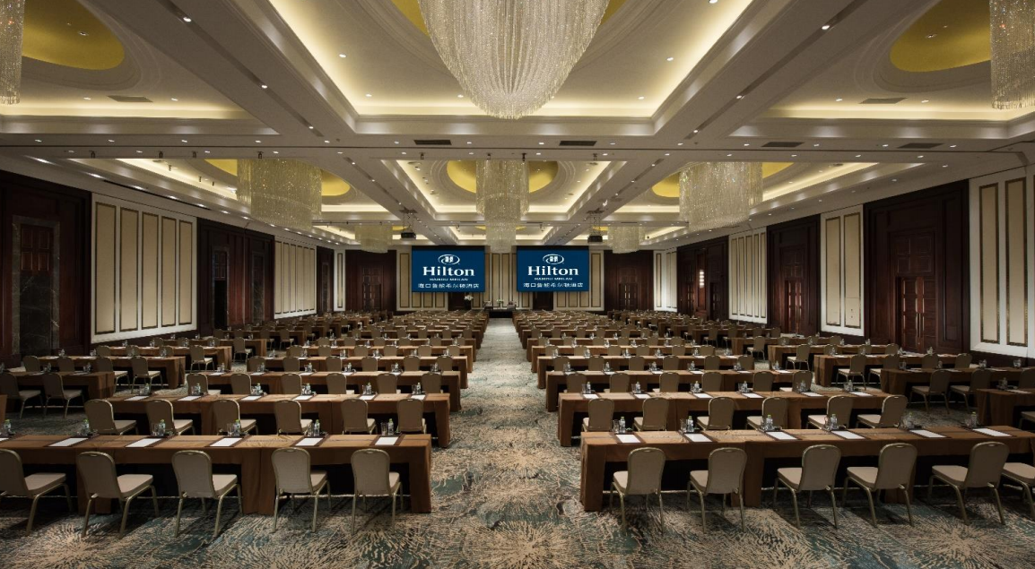
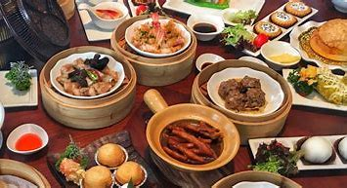

Slide 4

CPS Fall Meetings over the past twenty years
Hainan, October 2024

Slide 5
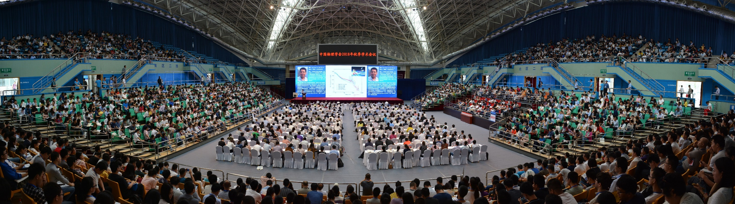
CPS Fall Meetings over the past twenty years
In 2023: 5,500+ participants, 20 parallel sessions + 2 joint sessions with
APS, IOP, with 1790 talks and posters.
In 2024, 6000+ participants are expected.

Slide 6
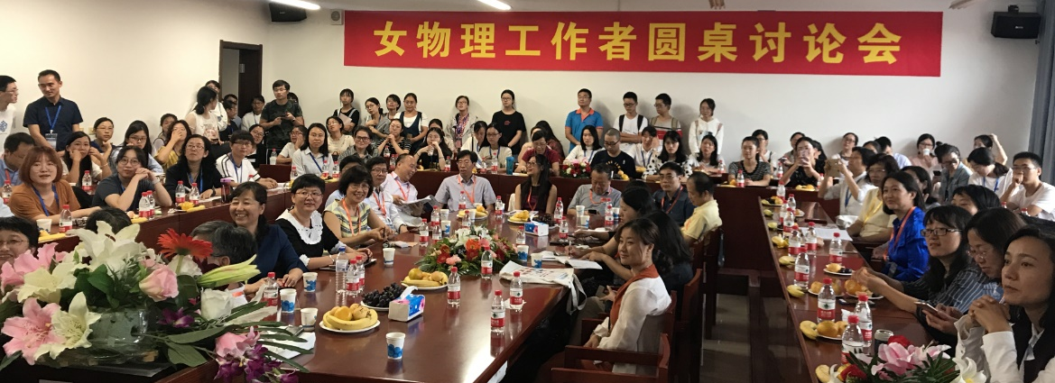
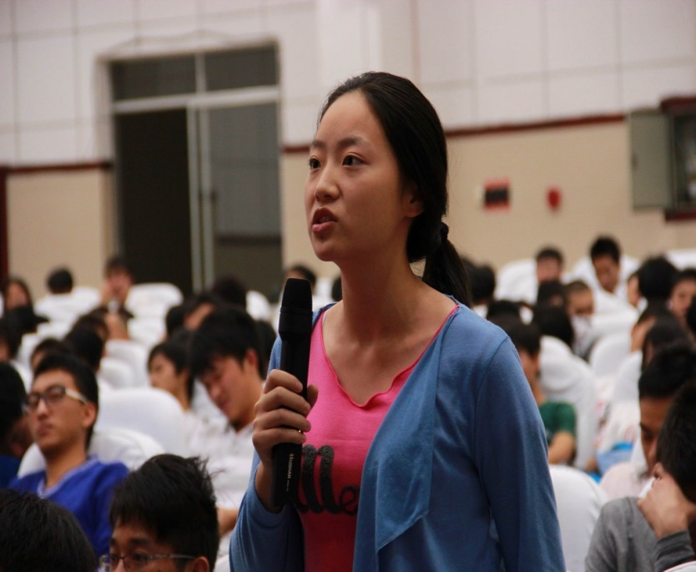
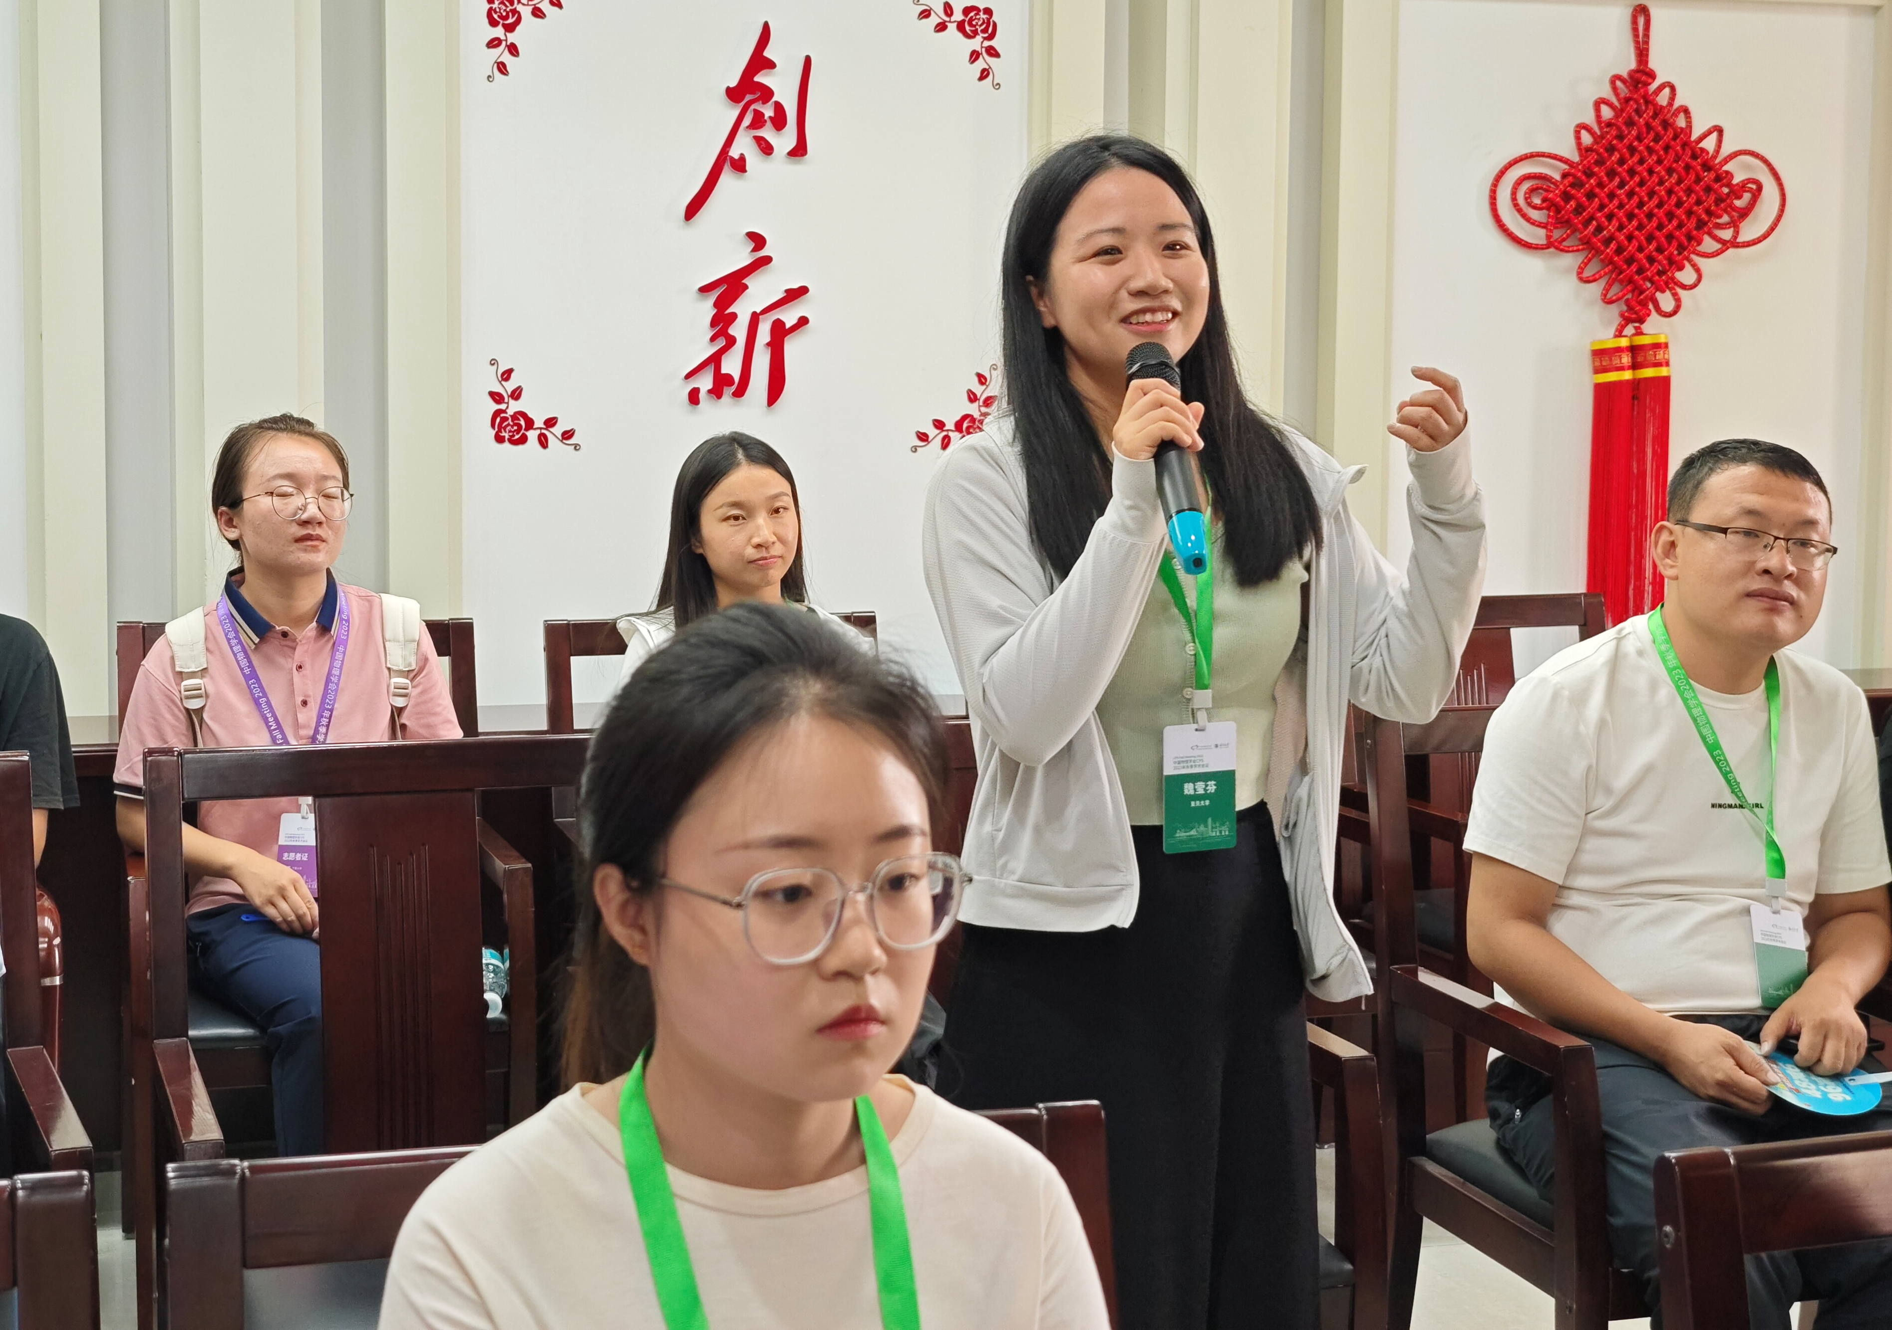
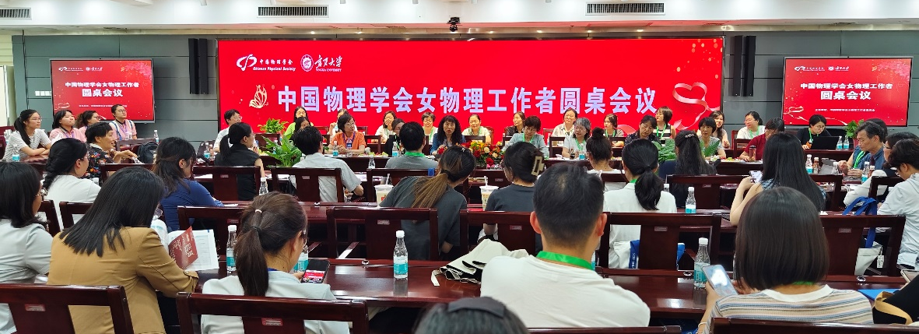
Special Session“Women in Physics”
2018
2023

Slide 7
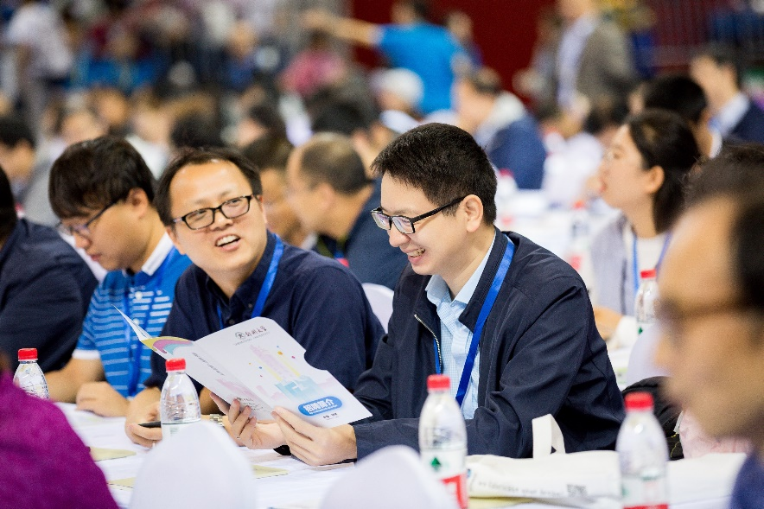
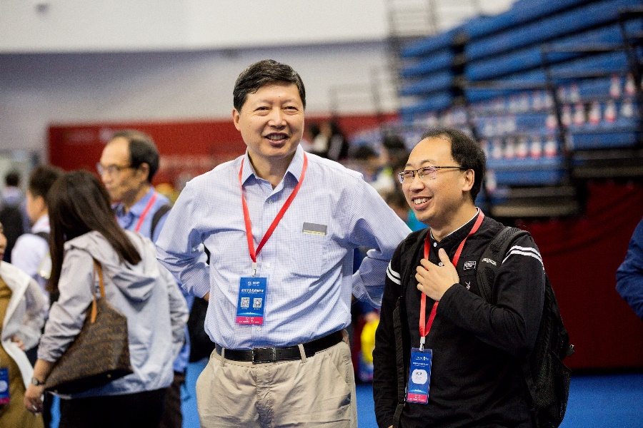
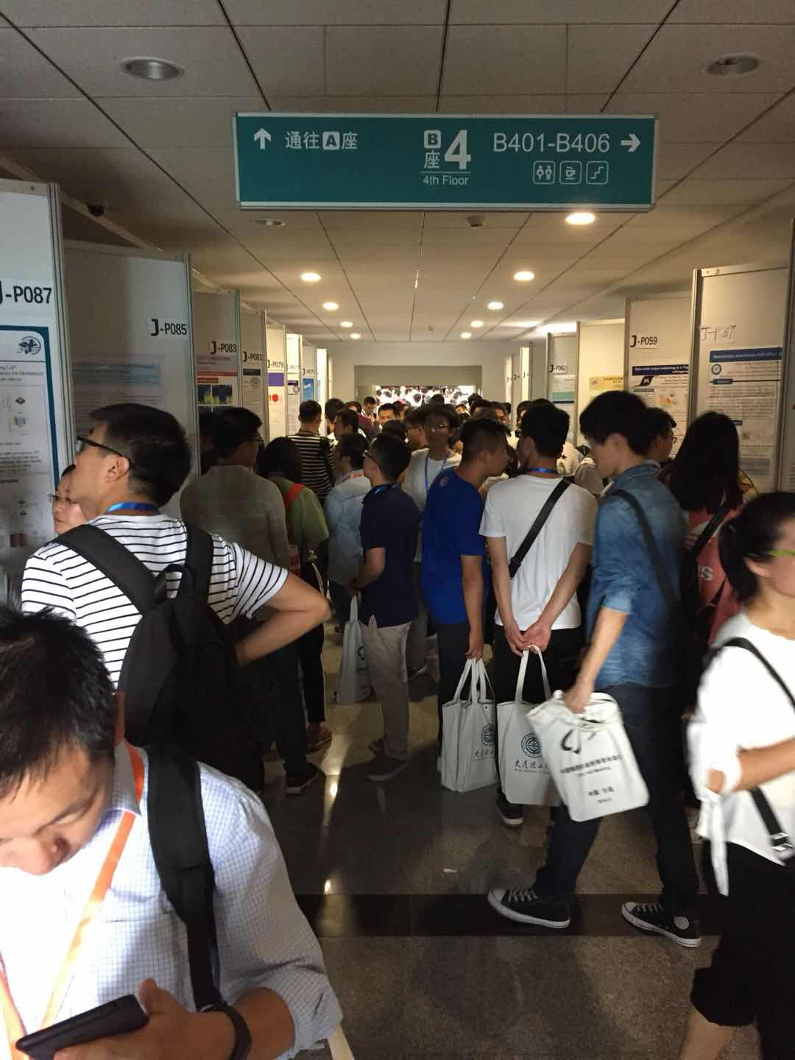
With the help from IUPAP, we wish to organize some jointly events with IUPAP during CPS Fall Meeting 2024:
  (1) Public lectures presented by famous physicists invited by IUPAP
  (2) “Women in Physics” special session and exhibition … …
We cordially invite all of you to Hainan, China next year !

Slide 9
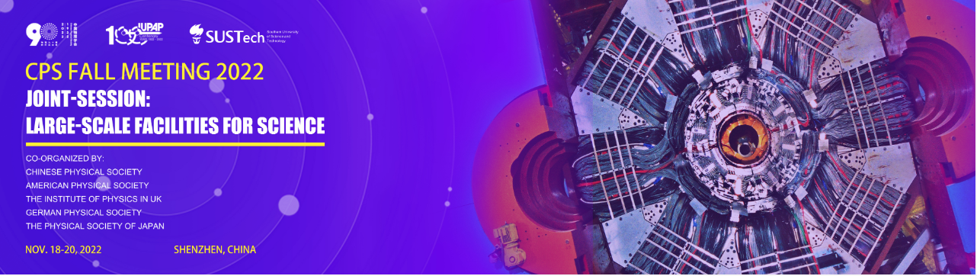
Joint Sessions with Other Societies

Slide 10
The advantages/disadvantages of the two locations in China
Locations | Advantages | Disadvantages
Beijing | Convenient for travel | Need a visa
Haikou City, Hainan Province | Visa free entry for 59 countries Requires to enter Hainan by flying from outside of mainland China (e.g., a transit at Peking does not work). With possibilities of organizing joint activities in CPS annual meeting | Slightly inconvenient for travel Very likely there is no direct flight to Haikou city. One needs to take a transit at Hong Kang, Macao, Singapore, Bangkok, Paris, Geneve, etc.

Slide 11
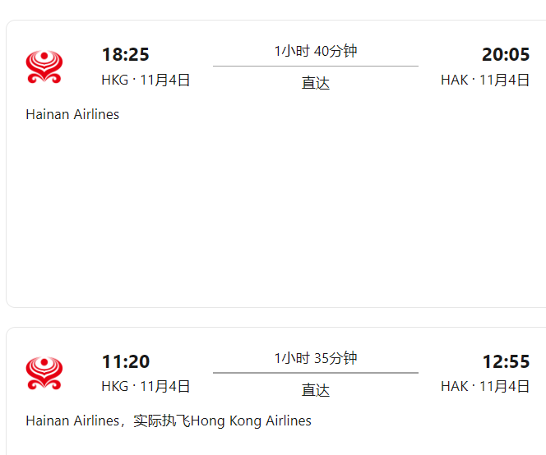
About travel: take a transit from Hong Kang to Haikou
Hong Kang is a visa-free place for most countries

Slide 12
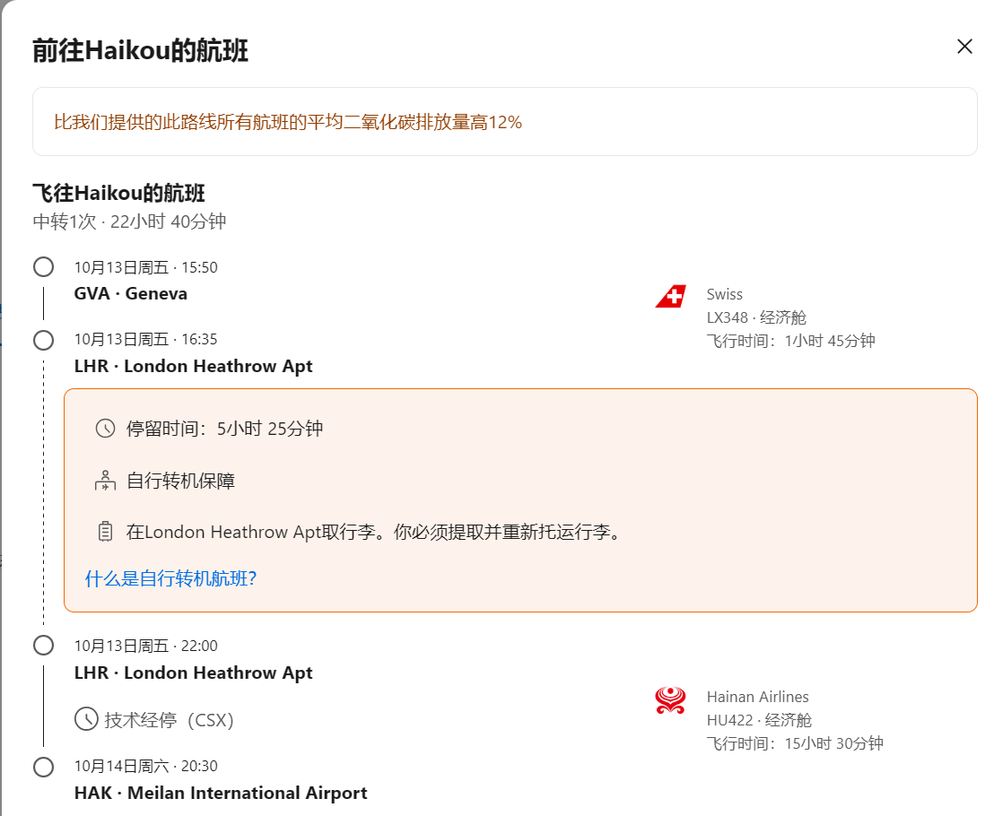
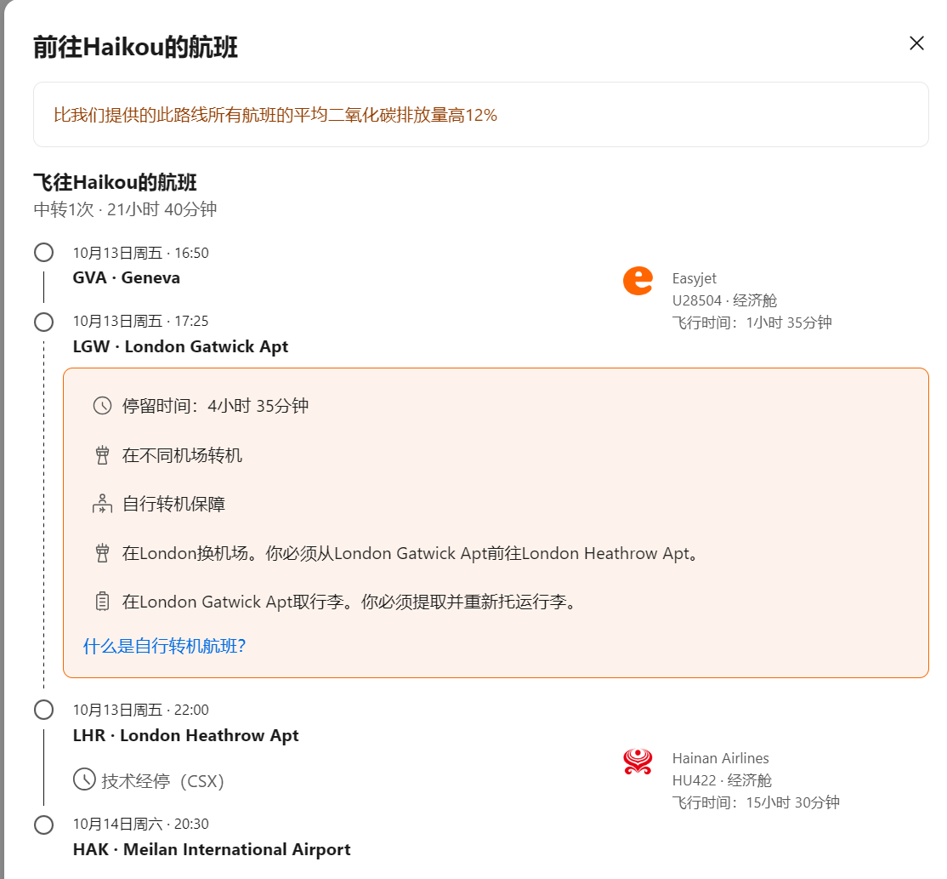
About travel:
Haikou – London - Geneve

Slide 13
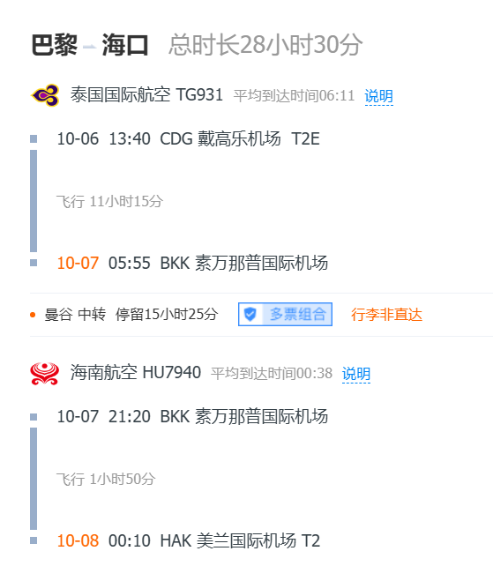
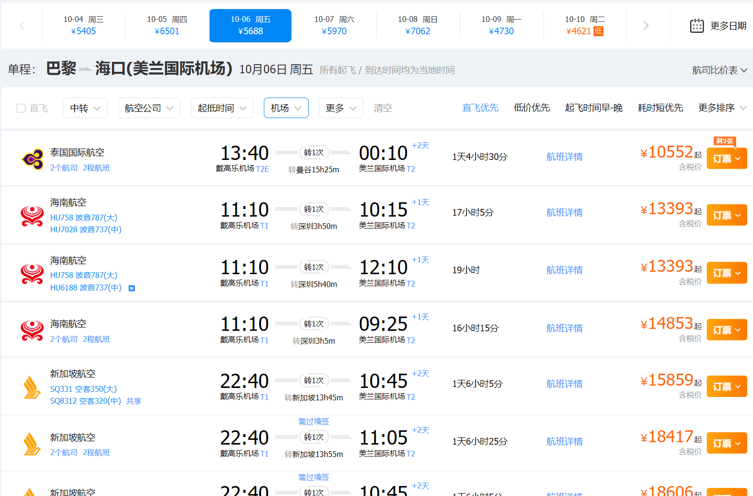
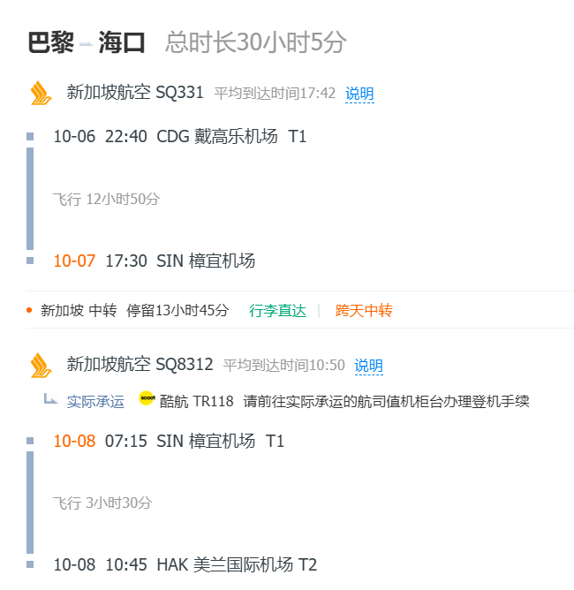
About travel:
Paris – Singapore/Bangkok - Haikou

