Slide 1

Centenary Symposium: Concluding remarks
Michel Spiro, IUPAP President, 13 July 2022, ICTP, Trieste, Italy
With the help of Jens Vigen

Slide 2
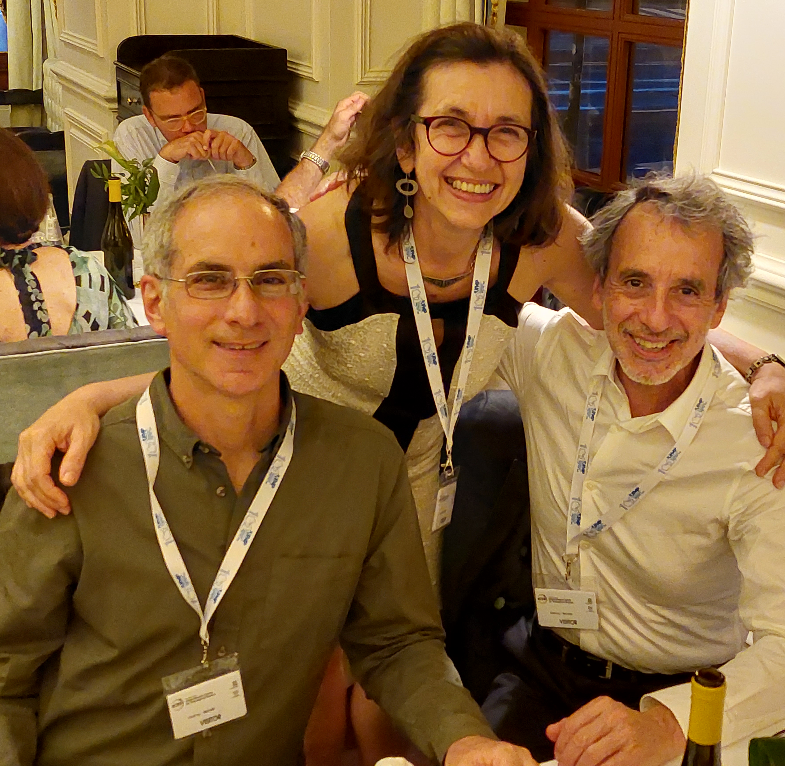
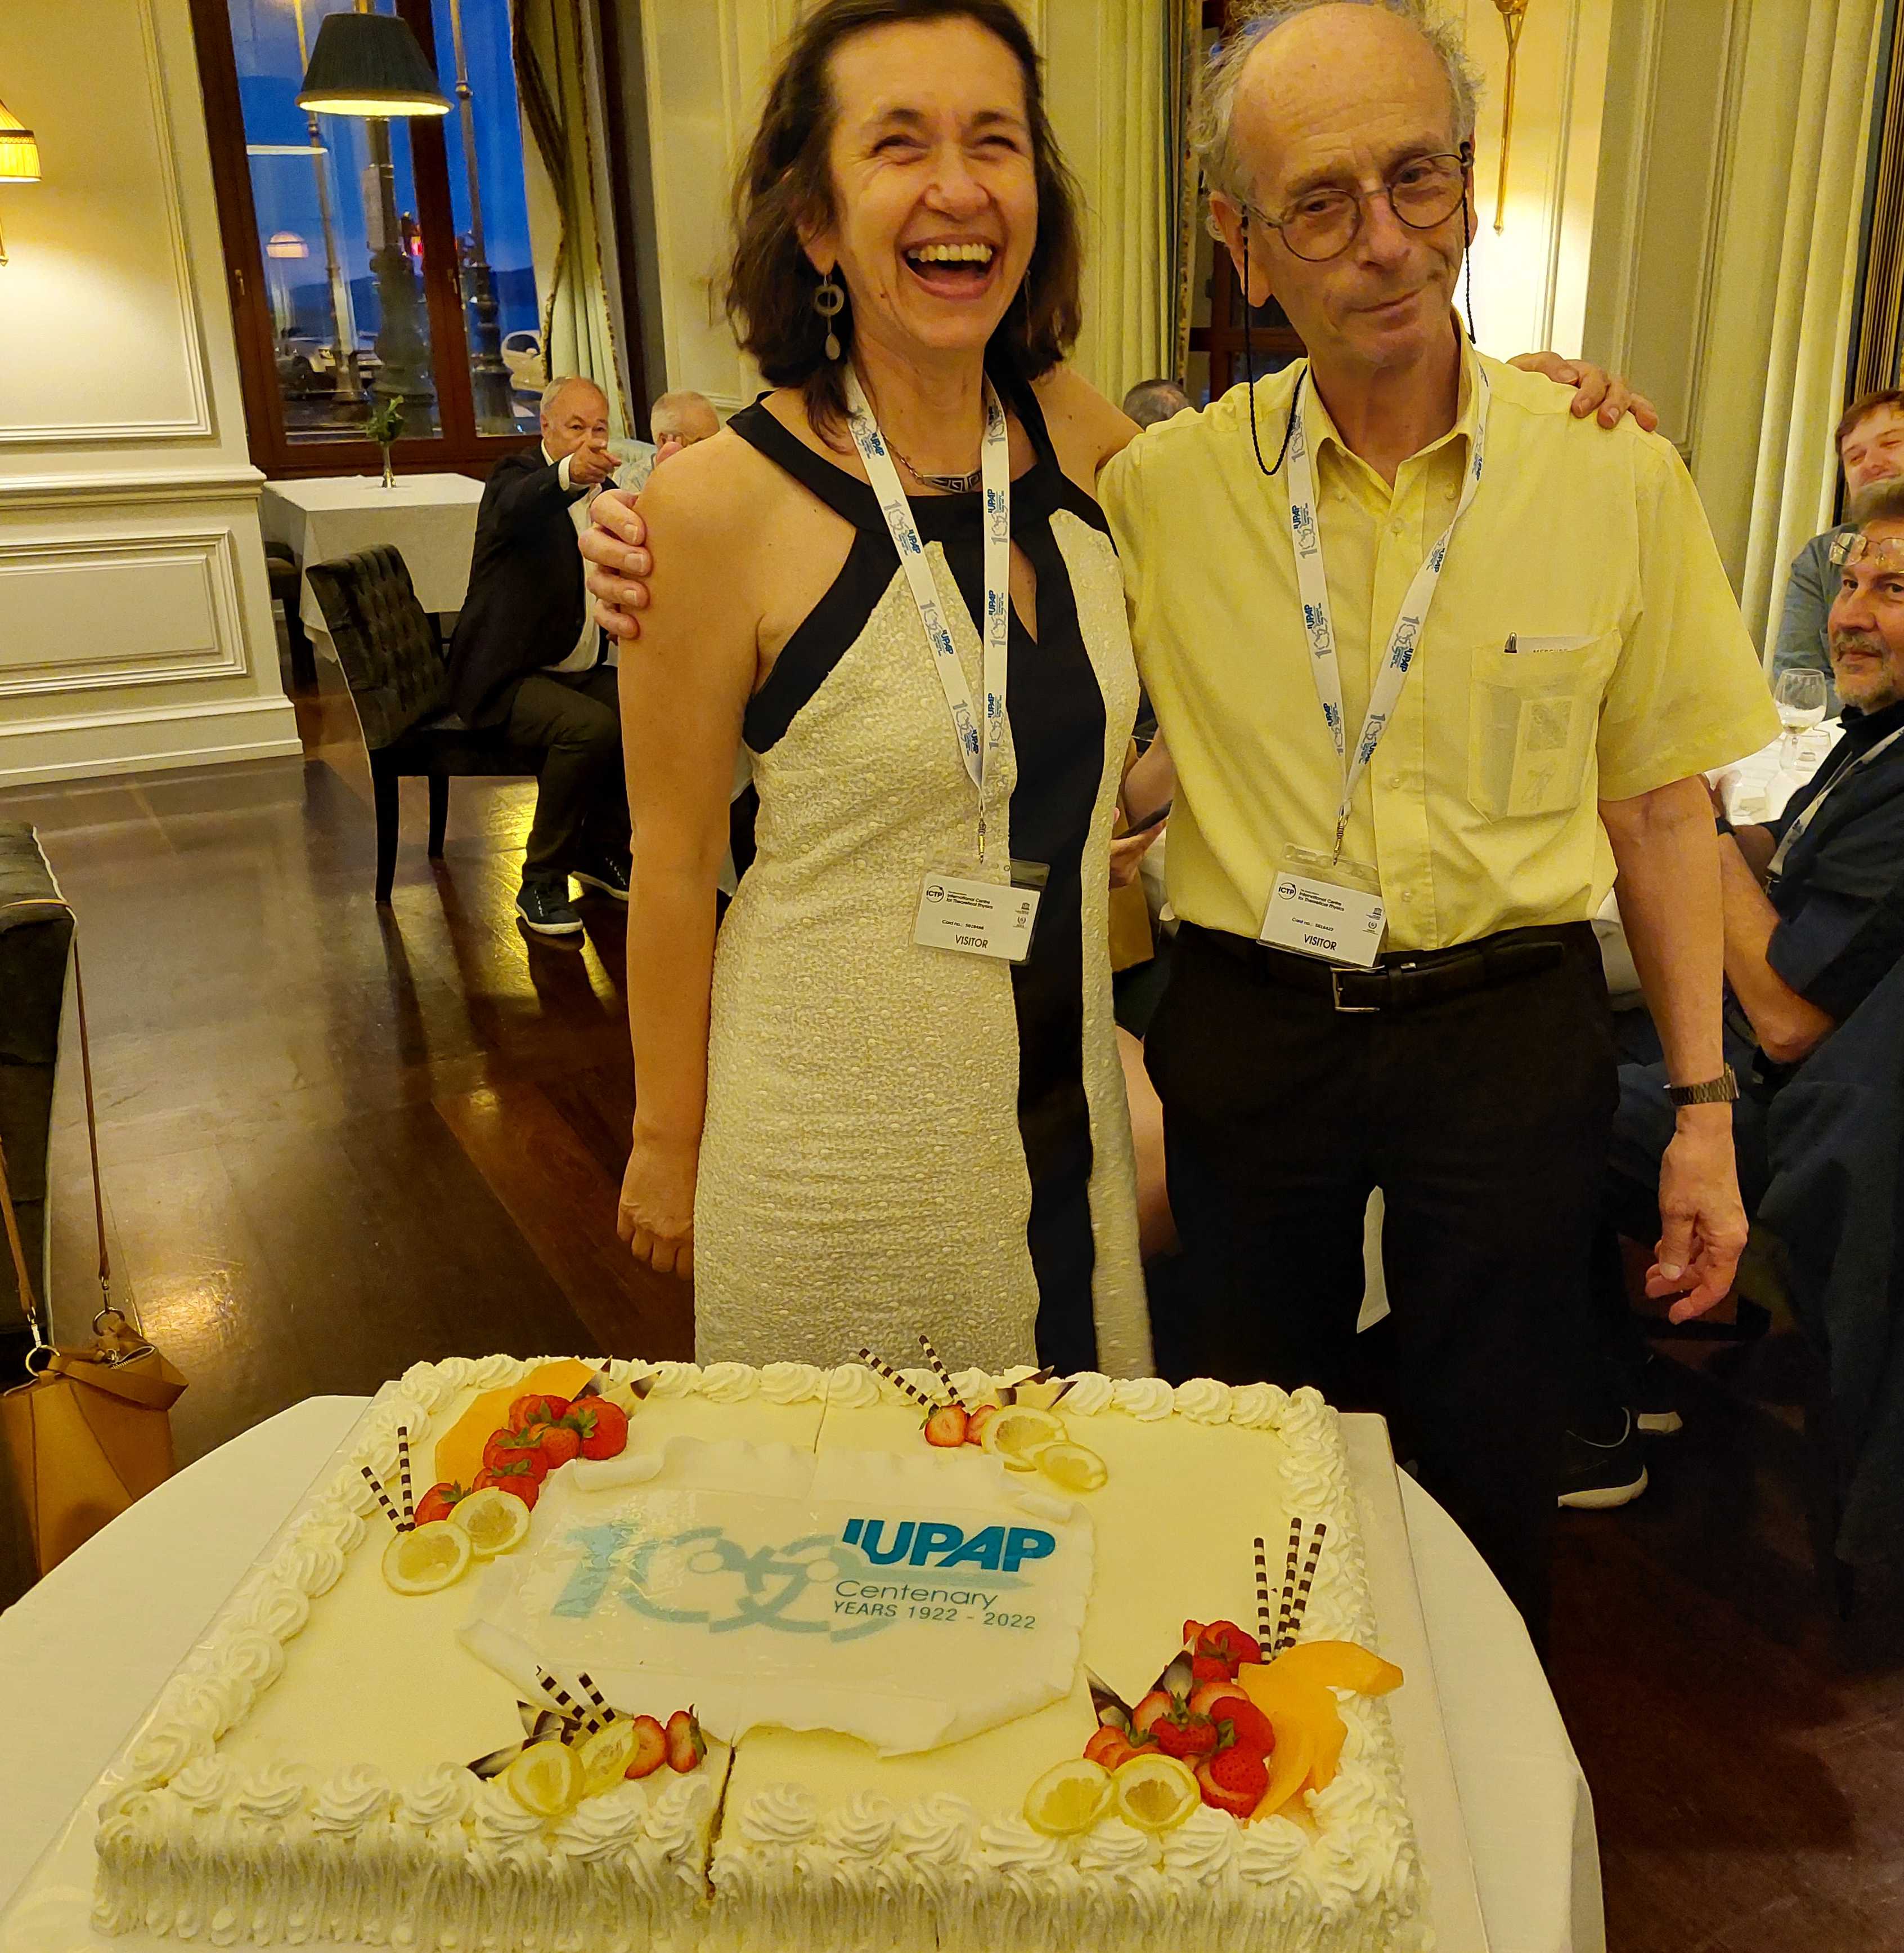
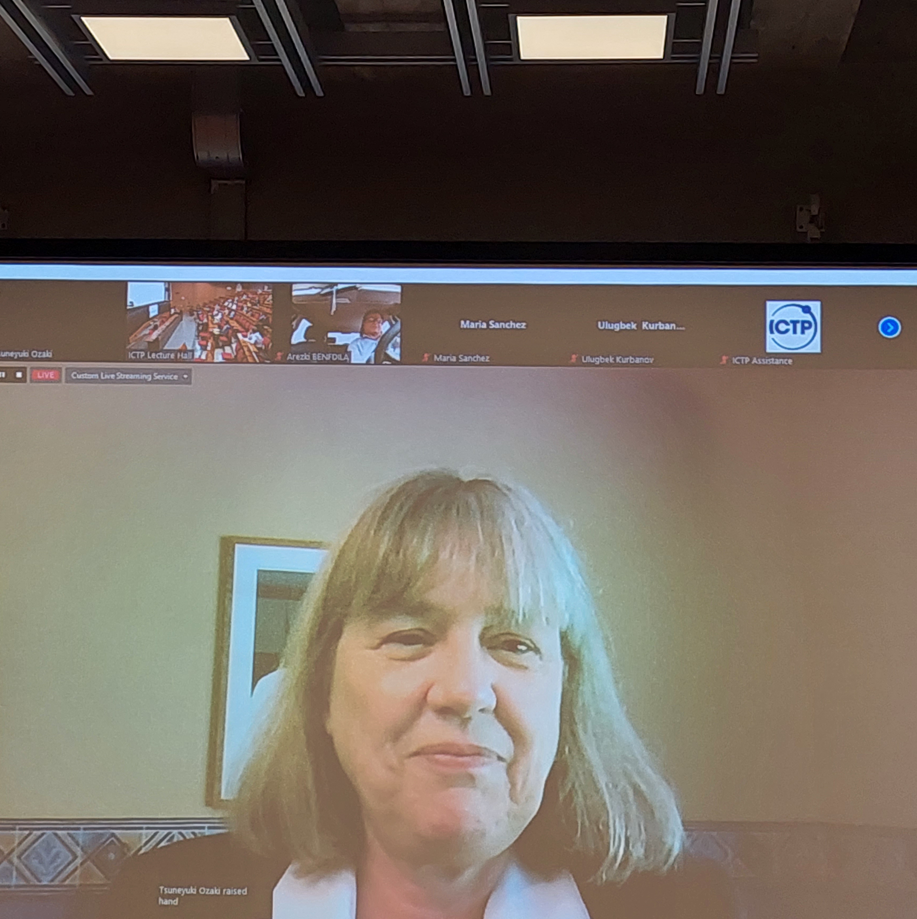

Bravissimo—this was simply magnificent!
This was an exceptional meeting—not of the type we often are used to
  The content, the atmosphere, and the exceptional environment!!
We cannot afford to wait for another 100 years for having another symposium like this!!!!

Slide 3
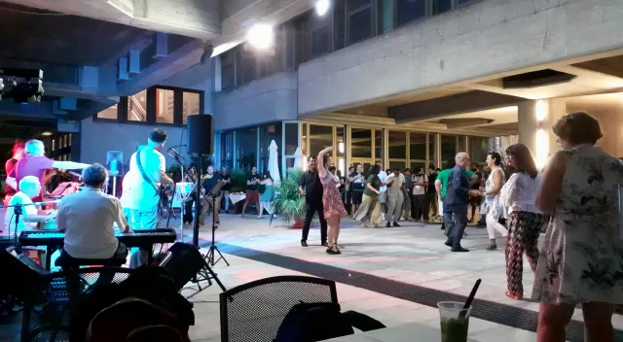

Slide 4
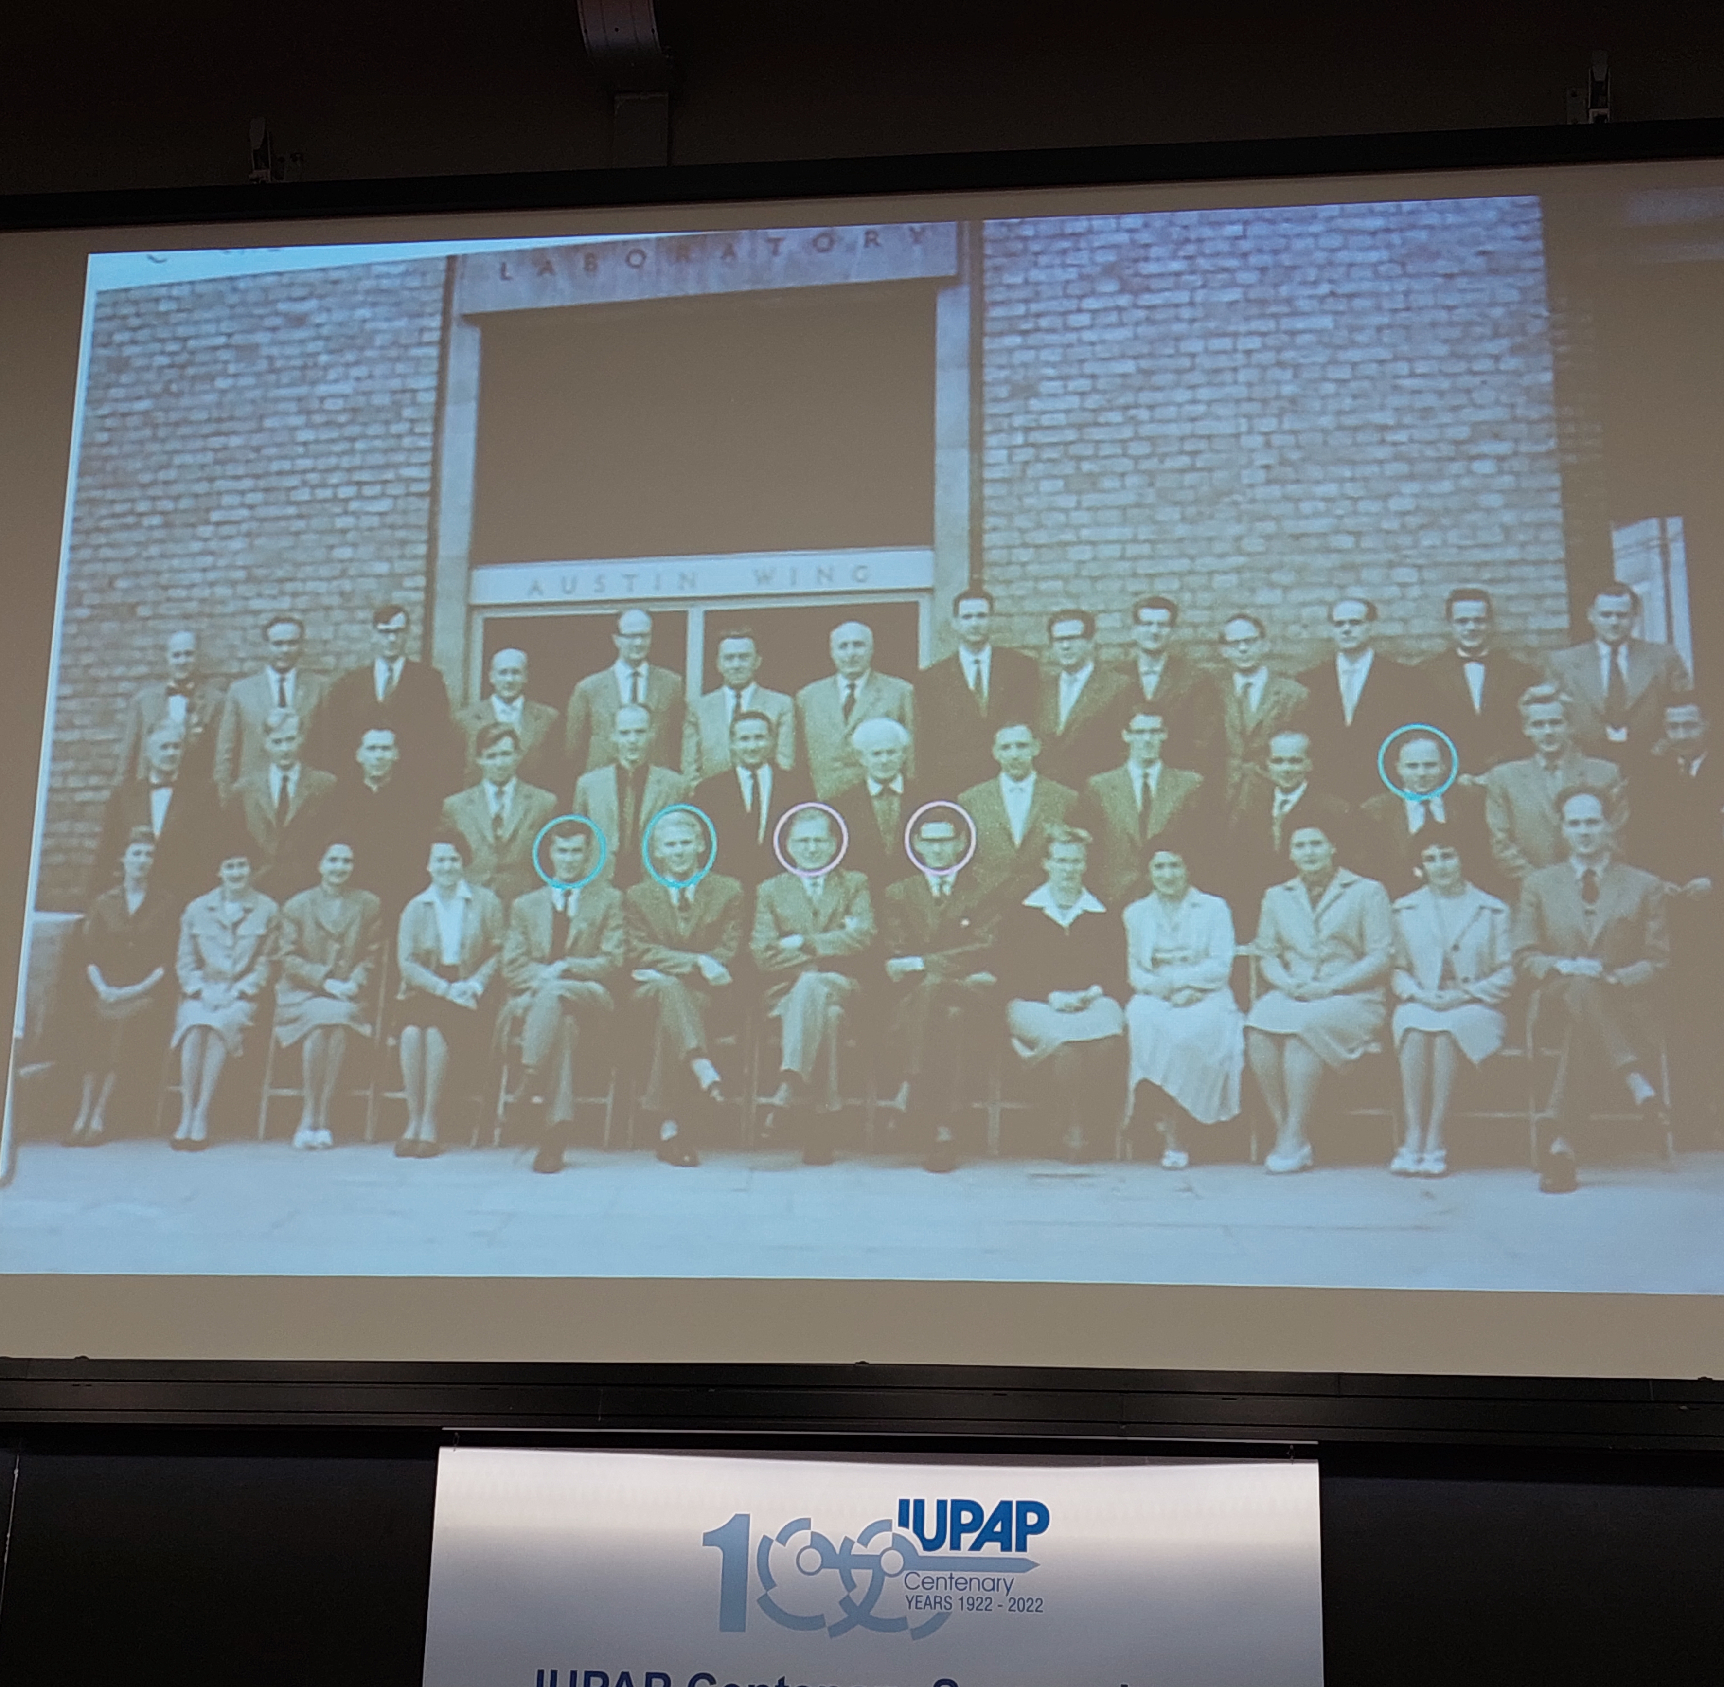
The genuine spirit of the symposium
The mission of IUPAP has always been and is still “To assist in the worldwide development of physics, to foster international cooperation in physics, and to help in the application of physics toward solving problems of concern to humanity”.
This was illustrated all along this IUPAP centenary celebration
The symposium was inter-generations, covered from the past to the future, inter regional, focused on physics connected to basic sciences and sustainable development

Slide 5
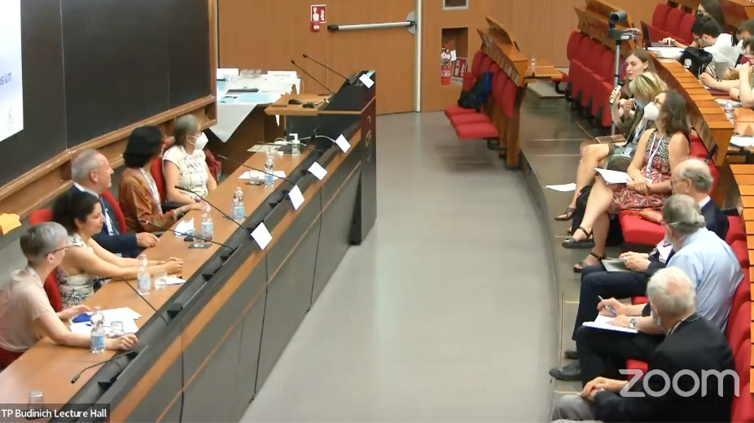
Inclusiveness and development
Development of physics with many inspiring talks. Physics is still animated by curiosity and explores the soul of the Universe.
Foster international cooperation in physics: this happened all along the history of IUPAP starting with 13 and now with 64 territorial members (Ukraine being the last one). In addition, we start to have corporate associate members, and soon associate territorial members. Physics is a collective endeavor. We need to embark all physicists from all territories (help regional societies), from academia and from outside academia with an emphasis on early carrier physicists. We also offered the possibility of individual IUPAP affiliations in IUPAP sponsored or endorsed conferences targeted to promote peace, and democratic ways to solve problems. A strong effort is made for inclusion of more women and under-represented groups in physics, with a push for open sciences. This was discussed in many panels

Slide 6
Diversity and interdisciplinarity
To help in the application of Physics toward solving problems of concern to humanity: starting with reducing the threat of nuclear weapons, advising governments, the role of Physics to face global challenges (Climate, energy, water and food shortage) and the role of Physics in the Green Economy. This was evoked in many talks and panels
However, Physics cannot be isolated. It must liaise more with all Basic Sciences, for improving human well-being and a healthy and lively planet, for Sustainable Development, for a better world. This started but a lot more must yet be done, so that Physics is well integrated together with other fields in Sustainability Sciences.
There is still a great future for IUPAP to achieve its mission and to help future generations!!

Slide 7
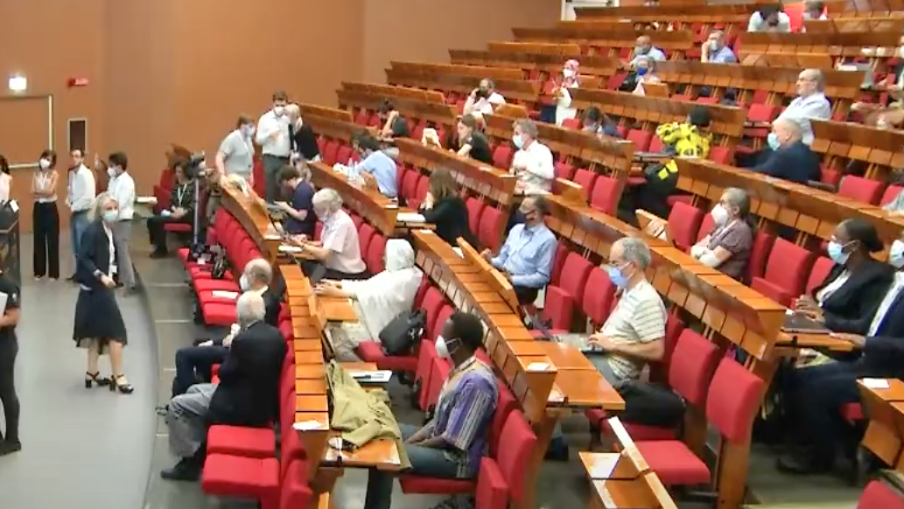
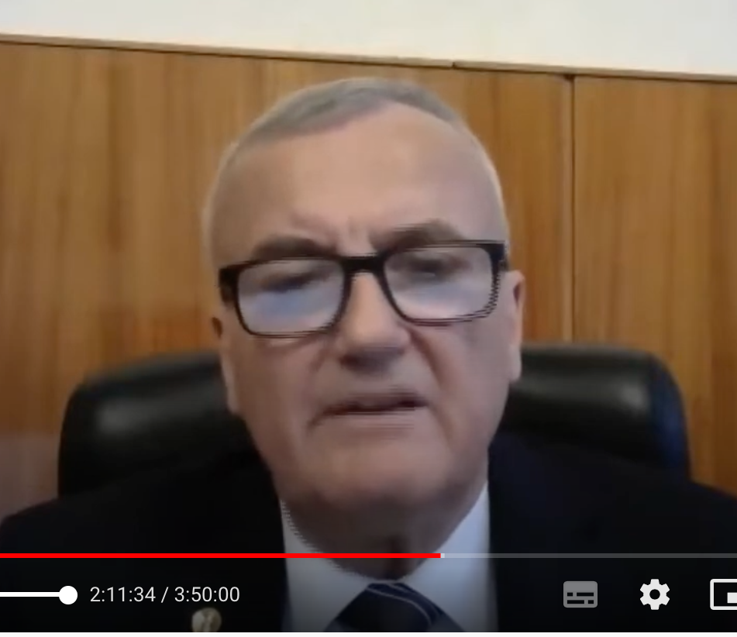
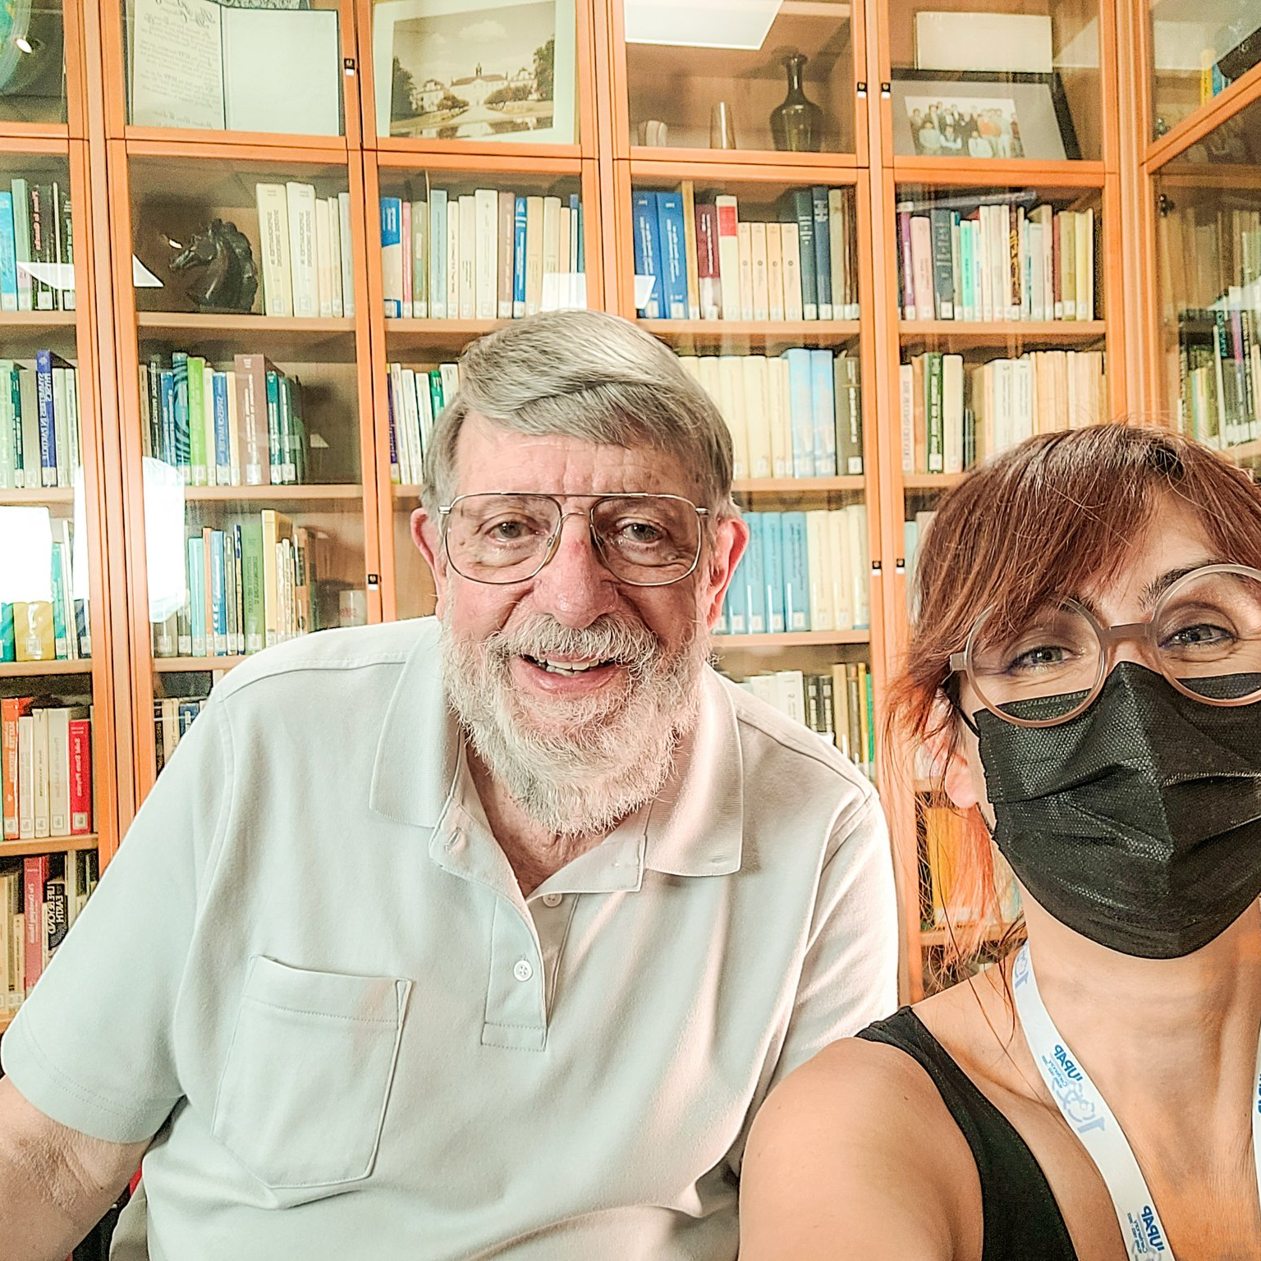
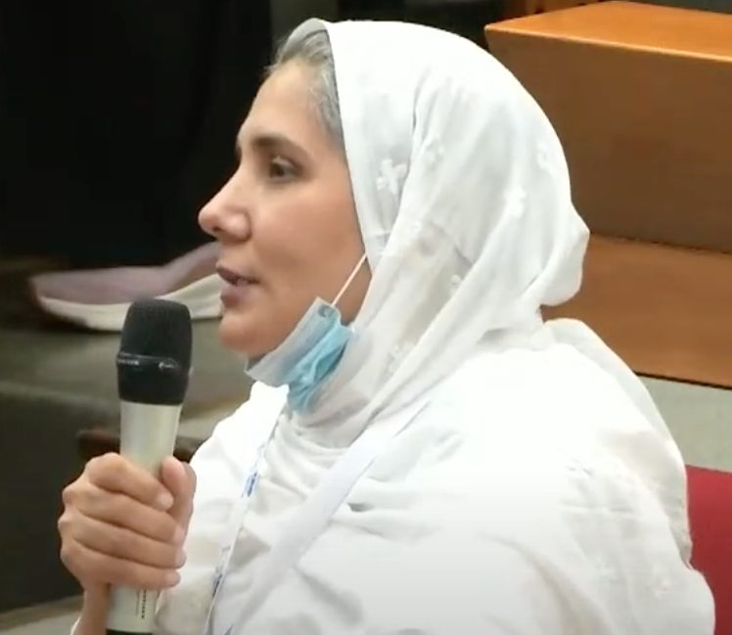
Information exchange and interaction
Thanks to all participants who took part, in person or online
Thanks to all speakers and session chairs

Slide 8
Thanks to the following institutions
Regione Friuli-Venezia Giulia, for the cocktail reception (The Regional Minister for Education and Research, Ms Alessia Rosolen, attended the opening session of the symposium)
SISSA MediaLab, for the partnership on the communication of the symposium (=Federica), interesting stand in the hall, and for the conference bags
Fondazione Internazionale Trieste per il Progresso e la Libertà Delle Scienze (FIT), as secretariat
International Centre for Theoretical Physics (ICTP), for all the logistics and for hosting us

Slide 9
Thanks to all {iaps} members for having ensured the smooth operation of the symposium
Thara Caba
Ruhi Chitre
Yash Gurbani
Owen Higgins
Margaret Rosenberg
Atlas Varsted
Zlatan Vasovic
Cyrus Walther

Slide 10

Thanks to the ICTP staff
  Doreen Sauleek
  Tiziana Derni
  Fabrizio Coana
  Massimo Oreste
  Sabina Emili
  Marco Macor
  Michela Filippini

Slide 11
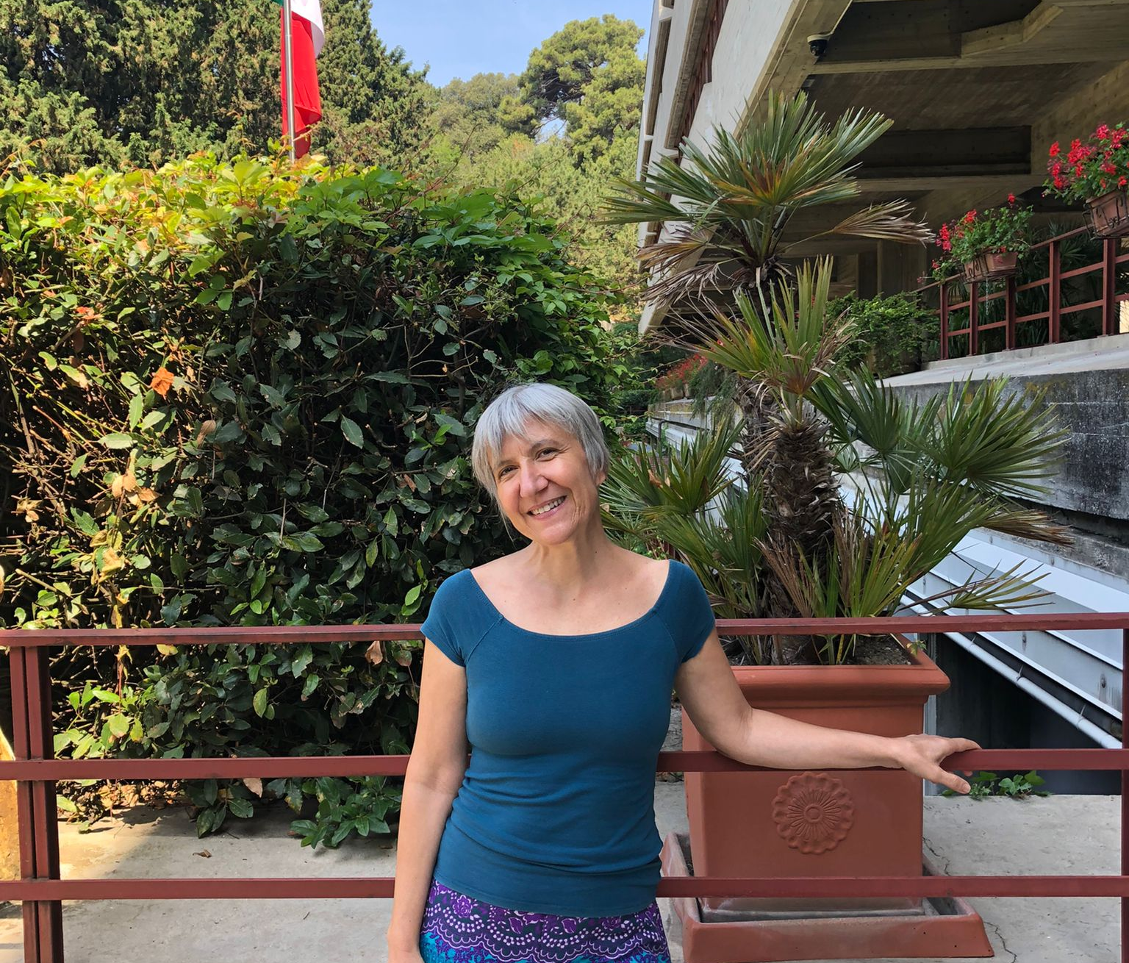
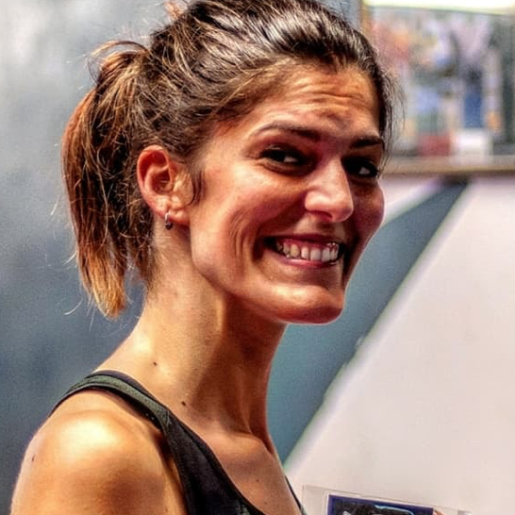
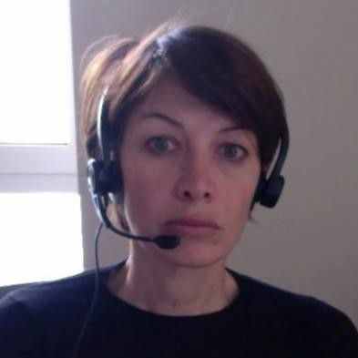
Thanks to the “magic trio”
Federica Sgorbissa, for outreach and communication
Cecilia Cressi, general support (IUPAP administrative office/FIT)
Anna Lisa Cesaro, secretary of the symposium—she did a large bulk of the work!

Slide 12
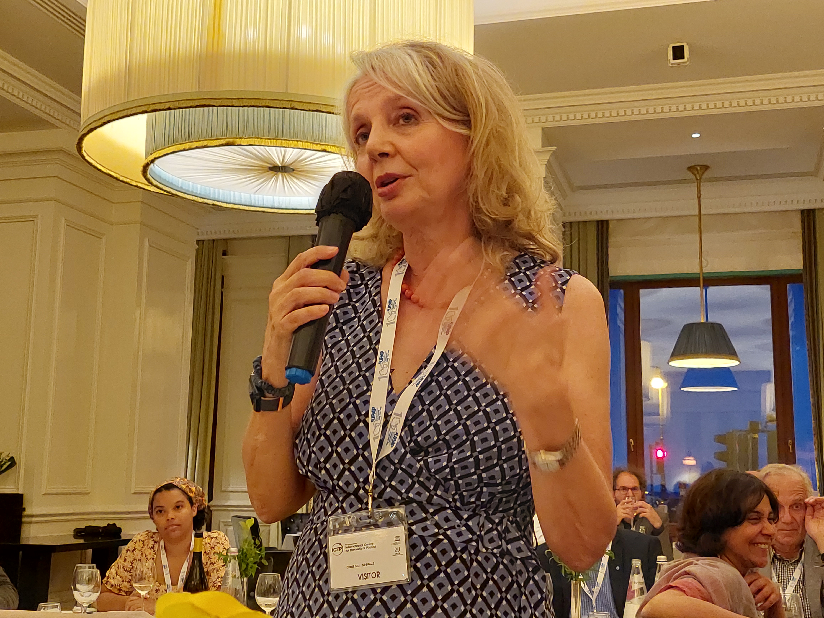
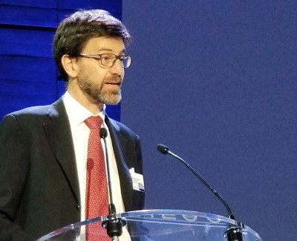
Thanks to the following persons
Monica Pepe-Altarelli, the soul of the symposium
Sandro Scandolo, the conductor of the ceremony

Slide 13
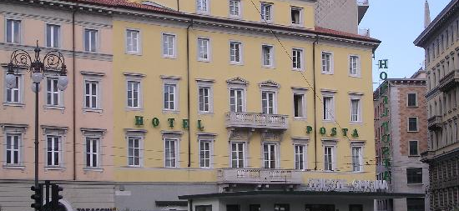
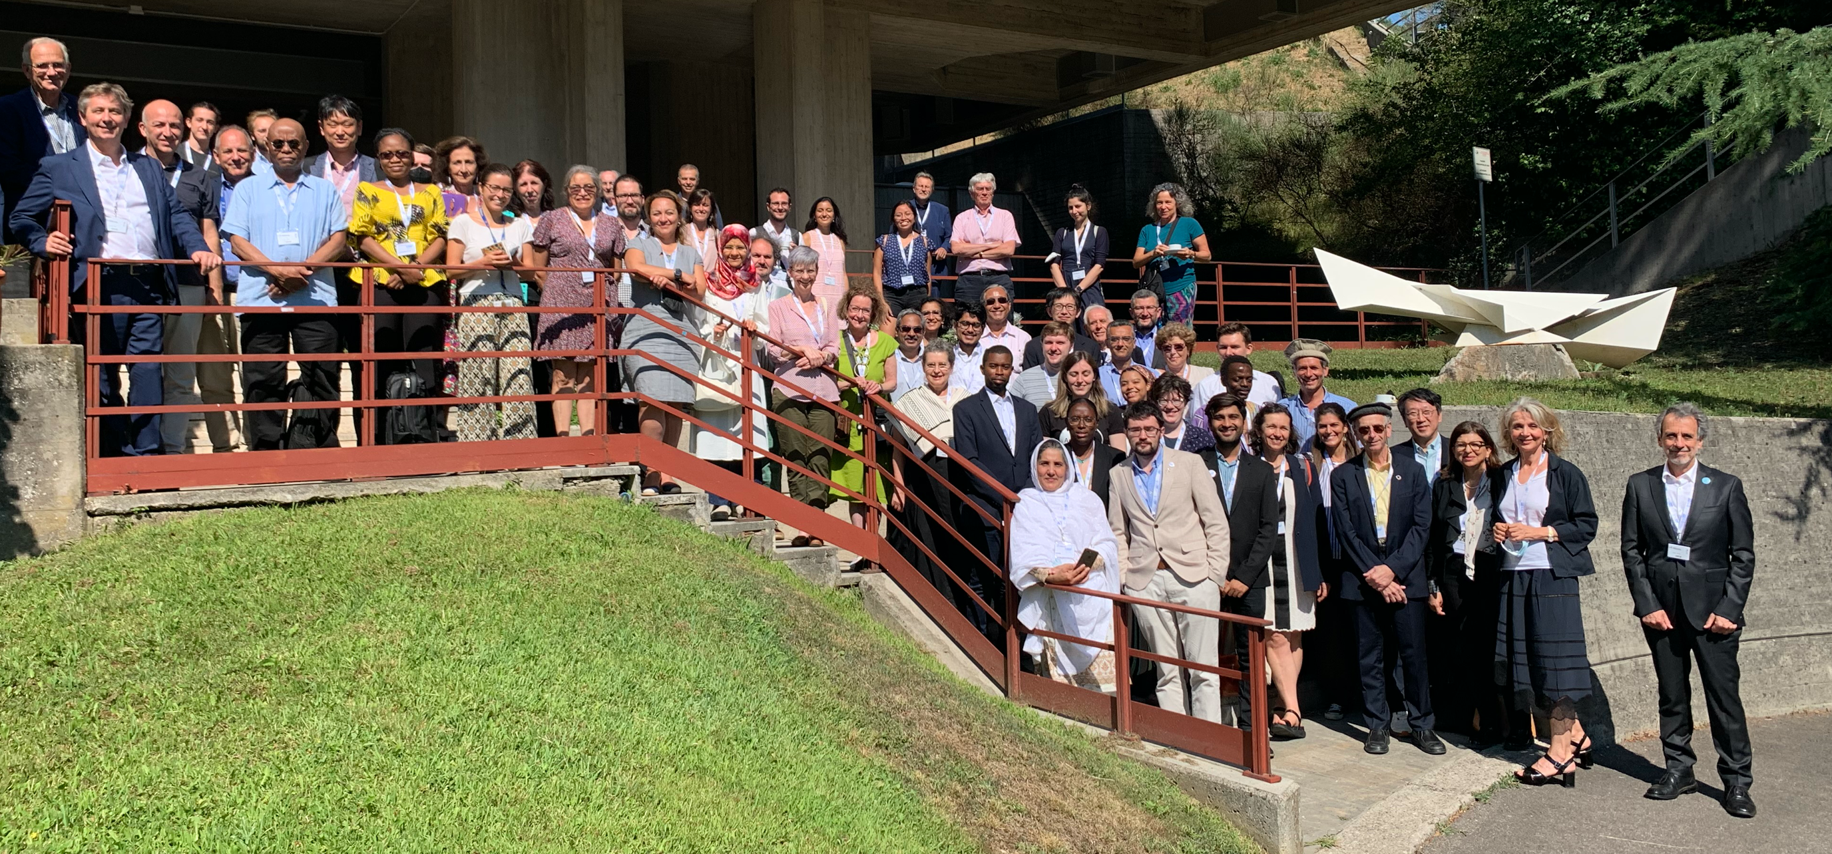
Bon voyage et à bientôt!
Take care and stay safe!

