Slide 1
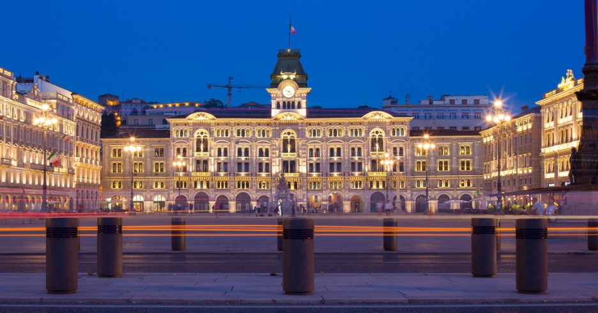


Stefano Fantoni
Trieste International Foundation for Scientific progress and Freedom
Secretary General for administrative affairs, IUPAP

Slide 2

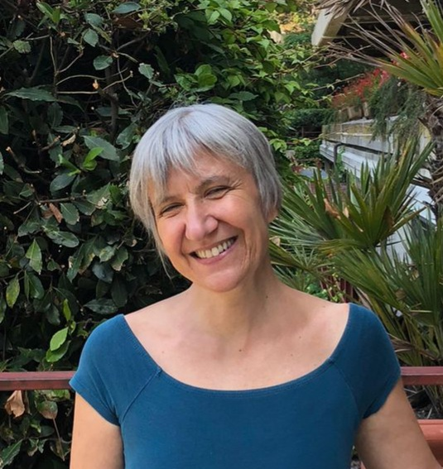

MAIL ADDRESSES
secretariat@iupap.org
iupap100@iupap.org
where sharing the necessary
information on the centenary
communication@iupap.org
for updating and sharing
the website news
Cecilia Cressi
Annalisa Cesaro
Francesca Zavino

Slide 3
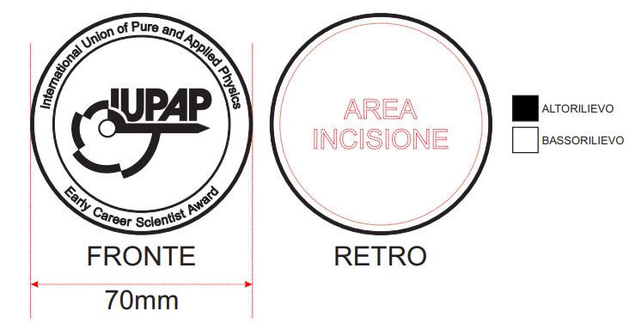
FEW information on the office activity
Collecting and arranging the IUPAP data in strict collaboration with the Geneve Office
Collecting data on the awards: there was a delay with last year's awards, which is being recovered as regards the payments of the monetary prize.
We are catching up with the shipment of the medals. The order of 100 medals has been already made. We expect their arrival in Trieste at the end of July. Then, the name of the commission will be engraved on the back of the medal
We (Francesca Zavino) is updating the IUPAP web site under the guidance of Silvina Ponce Dawson and the collaboration of Hari Haran
As far as completing the implementation of the financial regulations is concerned, we are moving slowly (due to lack of information) but steadily from an emergency to a normal phase
Large amount of work, by Annalisa Cesaro
for the centennial

Slide 4
As soon as the winner is chosen we need
For the site: photo, short bio, citations, short article on the work of the winner (from the CC)
for the payment of the 1.000 EUR the winner must send the details banking to secretariat@iupap.org (see next slide)
For the medal, send to secretariat@iupap.org the address it has to be sent (either to the Commission Chair or directly to the awardee)
For the certificate, the CC fills it in and send / take it to the awardee (the certificate template can be asked to secretariat@iupap.org)

Slide 5
For the payment of the 1000 Euro
Please send the following details banking
• email
• Address
Bank information:
• Name of Bank
• Address of Bank (City & Country)
• Beneficiary Name on Account:
• Bank's Account Number
• Bank SWIFT Code / ABA Routing Number / Sort Code :
• *IBAN Number:
*A full IBAN number is required for all European destinations
Please confirm that your bank account can receive EUR

