Slide 1
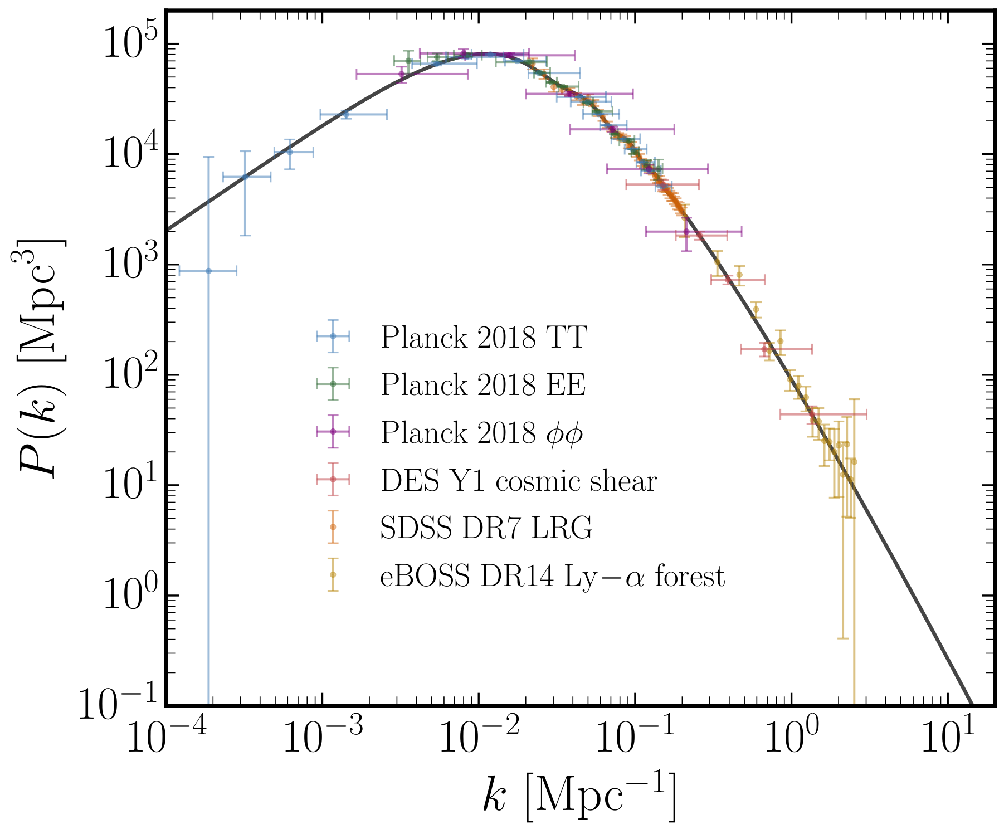

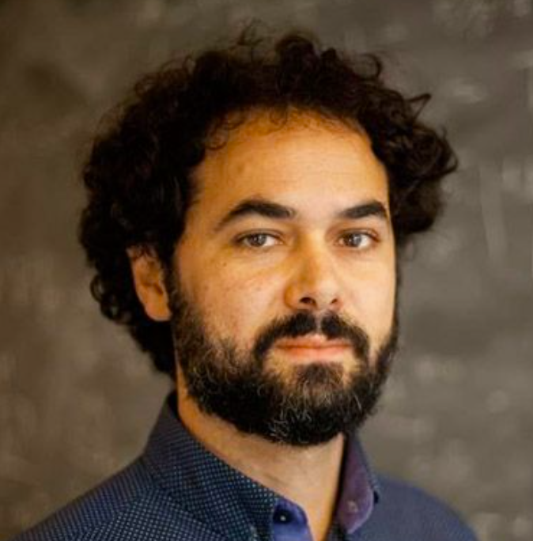


New Roads to the
Small-Scale Universe:
Measurements of the Clustering of Matter with
the High-Redshift UV Galaxy Luminosity Function
Nashwan Sabti
In collaboration with:
Diego Blas (IFAE & UAB)
Julian B. Muñoz (Harvard-CfA)
Based on 2110.13161 and 2110.13168

Slide 2
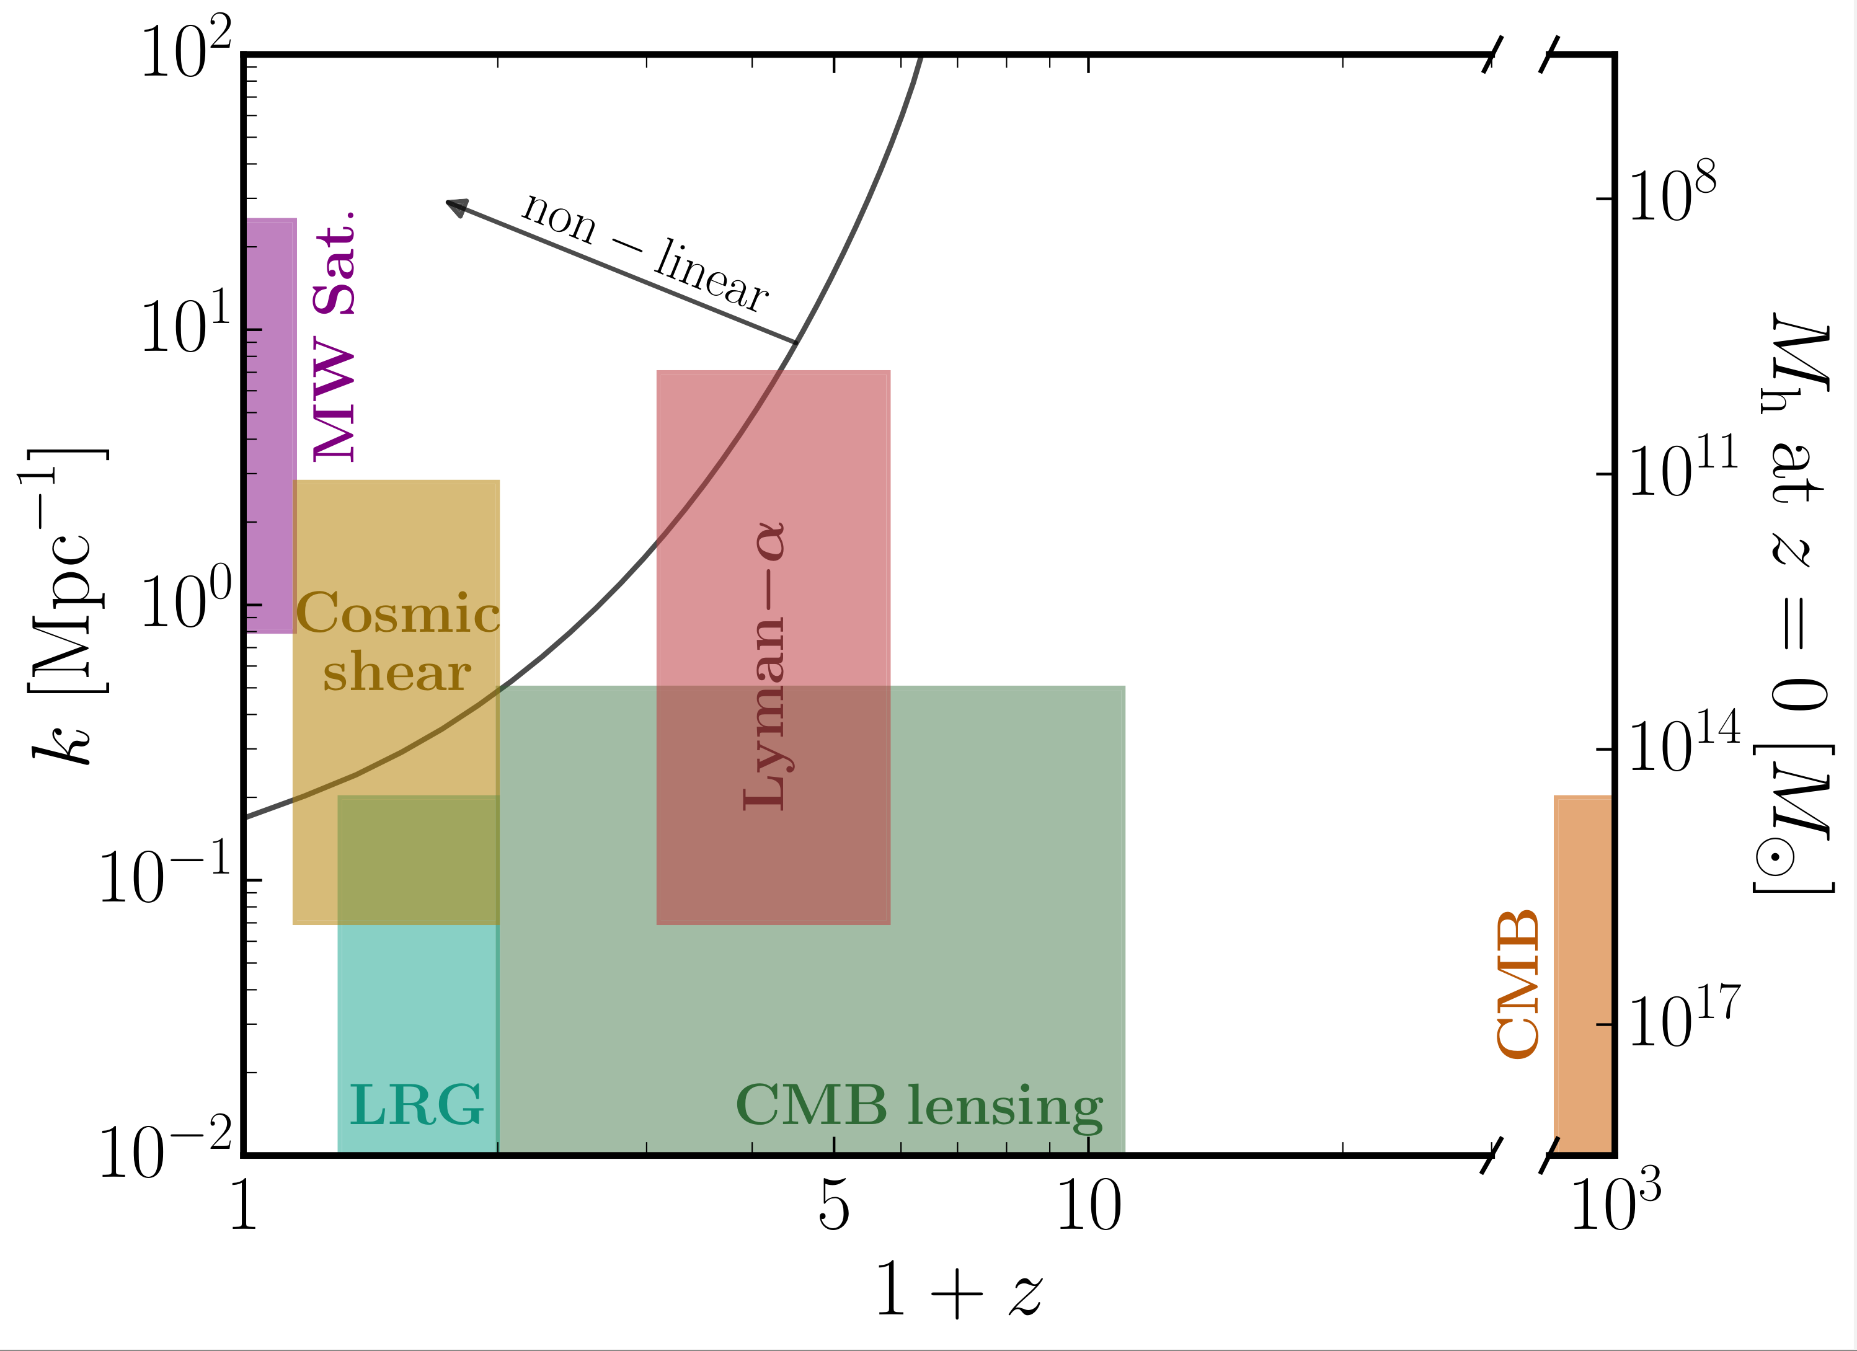

Landscape of probes
ADM
FDM (ULDM)
WDM
CDM
NS, Muñoz, Blas
2110.13161

Slide 3
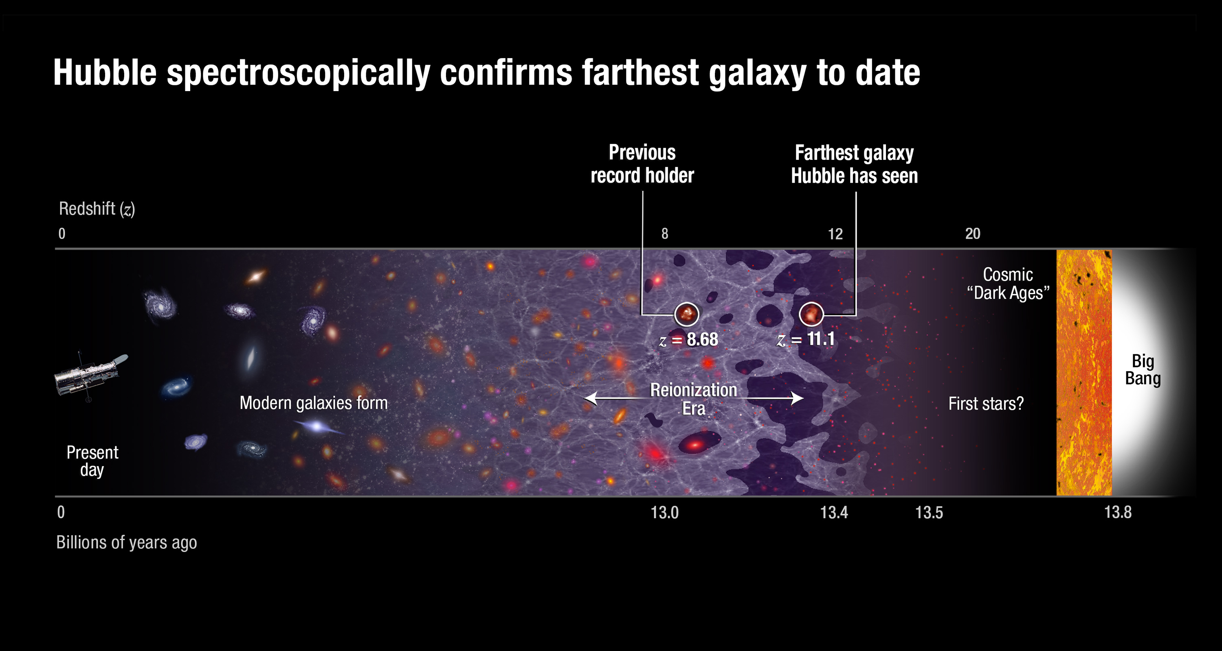
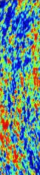
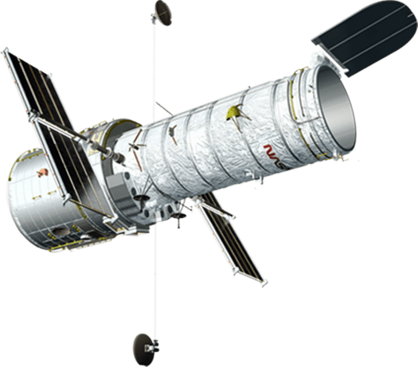
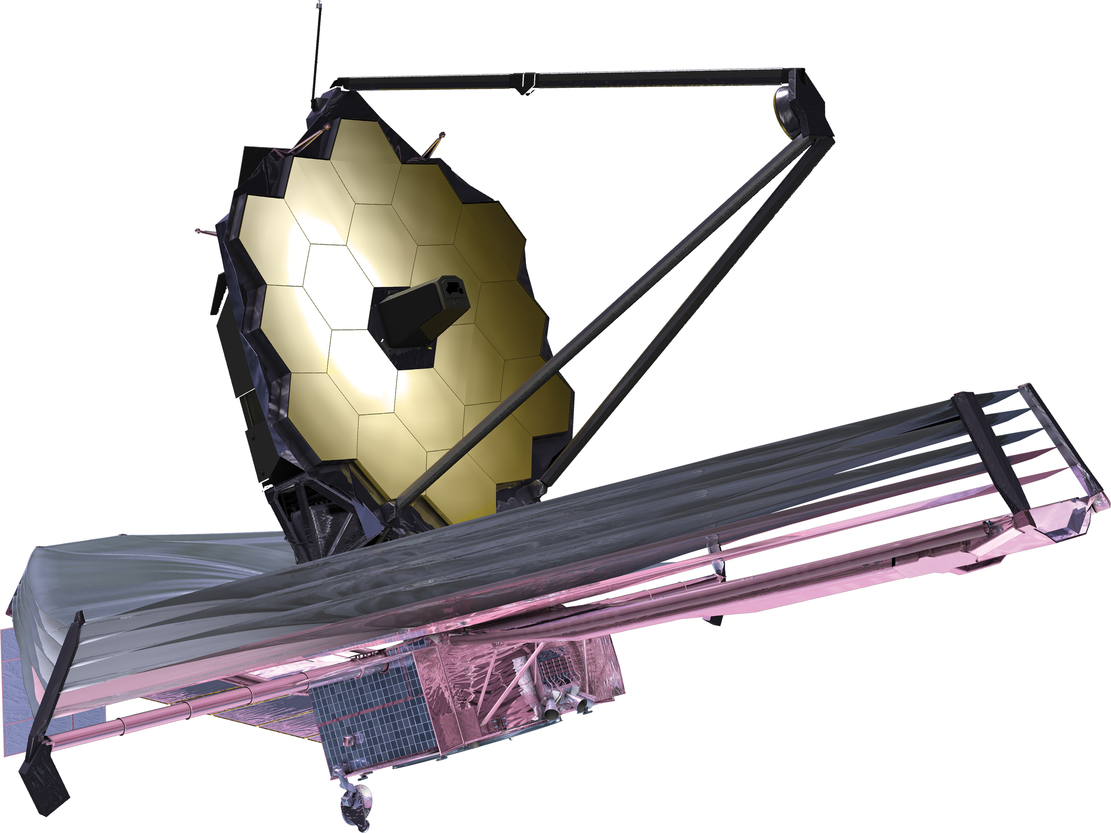

Timeline of Universe
Current data
z ~ 4 $−$10
z = 0
4
6
20
1000
Local Universe
Reionisation
Cosmic Dawn
CMB
Image credit: Adapted from NASA, ESA, P. Oesch, B. Robertson, A. Feild

Slide 4
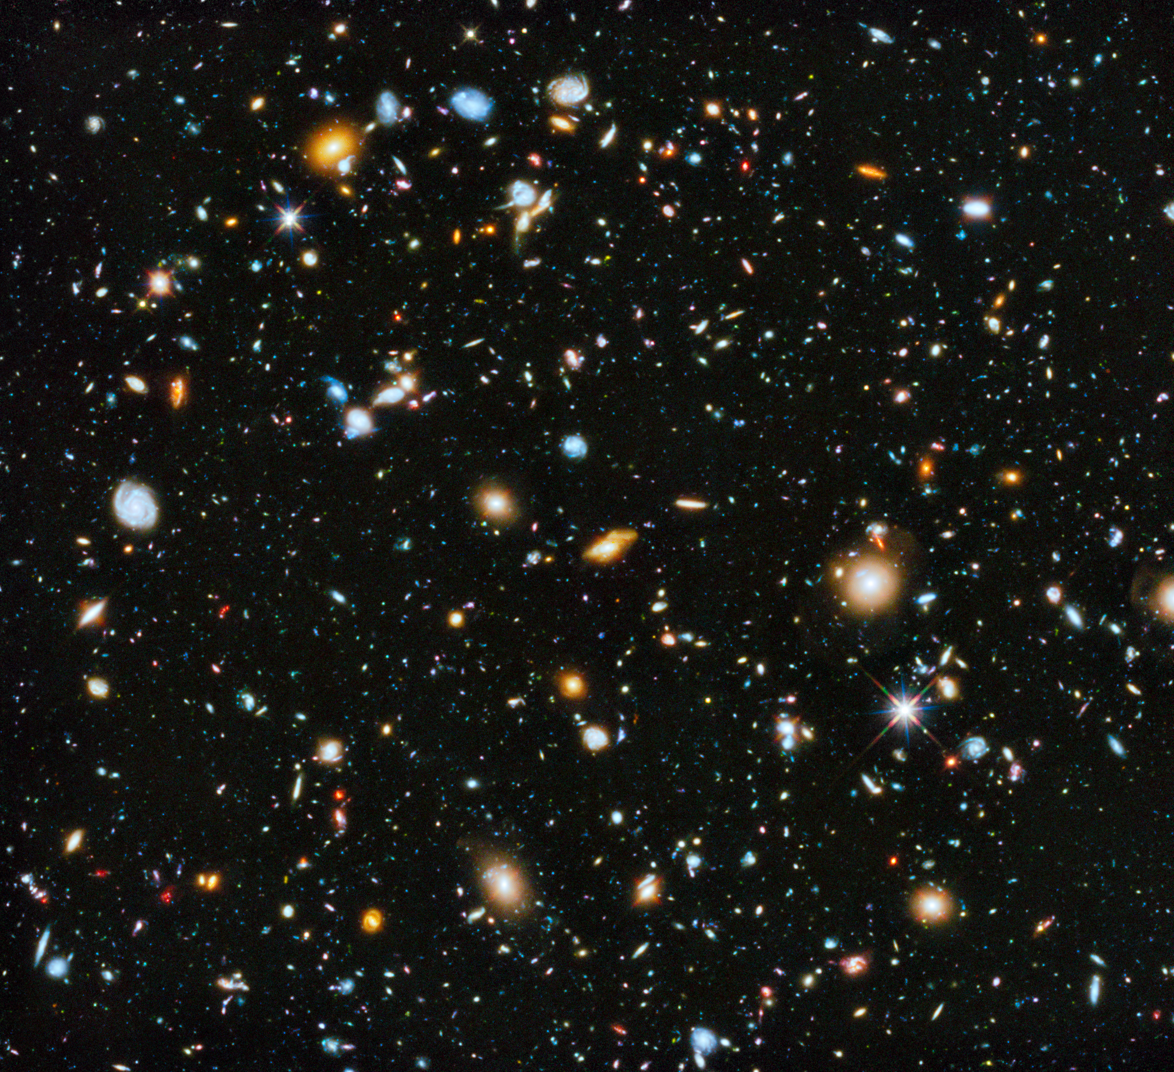
Observing galaxies at high redshifts
High-redshift galaxies contain young stars that emit UV radiation
UV radiation redshifts due to expansion of Universe
UV emission is observed today with, e.g., Hubble Space Telescope
Obtain abundance of galaxies as a function of their luminosity/magnitude
NASA, ESA, R. Ellis (Caltech), and the HUDF 2012 Team

Slide 5
Goal of this Work
What can The high-redshift UV LF tell us about the clustering of matter?

Slide 6
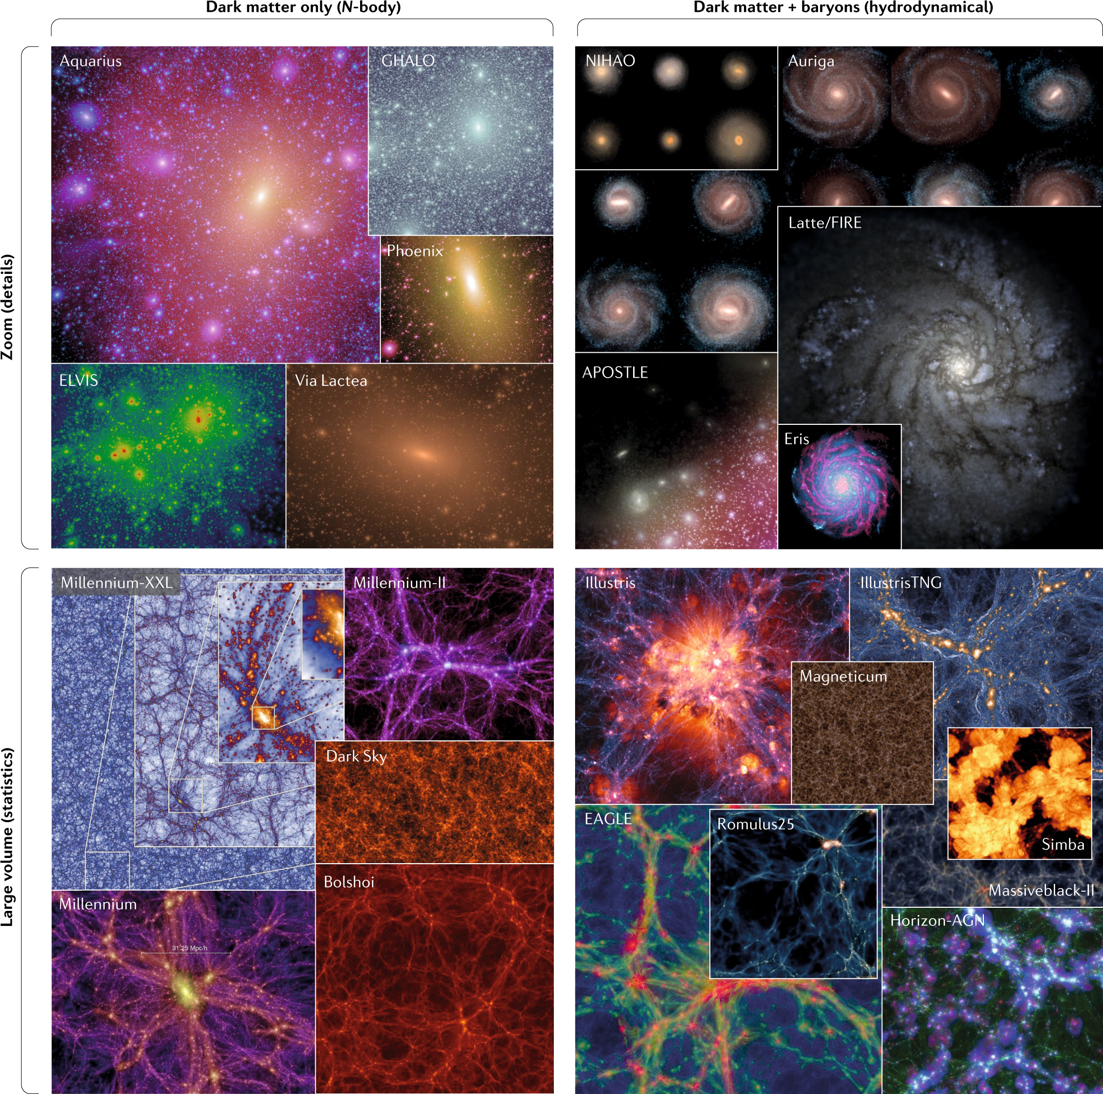


The UV Luminosity Function
$$Φ_{UV}=\frac{dn}{dM_{UV}}=\frac{dn}{dM_{h}}×\frac{dM_{h}}{dM_{UV}}$$
$$M_{h}↔M_{UV}$$
Halo mass function
Halo-galaxy connection
Vogelsberger+2020
Cosmology
Astrophysics

Slide 7


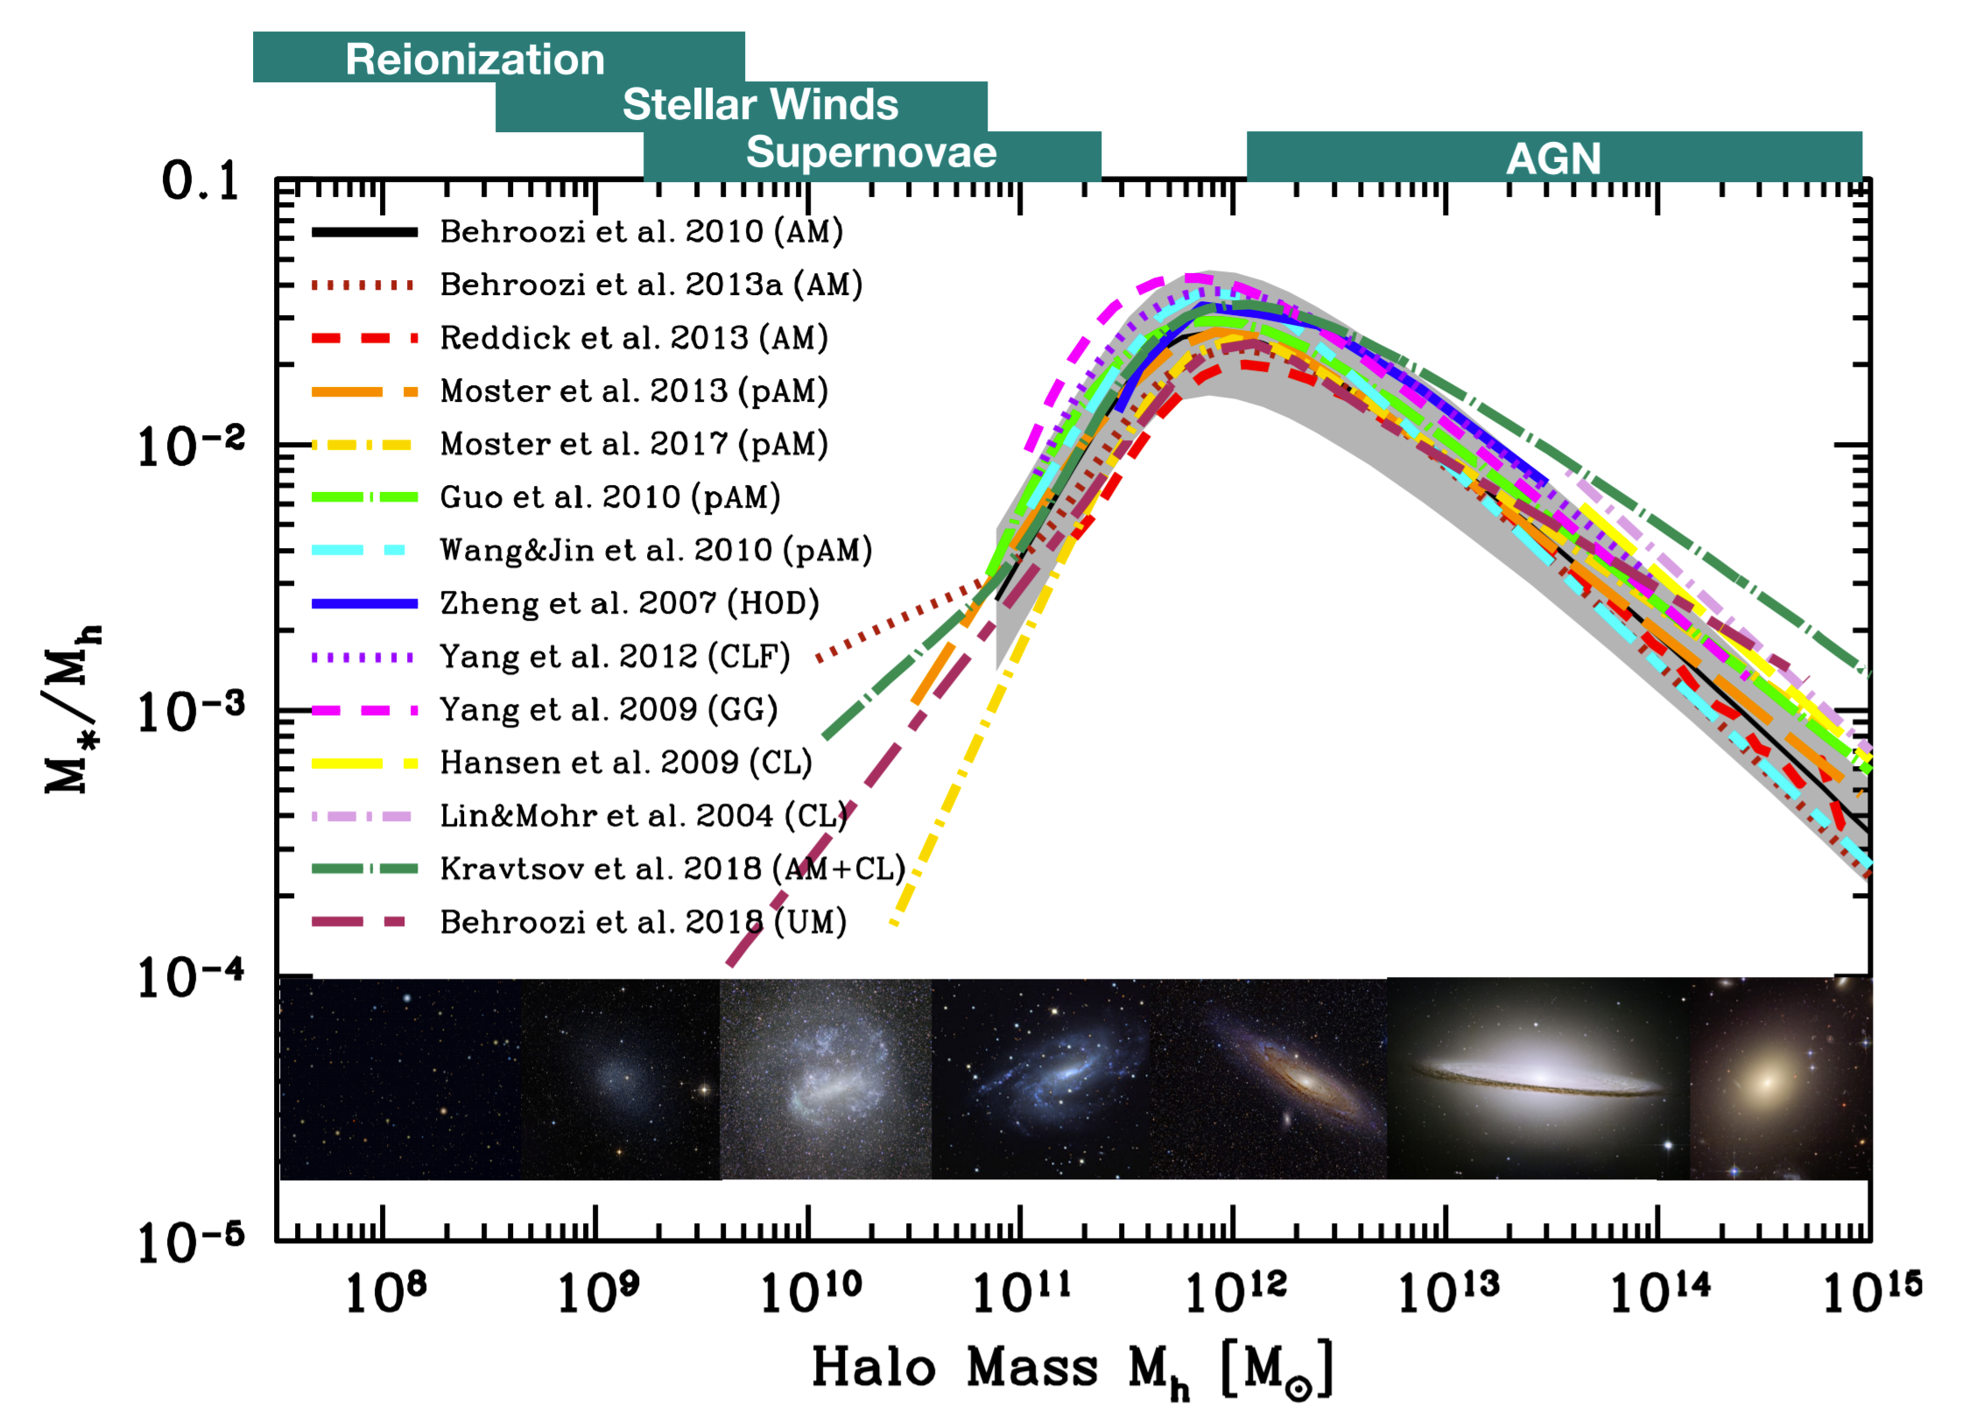



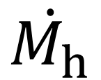
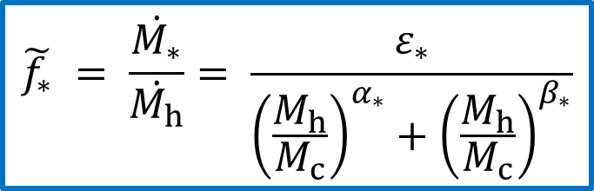




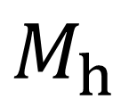
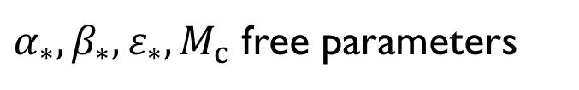




Modelling the Halo-Galaxy Connection
$$⟨L_{UV}⟩$$
$$M_{h}$$
$$accr.$$
$$\dot{M_{h}}$$
$$\tilde{f_{∗}}$$
$$\dot{M_{∗}}$$
$$\tilde{κ}$$
$$L_{UV}$$
N-body calibration
$$\tilde{f_{∗}} = \frac{\dot{M_{∗}}}{\dot{M_{h}}}= \frac{ε_{∗}}{{\left(\frac{M_{h}}{M_{c}}\right)}^{α_{∗}}+{\left(\frac{M_{h}}{M_{c}}\right)}^{β_{∗}}}$$
$$\dot{M_{∗}}=\tilde{κ}L_{UV}$$
${P(L}_{UV}$)
$$σ_{L_{UV}}$$
$α_{∗},β_{∗}, ε_{∗},M_{c}$ free parameters
$$⟨L_{UV}⟩$$
$$L_{UV}$$
Wechsler+2018
Stochasticity

Slide 8
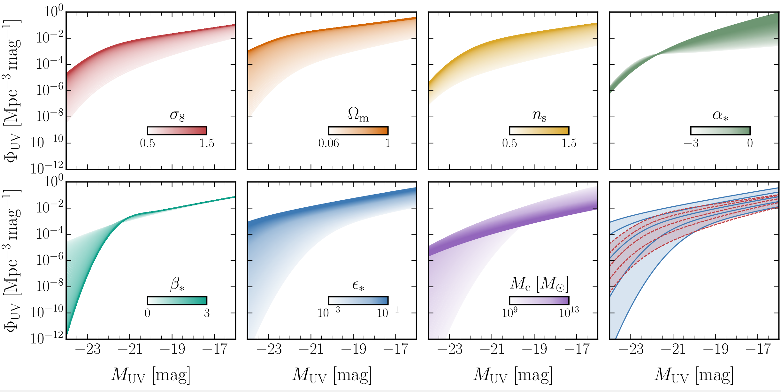

UV LF Parameter Dependence
$$M_{UV}$$
Brighter galaxies
Fainter
galaxies
NS, Muñoz, Blas - 2110.13168

Slide 9
UV LF Parameter Dependence
More
galaxies
Brighter galaxies
NS, Muñoz, Blas - 2110.13168

Slide 10
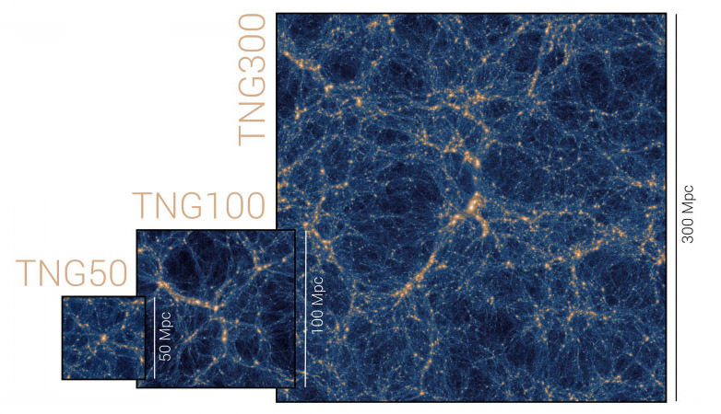
UV LF Data
Hubble Legacy Fields
Blank-field surveys
Large observed areas → probes mid and bright end of the UV LF
Easier to model than lensing fields
Bouwens+2021
IllustrisTNG Mock Data
Hydrodynamical simulation
Three boxes: 300, 100, & 50 cMpc
Cross-check
TNG Collaboration
Vogelsberger+2019
NASA, ESA, R. Ellis (Caltech), and the HUDF 2012 Team

Slide 11
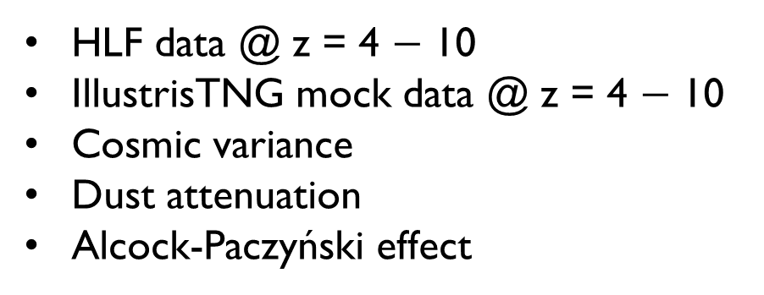
UV LF Data
Hubble Legacy Fields
Blank-field surveys
Large observed areas → probes mid and bright end of the UV LF
Easier to model than lensing fields
HLF data @ z = 4 $−$ 10
IllustrisTNG mock data @ z = 4 $−$ 10
Cosmic variance
Dust attenuation
Alcock-Paczyński effect
IllustrisTNG Mock Data
Hydrodynamical simulation
Three boxes: 300, 100, & 50 cMpc
Cross-check

Slide 12

GALLUMI
Galaxy Luminosity Function Pipeline for Cosmology and Astrophysics
Fast likelihood code implemented in the MCMC
sampler MontePython
Can be readily used in conjunction with other
data sets (e.g., Planck CMB, Pantheon/JLA SNe)
Contains a variety of astro models, HMFs, dust calibrations, and more!
Publicly available: github.com/NNSSA/GALLUMI_public

Slide 13
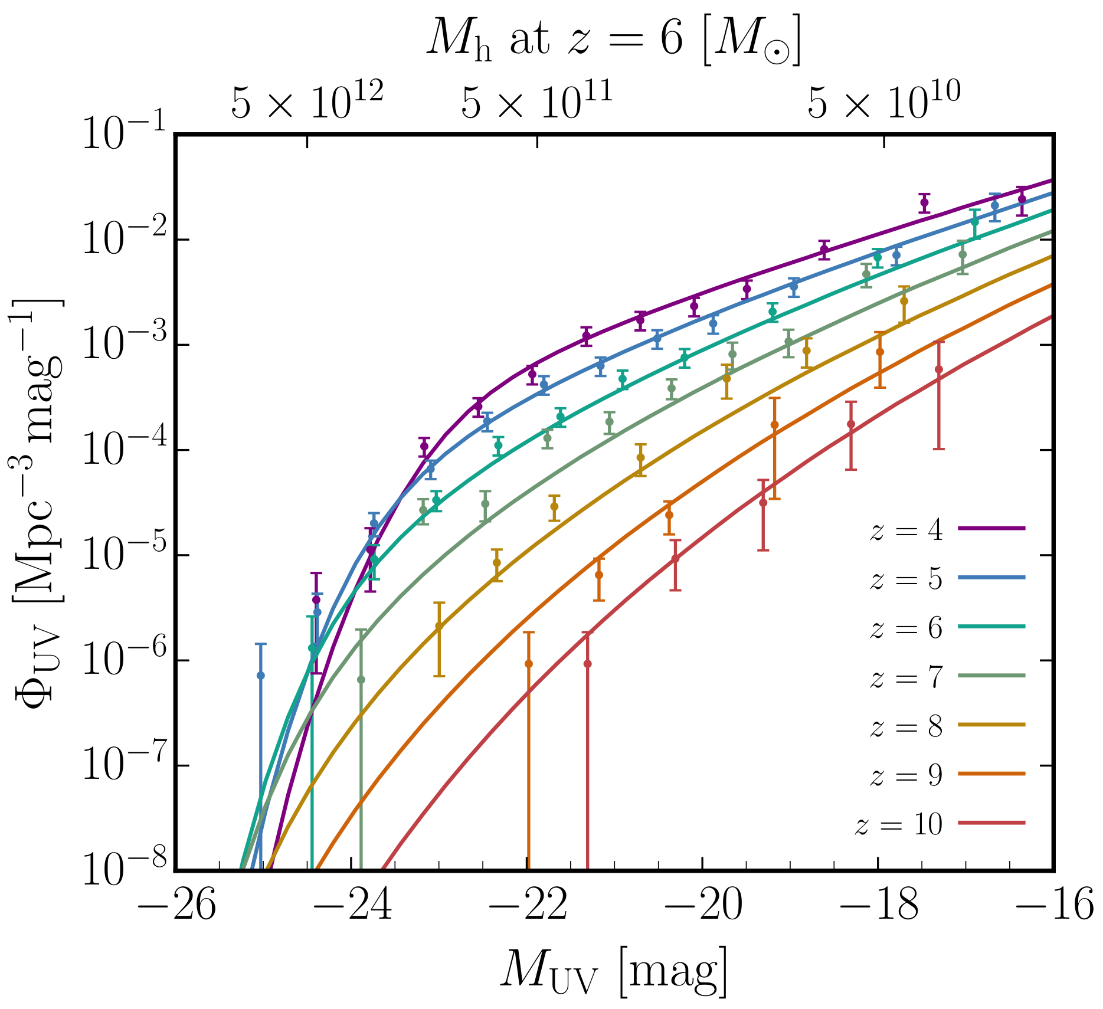
Best-fit to data
NS, Muñoz, Blas
2110.13161
Brighter
Fainter

Slide 14
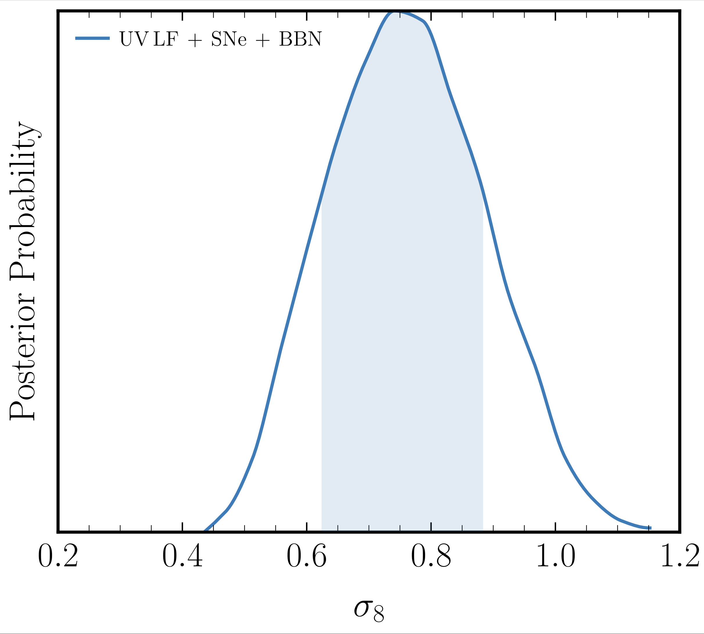


Results: large-scale clustering amplitude
$${(Ω}_{m})$$
$${(ω}_{b})$$
15%
NS, Muñoz, Blas
2110.13168

Slide 15
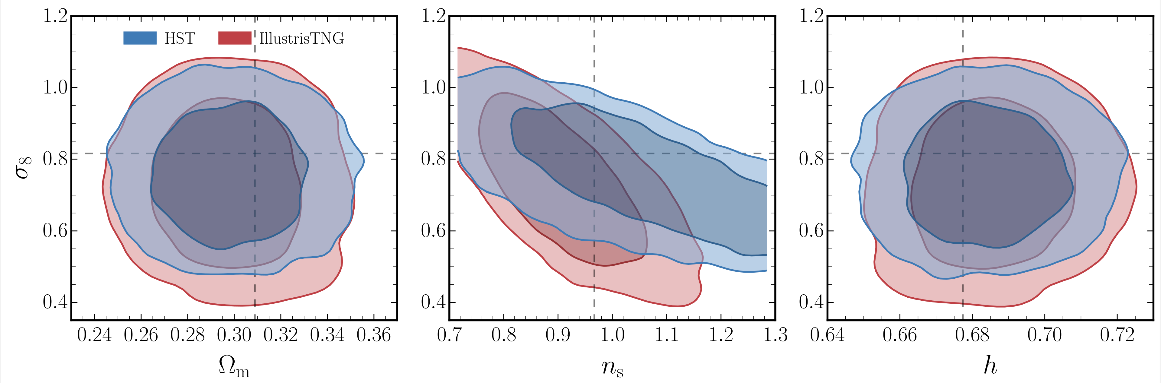
Results: large-scale clustering amplitude
NS, Muñoz, Blas
2110.13168

Slide 16
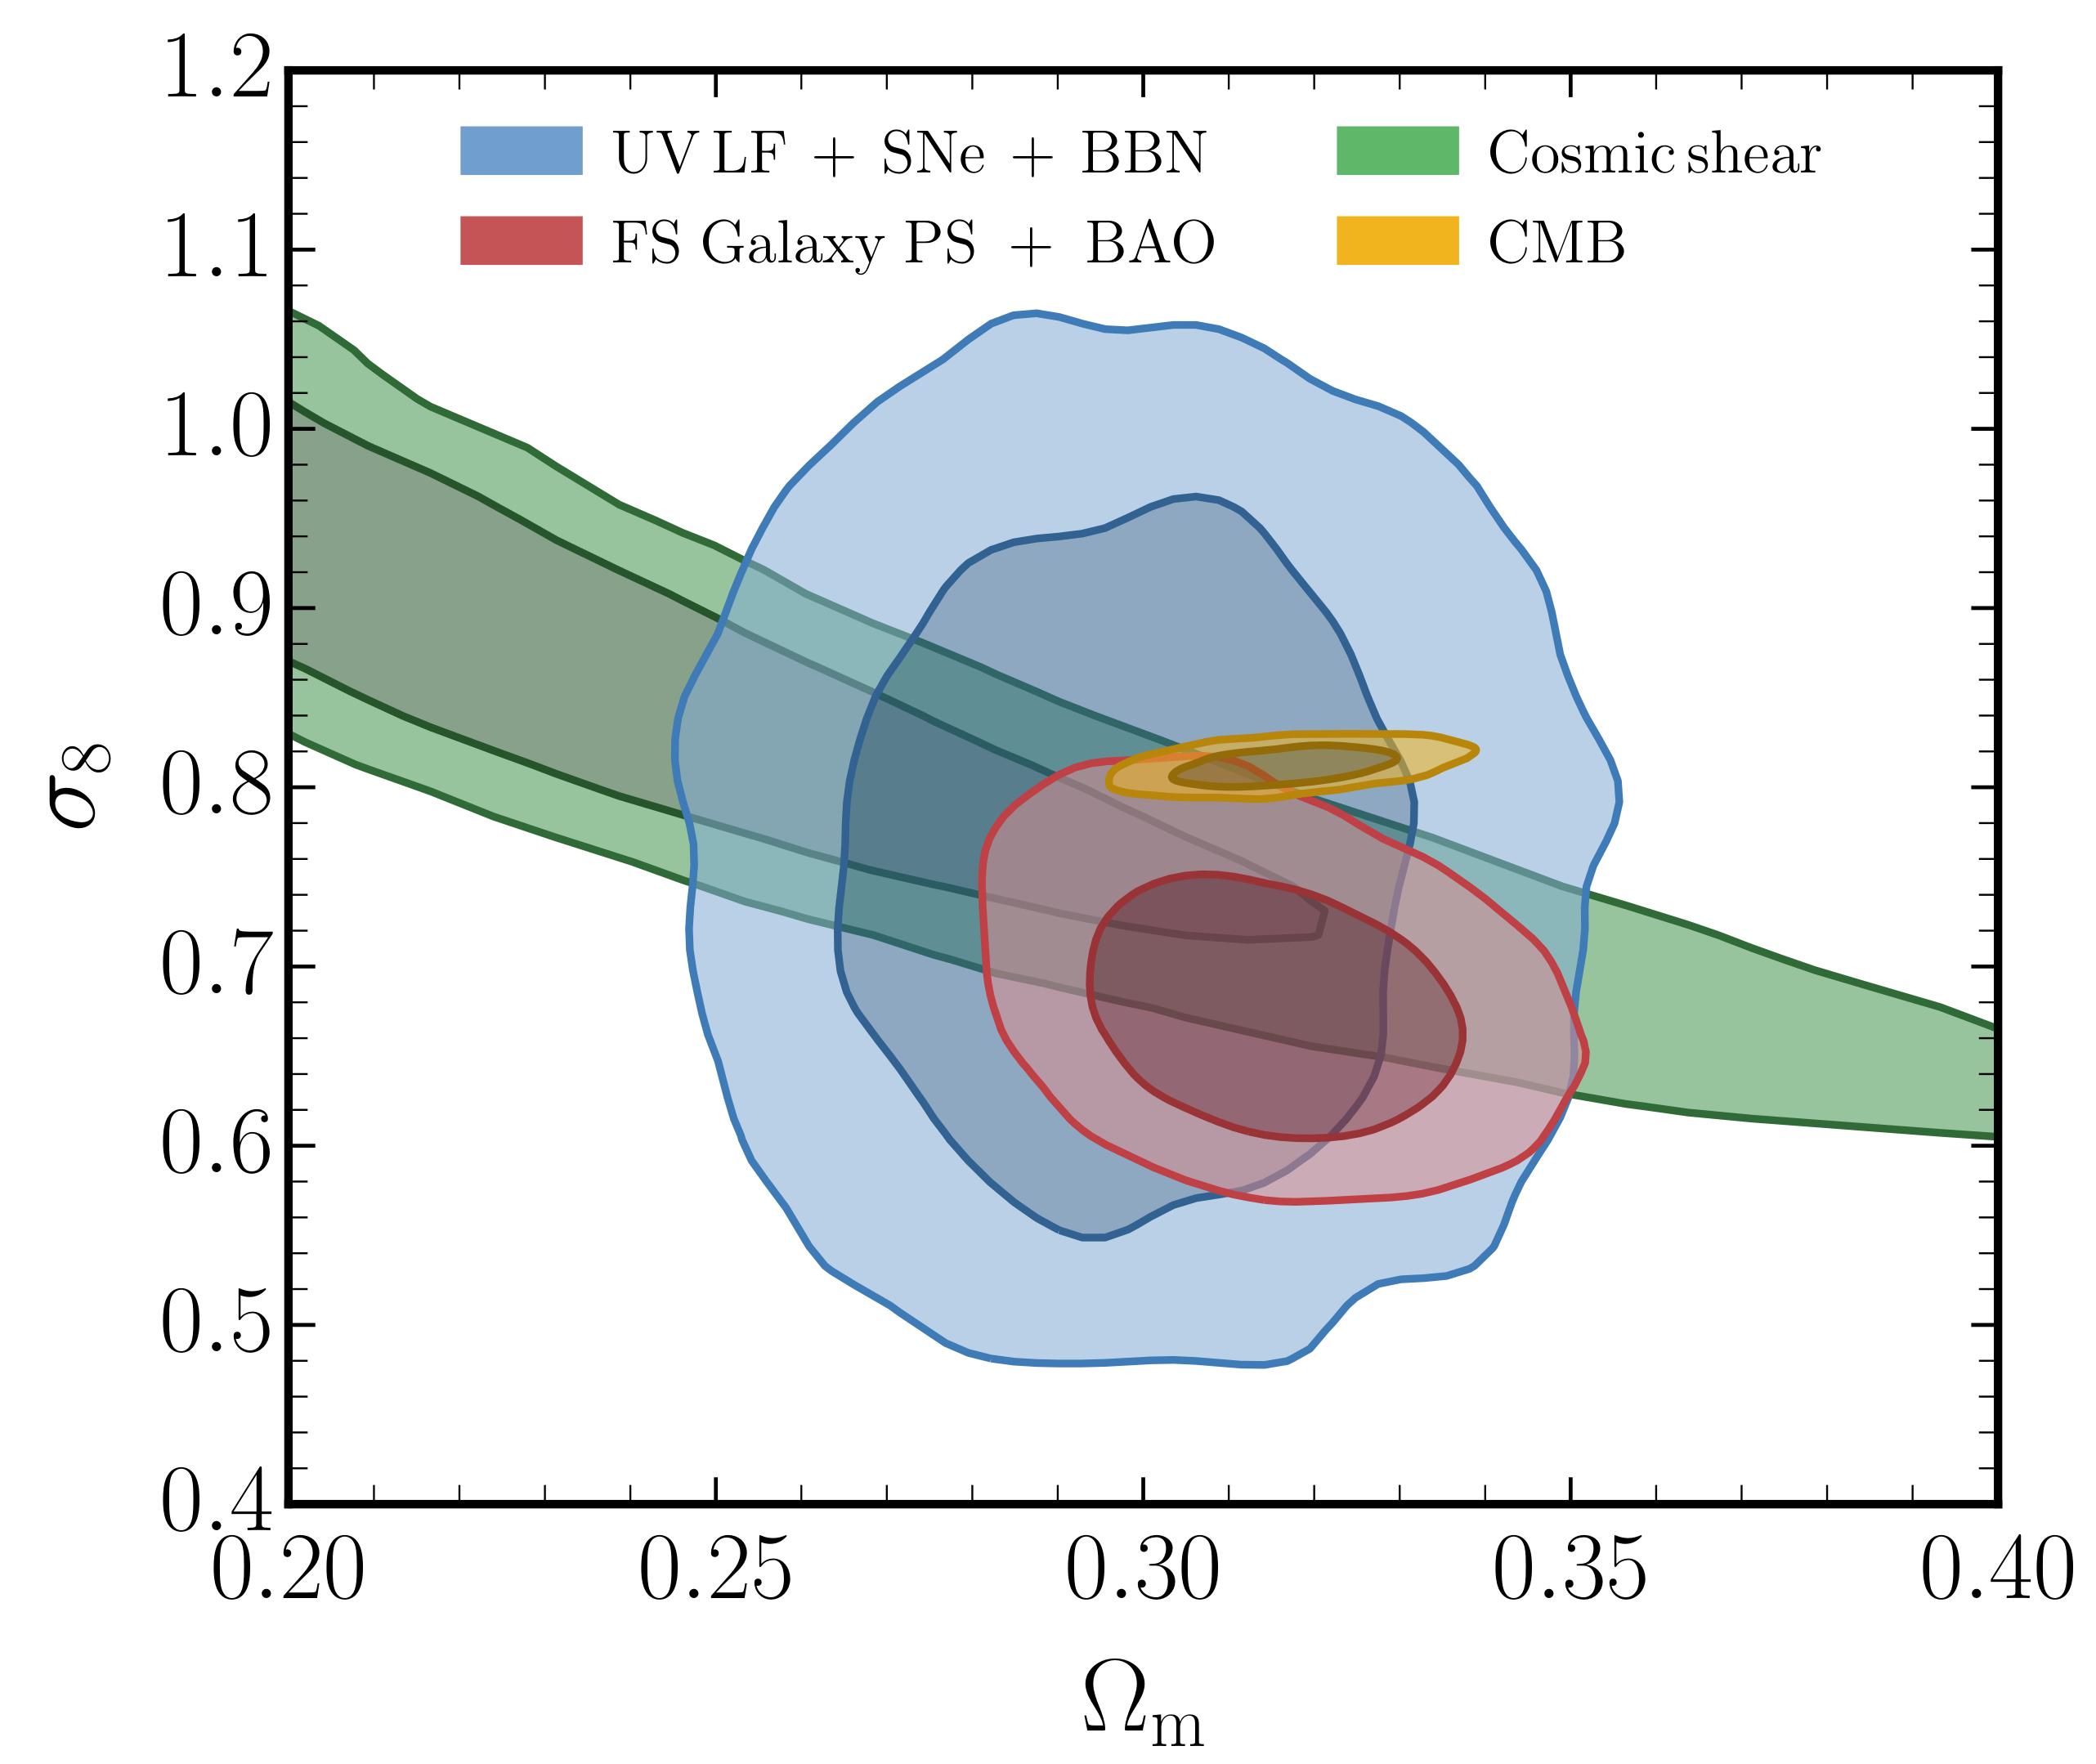
Results: large-scale clustering amplitude
NS, Muñoz, Blas
2110.13161

Slide 17
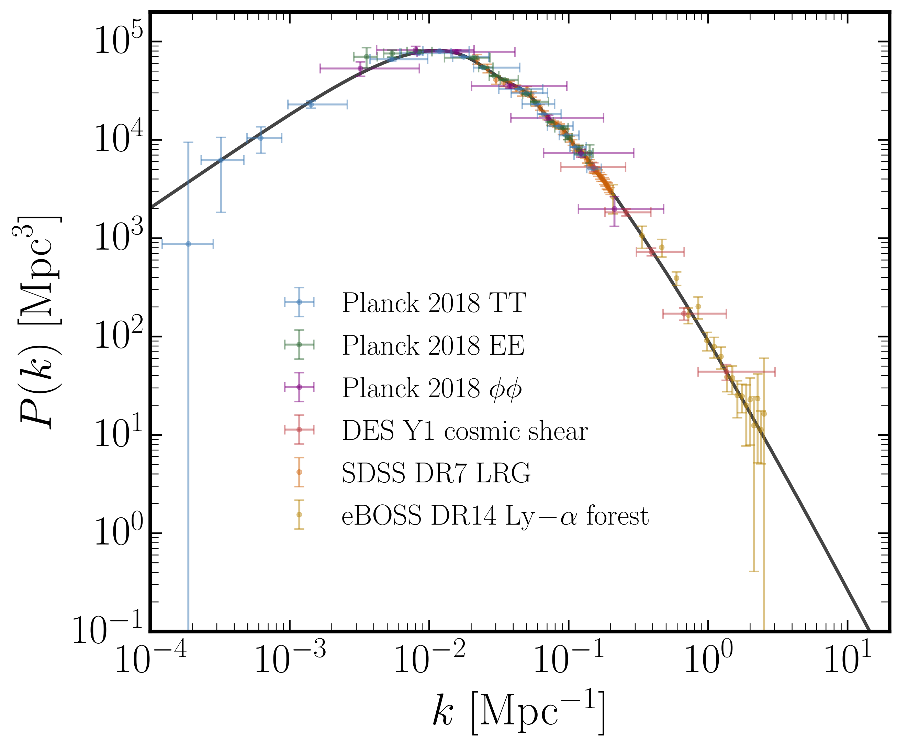
Results: SMALL-scale clustering amplitude
NS, Muñoz, Blas
2110.13161
Data: Chabanier+2019

Slide 18
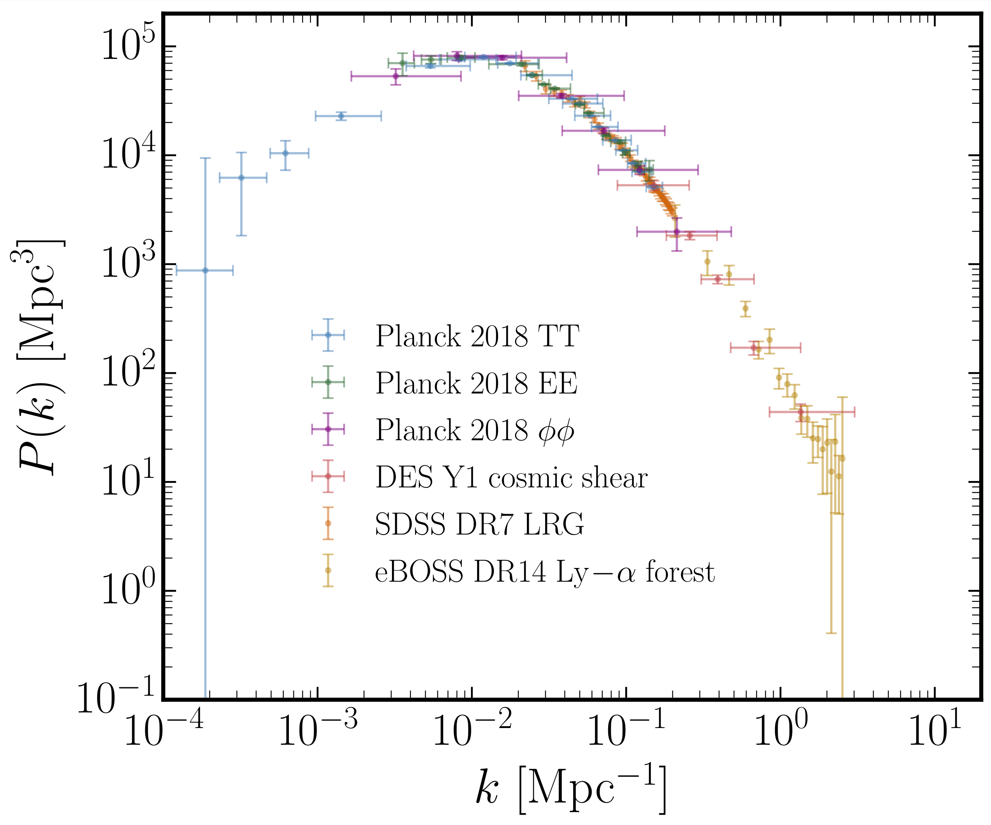
Results: SMALL-scale clustering amplitude
NS, Muñoz, Blas
2110.13161
Data: Chabanier+2019

Slide 19
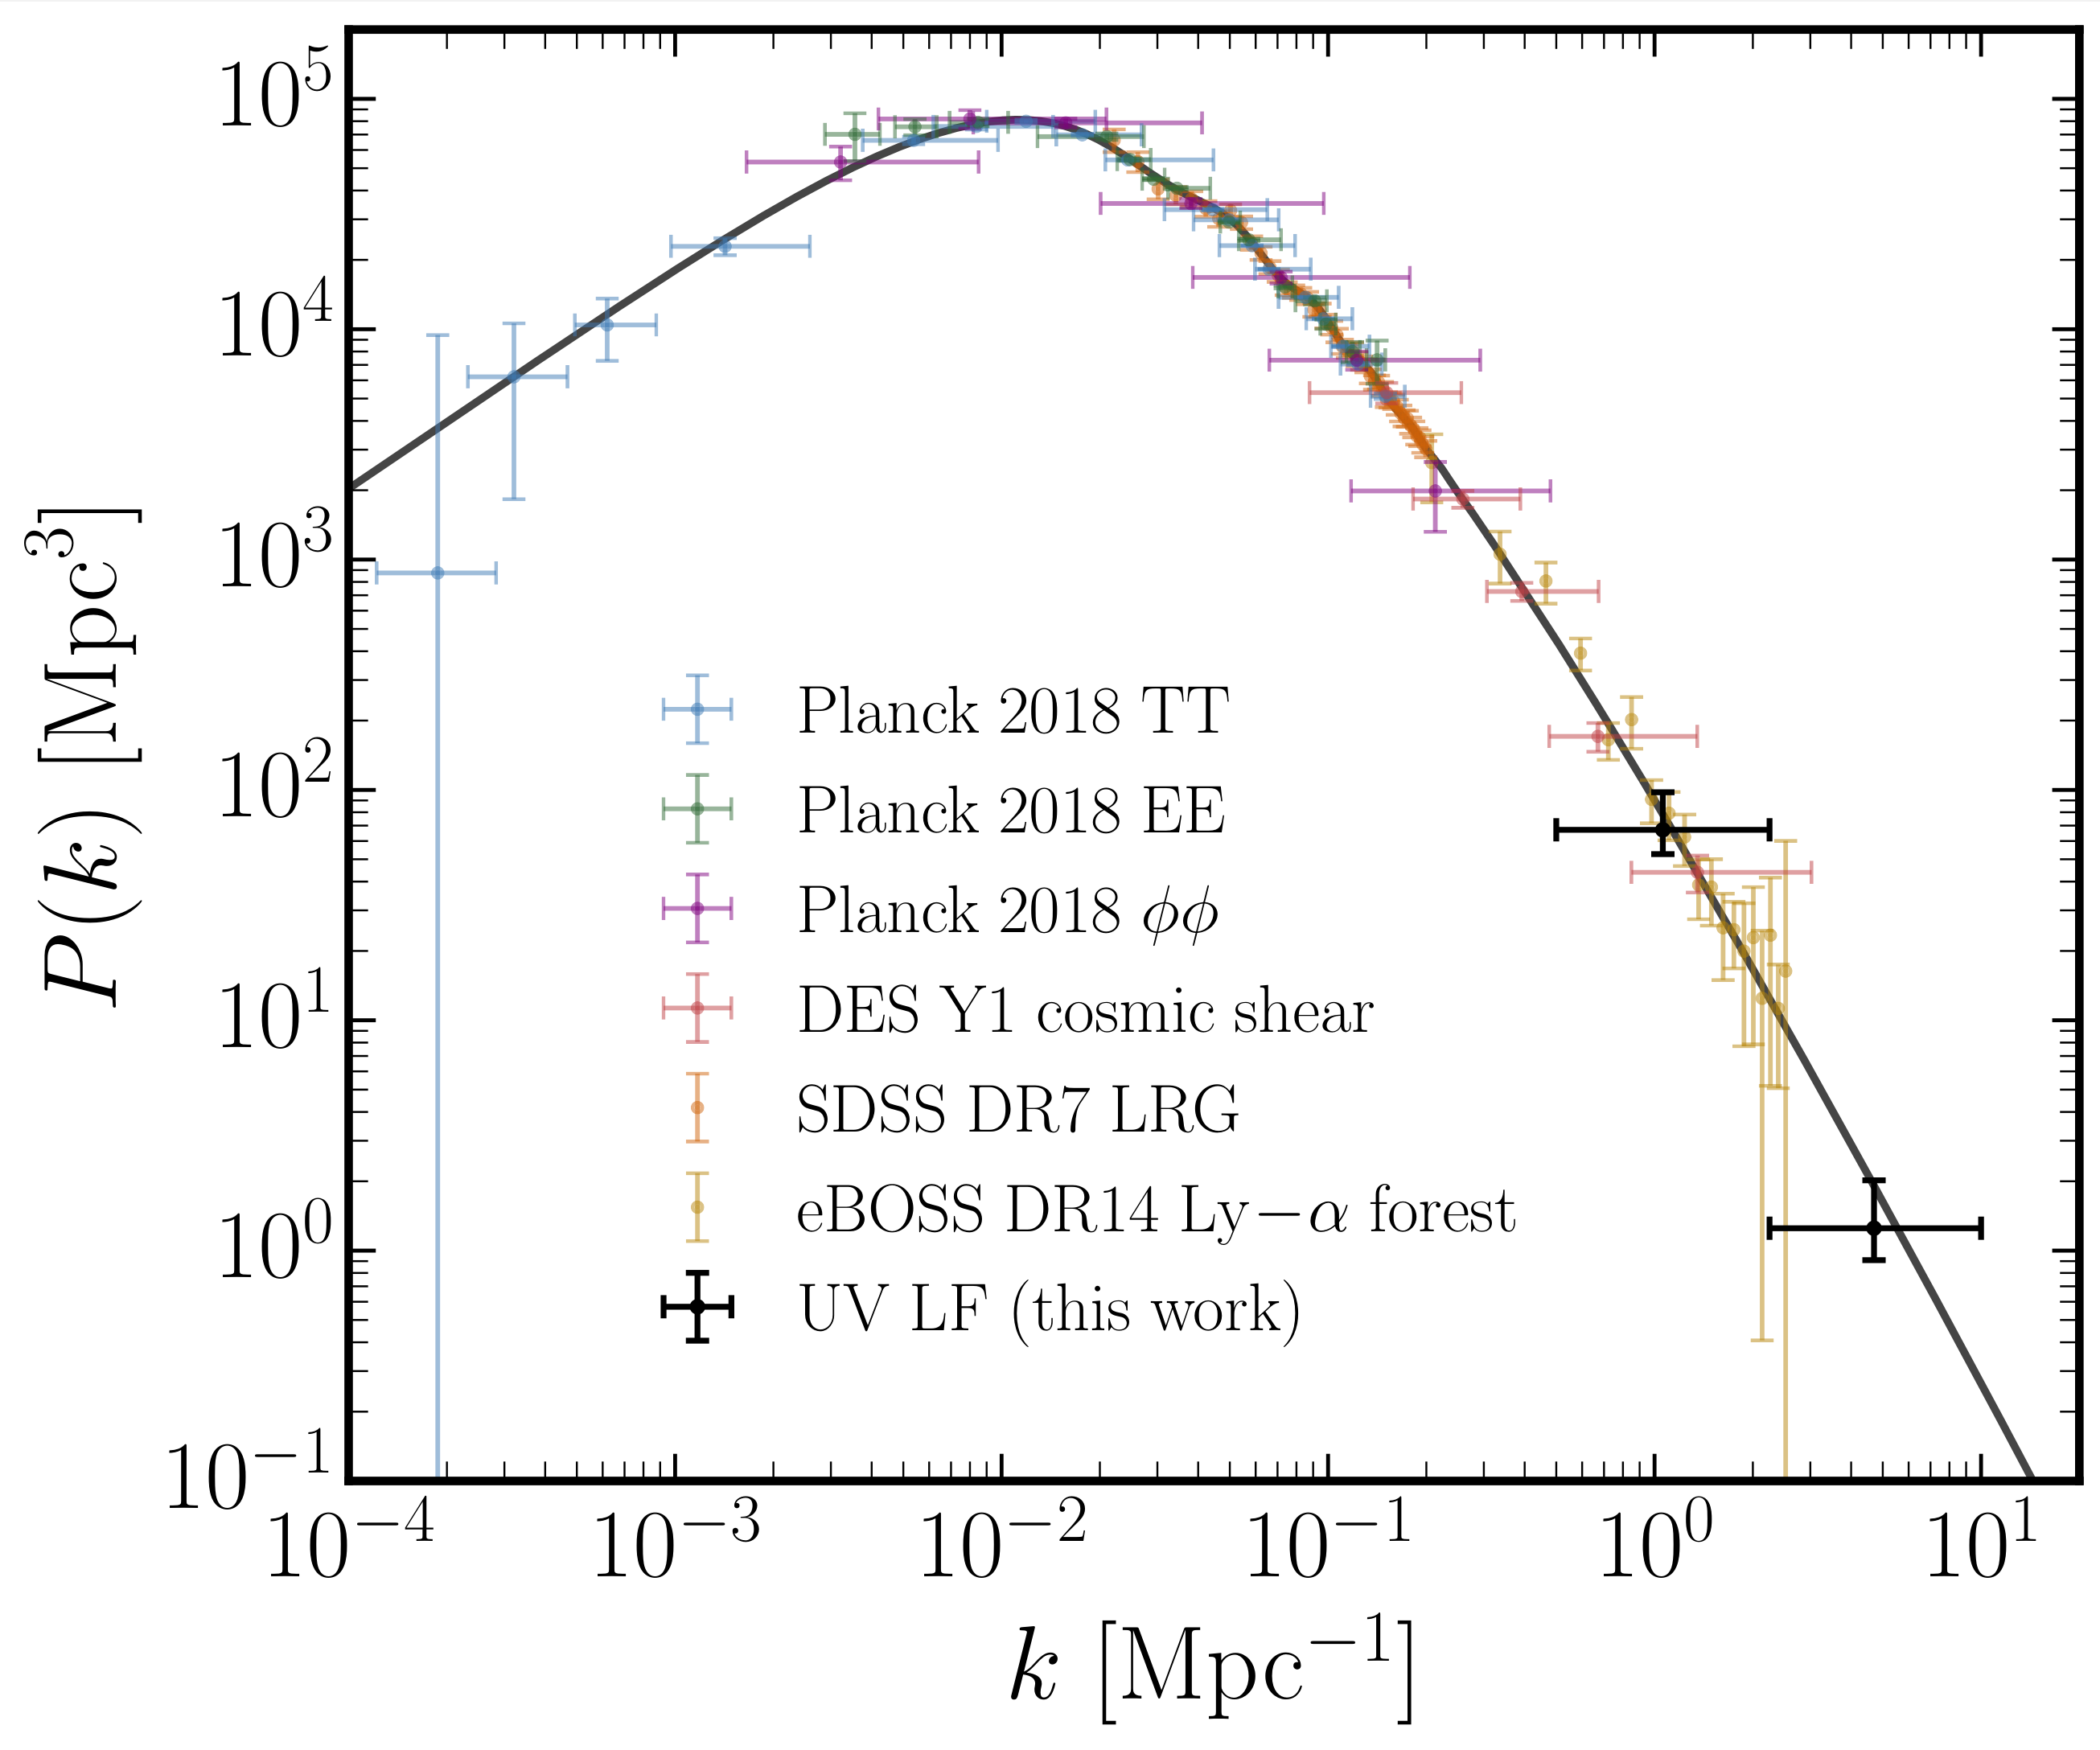
Results: SMALL-scale clustering amplitude
NS, Muñoz, Blas
2110.13161
Data: Chabanier+2019

Slide 20
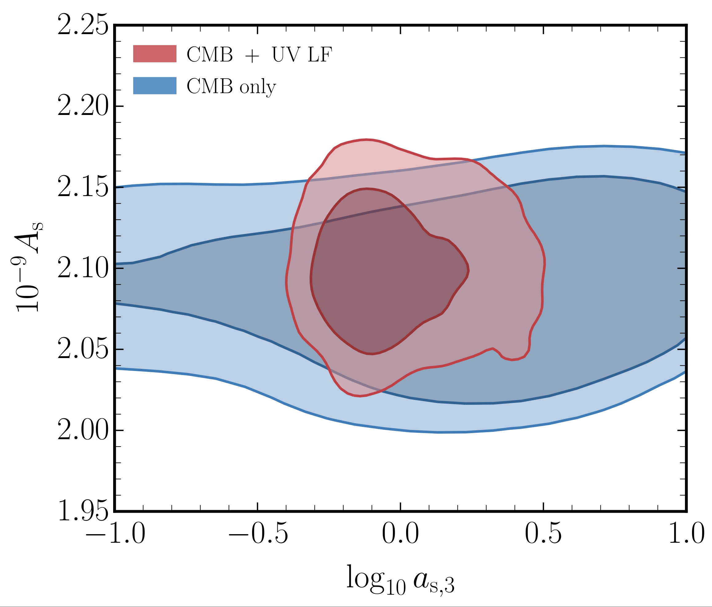
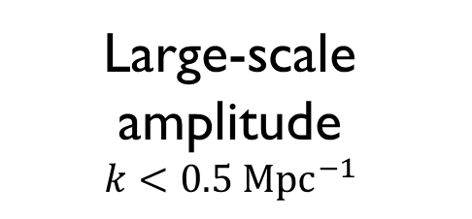
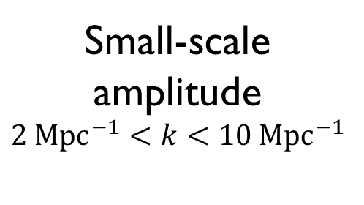
Results: SMALL-scale clustering amplitude
CDM
Large-scale amplitude
$$k<0.5 {Mpc}^{−1}$$
Small-scale amplitude
$$2 {Mpc}^{−1}<k<10 {Mpc}^{−1}$$
NS, Muñoz, Blas
2110.13161

Slide 21
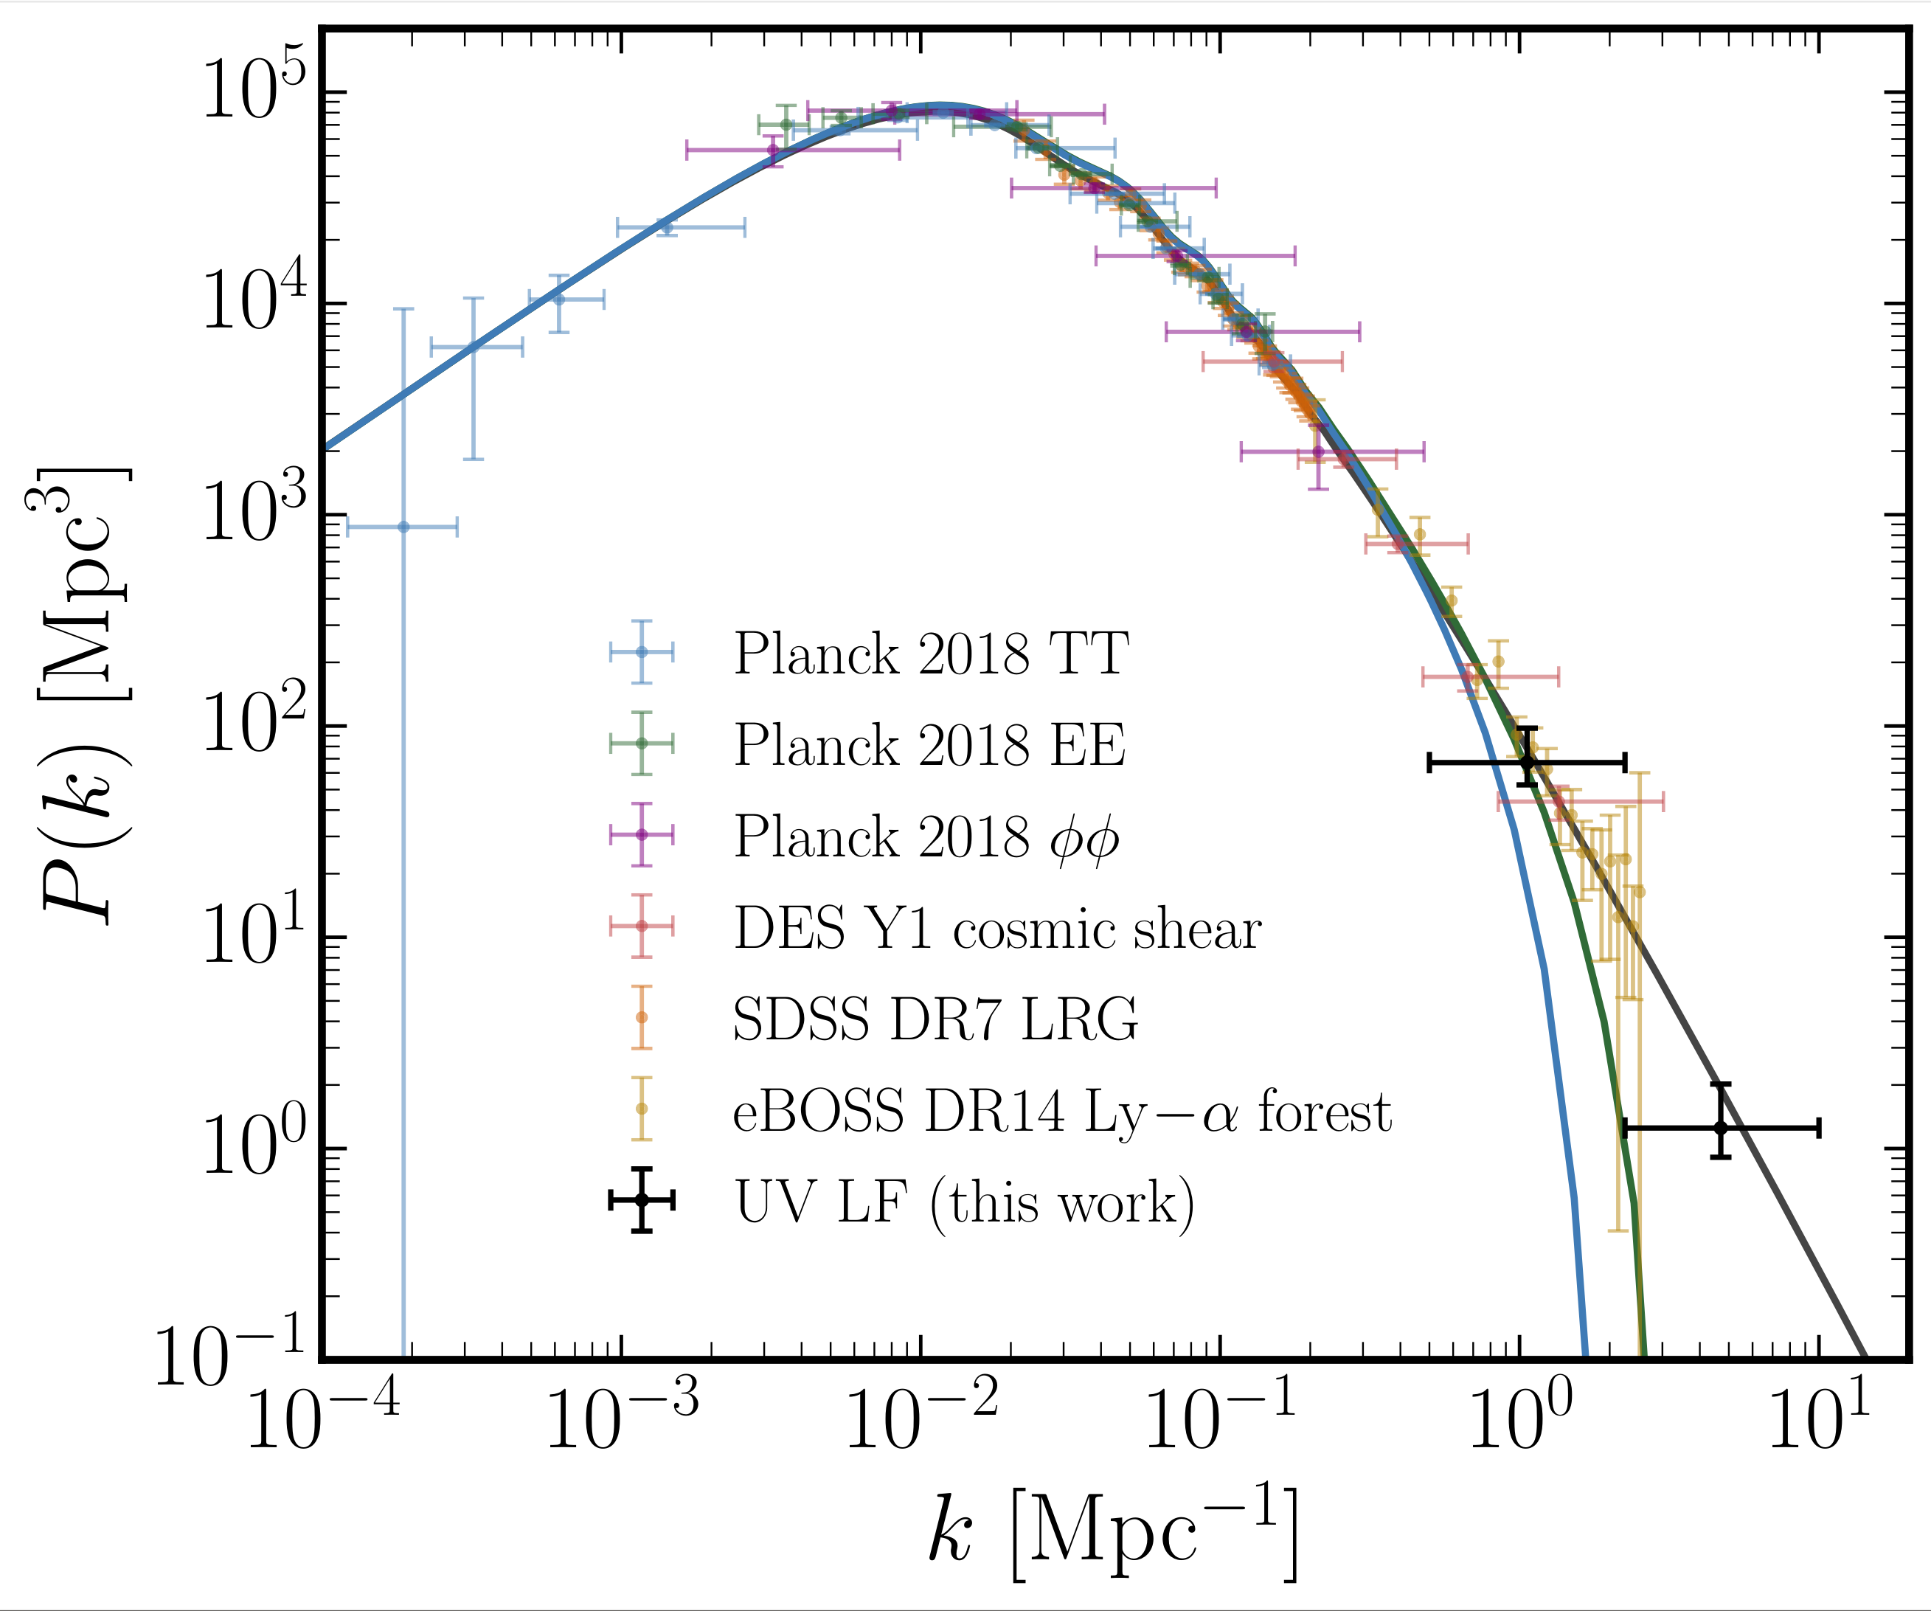
Results: SMALL-scale clustering amplitude
CDM
0.5 keV
WDM
1 keV
WDM
NS, Muñoz, Blas
2110.13161

Slide 22
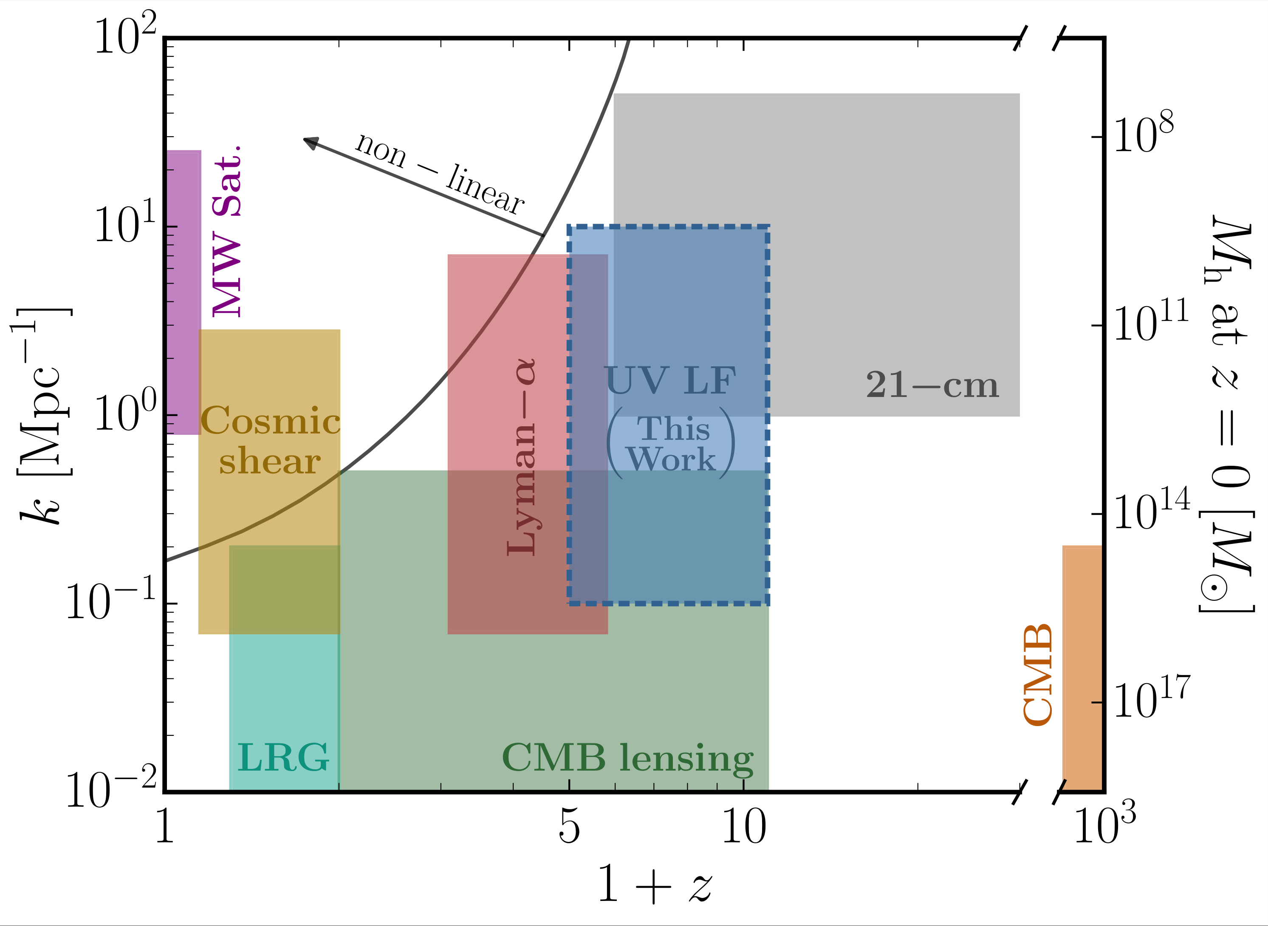
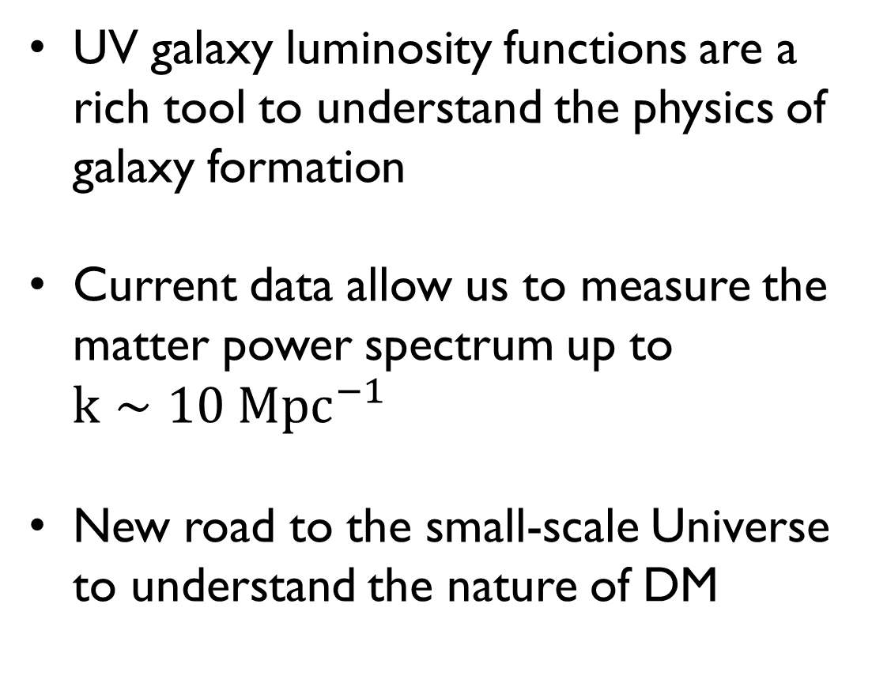
Summary
UV galaxy luminosity functions are a rich tool to understand the physics of galaxy formation
Current data allow us to measure the matter power spectrum up to
$k∼10{ Mpc}^{−1}$
New road to the small-scale Universe to understand the nature of DM
(future)
NS, Muñoz, Blas - 2110.13161
THANK YOU! ☺

Slide 23
Appendices

Slide 24
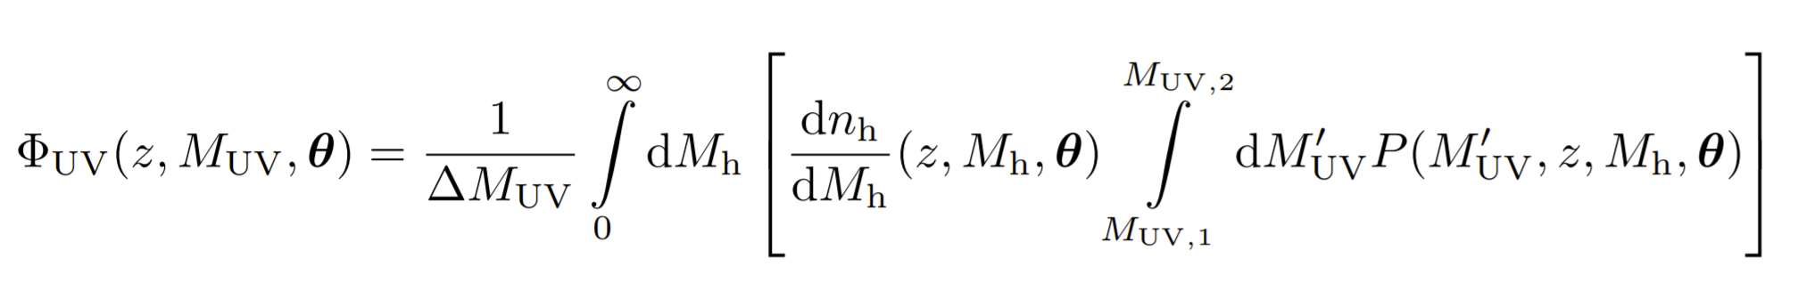
Discrete form of UV LF

Slide 25
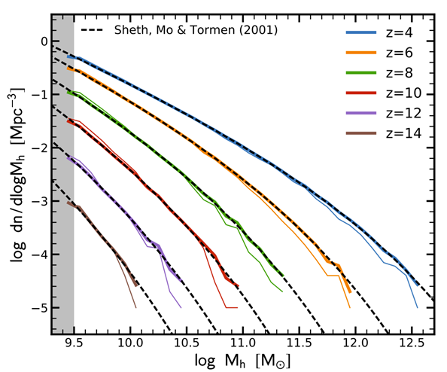
Halo mass function
Tacchella+2018

Slide 26
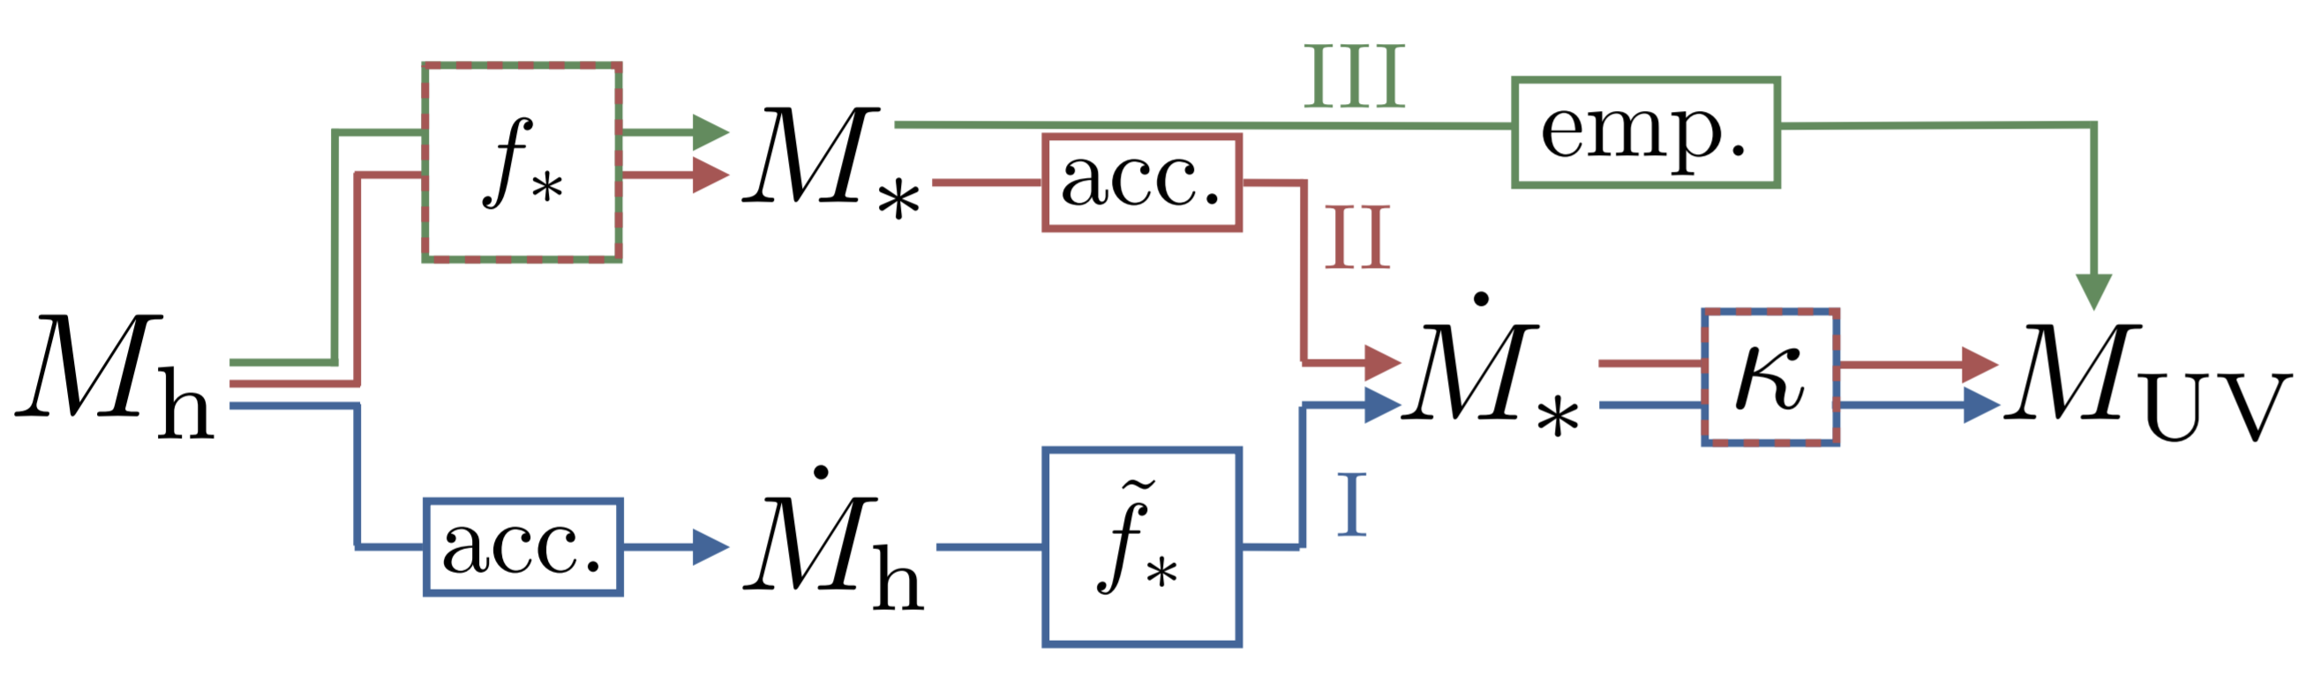
Astro models

Slide 27
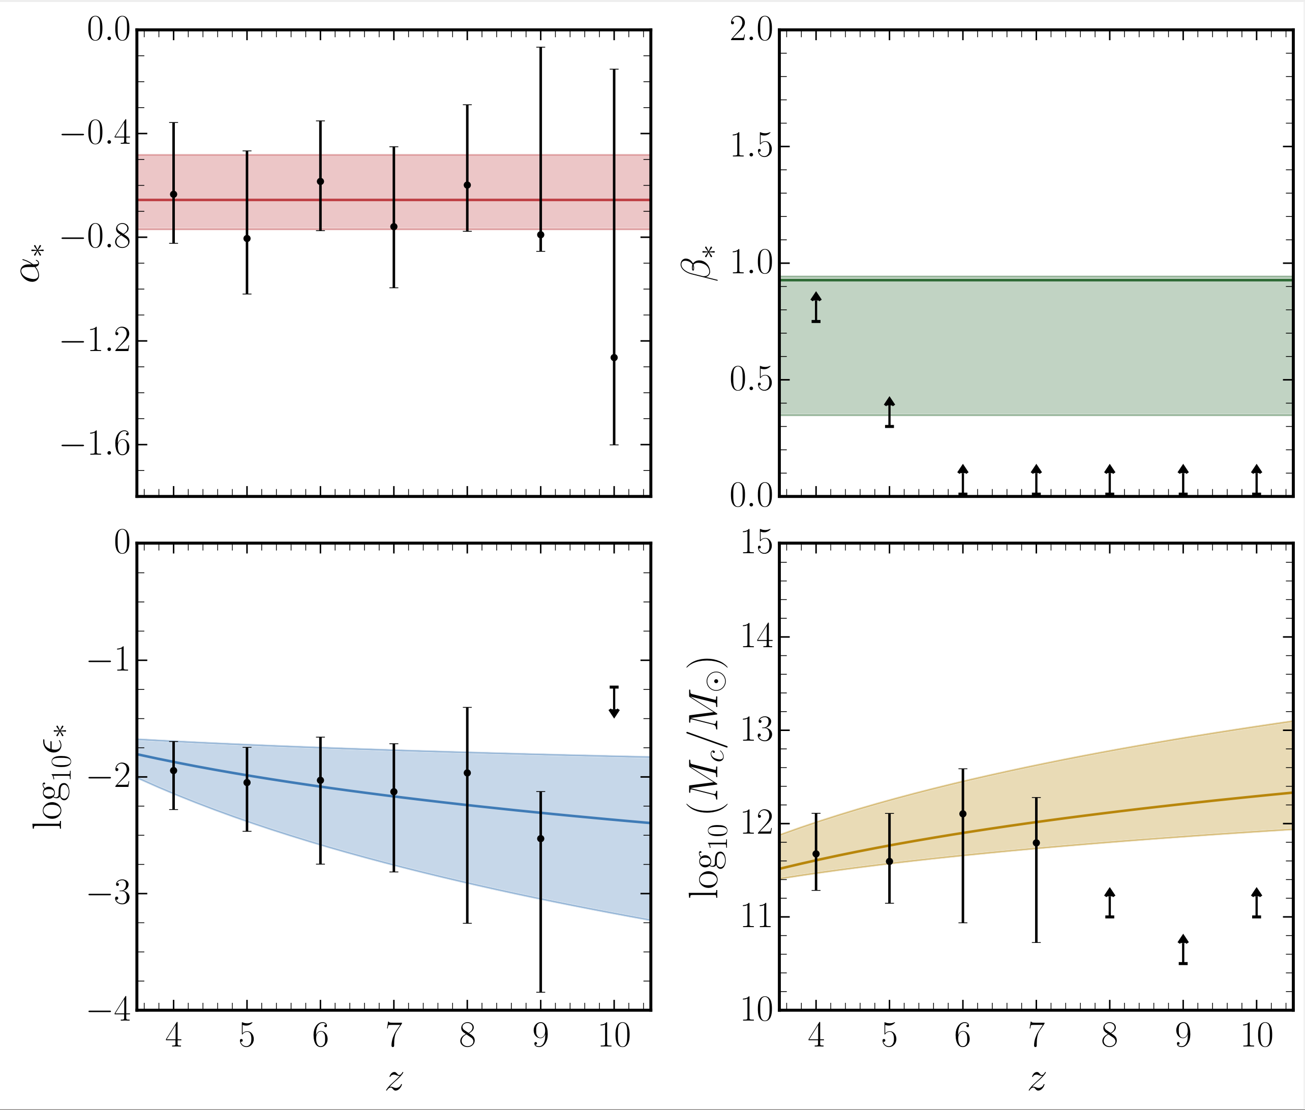
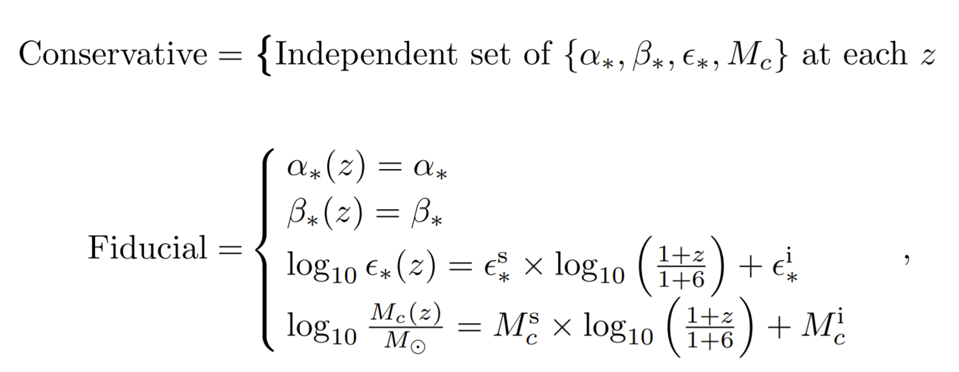
Astro redshift evolution

Slide 28
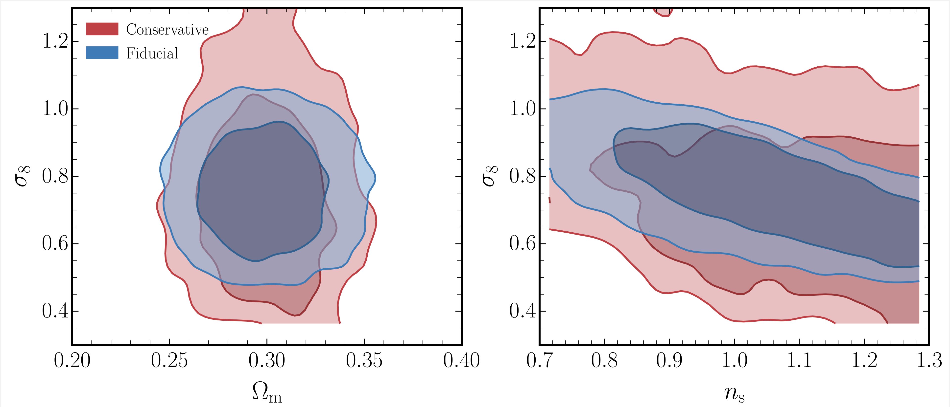
Conservative Astro parameterisation

Slide 29
Posteriors for cosmo parameters

Slide 30
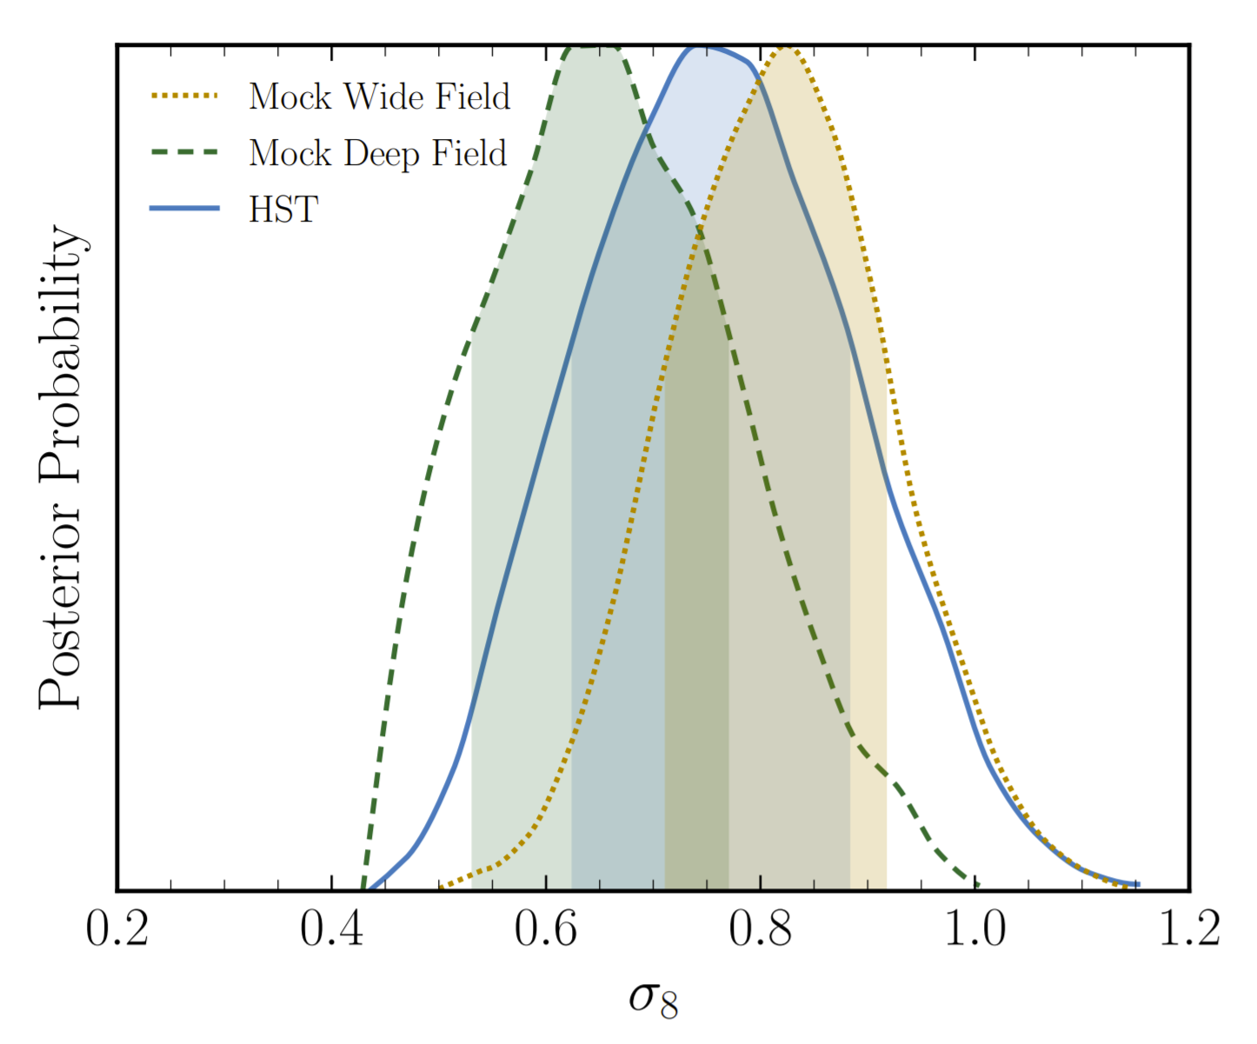
Forecasts

Slide 31
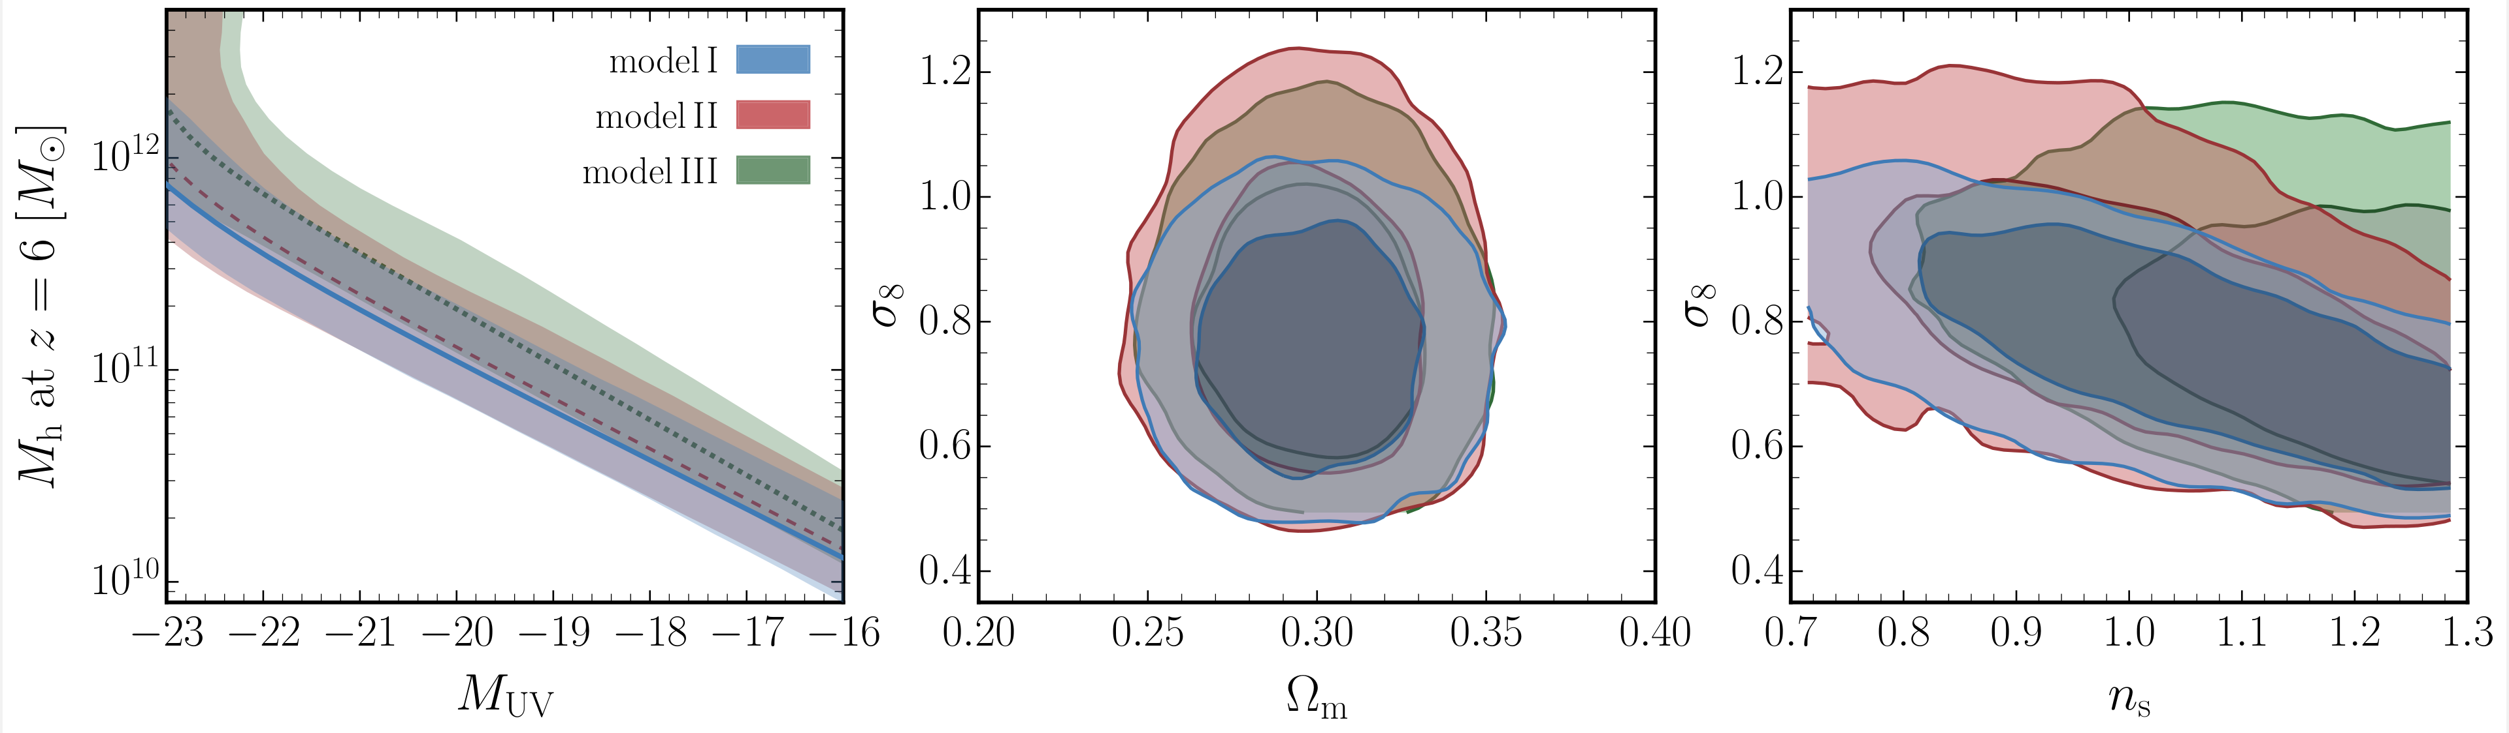
Alternative Astro models

Slide 32
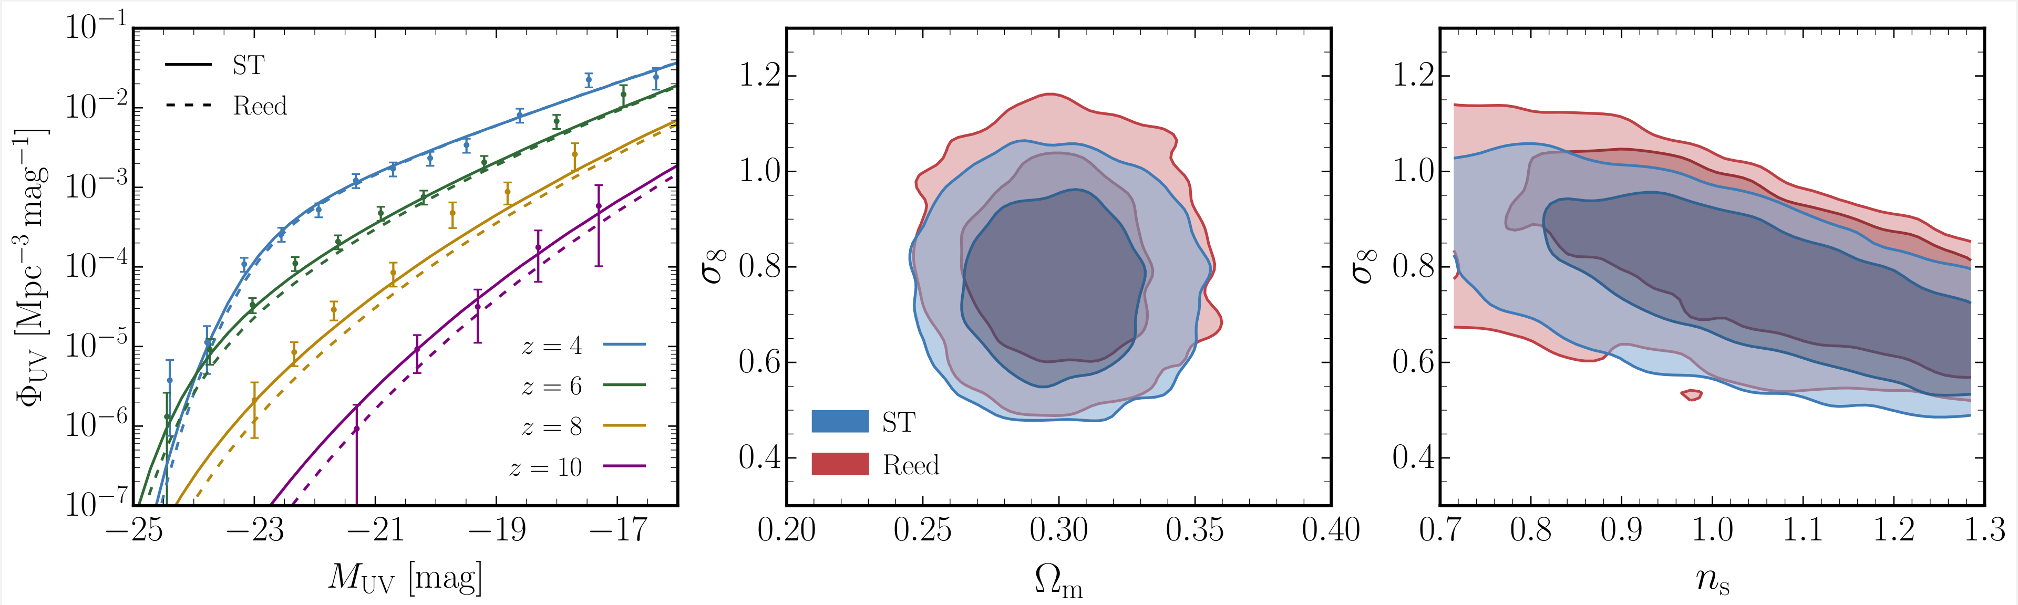
Alternative HMF

Slide 33
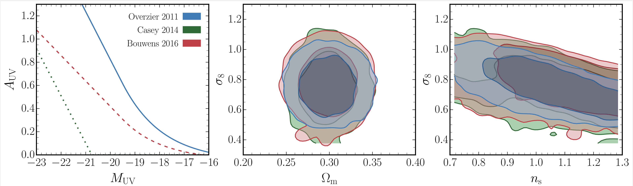
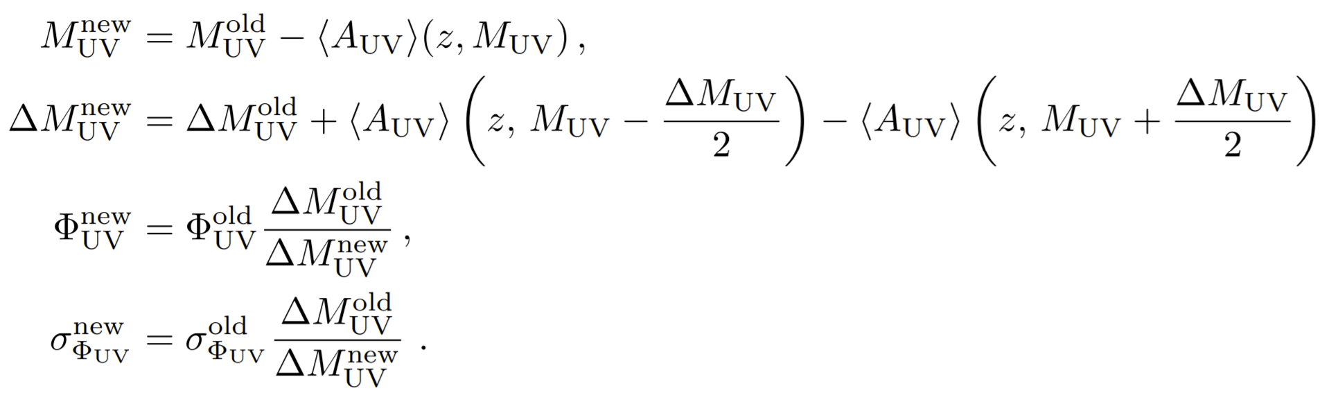
Alternative Dust calibration

Slide 34
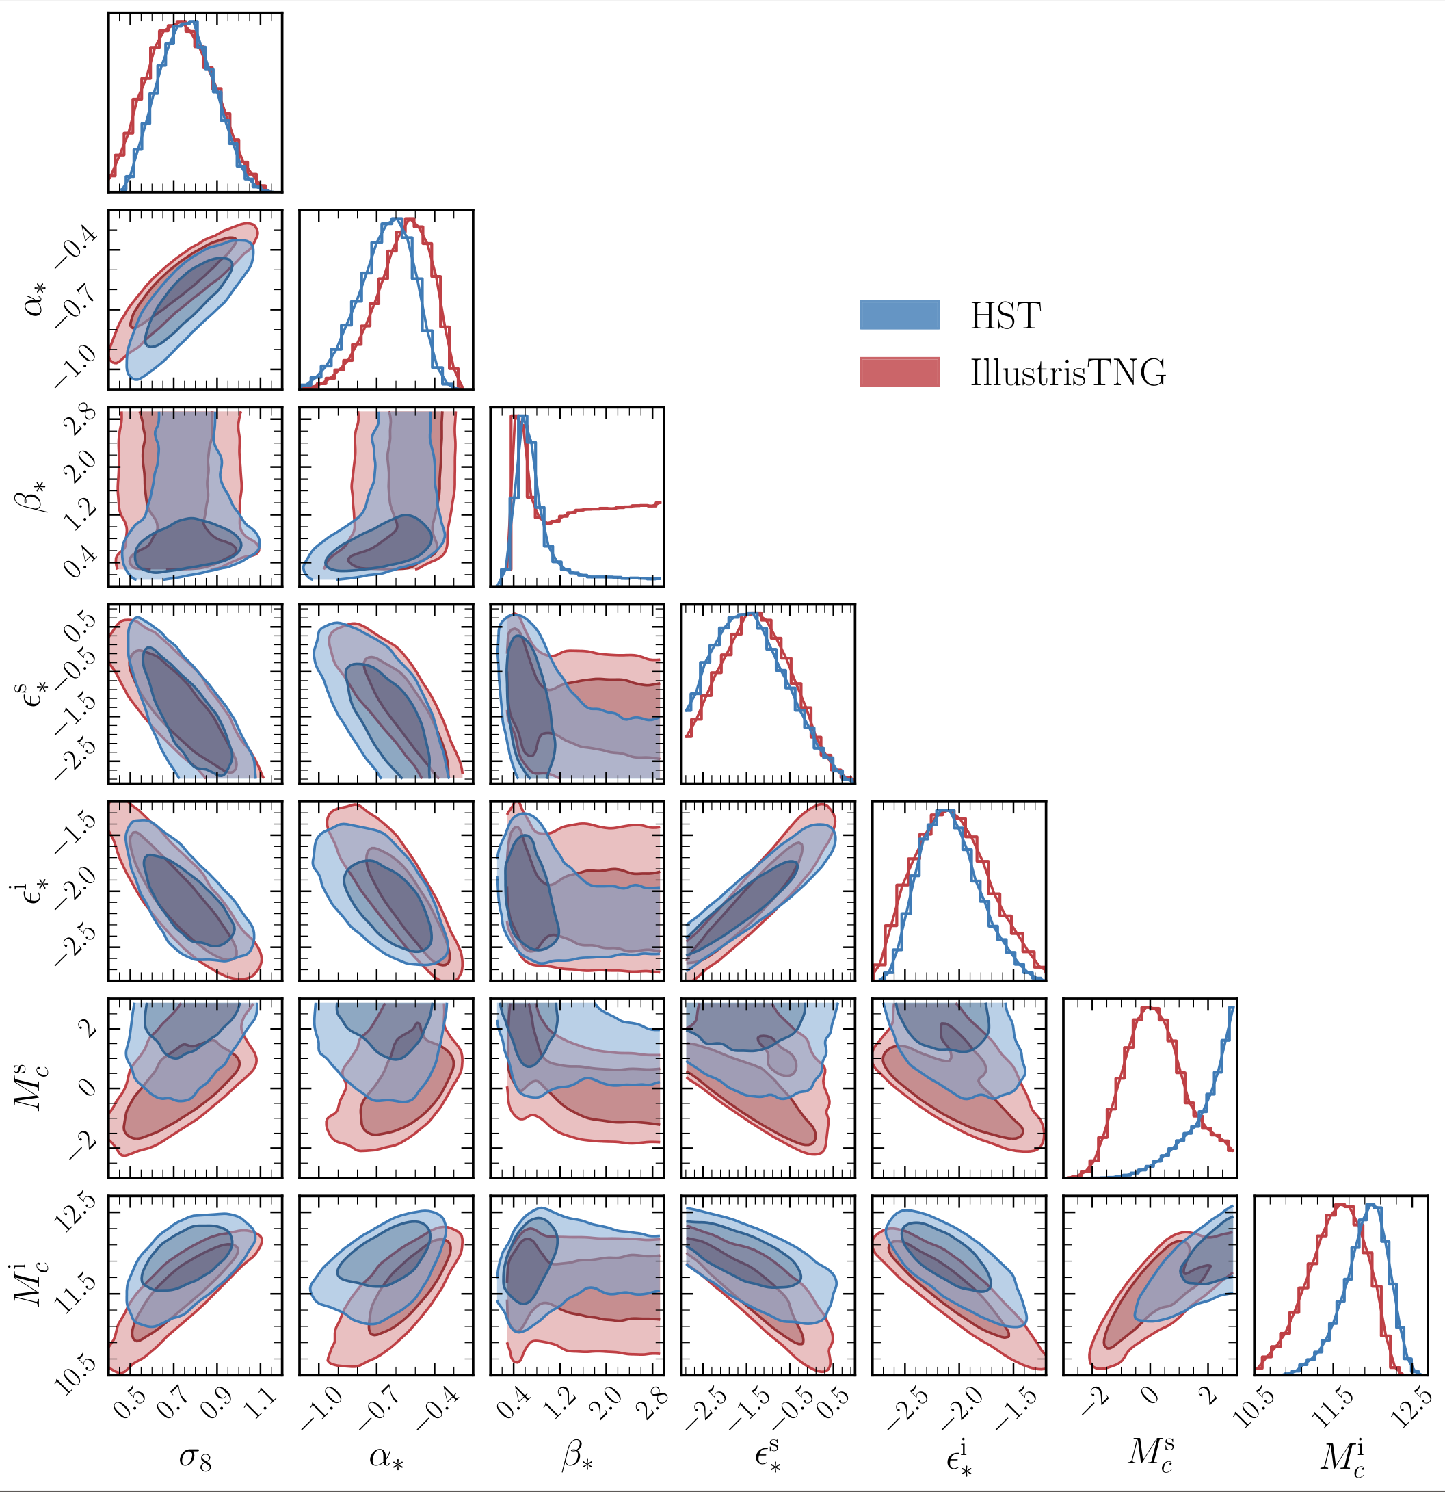
Astro posteriors

Slide 35
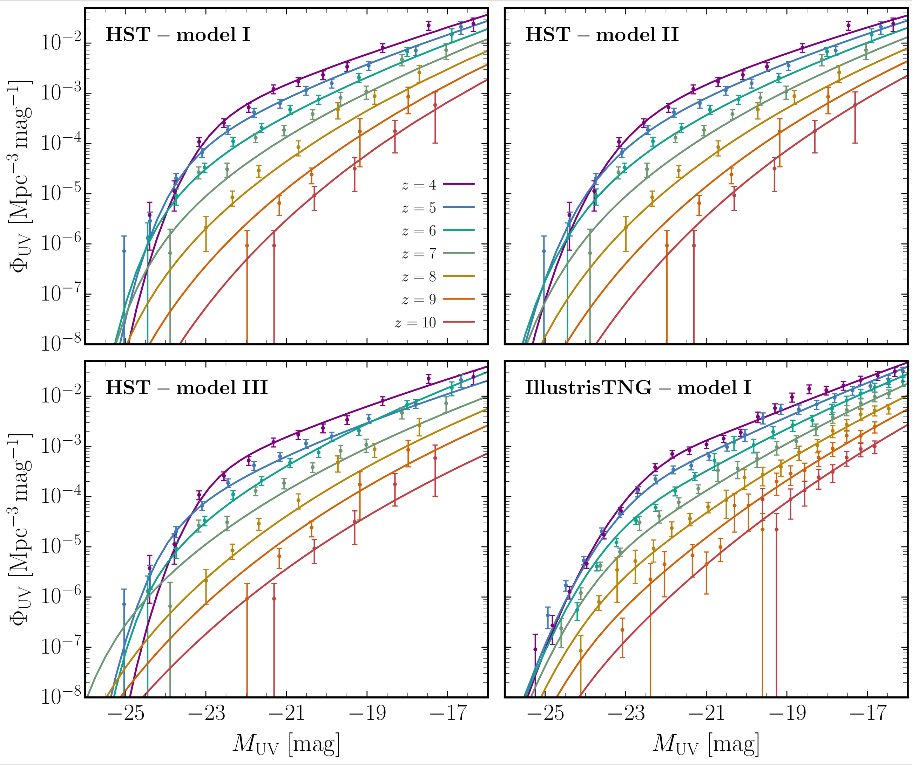
Best fits

Slide 36
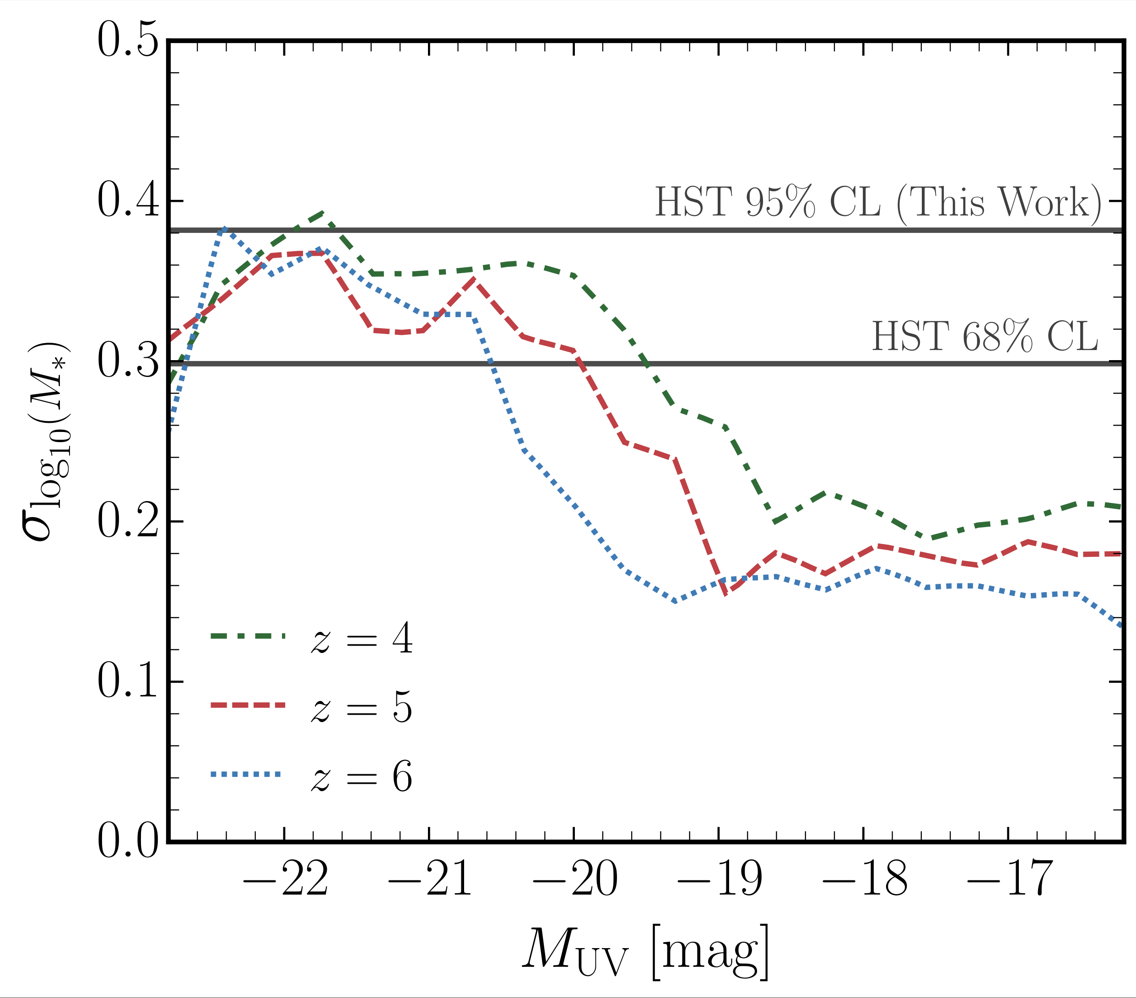
Scatter comparison with illustrisTNG

