Slide 1


Puzzles Regarding the Warping of the EFT Cutoff in AdS
Lexi Costantino (UC Riverside)
2002.12335
2011.06603
211X.XXXXX
w/ Sylvain Fichet (ICTP-SAIFR)
Flip Tanedo (UC Riverside)

Slide 2
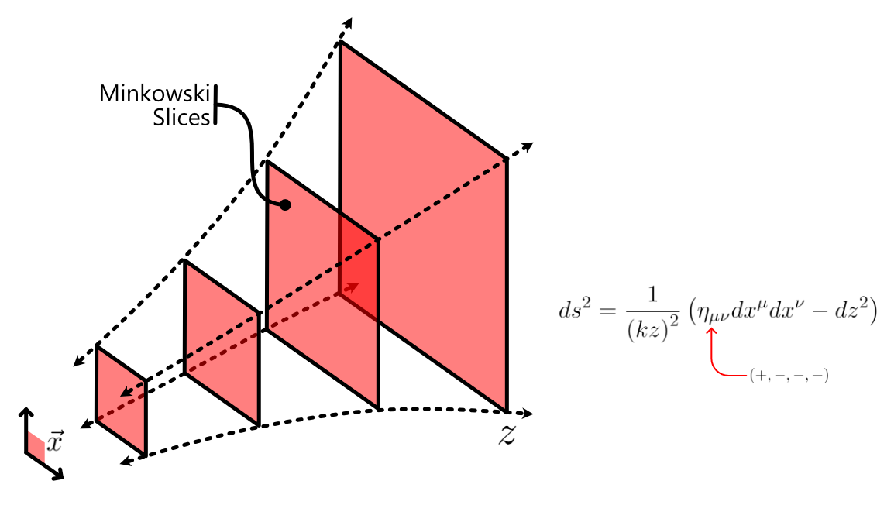
Anti-de Sitter Spacetime

Slide 3
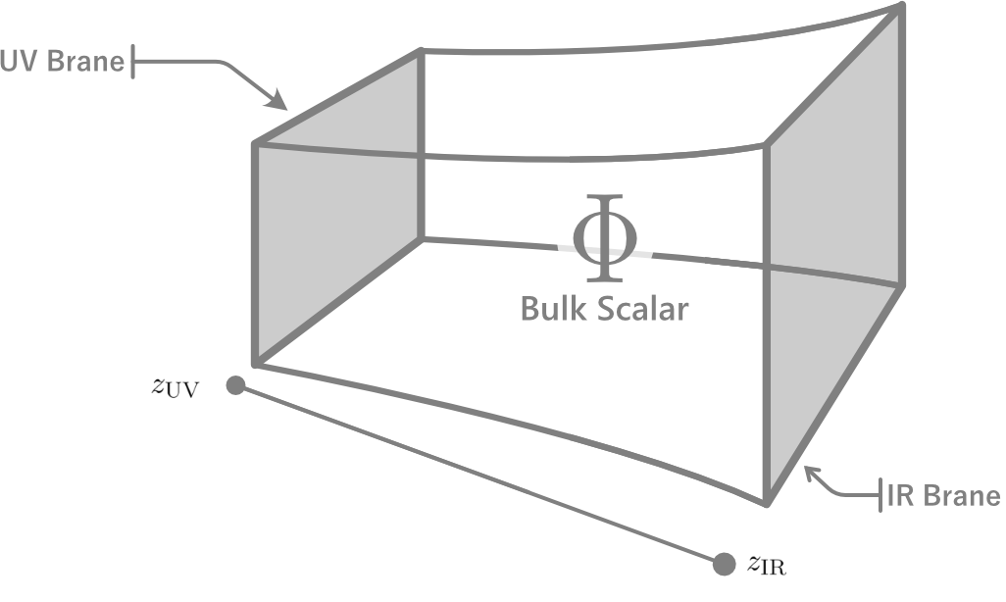
Why AdS?
AdS/CFT correspondence tells us that the theory in AdS is dual to a CFT via holography(hep-th/9711200 by Maldacena, hep-th/9802109 by Gubser et al., hep-th/9802150 by Witten)
Lots of interesting physics that has not yet been fully explored!

Slide 4
An (Incomplete) List of Related Work
Spherical jets (“Soft Bombs”)
  Knapen et al., 1612.00850, “Triggering Soft Bombs at the LHC”
  Csaki, Reece, Terning, 0811.3001 “AdS/QCD, Still Undelivered”
  …
Warped dark sectors / continuum mediated dark sectors
  von Harling and McDonald, 1203.6646, “Secluded DM Coupled to a Hidden CFT”
  McDonald and Morrissey, 1010.5999 and 1002.3361, “Low Energy Probes of Warped Hidden Sector/Extra Dimension”
  Dienes et al., 1912.10588 and 1610.04112, “Partially Composite Dynamical Dark Matter”/ “Dark Matter From Strongly Coupled Dark Sectors”
  Brax, Fichet, Tanedo, 1906.02199, “The Warped Dark Sector”
  Chaffey, Fichet, Tanedo, 2102.05674, “Cotinuum Mediated Self-Interacting Dark Matter”
  Bernal et al., 2004.14403, “KK FIMP Dark Matter in Warped Extra Dimensions”
  …
See also: Randall–Sundrum models, hidden valley models, unparticles, …

Slide 5

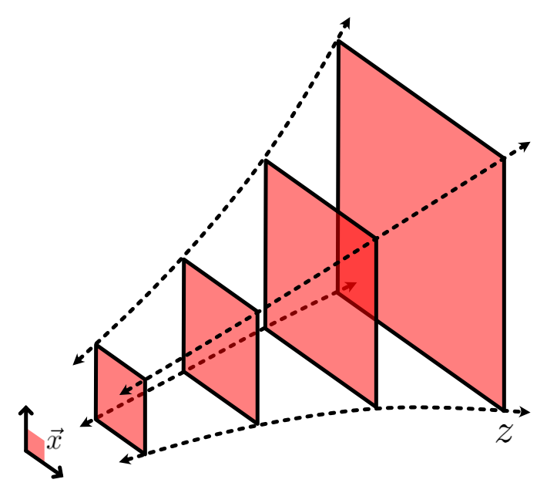
Wave Operator in AdS

Slide 6
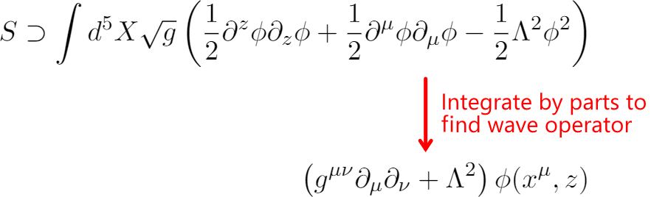
Wave Operator in AdS

Slide 7
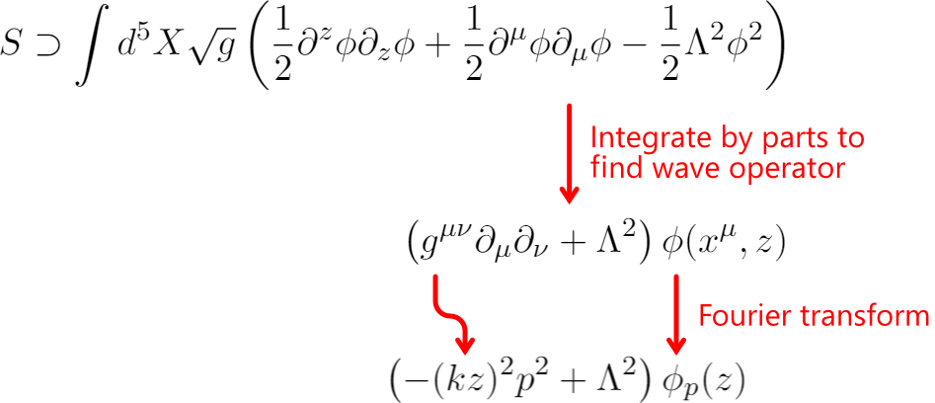
Wave Operator in AdS

Slide 8
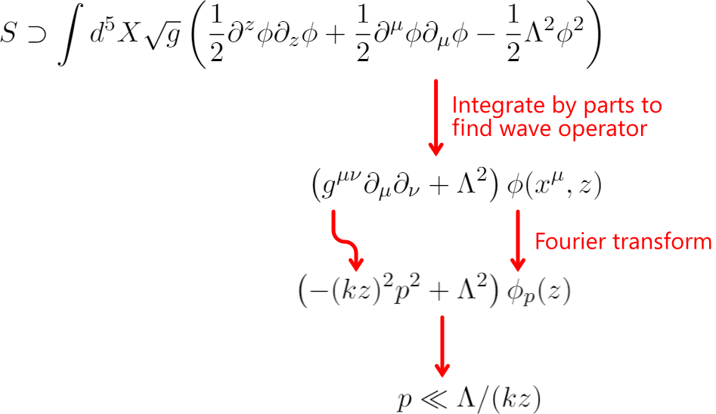
Wave Operator in AdS

Slide 9
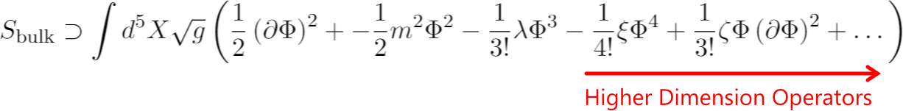
Toy EFT in AdS

Slide 10
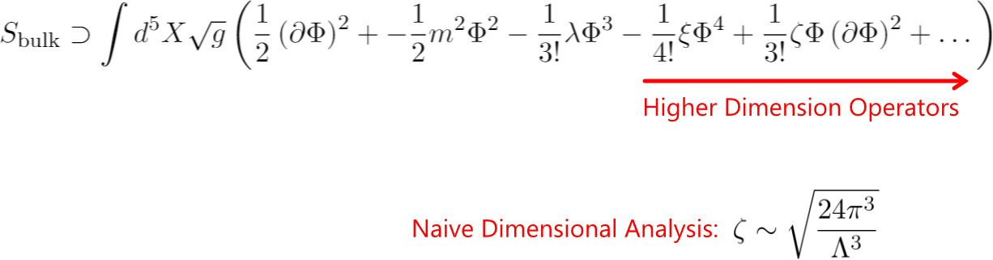
Toy EFT in AdS
For details on naïve dimensional analysis, see
hep-ph/9909248 by Chacko, Luty, and Ponton.
Also, see the Ponton TASI lectures.

Slide 11
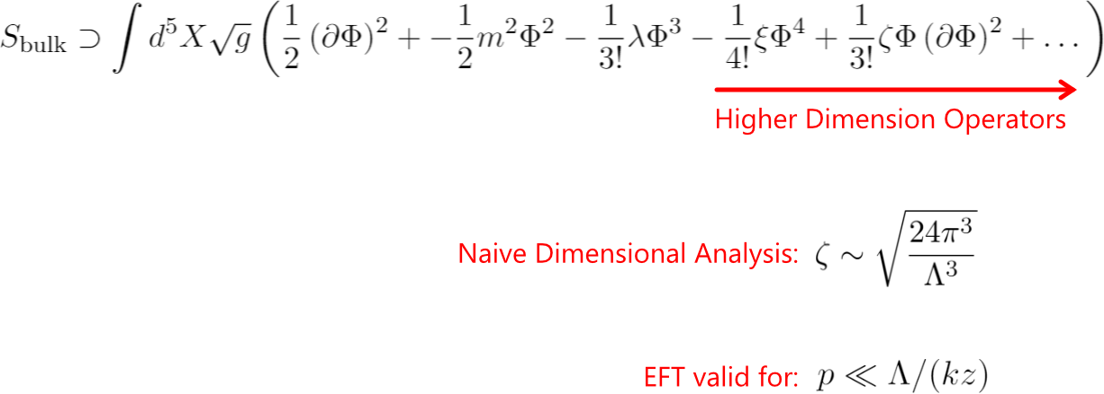
Toy EFT in AdS
For details on naïve dimensional analysis, see
hep-ph/9909248 by Chacko, Luty, and Ponton.
Also, see the Ponton TASI lectures.

Slide 12
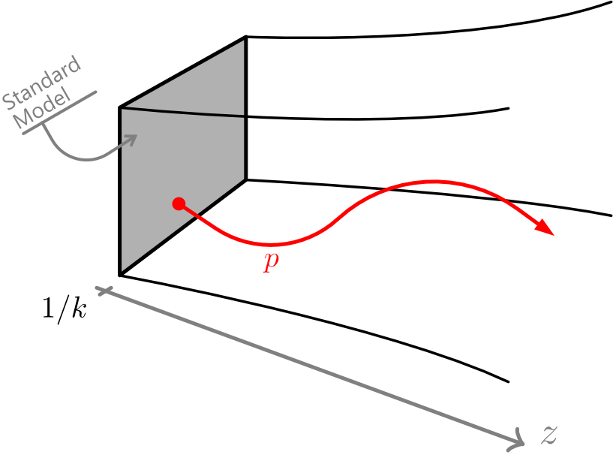
Puzzle #1

Slide 13
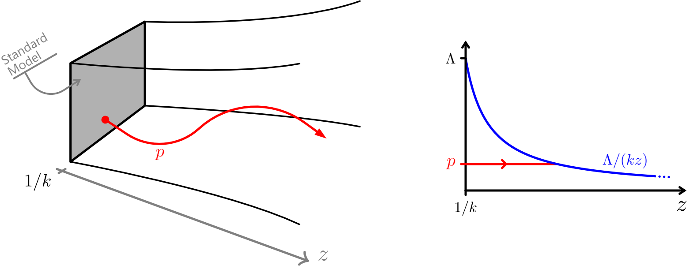
Puzzle #1

Slide 14
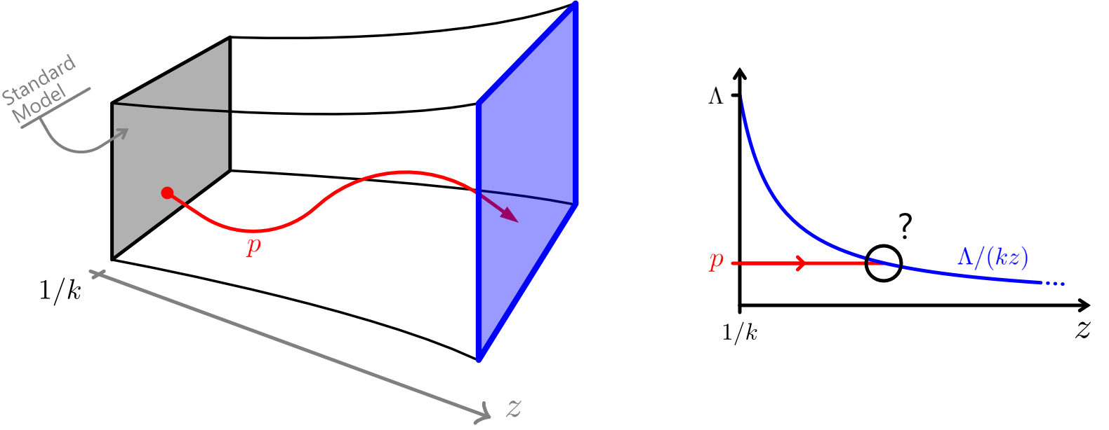
Puzzle #1

Slide 16
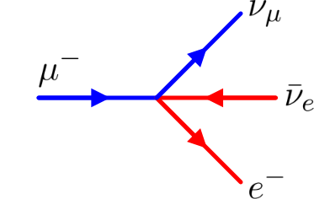
Standard Model Analogy

Slide 17
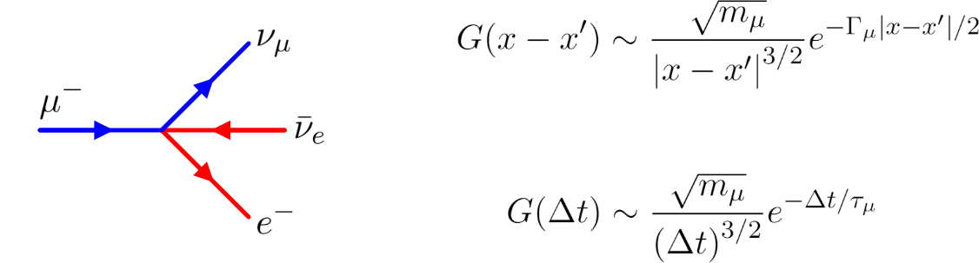
Standard Model Analogy

Slide 18
Puzzle #1

Slide 19
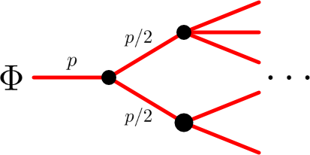
Possible Resolution

Slide 20
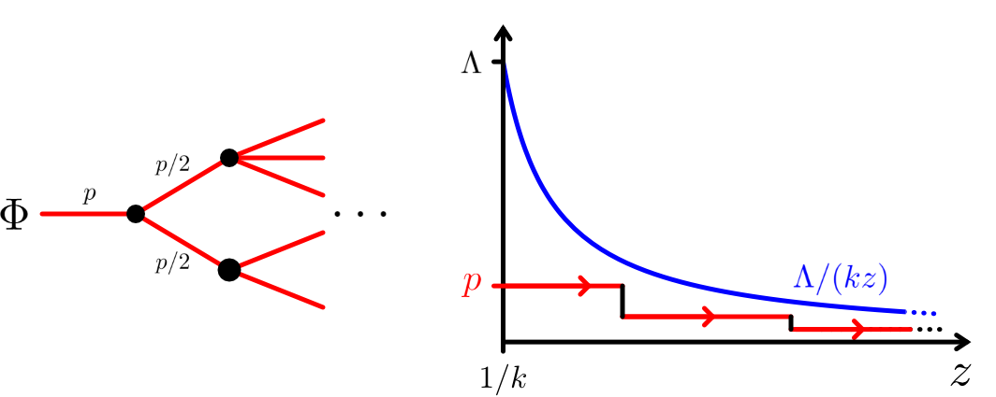
Possible Resolution

Slide 21
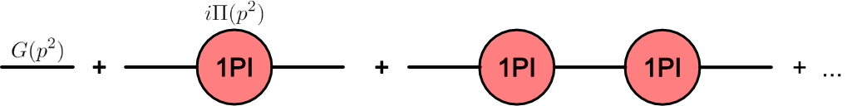
Resummed Propagator

Slide 22
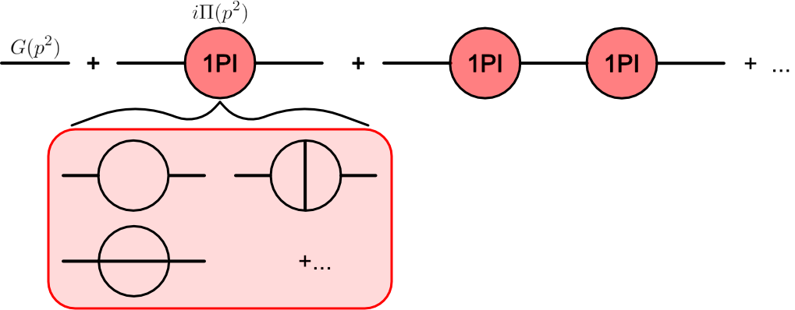
Resummed Propagator

Slide 23
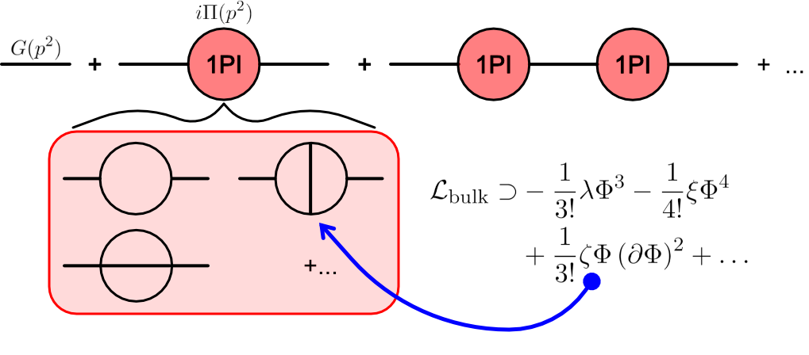
Resummed Propagator

Slide 24
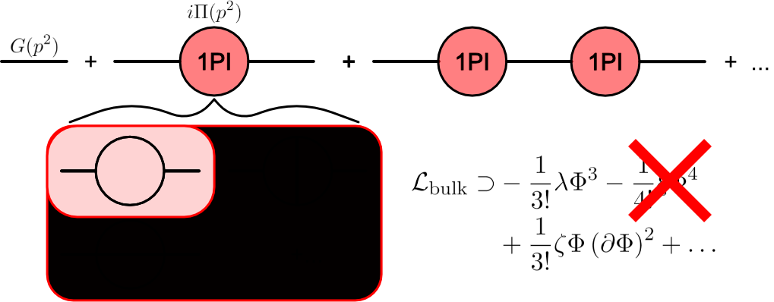
Resummed Propagator

Slide 25
Resummed Propagator

Slide 26
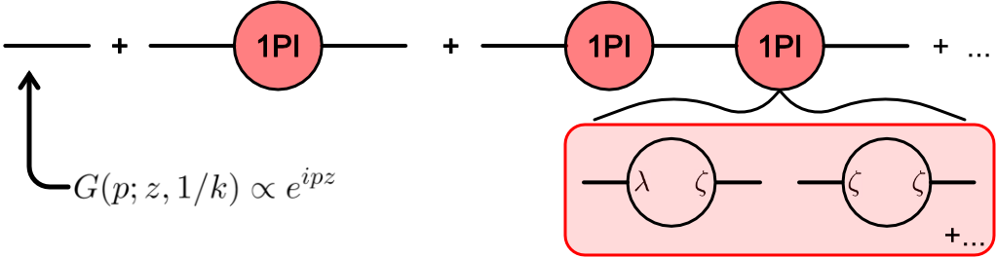
Resummed Propagator

Slide 27
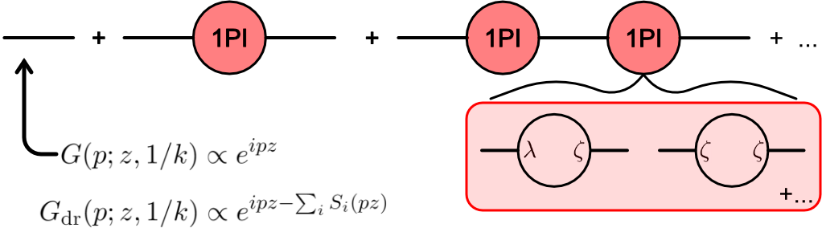
Resummed Propagator

Slide 28
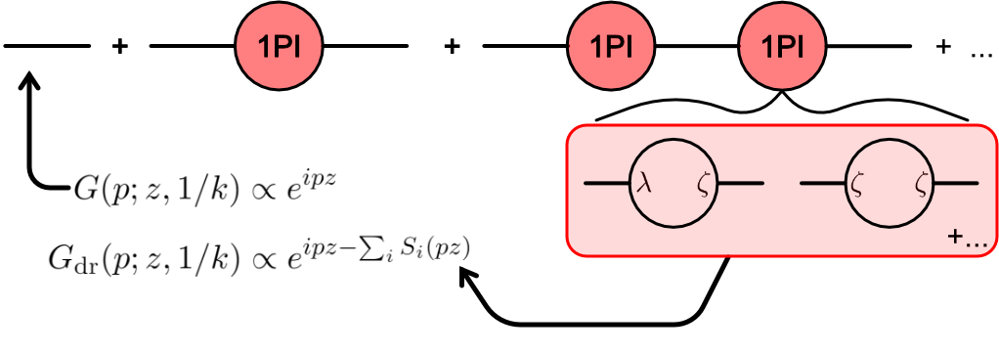
Resummed Propagator

Slide 29
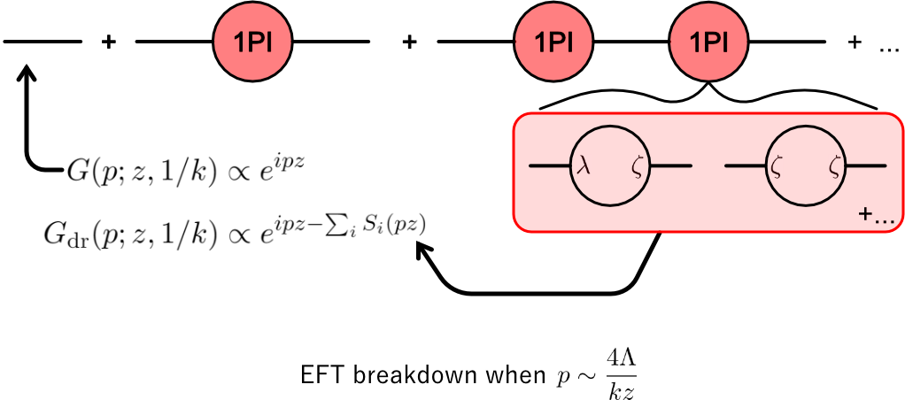
Resummed Propagator

Slide 30
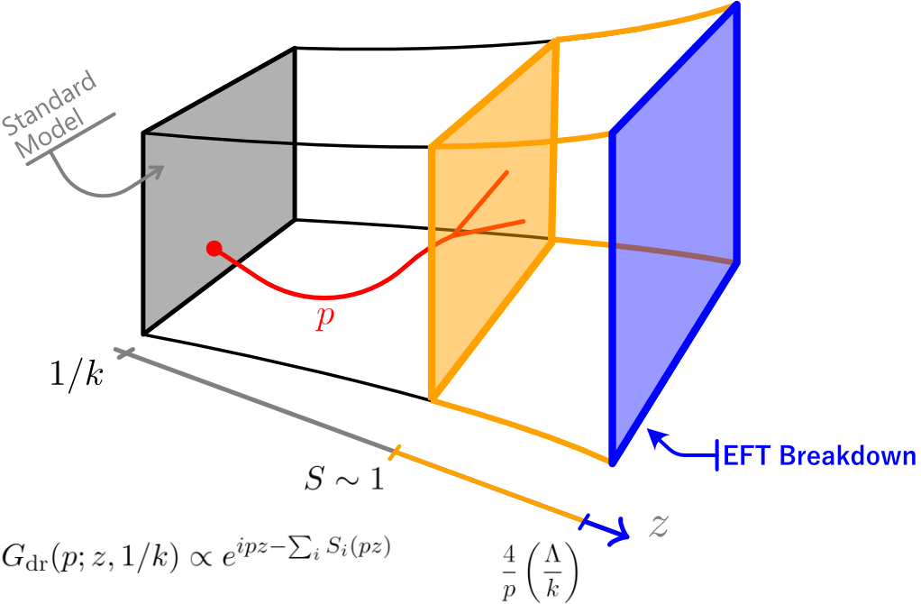
Resummed Propagator
A very early version of this idea was sketched by Fichet in 1905.05779
See also hep-th/0012148, in which Arkani-Hamed
et al. hinted at a large z censorship property.

Slide 31
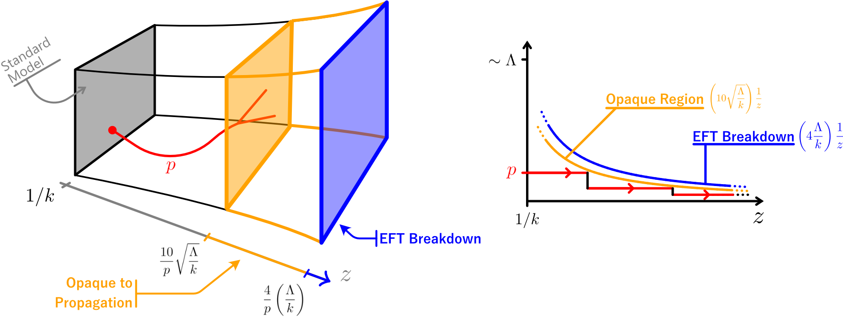
Resummed Propagator
An early version of this idea was sketched by Fichet in 1905.05779
See also hep-th/0012148, in which Arkani-Hamed
et al. hinted at a large z censorship property.

Slide 33
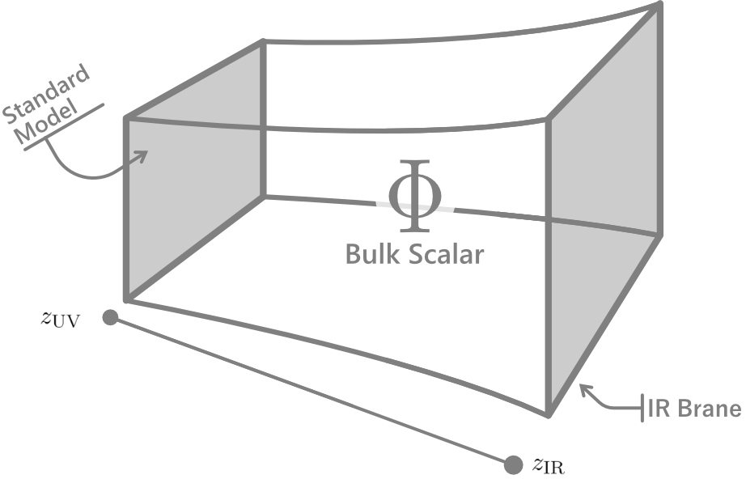
IR Brane

Slide 34
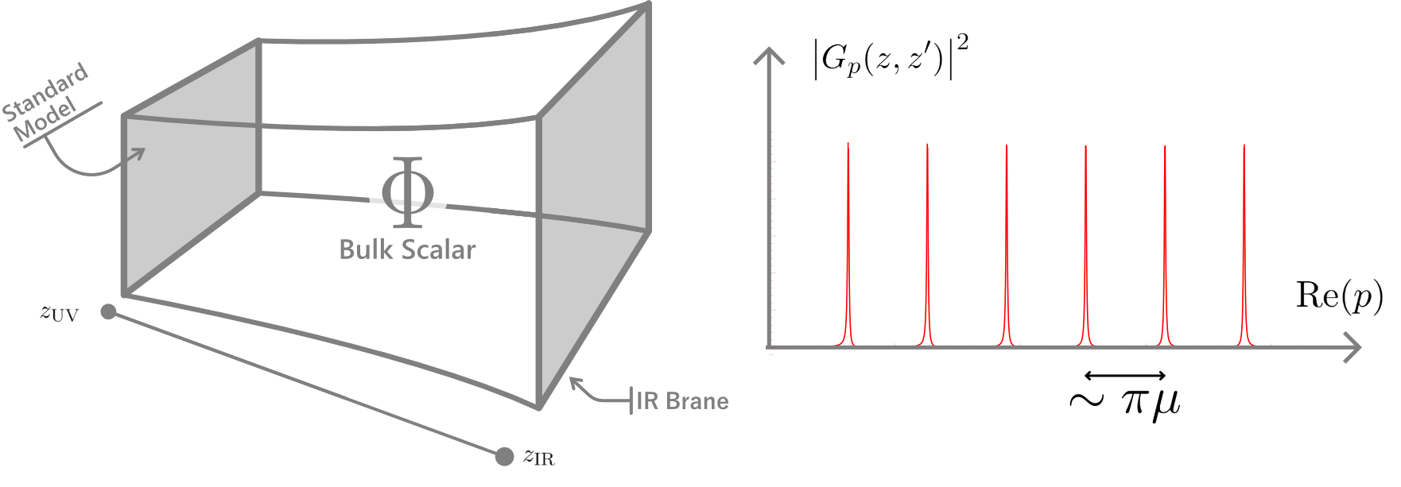
IR Brane

Slide 35
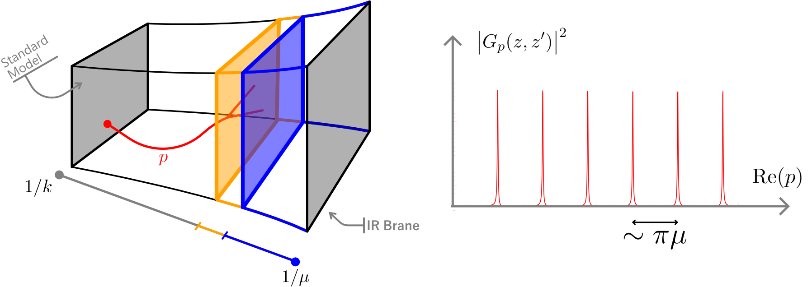
Puzzle #2

Slide 36
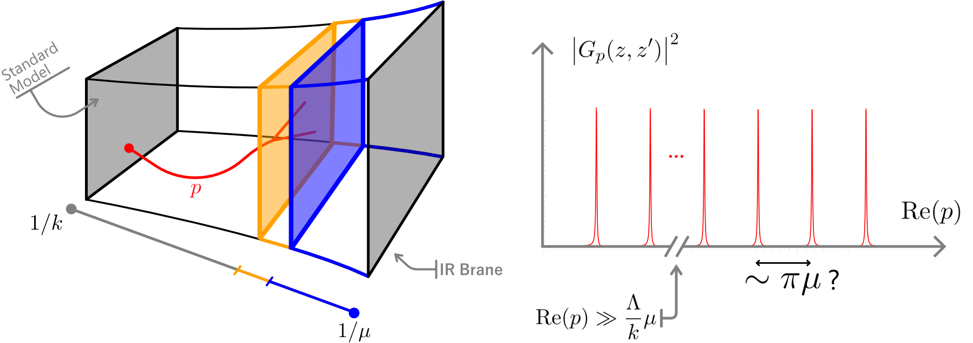
Puzzle #2

Slide 37
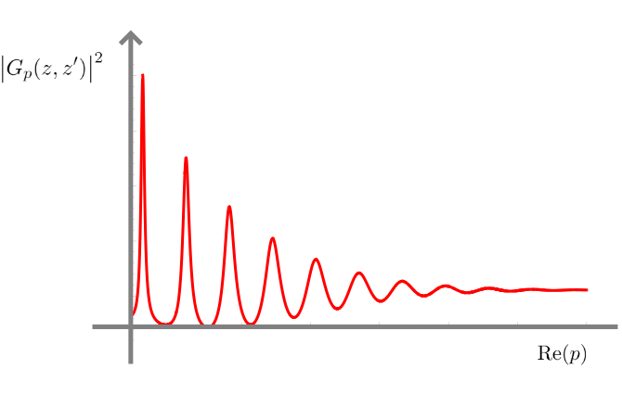
Resolution
Details will appear in an upcoming paper
by AC and Sylvain Fichet, 211X.XXXXX

Slide 38
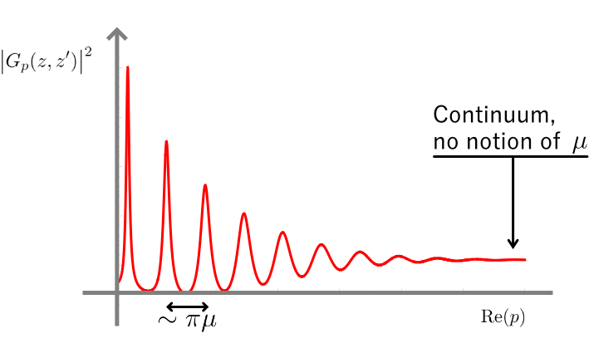
Resolution
Details will appear in an upcoming paper
by AC and Sylvain Fichet, 211X.XXXXX

Slide 40
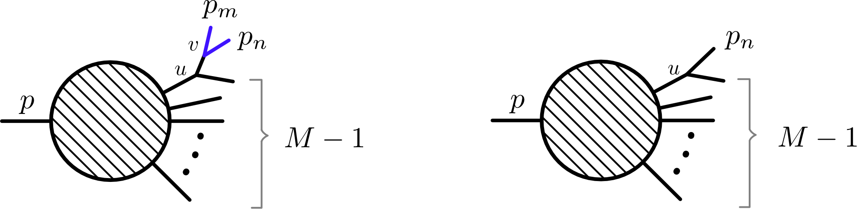
Other Research – Cascade Decay Recursion
AC, Fichet, Tanedo, 2002.12335

Slide 41
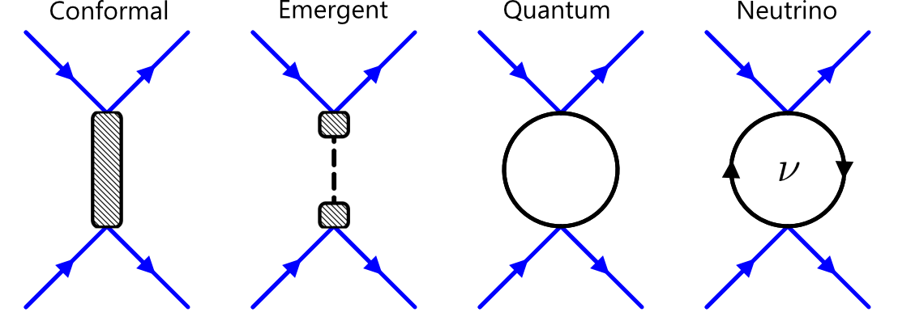
Other Research – Exotic Forces
AC, Fichet, Tanedo, 1910.02972
AC, Fichet, 2003.11032

Slide 42
Open Questions
Narrow modes at one energy scale, continuum at a different scale. How does this model behave differently than the other continuum models?
How is the interacting continuum different than the continuum of an unbroken CFT?

Slide 43
Thanks!

