Slide 1
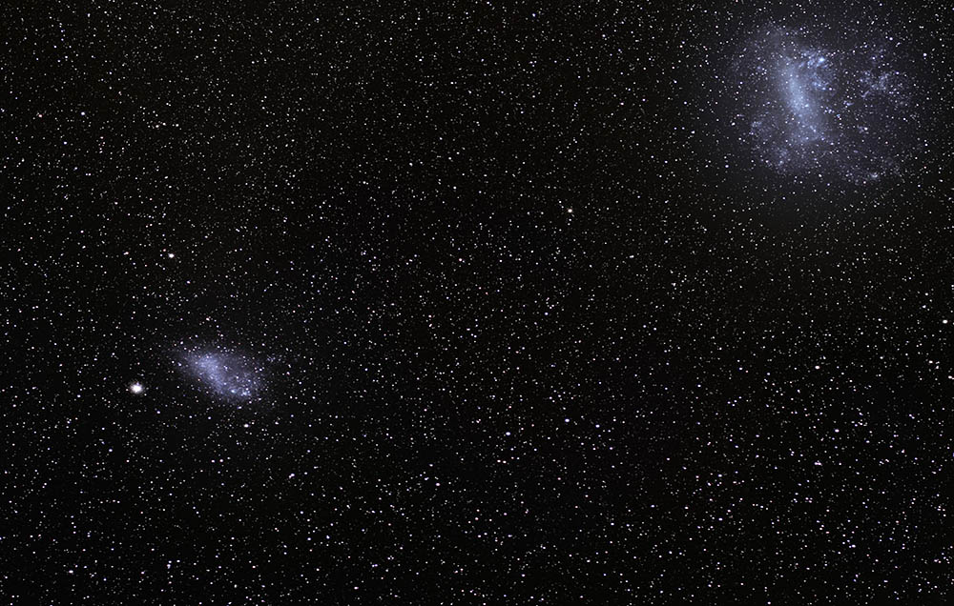

The fastest particles in the Solar Neighborhood come from the Large Magellanic Cloud
Annika Peter (The Ohio State University)
Based on work w/Gurtina Besla and Nico Garavito-Camargo
1909.04140
Notes:
The Large (top right) and Small Magellanic Clouds. Credit: ESO/S. Brunier
https://physicstoday.scitation.org/do/10.1063/PT.6.1.20181105a/full/

Slide 2
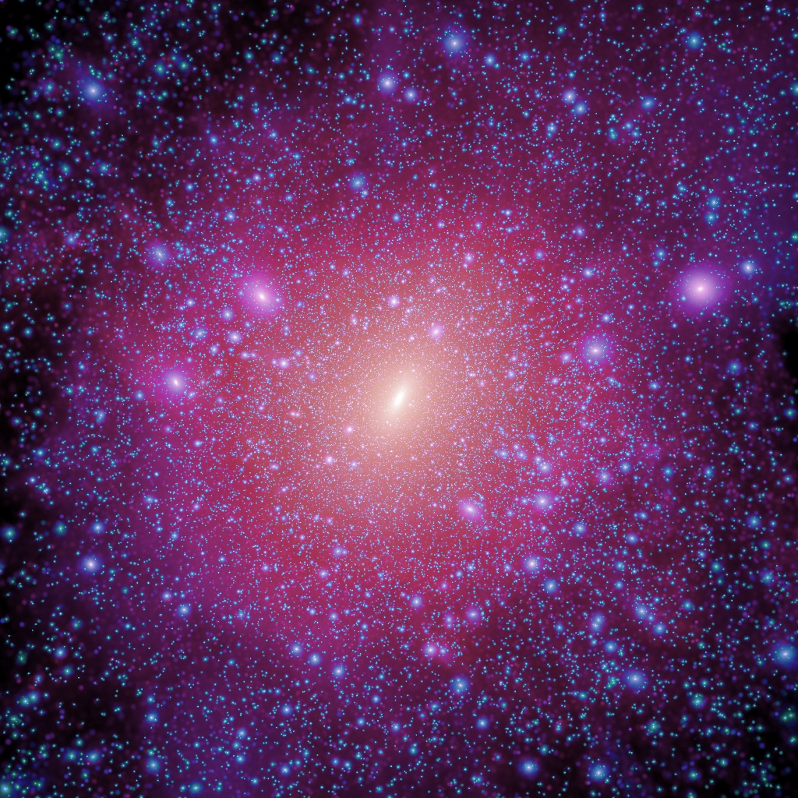
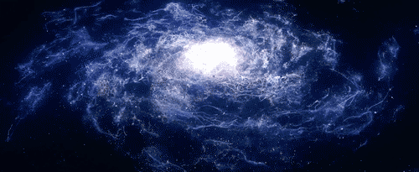
Our Galactic environment
“halo”
Image credit: V. Springel, MPA
https://giphy.com/gifs/ZzyOiywrAjnXi

Slide 3
Our Galactic environment
“halo”
You are here
Image credit: V. Springel, MPA
https://giphy.com/gifs/ZzyOiywrAjnXi

Slide 4
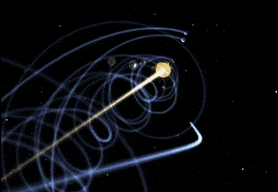
“you revolve around me as we fly around the galaxy”
—Kids Learning Tube, “The Sun”
http://infinity-imagined.tumblr.com/

Slide 5
Direct detection
Energy Q
Nucleus
Mass m_{A}
θ
Who’s the wimp now, sucker?
v
WIMP
Mass m_{Χ}
©Annika Peter

Slide 6
Rates
If elastic
≈ρf(v, t)
Assume scattering off nuclei
Includes motion of Sun and Earth

Slide 7
Rates: ρ
Norm ~ σρ/m_{χ}
Energy Q
dR/dQ
Q

Slide 8
Rates: f(v)
High speed
Energy Q
dR/dQ
Low speed
Q

Slide 9
Rates: mass
High m_{χ}
Energy Q
dR/dQ
Low m_{χ}
Q

Slide 10
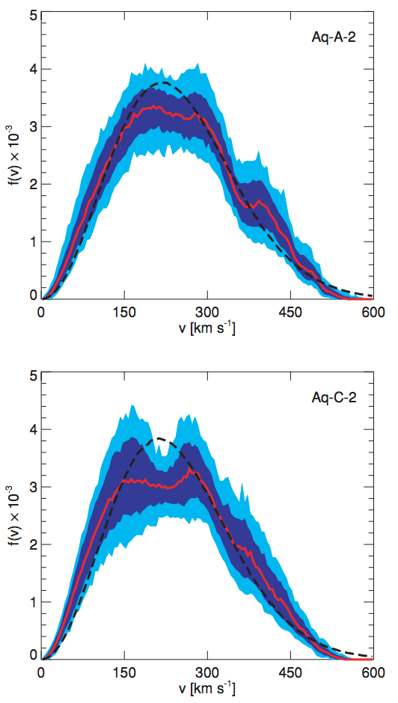
The problem AND the opportunity
The local phase space density is unknown.
The local phase space density depends on the assembly history of the Milky Way.
Renewed interest and capability in the Gaia era.
Vogelsberger+ 2009

Slide 11
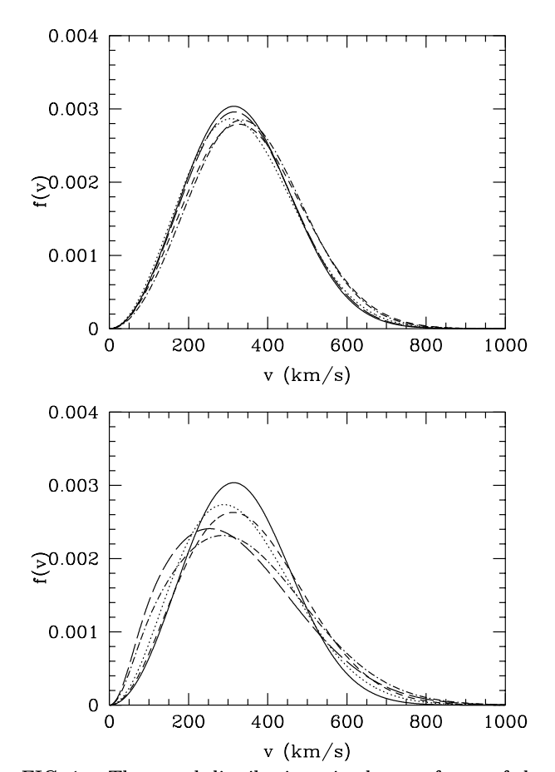
Smooth halo
Key unknowns:
Milky Way halo mass
Velocity anisotropy of dark matter particles
Shape of density profile (3D)
See Read 1404.1938 on local density,
Strigari 1211.7090 Galactic searches
Green astro-ph/0207366

Slide 12
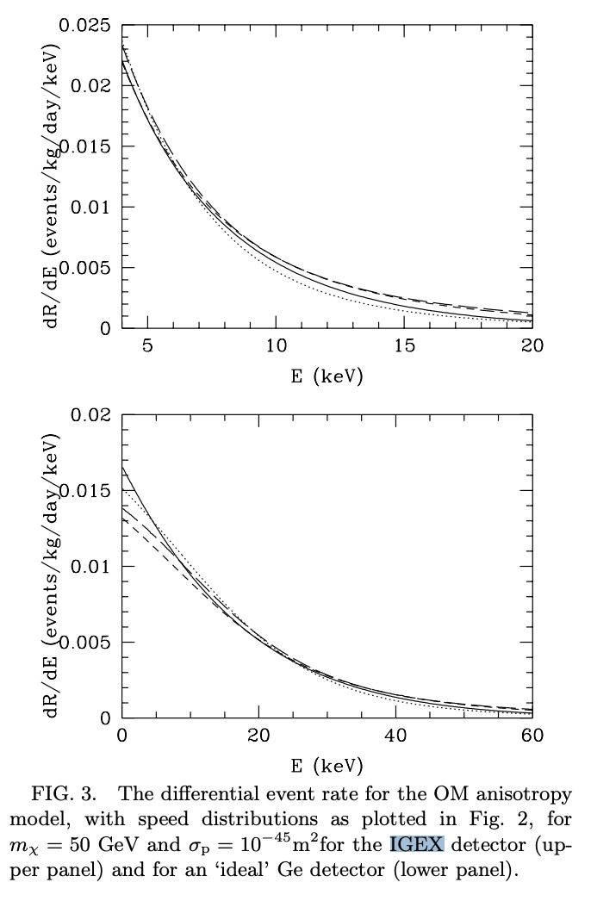
Smooth halo
Key unknowns:
Milky Way halo mass
Velocity anisotropy of dark matter particles
Shape of density profile (3D)
See Read 1404.1938 on local density,
Strigari 1211.7090 Galactic searches
Green astro-ph/0207366

Slide 13
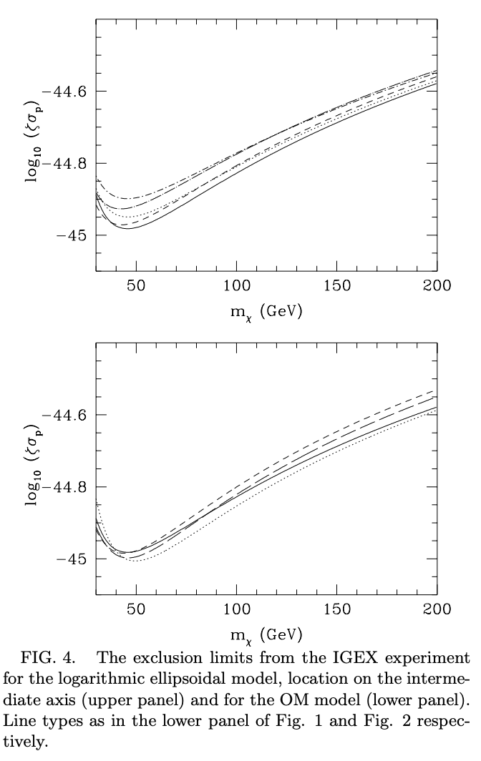
Smooth halo
Key unknowns:
Milky Way halo mass
Velocity anisotropy of dark matter particles
Shape of density profile (3D)
See Read 1404.1938 on local density,
Strigari 1211.7090 Galactic searches
Green astro-ph/0207366

Slide 14
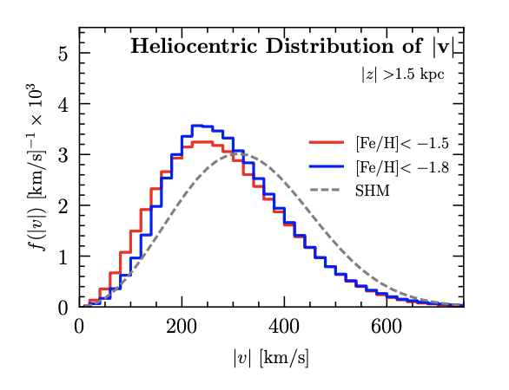
Smooth halo
Key unknowns:
Milky Way halo mass
Velocity anisotropy of dark matter particles
Shape of density profile (3D)
Trace with metal-poor halo stars?
Herzog-Arbeitman, Lisanti, Necib 1708.03635
RAVE-TGAS

Slide 15
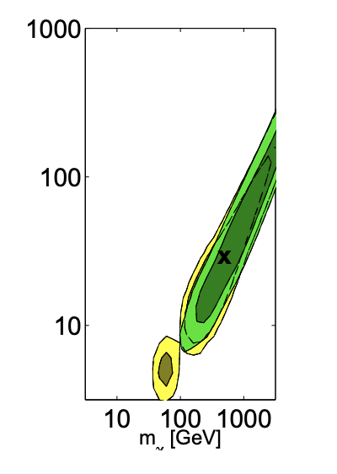
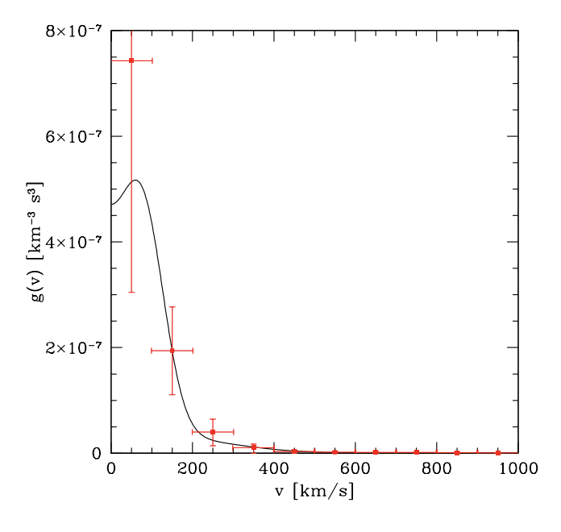

Smooth halo: recover
AP
1103.5145
Includes a dark disk
See papers by Kavanagh, O’Hare, Green, Ferrer, Shan, Arina, McCabe w/more ideas on recovering the velocity distribution from experiment
Reviews by AP+ 1310.7039, Green 1703.10102

Slide 16
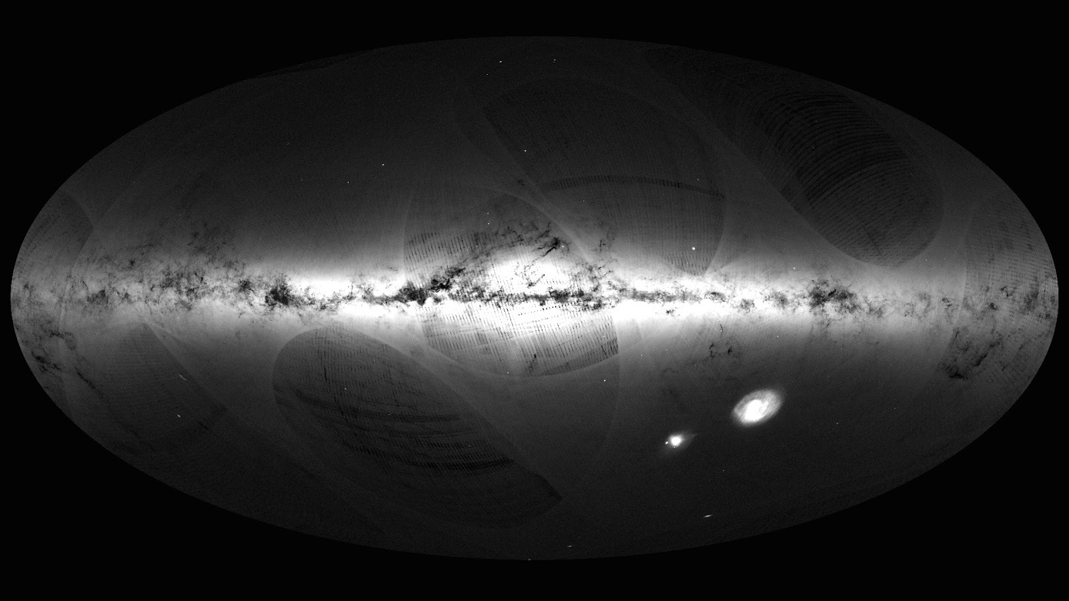
The unsmooth bits
Gaia DR1 skymap

Slide 17
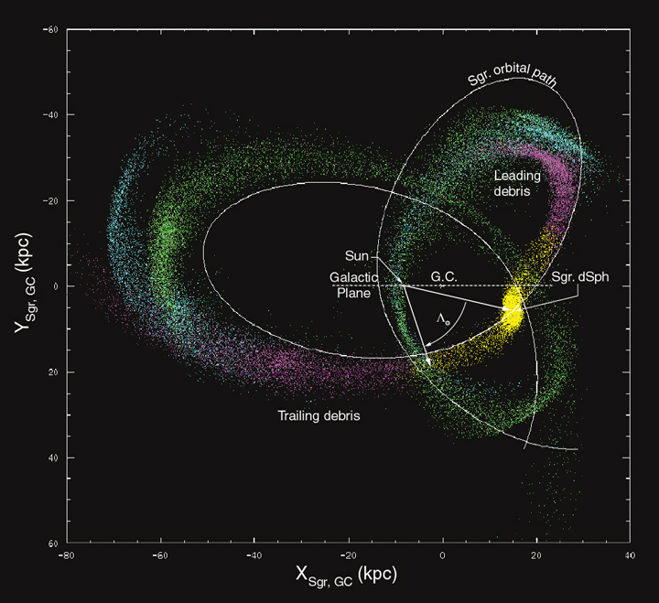
Sagittarius
Majewski+ 2003; first discovered by Ibata+ 1994

Slide 18
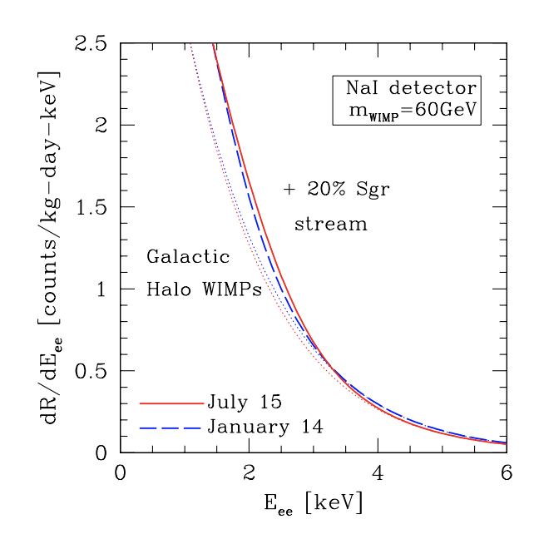
Sagittarius
Freese+ 2004
See also Purcell+ 2012
Majewski+ 2003; first discovered by Ibata+ 1994

Slide 19
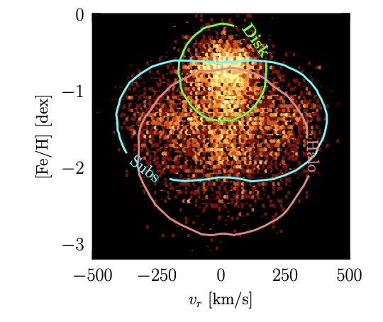
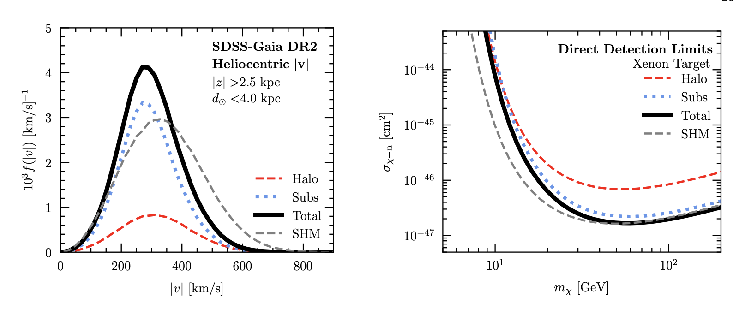
Debris flow
Smooth in position space but not velocity space
Unmixed merger remnants
SDSS-Gaia
Necib, Lisanti, Belokurov 2019
See also Lisanti & Spergel 2012
Kuhlen+2012

Slide 20
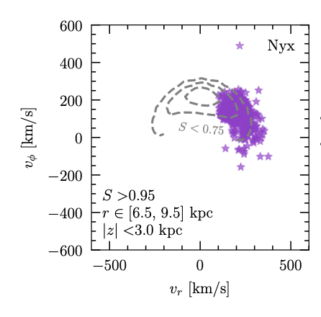
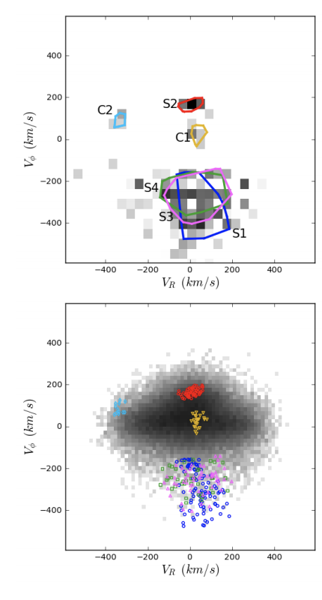
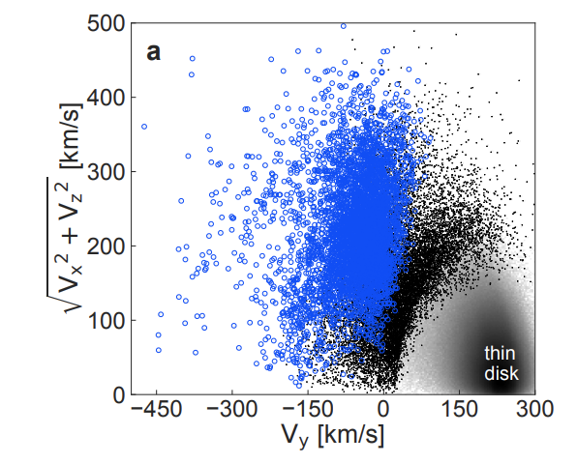
Gaia discoveries
Nyx; Necib+ 2020
Gaia-Enceladus/Gaia Sausage
Small Magellanic Cloud-sized system infalling ~10 Gyr ago
Helmi+ 2018
Belokurov+ 2018
+more! See papers on the Helmi streams
Helmi’s ARAA review article from 2020
Myeong+ 2018

Slide 21
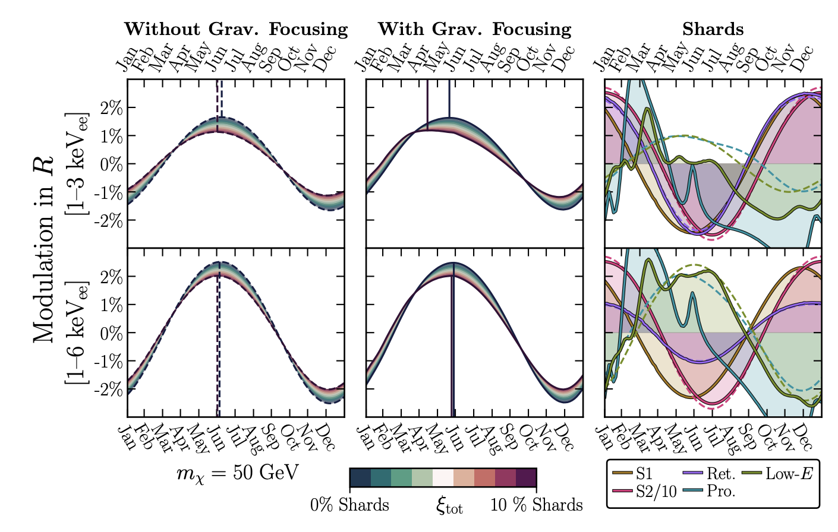
Gaia discoveries
DarkShards
O’Hare+ 2020

Slide 22
What’s missing when you focus on stars?
Only the biggest thing to ever hit the Milky Way

Slide 23
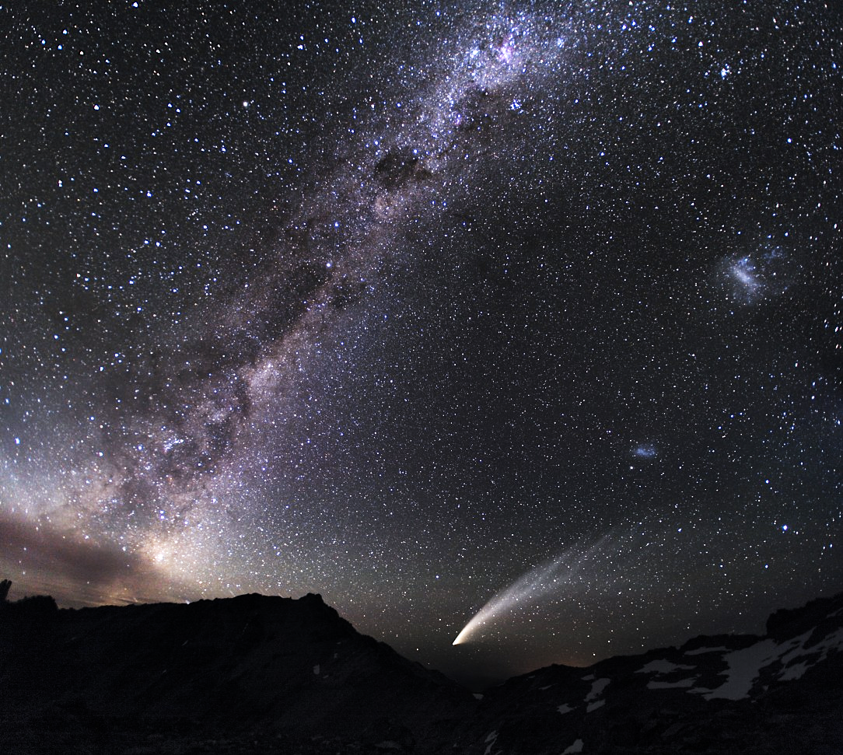
LMC
SMC
Southern Hemisphere
Image Credit: Miloslav Druckmuller
Notes:
~ 10-100 times smaller than the MW
LMC 157 000 light year s SMC 170 0000 ly
Humans have known about other companion galaxies to our Milky Way for as long as we’ve been around.
Interests -- two brightest satellites of the MW. Their interaction history with our MW. How has the MW influenced their evolution? How has their mutual interaction history
Our home galaxy, the Milky Way, is a collection of about 400 billions stars spread out in a thin disk more than 100,000 light year across. Our sun is one of those stars sitting about midway out in the disk moving around with the others on nearly circular orbits. The Milky Way would look like an average looking spiral galaxy if we could see it from the outside.
Explanation: Diffuse starlight and dark nebulae along the southern Milky Way arc over the horizon and sprawl diagonally through this gorgeous nightscape. The breath-taking mosaic spans a wide 100 degrees, with the rugged terrain of the Patagonia, Argentina region in the foreground. Along with the insider's view of our own galaxy, the image features our outside perspective on two irregular satellite galaxies - the Large and Small Magellanic Clouds. Recorded on January 28, the scene also captures the broad tail and bright coma of Comet McNaught, The Great Comet of 2007. Miloslav Druckmuller (Brno University of Technology)
MCs: Largest and brightest galaxies on the sky

Slide 24
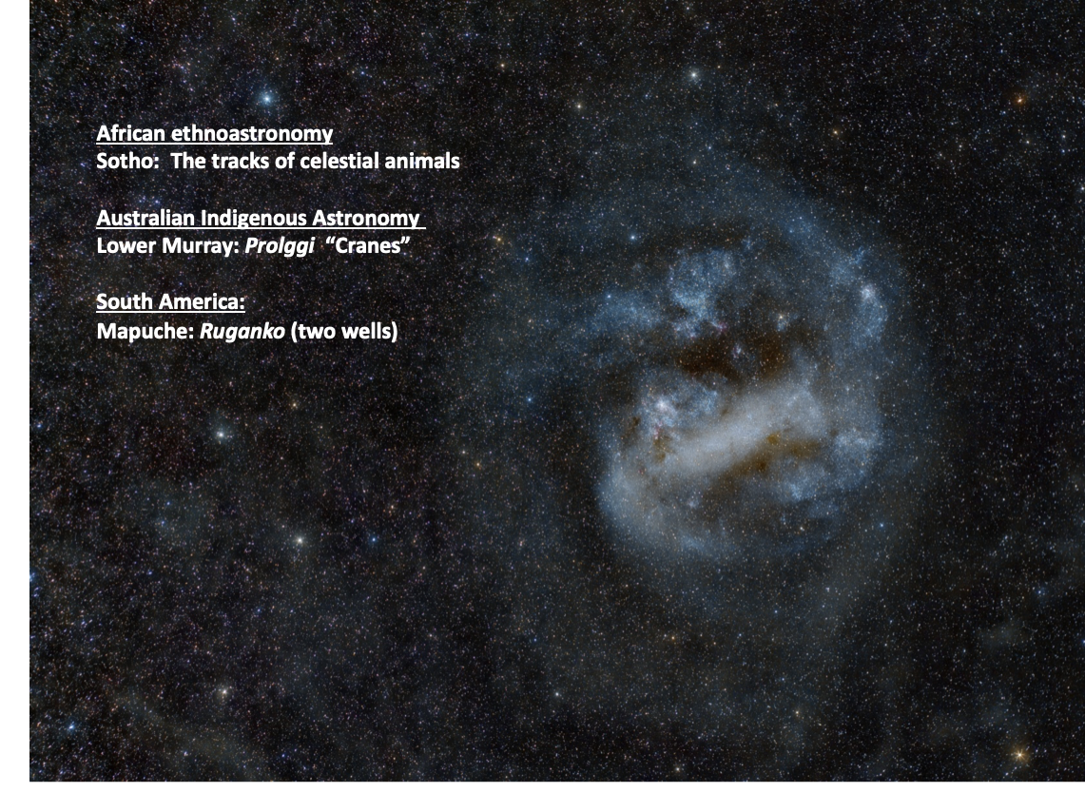
Image Credit: Carlos Milovic F.

Slide 25
The LMC as a Massive Satellite
Abundance Matching
  M₂₀₀ ~ 1.5 x 10¹¹ M (Moster+ 2013)
Perturbation of stellar streams
  M₂₀₀ ~ 1.5 x 10¹¹ M (Erkal+ 2019, Shipp+ 2019)
Satellite census
  M₂₀₀ > 1.24 x 1011 M (Erkal & Belokurov 2020; see also Patel+ 2020)
Existence of the SMC
  M₂₀₀ ~ 3.4 x 10¹¹ M (Shao+2018; Besla+ 2018)
Notes:
SMC and LMC – hold a substantial amount of gas.
Abundance matching with large error bars
Also the timing argument

Slide 26
The LMC as a Massive Satellite
Milky Way
Clouds
Notes:
SMC and LMC – hold a substantial amount of gas.
Abundance matching with large error bars
Also the timing argument

Slide 27
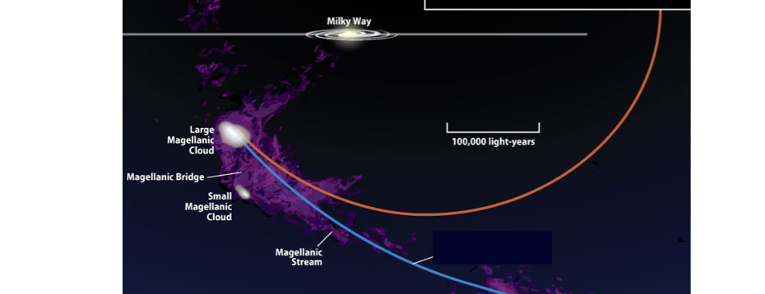
Only recently captured by the Milky Way
The LMC has made its closest approach to the Milky Way ~ 50 Myr ago at a distance of ~49 kpc.
Orbit over the past 1 Gyr is largely independent of Milky Way halo mass or density profile.
SOLAR MOTION. Vy ~240 km/s
LMC MOTION:
Vy ~ 226 km/s

Slide 28
Only recently captured by the Milky Way
Dark matter from the Clouds is tidally stripped by the Milky Way—but stars only start being stripped when >90% of the dark matter is gone.
SOLAR MOTION. Vy ~240 km/s
LMC MOTION:
Vy ~ 226 km/s

Slide 29
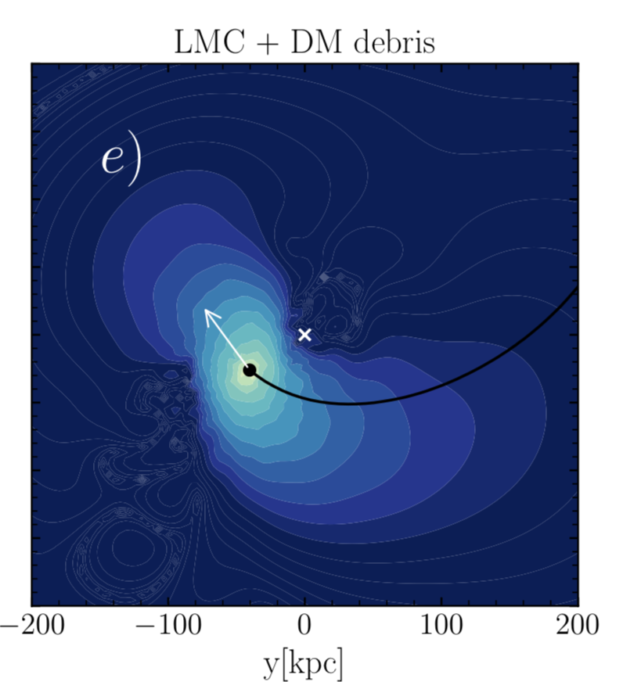
Dark matter effects of the Clouds
Tidal debris from the Clouds.
Garavito-Camargo+ 2020

Slide 30
Dark matter effects of the Clouds
Tidal debris from the Clouds.
Dynamical imprint of the Clouds on the Milky Way dark matter halo.

Slide 31
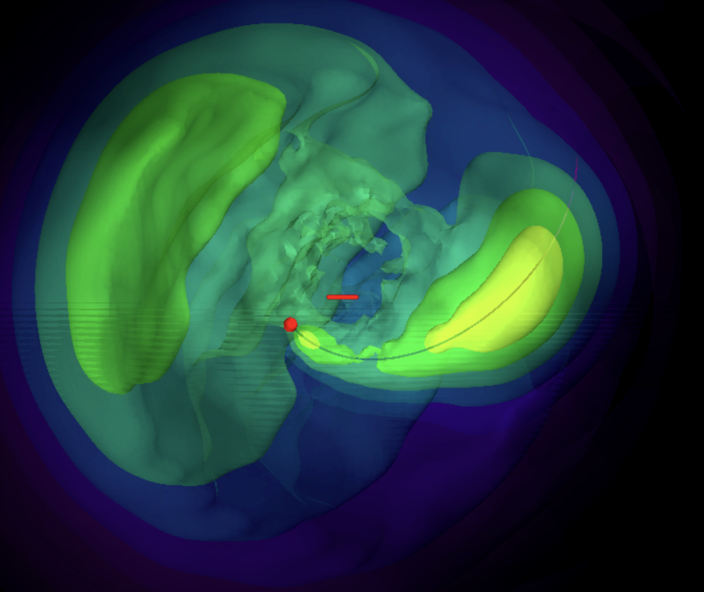
Dynamical Friction
(details depend on nature of dark matter particle)
Collective response
Transient wake
Garavito-Camargo, Besla+ 2019, 2020
See also
Vesperini & Weinberg 2000
Video courtesy of Gurtina Besla

Slide 32
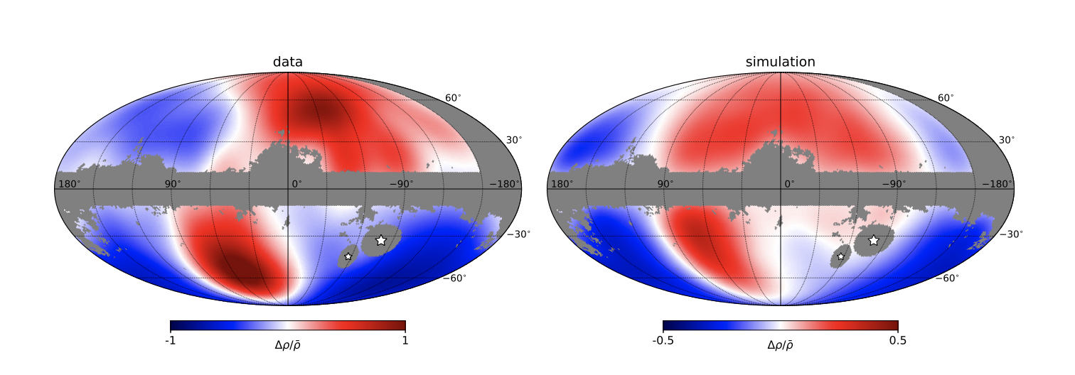
Observed in stars in the Milky Way!
collective
wake
Conroy+ 2021
Notes:
Neither direct or indirect detection – LSST
Normalized change in density
Where = 1.0 is where ambient density has essentially doubled.
rho = (rho_mwlmc - rho_mw)/rho_mw

Slide 33
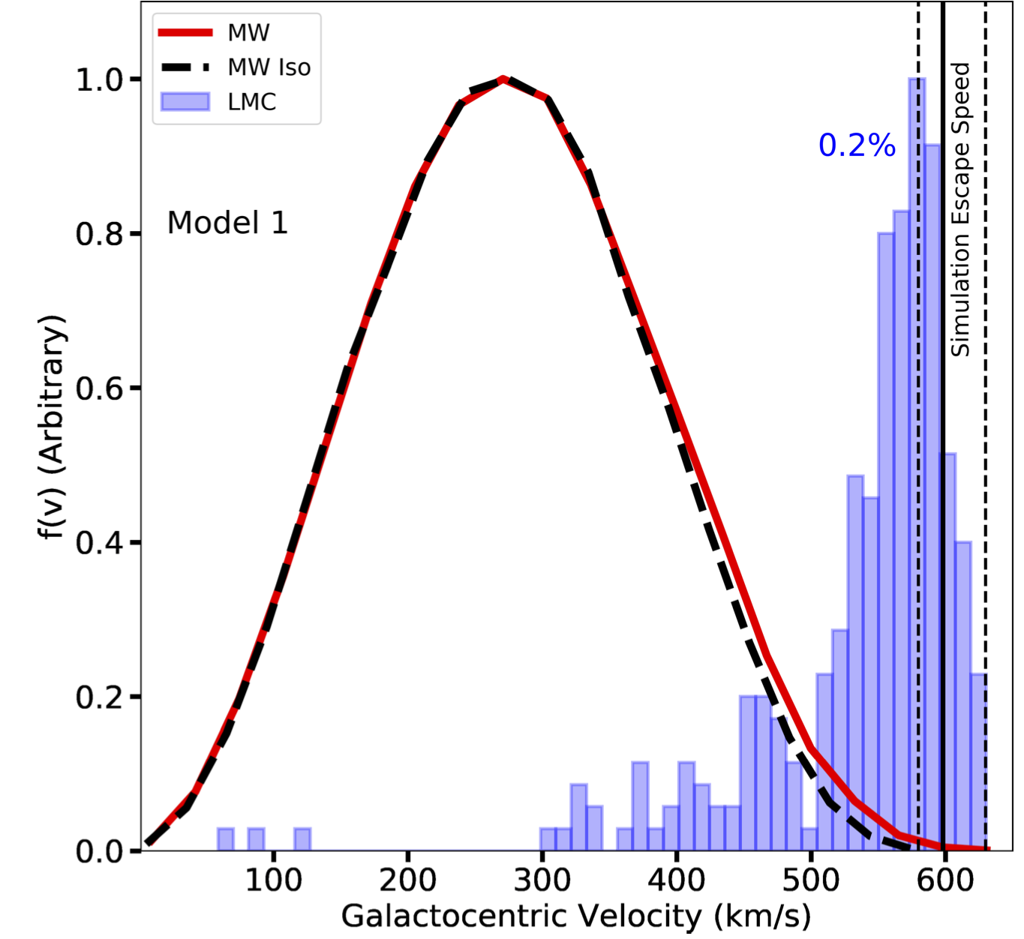
76% of DM particles with Galactocentric speeds > 600 km/s originate from the LMC
Besla, Peter & Garavito-Camargo + 2019
Notes:
While LMC particles comprise a small fraction (∼0.2%) of particles in the Solar Neighborhood, they dominate the high speed tail: 76% of DM particles with Galactocentric speeds > 600 km/s originate from the LMC in Model 1.
The combined effect of LMC particles and accelerated MW halo particles together augment the local DM density distribution by ∼5%.
LMC particles contribute at high speeds, primarily from 550km/s−630km/s (blue histograms), with a median value of ∼570 km/s in both Model 1 (left panel; quartile Q1 = 529, Q3 = 598km/s) and Model 2 (right panel; Q1 = 545, Q3 = 592km/s). These speeds are near or exceed the local escape speed,

Slide 34
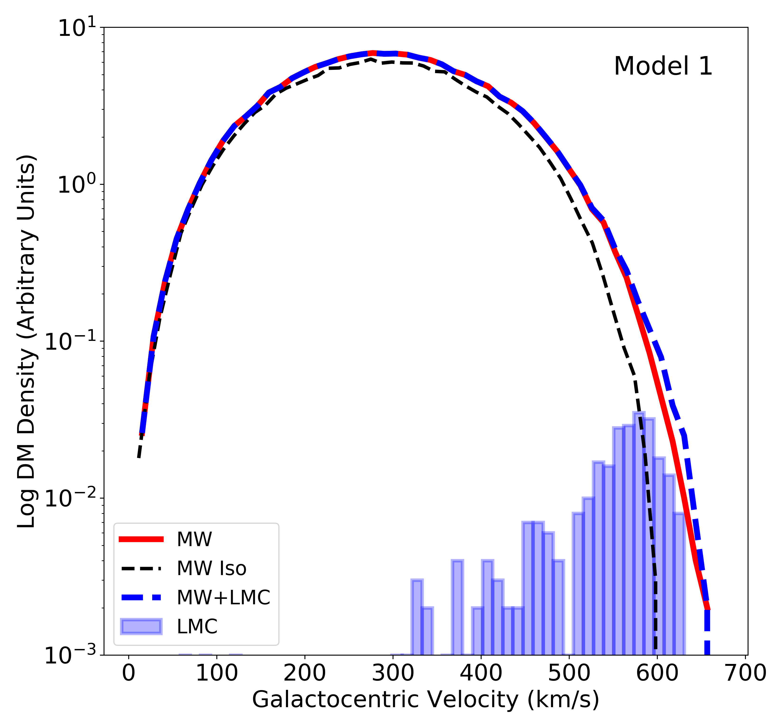
The combined effect of LMC particles and accelerated MW halo particles together augment the local DM density distribution by ∼5%.
Besla, Peter & Garavito-Camargo + 2019
Notes:
The mass density at speeds > 500 km/s increases by a factor of 2 in Model 1 and a factor of 5 in Model 2.

Slide 35
Earth Frame: Velocity boost because the LMC is moving in the opposite direction as the Sun
SOLAR MOTION. Vy ~240 km/s
LMC MOTION:
Vy ~ 226 km/s

Slide 36
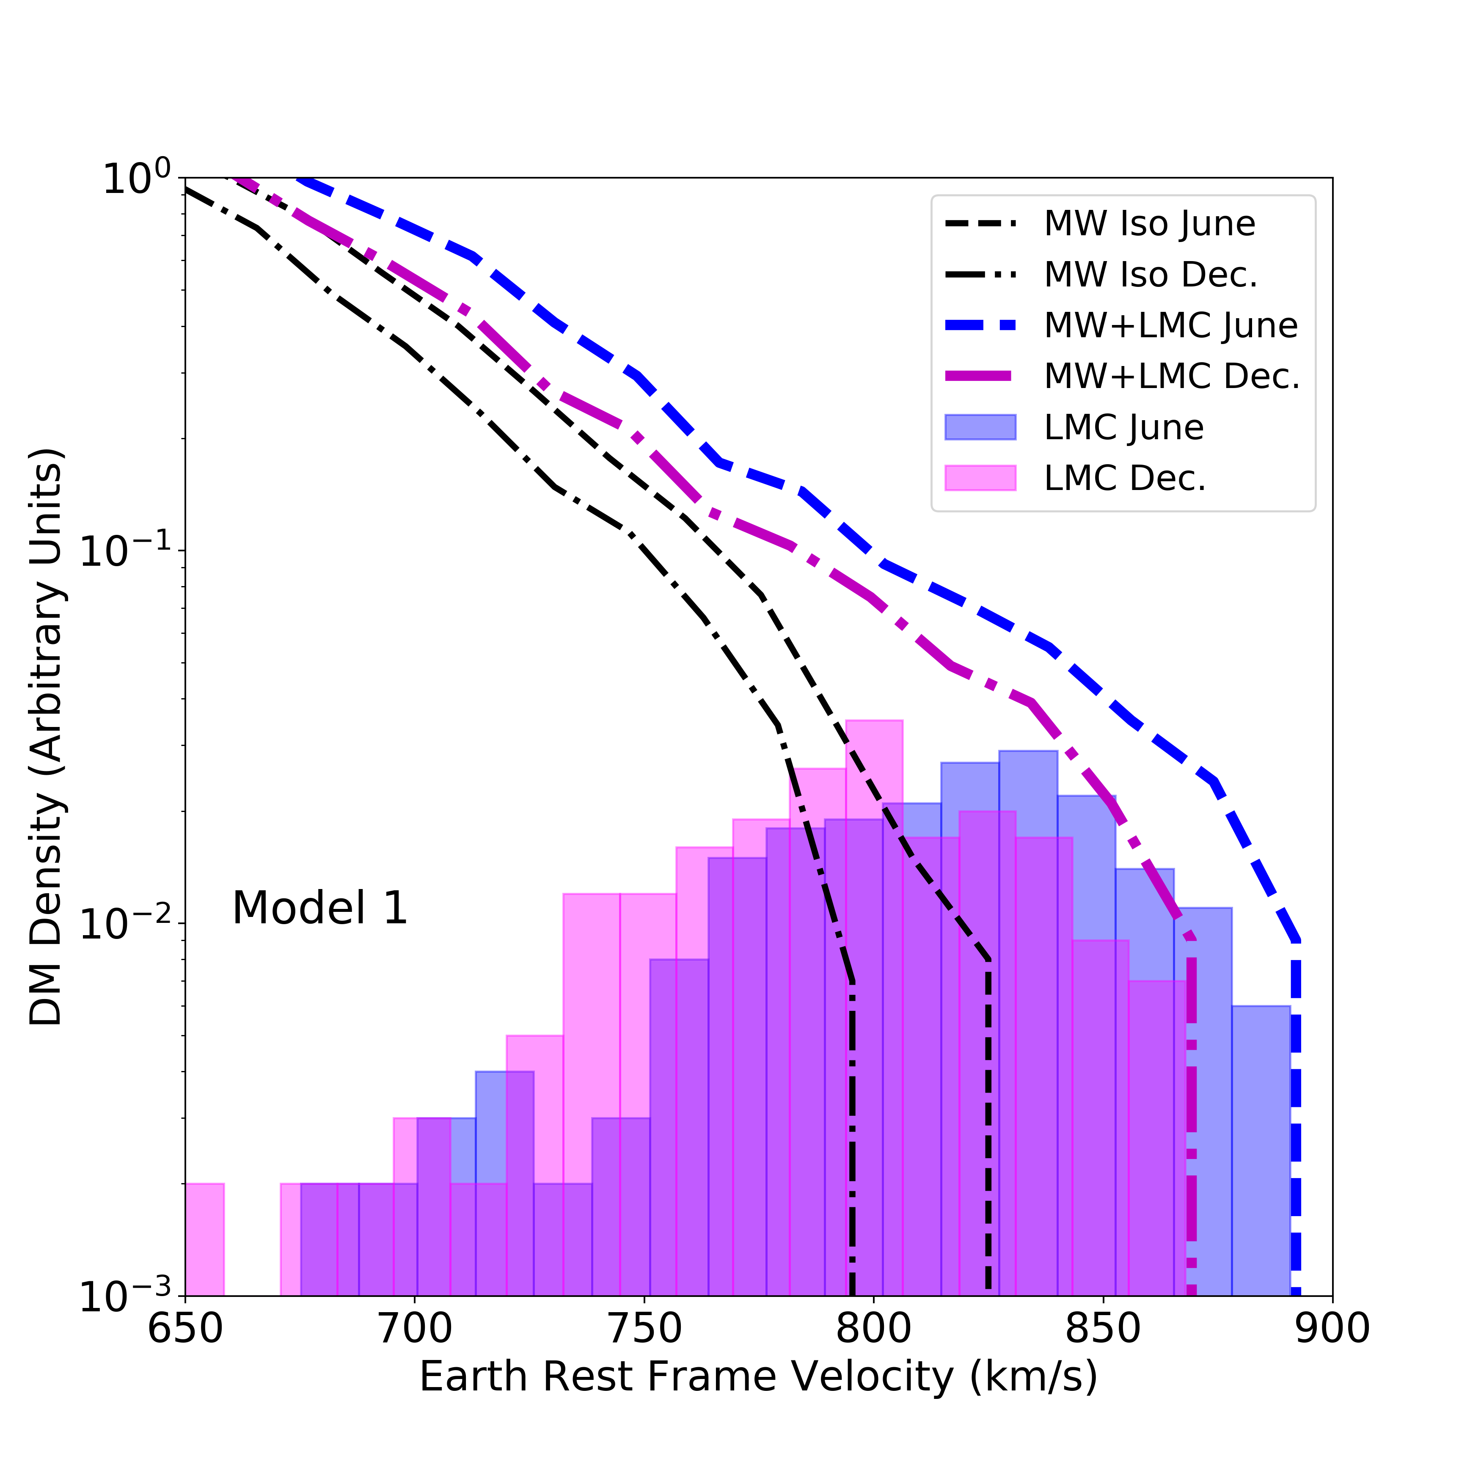
Isotropic Halo Model
LMC particles dominate the change in the density profile
Besla, Peter & Garavito-Camargo + 2019
Notes:
800-840 is roughly the escape speed in these units.

Slide 37
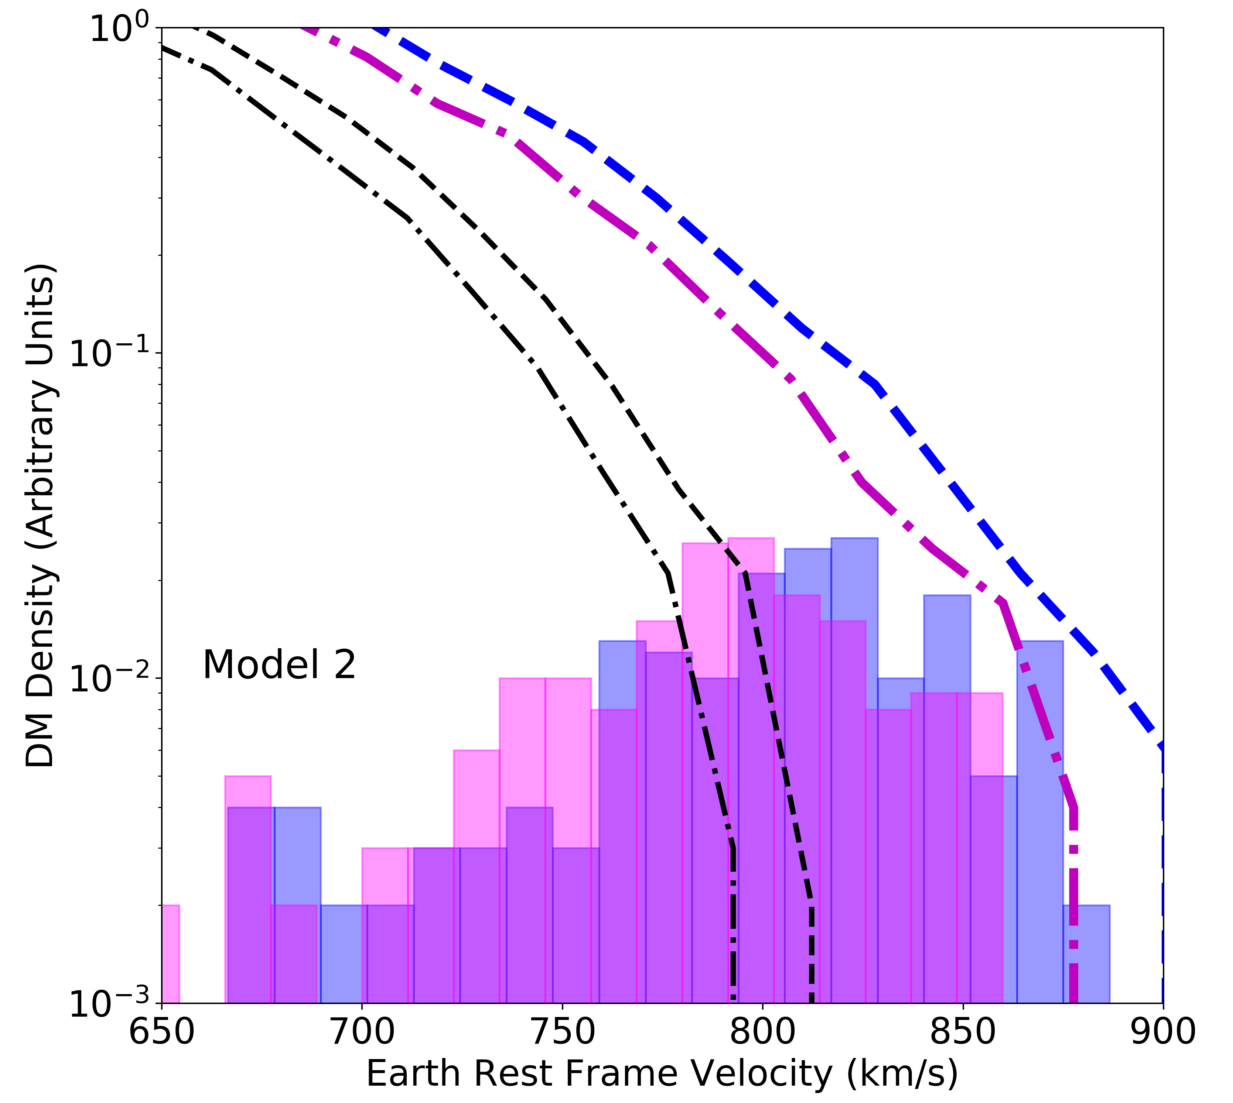
Radially Biased Anisotropy Halo Model
Accelerated MW particles dominate the change in the density profile
Besla, Peter & Garavito-Camargo + 2019

Slide 38
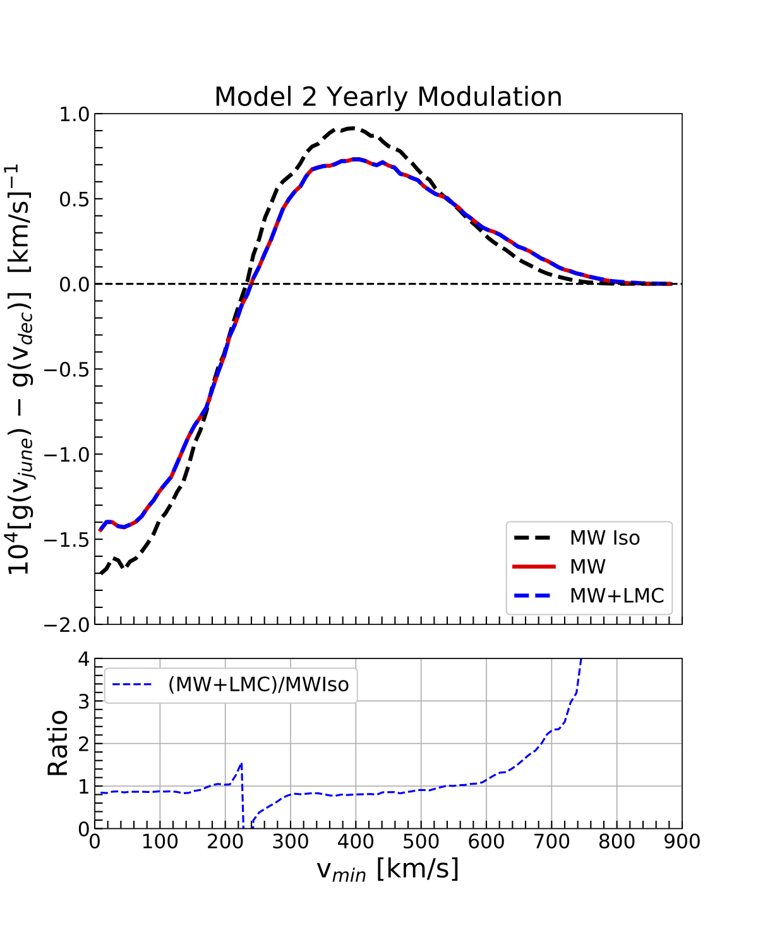

Implications
Annual modulation amplitude becomes large at large energies.
For elastic scattering,
g(vmin) $=\int_{vmin}^{∞}{d^{3}v f(v)/v^{3}}$
Energy spectrum ~ g(vmin)

Slide 39
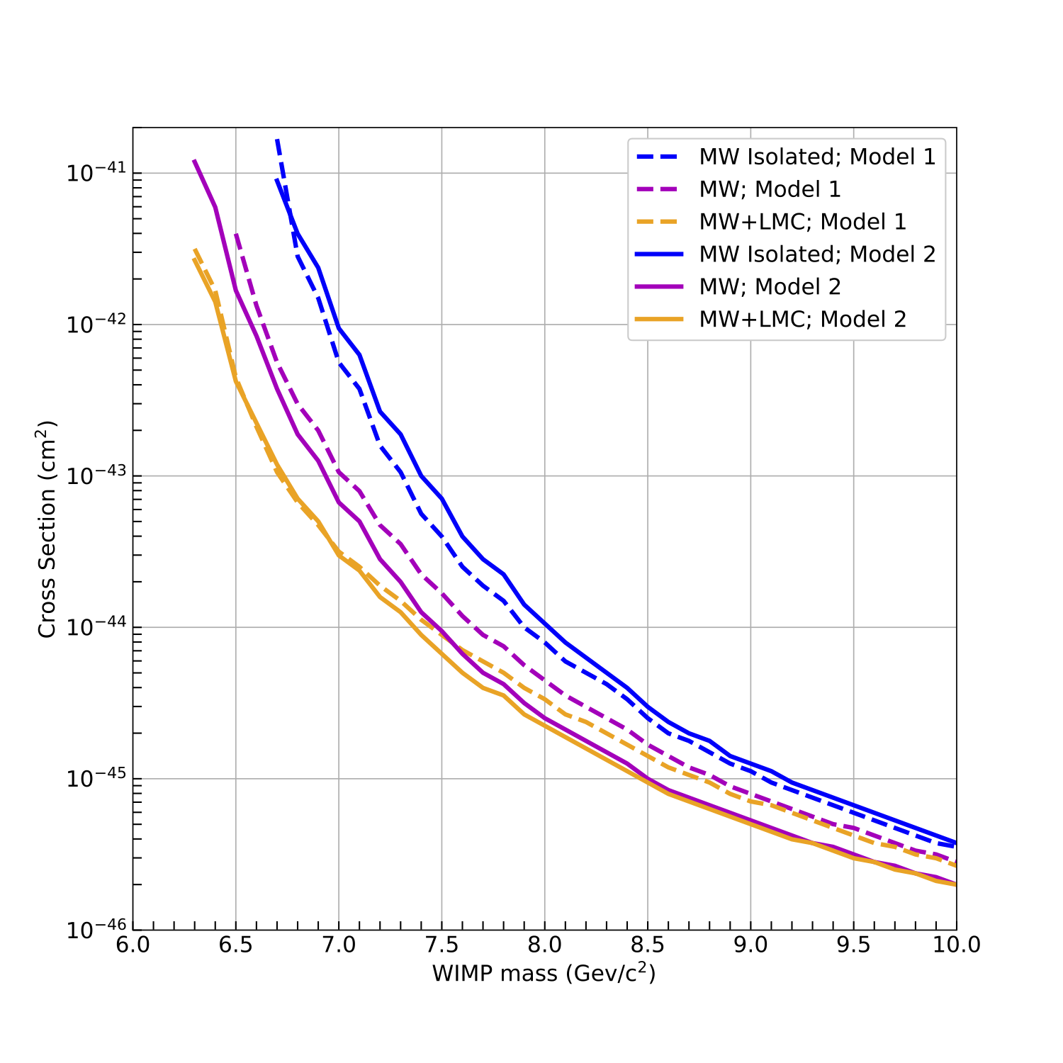
Implications
More sensitivity for low-mass WIMPs
Exclusion curves based on the first ton-year of Xenon 1T, and assumptions in Necib+ 2018.

Slide 40
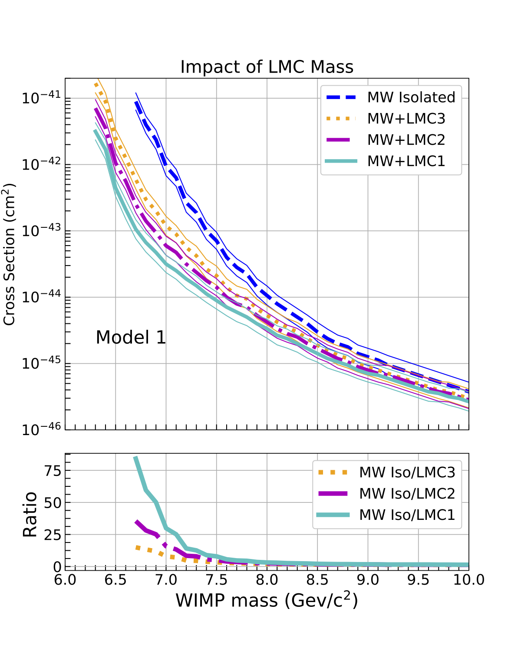
Implications
The extra sensitivity is not a (very) strong function of LMC mass---it is a consequence of the LMC’s unicorn orbit.

Slide 41
Conclusions

