Slide 1
Some Initial Ideas on Mechanics
Chris Tully
Princeton University
CalVision Workshop, 29-30 July 2021

Slide 2
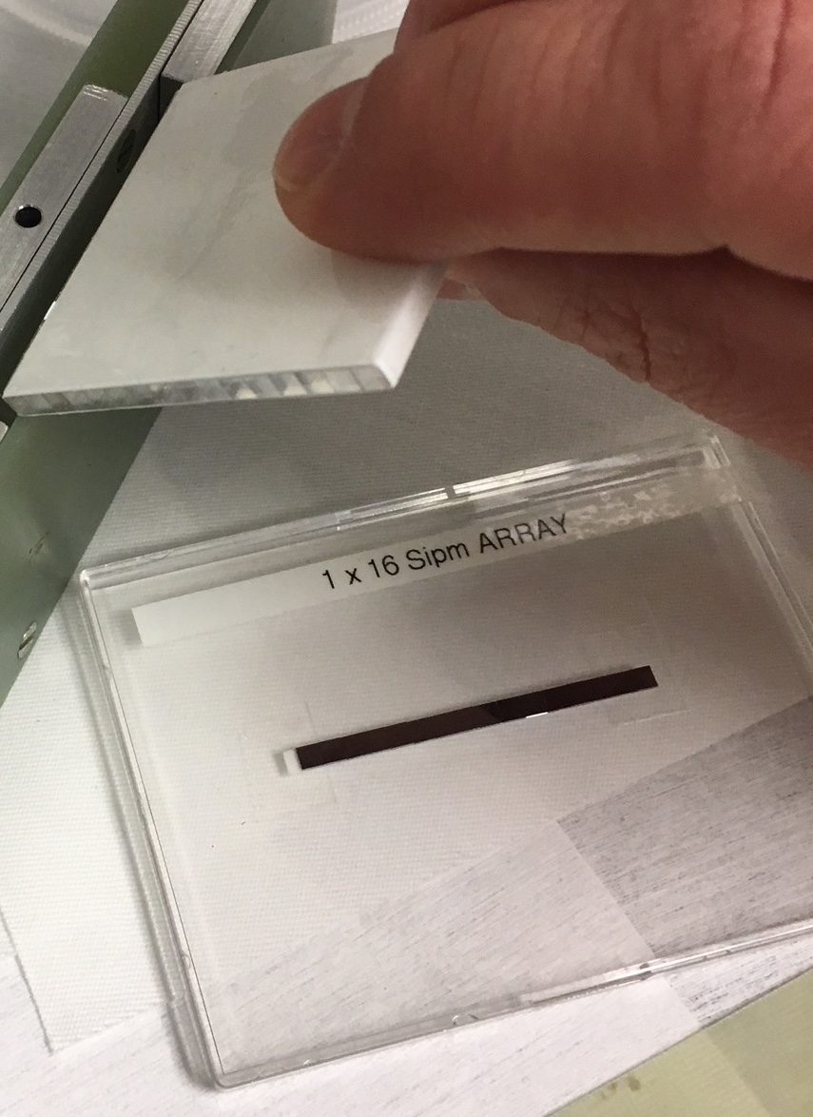
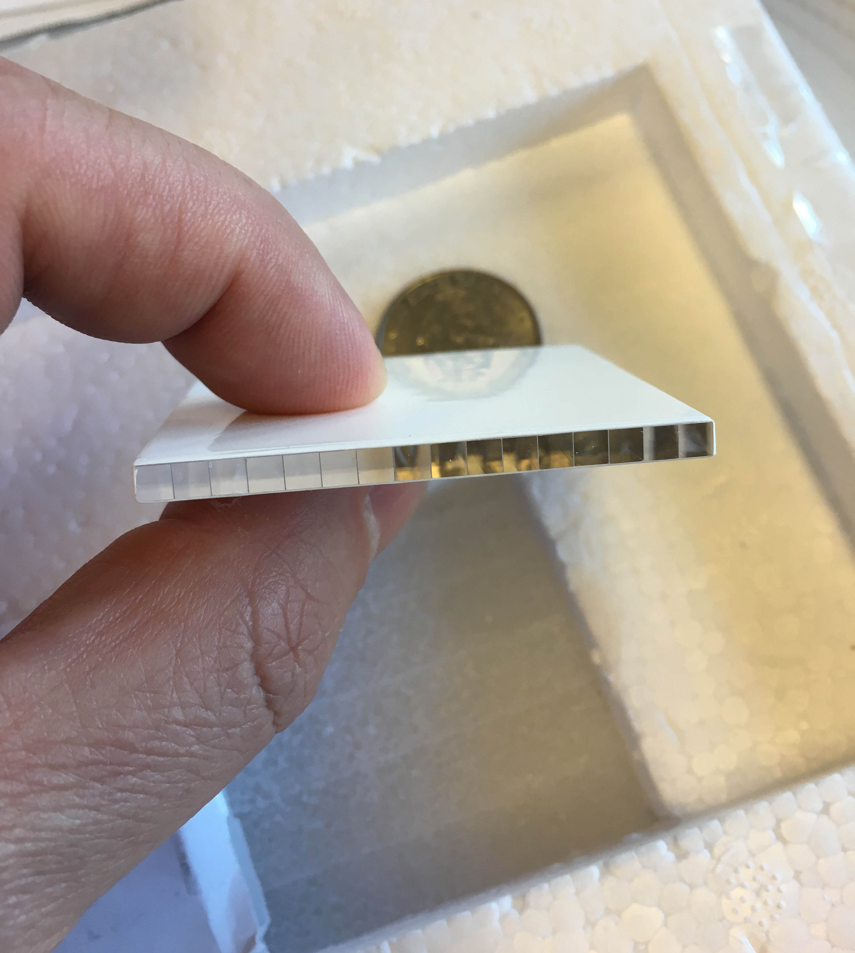
Example: BTL Fine Crystal Arrays

Slide 3
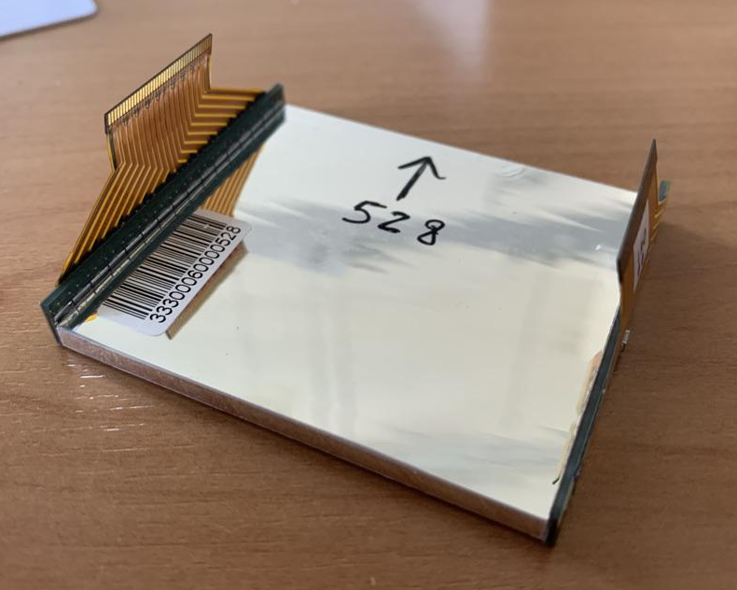
Assembled into Modules w/ Digital Outputs

Slide 4
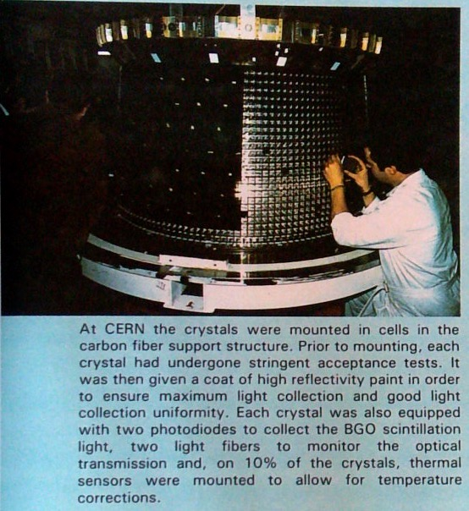
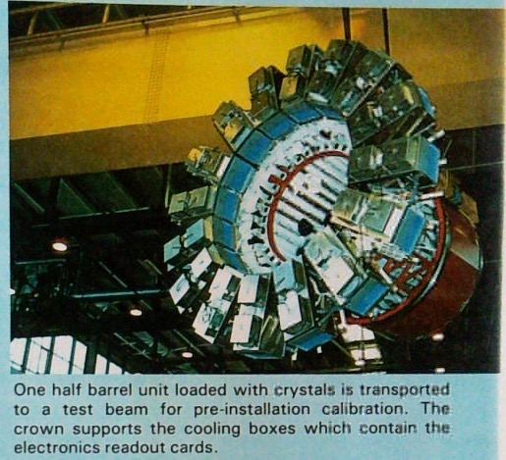
L3 BGO Carbon Fiber Support

Slide 5
L3 BGO Simulation Geometry

Slide 6
CMS PbWO Crystals w/ Flying Analog Pigtails

Slide 7
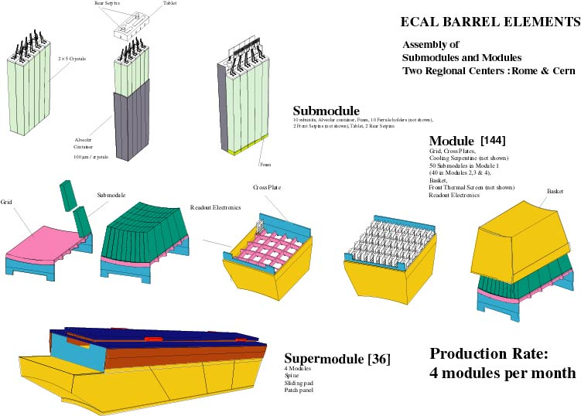
Packed into Submodules, Modules, Supermodules

Slide 8
CMS ECAL Barrel Supermodules

Slide 9
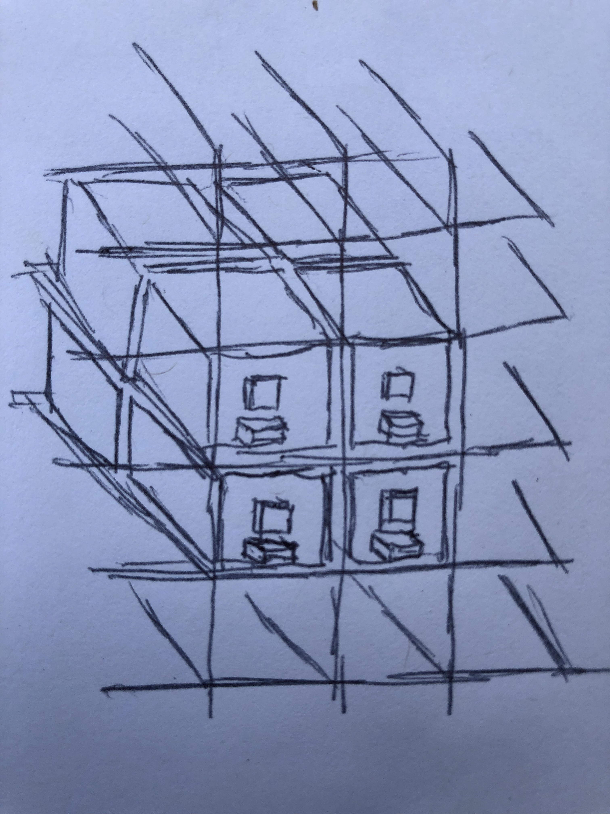
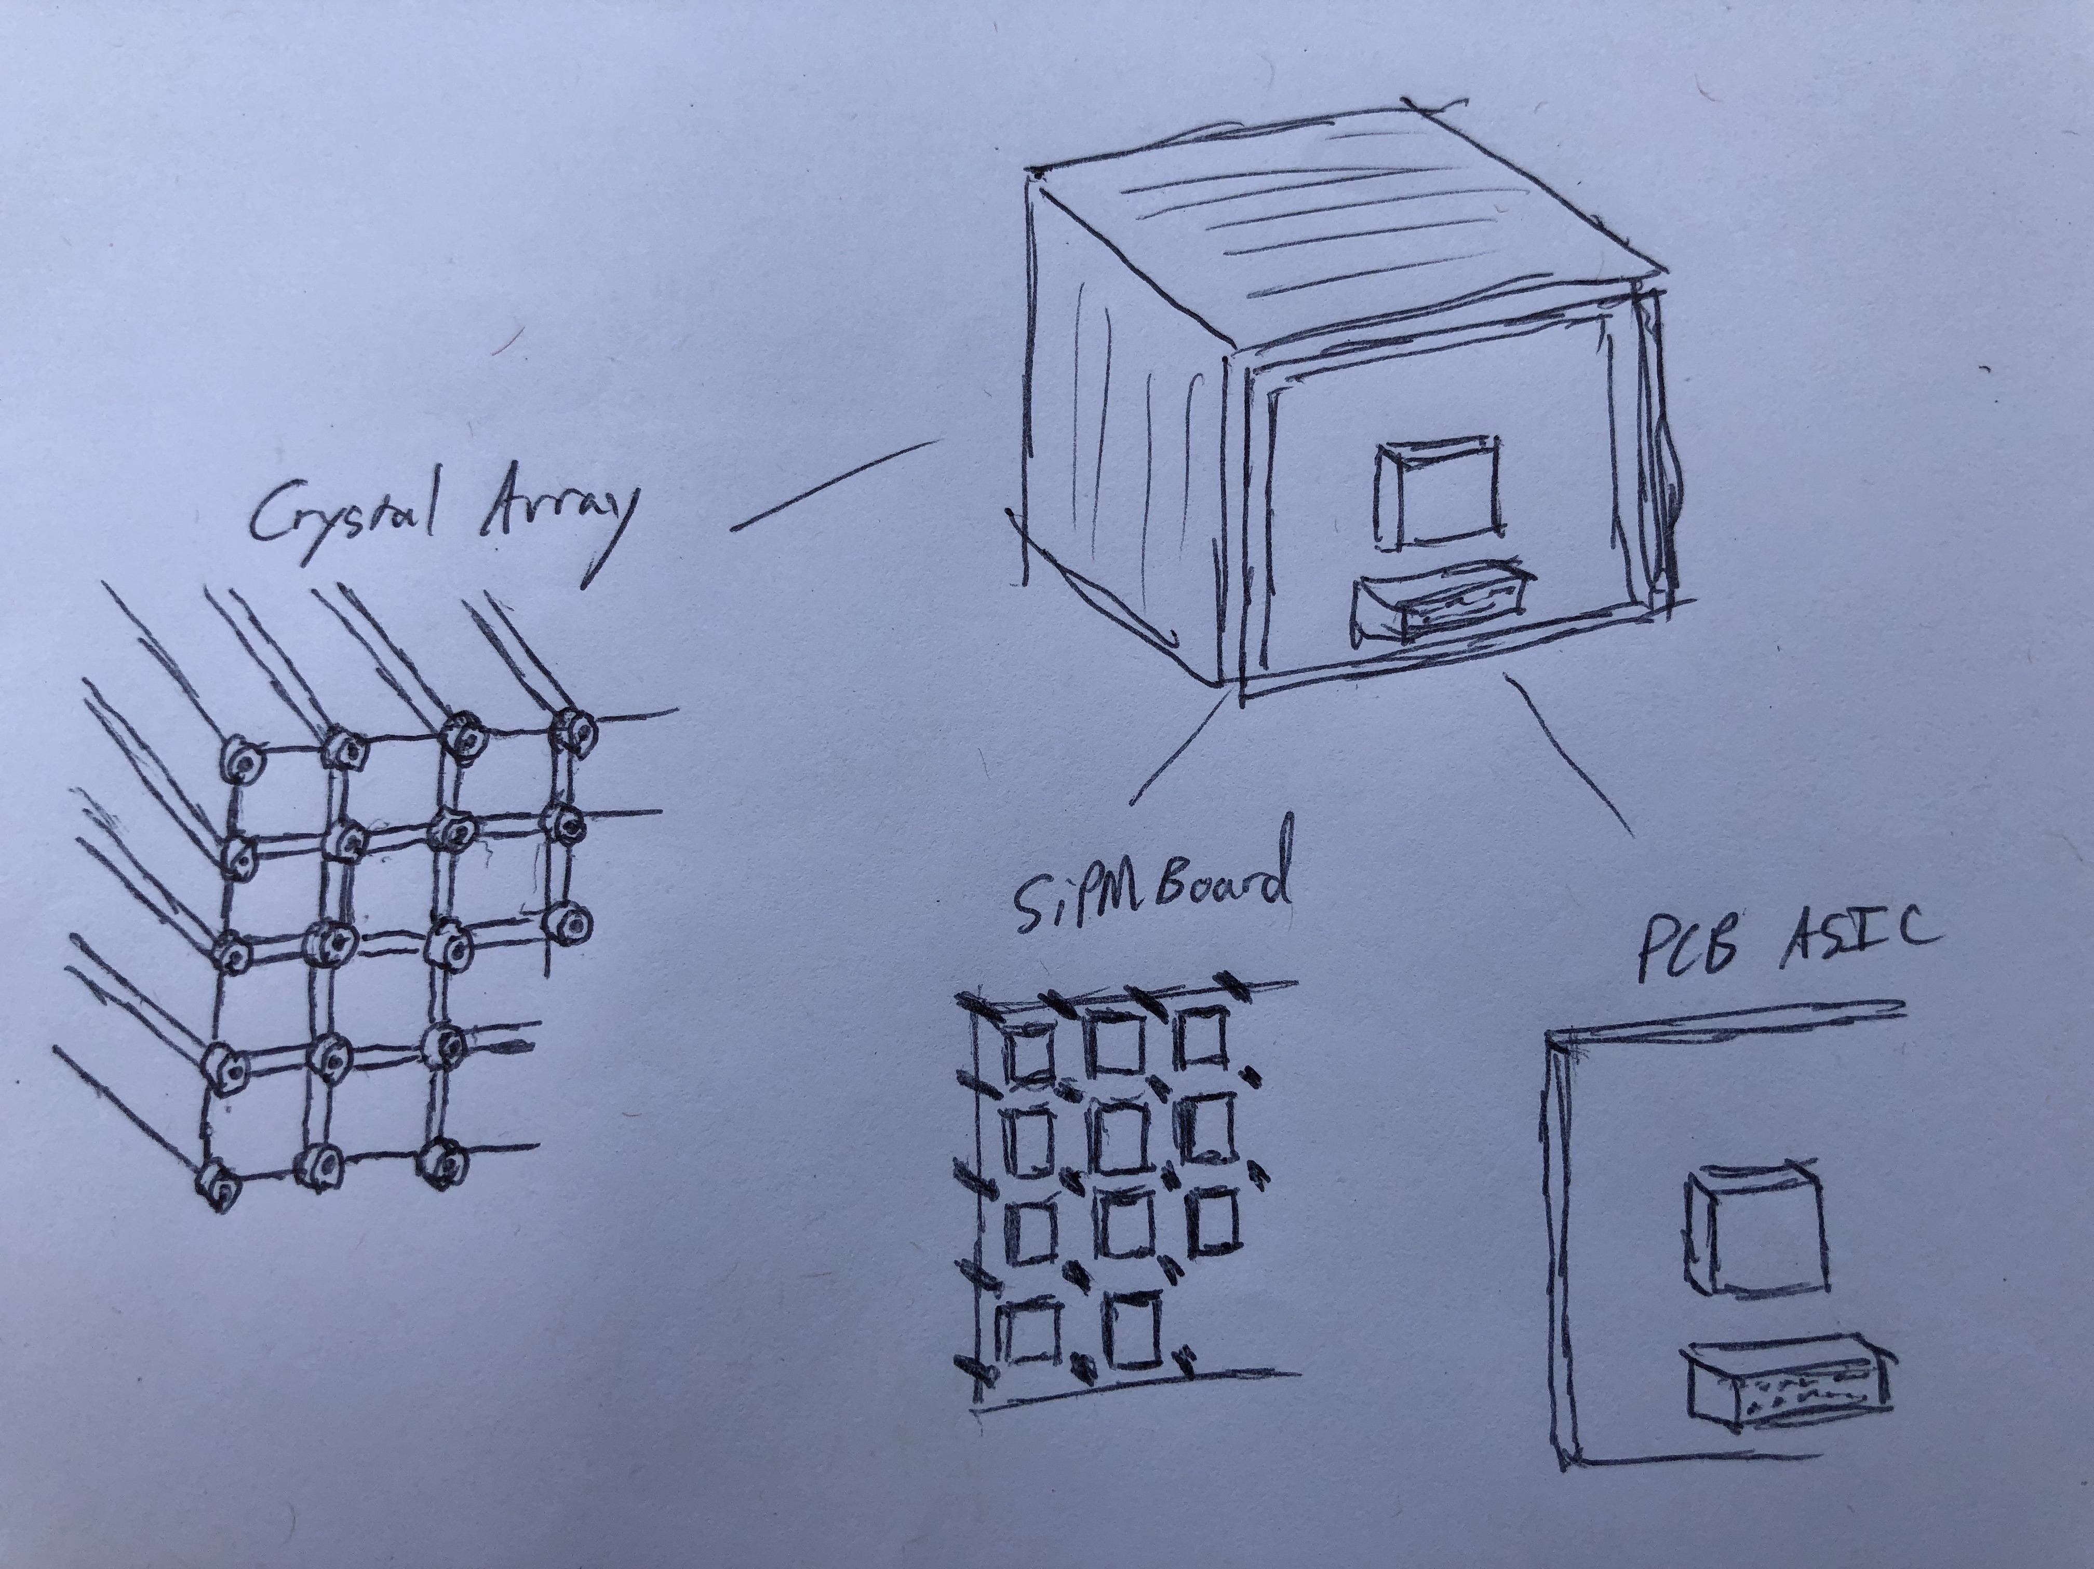
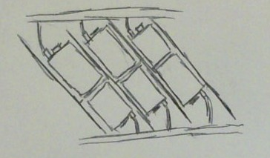
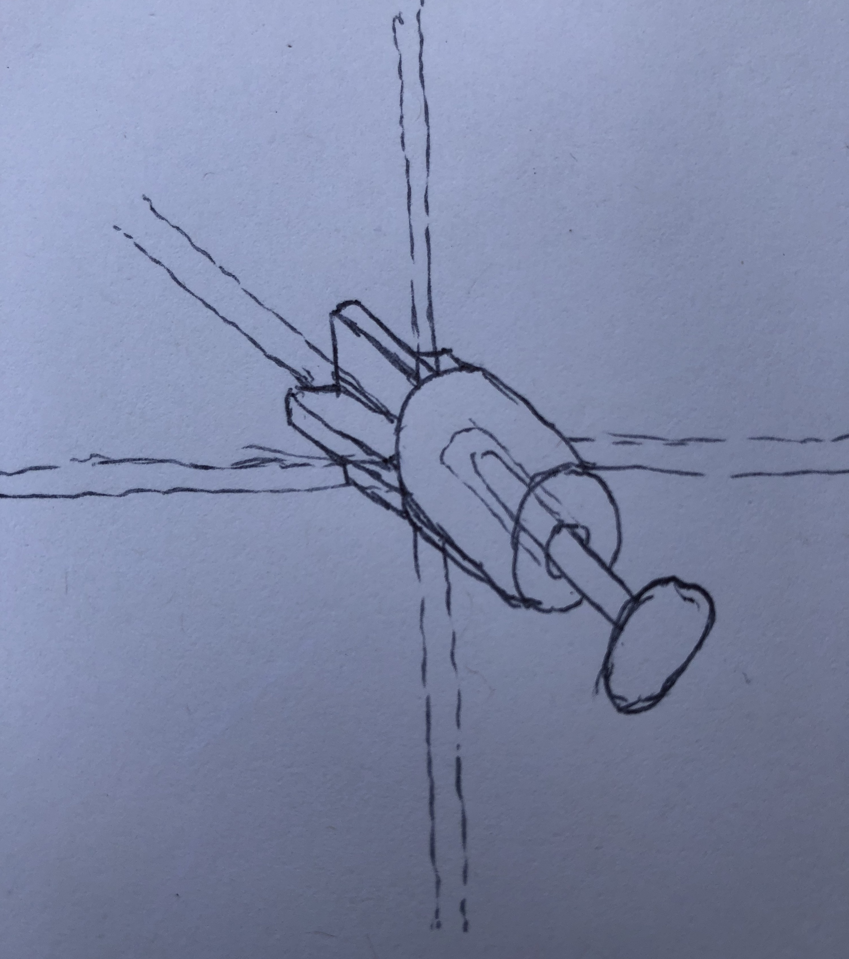
Module w/ Digital Outputs

Slide 10
Overall Structure
Individual crystals (a la BGO/PbWO) replaced with PET-like packs of Crystal Arrays similar to CMS BTL but extended to 2D
Alignment pins used to managed 2D SiPM array mounting (SiPM Board likely to be TEC controlled)
PCB ASIC piggy-backs onto SiPM Board w/ Digital Output
Digital pigtails replace the analog pigtails of CMS ECAL/L3 BGO
Crystal Arrays assembled in a similar Submodule/Module/Supermodule structure (a la CMS) but with Front and Rear digital pigtails
Support structures assembled out of Carbon Fiber (a la L3 BGO/CMS BTL/BTST) – CF was dropped by CMS because of the analog front-end APD noise/poor grounding of CF structures

