Slide 1

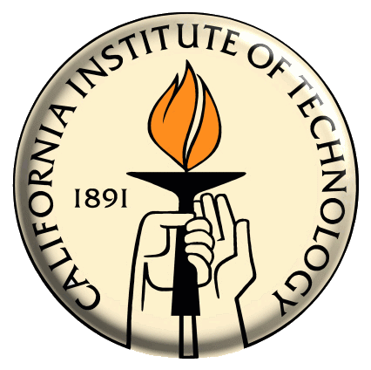
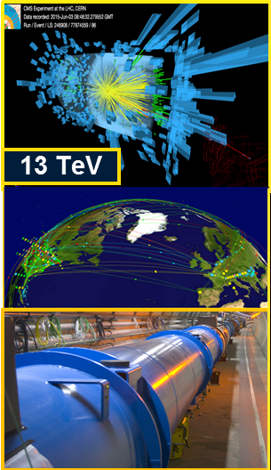
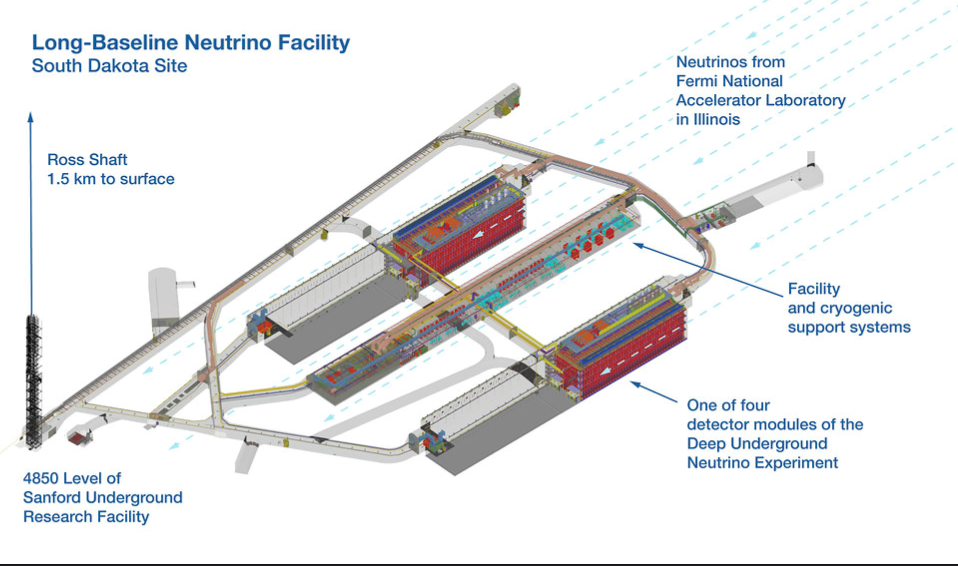
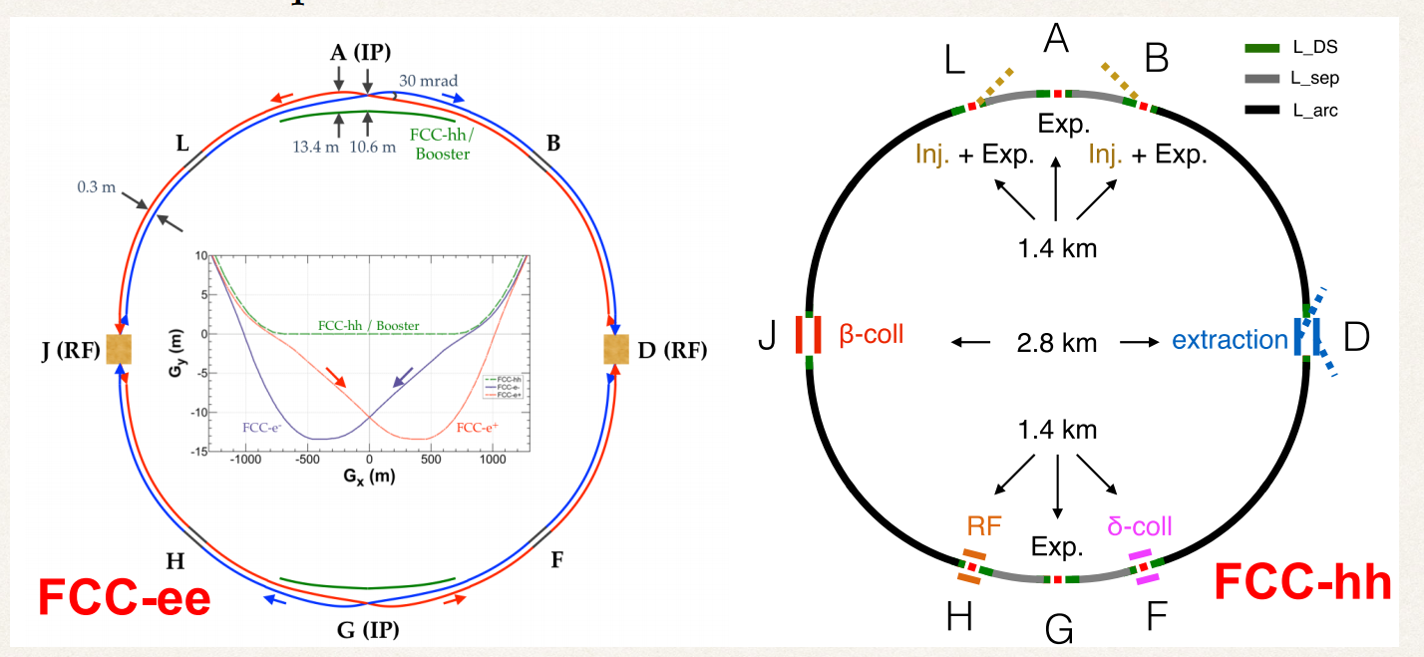
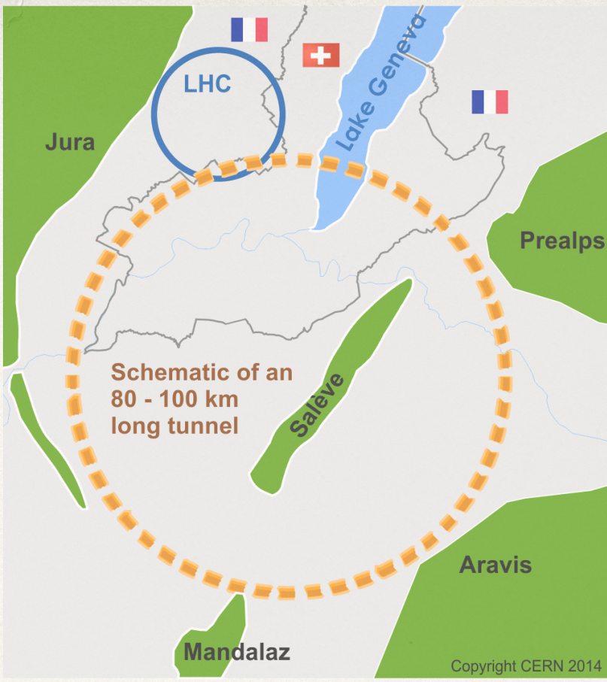
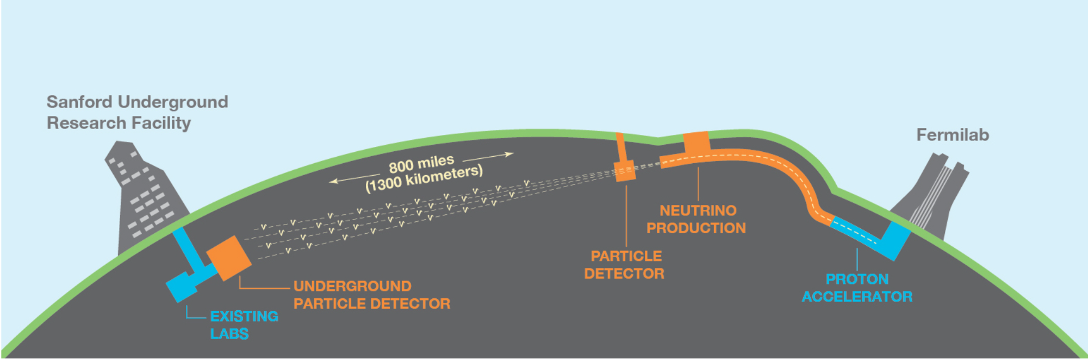
CalVISION Maximum Information Calorimetry
Blue Sky R&D Group
Argonne, Caltech, Fermilab, ORNL
New Heavy Glass Scintillators
Improved Crystals (EIC)
UV/Vis QD Wave Shifters, Pulsed
Light Sources
Dual C/S EM:
Optical Interfaces, Photodevices, Readout
HHCAL:
Design, Layout
Simulations: POC,
Reconstruction
LHC/HL LHC
LBNF/DUNE
FCC ee
+Mu2e, g-2, ILC, CEPC, EIC; other Future HEP Experiments
H. Newman, S. Chekanov, M. Demarteau, S. Magill, H. Wenzel, R. Zhu
CalVISION Workshop
June 29-30, 2021

Slide 2
Calvision Workshop: Blue Sky R&D Session
Introduction to the Team; Design and R&D Issues HN
Cost Effective Inorganic Scintillators RZ
Quantum Dot Wavelength Shifters SM
Simulation of HHCAL SC
Discussion MD + All

Slide 3
CalVision: HHCal Discussion Points
Crystal ECAL and dual readout spaghetti HHCAL concept
is relatively well developed in [3]
HHCAL concept with a scintillating glass needs to be similarly proven;
Reference parameters (HHCAL volume, channels etc.) need to be set
Finding a dense glass within the price limits (see [4] and [5])
is a key activity
  Further developing it to have dual C/S readout, with appropriate wave shifter setup, can be done once a glass is found, and decided upon
  There are very good pointers to the current state
  at the EIC Workshop and CPAD 2021 [6] and [7]
We need to study a couple of detector layouts (e.g. SiD, CEPC using the HEPSim repository) and further development/integration of the crystal ECAL + HHCAL concept [8] are part of the plan; strong experience exists
We need to understand the current state of the HHCAL design including the readout ([7] Demarteau slide 11, 12) and the glasses developed at CUA are (slide 14)
I also found this EIC progress report: https://wiki.bnl.gov/conferences/images/4/44/ERD1_EIC_Calorimetry_Report_March2021.pdf

Slide 4
Calvision: HHCal and Associated References
[1] Calvision Proposal: https://www.dropbox.com/s/cld2bk3glmulc1z/Calvision_proposal_2021%20%2815%29-1.pdf?dl=0
[2] Calvision Reviews: https://www.dropbox.com/s/0g23azd5pzxq288/CalvisionReviews_HM052021.docx?dl=0
[3] Eno and Tully Paper: A robust case for the Calvision concept with a two segment crystal ECAL and Spaghetti dual readout HCAL https://www.dropbox.com/s/ltdpnqhsj7t7mc9/SegmentedCrystalCalorimetersforFutureColliders_EnoTullyetal_Arxiv2008.00338.pdf?dl=0
[4] Hafnium Fluoride glass:
This was considered as an alternative to CeF3 or PBWO4 crystals for CMS in the 1990s: https://www.dropbox.com/s/rz8v26s02kbk5rc/HafniumFluorideGlasses_Auffrayetal_NIMA19961-s2.0-0168900296007176-main-1.pdf?dl=0
[5] DSB heavy scintillator glass: https://www.dropbox.com/s/o2oogabvs2u7azk/DSBGa_SCINTIGLASS.pdf?dl=0 https://www.dropbox.com/s/zp5cdzapo9npjr3/DSBGdLoadedGlass_Novotny_2017_J._Phys.__Conf._Ser._928_012034.pdf?dl=0
[6] RY Zhu at the 2021 EIC workshop: https://www.dropbox.com/s/prh2b2r6nrcis1u/InorganicScintillatorsforFutureCalor_ryz_210316_EIC_Crystal_CAL.pdf?dl=0 Especially slides 24-26. Or Chen Hu at CPAD 2021
[7] M. Demarteau at CPAD 2021: https://www.dropbox.com/s/fy5gf3g12hn51hc/TotalAbsorptionCalorforSuperiorJetResolution_Demarteau_cpad-hhcal.pdf?dl=0
[8] S. Chekanov et al., Calorimeter performance studies using Monte Carlo simulations for future collider detectors at CPAD 2021: https://indico.fnal.gov/event/46746/contributions/210055/

Slide 5
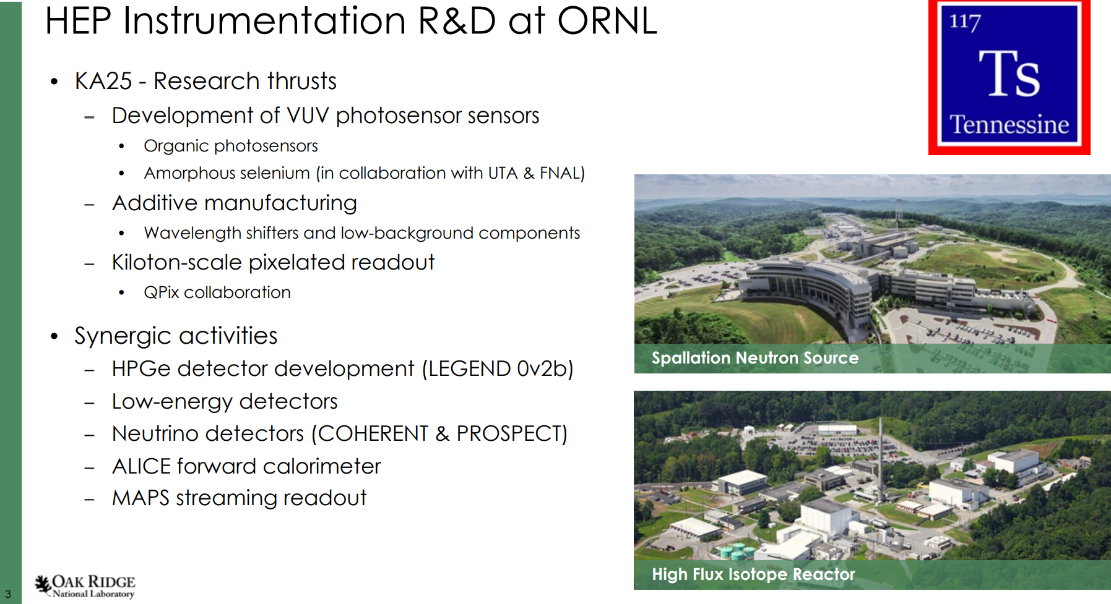
ORNL: M. Demarteau et al.
ORNL: A wide range of R&D on organic scintillators and readout

Slide 6
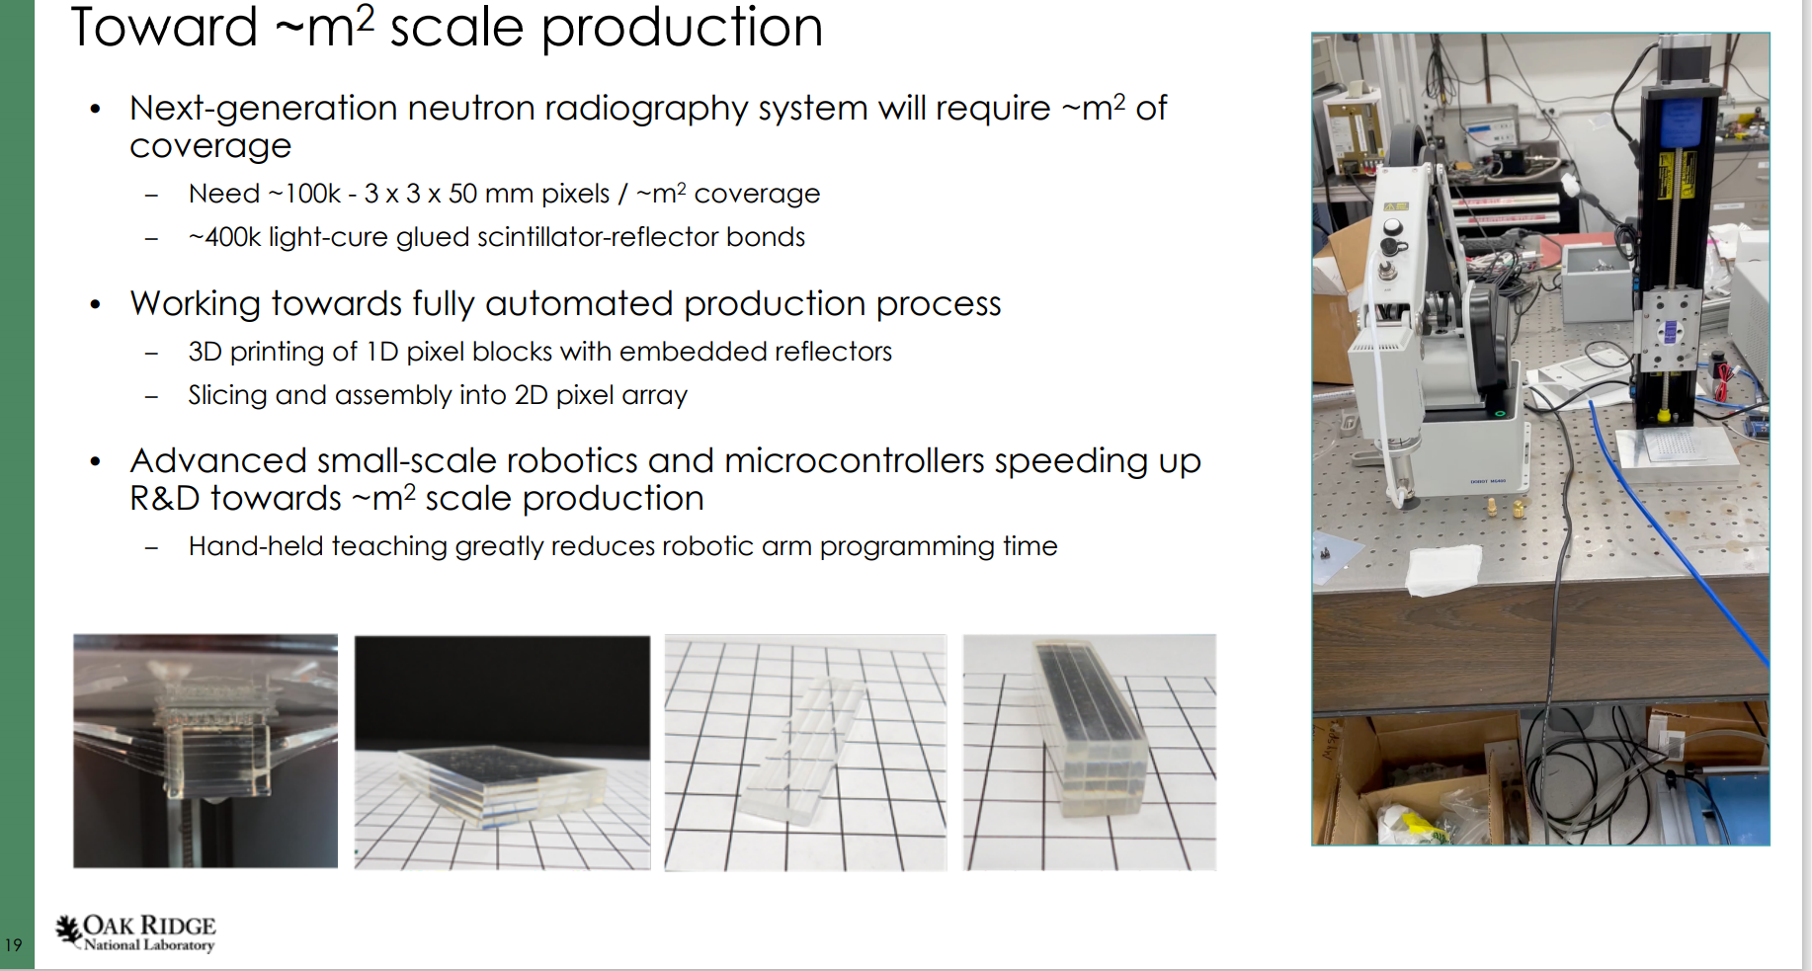
ORNL: M. Demarteau et al.
ORNL: strong mass production capabilities

Slide 7
ORNL in Calvision: Q&A
Where do you see ORNL developments being adapted to meet some of the challenges of the (evolving) Calvision detector concept ?
ORNL has some great scintillator development work ongoing in combination with the work on true digital SiPMs. The fact that we have folks in the Division with a chemistry background I found to be tremendously beneficial.
What ongoing effort could be leveraged ?
We are deeply involved in calorimetry at the EIC. For that effort we are exploring various glasses and various fibers to be used for calorimeters. We also have a photodetector effort ongoing for pixelated LAr readout. We can also leverage the effort on the streaming readout that we’re doing for ALICE and sPHENIX.
The HHCAL concept with a scintillating glass would need to be proven. Finding a glass within the price limits (see [4] and [5]), further developing it to have dual readout etc. are to be done once a glass is found, or decided upon.
We have some effort ongoing in the area of glasses, but I would need to study the possible synergies.
We need to understand the current state of the HHCAL design including the readout (Demarteau at CPAD 2021 slides 11, 12) and what the glasses developed at CUA are (on slide 14)
This effort is in collaboration with Tanja Horn at CUA. She is coming to visit ORNL next week and I can give an update then.

Slide 8
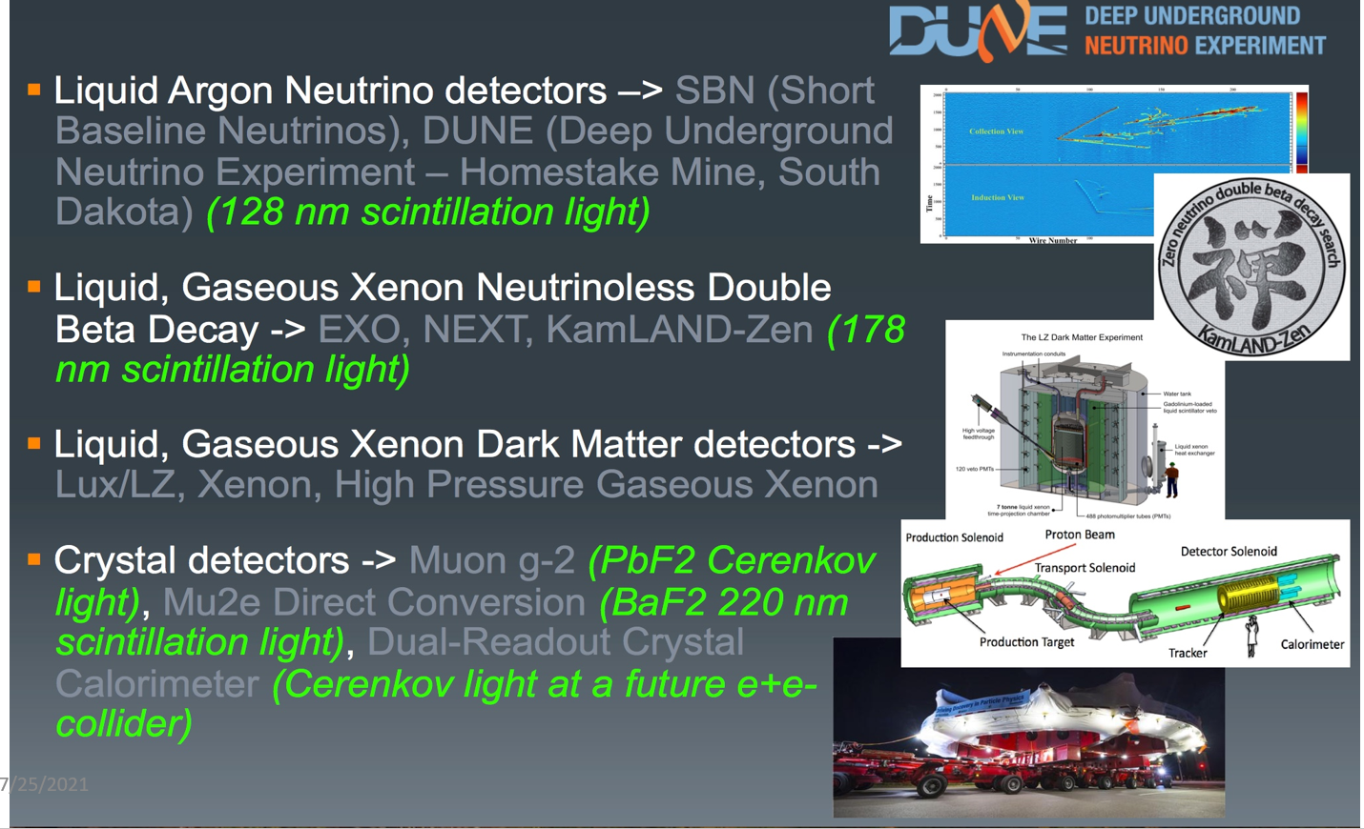
ANL: S. Magill, S. Chekanov et al.
QD Wavelength Shifters
ANL: A wide range of experience in film and QD waveshifters
For many experiments as well as a wide range of applications

Slide 9
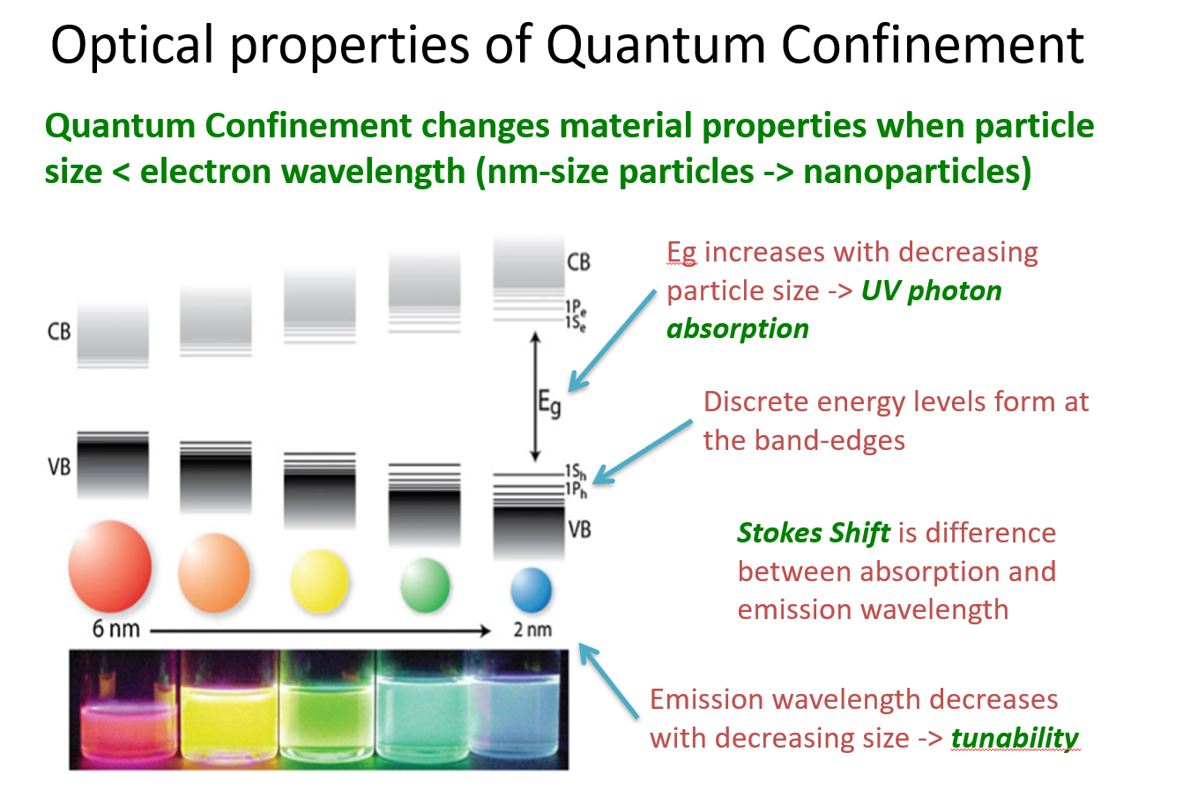
ANL: S. Magill, S. Chekanov et al.
Quantum Dots (e.g. QLED TVs)
For background see: https://chem.libretexts.org/Bookshelves/Analytical_Chemistry/Book%3A_Physical_Methods_in_Chemistry_and_Nano_Science_(Barron)/
08%3A_Structure_at_the_Nano_Scale/8.05%3A_Using_UV-Vis_for_the_detection_and_characterization_of_silicon_quantum_dots

Slide 10
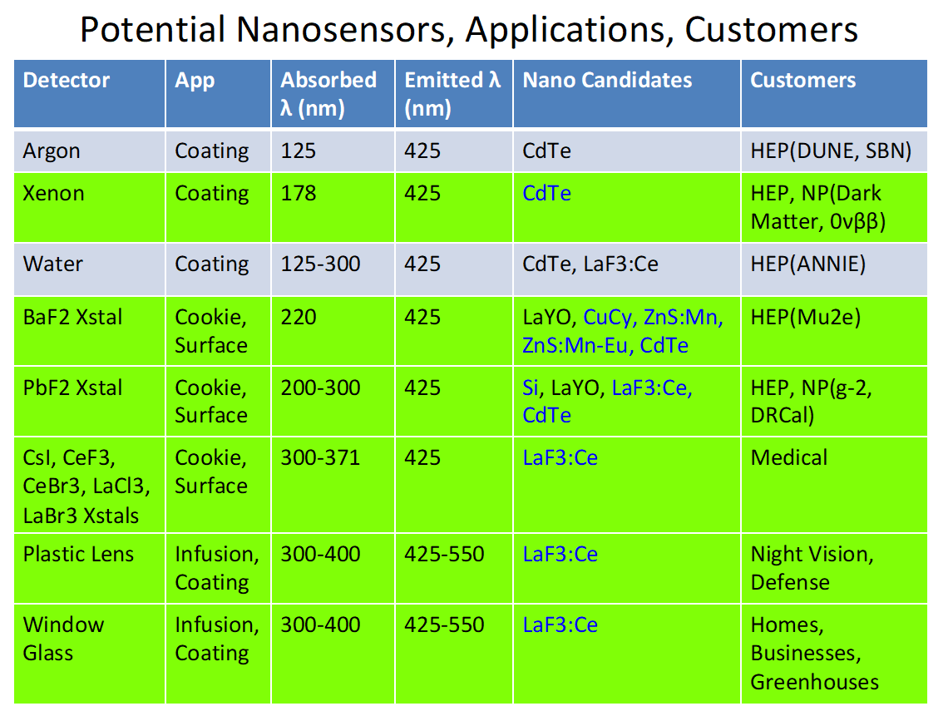
ANL: S. Magill, S. Chekanov et al.

Slide 11
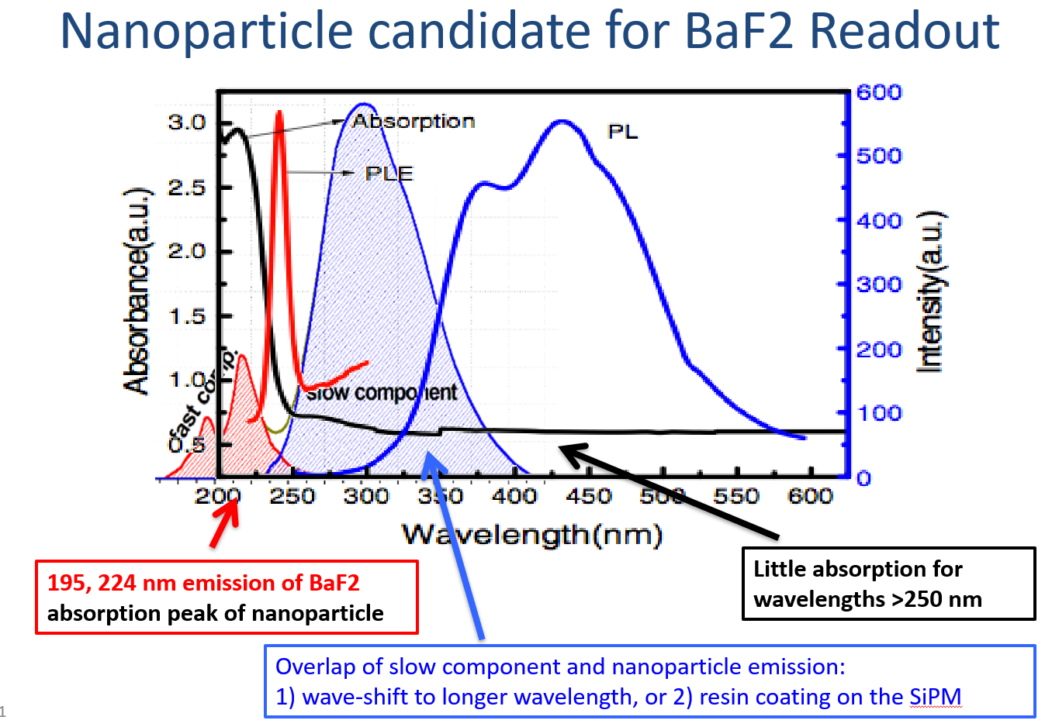
ANL: S. Magill, S. Chekanov et al.

Slide 12
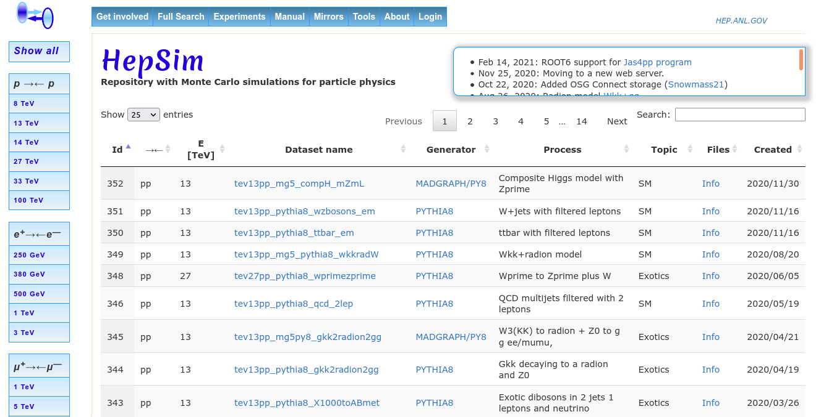
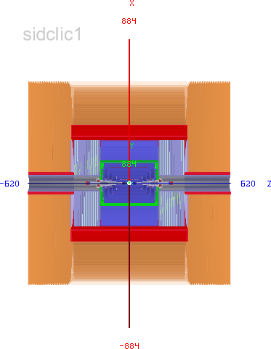
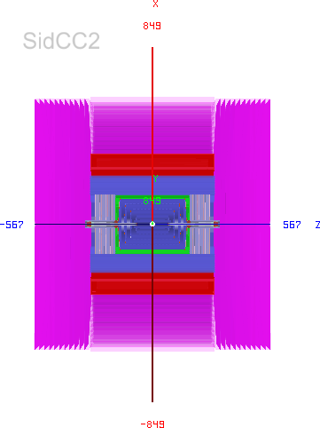
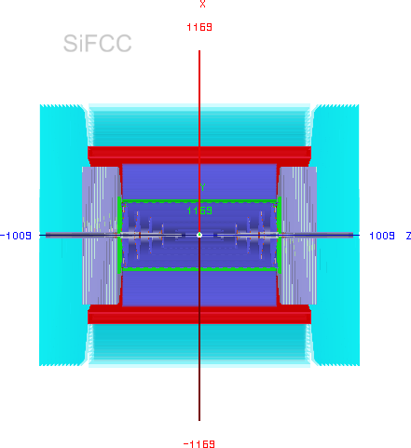
S.Chekanov
S.Magill
Monte Carlo Simulations at ANL
ANL supports event samples with Monte Carlo simulations with full simulations
350 samples for download, truth-level Monte Carlo, fast simulations, full Geant 4 simulations with 7 detector geometries
Indexed by www.osti.gov and assigned DOI
Linked to public data storage for data sharing
Used in various CDR reports, several ATLAS papers, contributed to ~30 articles and ~40 talks
All detectors based on Si/Fe and Si for HCAL & ECAL
Replacing ECAL/HCAL with crystals should not be significant problem
  Dual-readout was done in the past by S.Magill using SiD design
Recently used for timing studies of calorimeters:
  S.V. Chekanov, A.V. Kotwal, C.-H. Yeh, S.-S. Yu. Physics potential of timing layers in future collider detectors. (2020) JINST 15 P09021
https://atlaswww.hep.anl.gov/hepsim/
ANL: HEPSim Repository and wide range of experience in detector simulations, including several future collider experiments

Slide 13
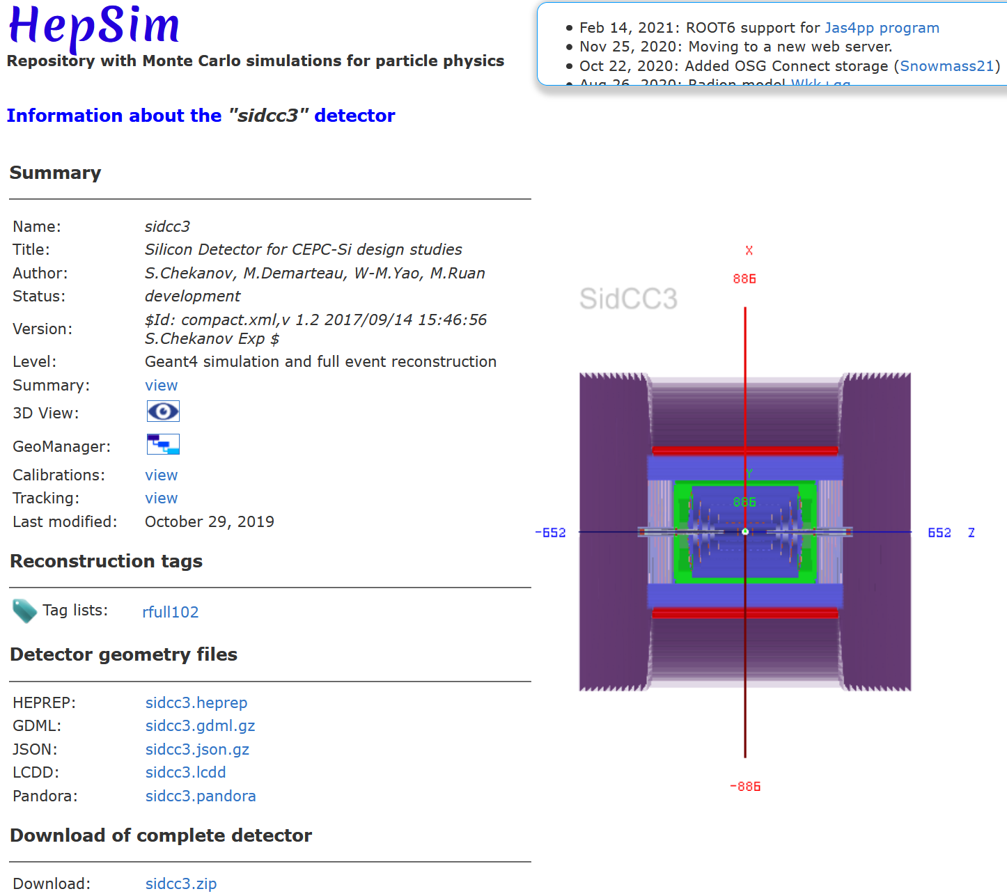
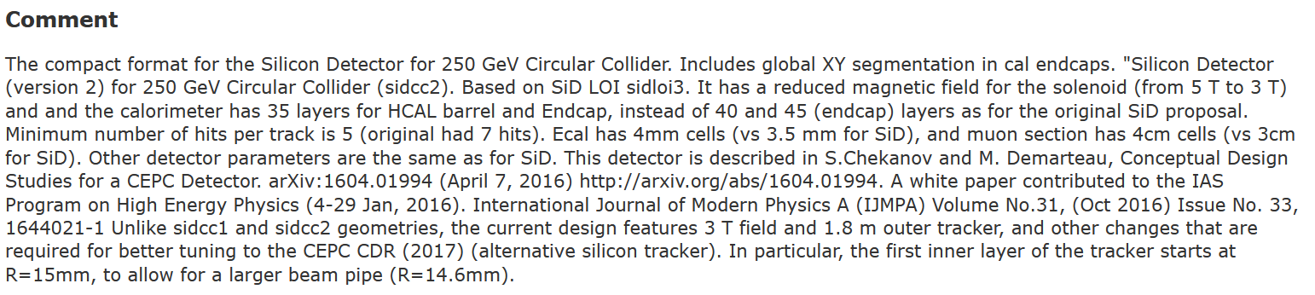
HEPSim Repository:
Chekanov, DeMarteau et al.
CEPC Reference Design Example
https://atlaswww.hep.anl.gov/hepsim/detectorinfo.php?id=sidcc3
Also see: http://jwork.org/chekanov/talks/

Slide 14
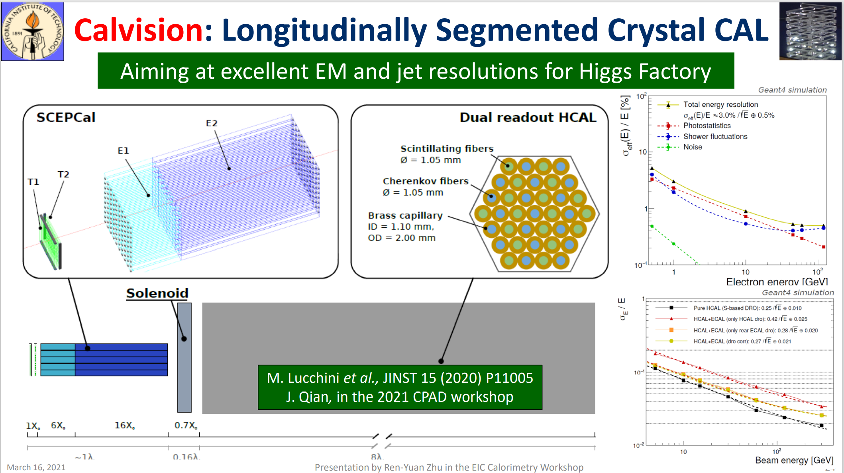
Ren-Yuan Zhu at the EIC Calorimetry Workshop
Leading experience with the characterization and testing of crystal scintillator properties and radiation damage

Slide 15
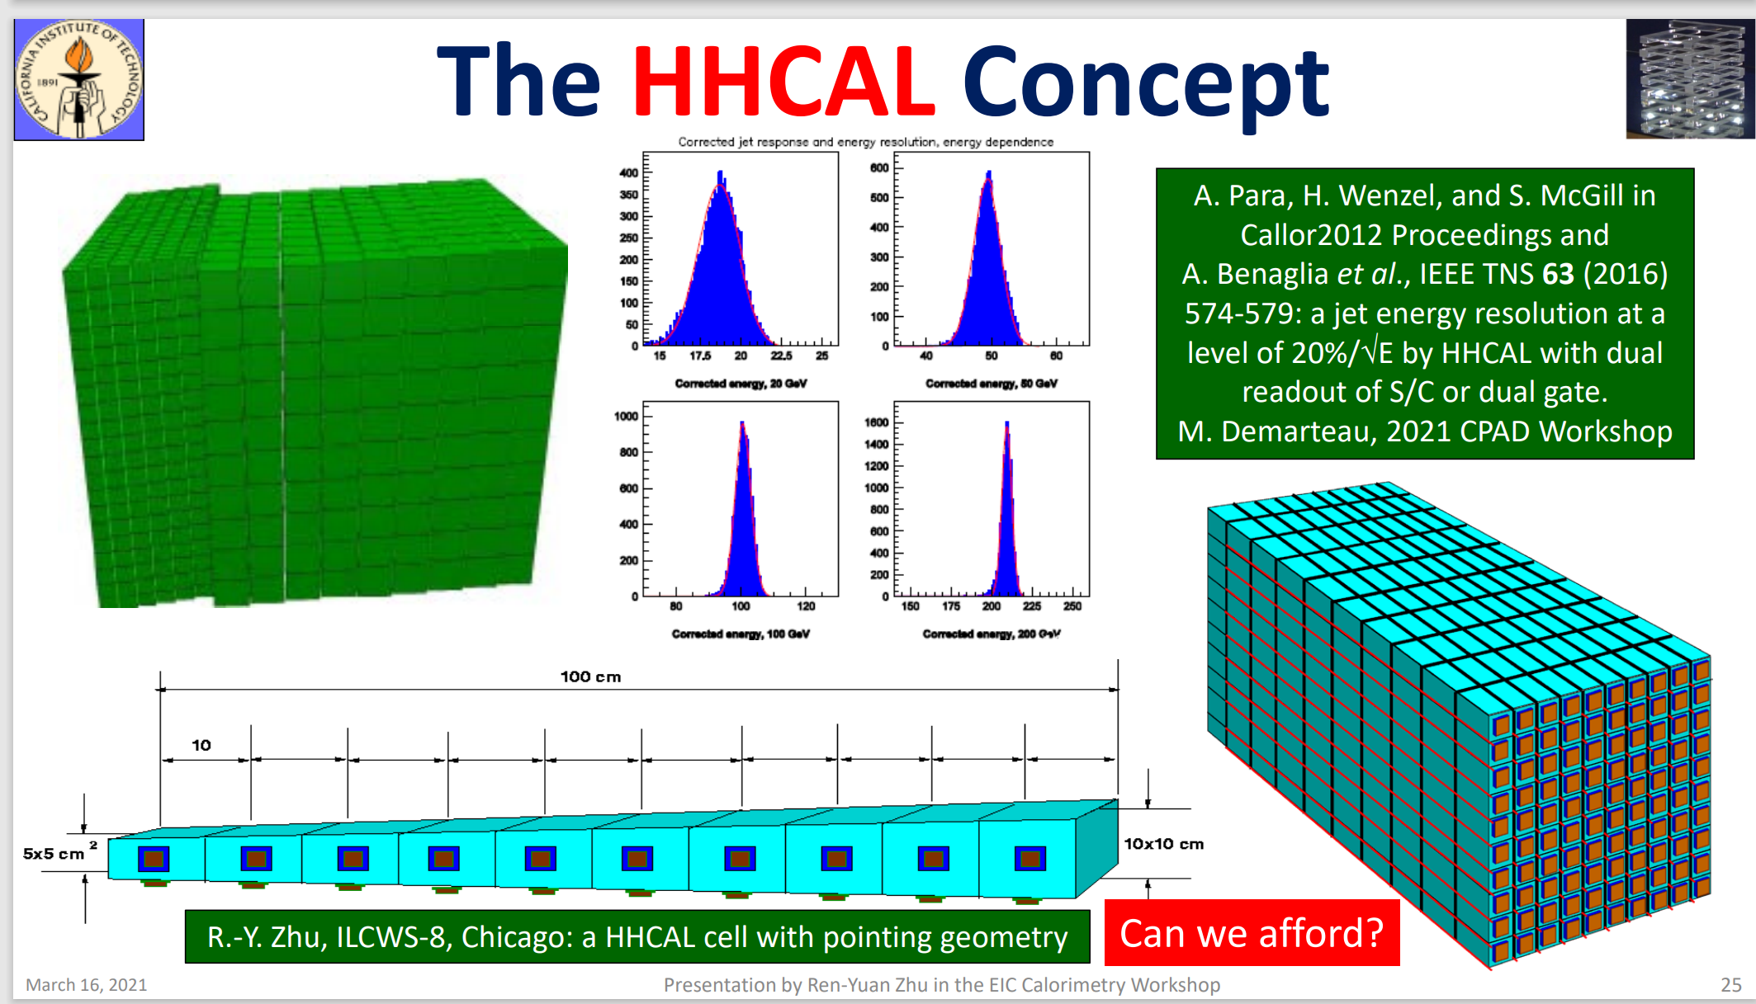
Ren-Yuan Zhu at the EIC Calorimetry Workshop
Need to set some reference parameters: detector layout, glass choice and volume,
number of elements and photodevices, optical readout scheme, etc.

Slide 16
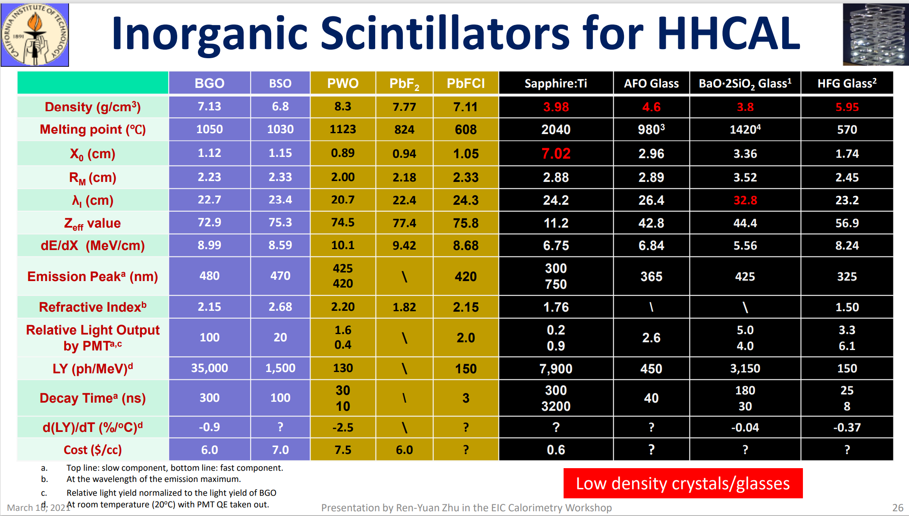
Ren-Yuan Zhu at the EIC Calorimetry Workshop

Slide 17
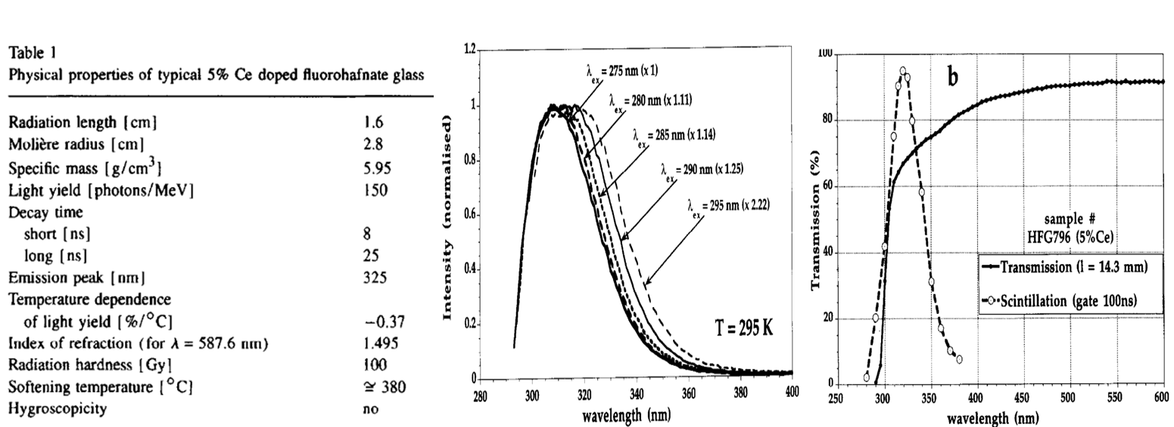
Calvision: HfF4 Glass Candidate Example (I)
Hafnium Fluoride glass:
Was considered as a possible alternative to CeF3 or PBWO4 crystals for CMS in the 1990s: https://www.dropbox.com/s/rz8v26s02kbk5rc/HafniumFluorideGlasses_Auffrayetal_NIMA19961-s2.0-0168900296007176-main-1.pdf?dl=0
May be a good cheap [*] glass candidate: Ce3+ glasses are very fast; sufficient light output. Melting temperature is low. Scintillation light confined to 300 to 360 nm; ~zero above 400 nm

Slide 18
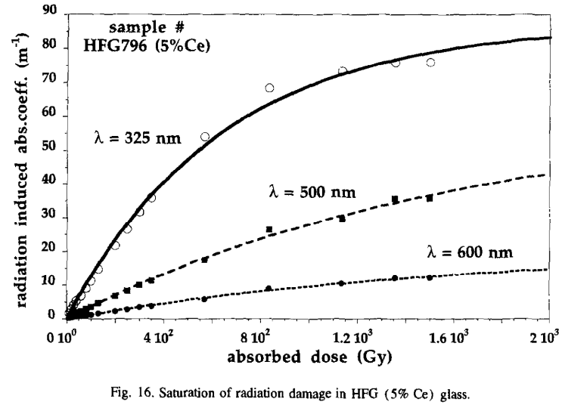
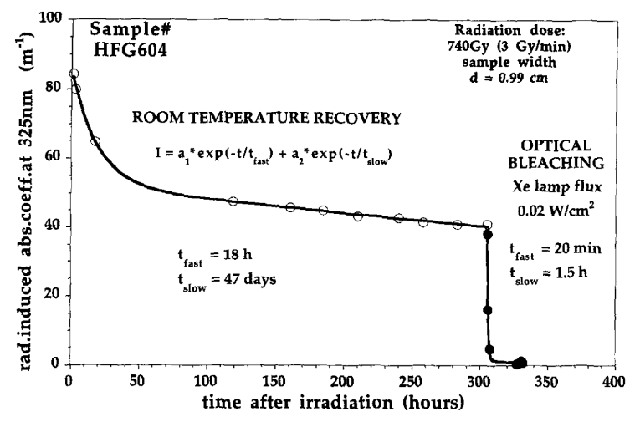
Calvision: HfF4 Glass Candidate Example (II)
But possible issues: Self absorption, radiation damage, recovery, may need optical beaching
Glass quality development and materials characterization would be required
~ 500 Ton Production is an issue: for any new glass candidate.

Slide 19
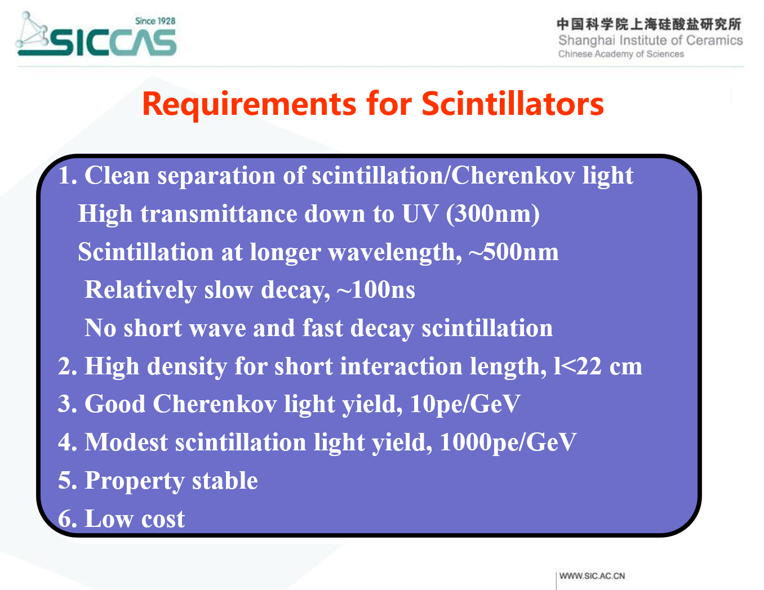
Calvision: Scintillating Glass Characteristics
SIC at HHCal Workshop 2010 (Shanghai)
https://indico.ihep.ac.cn/event/1470/timetable/#20100509.detailed

Slide 20
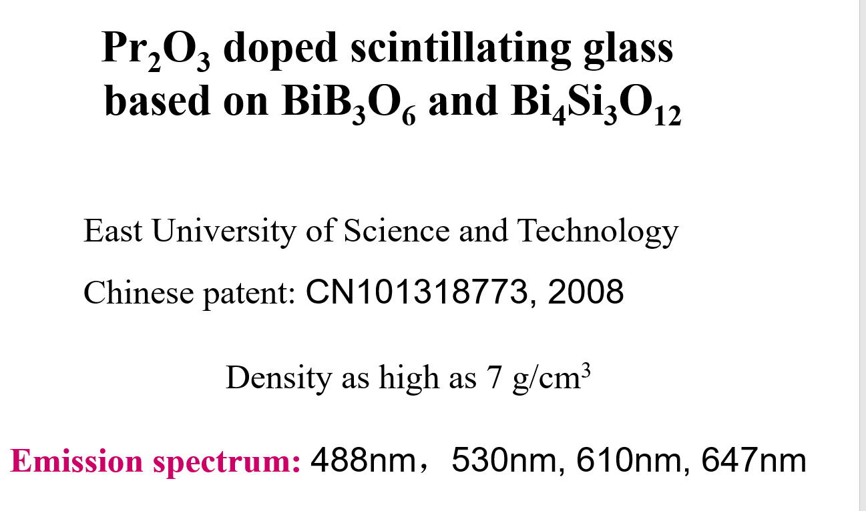
Zhang Yuepin at CALOR 2010

Slide 21
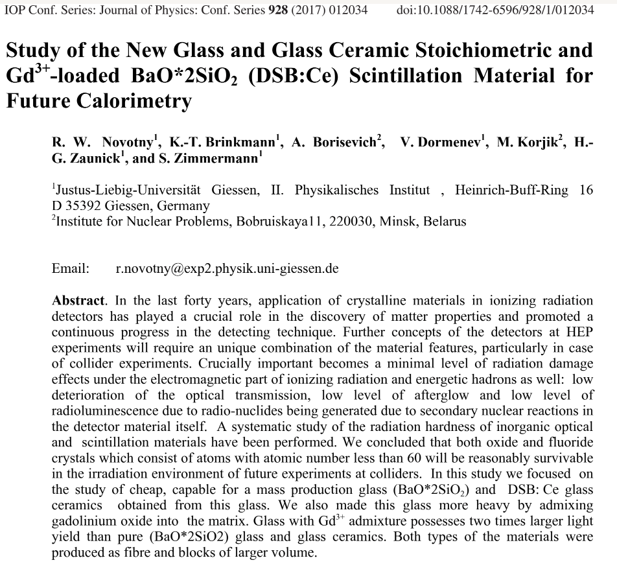
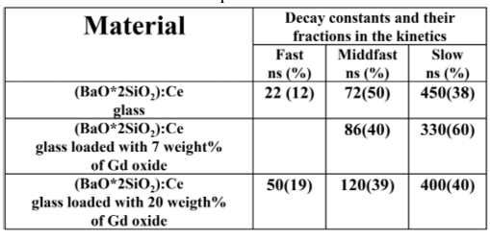
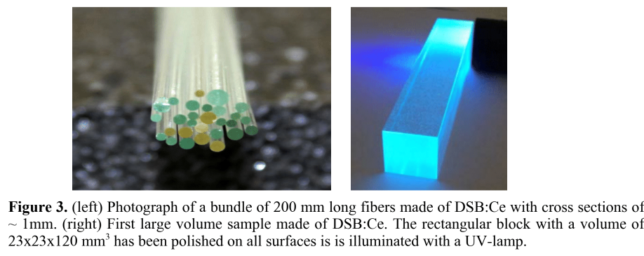
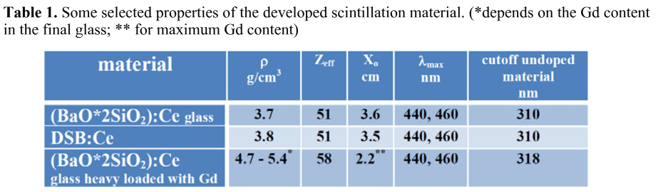
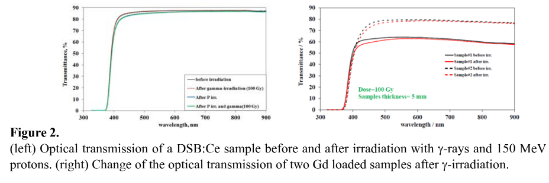
Calvision: Gd³⁺ Loaded BaO*SiO2 and DSB (Ce)
Glass Candidate Example: Novotny et al.
Heavily Gd-loaded glass may be dense enough; +higher light yield

Slide 22
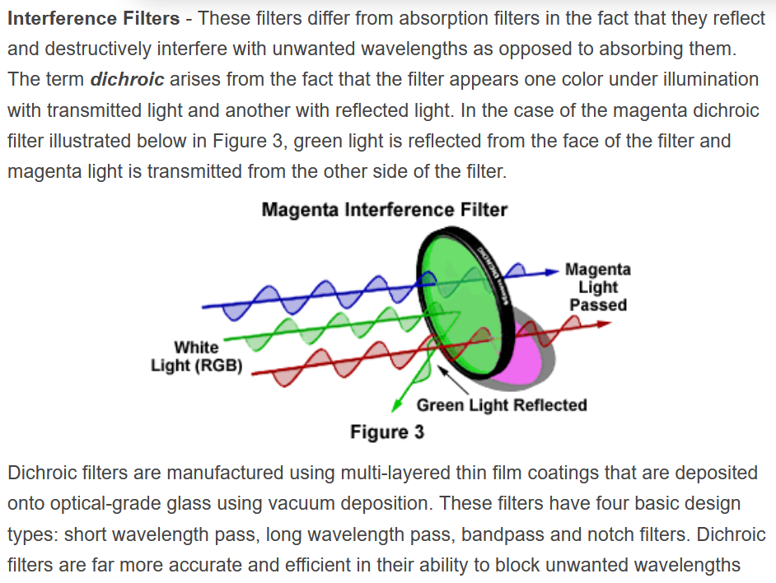
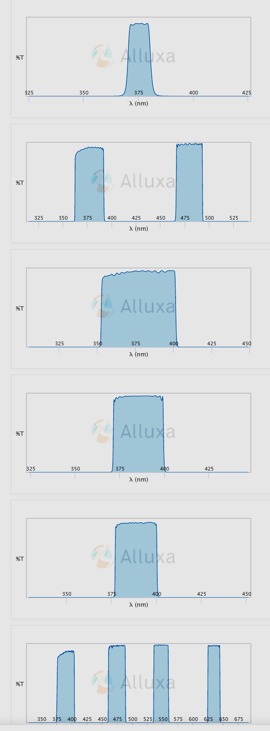
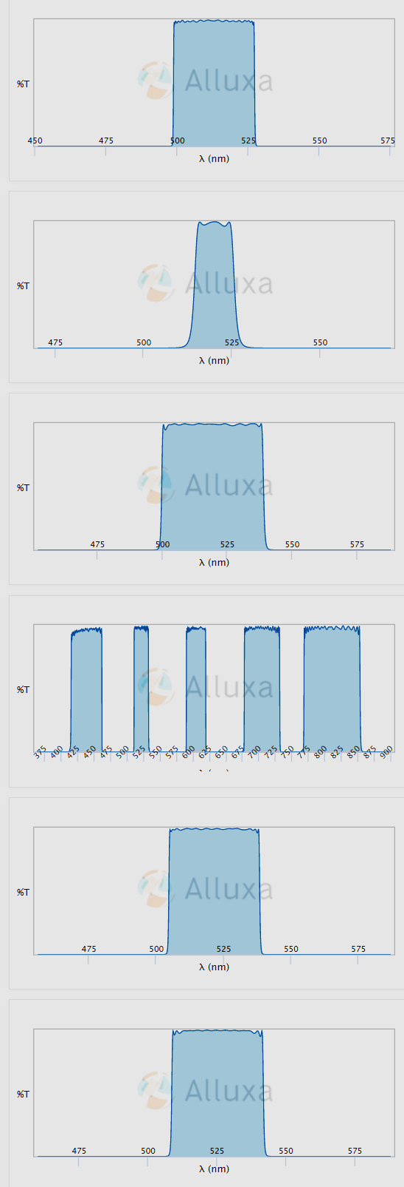
C/S separation scenarios:
Narrow Bandpass or Multipass Filters
Dichroic bandpass filters
(fused silica substrate)
e.g. Alluxa.com
Several hundred $ each: Can we manufacture our own ?
See https://www.olympus-lifescience.com/en/microscope-resource/primer/lightandcolor/filter/

Slide 23
Calvision: HHCal Discussion Points
We need to consider the coil placement wrt to an HHCAL
i.e. IMO: ~1% resolution for electrons can only be maintained in practice
if there is a separate EM section inside the coil
Cost: Referring to the dimensions in Figure 13 in [3] (the Eno and Tully paper) the HHCAL volume would be roughly 200 cubic meters for a tower depth of 1 meter (only about 4 absorption lengths)
At $ 1 per cc (an ambitious goal), that would be $ 200M for the glass alone;
or $ 400M at $ 2 per cc.
So the detector would likely need to be different, with a smaller tracker
(e.g. like CMS or a variant of SiD) with a higher magnetic field
Example scenario: a tracker radius and cavity length each 25% smaller:
Tracker 1.4m radius, ± 1.8m along the beam
[Looking at SiD, CEPC designs, the glass volume remains at roughly 100 m³ ]
Then the HHCAL volume would be around 95 m³
or $ 95M at $ 1 per cc for the glass
We also need to consider mass production, assembly and integration concepts, and QA/QC at the ~500 ton scale, for any new glass
Other technologies: photodetectors, light collection, filters, readout…

Slide 24

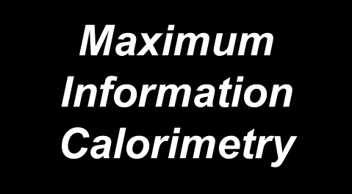
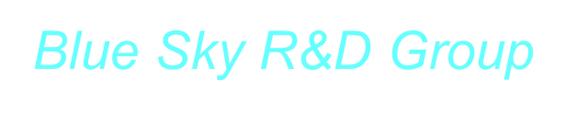
Backup Slides Follow

Slide 25
Other References of Interest
A. Benaglia, A, Para et al., H. Wenzel, et al., Space-Time Development of Electromagnetic and Hadronic Showers and Perspectives for Novel Calorimetric Techniques, IEEE-NS 63 April 2016. doi 10.1109/TNS.2016.2527758 https://www.dropbox.com/s/cld2bk3glmulc1z/Calvision_proposal_2021%20%2815%29-1.pdf?dl=0
H. Wenzel, Simulation Studies of a Total Absorption Dual Readout Calorimeter, 2012 J. Phys.: Conf. Ser. 404 012049
S. Magill, Use of Particle Flow Algorithms in a Dual Readout Crystal Calorimeter, 2012 J. Phys.: Conf. Ser. 404 012048
A. Para, H. Wenzel et al., Towards jet reconstruction in a realistic dual readout total absorption calorimeter, J. Phys. Conf. Ser. 293 012034

Slide 26
ANL Work and Resources:
Wavelength-shifting nanoparticles for detection of Cerenkov light
Focus on development of photodetectors using the wavelength-shifting properties of certain nanoparticle quantum dots. Potential for high photon efficiency, tunability of emitted light, thin profile and use of existing photosensors. Many applications using optical properties of nanoparticles from HEP to enhanced plant growth to illuminated skylights.
Planned accomplishments by year :
  1st year - obtain samples, prepare targets and perform first tests of absorption and emission; characterization of target properties - transparency, nanoparticle concentration, thickness, etc.
  2nd year - select optimized samples for >200 nm emission; characterize Stokes shift, time of emission, etc.; continue to test new/improved samples.
  3rd year - combine crystal, nanoparticle absorber and photosensor to test signals from particles in cosmic ray test stand and test beam; produce first photodetector system for crystal applications.
Contributing personnel :
  Stephen Magill (physicist) at 25% support (+ leverage current 25% ANL detector development support).
  Sergei Chekanov (physicist) at 10% support.
  Postdoc (new hire) at 100% shared with simulation work.
Details of personnel commitments :
  Stephen Magill - half time on nanoparticle detector development for at least the next 2 years. Current status : At least 3 current nanoparticle samples show absorption at wavelengths <300 nm. UV-transparent epoxy binders for nanoparticles are in hand. Capability to determine emission spectra vs absorbed wavelength. Modest M&S additions will add timing capability.
  Sergei Chekanov - help with postdoc supervision and development of simulations for understanding of nanoparticle response.
  Postdoc - share time between nanoparticle testing and dual readout calorimeter simulations (with Sergei).
  Summary : 1 FTE combined between S Magill and postdoc for nanoparticle testing and ~60% FTE for dual readout simulations including some nanoparticle property simulations as well.

Slide 27
Caltech Work and Resources:
Focus of 3 Year Work Program: Characterization of crystals, design and commission of fiber-based light monitoring and calibration system for a longitudinally segmented crystal ECAL matrix. Development of cost-effective inorganic scintillators for the HHCAL detector. Overall system design and integration
Contributing personnel:
Ren-Yuan Zhu (Senior Scientist, Co-PI): 2 months/year; Harvey Newman (Professor, Co-PI):
1 month/year; Liyuan Zhang (Senior optical engineer): 3 months/year; Chen Hu (Junior engineer):
6 months/year; Jason Trevor:(Engineer): 1 month/year.
Summary of Level of Effort: 11 Months/year at different levels.
Detailed List of Contributions, experience:
Ren-Yuan Zhu: Overseeing crystal procurement and characterization, design, construction and commission of light-based monitoring system, and development of cost-effective inorganic scintillators. Experience: L3 BGO, BaBar CsI:Tl, CMS PWO, Mu2e CsI and CMS LYSO:Ce crystals, and L3 BGO calibration and CMS PWO light monitoring.
Liyuan Zhang: Design, construction and commission of a light-based monitoring system for the test beam matrix. Experience: Laser monitoring system for CMS PWO and Shashlik test beam matrix, and Mu2e-II solar blind SiPM.
Chen Hu: Characterization of inorganic scintillators. Experience: Mu2e CsI, CMS LYSO:Ce, Mu2e-II BaF₂:Y and novel ultrafast and ultra-radiation hard inorganic scintillators, such as LuAG:Ce ceramics.
Jason Trevor: Design and construction of mechanical structure of the monitoring system.
Harvey Newman: ECAL and HCAL systems development, design, integration, technologies development as needed

Slide 28
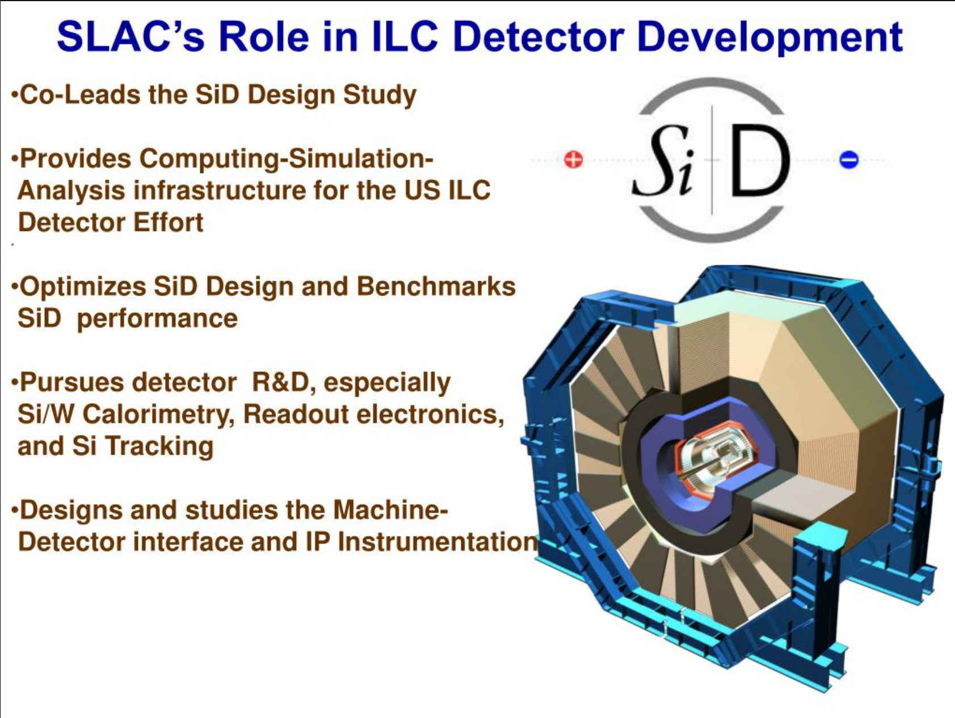
https://pages.uoregon.edu/silicondetector/sid-dimensions.html

Slide 29
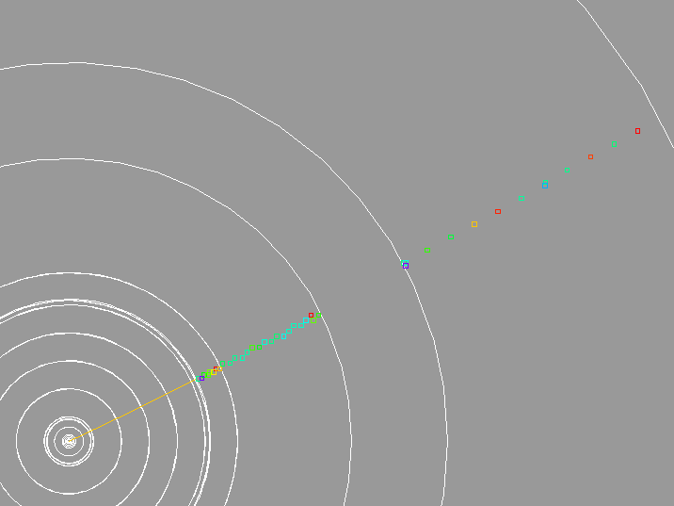
SiD: Dual Readout Calorimeter Detector Parameters
Dual Readout Calorimeter in SiD02 Shell (Barrel and EC)
DR ECAL DR HCAL
3 cm x 3 cm x 3 cm BGO 5 cm x 5 cm x 6 cm BGO
8 layers – 21.4 X₀ (1.1 λ_{I}) 17 layers – 4.6 λ_{I}
127 cm IR – 151 cm OR 151 cm IR – 253 cm OR
Scin/Ceren analog hits Scin/Ceren analog hits
ECAL – 8 layers
Muon Chambers – 11 layers
255 cm
Coil
127 cm
Total Absorption Crystal Calorimeter
25 total layers of BGO
5.6 λ_{I} in barrel – 2.5 m radius
HCAL – 17 layers
151 cm
In the end, the volume of glass looks similar: ~100 m³

Slide 30
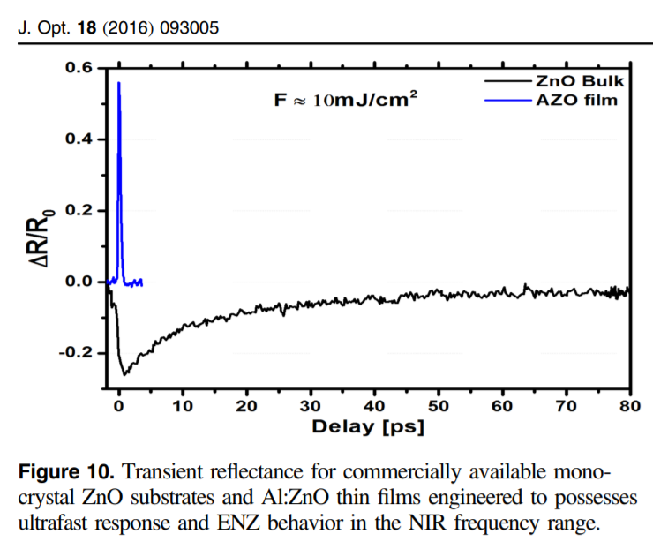
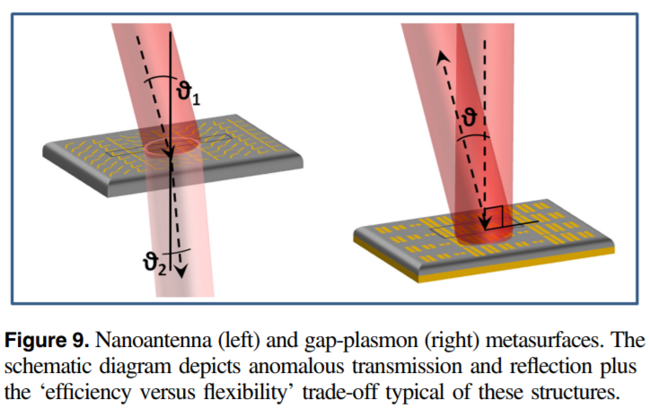
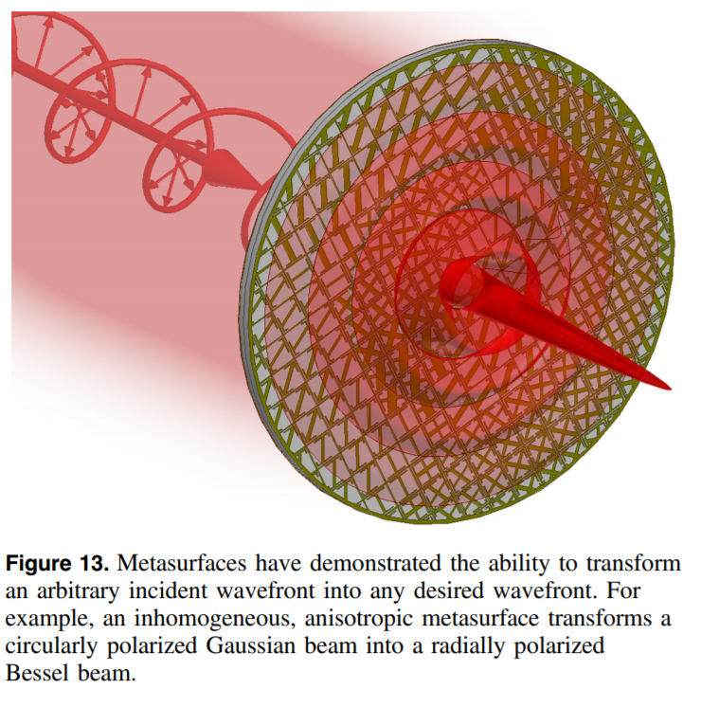
Optical Metamaterial Roadmap: Urbas et al.,
J. Opt. 18 (2016) 0930005 DOI 10.1088/2040-8978/18/9/093005
Metamaterials with nanopatterned surfaces offer the new possibility to design and engineer materials with desired material parameters temporally, spatially, locally and/or globally
This opens the unprecedented ability to tailor, manipulate, redirect and scatter waves, and
form beams and wavefronts as desired with an anisotropic, inhomogeneous metasurface
Introducing metal constituents (exhibiting electric resonances) into the world of photonics allows for extraordinary engineered composite materials with effective optical properties distributed over a more extensive region of the electromagnetic parameter space (ε–μ space)
New materials: transition metal nitrides (TMN) and transparent conductive oxides (TCO) provide lower losses and much improved tunability compared to silver and gold.
This makes them promising for next generation metamaterials and plasmonic devices.
(sub-)Picosecond Near-IR reflectance from AlZnO thin film
Anomalous Transmission and Reflection from Metasurfaces
Transforming a circularly polarized Gaussian bean to a radially polarized Bessel beam

