Slide 1
Intro to `Box 3’
Full-Detector Studies w/ PFA
Phil Harris (MIT), Chris Tully (Princeton)
CalVision Workshop, 29-30 July 2021

Slide 2
General Remarks
Performance in the Particle-Flow Realm is of major importance to collider collaborations
As is the information content of the PF objects
Hybrid segmented crystals and fiber dual-readout (DR) calorimeter already matches best PFA performance (in simulation) for 10-120 GeV jets, see EPS talk on Friday (https://indico.desy.de/event/28202/contributions/105676/)
We have just begun!
Many important full-detector topics to cover

Slide 3
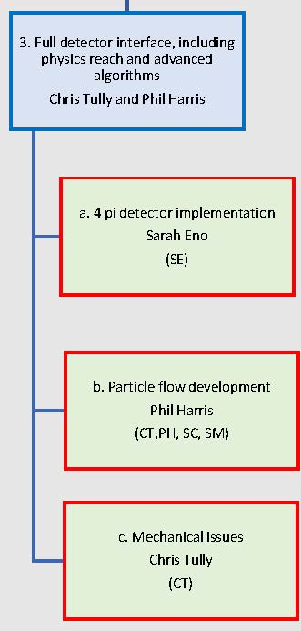
Initial List of Box 3 Topics
3.1.1 | Full detector performance evaluation
3.1.2 | Comparison of PF approaches
3.1.3 | Roles for ML in readout
3.1.4 | Impact of Deep Learning on clustering
3.1.5 | Full detector dd4hep design tools
3.1.6 | Mechanical support structures for full detector designs
3.2.1 | Maximal information strategies for particle identification
3.2.2 | Separation of beam-induced backgrounds
3.2.3 | Interface between dd4hep and PFA tools
3.2.4 | Services for full detector implementation
3.3.1 | Full detector assembly and regional center pre-assembly
3.3.2 | Computational infrastructure
3.3.3 | Realistic material descriptions

Slide 4
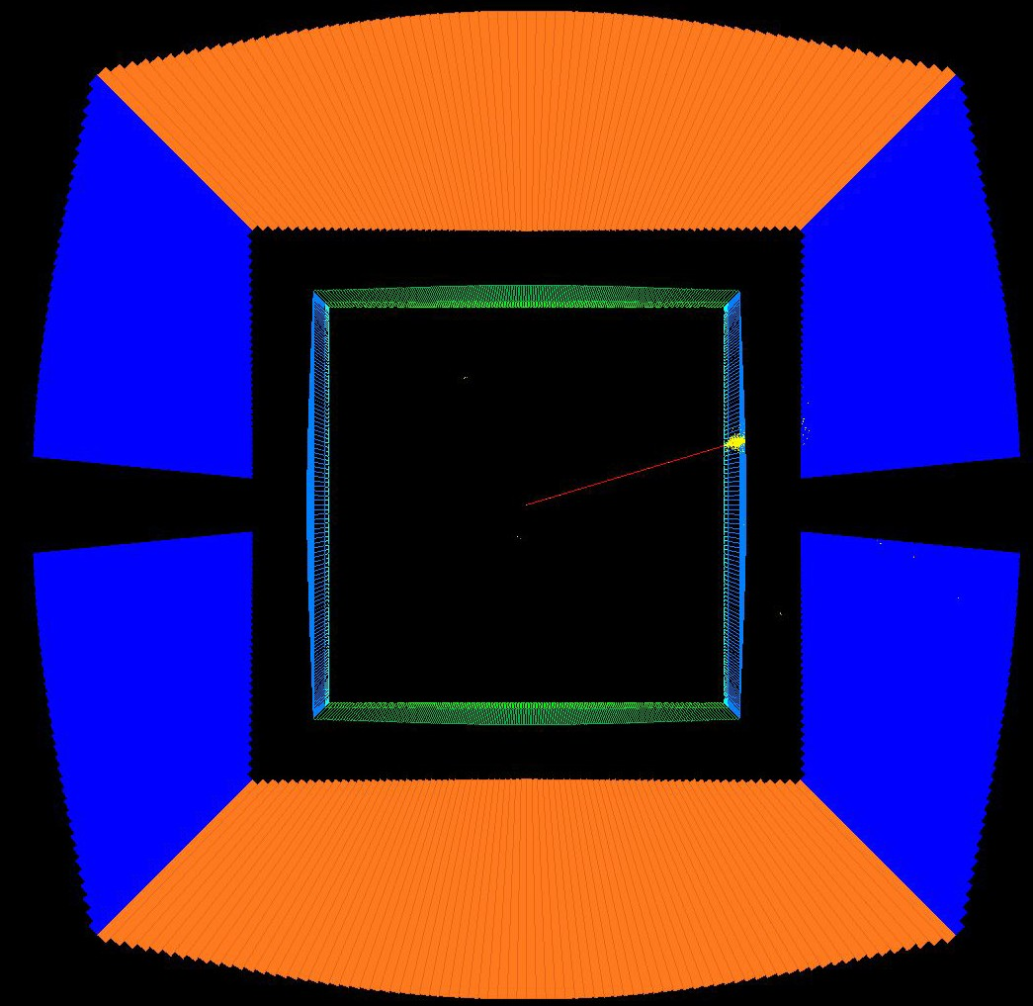
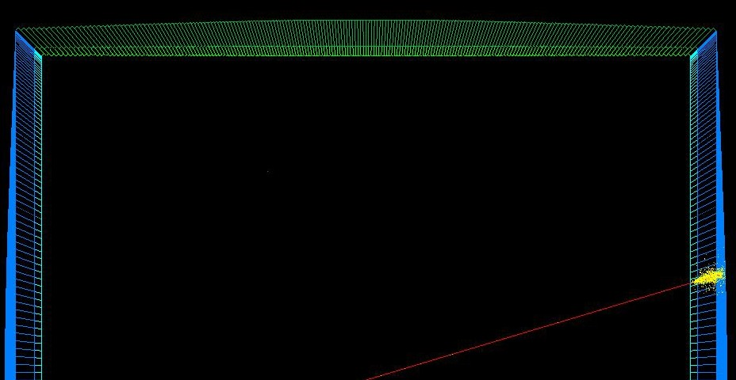
Integration of crystal calo option in 4π Geant4 IDEA simulation
Barrel crystal section inside solenoid volume
Granularity: 1x1 cm² PWO segmented crystals
Radial envelope: ~ 1.8-2.0 m
ECAL readout channels: ~1.8M (including DR)
 | solenoid
timing layers (<1X₀)
front barrel crystal segment (6 X₀)
rear barrel crystal segment (16 X₀)
front endcap crystal segment
rear endcap crystal segment
10 GeV electron shower
5

Slide 5
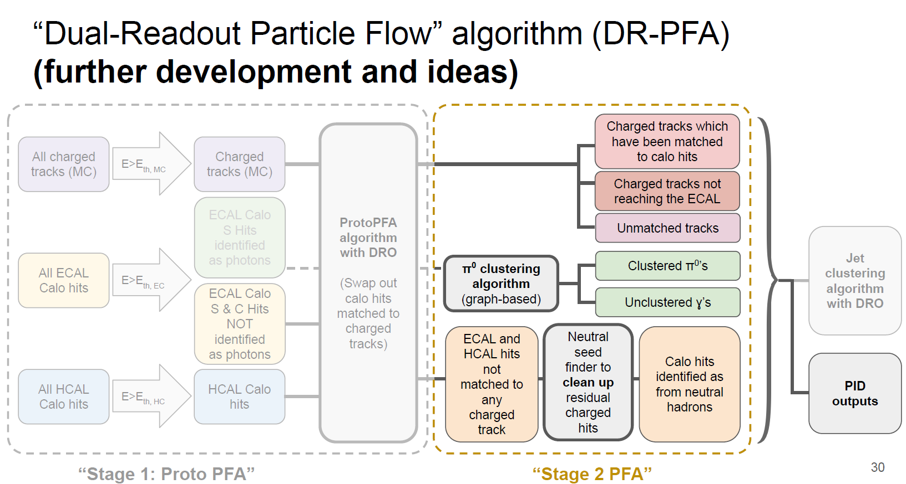
M. Lucchini

