Slide 1
Compilation of Costing Information
Slides taken from previous talks by:
1) Marco Lucchini (3/19)
- Segmented crystals (front/rear)
- Timing Layers
- Dual-Readout on rear
- Performance of Seg. Crystals + Fibers with thicker capillaries (as suggested by F. Bedeschi)
2) Franco Bedeschi (11/19)
- IDEA w/ Brass and Iron tubes
- With thicker Brass capillaries

Slide 2


Cost, channel count and power budget estimates for S-CEPCal
13/03/19
Sarah Eno², Marco Lucchini¹ , Chris Tully¹
¹ Princeton University
² University of Maryland, College Park

Slide 3
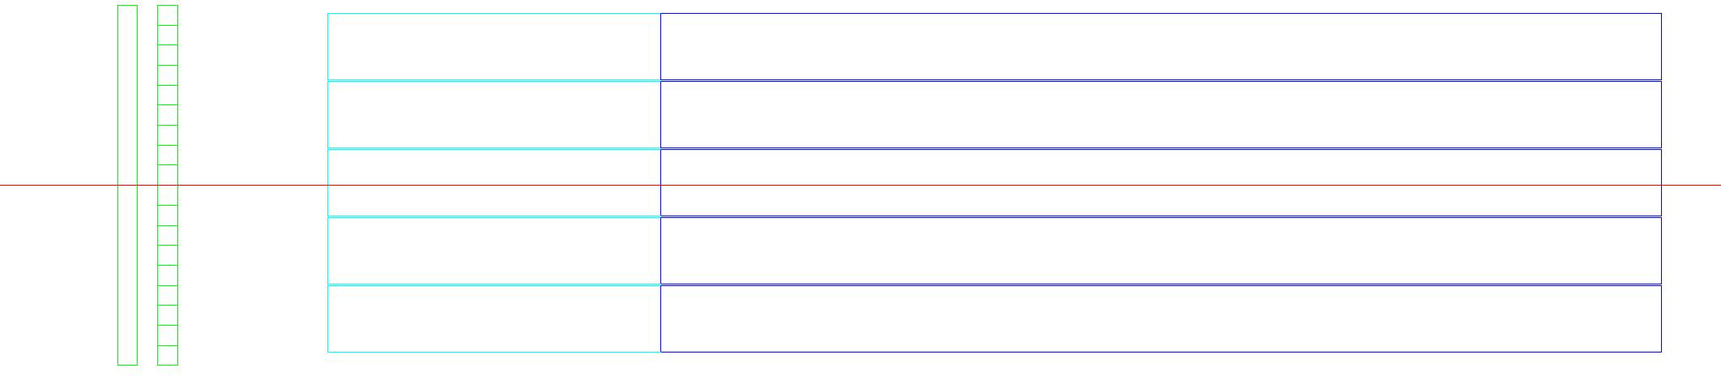

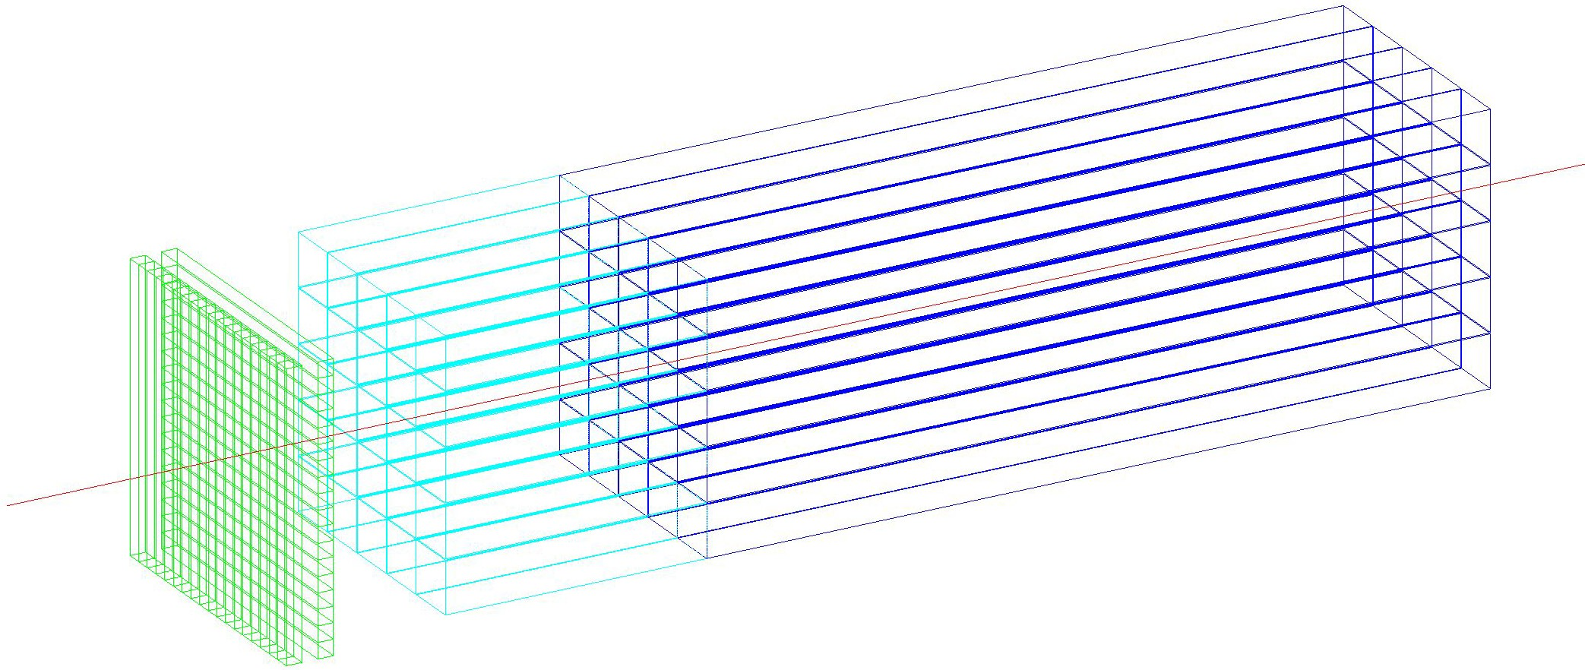
S-CEPCal layout overview
Segmented crystal electromagnetic precision calorimeter concept
Combine high sampling fraction with segmentation and timing
Very flexible design with both PFA and dual read-out potential
Room for optimization of performance / cost
<5%/sqrt(E) + 1%
~30 ps timing achieved for p_{T}>40GeV
T1+T2 0.8X₀
E1 5X₀
E2 15X₀
layer: 30 ps
layers: 20 ps + tracking
4 crystal layers

Slide 4
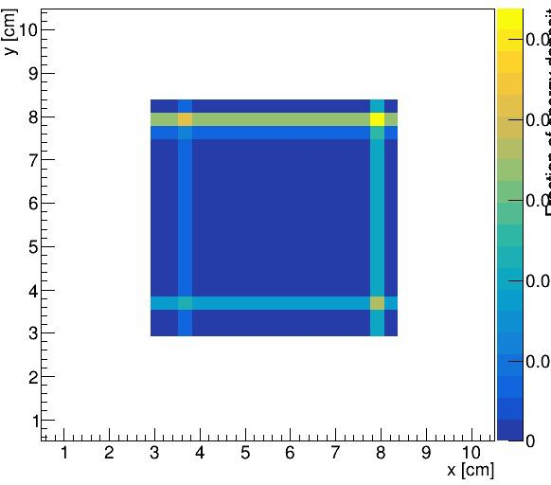
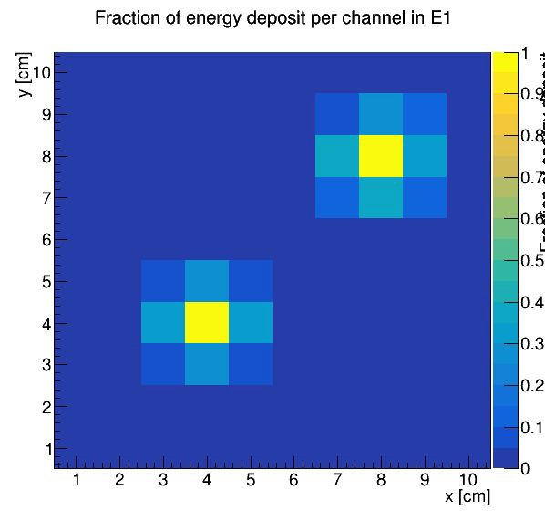
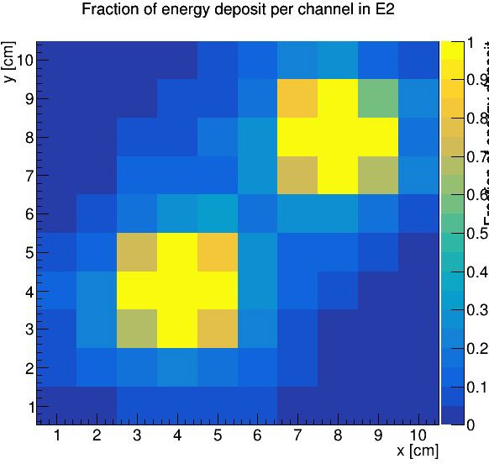
S-CEPCal granularity
T1+T2
2 TIMING layers (T1 and T2) with crystal bars XY oriented - 0.8 X₀
  High granularity, tracking capability and precision timing
Enabled by fast and bright crystals and double ended SiPM readout
Crystal bar length: 3x3x56 mm³
E1
length to fit an ECAL “module” of 5x5 1 cm³ crystals
bars could be made longer to decrease channel count
2 ECAL layers (E1 and E2) - 20 X₀
  Shower Moliere radius is smaller in the front segment
good for shower imaging and PFA
Avoids any dead space at shower maximum → optimal resolution
Transverse granularity of E1 and E2 could be optimized
  no big impact on cost since the crystal volume would be unchanged
E2

Slide 5
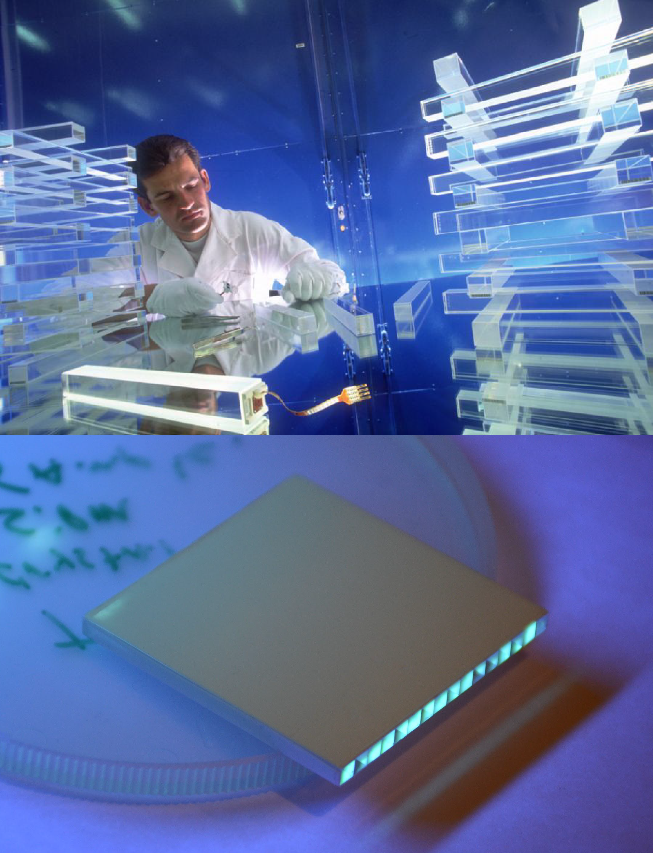
Detector cost drivers
Crystal options
CMS ECAL PWO crystals
LYSO:Ce for timing layer (optimal choice for the CMS MTD)
PWO (very compact - CMS and PANDA ECALs preferred choice)
Many other crystals on the market may allow further optimization
Crystal costs used as reference
  Recent quotes from SIC presented by R. Zhu
PWO: ~7€ /cc (for 10 m³, cut and polished)
LYSO: ~30€ /cc (for cut, polished and wrapped elements)
Array of LYSO crystal bars
SiPMs
  Recent estimates from CMS Upgrade experience:
    ~6€/SiPM (9x9 mm² active area)
    can embed a LED for monitoring: additional ~1€/channel
  Cost constantly dropping and technology improving in the last decade
    can aim at a factor ~2-4 reduction in the next decade

Slide 6

Channel count and cost estimate
 | T1+T2 (TIMING) | E1+E2 (ECAL)
Area barrel | 53 | 53
Area endcap | 19 | 19
Total area (barrel+endcaps) | 72 m² | 72 m²
# Channels barrel | 977k | 859k
# Channels endcaps | 344k | 374k
Total # of channels (barrel + endcaps) | 1.3 M | 1.2 M
Crystal cost | 10 M€ | 78 M€
SiPM cost (+monitoring for ECAL only) | 8 M€ | 8.5 M€
Electronics cost | 5 M€ | 4.5 M€
Cooling+power+mechanics cost | 5 M€ | 5 M€
Sub-total cost (barrel+endcaps) | 28 M€ | 96 M€
Total cost (barrel+endcaps) | ~124 M€
Geometrical assumptions for cost estimate:
  Barrel
    Radius = 1.8 m
    Length = 4.7 m
    Area ~ 53 m²
    Pointing geometry → saving ~20% channels
Endcaps (x2)
  Inner radius = 0.3 m
  Outer radius = 1.75 m
  Area ~19 m²
Details of the cost estimate here
5

Slide 7
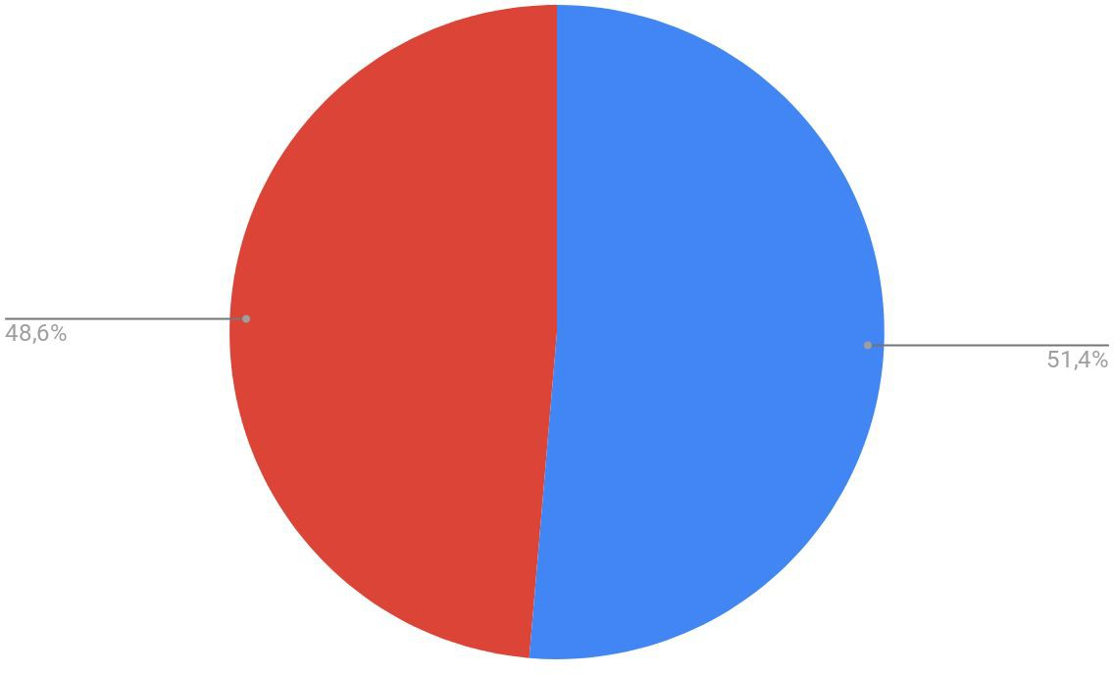
Power budget estimate
Power per SiPM (~10 mm² active area): ~2 mW
  This scales with active area, using cell pitch <15 um would also decrease power budget significantly
Power per electronic channel: ~27 mW
Total power budget ~74 kW (18.5 kW / layer)
  Equally shared between TIMING and ECAL layers
 | T1+T2 (TIMING) | E1+E2 (ECAL)
Total # of readout channels | ~1.3M | ~1.2M
SiPMs (kW) | 2.7 | 2.5
Electronics (kW) | 34.3 | 33.5
Sub-total (kW) | 38 | 36
Total (kW) | ~74 kW
ECAL
TIMING
6

Slide 8
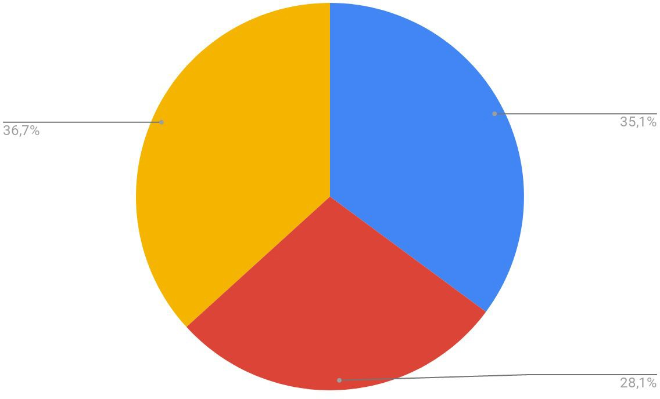
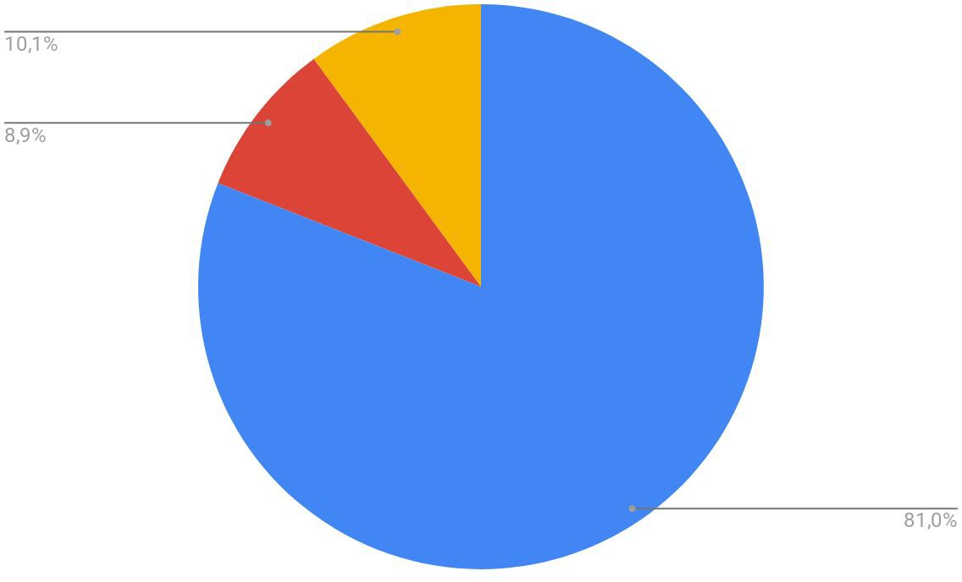
Summary
Channel count in S-CEPCal is limited to ~2.5M
  625k channels/layer
Cost drivers in TIMING layers (tot ~28M€):
  35% crystals, 28% SiPMs, 37% electronics+cooling+mechanics
Cost drivers in ECAL layers (tot ~96M€):
  81% crystals, 9% SiPMs, 10% electronics+cooling+mechanics
Power budget driven by electronics: ~74 kW
  18.5 kW/layer
Room for optimization of the detector performance vs cost
Electronics Cooling Mechanics
Crystals
SiPMs
Electronics, Cooling, Mechanics
SiPMs
Crystals

Slide 9
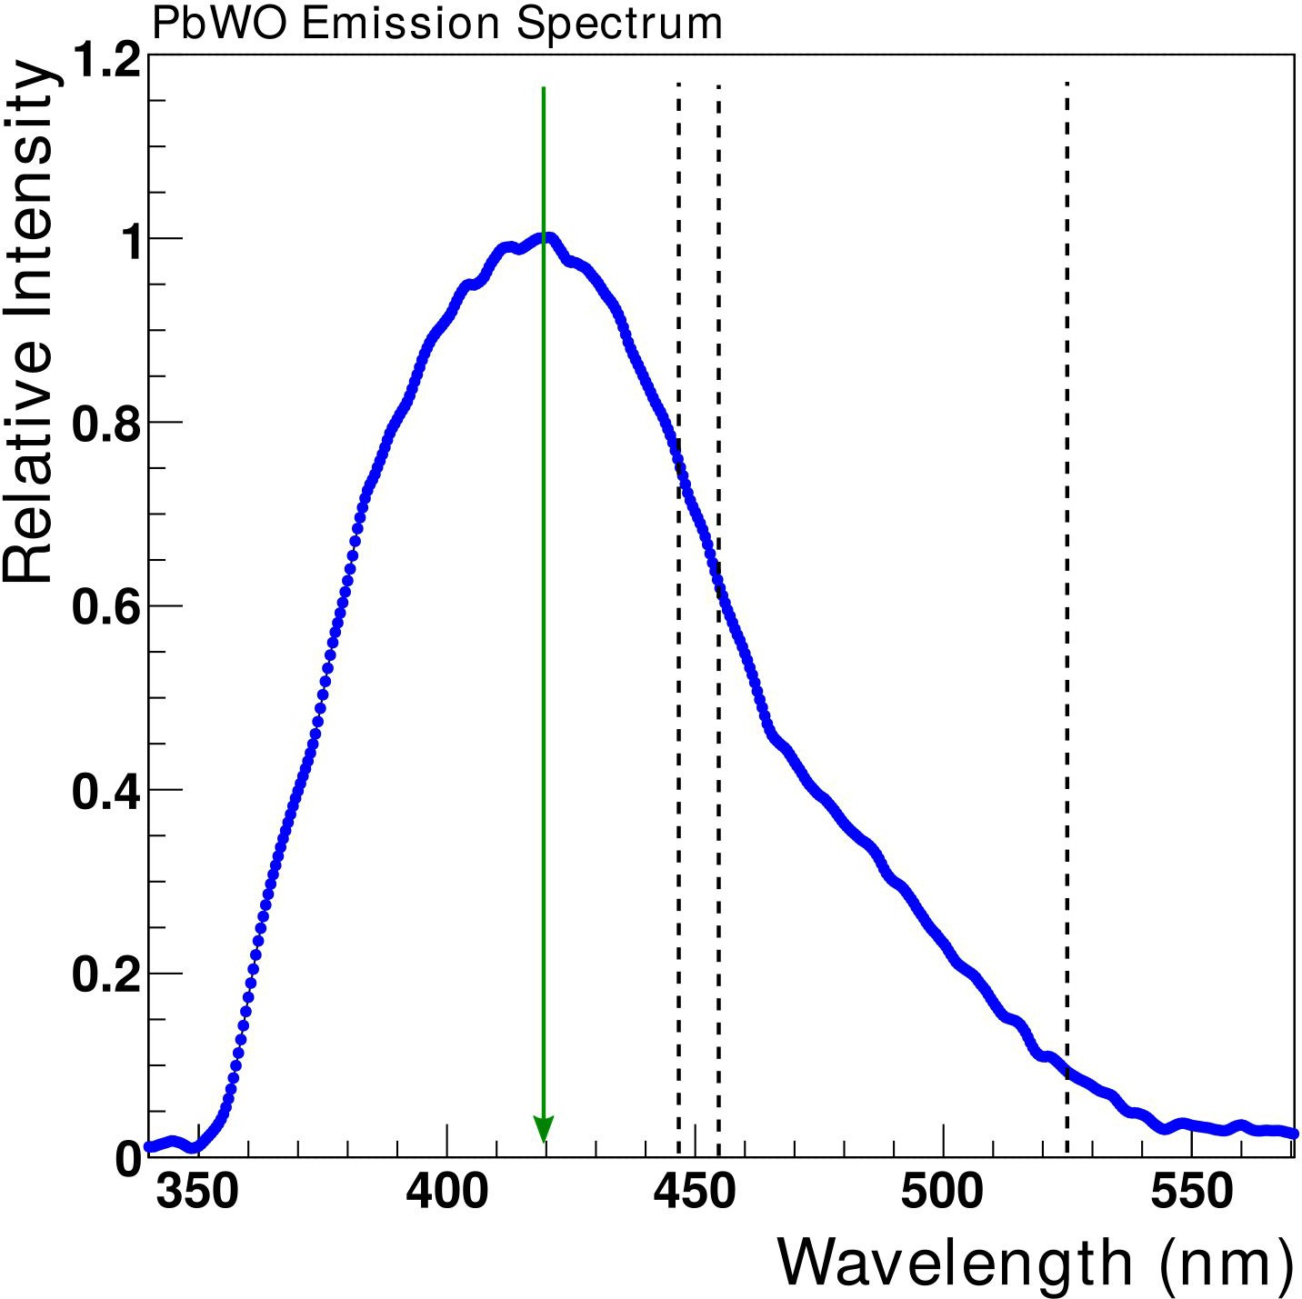
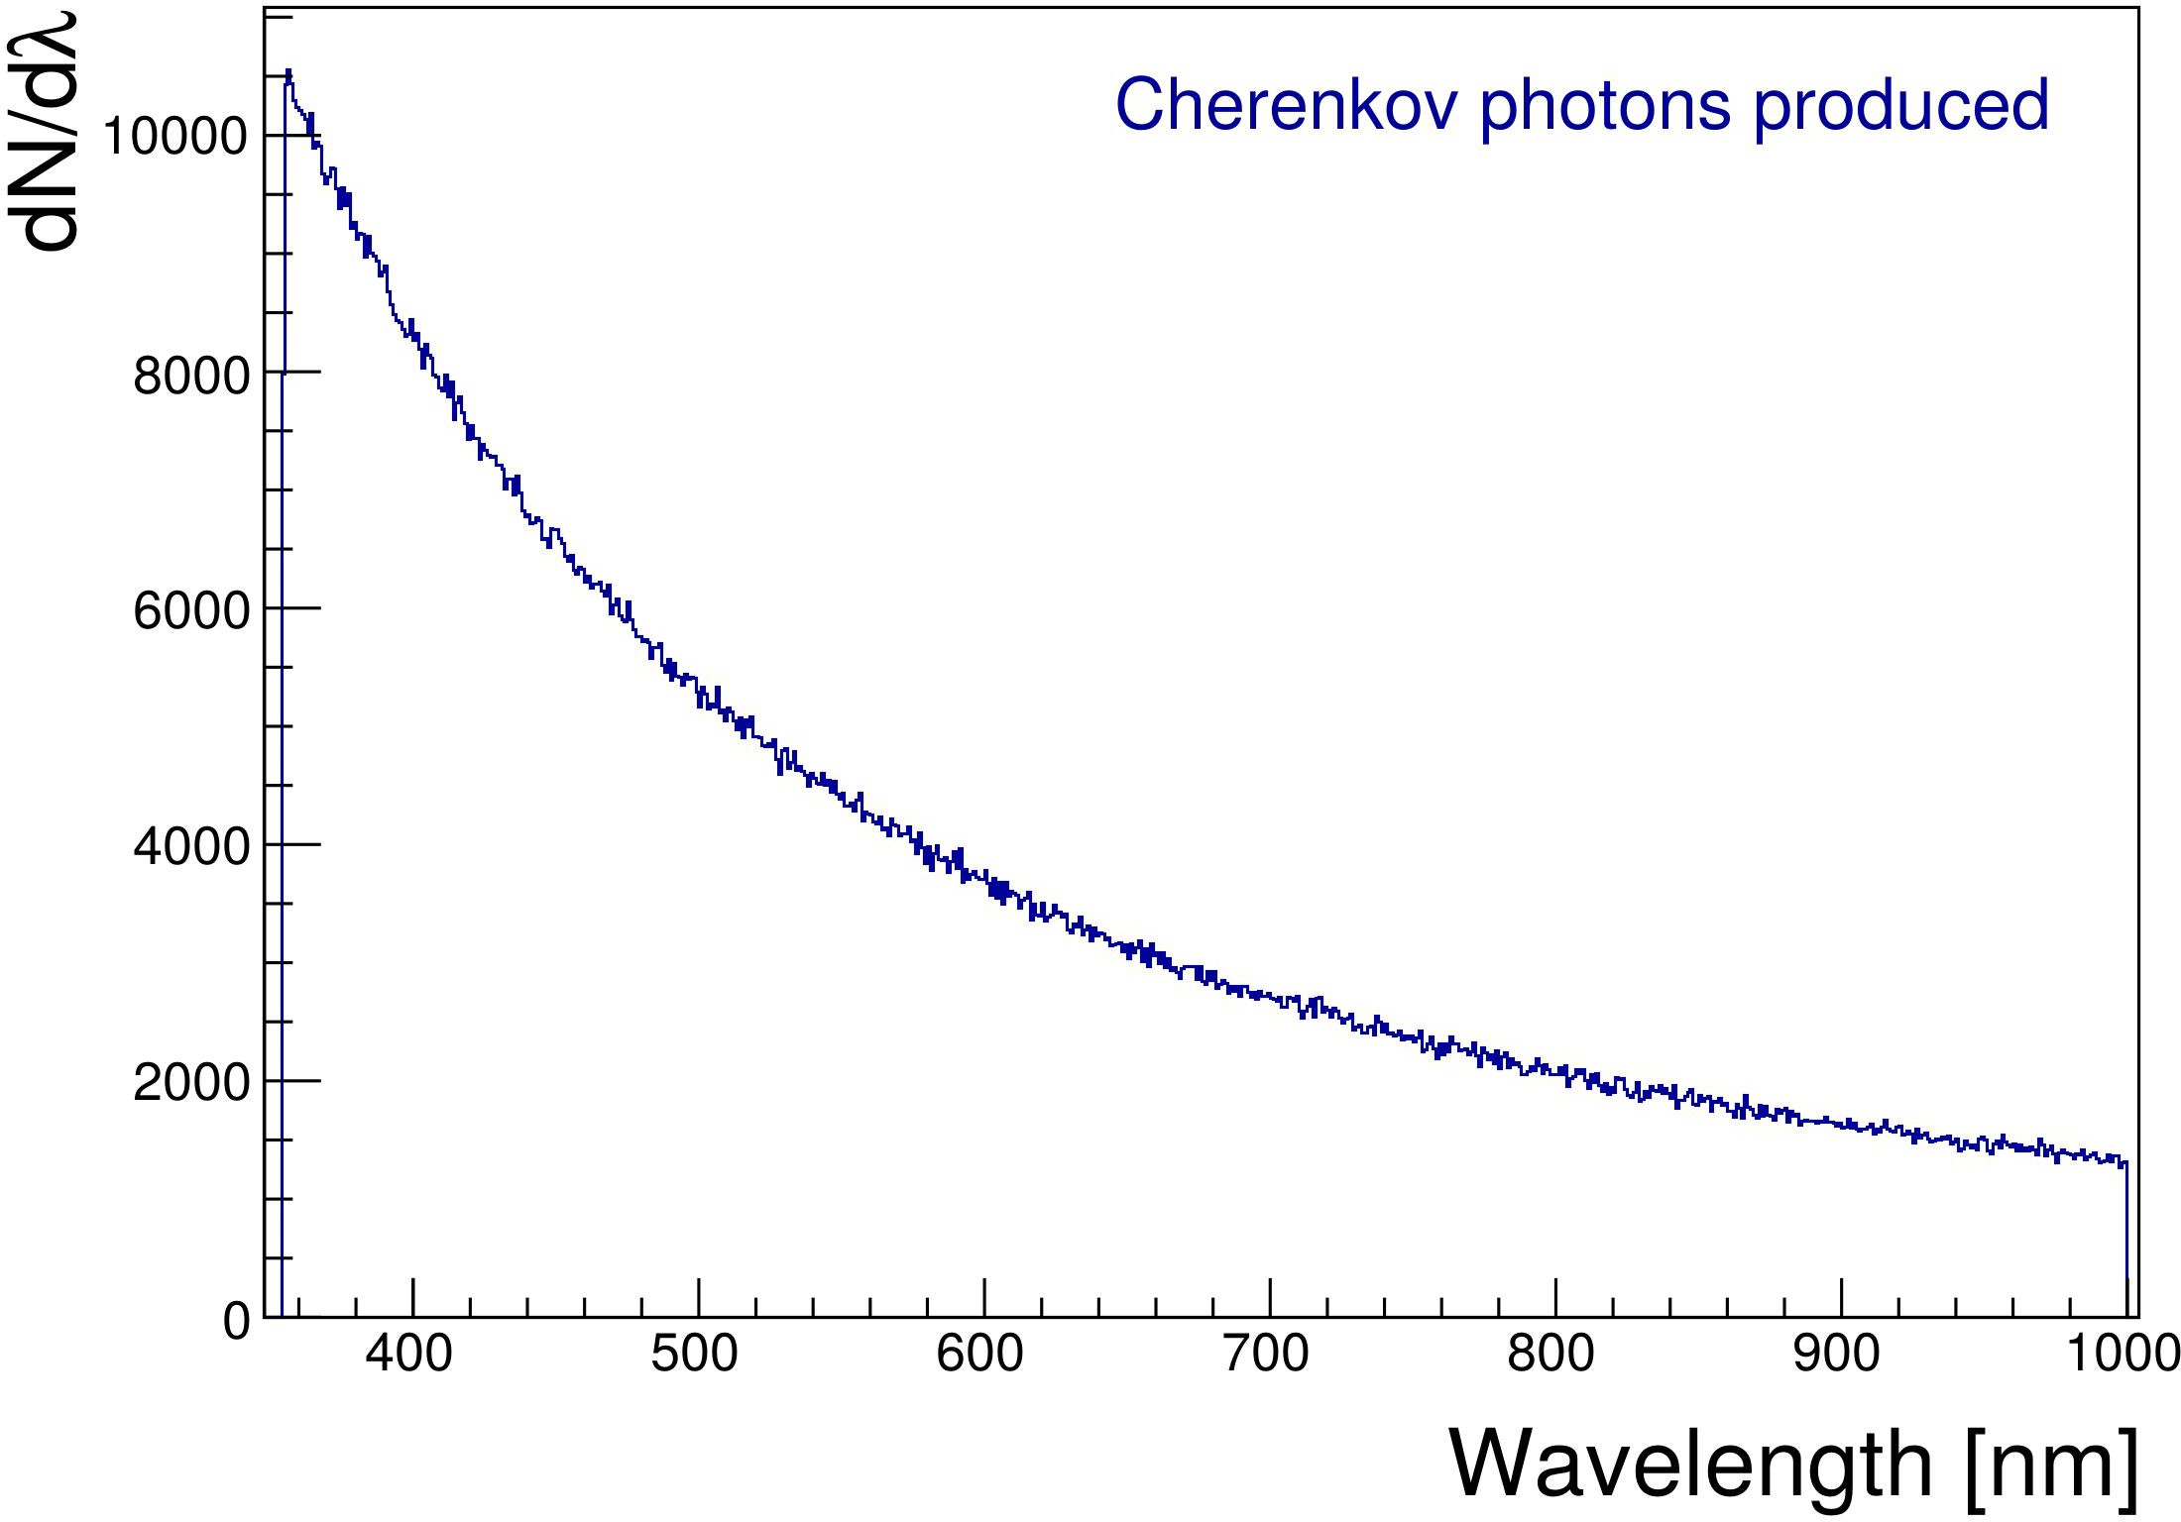
Including dual-readout in the ECAL segments
Possibility of using 2 SiPMs / crystal for the ECAL readout
Scintillation photons (420 nm peak)
Provide sensitivity to scintillation and Cherenkov light separately with optical filter (dual-readout)
Add redundancy to the system
Improve stochastic term of energy resolution
Limited impact on ECAL cost (+14%)
optical filter
 | Single ECAL readout | Dual ECAL readout
Crystal cost | 78 M€ | 78 M€
SiPM cost (+monitoring for ECAL only) | 8.5 M€ | 17 M€
Electronics cost | 4.5 M€ | 9 M€
Cooling+power+mechanics cost | 5 M€ | 6 M€
Total cost (barrel+endcaps) | 96 M€ | 110 M€
C+S
C

Slide 10
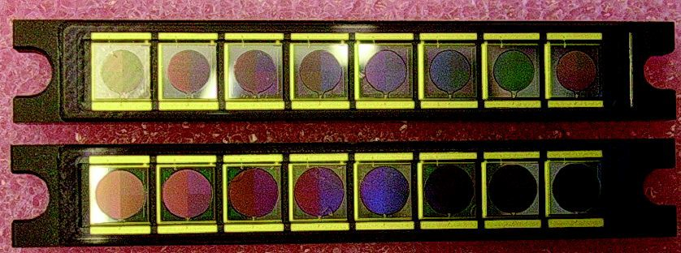
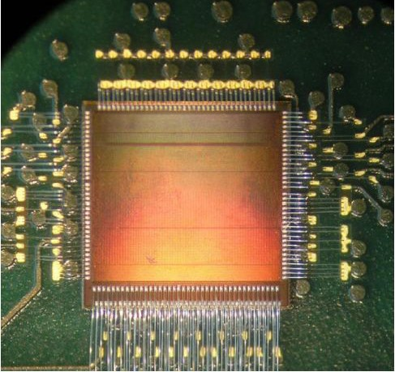
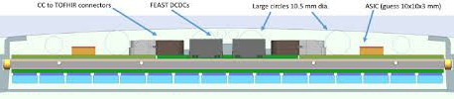
Readout of timing layers
Large experience in SiPM packaging and readout electronics within the:
SiPM
arrays for the CMS HE/HB
upgrade
CMS EB Calorimeter Phase-2 Upgrade [TDR]
CMS MTD (Mip Timing Detector) Phase-2 Upgrade [TP]
CMS MTD capitalizing ASIC developments from PET applications (TOFPET2 chip)
TOFPET2 ASIC chip
Compact, 64 channels, CMOS 110 nm technology
Amplifier, discriminators and a TDC with 20 ps time binning for timing
Amplifier, charge integrator and 10-bit ADC for energy measurement
Compact readout for CMS MTD
  Full detector layer fits within 2.5 cm thickness
~10 mm for electronics
~5 mm for cooling (Al plate + CO2 pipes)
~2.5 cm
crystal layer

Slide 11
Fiber Cost Comments from Franco Bedeschi
If one removes the requirement that the DR calorimeter has to provide a good EM resolution, the sampling fraction can be reduced and correspondingly the costs go down. The degradation of the hadronic resolution should be studied, but I expect it to be much less affected then the EM resolution.
You'll see that I have already made an exercise to understand the impacts of using thicker tubes with the same fiber size inside. The cost for the baseline detector with 1.5 mm outer diameter tubes is 75 +/- 25 M$. This drops to 50 +/- 20 M$ with 2 mm tubes and 35 +/- 15 M$ for 2.5 mm. Correspondingly the EM resolution goes from 8%/sqrt(E) to 12% and 16% (without including photon statistics contributions).

Slide 12
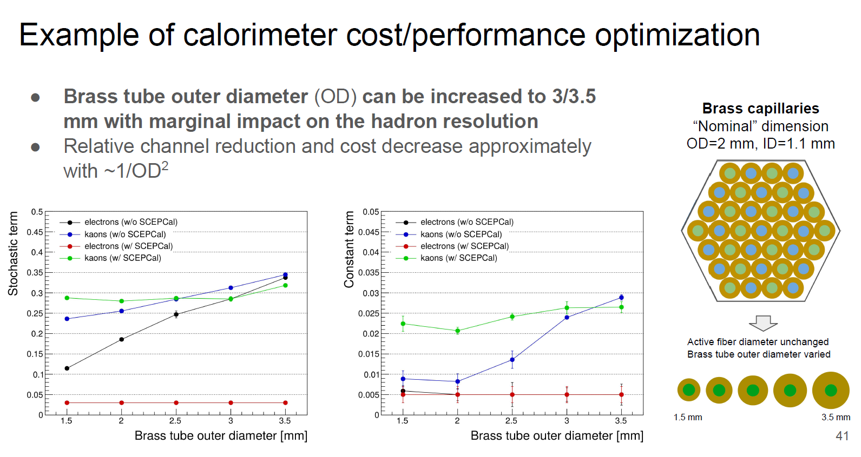
Thickening of Brass capillaries applied to Hybrid Segmented Crystal and Fiber DR Calorimeter

Slide 13
Dual readout calorimeter
Franco Bedeschi.
November 2019
OUTLINE
Basic geometry
  Options
Cost evaluation
  Unit costs
  Global cost
R&D for cost consolidation

Slide 14
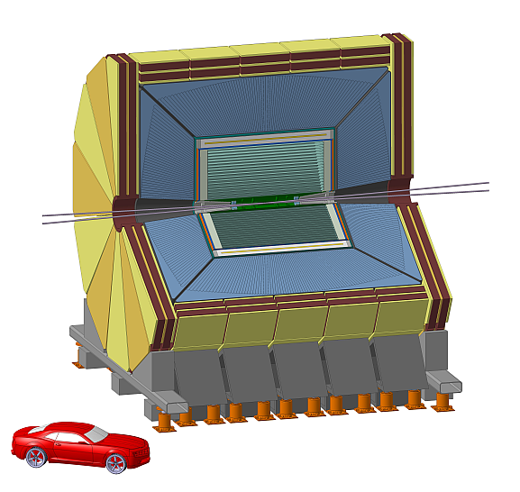
IDEA DR geometry
Fiber size & spacing
  1.0 mm fibers
  0.5 mm absorber
    1.5 mm pitch

Slide 15
IDEA DR geometry
2x75 θ slices
  Each split in 36 φ towers
Δθ = 1.125º
Δφ = 10º
Total number of fibers
130,729,608 ~ 131 M

Slide 16
IDEA DR Geometry
Fibers have different lengths
  ~35% are 2m long
  ~38% are < 1m long
Total length 166,987 km ~167,000 km
Tower 75

Slide 17
IDEA DR fiber grouping
Optimal grouping is 8 + 8 = 16 fibers → 2 readout channels
  Granularity is 6 mm x 6 mm
Total readout channels: 131 M/8 = 16 M

Slide 18
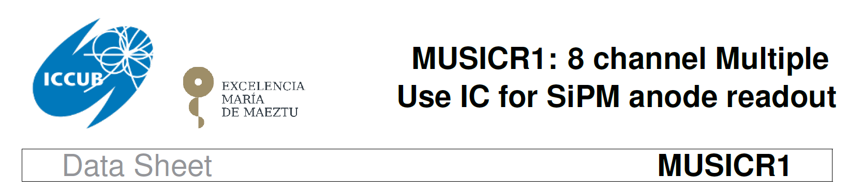
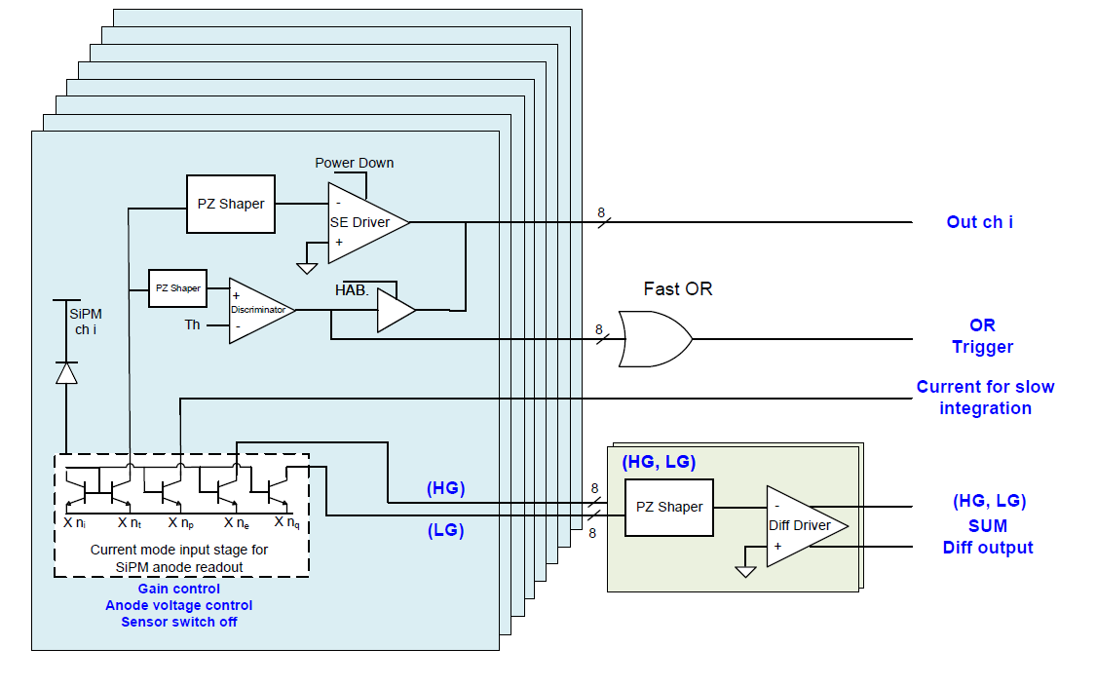
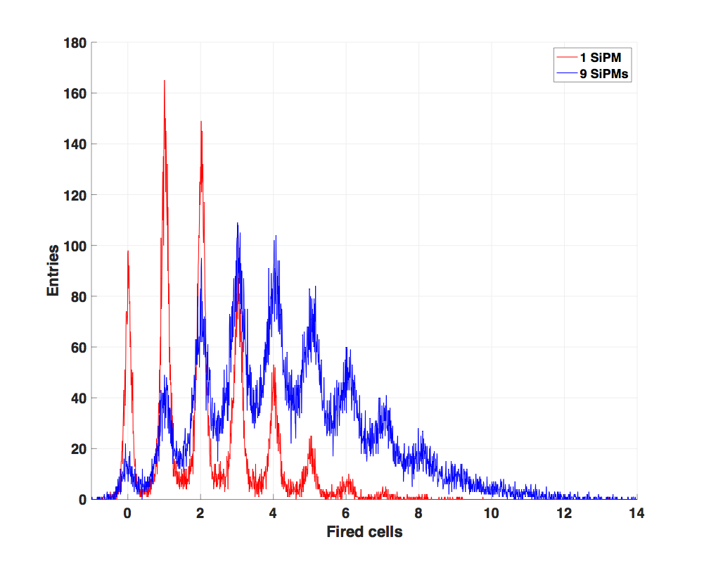
IDEA DR fiber grouping. Opt 1
8 SiPM are summed electronically
  Demonstrated with custom board
  Investigating use of dedicated chip: MUSIC (made for CTA)
Multi-Photon spectrum preserved also with 9
grouped SiPM

Slide 19
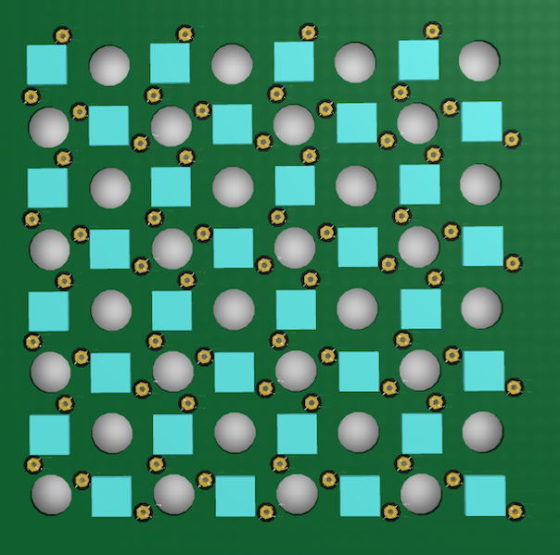
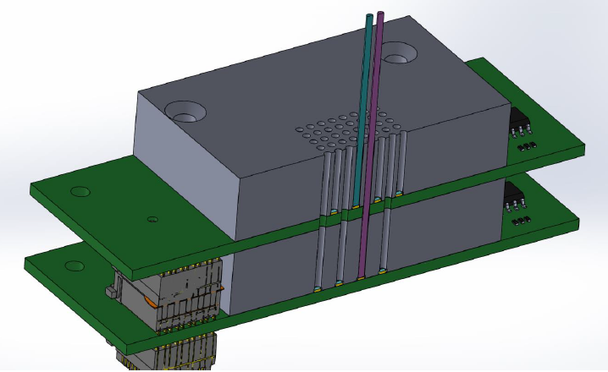
IDEA DR fiber grouping. Opt 2
Try using fewer SiPM’s → Save ~57 M SiPM
  Treat Cherenkov fibers electronically (low light levels)
  Merge Scintillator fibers optically with concentrator cookie
Cherenkov fiber SiPM board with holes for Scintillating fibers
Current two layer readout to minimize optical x-talk

Slide 20
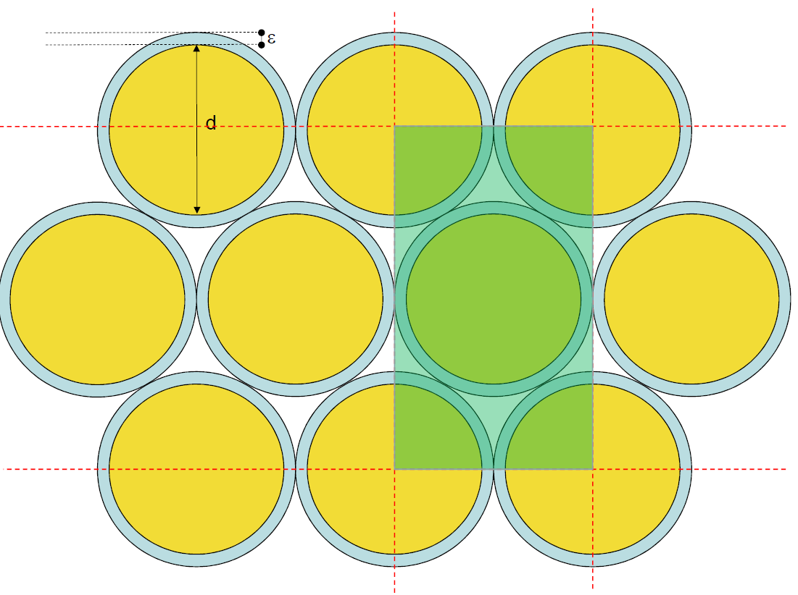
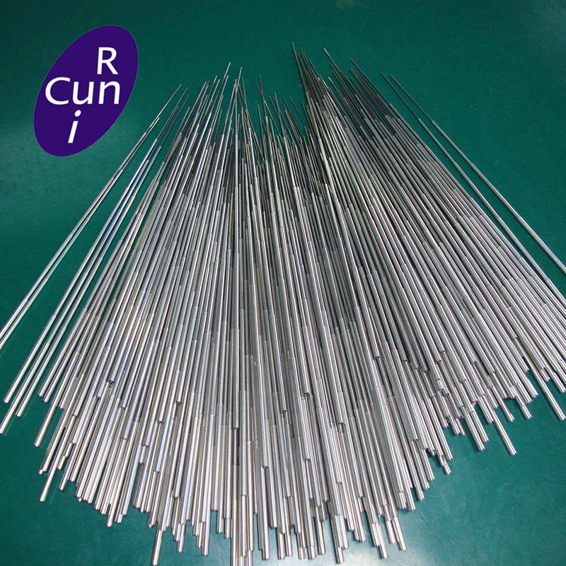

IDEA DR metal
Current options use capillary tube assembly
  Total weight – Iron: 1.1 kton
  Total weight – Copper: 1.2 kton
1/$\sqrt{E}$

Slide 21
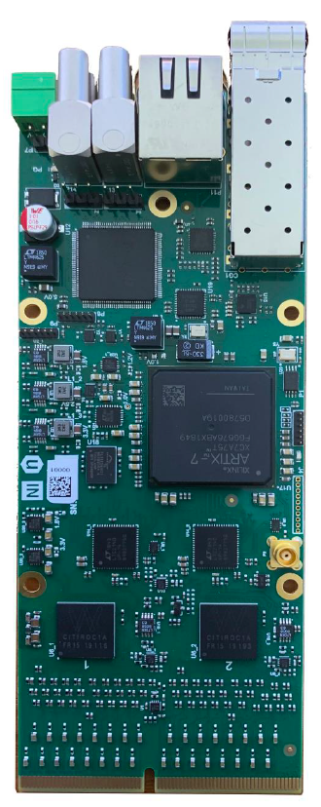
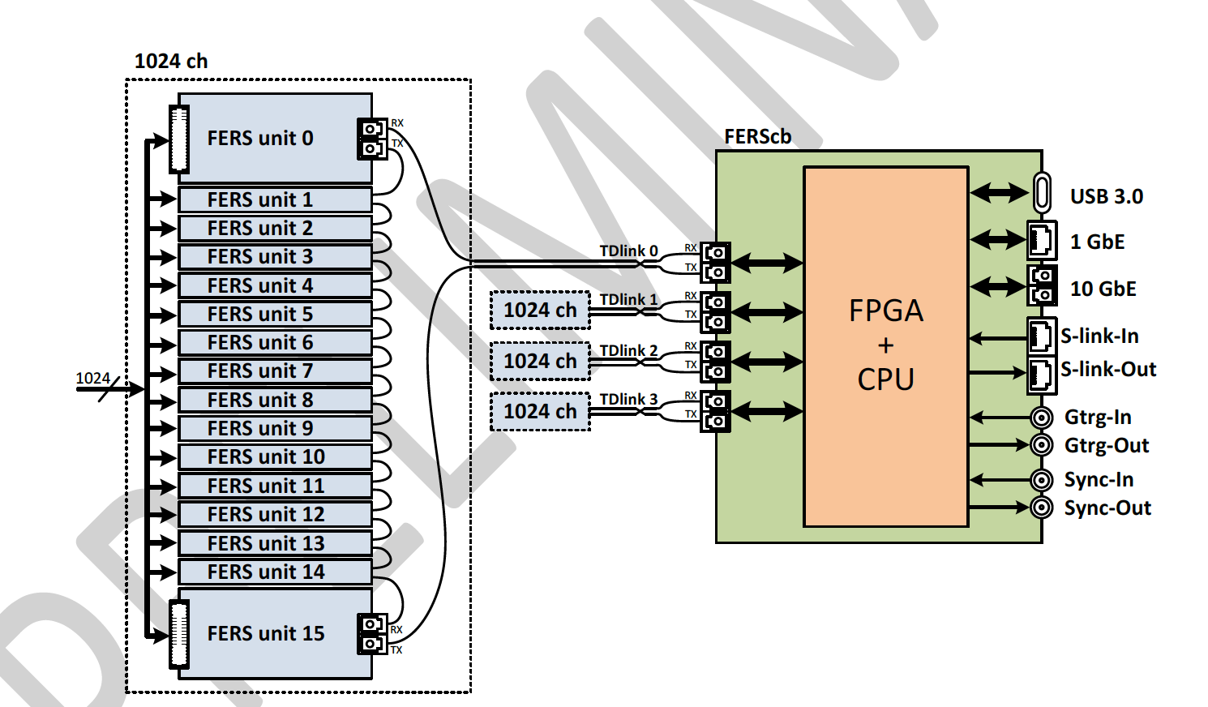
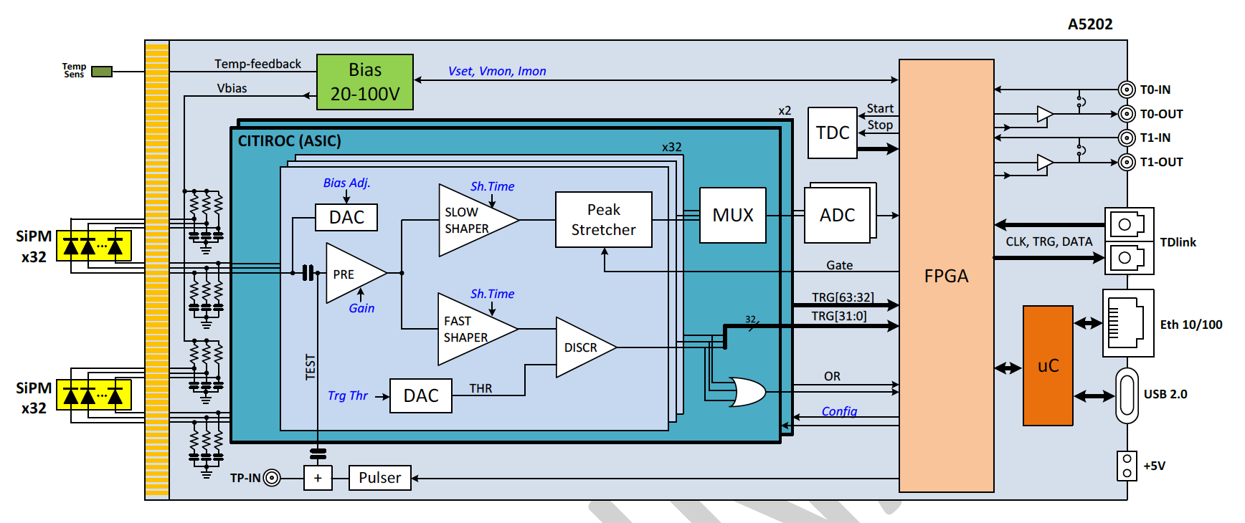
Readout - Citiroc
Some options already on the market
  CAEN FERS system based on Citiroc → 64 ch/board
  16 boards/opt link
  4 opt link/concentrator
  4096 ch/concentrator

Slide 22
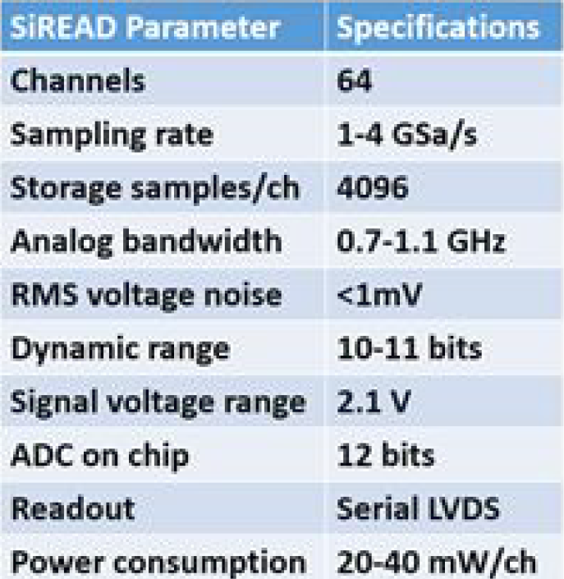
Readout - SiREAD
Nalu Scientific – SiREAD chip
  Next version 32 → 64 ch

Slide 23
Cost assumptions
Metal tubes (Source ALIBABA):
  Iron: 2,000 €/ton [1.1 kton] → 2.1 M€
  Copper: 6,000 €/ton [1.2 kton] → 7.3 M€
Fibers:
  Scintillating: 250 €/km [83,500 km] → 20.9 M€
  Clear: 100 €/km [83,500 km] → 8.3 M€
SiPM (1 mm): 0.30 € each (goal) → 0.1 € each (maybe)
  Opt 1: full readout [131 M] → 39.2 M€
  Opt 2: optical concentrator [ 73 M] → 22.1 M€
Readout: 1.5 €/channel (goal) [ 16 M] → 25.5 M€
  Could bring down to 13-15 M€

Slide 24
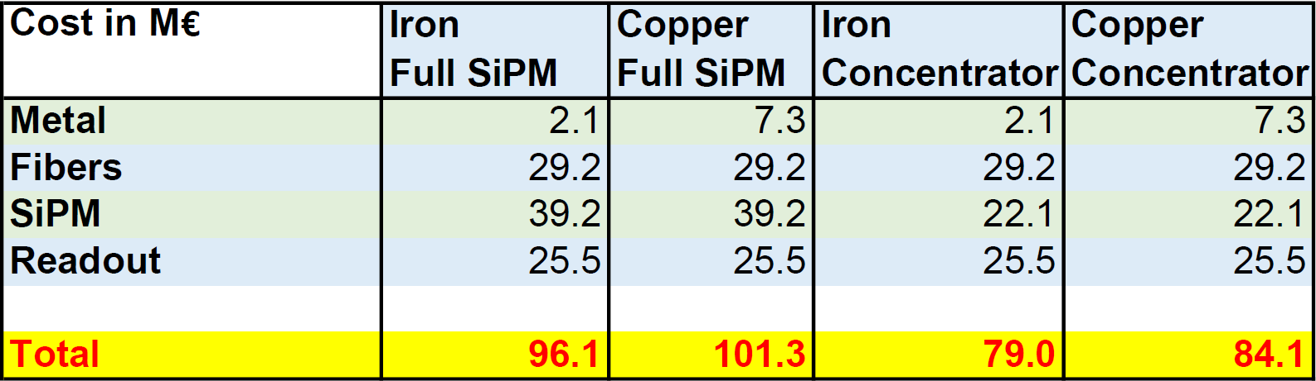
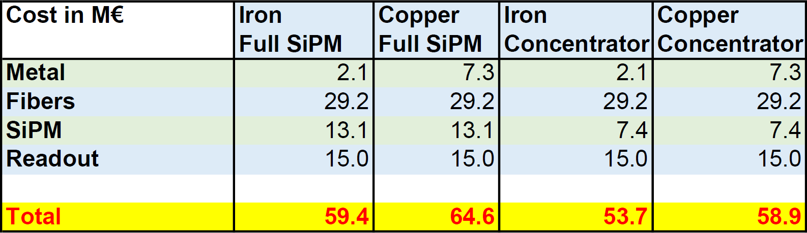
Cost summary baseline
4 options related to absorber and # SiPM
SiPM → 0.1 € each, Readout total 15 M €

Slide 25
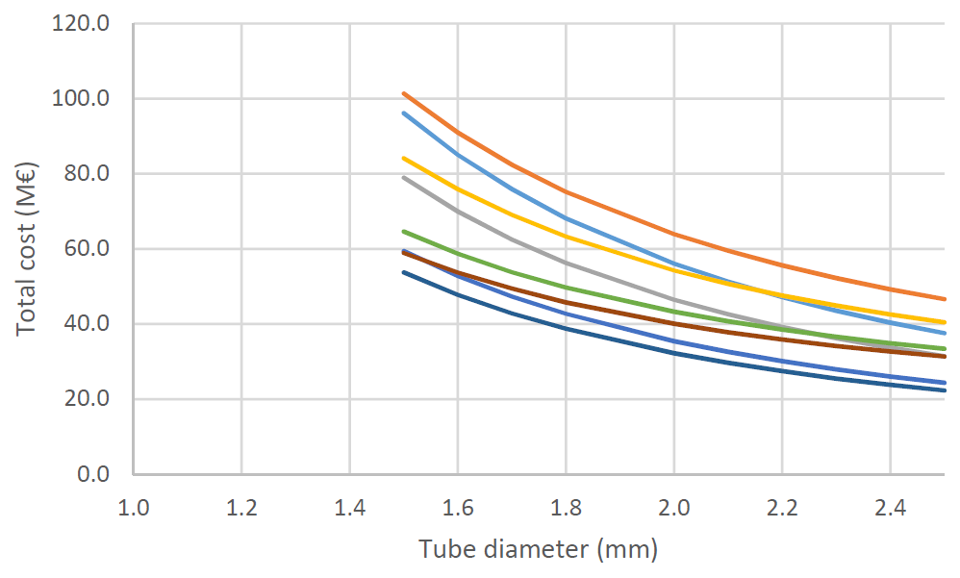
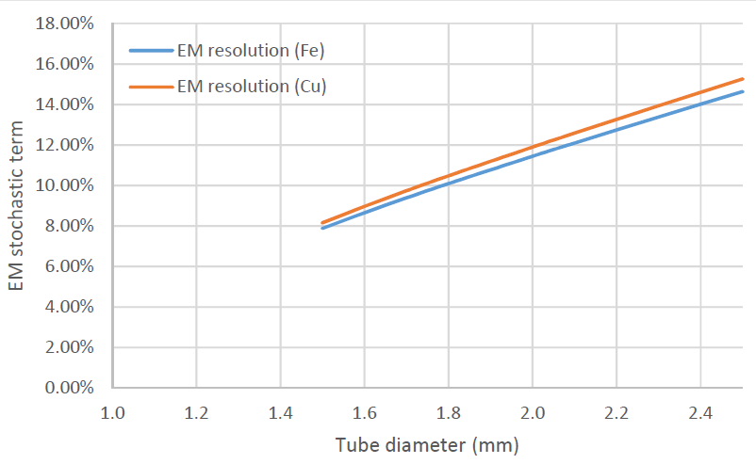
Scaling granularity
Scale by tube diameter (1.5 → 2.5 mm)
  All costs but material scale as 1/d^2
Baseline
Optimistic

Slide 26
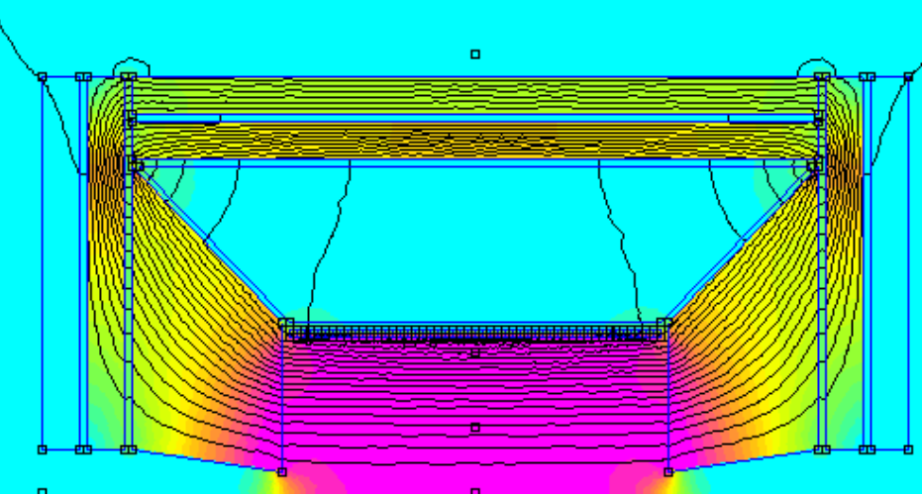
Final comments
Total cost < 100 M€
  Includes both Em and Had calorimeters
Forward/backward made of iron reduce needs for yoke
Critical items:
  SiPM
  Readout electronics
    Needs much larger integration ~ 4096 ch/board
    Preliminary estimates indicate that total costs of 13-15 M€ could be possible i.e. < 1 €/ch
Additional savings possible on fibers due to large quantity
Sampling fraction/EM resolution drives cost

