Slide 1
Bluebox 1
Jianming Qian
With help from Sarah Eno, Bob Hirosky, Junjie Zhu

Slide 2
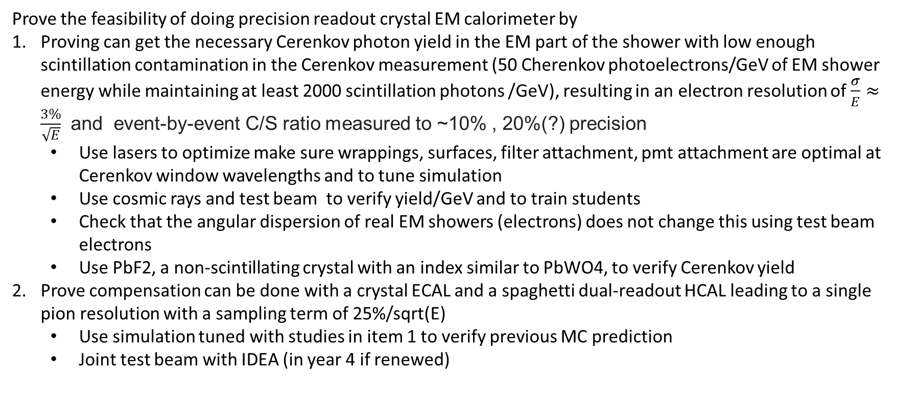
Blue box 1
Prove the feasibility of doing precision readout crystal EM calorimeter by
Proving can get the necessary Cerenkov photon yield in the EM part of the shower with low enough scintillation contamination in the Cerenkov measurement (50 Cherenkov photoelectrons/GeV of EM shower energy while maintaining at least 2000 scintillation photons /GeV), resulting in an electron resolution of $\frac{σ}{E}≈\frac{3\%}{\sqrt{E}}$ and event-by-event C/S ratio measured to ~10% , 20%(?) precision
  Use lasers to optimize make sure wrappings, surfaces, filter attachment, pmt attachment are optimal at Cerenkov window wavelengths and to tune simulation
  Use cosmic rays and test beam to verify yield/GeV and to train students
  Check that the angular dispersion of real EM showers (electrons) does not change this using test beam electrons
  Use PbF2, a non-scintillating crystal with an index similar to PbWO4, to verify Cerenkov yield
Prove compensation can be done with a crystal ECAL and a spaghetti dual-readout HCAL leading to a single pion resolution with a sampling term of 25%/sqrt(E)
  Use simulation tuned with studies in item 1 to verify previous MC prediction
  Joint test beam with IDEA (in year 4 if renewed)

Slide 3
Plan
This is a precision measurement, with a small signal under a (potentially) large background. Also, there will be many doubters of our results. We need a bullet-proof demonstration. To do this, we need
Well-characterized state of the art materials
  Crystals with best possible attenuation length, especially in the UV
  High PDE SiPMS with extended wavelength sensitivity
  Appropriate filters
  All connected with well understood optics
Tests of single crystals and a multi-crystal array with muon beams, as these are the cleanest environment. A variety of redundant measurements to be sure of the yield and contamination
Use PbF2 to verify Cerenkov yield
electron beams to be sure of our Cherenkov yield for EM showers, which have a less well defined direction due to the shower
Well tuned simulations to understand our results.
maintain stable response for <1% EM resolution
A joint test beam with IDEA to prove compensation
We also need to be realistic about what we can achieve. While our collaboration has ample members with crystal experience, dual-readout experience is limited to the Texas Tech group. We need time to build up our infrastructure and expertise to do precision measurements.

Slide 4
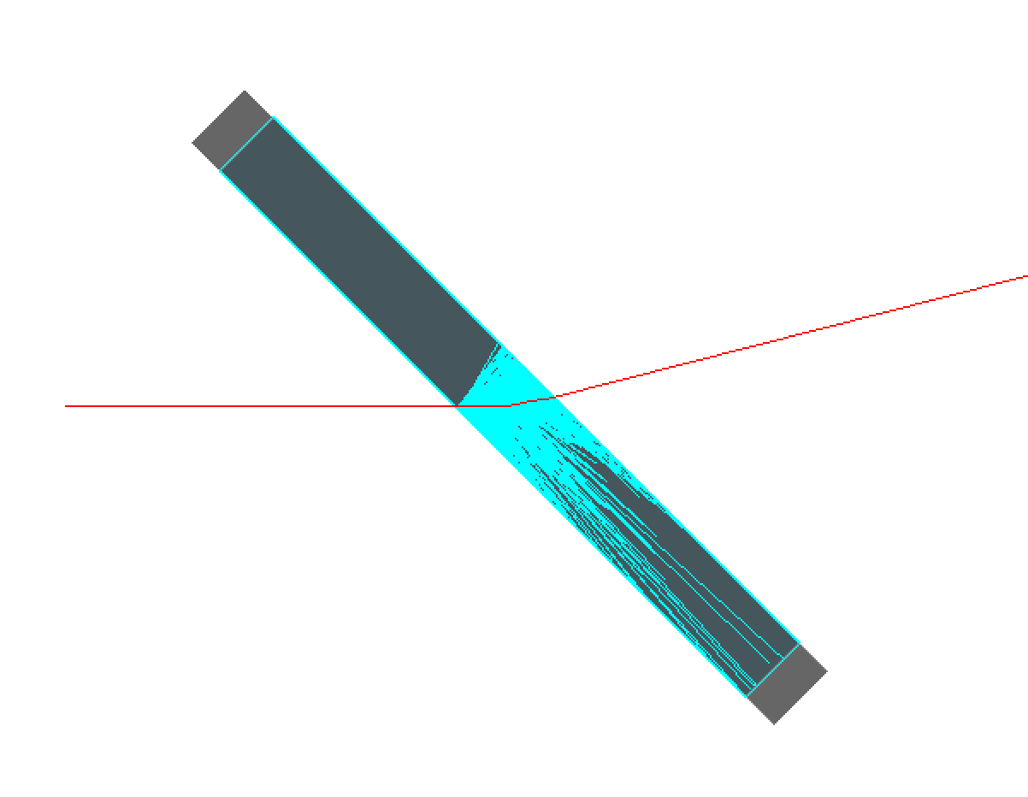
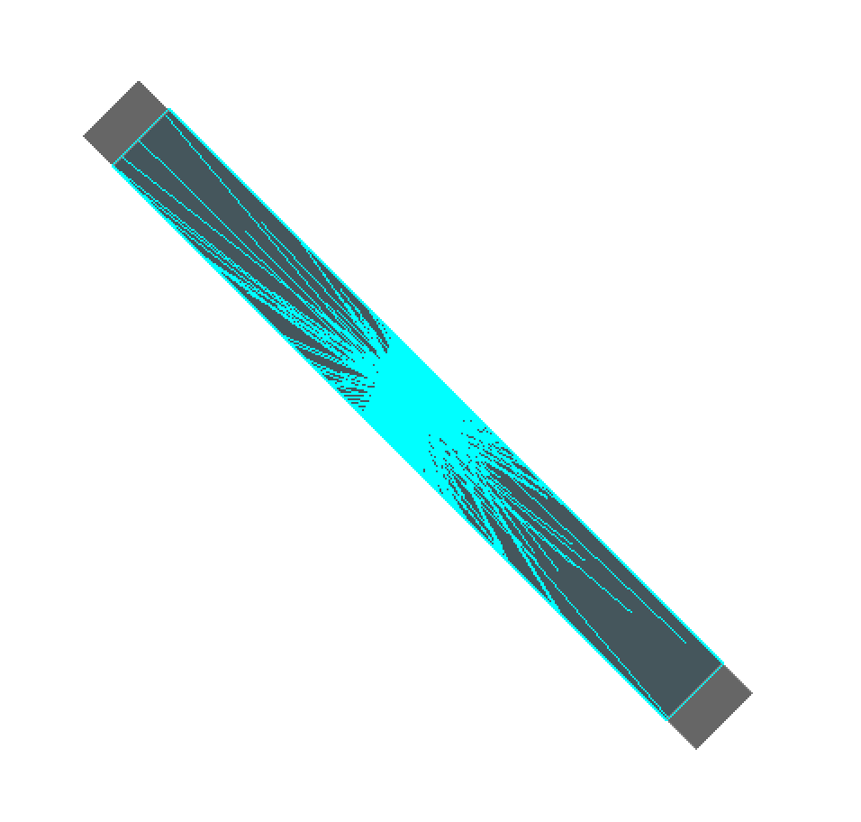
Plan
Well coordinated team using standard coordinated tools developing common simulation for all test apparati
Will build a test beam module with 2 depth segments and 20 radiation lengths and a width wide enough for electron showers with minimal dead material. Will test with muon and electron test beams.
  Smaller width will make cost lower and will simplify initial daq
  evaluate readout requirements to optimize performance/cost for C/S measurement
Will start planning work for if we get renewed, which would include
  Extending diameter of test beam module to be wide enough for hadronic showers
  Extend daq
  Plan for hadron test beam at DESY with IDEA
50 MeV µ
50 MeV e
Muons

Slide 5
By year
YR1
Setup testbench and test beam simulation infrastructure and team: Hans Wenzel (FNAL), Yihui Lai (UMD), Sasha Ledovskoy (Uva), Sonakshi Ahuja (UVA), John Hakala (UVA), Carlos Perez (UVA), Sonakshi Ahuja (UVA), UMD student A (UMD)
Setup event display for testbench and test beam: Sonakshi Ahuja (UVA), UMD student A (UMD)
Prepare cosmic test stand at U.Mich: Yuxiang Guo (UMich), Meng-Ju Tsai (UMich)
Prepare DAQ testbed at Uva: Thomas Anderson (UVA) Carlos Perez (UVA), Yuxiang Guo (UMIch)
Setup photodetector, filter characterization, and laser optics tests at UMD: Tim Edberg (UMD), UMD grad student A (UMD)
First set of results from all 3 test stands
Caltech purchase and characterize crystals for bench tests (larger to make measurement easier, largest size of sipmm 27x27x100 mm), including PbF2 crystal: Ren-Yuan Zhu (Caltech)
Princeton/Purdue design mechanical support for testbeam module and shipping crate: Chris Tully (Princeton)
YR2
More inclusive results from all 3 test stands
JLAB electron test beam of single crystal: organized by Tim Edberg (UMD)
FNAL muon/pion/electron/proton test beam of single crystal: organized by Tim Edbert (UMD)
Caltech purchase and characterize crystals for test beam module
Caltech construct test beam module monitoring system
Construction of test beam module
Write paper on single crystal results
YR3
Shakedown of test beam module daq and monitoring system at UVa
Testbeam module at JLAB with electrons
Testbeam module at FNAL with muons
Prepare with IDEA for joint testbeam (if renewed for YR4)
Write paper on test beam module results

Slide 6
organization

Slide 7
Institutional responsibilities
Strawman: to be discussed and optmized
UMich will develop a large cosmic ray test stand for studying Cherenkov light collection
UVA will develop the DAQ for CalVision electron test beams and CalVision+IDEA hadron test beams
CalTech will characterize the crystals
CalTech will build a monitoring system for the test beam module
FNAL will work with students and postdocs at all institutions on the simulation
UMD will characterize SiPMs, wavelength filters, and use lasers to study and optimize light collection versus angle and wavelength

Slide 8
Detailed plan
Jianming, Junjie, Bob, and Sarah have been drawing up a detailed plan at: https://docs.google.com/spreadsheets/d/11qdGhRv8ZnGixsMK625pS-2X_rBY2dr1E0Te-KgQ_8c/edit?usp=sharing
Please open this on your laptop now
Only a strawman, to be discussed at this workshop

Slide 9
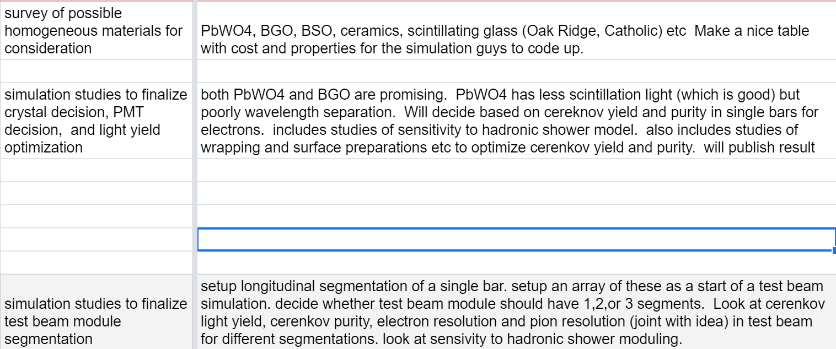
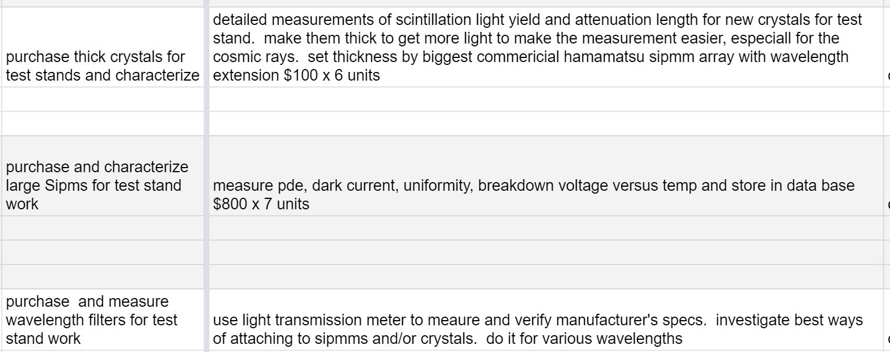
FY1

Slide 10
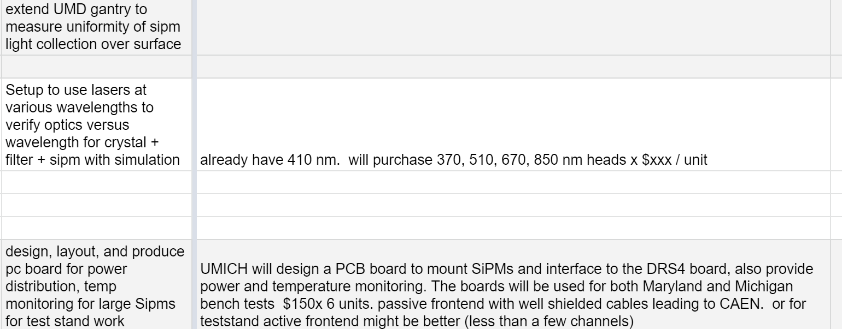
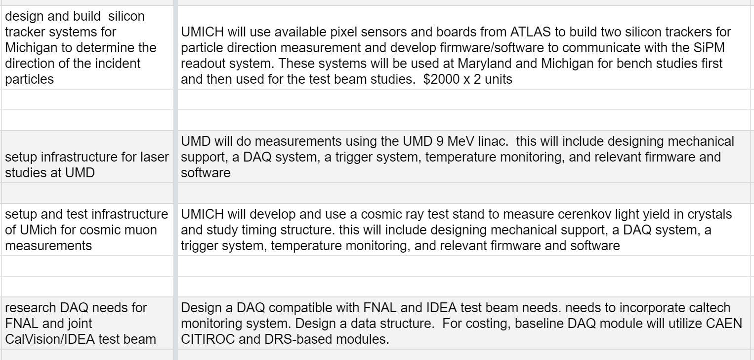
FY1

Slide 11
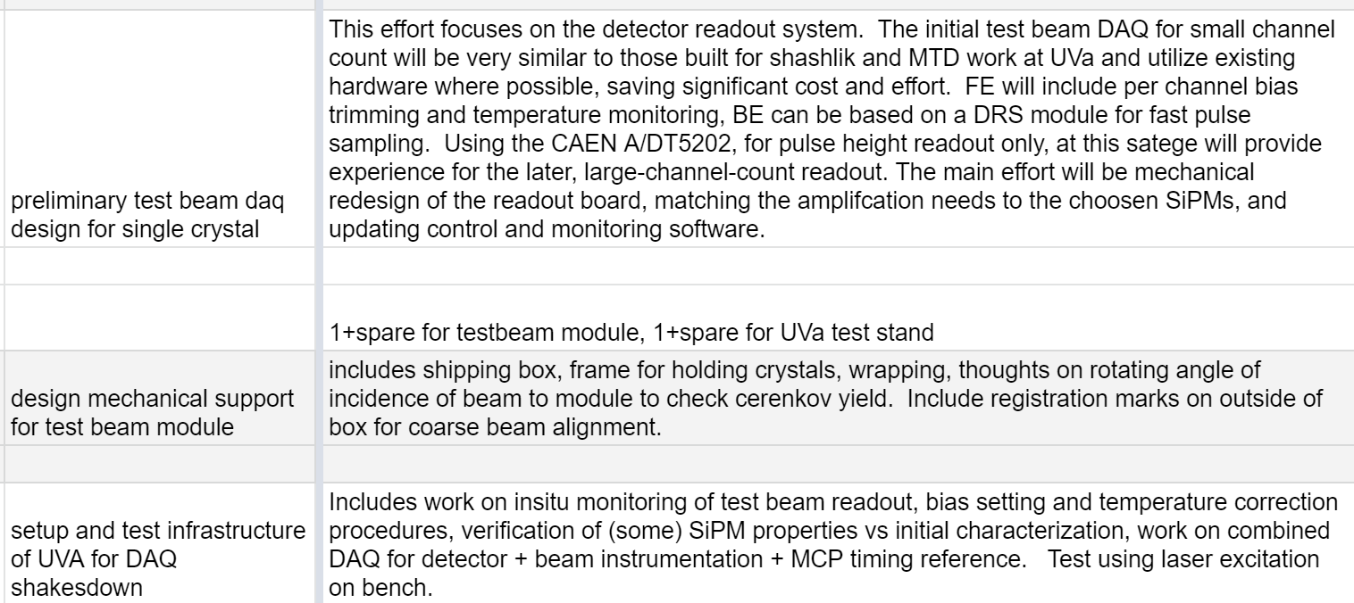
FY1

Slide 12
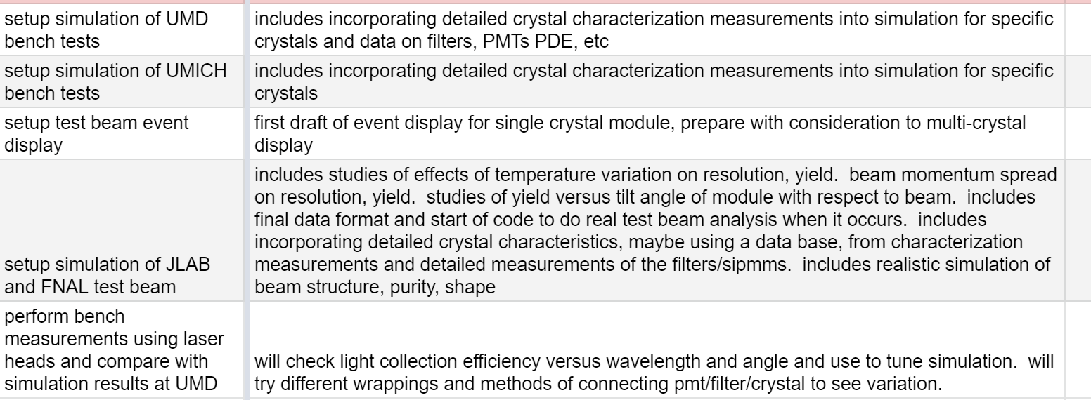
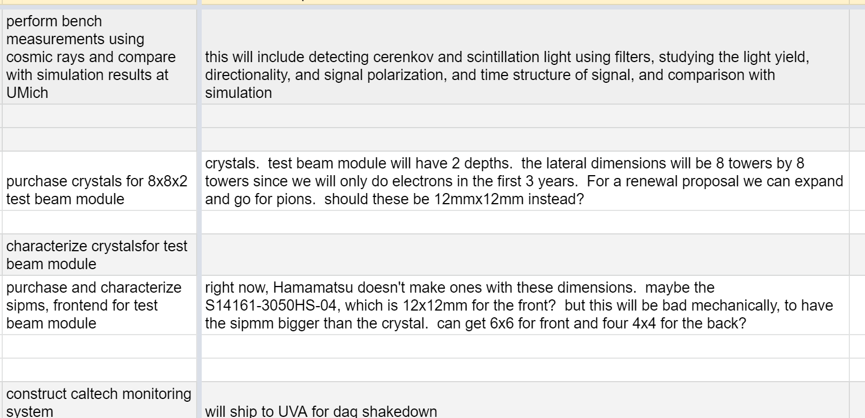
FY2

Slide 13
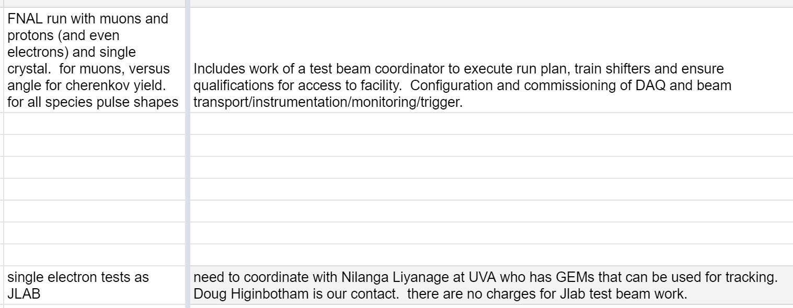
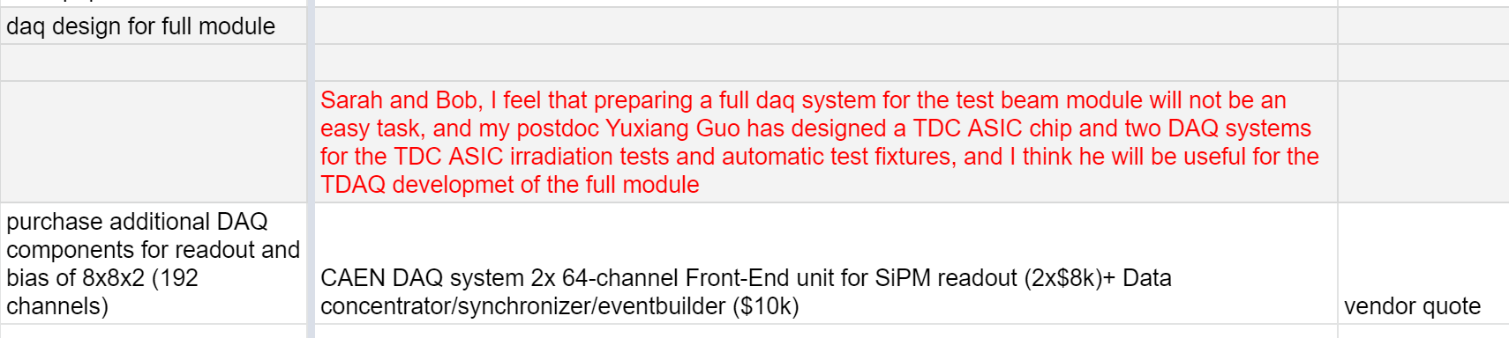

Slide 14
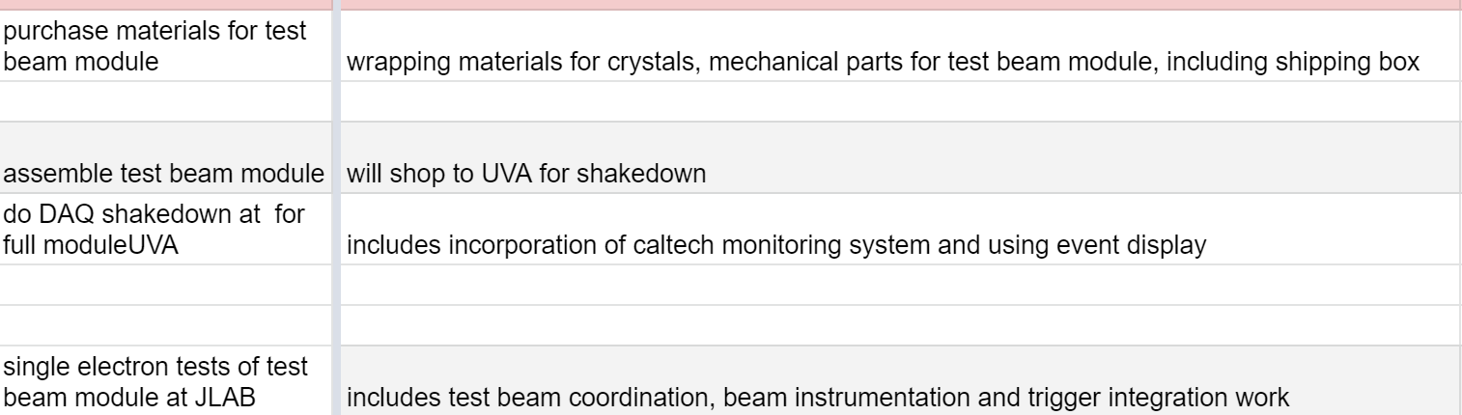
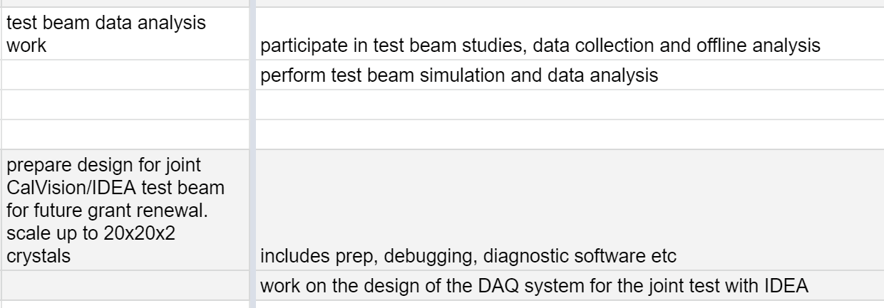
FY3

