Slide 1


Lyman-α forest perturbative modeling and improved CMB constraining power
Jahmour Givans
BSM Double Feature
September 29, 2020
1

Slide 2
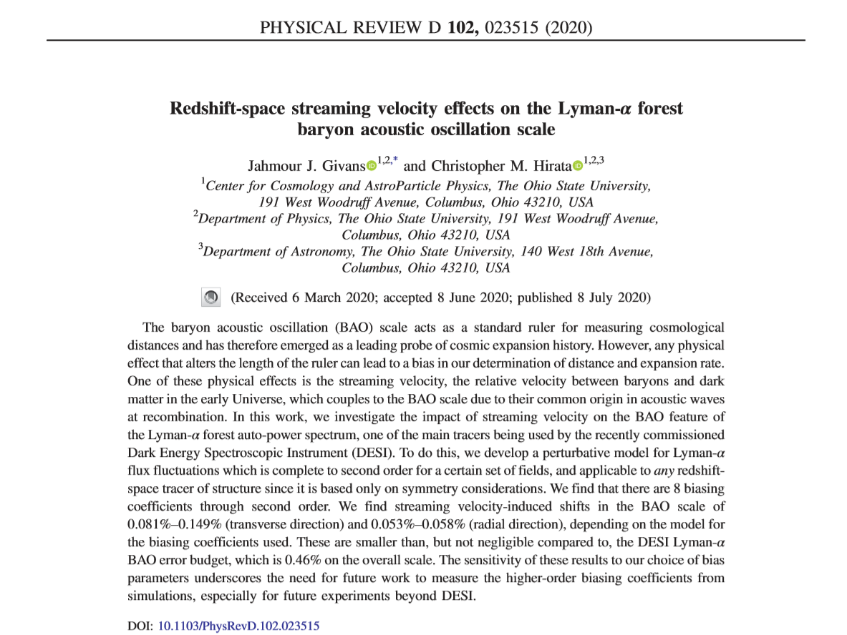
Based in part on . . .
2

Slide 3
Breaking down the paper title
Over the next several slides, we’ll address
Redshift space
Baryon acoustic oscillations (BAOs)
Streaming velocity
Lyman-α forest
3

Slide 4
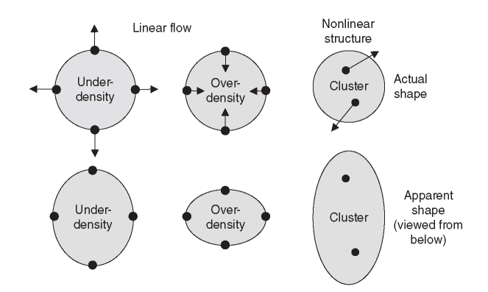
Redshift space
In real space, objects (like galaxies) are where they appear to be.
In redshift space, an object’s position is distorted along our LOS
  Caused by peculiar velocities
  Convention is that line-of-sight lies along the z axis
Image credit: Will Percival
4

Slide 5
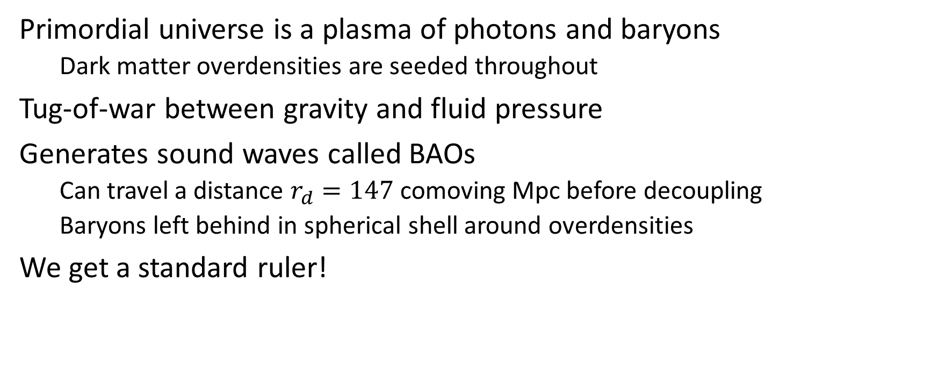
BAOs
Primordial universe is a plasma of photons and baryons
  Dark matter overdensities are seeded throughout
Tug-of-war between gravity and fluid pressure
Generates sound waves called BAOs
  Can travel a distance $r_{d}=147$comoving Mpc before decoupling
  Baryons left behind in spherical shell around overdensities
We get a standard ruler!
5

Slide 6
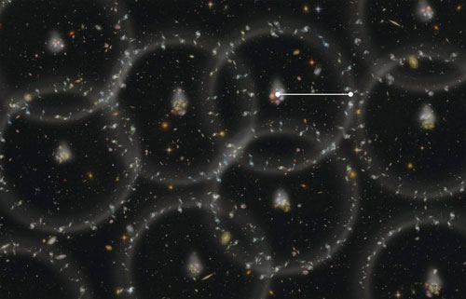
Credit: BOSS Collaboration
6

Slide 7
Streaming velocity
Generated by the same physics that produced BAOs
Baryons and dark matter have a supersonic relative velocity at decoupling
More important than usual Jeans criteria for structure formation
  Changes filtering mass of the intergalactic medium
Will impact the BAO scale by some amount
7

Slide 8
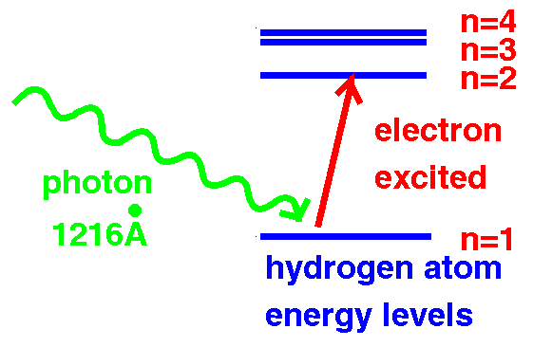
Lyman-α forest overview
H I gas clouds spread throughout IGM
Background quasar shines light, exciting Lyman-α transition
Absorption in multiple H I clouds along LOS
Creates a “forest” of absorption features in transmitted flux
Credit: M. White and L. Hernquist
8

Slide 9
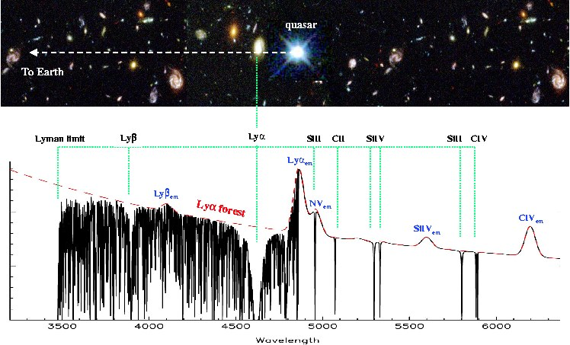
Visualizing the forest
Credit: John Webb
9

Slide 10
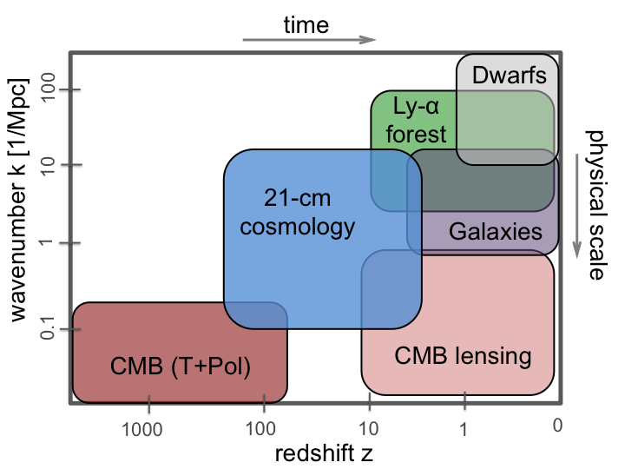
Why the Lyman-α forest?
Robust tracer of structure at 2 < z < 6
Study reionization & thermal history of IGM
Probe smaller physical scales
Complement data from other probes
1903.05140
10

Slide 11
LSS perturbation theory basics
Assume underlying matter field smooth, collisionless DM
  Follows Poisson, continuity, and Euler equations
At large scales, some fields can be treated as perturbations to others
Linearize equations to solve for evolution of fields
These fields are perturbations | To these local fields
Density contrast | Cosmic density
Peculiar velocity | Particle velocity
Cosmological gravitational potential | Newtonian potential
11

Slide 12
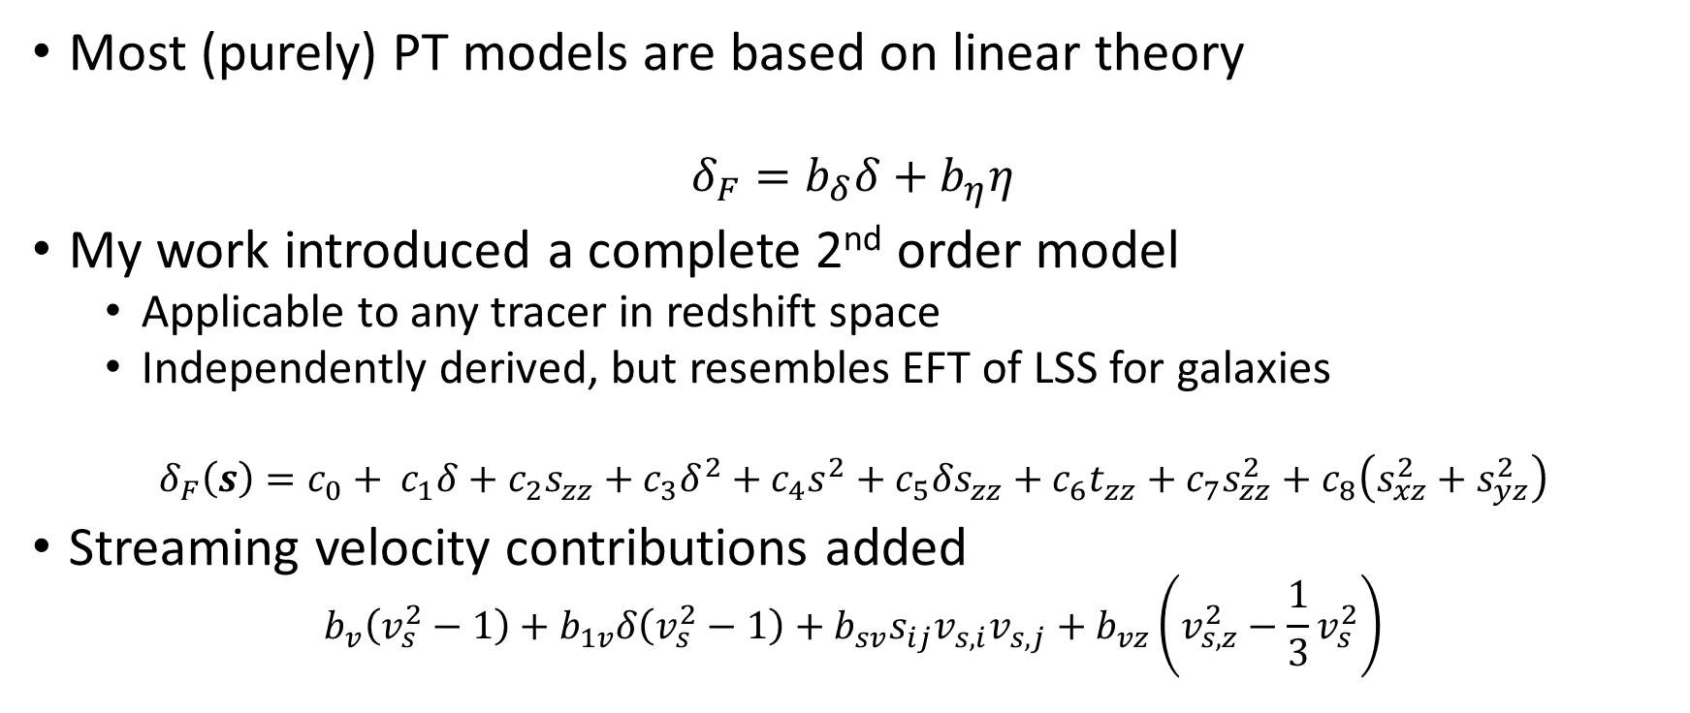
PT and bias in Lyα forest
Most (purely) PT models are based on linear theory
$$δ_{F}=b_{δ}δ+b_{η}η$$
My work introduced a complete 2nd order model
  Applicable to any tracer in redshift space
  Independently derived, but resembles EFT of LSS for galaxies
$$δ_{F}\left(s\right)=c_{0}+ c_{1}δ+c_{2}s_{zz}+c_{3}δ^{2}+c_{4}s^{2}+c_{5}{δs}_{zz}+c_{6}t_{zz}+c_{7}s_{zz}^{2}+c_{8}\left(s_{xz}^{2}+s_{yz}^{2}\right)$$
Streaming velocity contributions added
$$b_{v}\left(v_{s}^{2}−1\right)+b_{1v}δ\left(v_{s}^{2}−1\right)+b_{sv}s_{ij}v_{s,i}v_{s,j}+b_{vz}\left(v_{s,z}^{2}−\frac{1}{3}v_{s}^{2}\right)$$
12

Slide 13
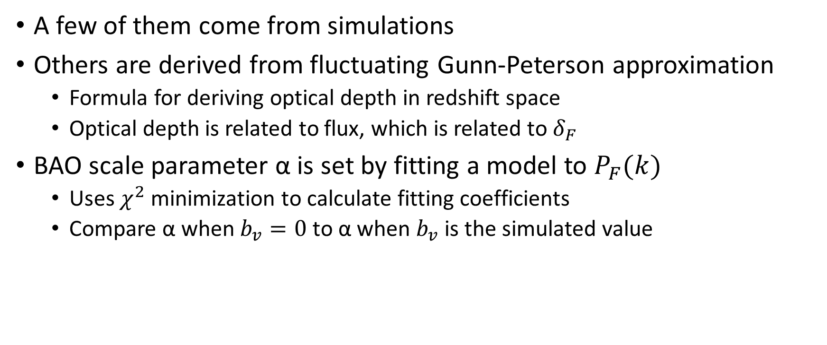
Getting bias coefficients and BAO scale shift
A few of them come from simulations
Others are derived from fluctuating Gunn-Peterson approximation
  Formula for deriving optical depth in redshift space
  Optical depth is related to flux, which is related to $δ_{F}$
BAO scale parameter α is set by fitting a model to $P_{F}(k)$
  Uses $χ^{2}$ minimization to calculate fitting coefficients
  Compare α when $b_{v}=0$ to α when $b_{v}$ is the simulated value
13

Slide 14
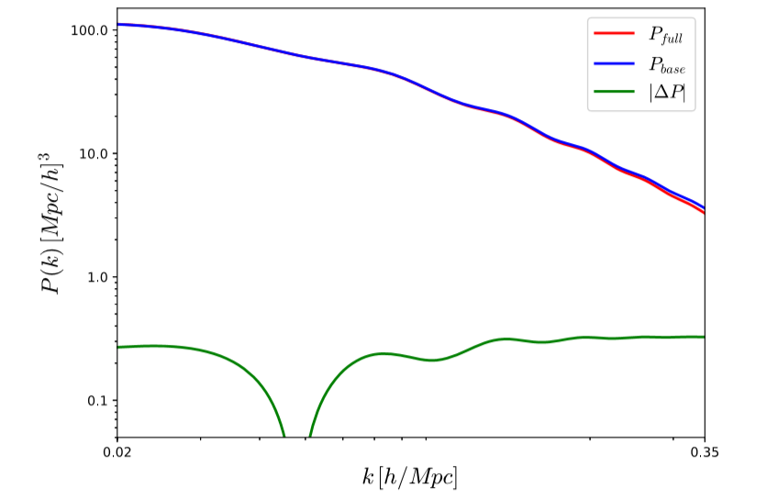
Visualizing the shift
14

Slide 15
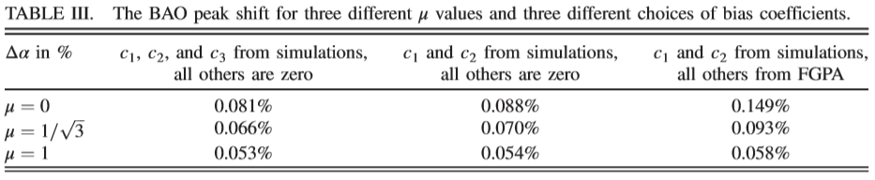
Paper results and takeaways
Results for peak shift depend strongly on bias parameters
DESI precision for Lyman-α forest is 0.46%
  Streaming velocity alone is important but relatively minor
Go to higher order PT and get bias parameters
15

Slide 16
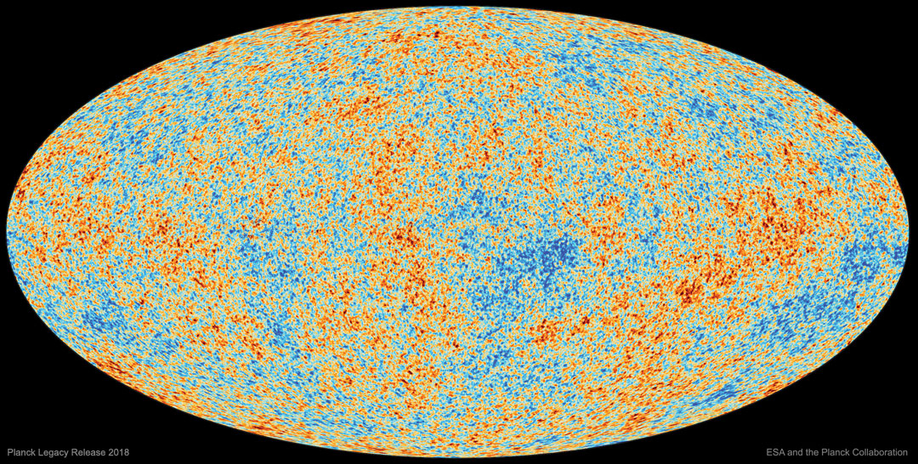
CMB Constraints
16

Slide 17
CMB application: neutrino masses (1/2)
Expansion history changes as they become non-relativistic
  Probes sensitive to history, like BAO, can measure the effect
Neutrino masses suppress late-time amplitude of fluctuations
Primary CMB spectrum and secondary CMB lensing spectrum
17

Slide 18
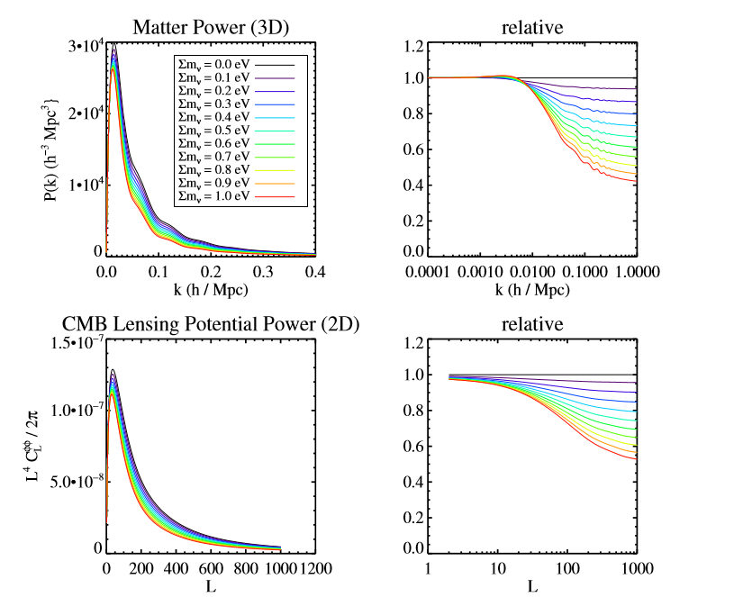
Suppression of power
Abazajian et al. 2016 (CMB-S4 Science Book)
18

Slide 19

CMB application: neutrino masses (2/2)
DESI BAO information helps break degeneracy of $Σm_{ν}$ with $Ω_{m}$
  Get BAO from galaxies, quasars, and Lyα forest
SO (Goal) + DESI BAO + τ (LiteBIRD) : $σ\left(Σm_{ν}\right)=17$ meV
  Enable detection of $Σm_{ν}=0.06$ eV at 3.5σ and $Σm_{ν}=0.1$ eV at 5.9σ
19

Slide 20
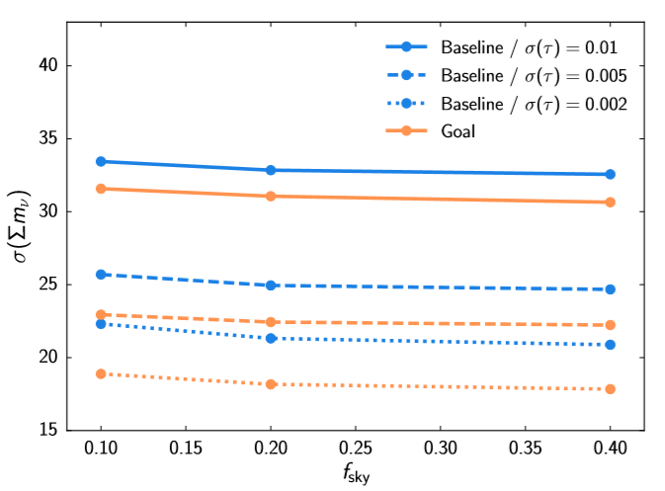
Limits from Simons + DESI + τ
SO Collaboration, JCAP 02 (2019) 056
20

Slide 21
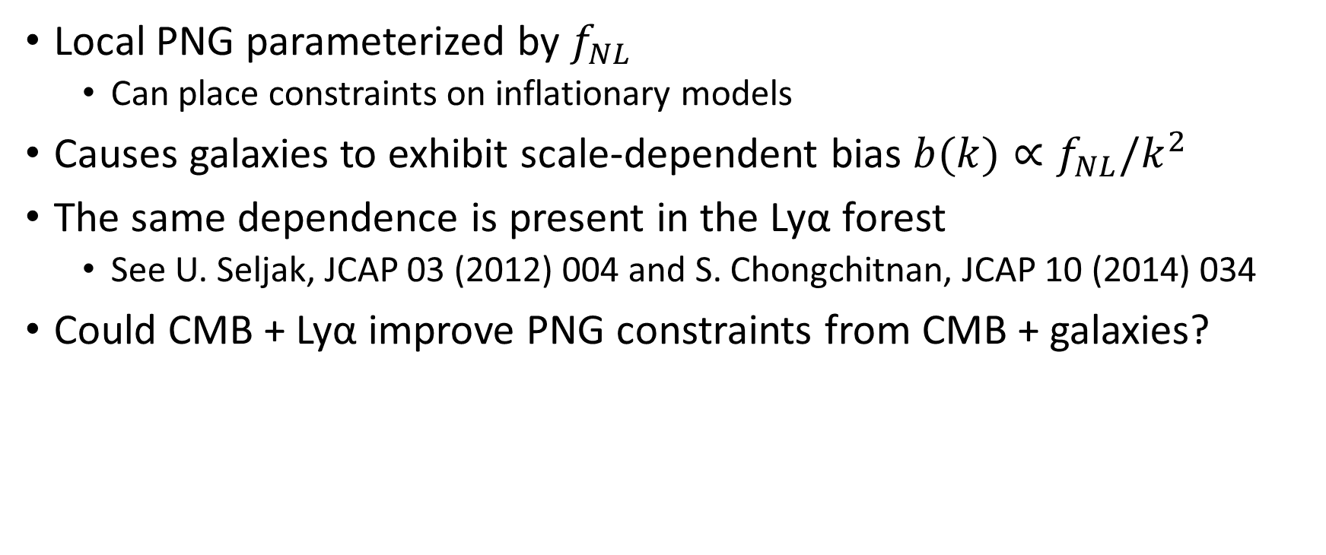
CMB application: primordial non-Gaussianity
Local PNG parameterized by $f_{NL}$
  Can place constraints on inflationary models
Causes galaxies to exhibit scale-dependent bias $b(k)∝f_{NL}/k^{2}$
The same dependence is present in the Lyα forest
  See U. Seljak, JCAP 03 (2012) 004 and S. Chongchitnan, JCAP 10 (2014) 034
Could CMB + Lyα improve PNG constraints from CMB + galaxies?
21

Slide 22
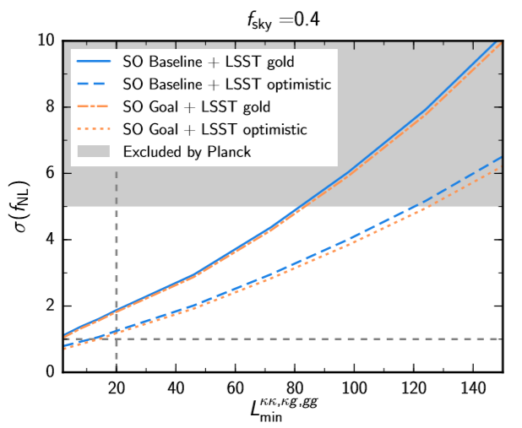
Limits from Simons lensing + Rubin clustering
SO Collaboration, JCAP 02 (2019) 056
22

Slide 23
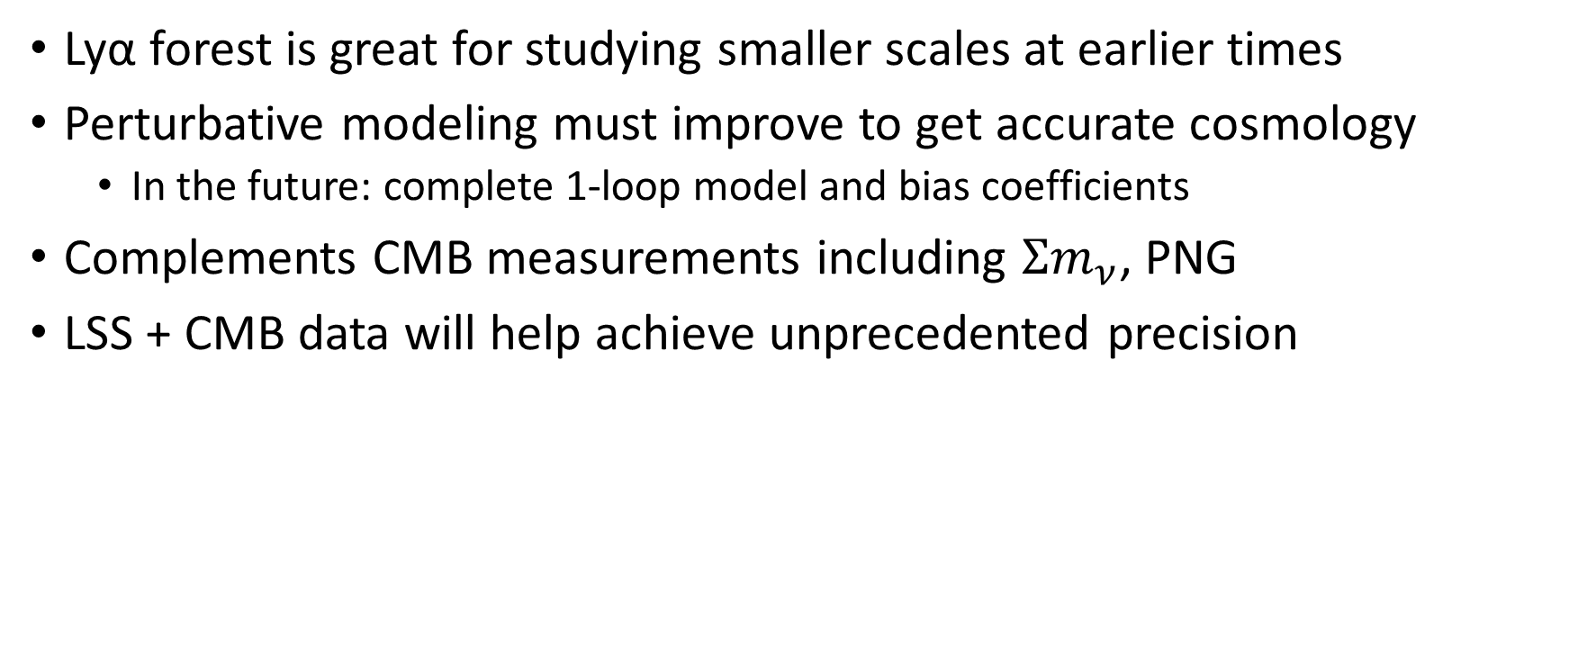
Conclusions
Lyα forest is great for studying smaller scales at earlier times
Perturbative modeling must improve to get accurate cosmology
  In the future: complete 1-loop model and bias coefficients
Complements CMB measurements including $Σm_{ν}$, PNG
LSS + CMB data will help achieve unprecedented precision
23

Slide 24


Slide 25

Where did $δ_{F}(s)$ come from?
Get a physical picture of the situation
Ask what symmetries are present (azimuthal symmetry)
Consider all relevant fields
Use group theory!
Prove our expansion is the most general one possible for fields we consider

Slide 26
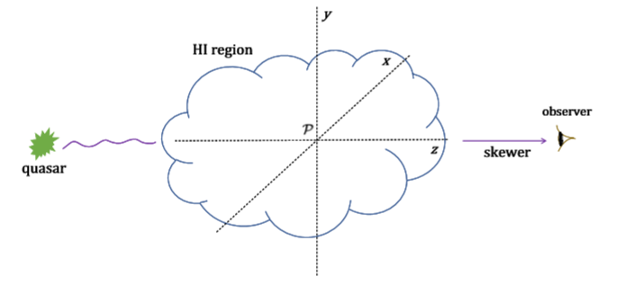
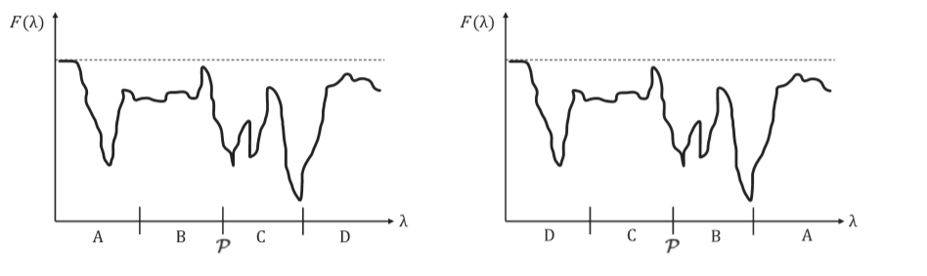
Physical picture

Slide 27
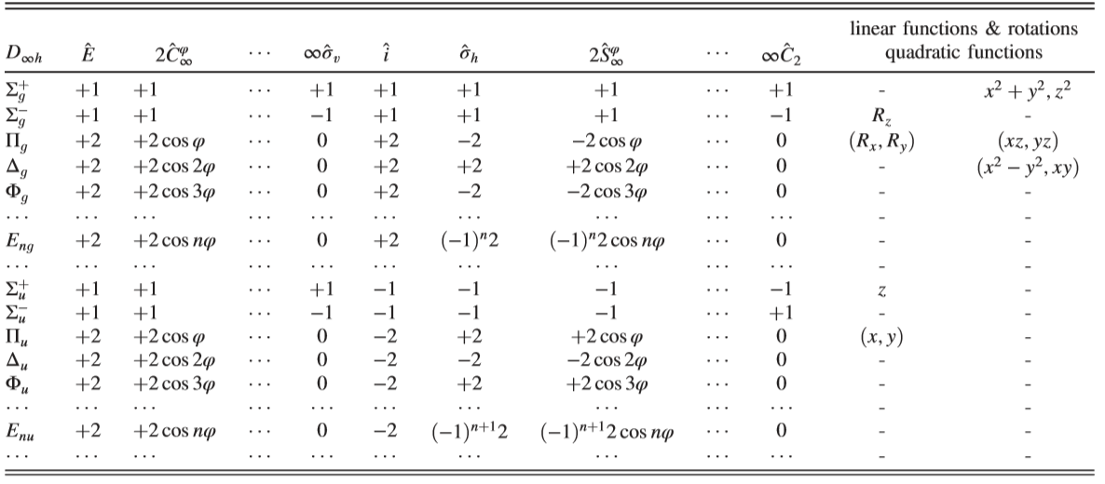

What group is this?
System obeys group properties of $D_{∞h}$
  True if your region is over a very small redshift range
  Same group that describes symmetry transformation of H₂ and CO₂
Use a character table to get forms of contributions

