Slide 1
Annual Meeting
WP 30: JRA12 – Spin for FAIR
Rahul Shankar (UniFe, INFN)

Slide 2
Plan of the presentation
Important highlights of the performed work
Latest progress achieved by Spin for FAIR
Plans and remaining tasks until the end of the project (31 July 2024)
PS. We kindly ask you to focus your presentations on the scientific progress of your WP (financial and administrative aspects of the implementation of the tasks are not required for this Annual Meeting)

Slide 3
JRA12 – Spin for FAIR: Motivation
Development of an efficient method for polarizing antiproton beams at FAIR

Slide 4
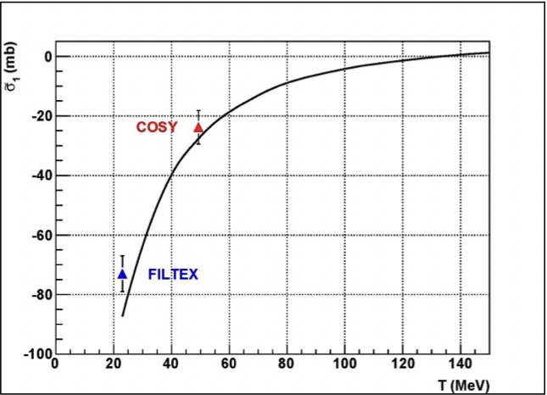
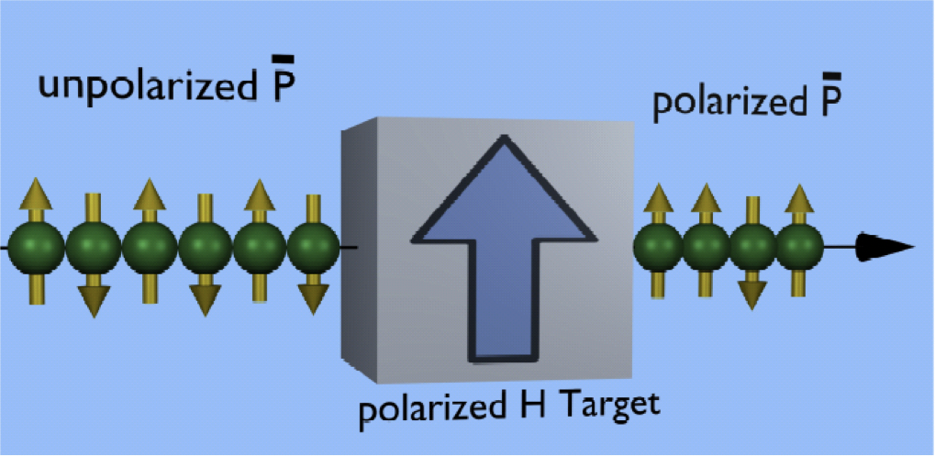
JRA12 – Spin for FAIR: Motivation
Methodology
Testing
Development of an efficient method for polarizing antiproton beams at FAIR
  Spin filtering of protons with transverse polarization performed at COSY
Test with longitudinal polarization needed to complete the measurement
  Full determination of the pbar-p cross section
  Experimental Storage Ring at FAIR

Slide 5
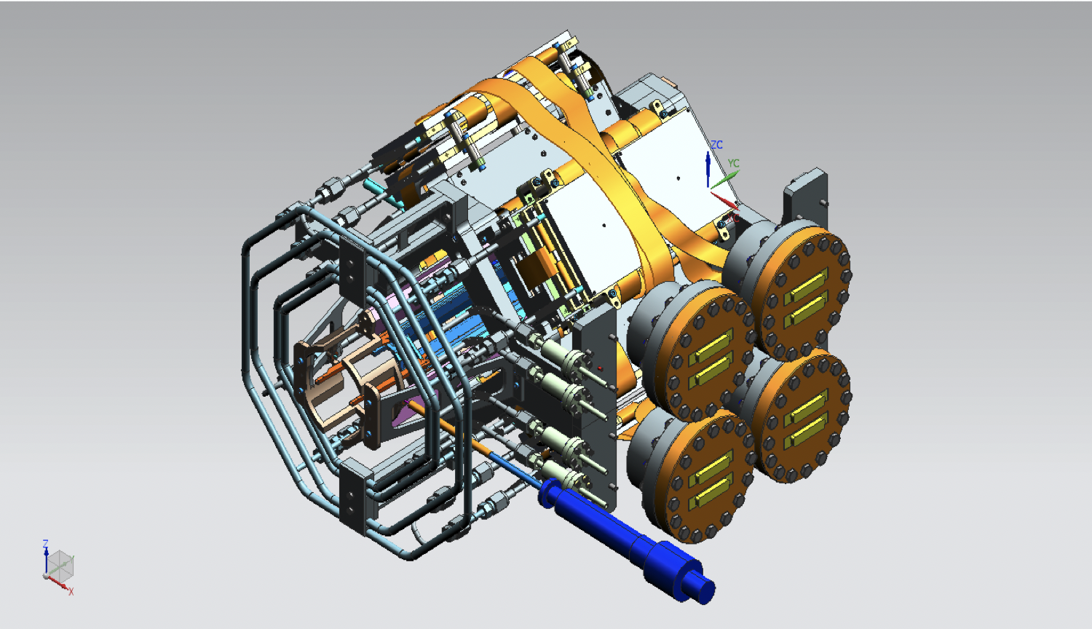
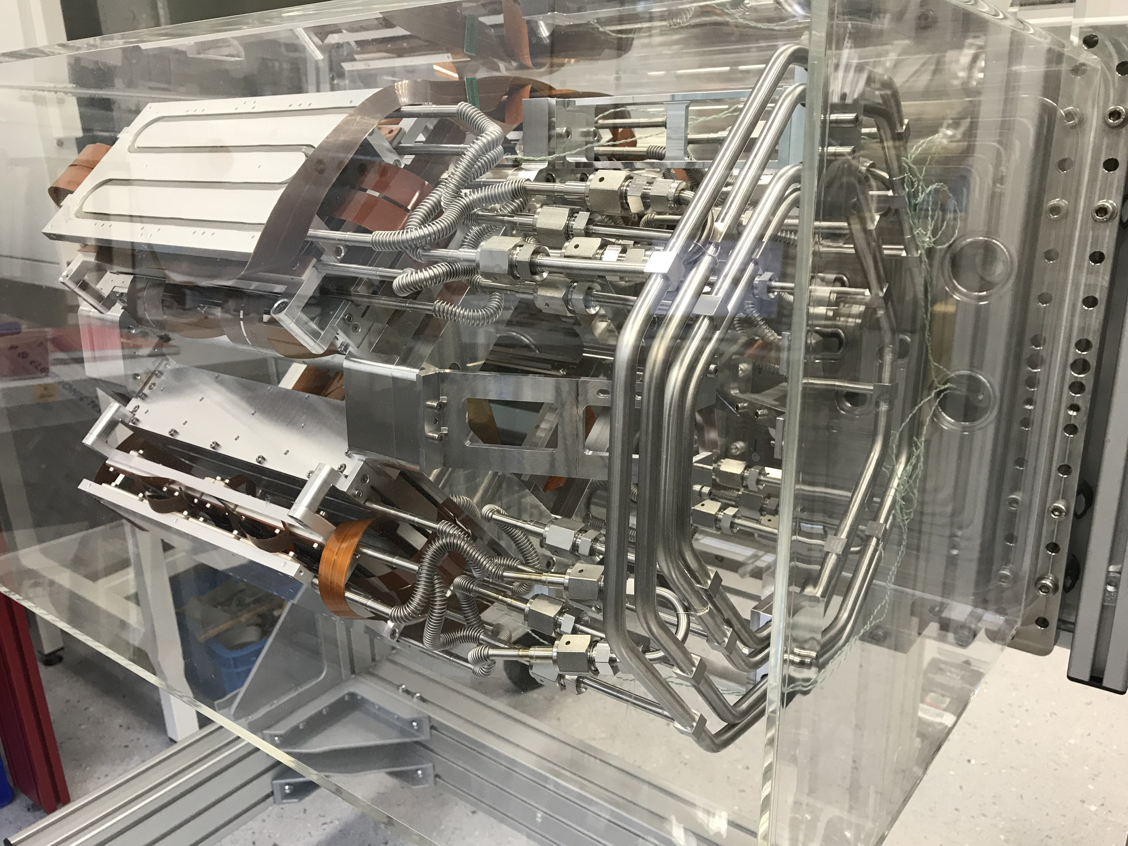

PAX Detector
Multi-purpose silicon vertex detector installed
around the storage cell for:
  $\overline{p}$-$p$ (pbar-p) elastic
  $p$-$d$ elastic
  Deuteron breakup
Energy: 30-200 $MeV$

Slide 6
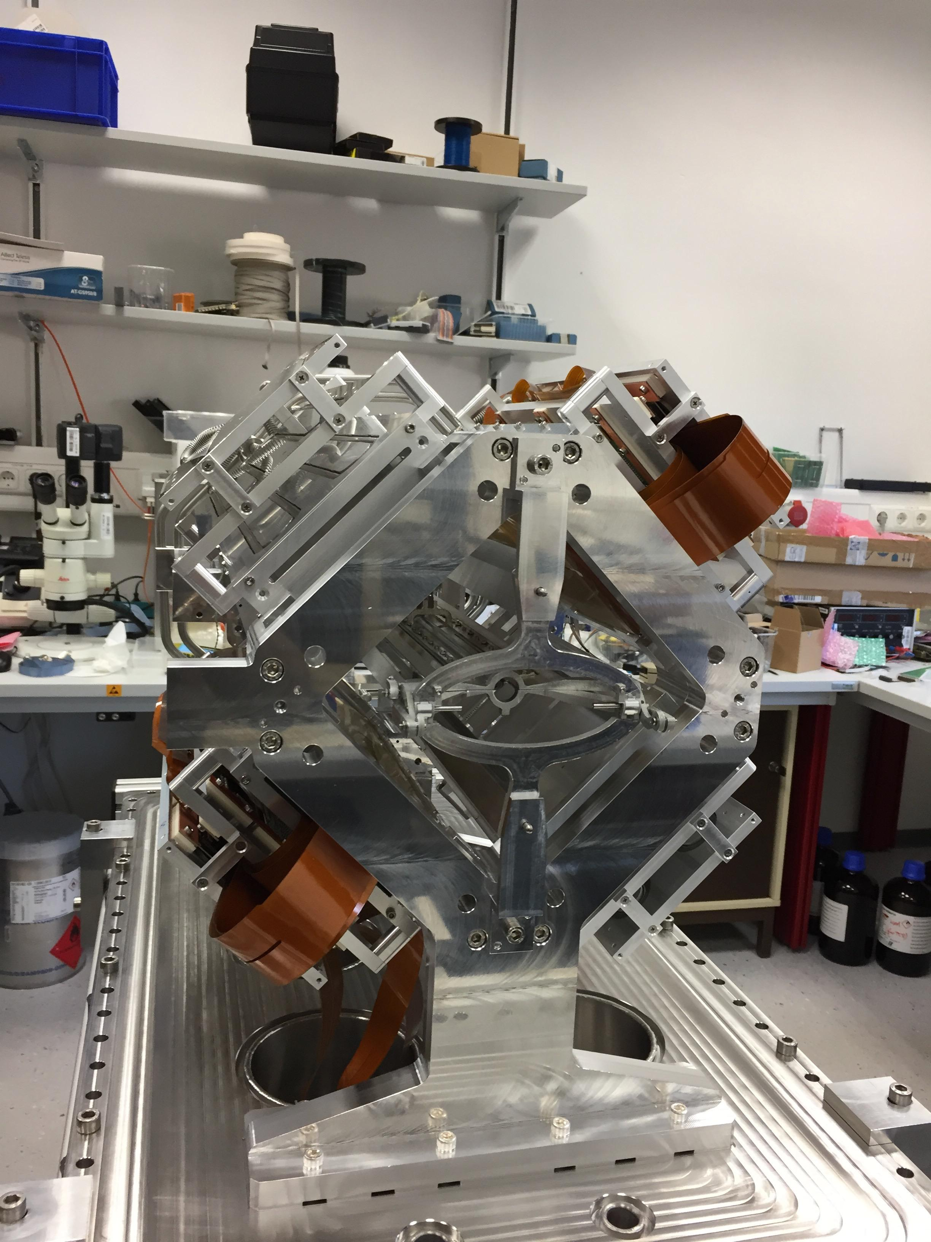

PAX Detector
Installed at PAX section for commissioning with 2 quadrants
Unpolarized $p$ beam vs. polarized $d$ target
Identification of $p$-$d$ elastic events

Slide 7
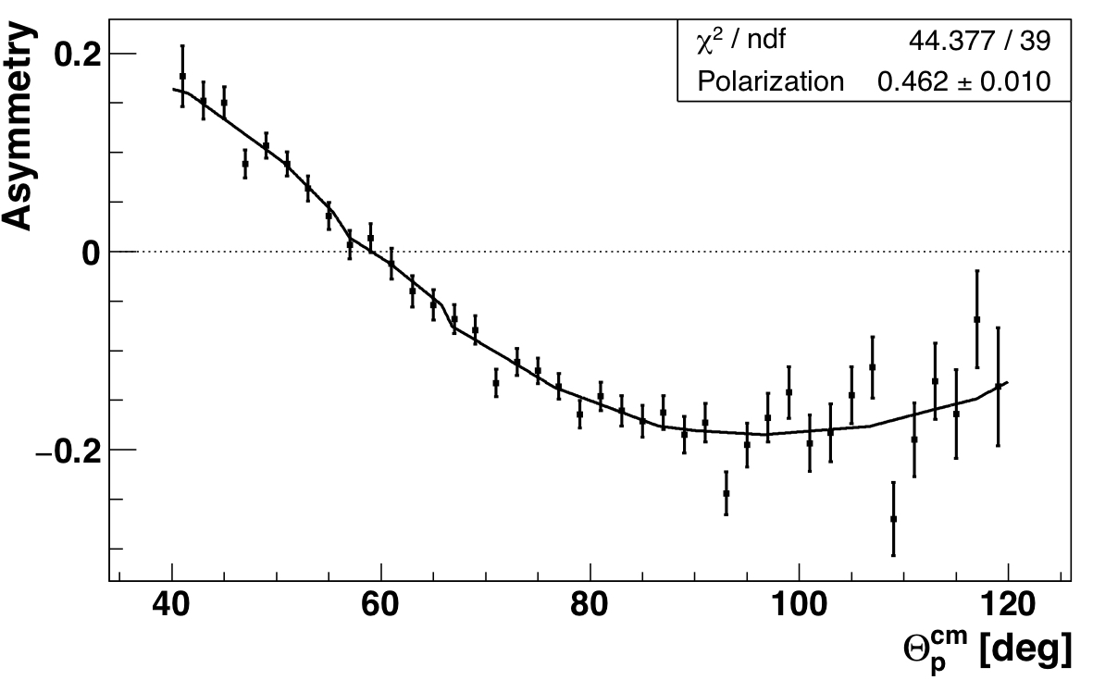
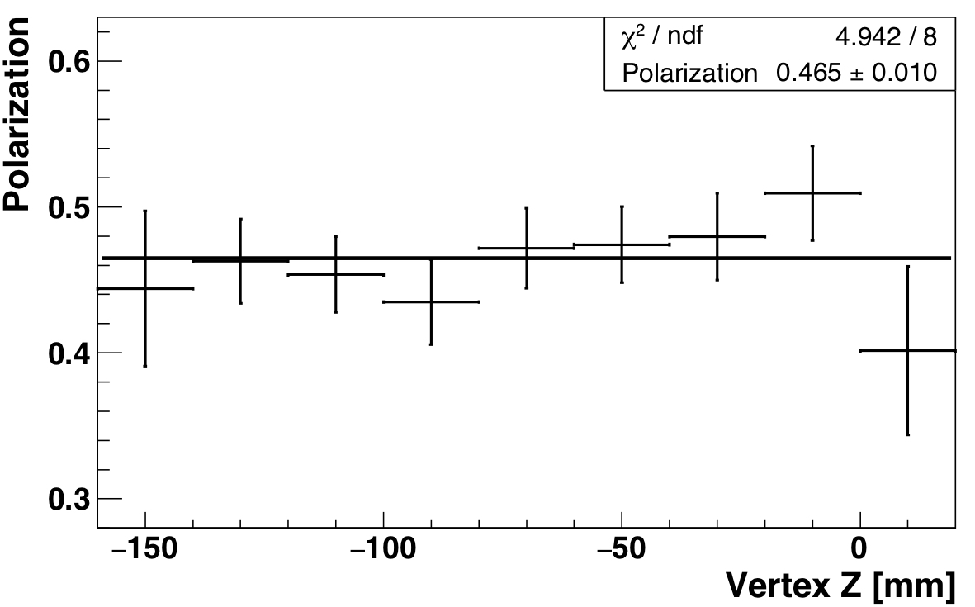

Commissioning of PAX detetctor with 2 quadrants:
Determination of Target Polarisation
$$〈Q〉=0.462±0.010$$

Slide 8
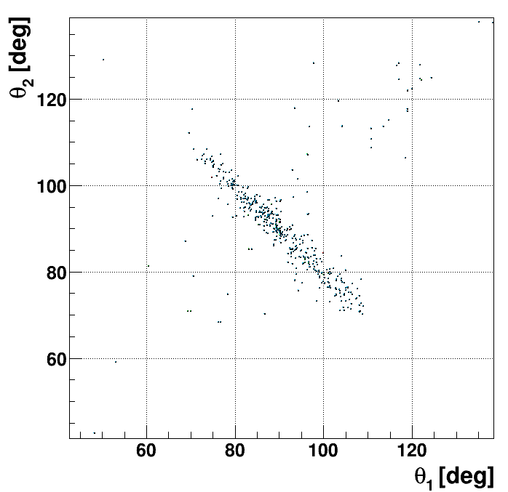
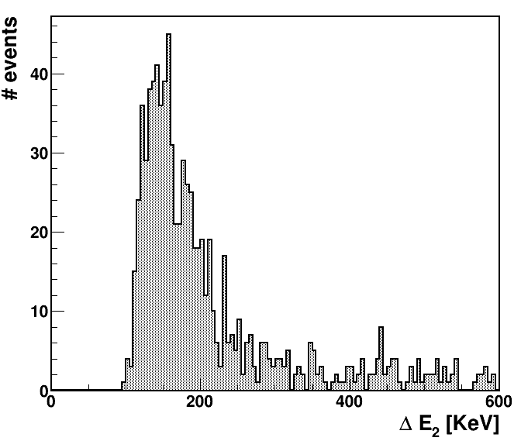
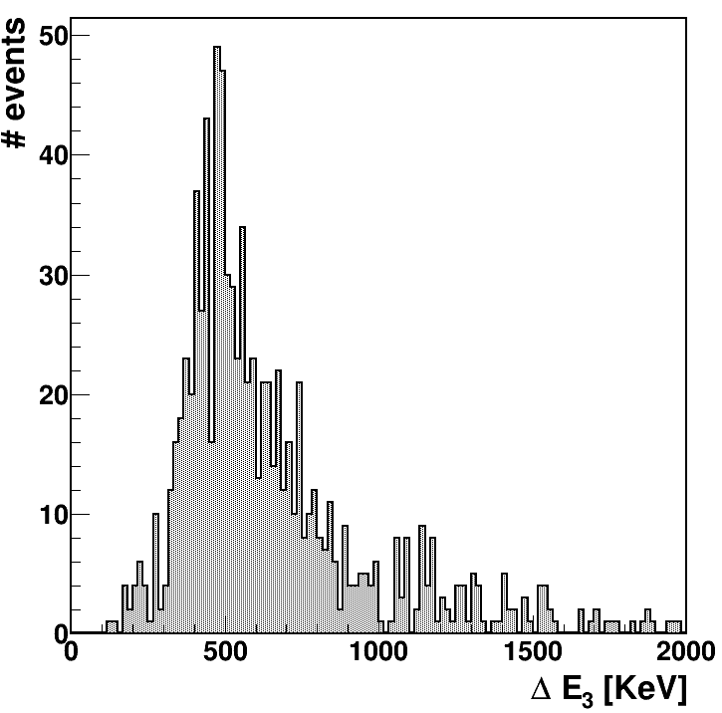
Commissioing of the full PAX detector 4 quads:
Cosmics Data
4 quadrants assembled!
Test bench for cosmics data acquisition set up in IKP

Slide 9
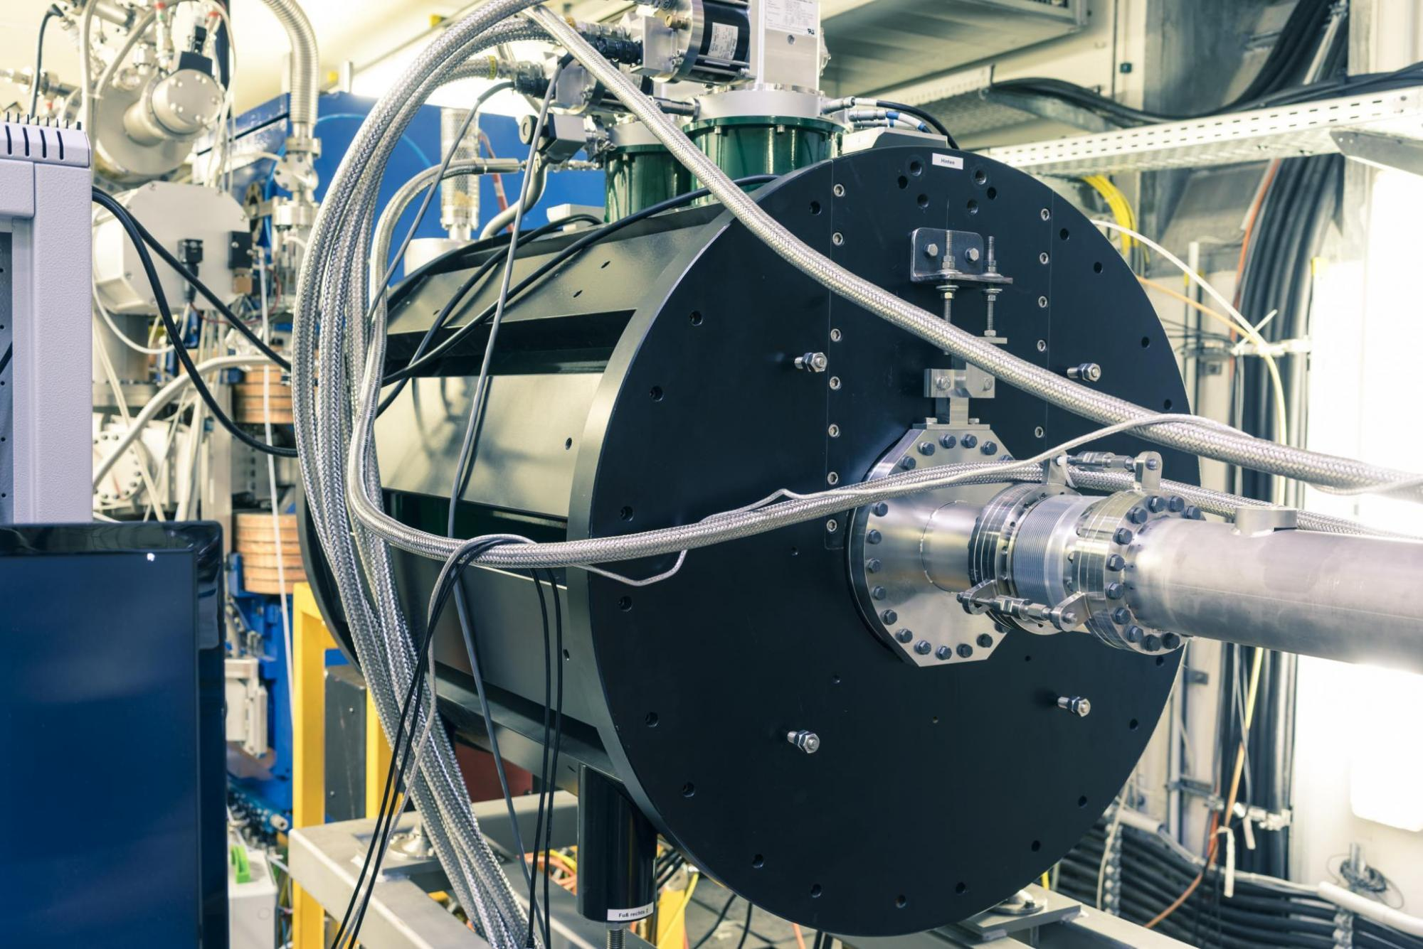
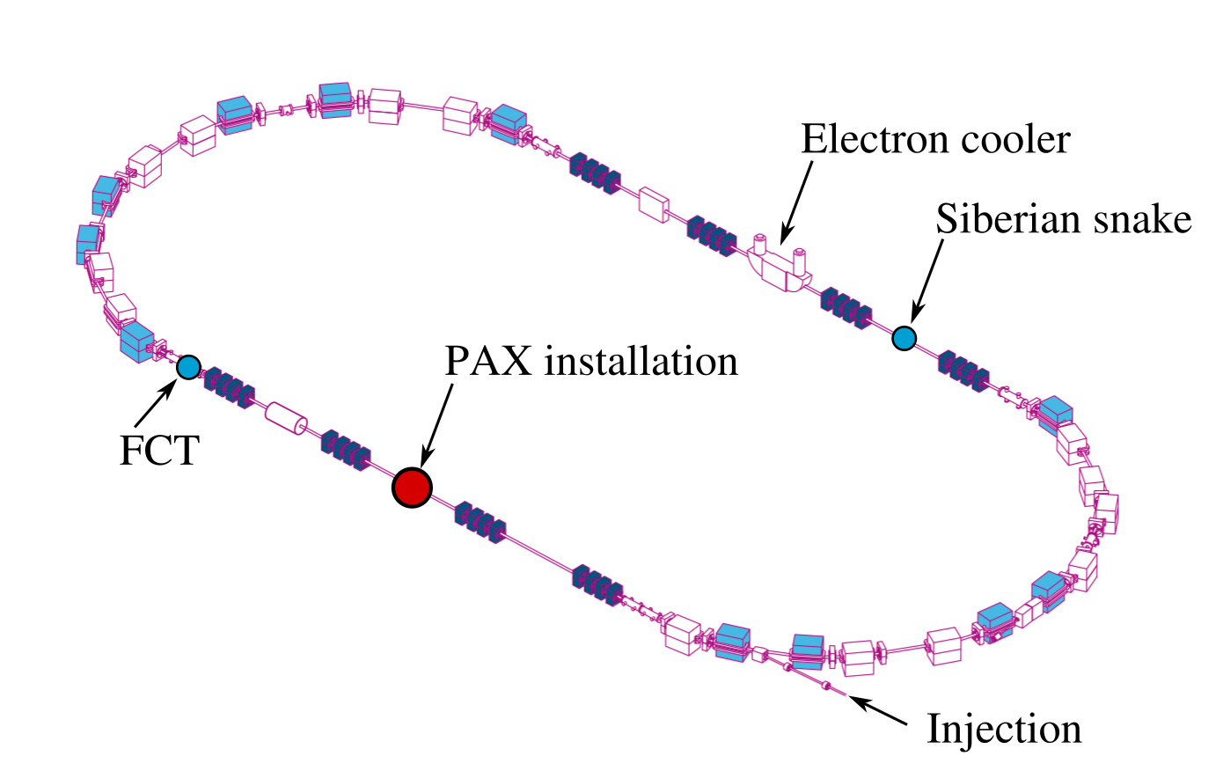
Siberian Snake
Installed in COSY @ ANKE place
First commissioning beam time in March 2020
Will provide longitudinal polarization at PAX-IP

Slide 10
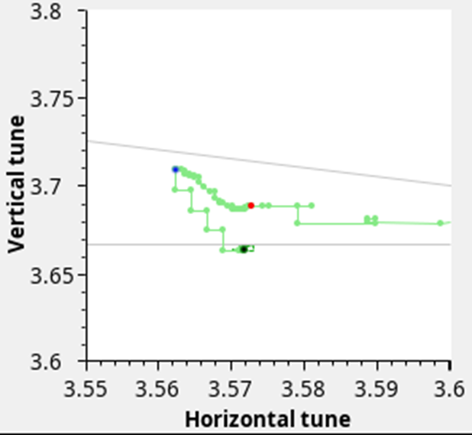
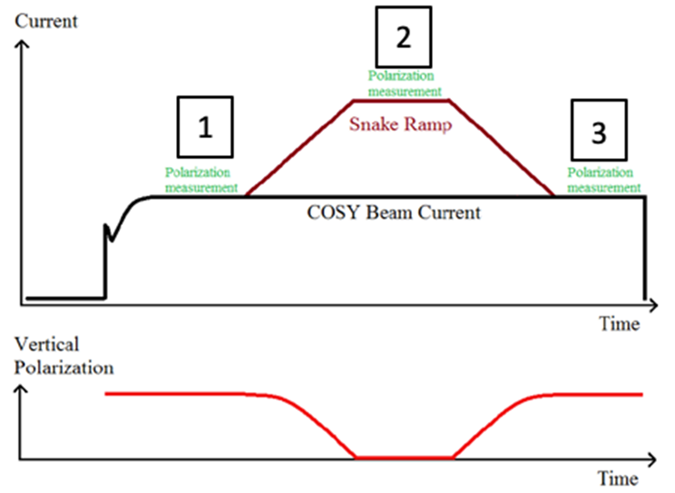
Siberian Snake
  Tune shift observed during Snake ramp

Slide 11
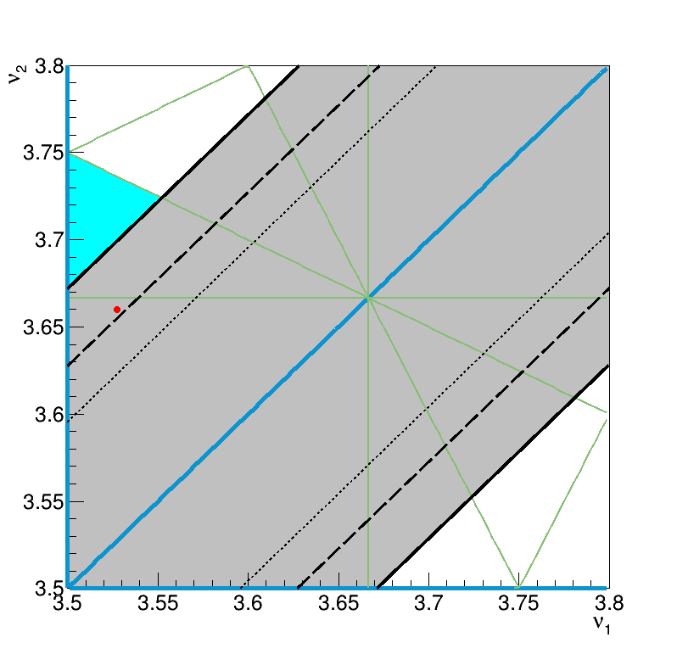
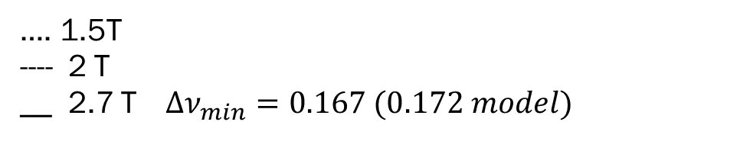
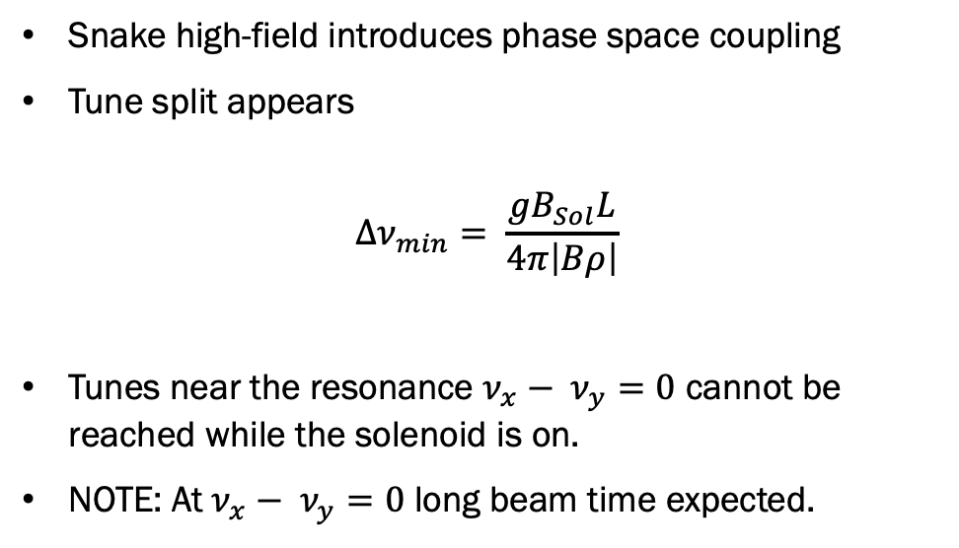
Siberian Snake
Snake high-field introduces phase space coupling
Tune split appears
$$∆ν_{min}= \frac{gB_{Sol}L}{4π\left|Bρ\right|}$$
Tunes near the resonance $ν_{x}− ν_{y}=0$ cannot be reached while the solenoid is on.
NOTE: At $ν_{x}− ν_{y}=0$ long beam time expected.
…. 1.5T
---- 2 T
__ 2.7 T $∆ν_{min}=0.167 (0.172 model)$

Slide 12
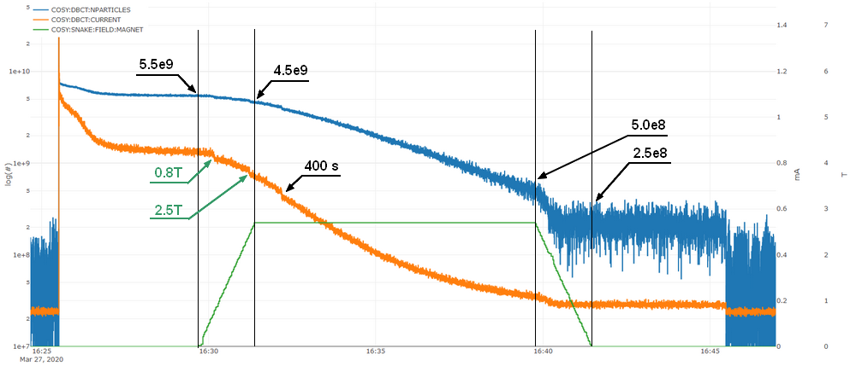

Siberian Snake
Initial Tunes: $ν_{x}= 3.572$; $ν_{y}= 3.688$
Flattop @ 2.7 $T$
MQU1/MQU5 and MQU2/MQU6 used to compensate the tune shift
$\sim 2.5×{10}^{8}$ particles survive after ramp-down
Jump | B_{Sol} | MQU 1,5 | MQU 2,6 | MQU 4
I | 0.0 T | 123% | -23% | 185%
II | 0.0 T – 1.5 T | -23% | -8.5 | 0.0%
III | 1.5 T – 2.4 T | -90% | 11% | 0.0%
IV | 2.4 T – 2.7 T | -15% | 0.0% | 0.0%

Slide 13
Conclusions
MS70: Detector commissioning
  Commissioned in COSY with 2 assembled quadrants
  First measurement of target polarization
  4 quadrants completed and assembled and commissioned with cosmics data
MS71: Snake commissioning
  First commissioning beam time performed in March 2020
  Compensation of the tune shift induced by the solenoid
  Additional beam time would have been needed
MS72: Measurement of target and beam polarization
  First measurement of target polarization with the PAX detector
  Beam time would have been needed to perform beam polarization measurement
MS73: Predictions for spin-filtering with longitudinal polarization
  Simulations performed

Slide 14
Outlook
The PAX detector is fully assembled and functioning on a test bench in IKP, where data from cosmics has been collected and analyzed.
Discussion on how to decouple the tunes phase space when the siberian snake is on is ongoing.
IKP budget restrictions forced a revision of the COSY beam-time plans and an anticipated shut-down in 2023,
The assembled setup might be ready to perform measurements of pbar-p analyzing power at the ESR ring if antiprotons would be available at FAIR

