Slide 1
Annual Meeting
JRA10:Cryogenic Polarized Target Application Hartmut Dutz
Physikalisches Institut, Universität Bonn

Slide 2
Plan of the presentation
Progress achieved by the WP during the last year
  Recommissioning of the Dubna-Mainz dilution refrigerator (CryPTA:ScM, CryPTA:APT)
  Design of a combined holding coil system (CryPTA:ScM)
  Improved light efficiency read out (CryPTA:APT)
Important highlights of the performed work
Plans and remaining tasks until the end of the project (31 July 2024)
  Tilted coil configuration for frozen spin mode (CryPTA:ScM)
Conclusions

Slide 3
JRA10:CryPTA
Cooperation of four partners
Organization legal name | Short name | Activity leaders
Ruder Boskovic Institute Zagreb | RBI | M. Korolija
Ruhr-Universität Bochum | RUB | G. Reicherz
Rheinische Friedrich-Wilhelms-Universität Bonn | UBO | H. Dutz
Johannes Gutenberg Universität Mainz | UMainz | A. Thomas
M. Biroth, H. Dutz, St. Goertz, S. Heinz, A. Klotzbücher, M. Korolija,
O. Kostikov, V. Lagerquist, G. Reicherz, A. Thomas
→ Develop new polarized target technologies for future polarization experiments

Slide 4

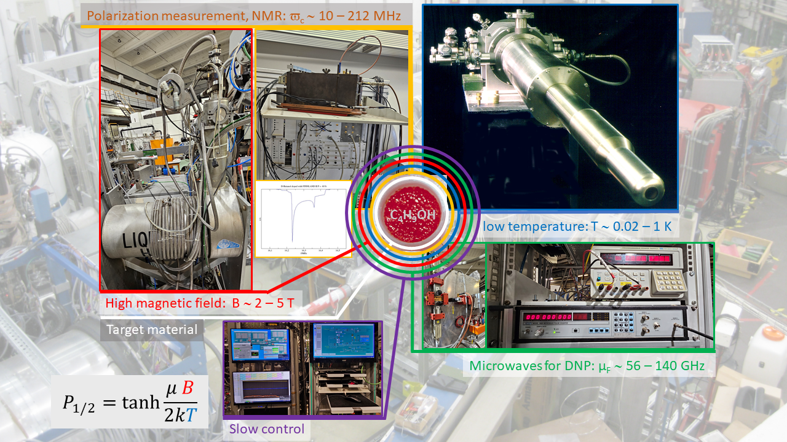



JRA10:CryPTA
PT-Ingrediencies and responsibilities
Low temperature
Refrigerator design and
operation
NMR
Target material preparation
and research
Target material preparation
and research
Magnet development
Slow Control
Cryogenic infrastructure
Microwaves
Active target material
preparation and research

Slide 5
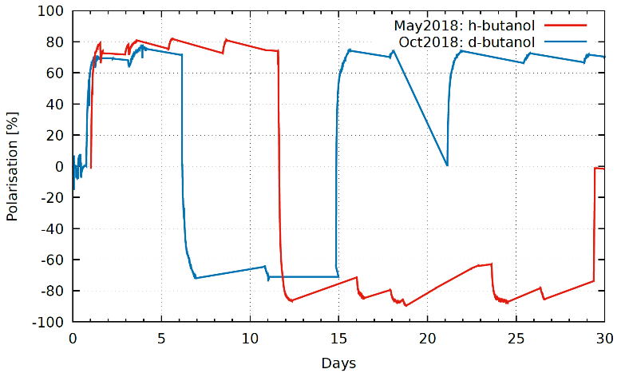
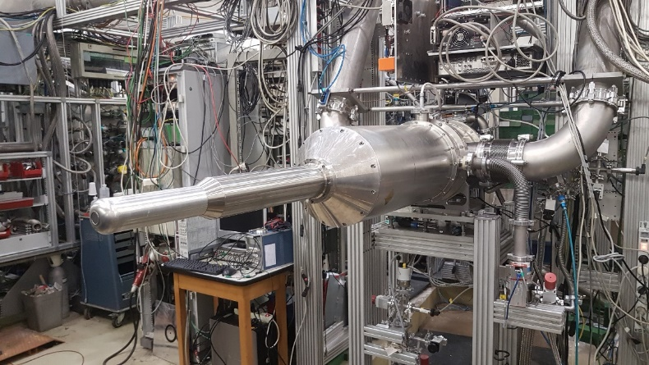
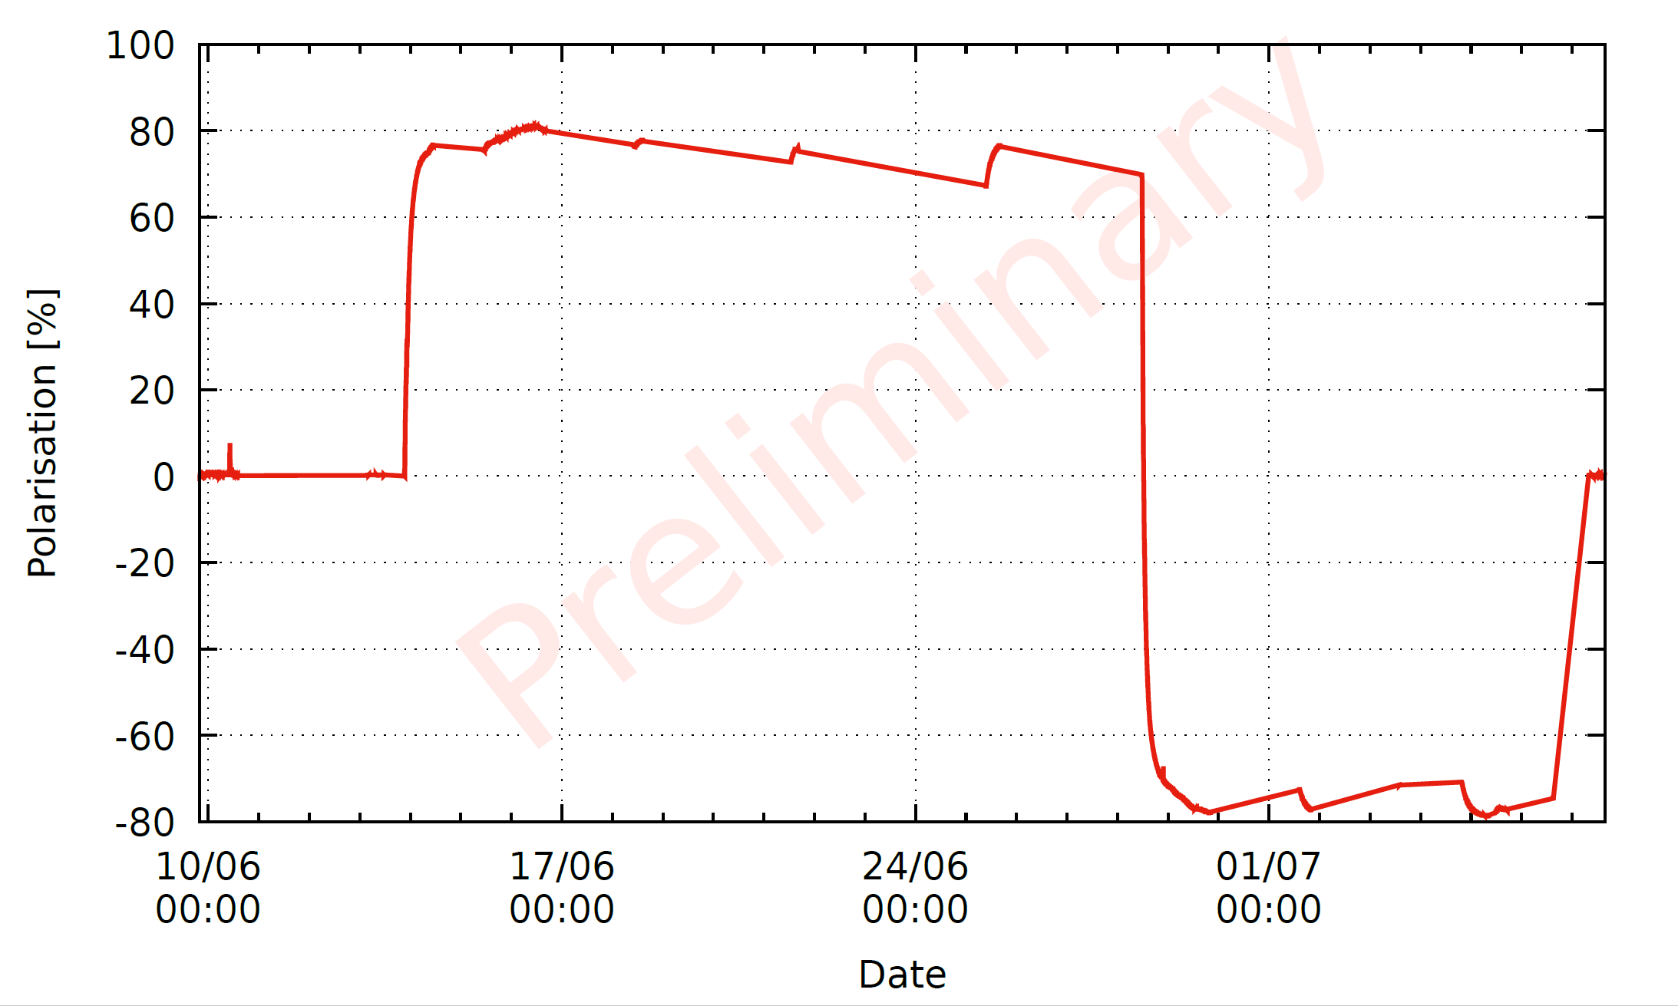
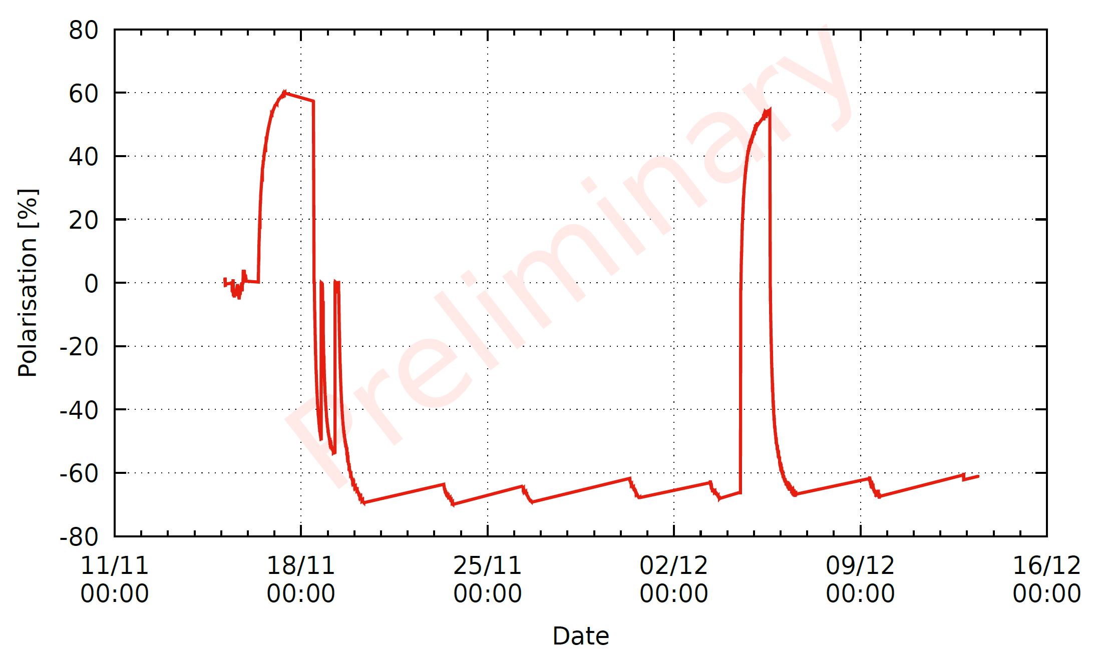
Recommissioning of the Dubna-Mainz dilution refrigerator
CBELSA/TAPS horizontal frozen spin target
with internal transverse or longitudinal holding magnet
Operation of the polarized target (cold cryostat) at
Crystal Barrel @ ELSA (CBELSA)
2017 (long. polarization) ∼ 800h b.o.t.
p_{p} = 63 %, (butanol, TEMPO), τ ∼ 1300h
2018 (transv. polarization) ∼ 1000h b.o.t.
p_{p} = 87 %, τ ∼ 500 h
2018 (transv. polarization) ∼ 800h b.o.t.
p_{d} = 76 %, τ ∼ 700 h
2019 (transv. polarization) ∼ 500h b.o.t.
p_{p} = 84 %, τ ∼ 800 h
2021 (transv. polarization) ∼ 440h b.o.t.
p_{p} = 78 %, τ ∼ 700 h
2021 (transv. polarization) ∼ 500h b.o.t.
p_{d} = 75 %, τ ∼ 500 h
Five years of successful operation on beam in Bonn and 8 years before at A2@MAMI
Polarization history plot
p/d-run 2018
Polarization history plot
June 2021
Collaborative target group: Bonn/Dubna/Mainz/Bochum (2015 – 2021)
‘Mainz/Dubna frozen spin target’ + internal ‘holding’ coil(s)
Polarization history plot
November 2021,
d-butanol
Dubna/Mainz dilution refrigerator is the
working horse for the PT projects

Slide 6
Recommissioning of the Dubna-Mainz dilution refrigerator
CBELSA/TAPS horizontal frozen spin target
with internal transverse or longitudinal holding magnet
Operation of the polarized target (cold cryostat) at
Crystal Barrel @ ELSA (CBELSA)
2017 (long. polarization) ∼ 800h b.o.t.
p_{p} = 63 %, (butanol, TEMPO), τ ∼ 1300h
2018 (transv. polarization) ∼ 1000h b.o.t.
p_{p} = 87 %, τ ∼ 500 h
2018 (transv. polarization) ∼ 800h b.o.t.
p_{d} = 76 %, τ ∼ 700 h
2019 (transv. polarization) ∼ 500h b.o.t.
p_{p} = 84 %, τ ∼ 800 h
2021 (transv. polarization) ∼ 440h b.o.t.
p_{p} = 78 %, τ ∼ 700 h
2021 (transv. polarization) ∼ 500h b.o.t.
p_{d} = 75 %, τ ∼ 500 h
Five years of successful operation on beam in Bonn and 8 years before at A2@MAMI
Polarization history plot
p/d-run 2018
All activities stopped in March 2022, because of the Russian invasion of the Ukraine
No refrigerator for the CryPTA-project for CryPTA:ScM and CryPTA:APT
No working refrigerator for the experiment
No reliable planning was (is) possible
Since no one (all) of us has operated the refrigerator in the past
Nevertheless we decided to cool down the system
Polarization history plot
June 2021
Collaborative target group: Bonn/Dubna/Mainz/Bochum (2015 – 2021)
‘Mainz/Dubna frozen spin target’ + internal ‘holding’ coil(s)
Polarization history plot
November 2021,
d-butanol
Dubna/Mainz dilution refrigerator is the
working horse for the PT projects

Slide 7
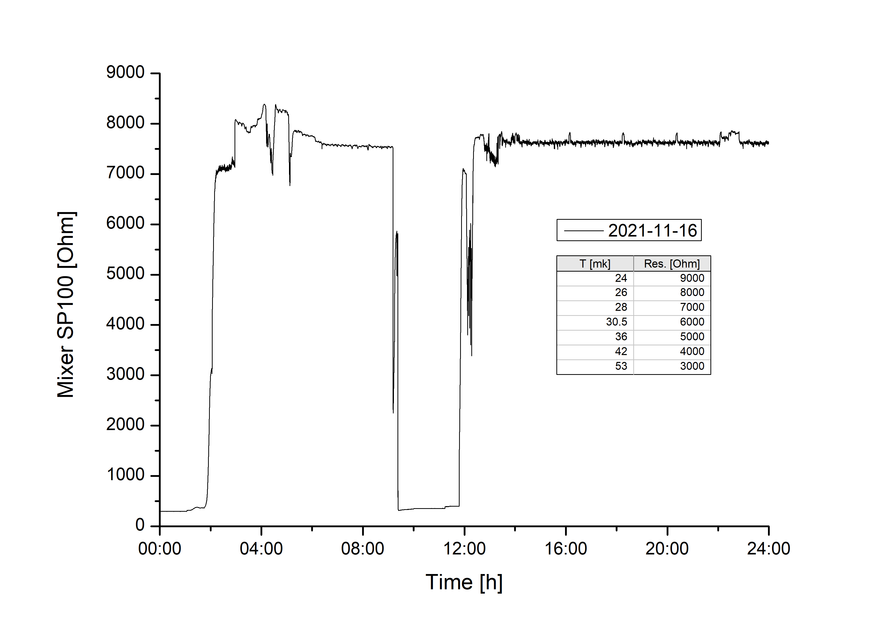
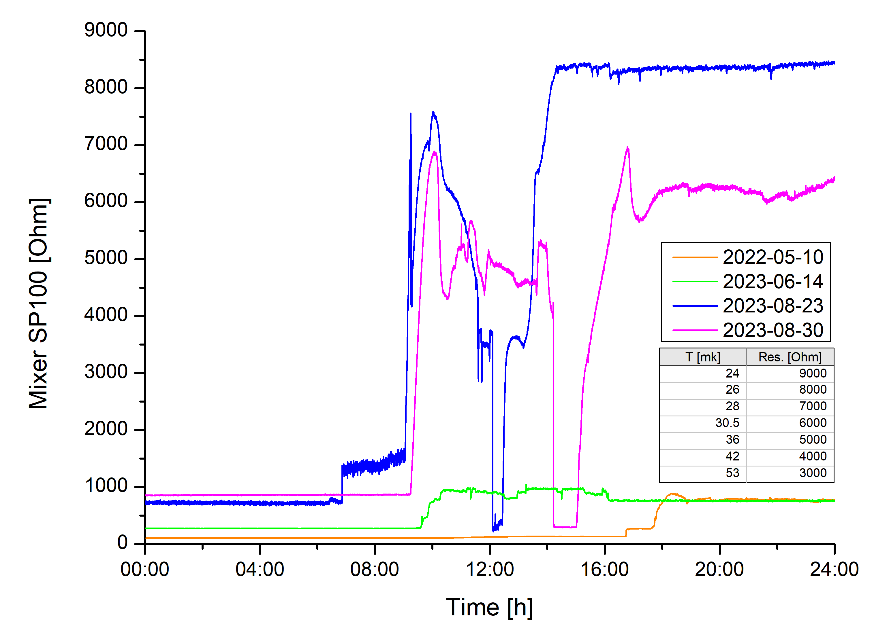
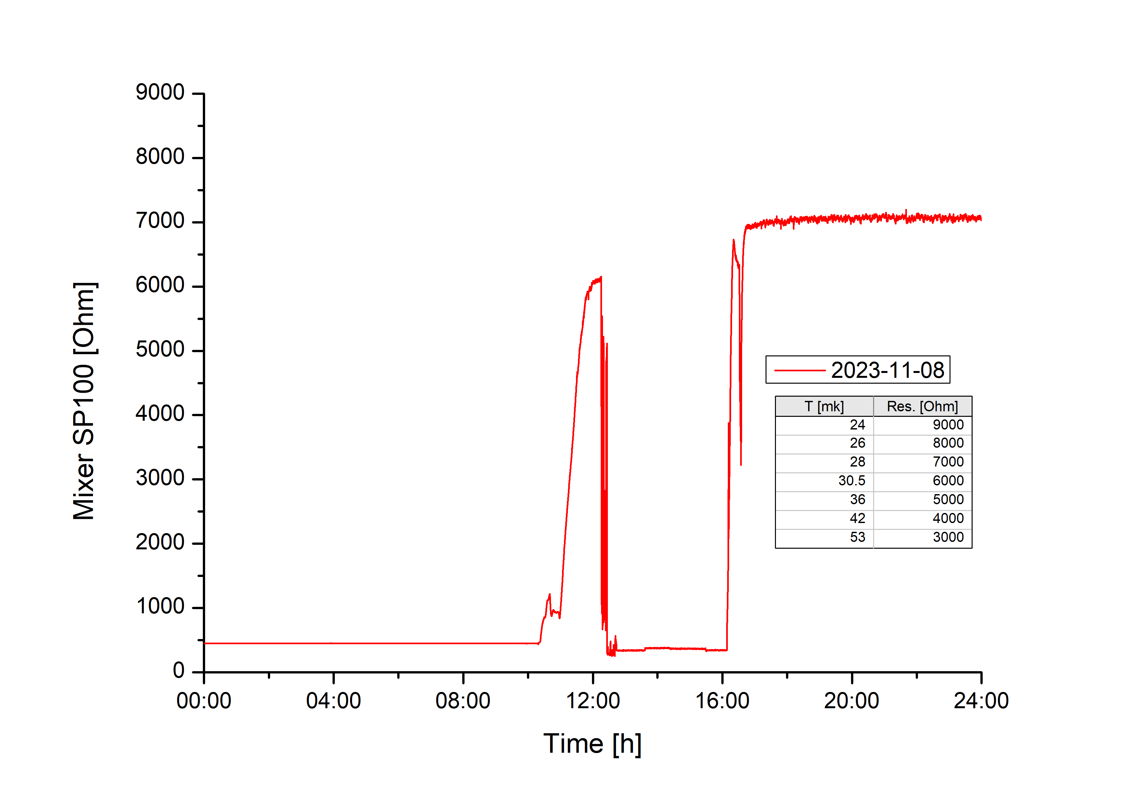
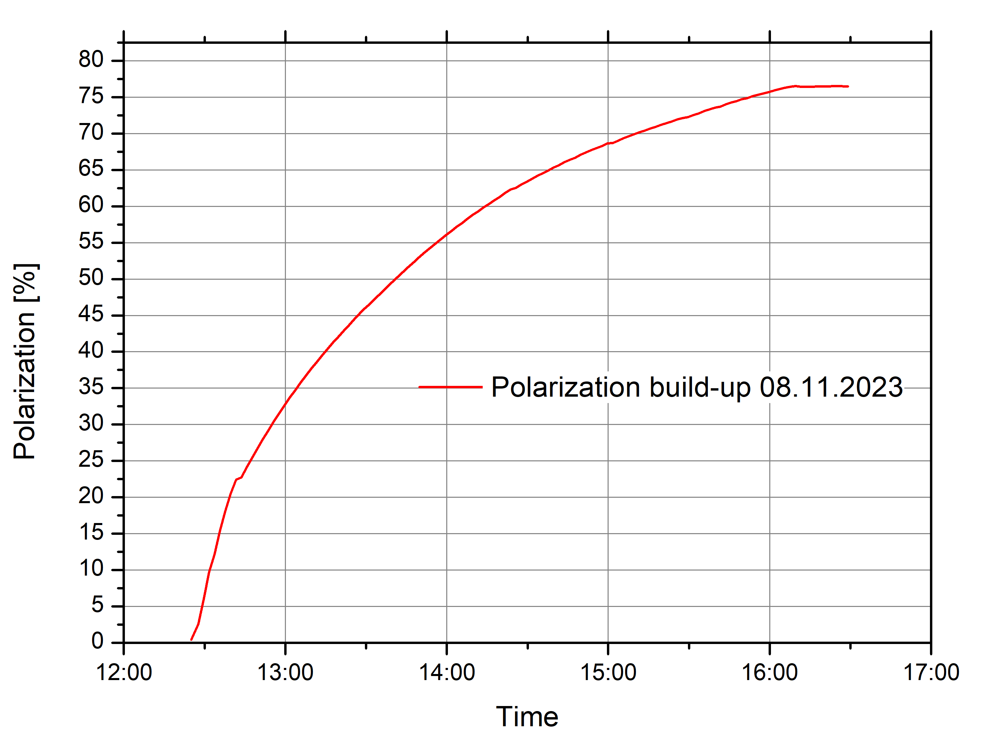
Recommissioning of the Dubna-Mainz dilution refrigerator
After one year of learning to cool down to < 28mK and testing, we could reestablish:
Reliable cool down procedure
Stable and reproduceable parameters for DNP
Good polarization for Butanol (76% in 4h)
Sufficient low temperatures (< 28 mK) for long relaxation times in frozen spin mode
(τ ∼ 2000h)
Next:
Being back in beam beginning next year
Combined internal coil project is now a high-priority work in progress
→ Important highlight of the performed work in 2023 →

Slide 8
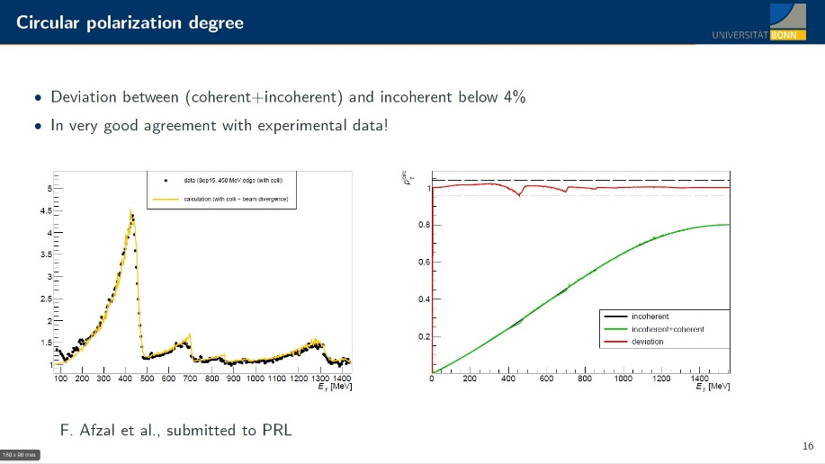
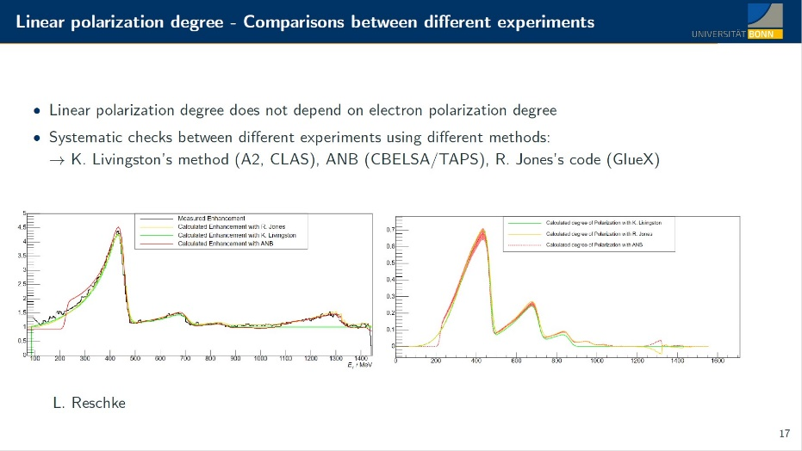
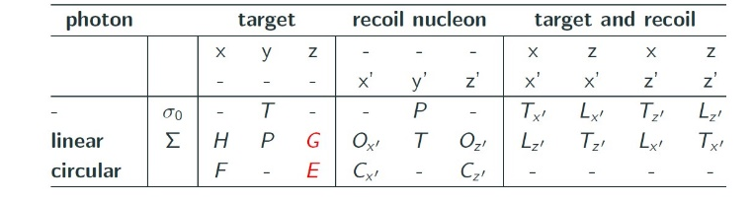

Design of a combined holding coil system (CryPTA:ScM)
New experimental approach in double polarized photo production experiments:
Longitudinal polarized electrons on a diamond radiator [F. Afzal et al., submitted to PRL. 2023]
Lets rotate the target polarization and measure them all

Slide 9
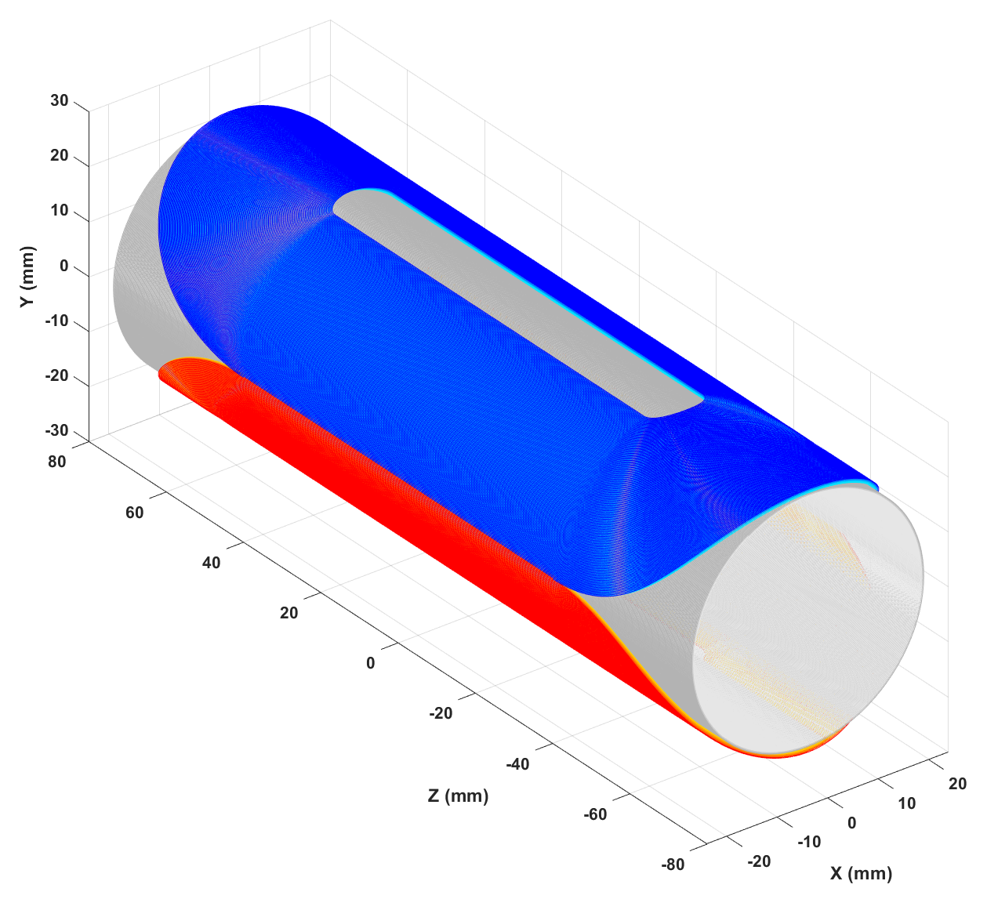
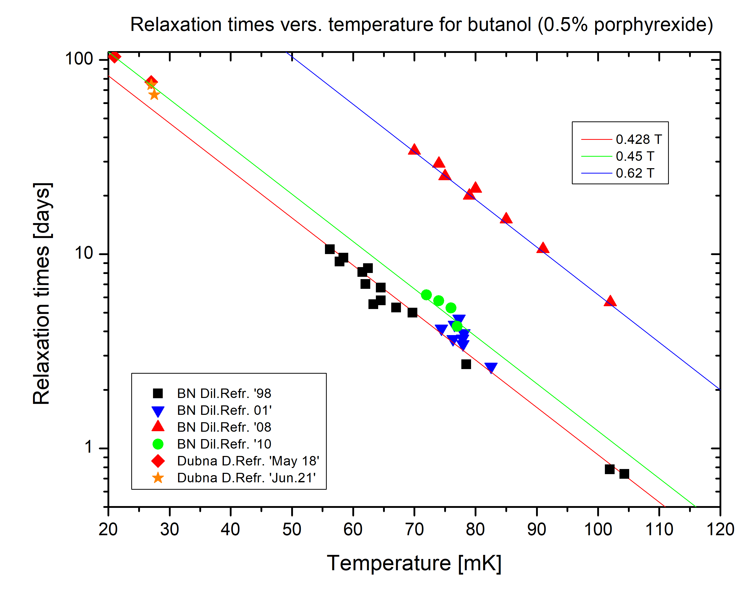
Design of a combined holding coil system (CryPTA:ScM)
Combined longitudinal and transverse field
for a variable polarization direction in yz-plane or xz-plane
→ Solenoid + ‘race-track’
Initial approach:
combine solenoid + race track
minimize radiation length
minimize thickness of the package
reduced field strength
concept only works as holding field
in frozen spin mode
0.4 T < B_{H} to get reasonable
relaxation times
Detailed studies and simulations are underway → V. Lagerquist

Slide 10
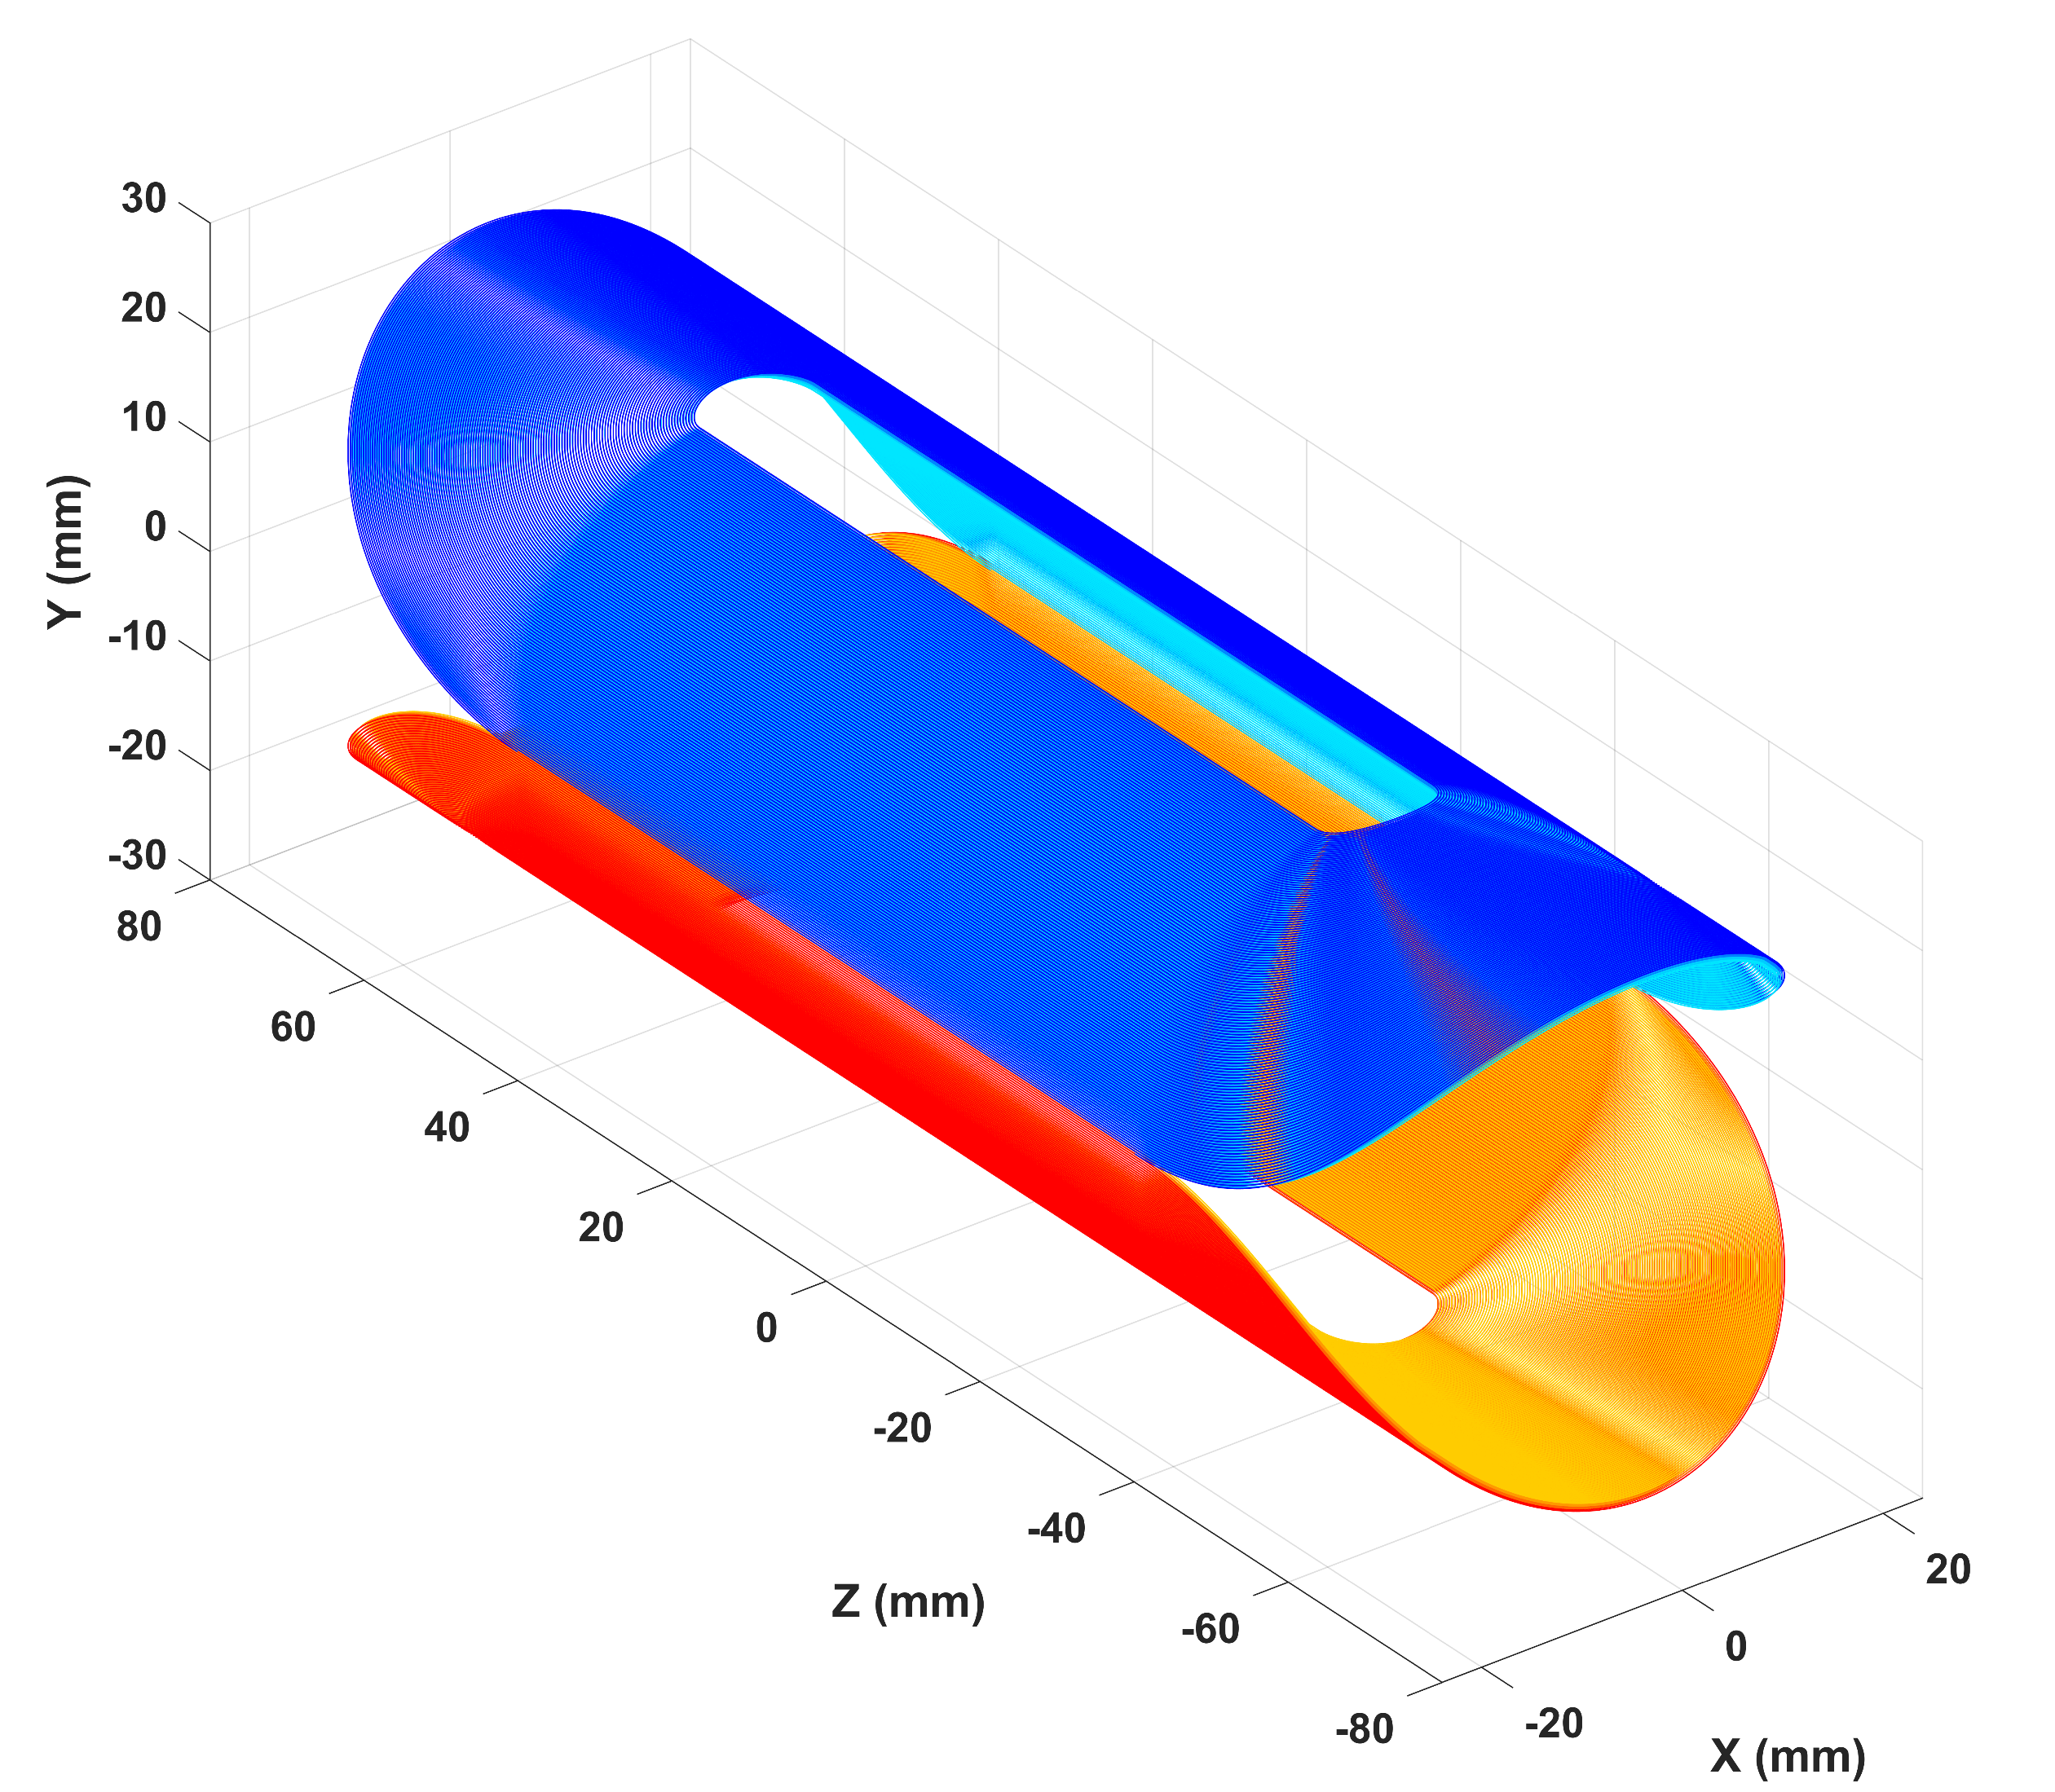
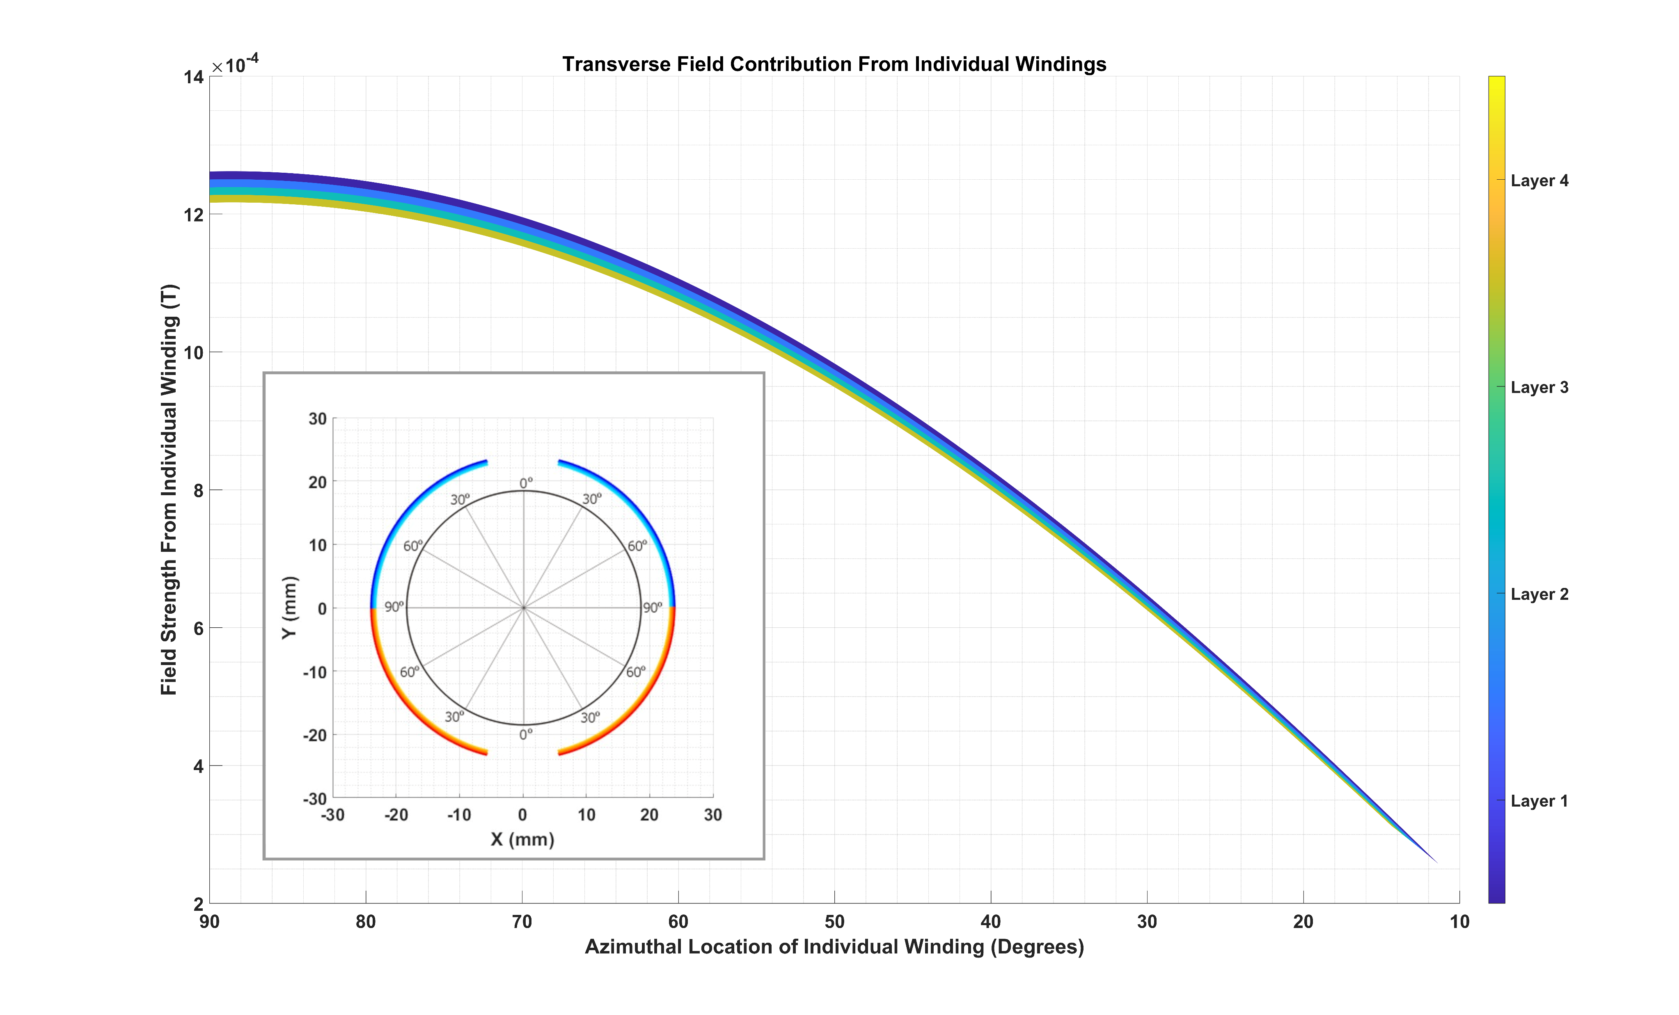
Design of a combined holding coil system (CryPTA:ScM)
Combined longitudinal and transverse field
for a variable polarization direction in yz-plane or xz-plane
→ Solenoid + ‘race-track’
Victoria Lagerquist, UBO
PostDoc STRONG2020, WP24
Maximum field, minimum thickness:
Cosine theta shape
Equal No. of windings per layer
Straight section angle ∼ 24°
Design / simulation boundary condition for the
compount:
field solenoid / race track B > 0.4 T
I_{nom} ≤ 40A
D = 45 mm / length = 150 mm
Almost homogeneous mass distribution
Final goal:
Optimize the compound for minimum thickness
with an available wire for the race-track (first) and
solenoid (easy task)
Notes:
Mantrel

Slide 11
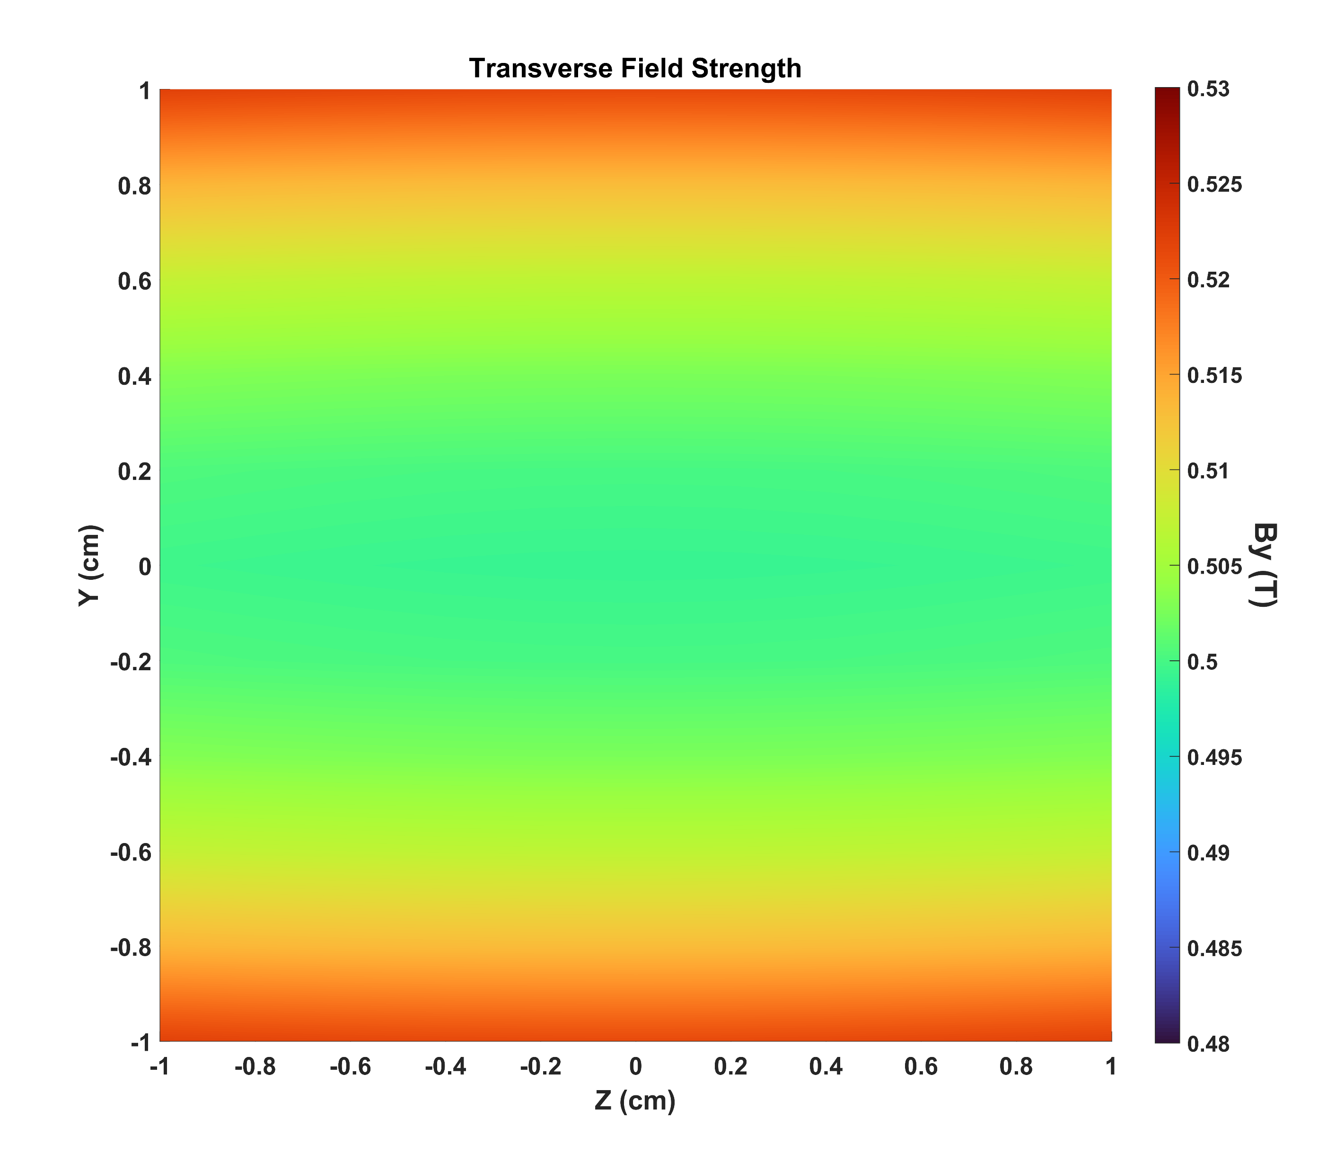
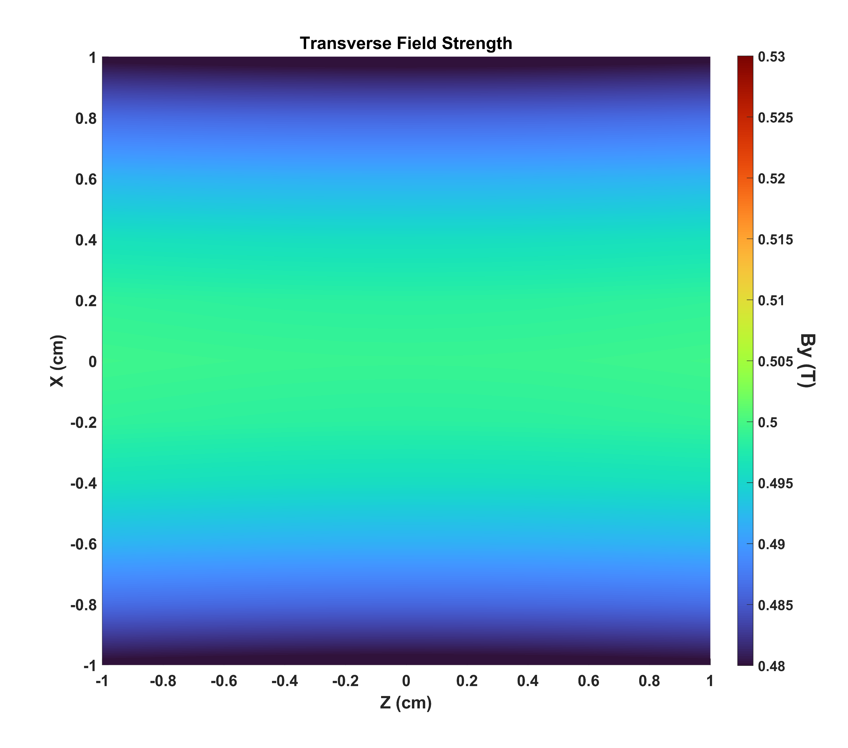
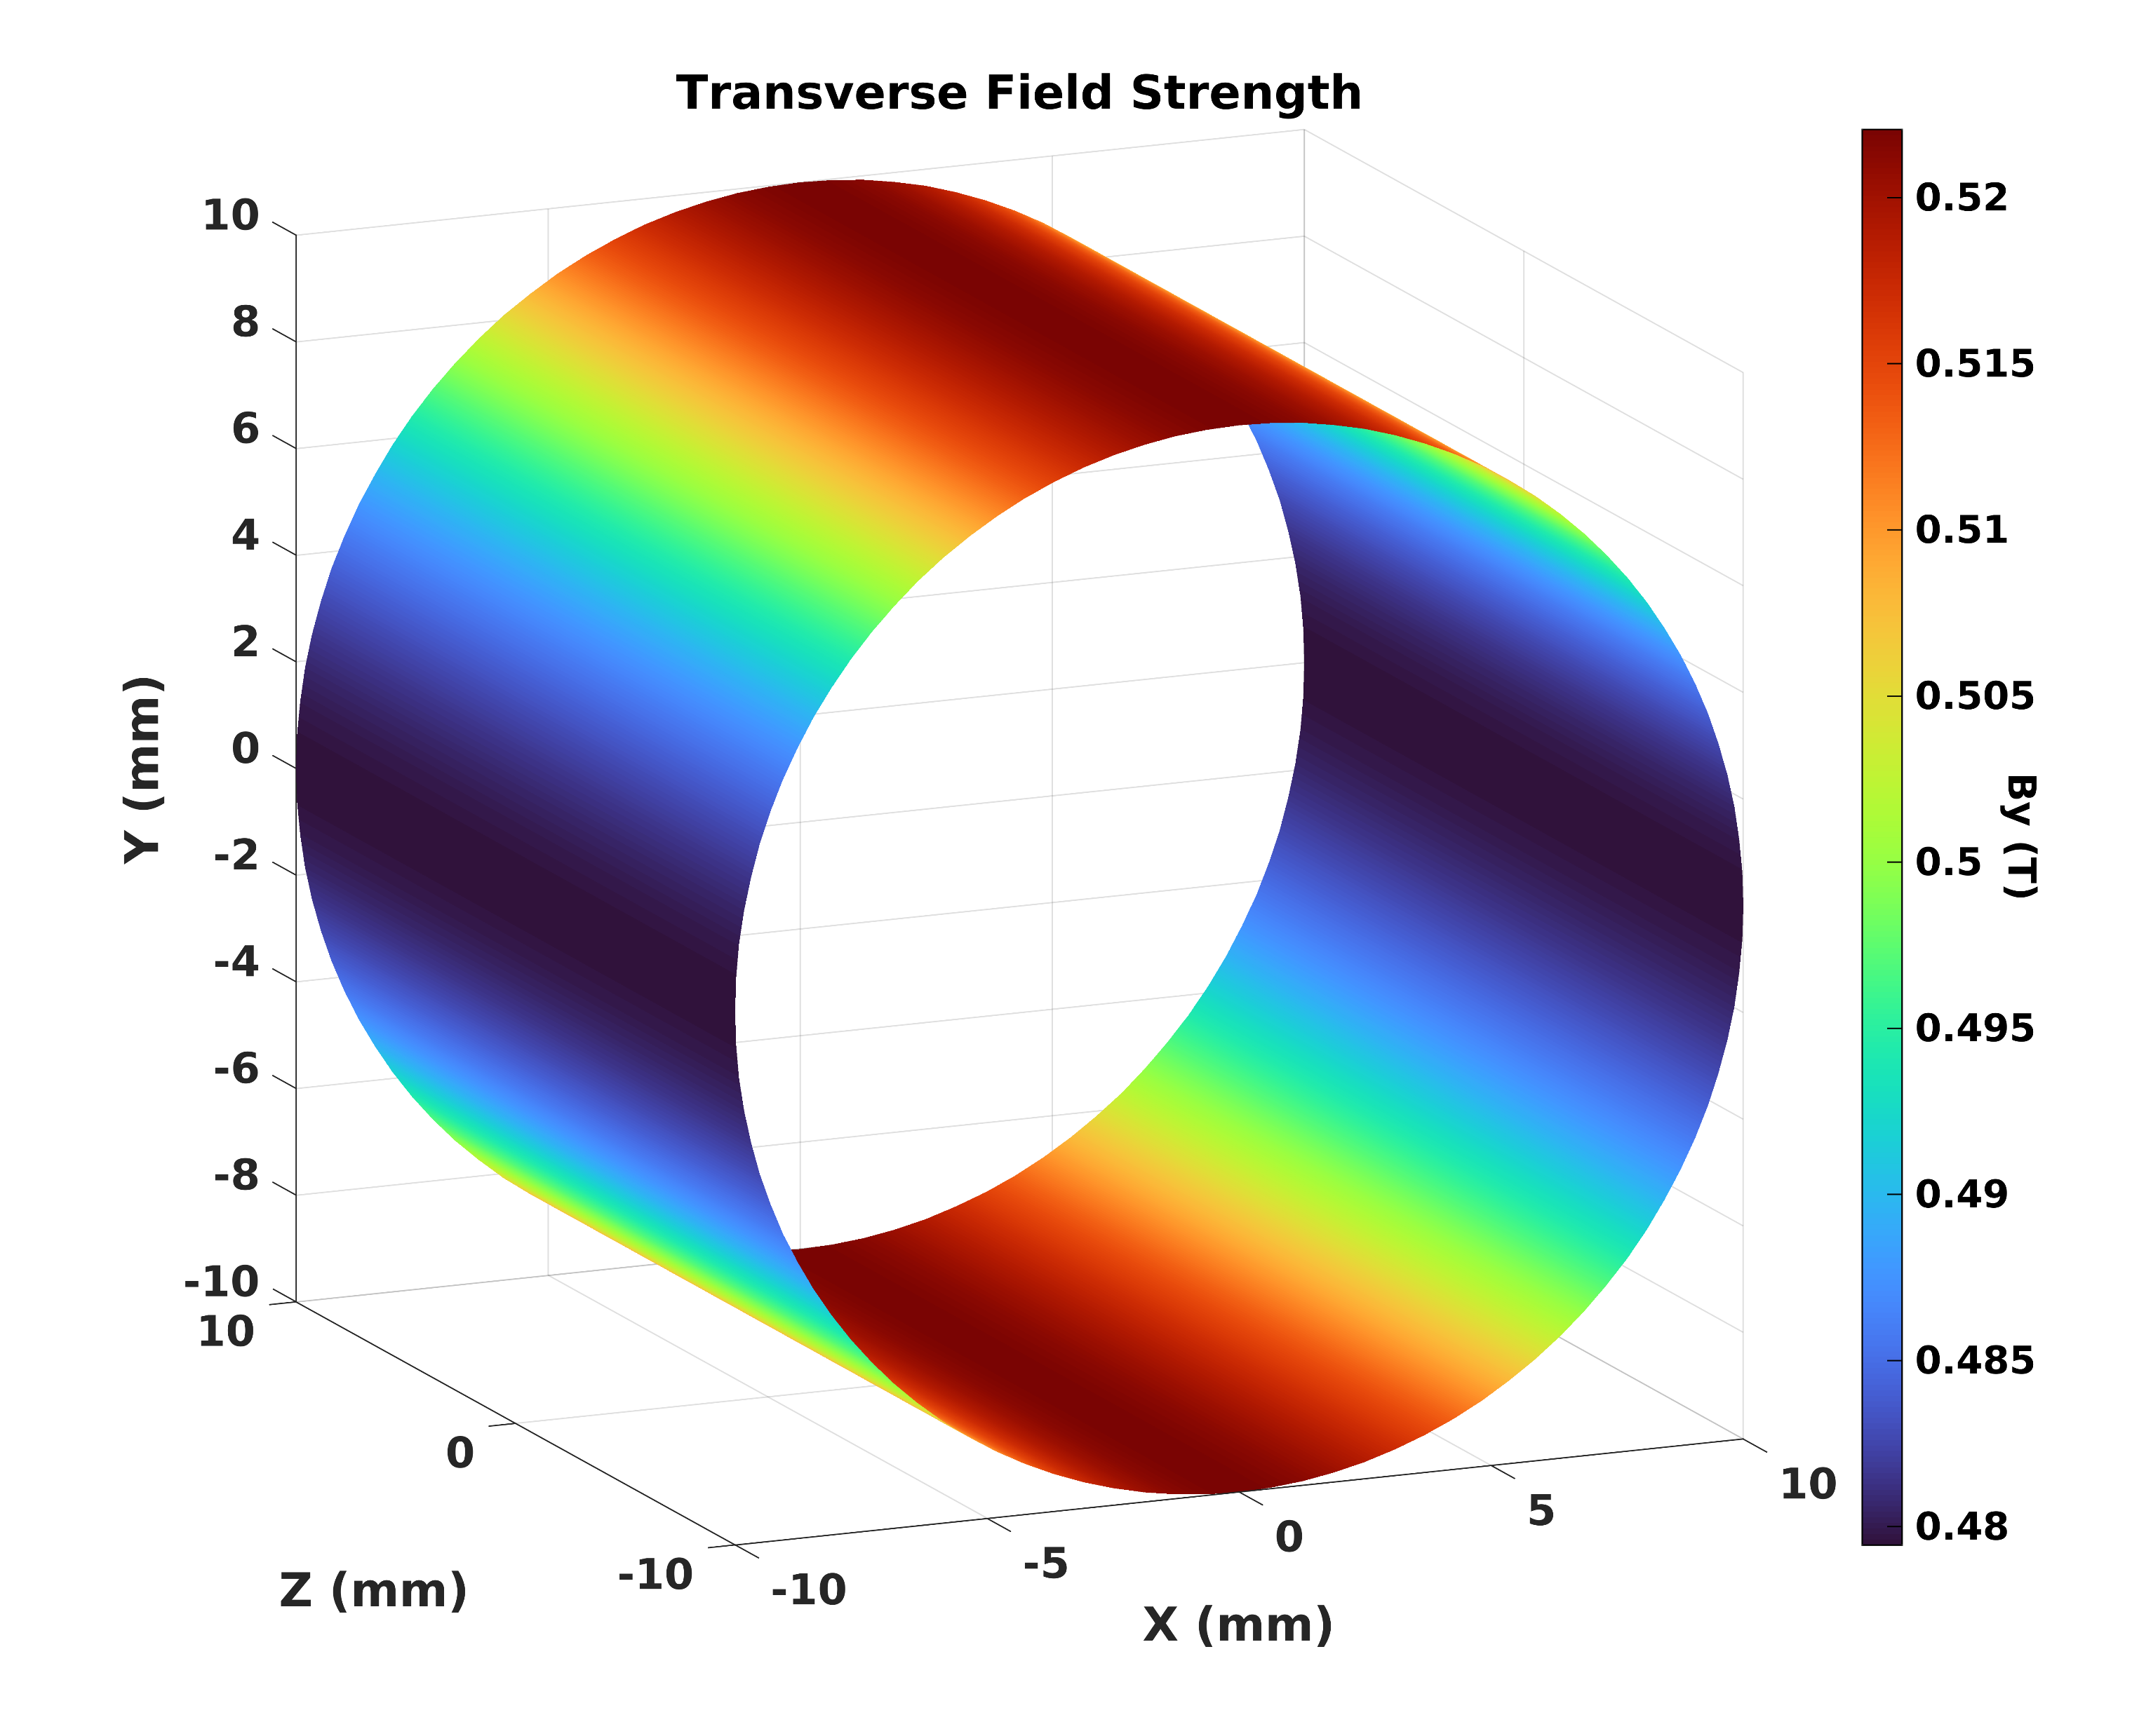
Design of a combined holding coil system (CryPTA:ScM)
Combined longitudinal and transverse field
for a variable polarization direction in yz-plane or xz-plane
→ Solenoid + ‘race-track’
Victoria Lagerquist, UBO
Maximum field, minimum thickness:
Cosine theta shape
Equal No. of windings per layer
Straight section angle ∼ 24°
Price to pay:
Field variation in target area ∼ 5%
Beam spot ∼ 2%
Corresponding τ variation has to
be measured
Field variation in yz-, xz-plane in target area
Field variation on target surface

Slide 12
Design of a combined holding coil system (CryPTA:ScM)
Combined longitudinal and transverse field
for a variable polarization direction in yz-plane or xz-plane
→ Solenoid + ‘race-track’
Victoria Lagerquist, UBO
Next steps:
(Plans and remaining tasks until the end of the project (31 July 2024))
Measure more τ(B)
Identify best scenario and
winding procedure
Wind race-track and solenoid
Test the combined coil system
2 compound scenarios possible:
(wire: 0.203/0.229 mm, Cu-support: 0.3 mm + separating foils)
‘high current’ I = 40 A → B = 0.4 T
Solenoid: 2 layers, N = 1280 → thickness: 0.45 mm
Race-track: 3 layers, N = 414 → thickness: 0.69 mm
Compound thickness: ∼ 1.6 mm
‘low current’ I = 35 A → B = 0.5 T
Solenoid: 3 layers, N = 1920 → thickness: 0.63 mm
Race-track: 4 layers, N = 552 → thickness: 0.92 mm
Compound thickness: ∼ 2.2 mm
Already strong interest in the technology by a SME for 3D-magnets
Or picking up an ‘old’ challenging idea: double helix configuration or canted cosine theta (cct) magnet

Slide 13
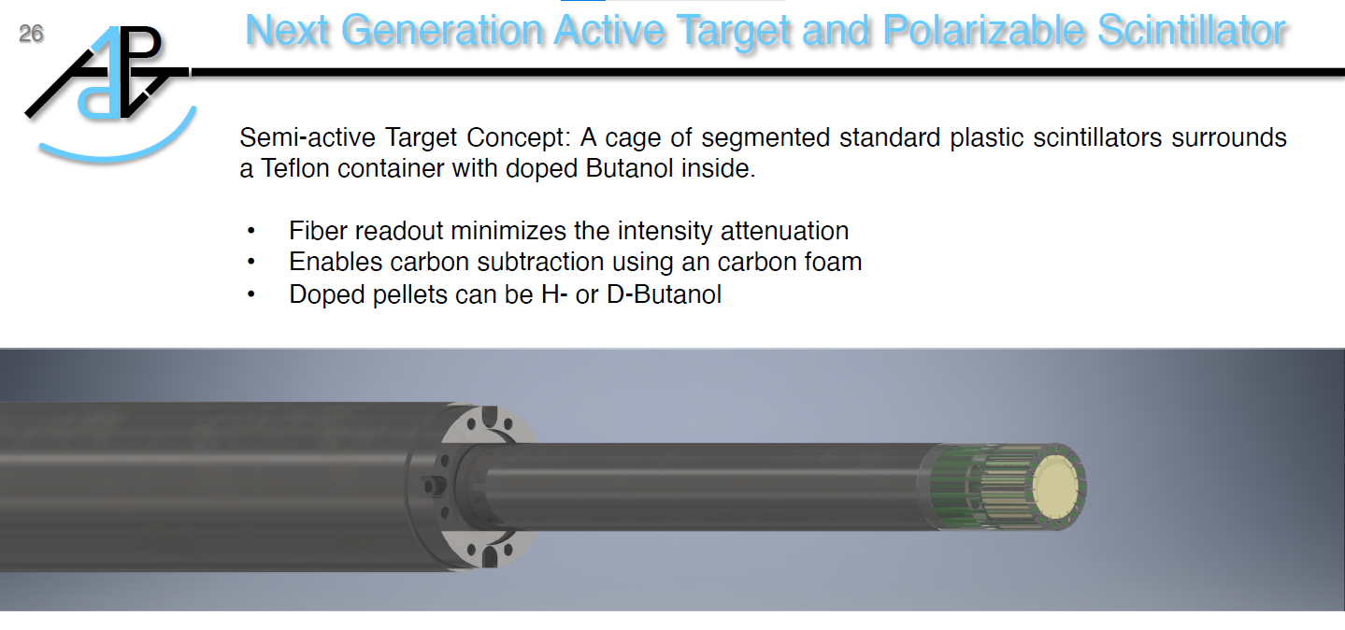
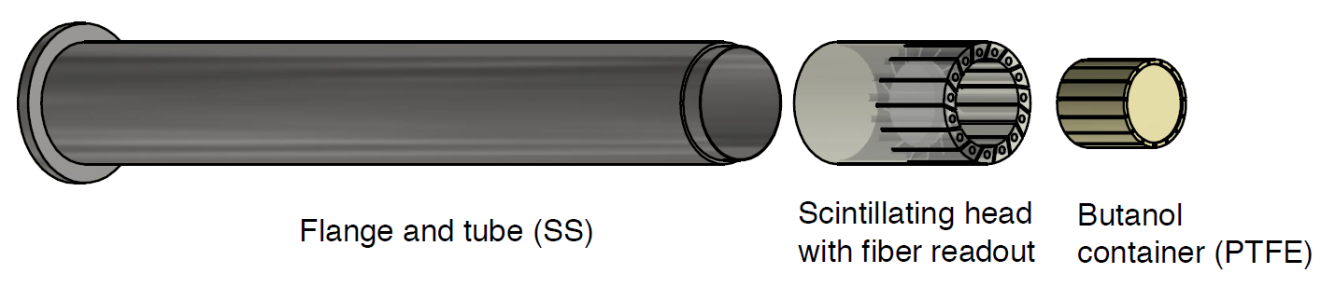
Improved light efficiency read out (CryPTA:APT)
New Apparatus:
M. Biroth, A.Thomas
Students (2023/2024):
BSc A.Klotzbücher,
BSc J.V.Patel
Focus on an improved light efficiency and readout under warm conditions:
Coupling of the scintillating fibers to the material and SiPMs
Geometry of the apparatus
Tests with ⁹⁰Sr-source
Tests with photon beam planned
Coincidence technique
to improve signal to noise ratio.
Light-tight test station with ⁹⁰Sr-Source and 3d-positioning

Slide 14
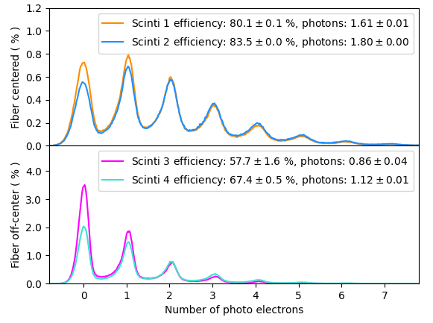
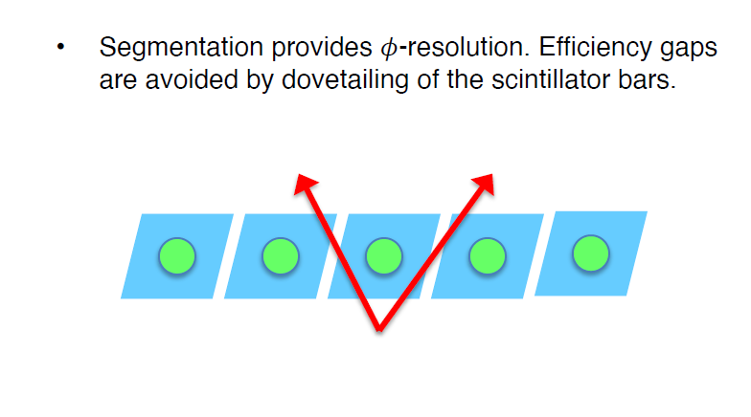
Improved light efficiency read out (CryPTA:APT)
Spectra for different geometrical configurations to specify the optimum with respect to the small dimensions (target 2cm x 2cm diameter) and the way of the fibers to the SiPMs in the cryostat.
Next steps:
(Plans and remaining tasks until the end of the project (31 July 2024))
Repeat same measurements at low temperatures
Design of a propriate insert and fiber feed throught
for the dilution refrigerator
Readout via optical fiber

Slide 15
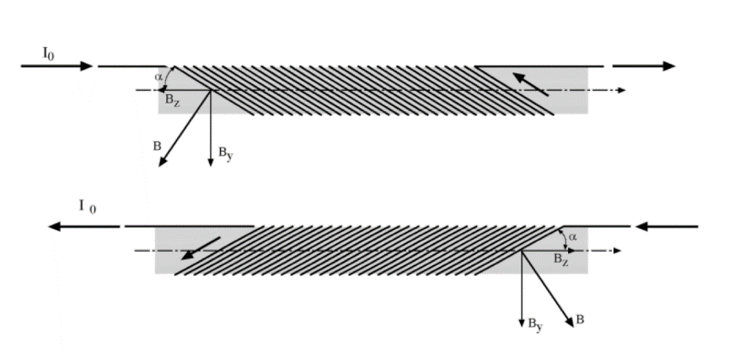
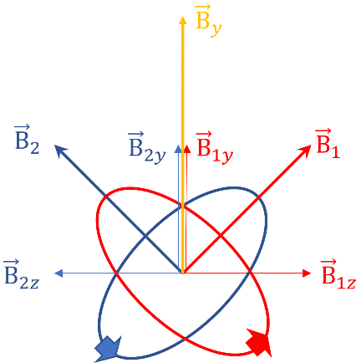
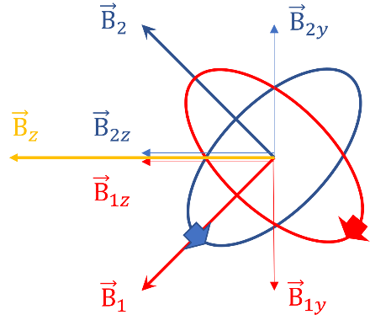









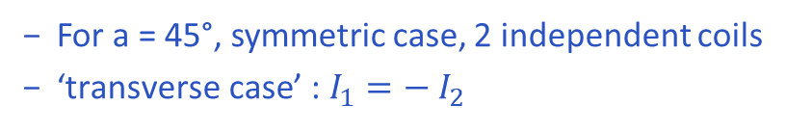


Tilted coil configuration for frozen spin mode (CryPTA:ScM)
Tilted coil configuration (TCC) for the new dilution refrigerator for a variable polarization direction in plane
‘canted cosine theta (CCT) magnet’
independent tilted coil (solenoid N) wound with a to z-axis
$$B_{y}= B_{S}\cos{α}$$
$$B_{S} \sim \frac{NI}{l}$$
C. L. Goodzeit et al., IEEE TRANSACTIONS ON APPLIED SUPERCONDUCTIVITY,
VOL. 13, NO. 2, JUNE 2003
$$B_{z}= B_{S}\sin{α}$$
For a = 45°, symmetric case, 2 independent coils
${\text{‘}\text{transverse} \text{case}\text{’}\text{ : }I}_{1}=− I_{2}$
$$I_{1}= {− I}_{2}$$
$$B_{y}= \sqrt{2}{∗B}_{S}$$
$$B_{z}=0$$
$$I_{1}= I_{2}$$
${\text{‘}\text{longituinal} \text{case}\text{’}\text{ : }I}_{1}= I_{2}$
$$B_{y}=0$$
$$B_{z}= \sqrt{2}{∗B}_{S}$$
In between: any field direction possible
$$B_{min}= B_{S}$$
15

Slide 16
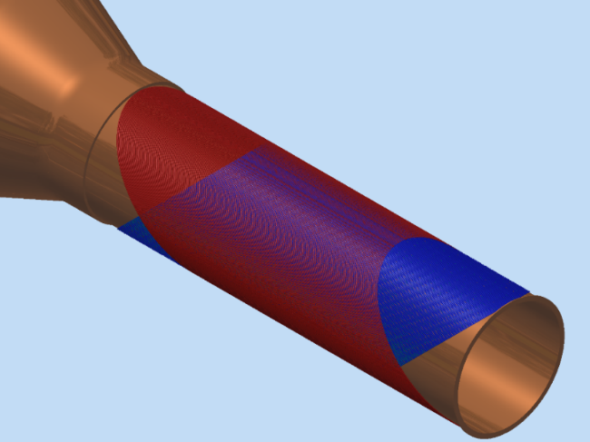
Tilted coil configuration for frozen spin mode (CryPTA:ScM)
Tilted coil configuration (TCC) for the new dilution refrigerator for a variable polarization direction in plane
‘canted cosine theta (CCT) magnet’
TCC Perfect solution for polarized target experiments:
Coupled TCC
homogeneous long. or transv. magnetic field
adjustable field direction
homogeneous mass distribution around the target
For a required B in a polarized target:
TCC needs to be longer than a standard solenoid
TCC needs more windings/layers or current
R.B. Meinke et al.: SUPERCONDUCTING DOUBLE-HELIX ACCELERATOR MAGNETS,
IEEE TRANSACTIONS ON APPLIED SUPERCONDUCTIVITY, VOL. 13, NO. 2, JUNE 2003
The real challenge:
Winding a 250 µm wire to a tilted coil
Our next task:
Full simulation needed (B, I, N, n_{L}, s.c.)
Wind (etching) a demonstrator coil (one layer)
uncoupled / independent TCC

Slide 17
Conclusions
Despite the unfavorable circumstances in the last 3 years
→ The complete target set-up is again available for experiments at ELSA, MAMI and the CryPTA project
CryPTA:ScM → the combined holding magnet for the dilution refrigerator and the near future data taking campaign is in progress.
CryPTA:APT → detailed design concepts for low temperature polarized active targets are defined.
→ the preparation of an improved target insert with optical fiber readout is on the way .
The extension gives us the opportunity to complete the project

