Slide 1
Annual Meeting
WP22 TMD-neXt,
Alessandro Bacchetta, INFN and U. Pavia

Slide 2
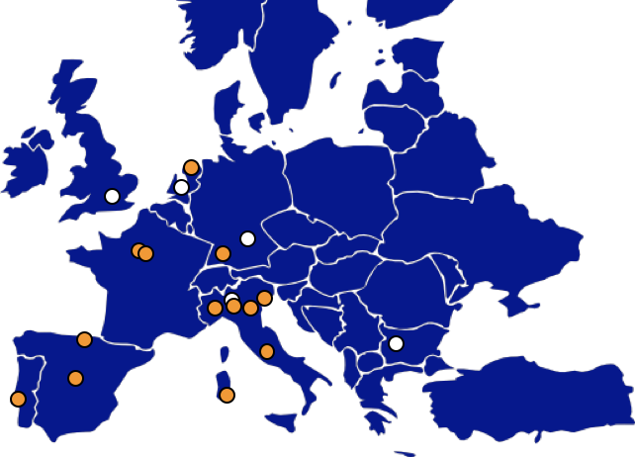
TMD-neXt network
INFN
  Frascati
  Cagliari
  Ferrara
  Pavia
  Torino
  Trieste
CEA/IRFU Saclay
CNRS/CPHT Palaiseau
University of the Basque Country, Bilbao
LIP, Lisbon
Universidad Complutense, Madrid
Rijksuniversiteit Groningen
University of Montenegro

Slide 3
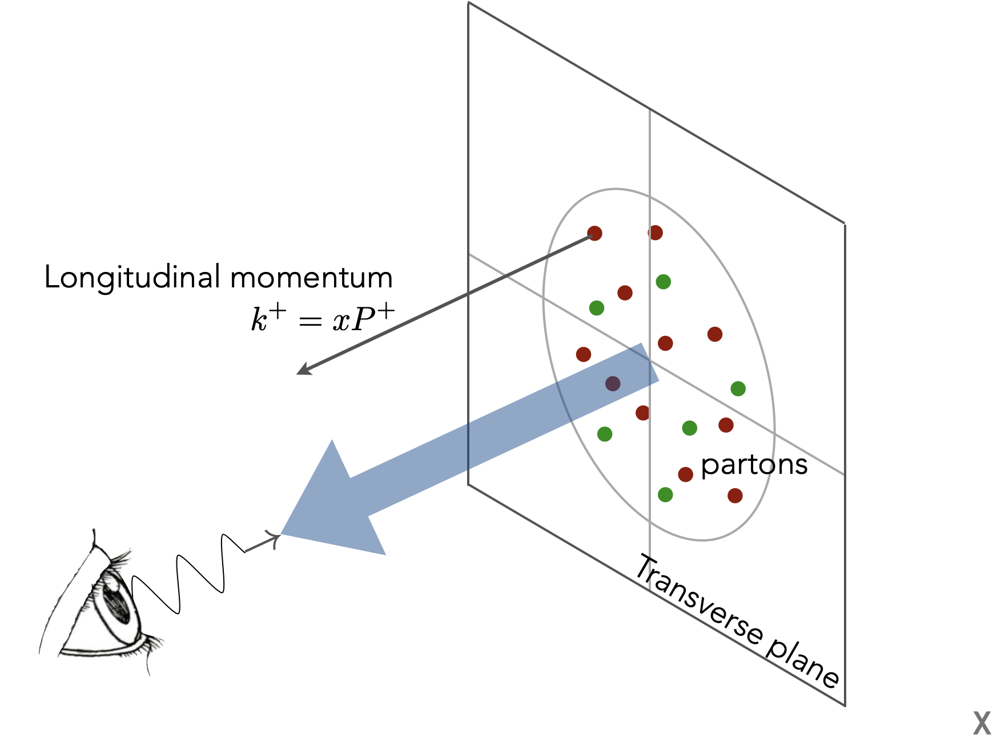
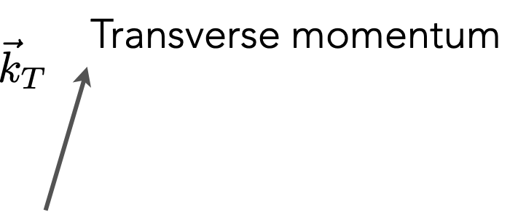
TMD-neXt goal
Study of transverse-momentum
distributions (TMDs)

Slide 4
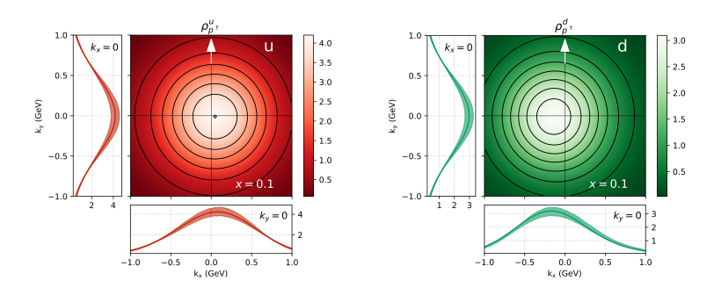
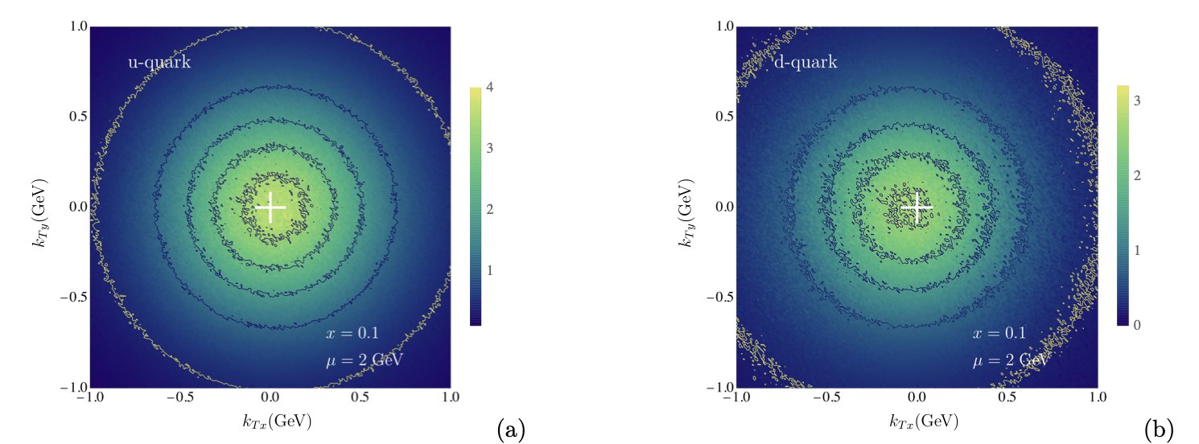
Example of what we achieved
Q= 2GeV
Bacchetta, Delcarro, Pisano, Radici, arXiv:2004.14278
Bury, Prokudin, Vladimirov, arXiv:2103.03270

Slide 5
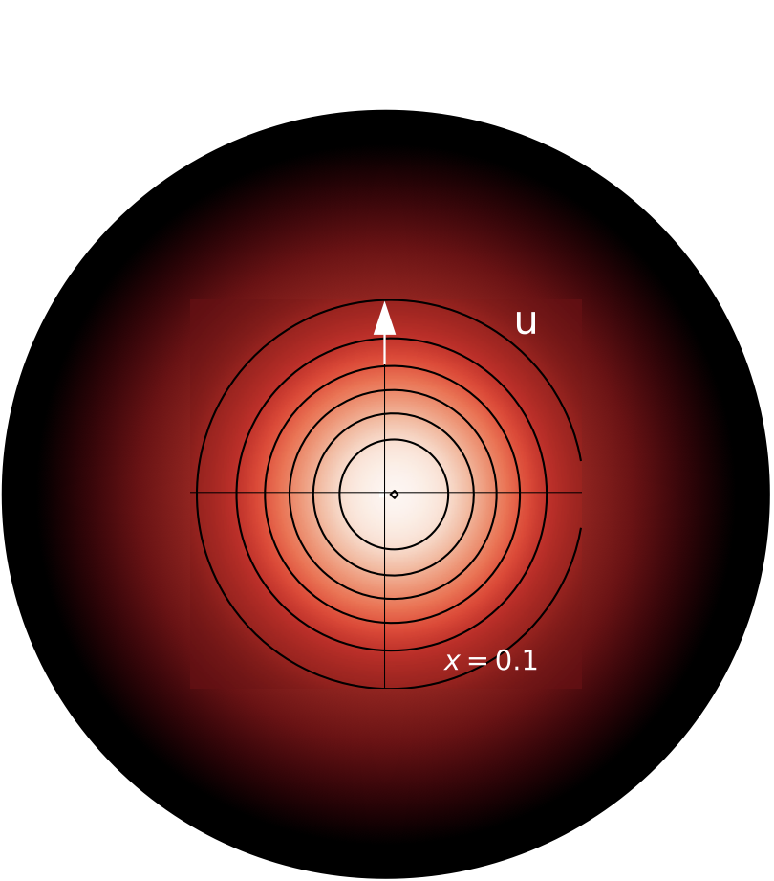
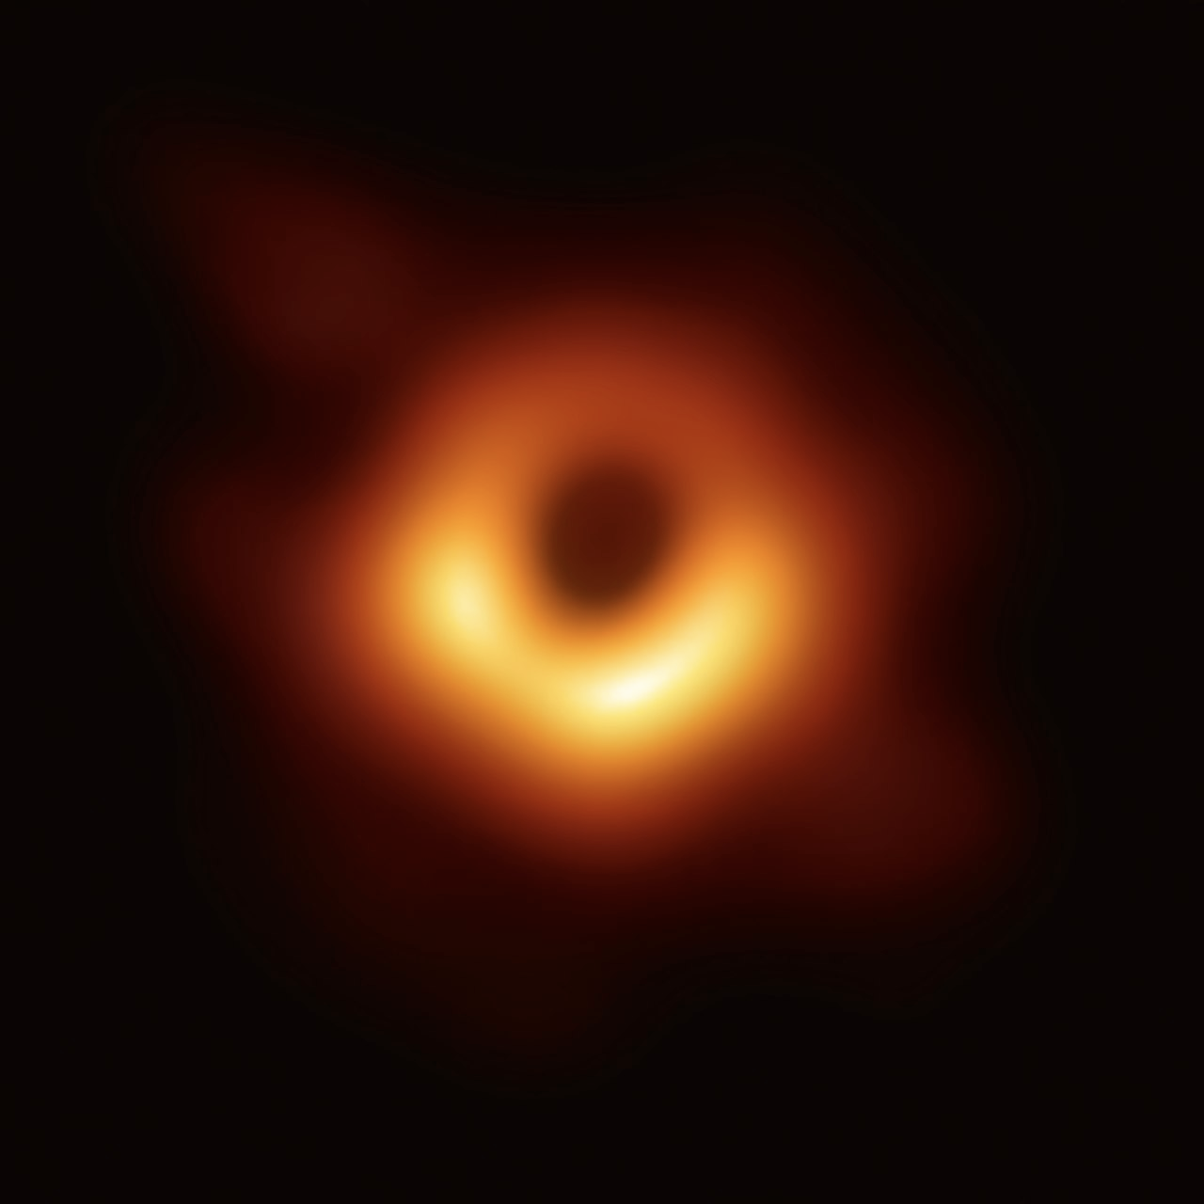
A picture of a black hole (2019)
A picture of a proton (2020)

Slide 6
Extract TMDs
Study new observables
Collect data
Analyze data

Slide 7
TMD-neXt tasks
2.2
2.3

Slide 8
Progress in the last year: Drell-Yan data
Task 1.1 (COMPASS)
Drell-Yan cross sections measured in ammonia, aluminum and tungsten were released this year in September.
Drafting of articles related to transverse-spin asymmetries (released in 2022) progressed well and are close to completion.
Beam test for Drell-Yan measurements with high intensity on CEDAR detectors at AMBER.
Task 1.2 (CMS)
Final publication of DY transverse-momentum spectra measured by CMS in EPJC.

Slide 9
Progress in the last year: SIDIS data
Task 2.1 (COMPASS)
Update the 2021 release with increased statistics.
Task 2.3 (CLAS)
Data taking with longitudinally polarized target completed.
Data processing ongoing.
Kaon production under analysis using RICH.

Slide 10
Progress in the last year: e⁺e⁻ data
Task 3.1 (BELLE)
Analysis progressing, albeit slowly (none of the main analyzers of the k_{T}-dependent cross-section is part of STRONG-2020 any longer).
Development of a framework for tuning Pythia MC generator ongoing, aiming at reducing strong Pythia model dependence of systematics.
Task 3.2 (BABAR)
The task has been canceled

Slide 11
Progress in the last year: quark TMD extractions
Task 4.1 (Theory)
Extraction of pion TMDs.
Extraction of proton TMDs from Drell-Yan data at N⁴LL.
Development of new approaches for the phenomenological extraction of TMD PDFs and FFs.
Several extensions of theoretical frameworks to Next-to-Leading power.

Slide 12
Progress in the last year: gluon TMD studies
Task 5.1 (Theory)
Gluon TMD fragmentation function into quarkonium.
Heavy quark production in gluon jets.
Factorization of GTMDs.
Task 5.3 (Theory)
Study of the TMD shape functions for J/ψ production in SIDIS.

Slide 13
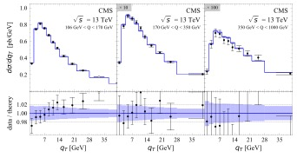
Important highlights: Drell-Yan
CMS DATA
arXiv:2305.07473
ART23 FIT

Slide 15
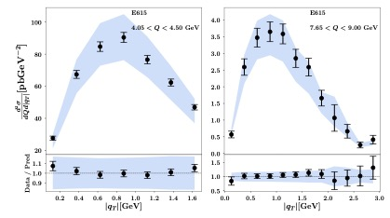
Important highlights: pion Drell-Yan
MAP22 pion FIT
NEW Compass data
arXiv:2210.01733

Slide 16
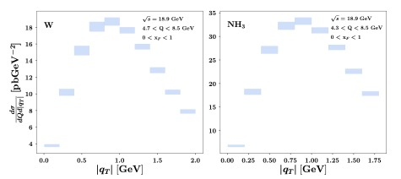

Slide 17
Important highlights: e⁺e⁻
BELLE DATA
arXiv:2306.02937
Torino FIT

Slide 18
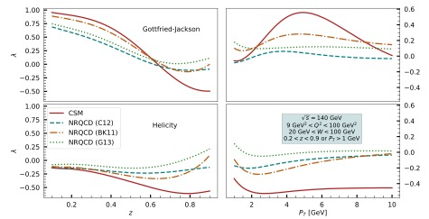
Important highlights: gluon TMDs
J/Ψ polarization
observables at EIC
arXiv:2301.11987

Slide 19
Important highlights
TMD-neXt provided content to the 3DPartons VA initiative (NangaParbat, arTeMiDe, TMDlib)

Slide 20
Deliverables
Number | Title | Status | Notes
D22.1 | TMD data from DY, SIDIS, e⁺e⁻ | Delivered | Less data than expected for e⁺e⁻ , but more than expected in the other experiments, also thanks to extension
D22.2 | Parametrizations of TMD PDFs and FFs | Delivered | Many results with increasing degree of accuracy and increasing data
D22.3 | Estimates of quarkonium production in SIDIS | Delivered | Several observables have been investigated

Slide 21
Plans until the end of the project
Task 1 [Drell-Yan]
Task 2 [SIDIS]
Task 3 [e⁺e⁻]
[COMPASS] Article on transverse spin asymmetries for Drell-Yan high mass range (4.3 – 8.5 GeV/c2) close to completion
[COMPASS] Update the COMPASS 2021 release with increased statistics
[CLAS12] Release of preliminary data for CLAS12 longitudinally polarized SIDIS
[BELLE] Release of unpolarized cross-section of pseudo-scalar and vector mesons
[BELLE] Publication of results concerning framework for tuning Pythia MC generator

Slide 22
Plans until the end of the project
Task 4
Task 5
Improved extractions of TMDs and better uncertainty estimates
Benchmarking of available codes, especially for Drell-Yan precision physics
Extraction of a purely soft factor and related studies
Global reweighting of Sivers, transversity, and Collins functions from azimuthal asymmetries
Study of the kinematic regions in SIDIS pion and kaon production at an upgraded JLab 22
Analysis of single and double spin asymmetries for C-even quarkonium production
Calculation of matching coefficients of gluon TMDs
Model calculation of T-odd gluon TMDs
Extraction of gluon TMDs from Higgs p_{T} data

Slide 23
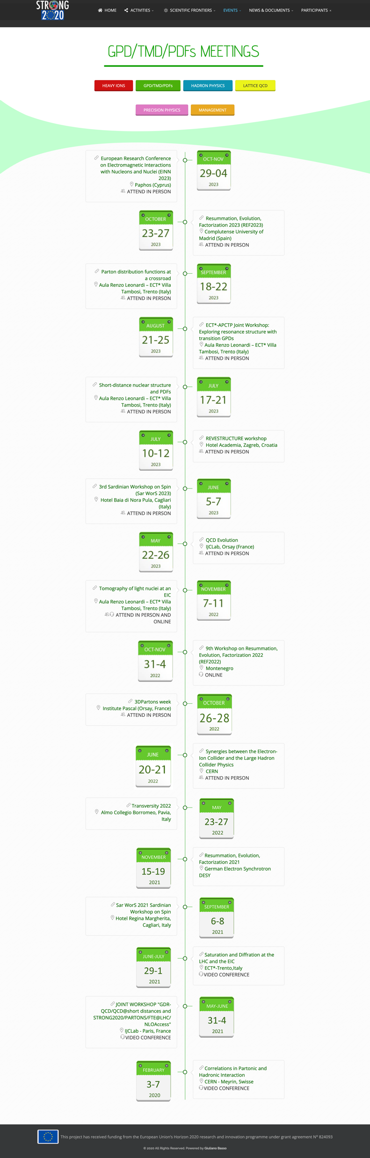
Workshops

Slide 24
General considerations and future perspectives
TMD-related data taking will continue at CERN, JLab, KEK, BNL and in the future at EIC
TMD extractions will continue and there are several directions to explore (gluon TMD extractions, polarized TMDs, higher-twist contributions, combined TMD/PDF/GPD fits…)
From the perspective of infrastructure access, we used CERN access for experimental work and meetings and ECT* access for meetings
From the perspective of VA, we provided content to 3DPartons. We would be happy if we could get access to workforce and computing resources

