Slide 1
Annual Meeting
João Barata
on behalf of NA3-Jet-QGP

Slide 2
Plan of the presentation
NA3 Goals
Progress during reporting period
Survey of jet quenching observables [highlights]
Plans and remaining tasks until the end of the project

Slide 3
1. NA3 Goals
Theory-experiment collaboration on probing the QGP with jets
main goal: survey/benchmark of observables
  Large number of potential jet shape/structure observables
  Identify observables that are sensitive to specific aspects of parton energy loss
one parton energy loss model as main reference
provide public tools for the above

Slide 4
2. Progress during reporting period
Report on the survey of observables submitted for publication in SciPost Physics [peer-witnessed refereeing] in May 2023
  very slow review process [5 months to receive referee reports]
All analysis pipeline and MC data released publicly
  Full public reproducibility of the survey
  Codes adaptable for further analyses

Slide 5
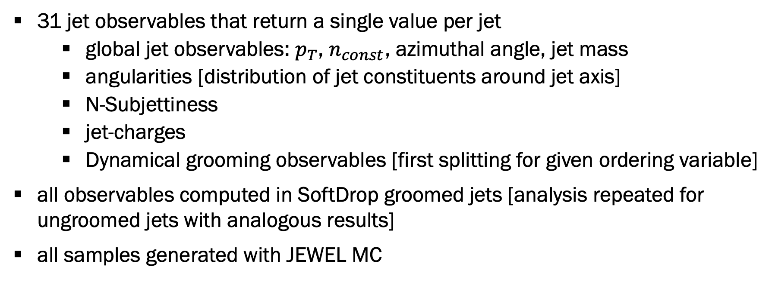
3. Survey of jet quenching observables
31 jet observables that return a single value per jet
  global jet observables: $p_{T}$, $n_{const}$, azimuthal angle, jet mass
  angularities [distribution of jet constituents around jet axis]
  N-Subjettiness
  jet-charges
  Dynamical grooming observables [first splitting for given ordering variable]
all observables computed in SoftDrop groomed jets [analysis repeated for ungroomed jets with analogous results]
all samples generated with JEWEL MC

Slide 6
3. Survey of jet quenching observables
Two complementary ML analysis to establish correlations between observables
  separately for unquenched [pp] and quenched [AA] jets
  Principal Component Analysis [PCA] sensitive only to linear correlation
  Deep Auto-Encoder Analysis [AE] also sensitive to non-linear relations among observables
Unquenched vs Quenched Discrimination Analysis
  Boosted Decision Trees [BDT]

Slide 7
3. Survey of jet quenching observables
Ability to reconstruct full distributions of all observables
given a number of independent dof
number of independent dof
Subsets of observables are highly mutually correlated
Information content of the entire set can be described by a small number of effective dof
Number of effective dof decreases once non-linear relations [AE] taken into account

Slide 8
3. Survey of jet quenching observables
PCA
These 5 dof account
predict full distributions
of all observables
with ~80% accuracy
Effective dof do not correspond to simple observables, but rather combinations of [almost] all observables

Slide 9
2. Survey of jet quenching observables
Quenching effects manifest themselves through strong population migration NOT modification of correlation

Slide 10
3. Survey of jet quenching observables
Discrimination power for BDT with all observables
Discrimination power for BDTs trained only on pair of observables
Some observables and pairs of observables [those in dark red] have same discrimination power as full set :: discrimination can be made using carefully selected pairs

Slide 11
4. Plans
Final workshop to be held in early 2024
  discussion on recommendations to experimental collaborations regarding priority observables
  Write-up of executive report with recommendations [final deliverable]
Postdoc [Ankita Budhraja] hired at NIKHEF to assist with final task
  Write-up of white paper [final deliverable]
  Supported by STRONG2020 until end of project; contract continuing for extra year supported by other sources

