Slide 2
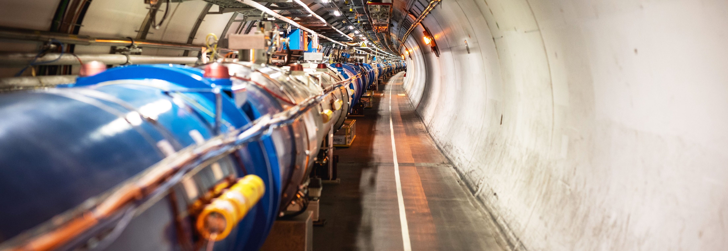
CERN
Present and Future Scientific Programme
Manfred Krammer, CERN Department Head Experimental Physics

Slide 3

Science for peace
CERN was founded in 1954 with 12 European Member States
CERN’s annual budget
is 1200 MCHF (equivalent
to a medium-sized European university)
23 Member States
Austria – Belgium – Bulgaria – Czech Republic
Denmark – Finland – France – Germany – Greece Hungary – Israel – Italy – Netherlands – Norway
Poland – Portugal – Romania – Serbia – Slovakia Spain – Sweden – Switzerland – United Kingdom
As of 31 December 2022
Employees:
2658 staff, 900 fellows
Associates:
11 860 users, 1516 others
3 Associate Member States
in the pre-stage to membership
Cyprus – Estonia – Slovenia
7 Associate Member States
Croatia – India – Latvia – Lithuania – Pakistan
Türkiye – Ukraine
6 Observers
Japan – Russia (suspended) – USA
European Union – JINR (suspended) – UNESCO
Around 50 Cooperation Agreements
with non-Member States and Territories
Albania – Algeria – Argentina – Armenia – Australia – Azerbaijan – Bangladesh – Belarus – Bolivia
Bosnia and Herzegovina – Brazil – Canada – Chile – Colombia – Costa Rica – Ecuador – Egypt – Georgia – Honduras
Iceland – Iran – Jordan – Kazakhstan – Lebanon – Malta – Mexico – Mongolia – Montenegro – Morocco – Nepal
New Zealand – North Macedonia – Palestine – Paraguay – People's Republic of China – Peru – Philippines – Qatar
Republic of Korea – Saudi Arabia – Sri Lanka – South Africa – Thailand – Tunisia – United Arab Emirates – Vietnam

Slide 4
A laboratory for people around the world
Distribution of all CERN Users by the country of their home institutes as of 31 December 2022
Geographical & cultural diversity
Users of 110 nationalities
19.4% women
Member States 7147
Austria 85 – Belgium 129 – Bulgaria 43 – Czech Republic 244 Denmark 49 – Finland 90 – France 844 – Germany 1225 Greece 119 – Hungary 73 – Israel 64 – Italy 1527
Netherlands 169 – Norway 79 – Poland 305 – Portugal 100 Romania 109 – Serbia 33 – Slovakia 70 – Spain 383
Sweden 103 – Switzerland 406 – United Kingdom 898
Associate Member States
in the pre-stage to membership 69
Cyprus 15 – Estonia 30 – Slovenia 24
Associate Member States 382
Croatia 38 – India 132 – Latvia 16 – Lithuania 14 – Pakistan 35
Türkiye 122 – Ukraine 25
Observers 2991
Japan 216 – Russia (suspended) 873 – United States of America 1902
Non-Member States and Territories 1271
Algeria 2 – Argentina 13 – Armenia 8 – Australia 21 – Azerbaijan 2 – Bahrain 4 – Belarus 18 – Brazil 122
Canada 199 – Chile 34 – Colombia 21 – Costa Rica 2 – Cuba 3 – Ecuador 4 – Egypt 20 – Georgia 32
Hong Kong 15 – Iceland 3 – Indonesia 5 – Iran 11 – Ireland 5 – Jordan 5 – Kuwait 4 – Lebanon 13 – Madagascar 1
Malaysia 4 – Malta 1 – Mexico 49 – Montenegro 4 – Morocco 19 – New Zealand 5 – Nigeria 1 – Oman 1
Palestine 1 – People’s Republic of China 333 – Peru 2 – Philippines 1 – Republic of Korea 147 – Singapore 2 South Africa 52 – Sri Lanka 10 – Taiwan 45 – Thailand 17 – Tunisia 2 – United Arab Emirates 7 – Viet Nam 1

Slide 5
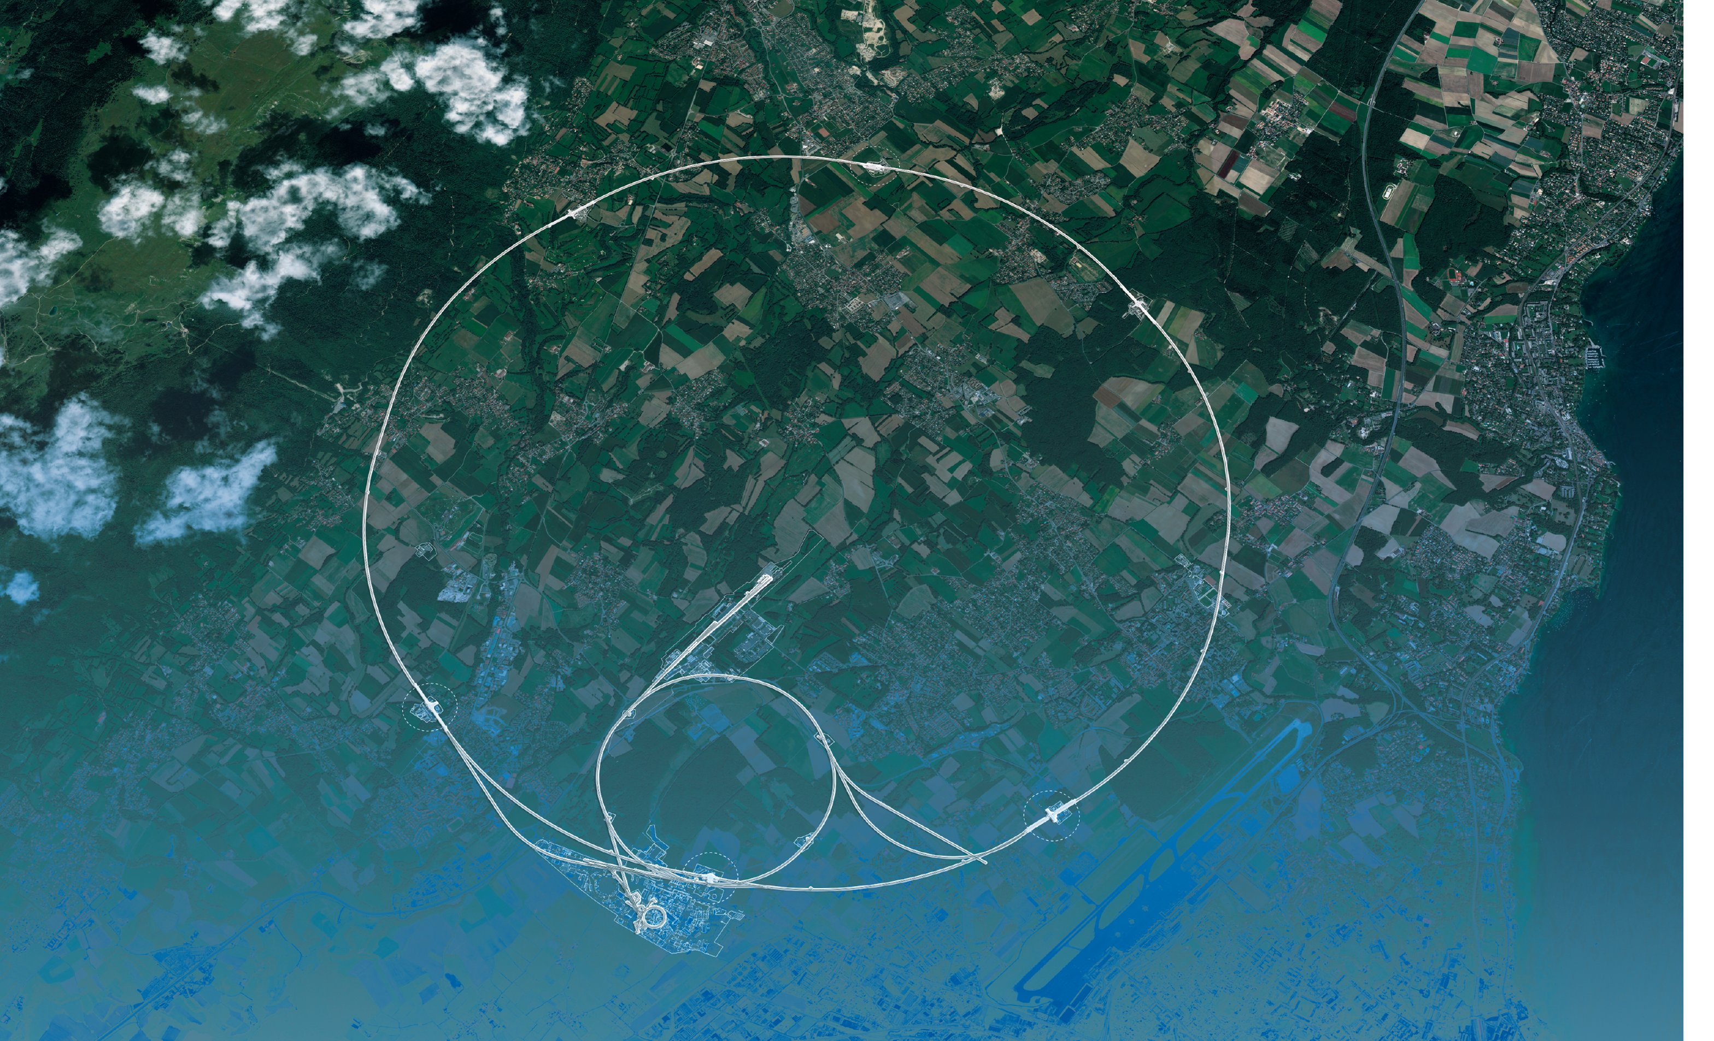
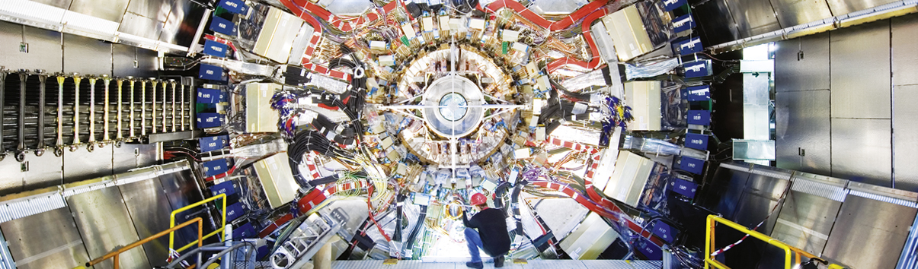
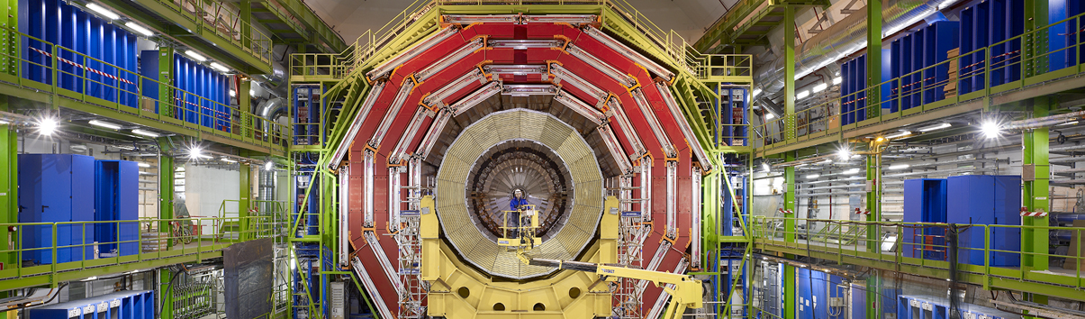
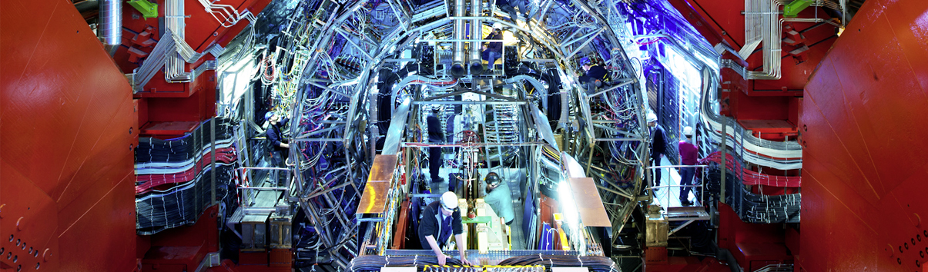
Large Hadron Collider and Experiments
ATLAS
CMS
CMS
ALICE
ALICE
ATLAS
LHCb
LHCb
+ TOTEM, LHCf, MoEDAL-MAPP, FASER, SND@LHC

Slide 6

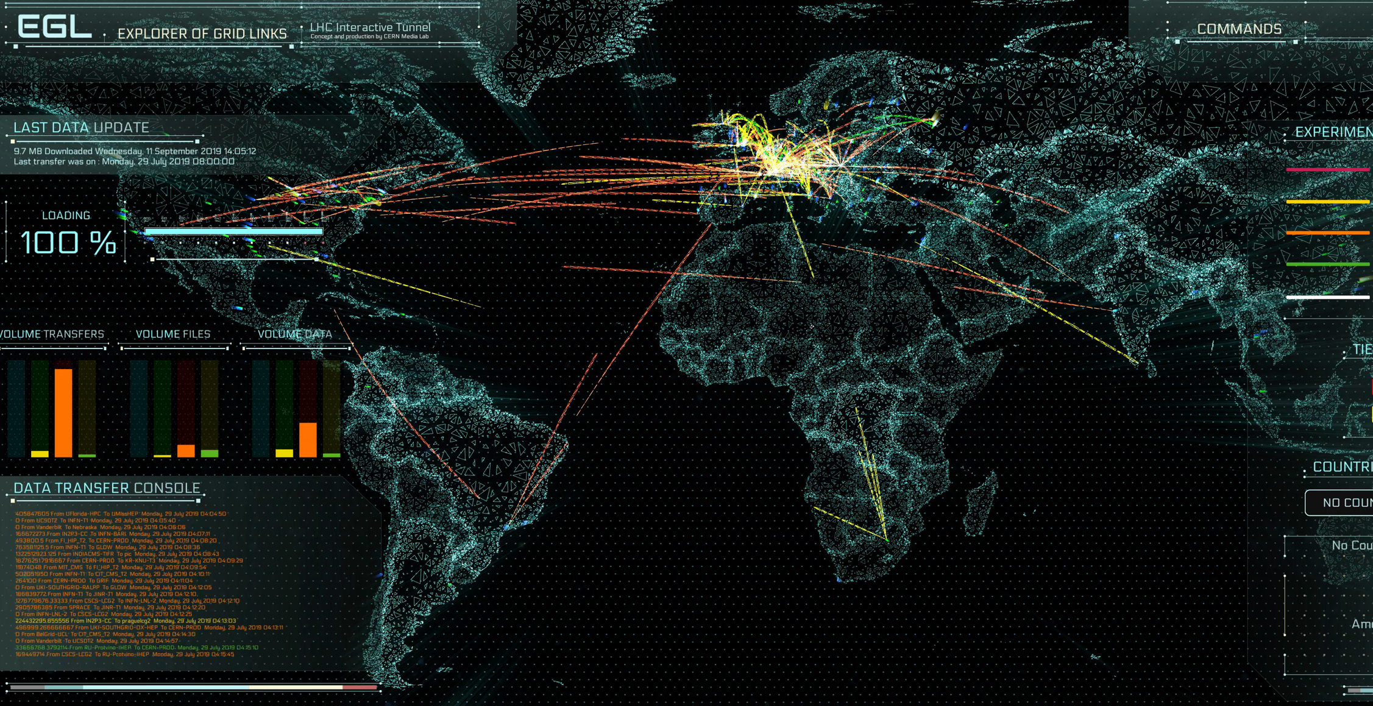
The Worldwide LHC Computing Grid (WLCG)
Used to store, distribute, process and analyse data.
1 million processing cores in about 170 data centres
and 42 countries.
More than 1000 Petabytes of CERN data stored world-wide.

Slide 7
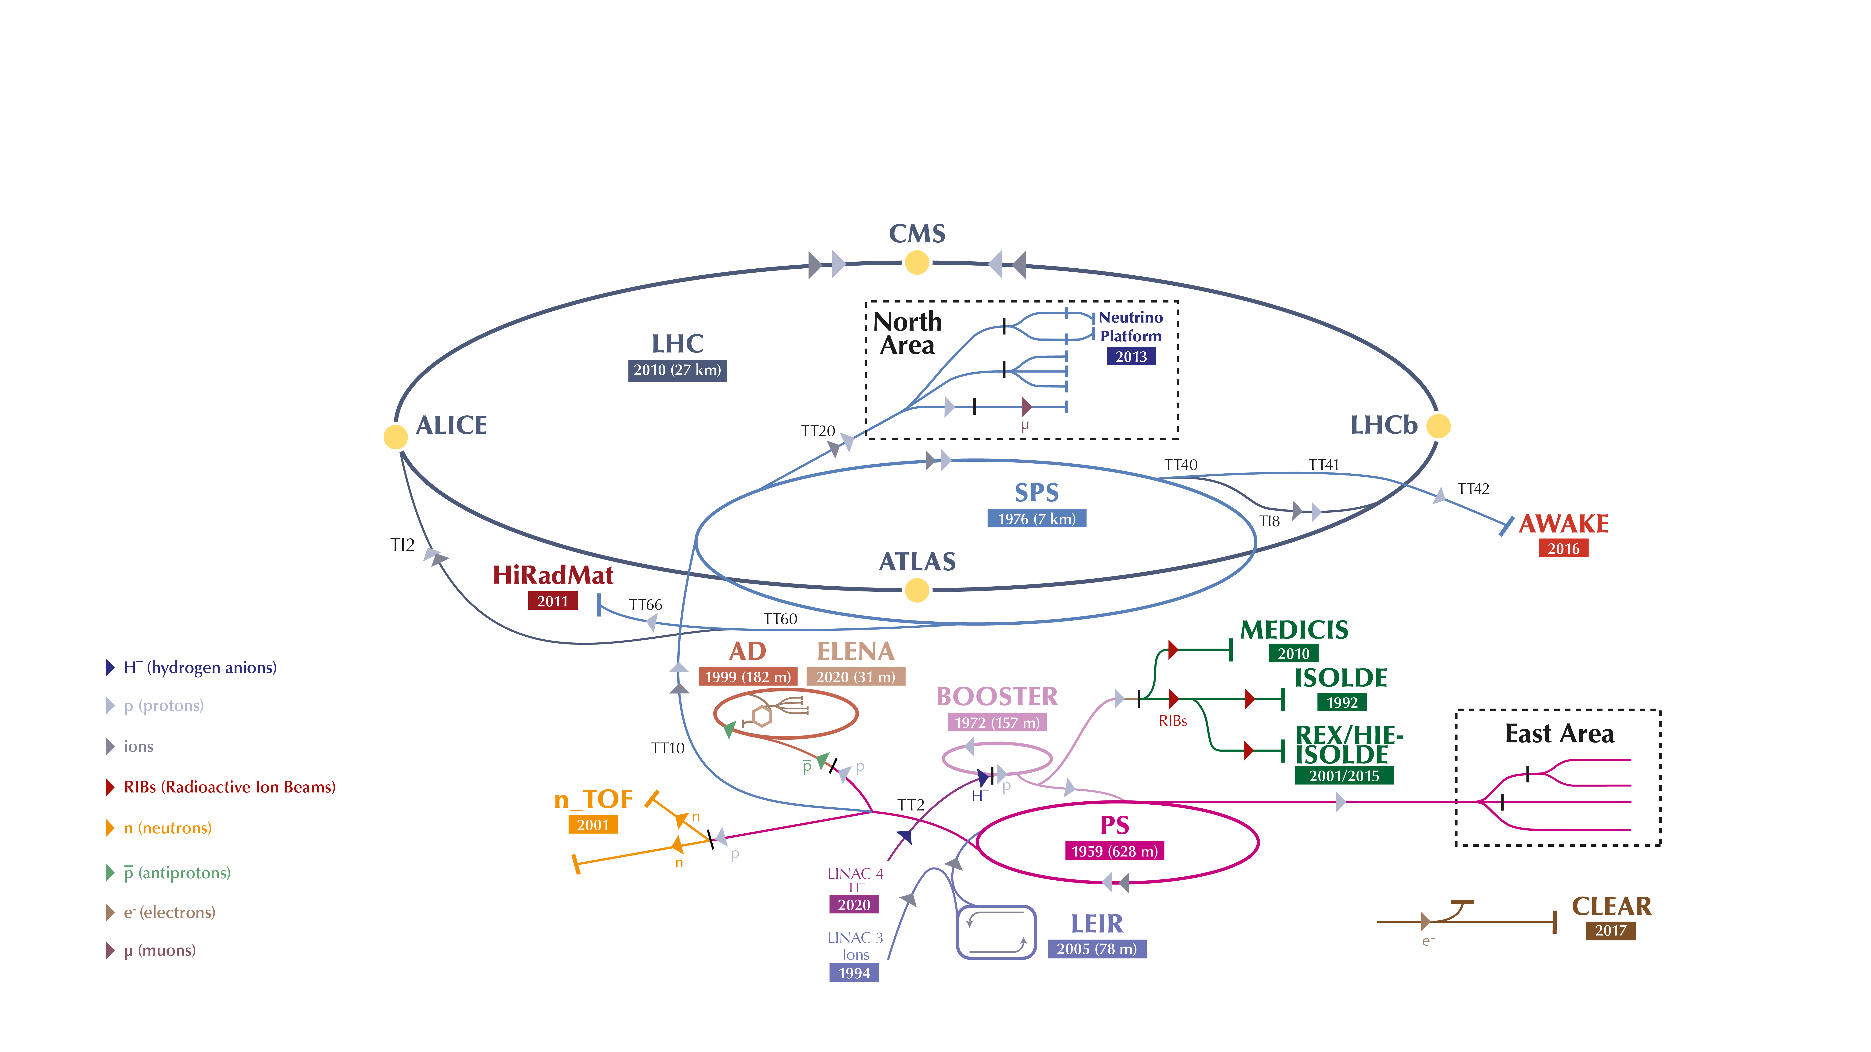
The CERN accelerator complex

Slide 8
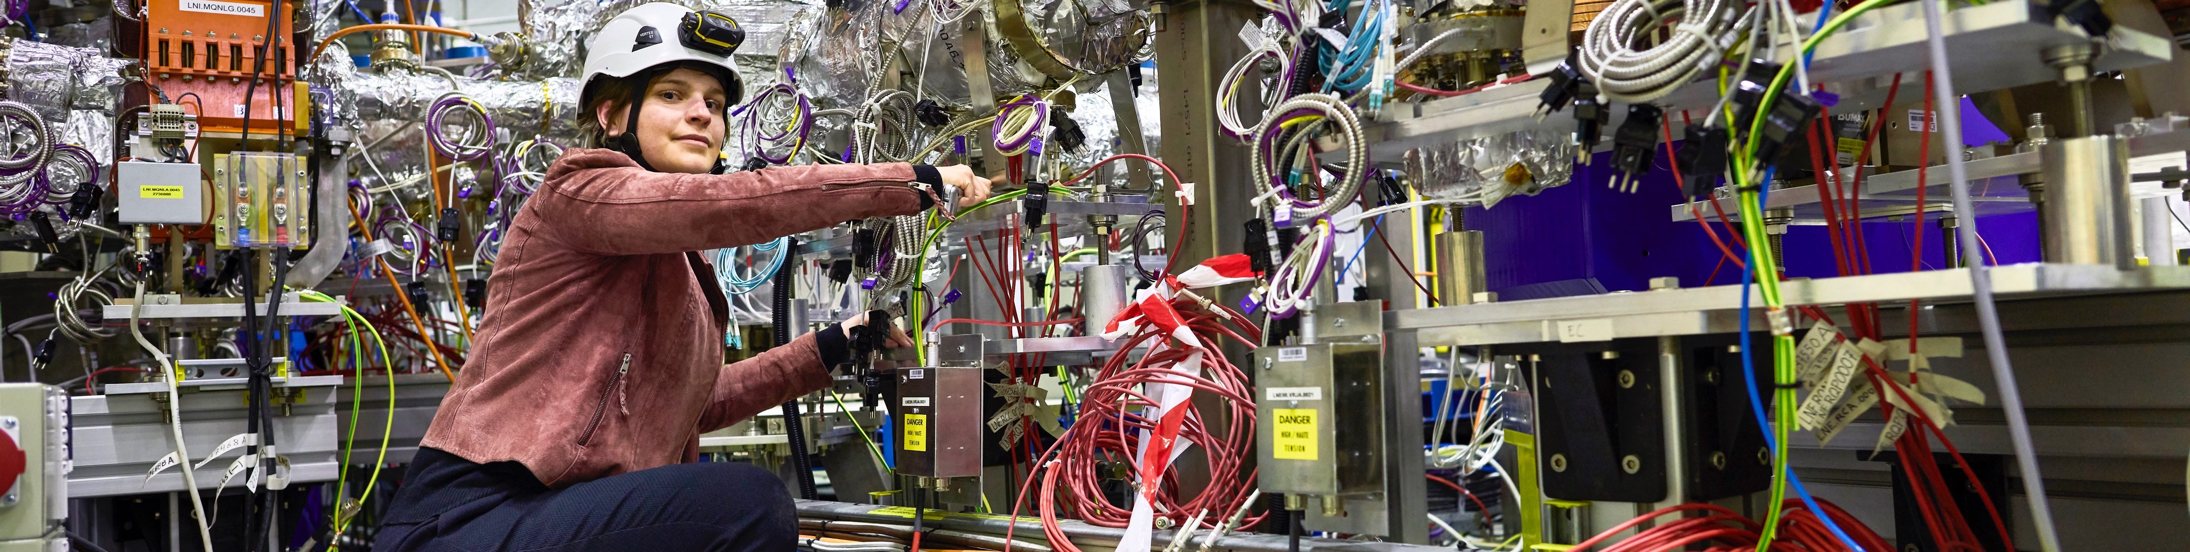
CERN has a diverse scientific programme
Nuclear Physics
(ISOLDE, n-TOF)
Antimatter Research
(Antiproton Decelerator)
Cosmic rays and cloud formation
(CLOUD)
Fixed-target experiments,
which include searches for rare phenomena
Contribution to the Long Baseline
Neutrino Facility in the USA (LBNF)
CERN Theory Programme

Slide 9

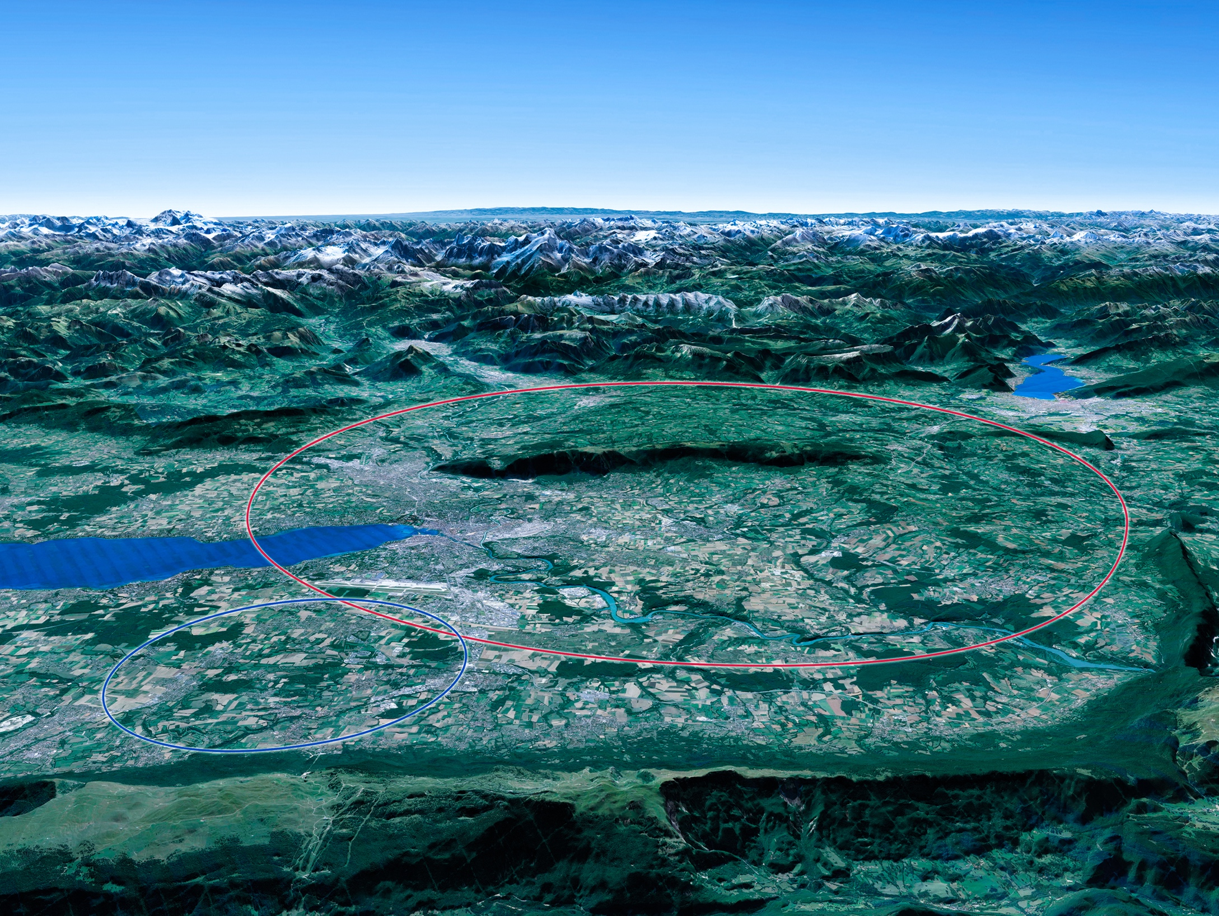

Scientific priorities for the future
Implementation of the recommendations
of the 2020 Update of the European Strategy
for Particle Physics:
• Fully exploit the HL-LHC
• Build a Higgs factory to further understand this unique particle
• Investigate the technical and financial feasibility of a future energy-frontier 100 km collider at CERN
• Ramp up relevant R&D
• Continue supporting other projects around
the world
LHC

Slide 10
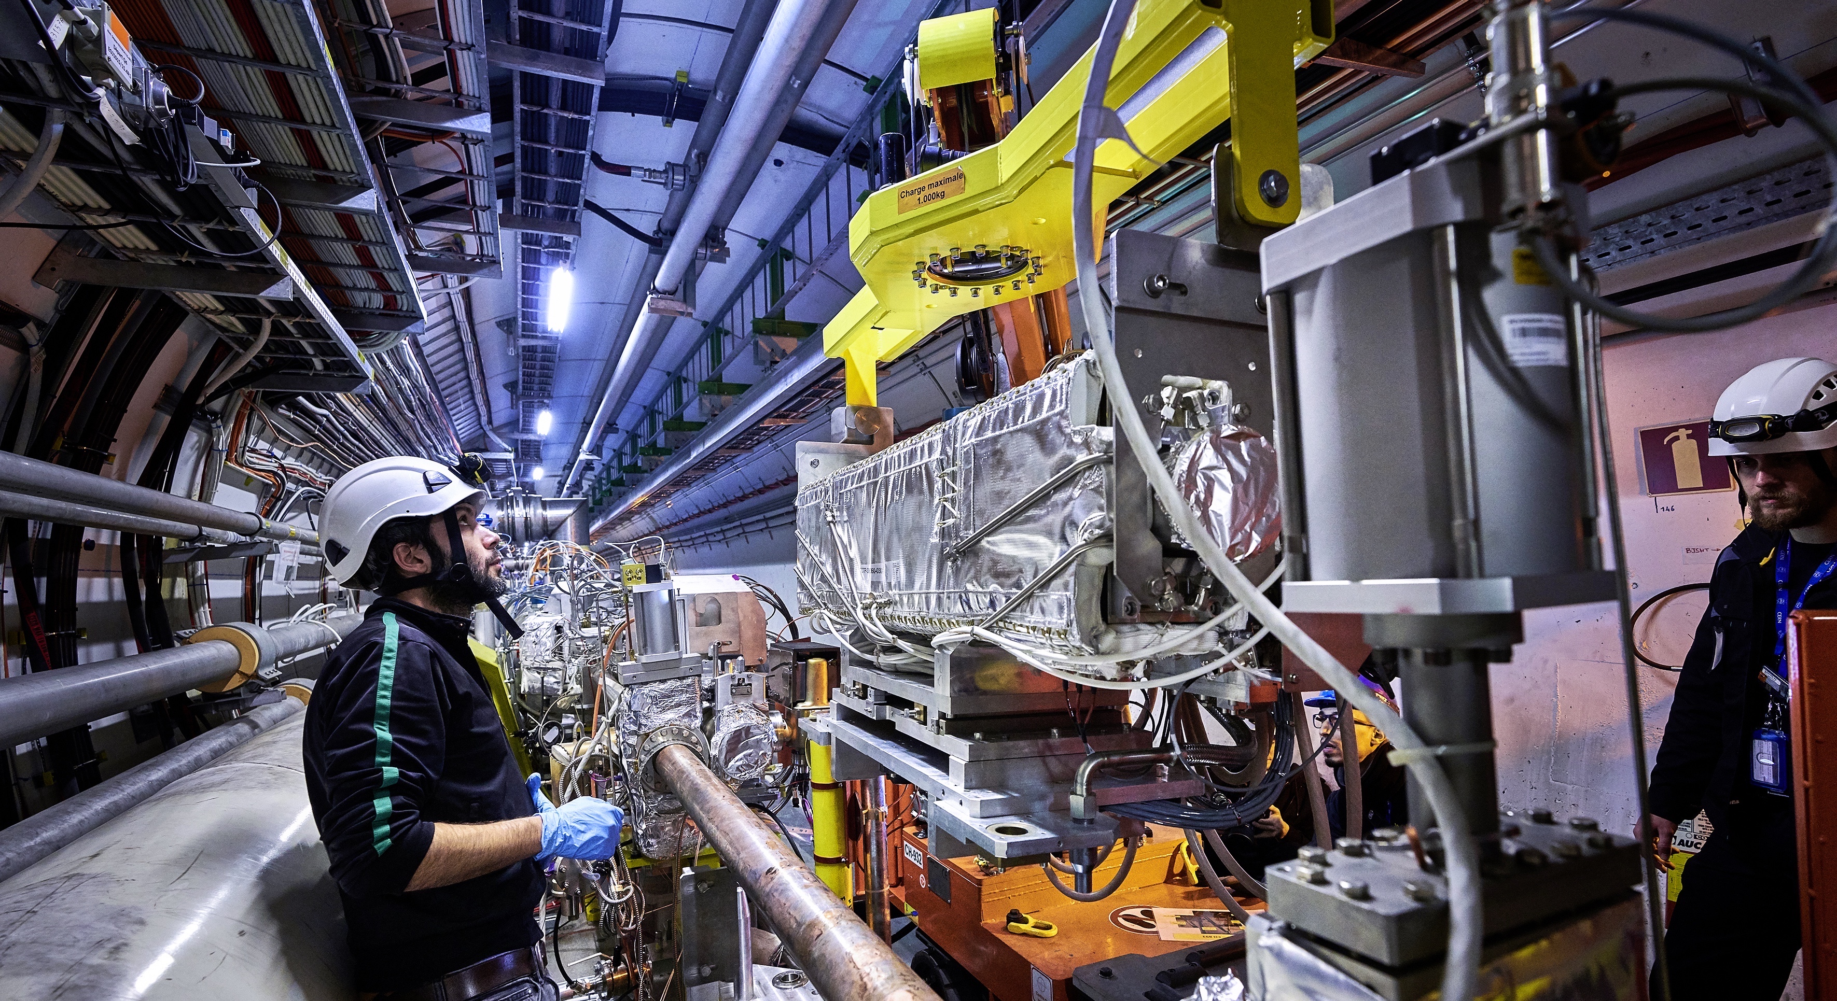
Upgrade to the
High-Luminosity LHC is under way
The HL-LHC will use new technologies to provide
10 times more collisions
than the LHC.
Large detector upgrade programmes.
It will give access to rare phenomena, greater precision and discovery potential.
It will start operating in 2029, and run until 2041.

Slide 11
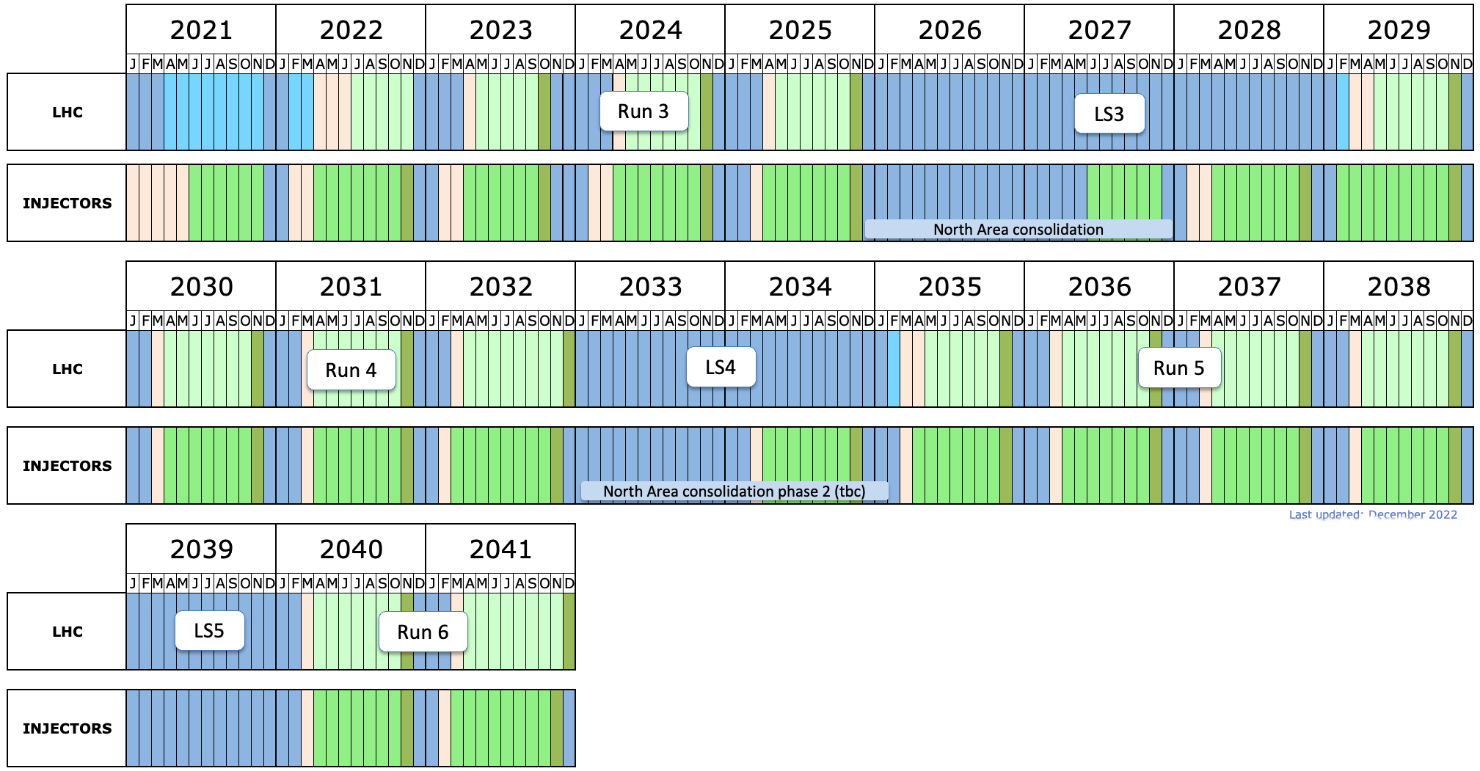
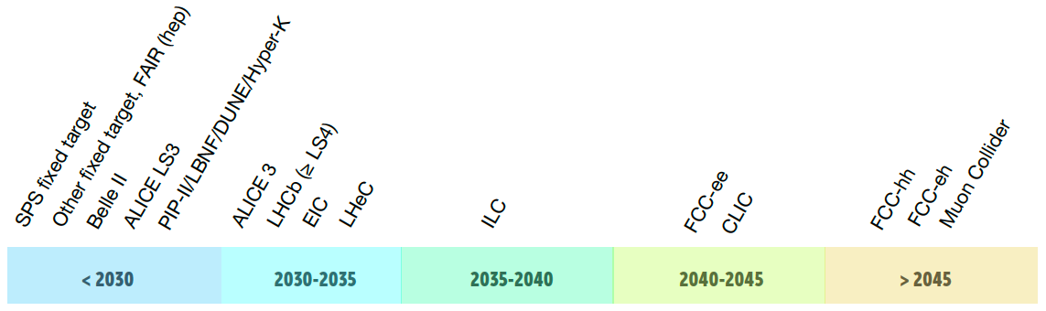
Experiment Upgrades and Future Projects
(HL-)LHC timeline:
ATLAS and CMS Upgrade
LHC
LHC LS3
LHC LS4
Visit of HPK

Slide 12
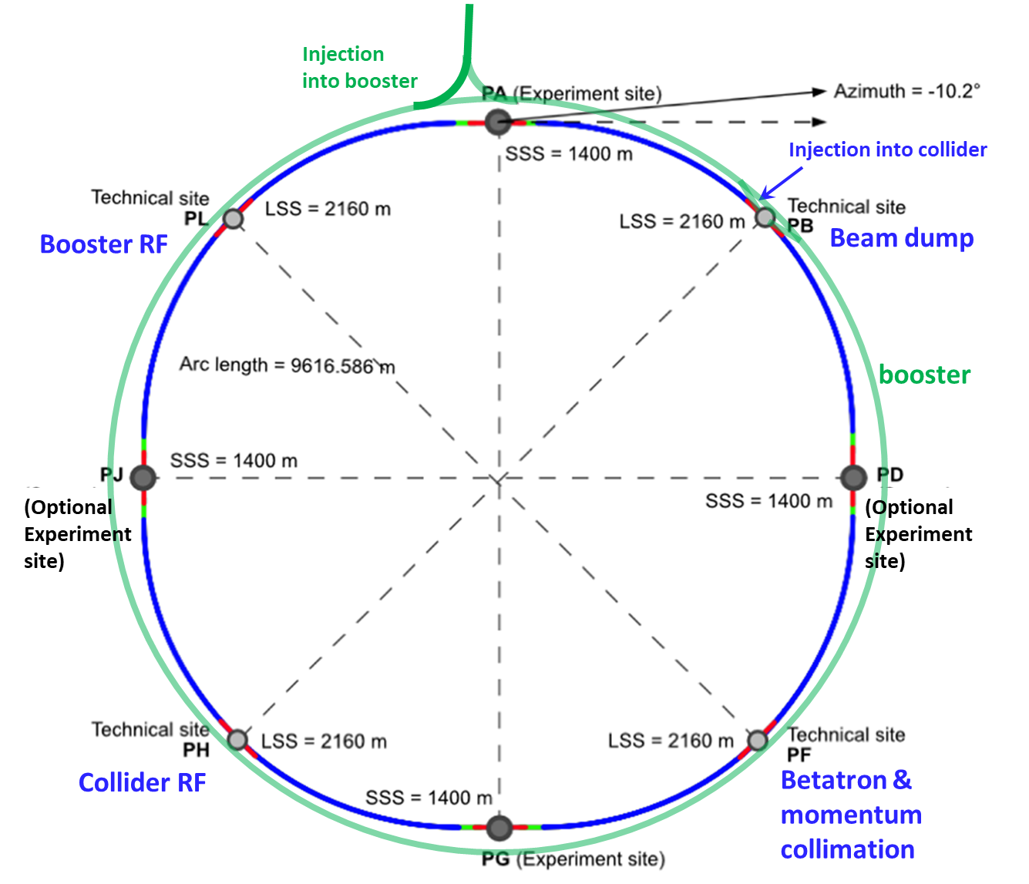
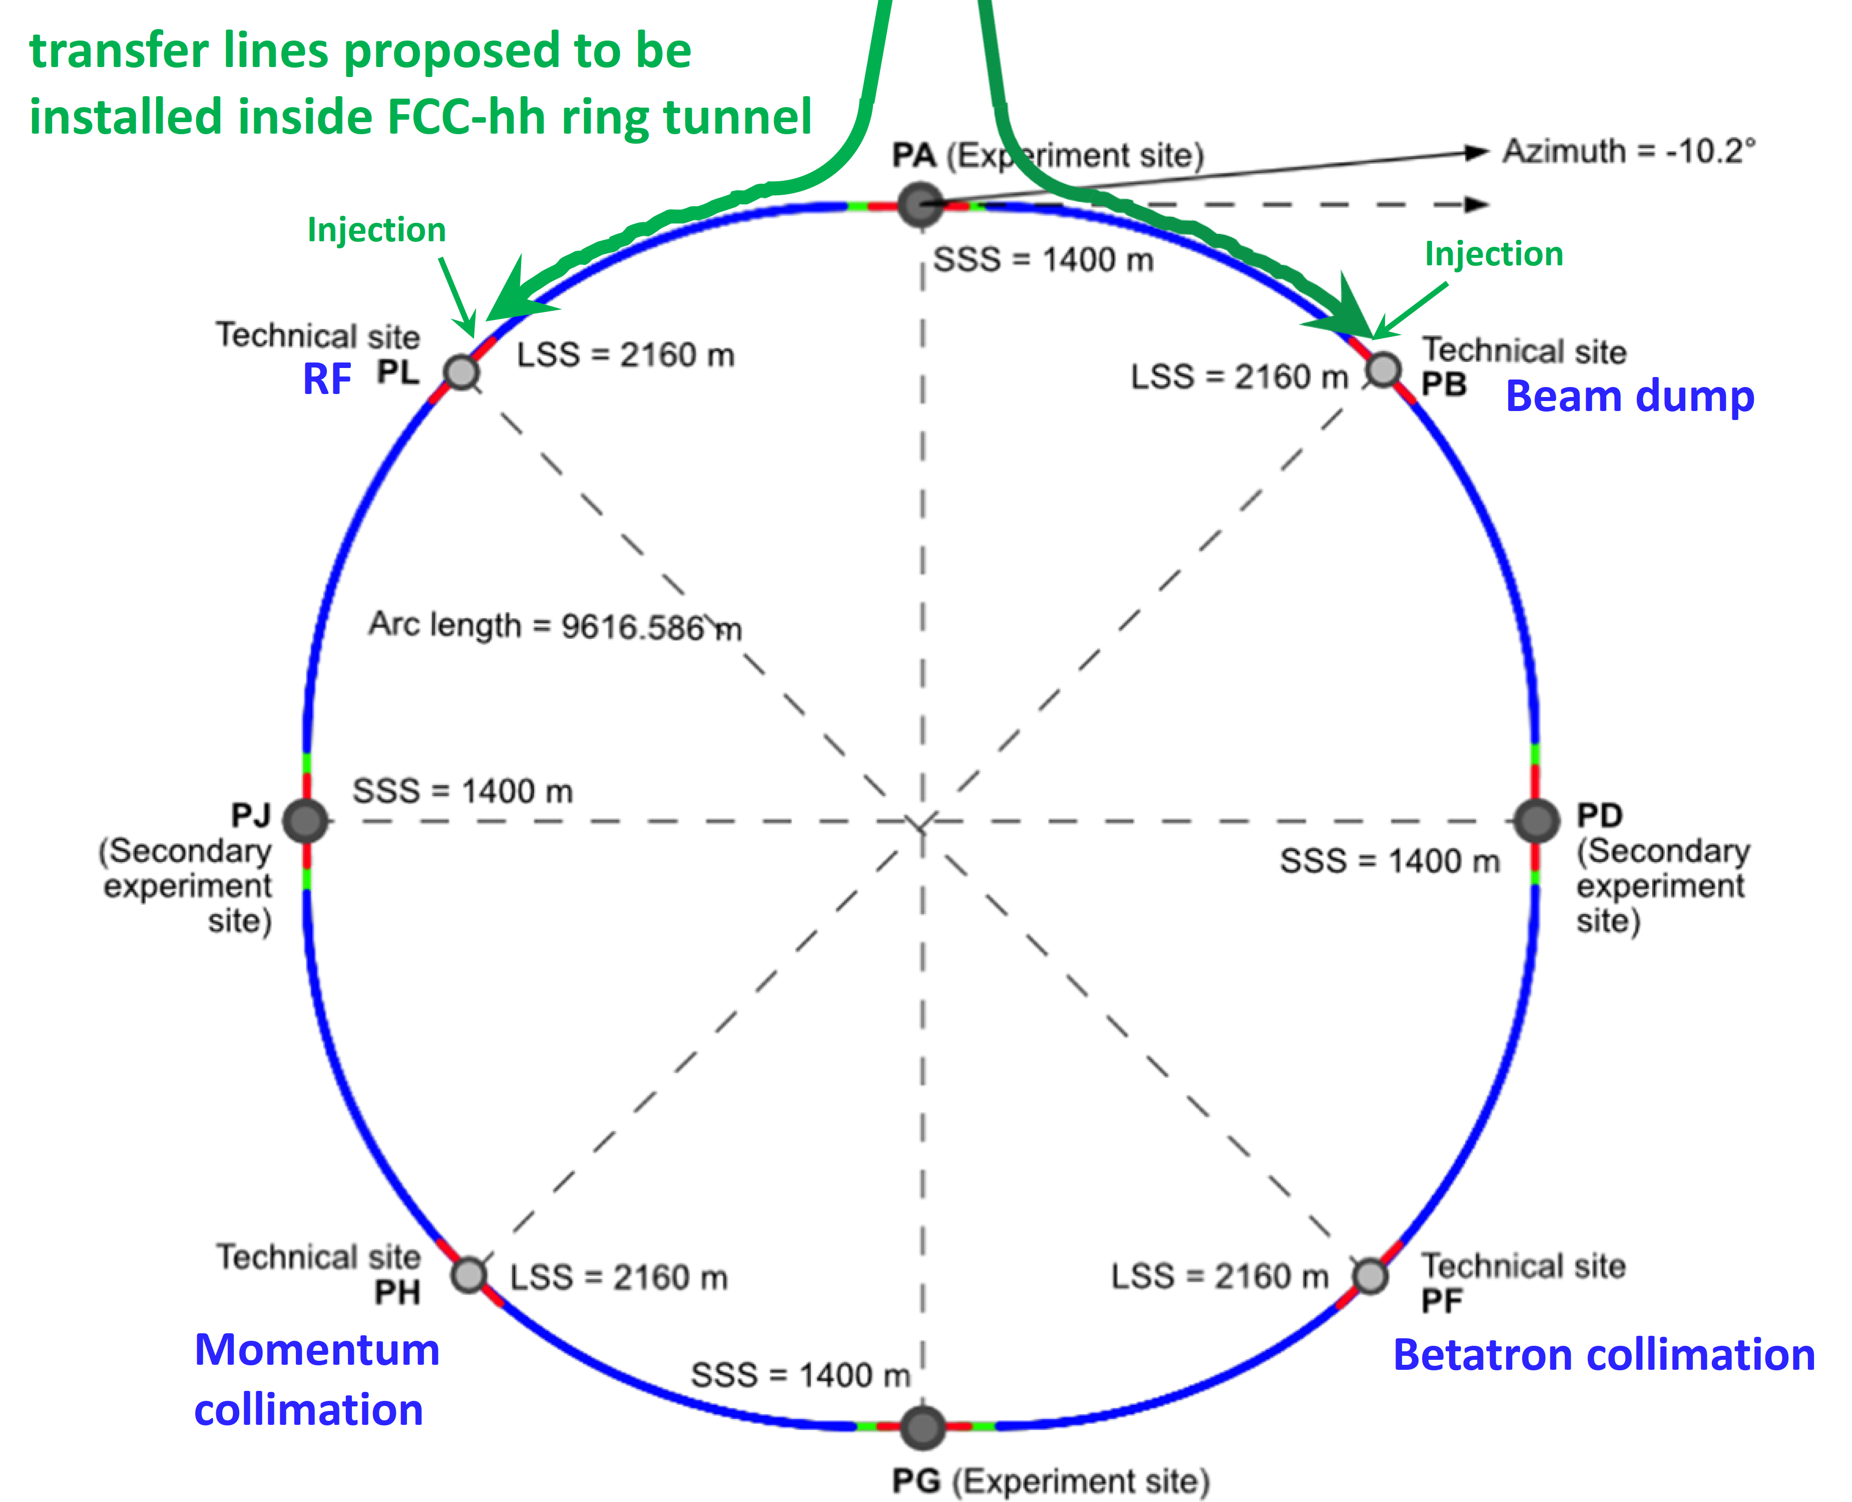

Future Circular Collider
Comprehensive long-term program maximizing physics opportunities
stage 1: FCC-ee (Z, W, H, $\text{t}\overline{\text{t}}$) as Higgs factory, electroweak & top factory at highest luminosities
stage 2: FCC-hh (~100 TeV) as natural continuation at energy frontier, pp & AA collisions; e-h option
Common civil engineering and technical infrastructures, building on and reusing CERN’s existing infrastructure
FCC integrated project allows the start of a new, major facility at CERN within a few years of the end of HL-LHC
Realistic schedule:
2025 FCC Feasibility Study delivered
~2028 Project approval by CERN Council
~2030 Construction of tunnel and FCC-ee starts
~2041 HL-LHC ends
2045-2048 Operation of FCC-ee
15 years physics operation
~2070 Operation of FCC-hh starts
  ~20 years physics operation
FCC-ee
FCC-hh
LHC
2020 - 2040
2045 - 2063
2070 - 2095

Slide 13
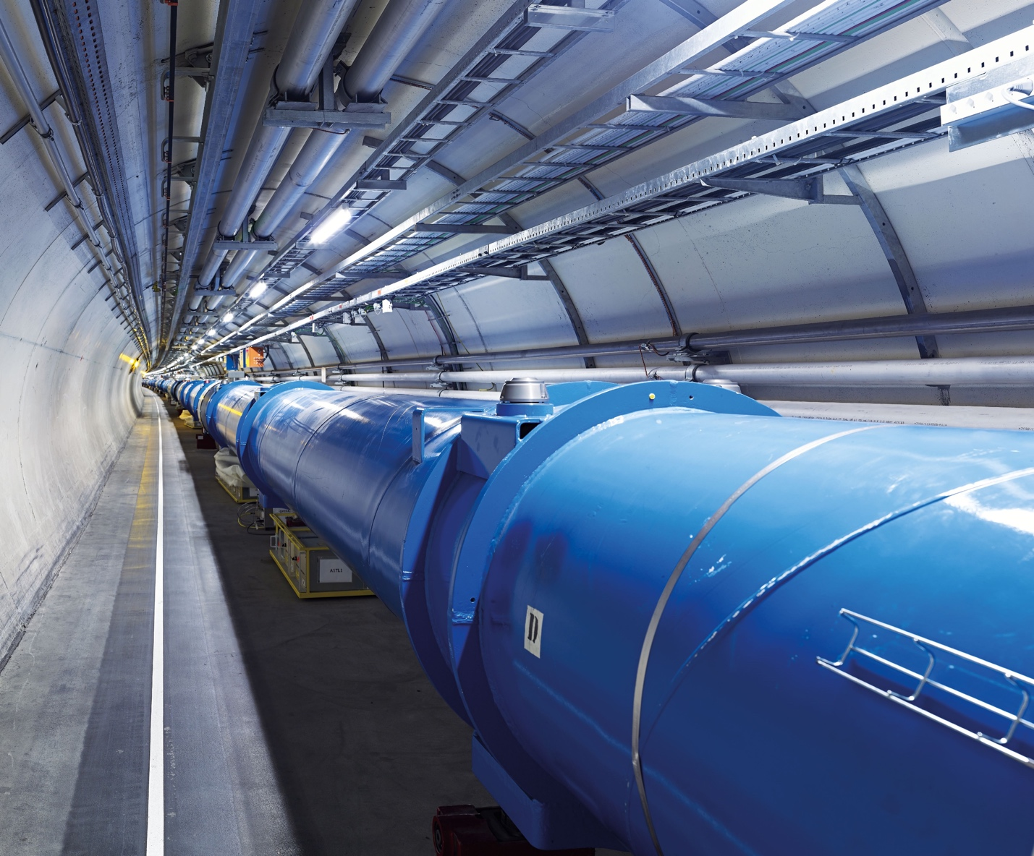
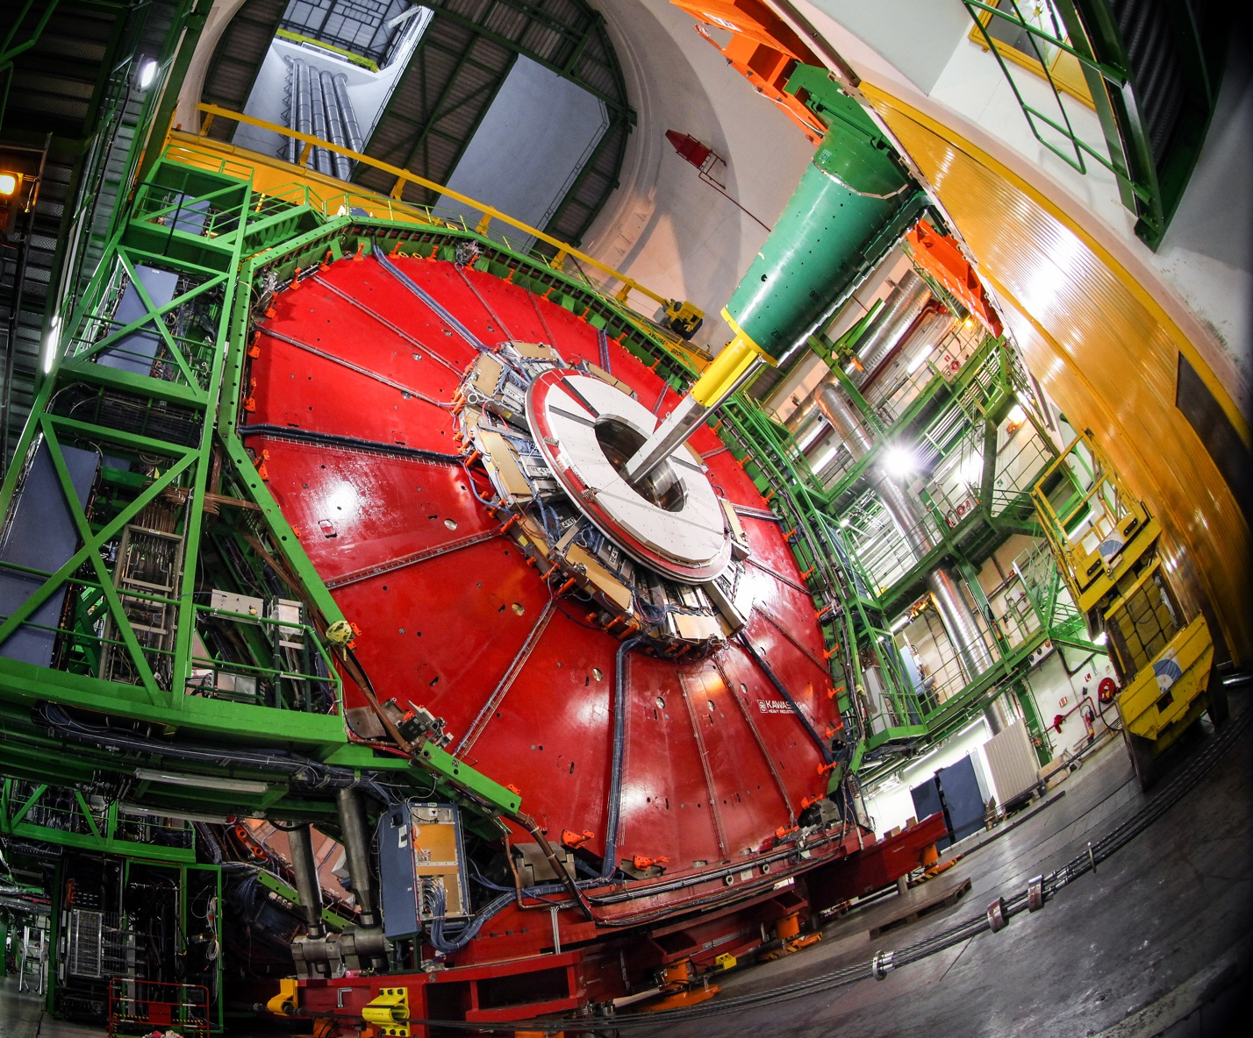
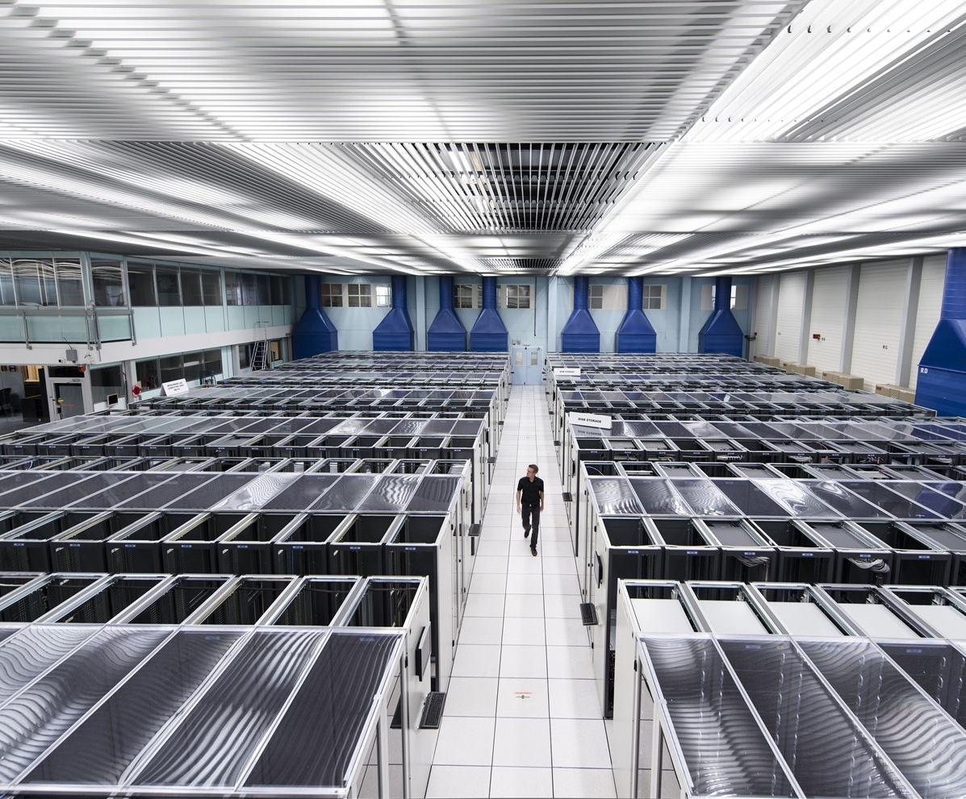
We develop technologies in three key areas
ACCELERATORS
DETECTORS
COMPUTING

Slide 14

CERN’s technological innovations have applications in many fields
CERN is the birthplace of the World Wide Web
And there are many more examples
Medical imaging, cancer therapy, material science, cultural heritage, aerospace, automotive, environment, health & safety, industrial processes.

Slide 15
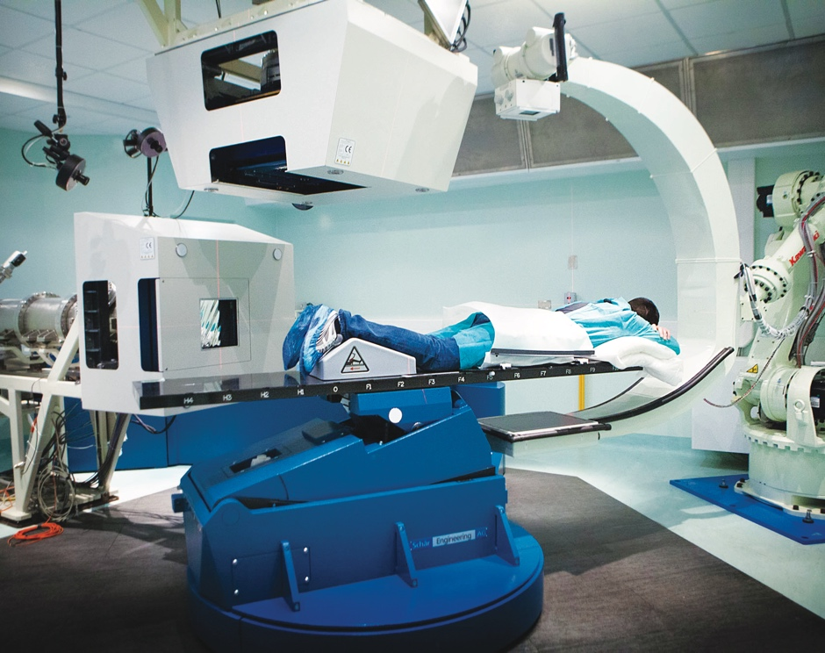
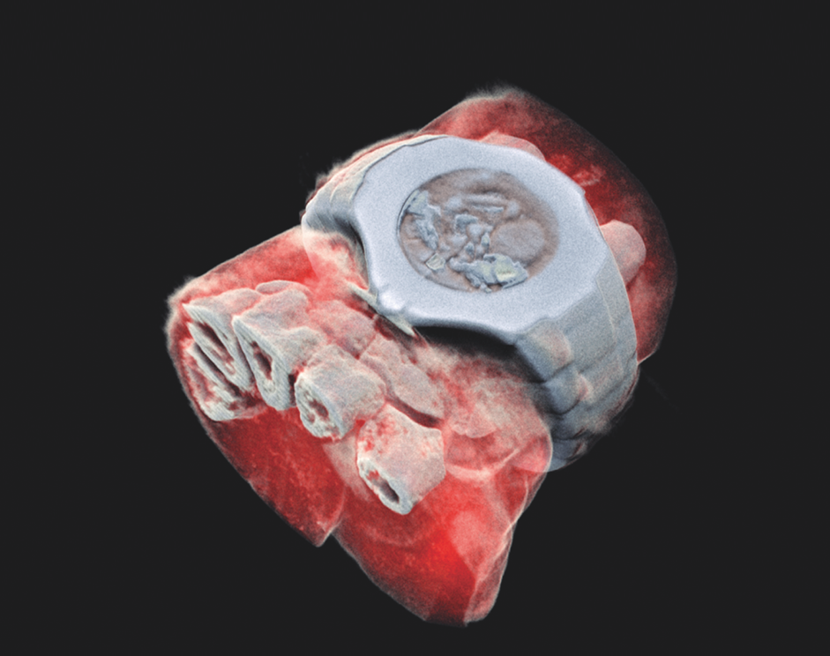
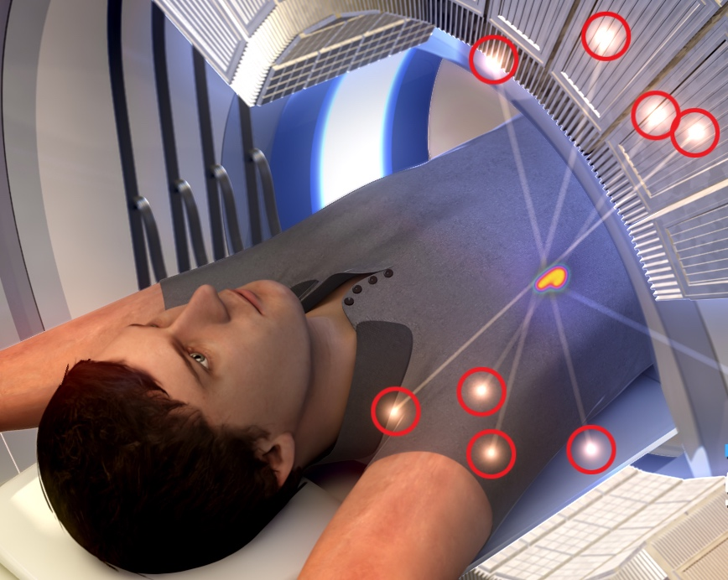
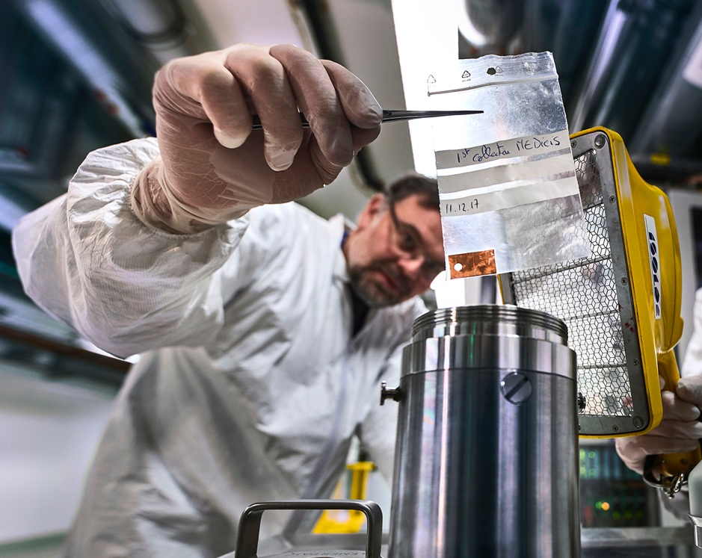
CERN’s technological innovations have important applications in medicine and healthcare
Technologies applied
at CERN are also used in PET, for medical imaging and diagnostics.
CERN produces innovative radioisotopes for nuclear medicine research.
© marsbioimaging
© CNAO
© ENVISION / ENLIGHT
Accelerator technologies are applied in cancer radiotherapy with protons, ions and electrons.
Pixel detector technologies are
used for high resolution
3D colour X-ray imaging.

Slide 16
Thank you for your attention
Enjoy your stay at CERN !

