Slide 1
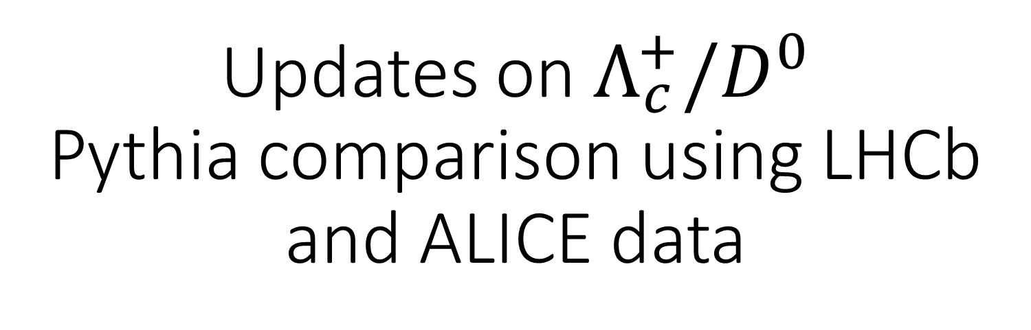
Updates on $Λ_{c}^{+}/D^{0}$
Pythia comparison using LHCb and ALICE data
31. 05. 2022.
HonexComb meeting

Slide 2
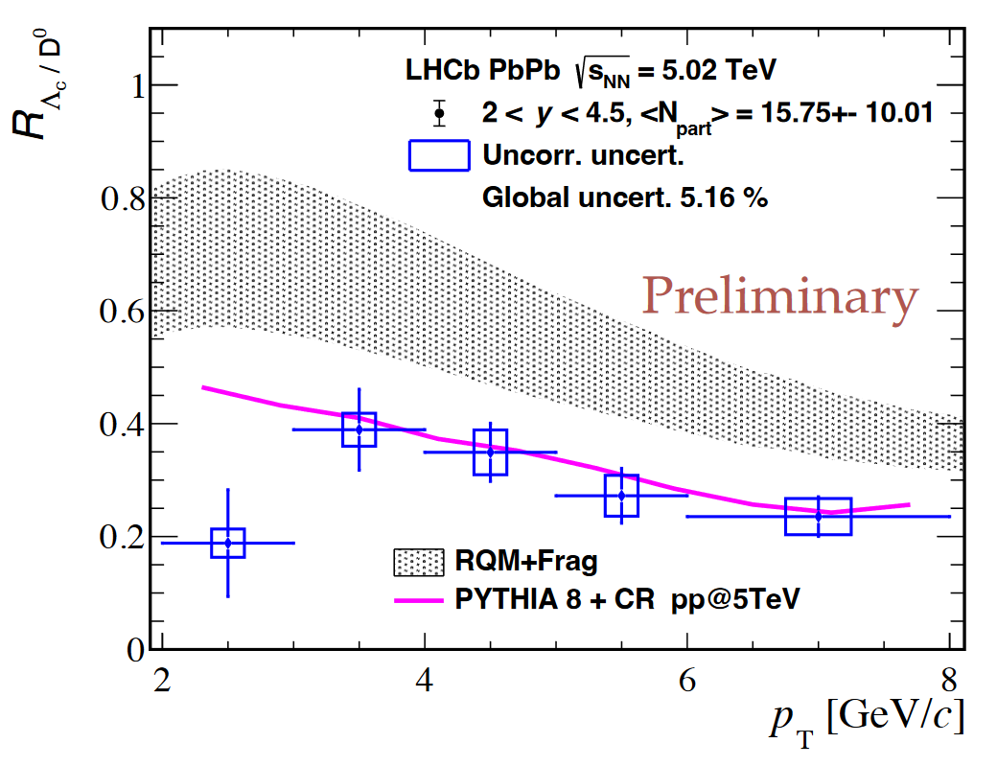
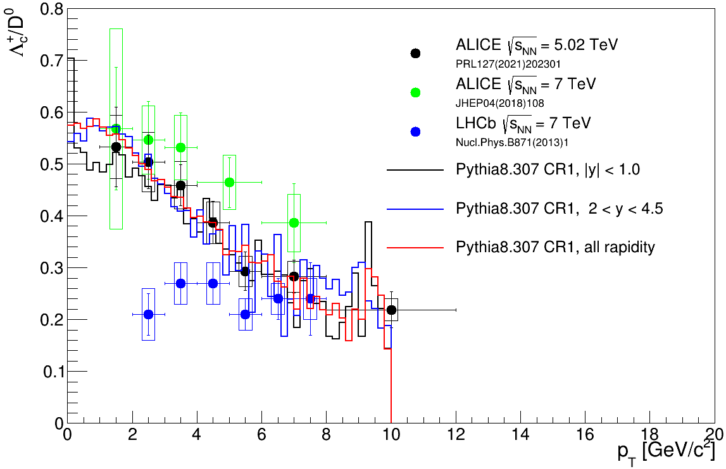

QM talk: link
Decreasing trend with $p_{T}$ pp @ 7 TeV ?

Slide 3
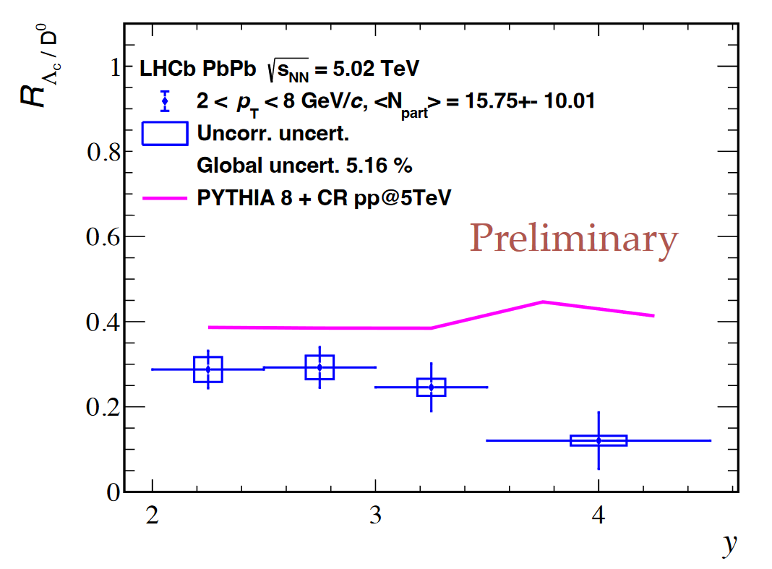
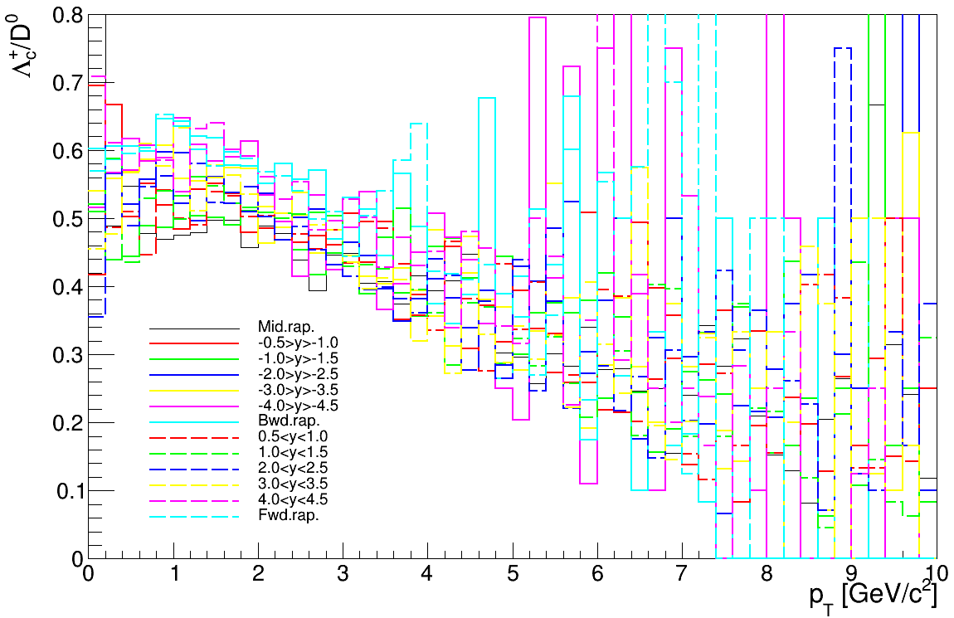
Pythia 8.307 CR 1
QM talk: link
No strong rapidity dependence from Pythia

Slide 4
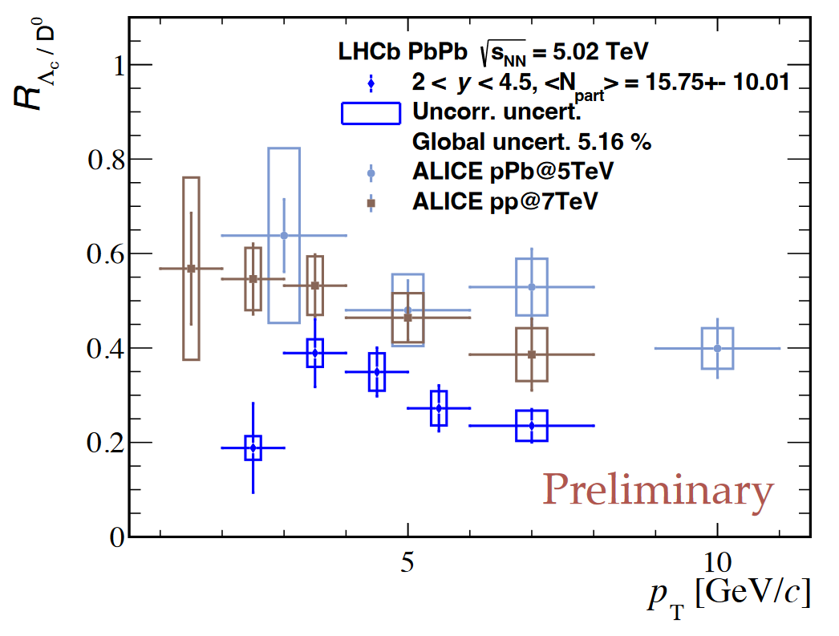
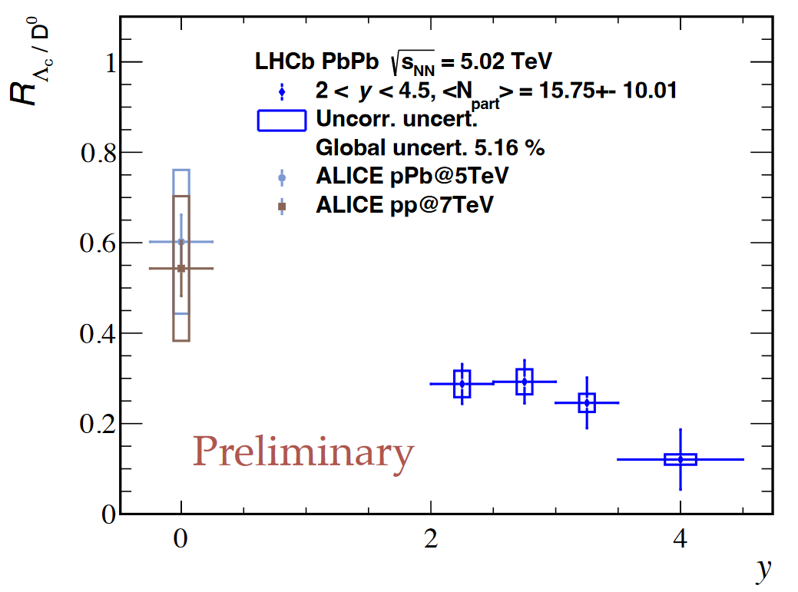
QM talk: link

Slide 5
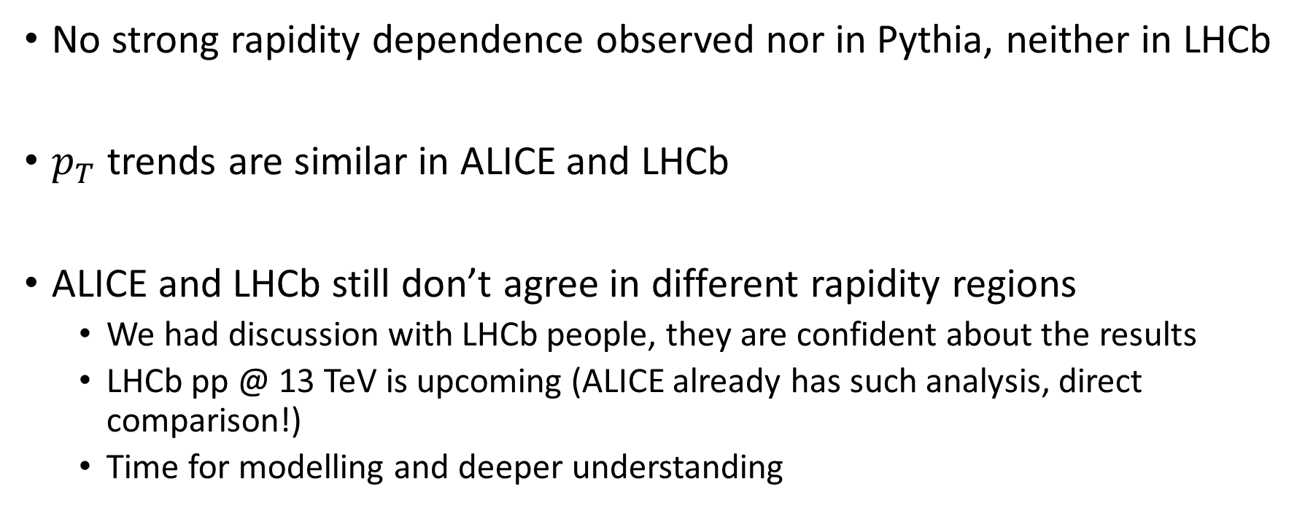
Summary
No strong rapidity dependence observed nor in Pythia, neither in LHCb
$p_{T}$ trends are similar in ALICE and LHCb
ALICE and LHCb still don’t agree in different rapidity regions
  We had discussion with LHCb people, they are confident about the results
  LHCb pp @ 13 TeV is upcoming (ALICE already has such analysis, direct comparison!)
  Time for modelling and deeper understanding

Slide 6
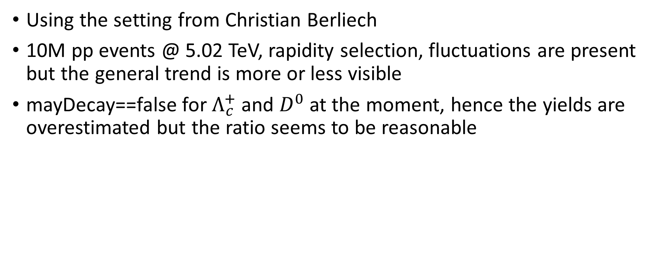
Backup – few details of the simulations
Using the setting from Christian Berliech
10M pp events @ 5.02 TeV, rapidity selection, fluctuations are present but the general trend is more or less visible
mayDecay==false for $Λ_{c}^{+}$ and $D^{0}$ at the moment, hence the yields are overestimated but the ratio seems to be reasonable

